Slide 1
Start the docker
docker pull electronioncollider/epic-gui
How to install docker:
eic.gitlab.io / documents / quickstart

Slide 2
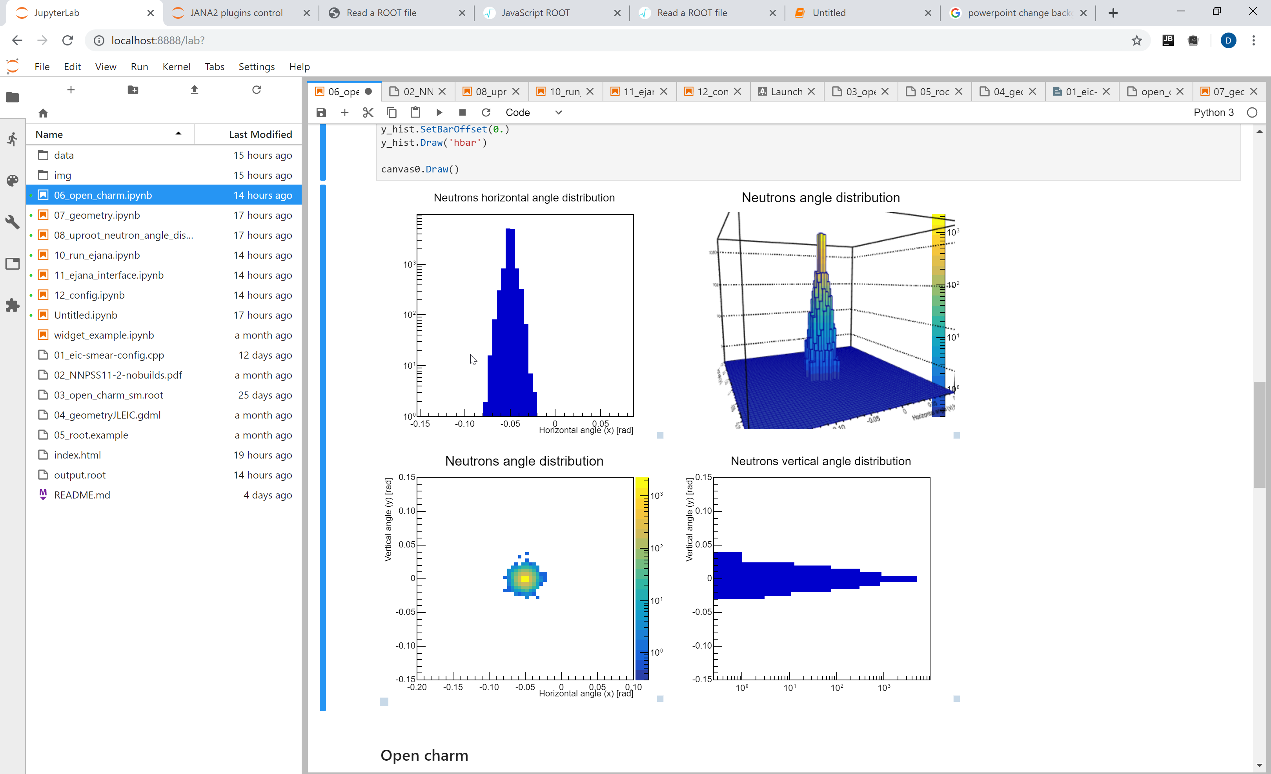
Entry point for EIC software
Interactive tutorial
Dmitry Romanov

Slide 3
Start the docker
docker pull electronioncollider/epic-gui
eic.gitlab.io / documents / quickstart /

Slide 4
Start the docker
docker pull electronioncollider/epic-gui
Plan:
Short introduction to our software
1. Hands on tutorial – running a simulation
2. Hands on tutorial – adding a detector
Answering most common questions (presentation)
Adjourn!
Answering most tricky questions,
showing some advanced stuff with Jupyter and our setup.

Slide 5
Software chain
MC generators
Fast
detector
simulation
Full
detector
simulation
Reconstruction and analysis

Slide 6
Software chain
MC generators
This tutorial coverage
Fast
detector
simulation
Full simulation
Tutorials:
January 29
February 6
Reconstruction and analysis

Slide 7
What software is in the docker container
MC sample files
Pythia
Beagle
Herwig
Fast simulation
Full simulation
Tutorials:
January 29
February 6
EIC Smear
Analysis & reconstruction
eJANA

Slide 8
What software is in the docker container
MC sample files
Pythia
Beagle
Herwig
Geant4Eic
Pure Geant4 implementation
Fast simulation
G4E
(Geant4)
ejana = EIC Jana
Community reference
reconstruction
EIC Smear
Analysis & reconstruction
eJANA

Slide 9
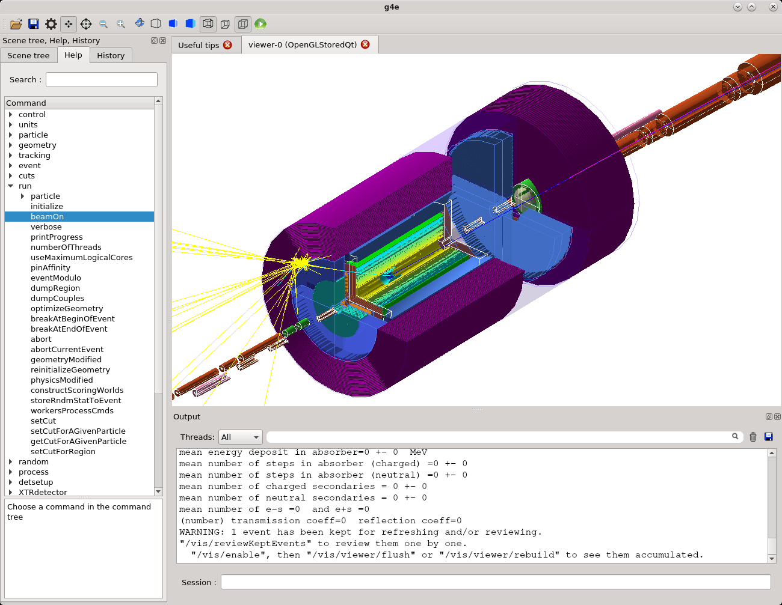
G4E – Geant 4 EIC
Standalone C++ Geant4 application
Various EIC MC file formats:
Beagle, Pythia6, HEPMC - Pythia8, Herwig and others
Integration with accelerator elements
Infrastructure to import Geant4 detector geometry and simulation code
https://gitlab.com/jlab-eic/g4e

Slide 10
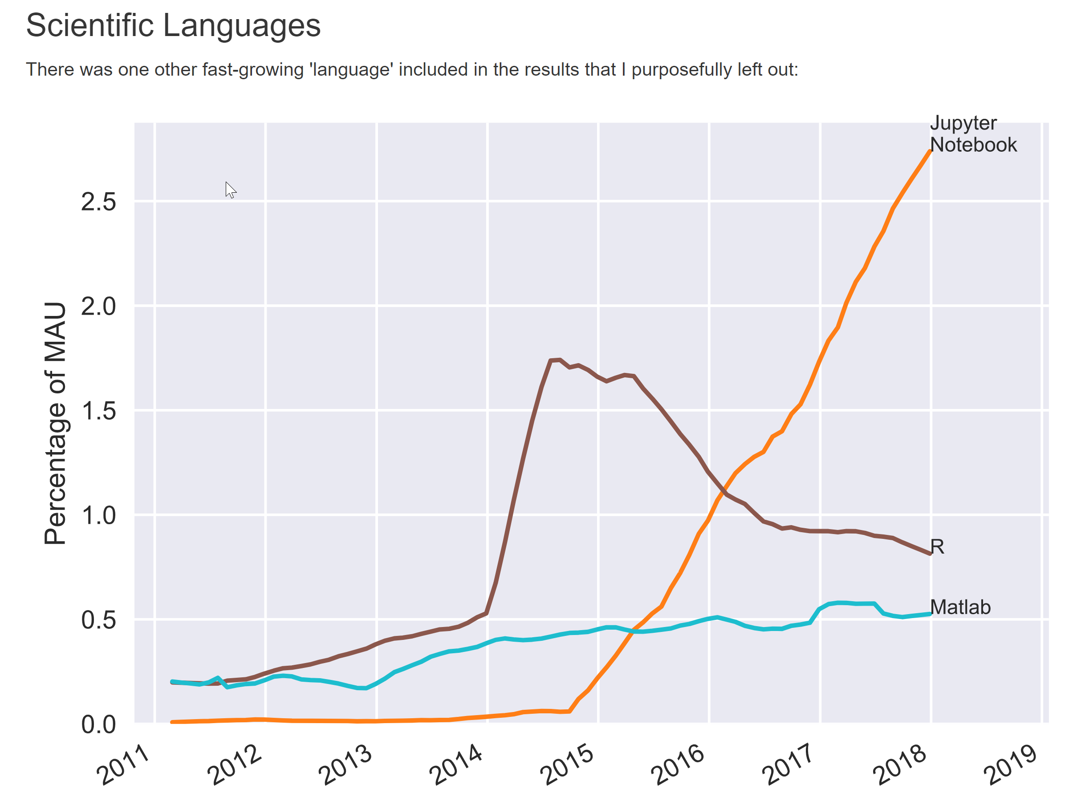
Jupyterlab new interface to Jupyter

Slide 11
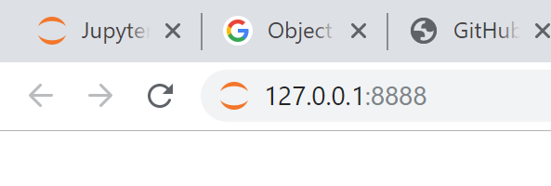
Start the docker
docker run --rm -it -p 8888:8888 -p 6080:6080 electronioncollider/epic-gui
…
[I 20:42:19.975 LabApp] The Jupyter Notebook is running at:
[I 20:42:19.975 LabApp] http://127.0.0.1:8888/
[I 20:42:19.975 LabApp] Use Control-C to stop this server

Slide 12
Jupyter lab, Jupyter notebooks, EPW, epic…

Slide 13
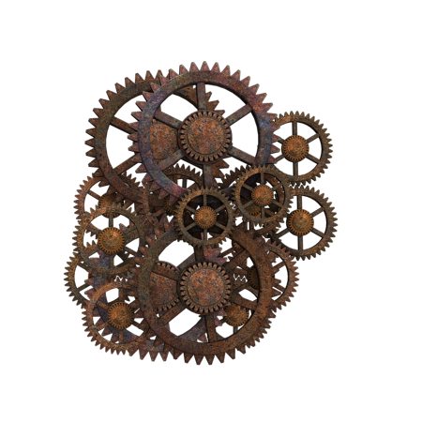
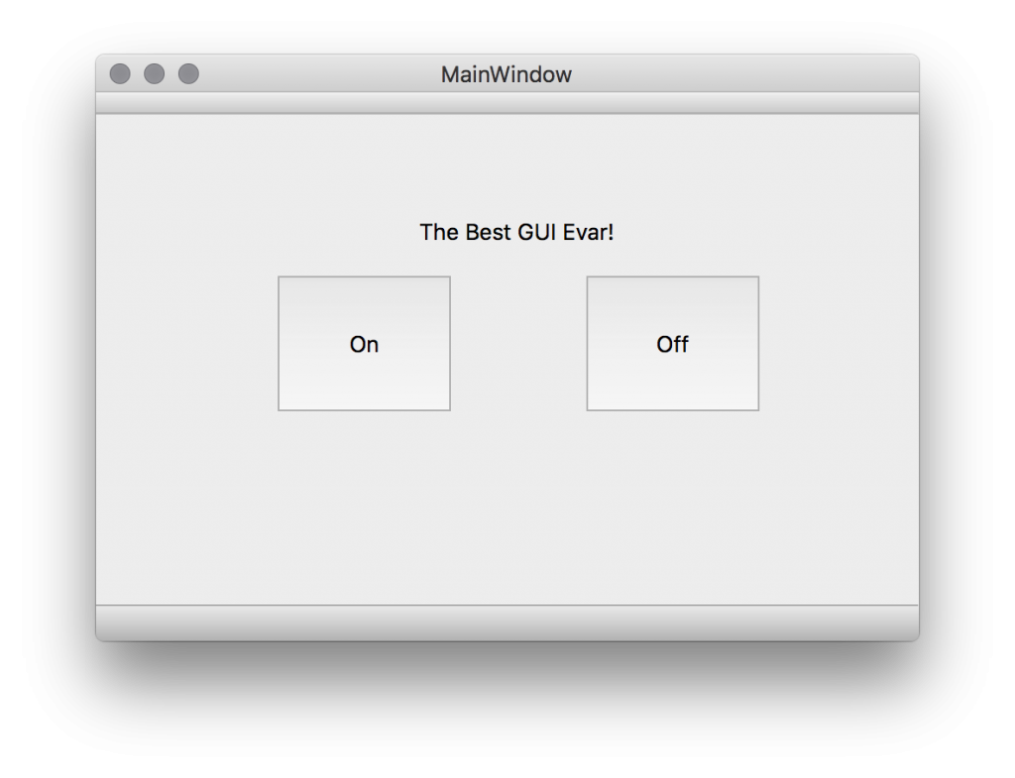
Do we hide complexity?
Jupyter lab, GUI,
Python, scripts, analysis
C++, eJANA, plugins
JANA, eic-smear, ROOT, Geant4

Slide 14
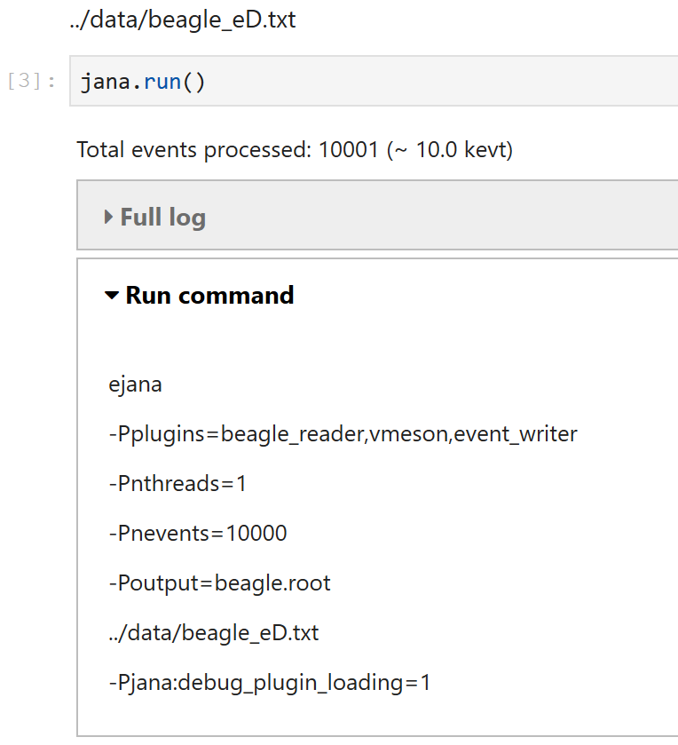
Transparency between layers
JupyterLab -> Python/ROOT C++. Python -> Command line…

Slide 15
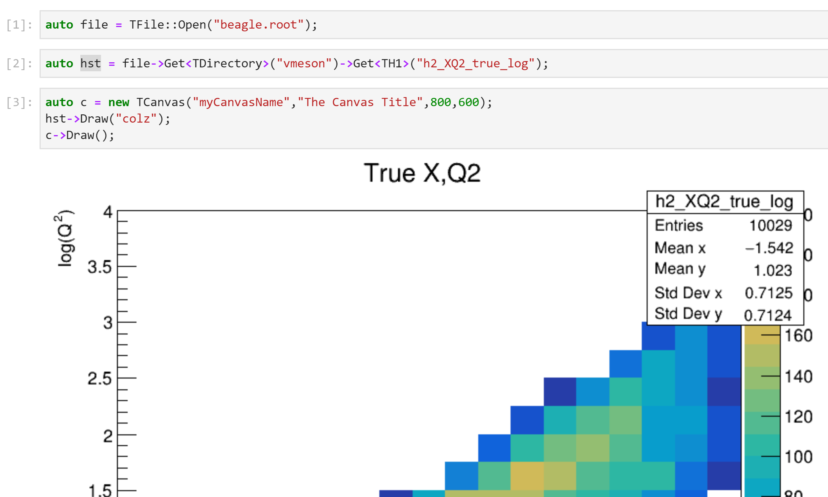
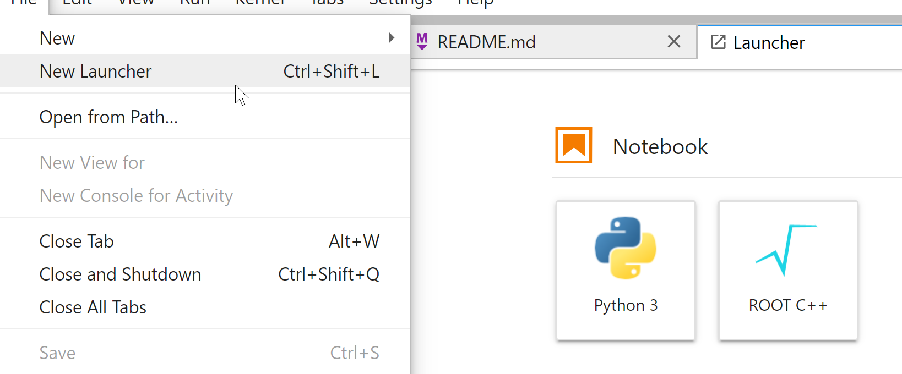
Working with ROOT and CLI
Run docker with bash
  docker run -it -p 8888:8888 eicdev/epic:latest bash
  To run jupyter lab environment > jlab
Run ROOT + C++ in notebooks:

Slide 16
Run on Open Science Grid
OSG
In preparation
Configuration
Run
(sim, recon, analysis)
Introspect results
Tamper with code

Slide 17
Ways to interact G4E with the docker
JupyterLab (in browser)
noVNC (in browser)
Any VNC viewer
X11 (directly or through ssh)
Remote debugging
… or just install everything on your machine
https://gitlab.com/eic/ejpm

Slide 18
Part 2 – Importing a ready detector to G4E

Slide 19
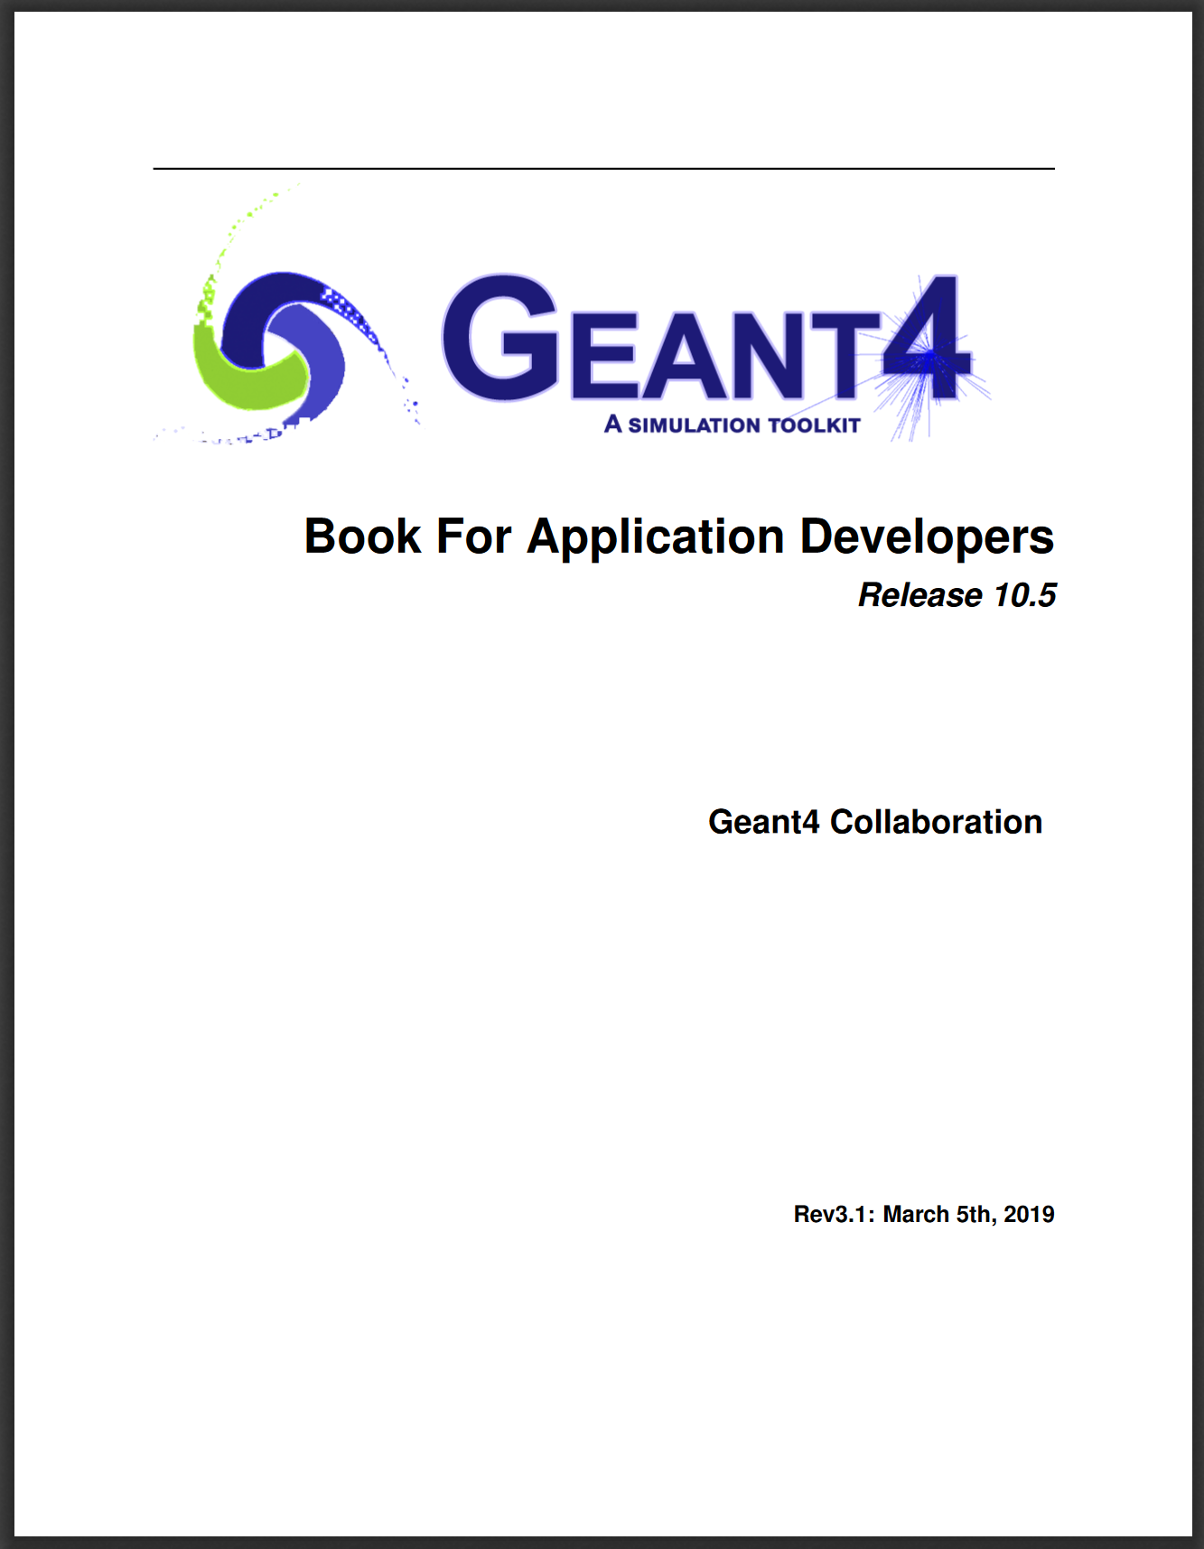
Geant4Eic (g4e)
https://gitlab.com/jlab-eic/g4e
Keep close to raw Geant 4
Small code base and fast compilation is good - KISS
Users coding in “Geant4” paradigms
Coding is OK GOOD
Few interfaces are well defined and documented. E.g.
  How to move in a detector
  What is the output root file structure
  etc.
It is up to users what to do, but there are Recommendations to commit code back

Slide 20
Main detectors – sub detectors
Beamlines
ERHIC
JLEIC
Future updates?
Master detectors
BEAST
JLEIC
ePhenix
Etc…
Subdetectors
Now 24 subdetectors

Slide 21
How one can add subdetecors to G4E
Create detector in place (in this tutorial)
Import detector from a library (this tutorial)
Import detector from ROOT Geometry (example is upcoming)
Define geometry with Geant4py (official G4 pyhon library).
(with C++ running speed)
Subdetectors are developed under its own repos
It would be good at this point not to disturb it

Slide 22
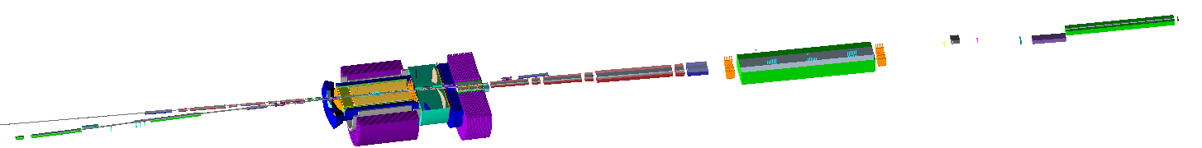
Naming convention
Names - <region>_<DETECTOR>_sub…
Example – cb_VTX
ffe_
e
far forward electron
central detector
p/A
p/A
IP
e
electron-endcap
barrel
ion-endcap
forward ion
(after D1)
far forward ion
(after D2)
ce_
cb_
ci_
fi_
ffi_

Slide 23
Naming sum up
Central Detector (c):
  Barrel (cb) == Central Barrel
    Solenoid (cb_Solenoid)
  Electron endcap (ce) == Central Electron endcap
    GEM tracking (ce_GEM)
  Ion endcap (ci) == Central detector Ion endcap
    GEM tracking (ci_GEM)
Forward ion (fi) direction area near D1 magnet:
  Tracker detector1 (fi_TRKD1)
FarForward ion (ffi) direction area (near D2, D3 magnets)
  ZeroDegree Calorimeter (ffi_ZDC)
  Roman Pots (ffi_RPOTS)
Far forward electron (ffe) direction area
  Low*Q2 tagger (ffe_LQ2)
  Electron Polarimeter (ffe_CPOL)
  Luminosity monitor (ffe_LUMI)

Slide 24
Volumes hierarchy
Each detector is placed in an outer placeholder volume

Slide 25
Detector design interface
Master Detector Construction
Subdetector implementation
detector_Conifg
detector_Design

Slide 26
Final improvements
Mapping User Actions
Using global root output
Adding ffe_LUMI_Config to master_Config
actionInit = initContext.ActionInitialization
actionInit.AddUserActionGenerator([&](){return new lumi::EventAction();});
actionInit.AddUserActionGenerator([&](){return new lumi::RunAction();});
initContext.RootManager->GetMainRootFile()
initContext.Arguments->OutputBaseName

Slide 27
Configuration
Master Config
Master Detector Construction
subConifg
Subdetector
subConifg
Subdetector
subConifg
Subdetector
subConifg
Subdetector

Slide 28
Configuration
InitializationContext
Master Config
Master Detector Construction
subConifg
Subdetector
subConifg
Subdetector
subConifg
Subdetector
subConifg
Subdetector

Slide 30
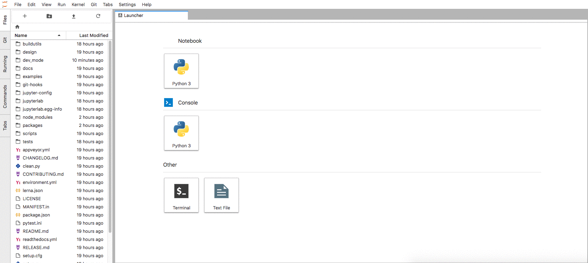
How can I save data?
Remove “remove” flag!
The project is a git repository. Jupyterlab-git is installed
docker run --rm -it -p 8888:8888 electronioncollider/epic-gui

Slide 31
How to process your file with this docker?
docker run -it --rm -p 8888:8888 -p 6080:6080 \
-v my_folder:/home/eicuser/epw/share \
electronioncollider/epic-gui
-v source:destination – flag to bind your and docker directories
/home/eicuser/epw/share – to instantly see in the default JupyterLab directory
Windows – you will need
  sharing a drive or…
  use WSL2 or…
  Virtualbox

Slide 32
Full docker run string
docker run -it --rm -p8888:8888 -p 6080:6080 -p 5901:5901 --cap-add=SYS_PTRACE --security-opt seccomp=unconfined electronioncollider/epic-gui
--cap-add=SYS_PTRACE --security-opt seccomp=unconfined - enables debugging
8888 – JupyterLab, 6080 – noVNC, 5901 – any VNC client

Slide 33
How to install things on my machine?
NO EFFORT AT ALL
Novice
Some effort
Experts
Efforts required axis
Containers
Farms
(BNL, Jlab)
Precompiled
Binaries
Workstation
Compilation
EJPM
Conda, CVMFS
EIC Jana Packet Build
Managaer = ejpm
This tutorials

Slide 34
Upcoming tutorials
Detector Full Simulation Tutorials:
The tutorial will cover Geant4 simulations of EIC detectors and will show how to modify existing detector concepts and how to integrate a new detector into one of the existing detector concepts.
  Thursday, February 6 (TBC). Please stay tuned for the final date.
Remote access for both tutorials will be provided via BlueJeans.
Please register for the tutorials!
Topics not covered in planned tutorials:
EIC Smear, Jana2 / eJANA, ROOT7, OSG, Data science tools, JupyterLab, Reconstruction

Slide 35

Users input needed!
We’ve built a base for our software stack.
Users are welcome to steer and drive the further development

Slide 36
Grow with user input
Develop
Workflow environment for EICUG
to use (tools, documentation, support) and
to grow with user input (direction, documentation, tools)
Support
Involvement from EICUG

Slide 37
Support
Thank you!
https://gitlab.com/jlab-eic/g4e
https://gitlab.com/eic/ejpm
support team
weekly shifts
Users
Developers
experience
software-support@eicug.org
Mailing list (anyone can contact)
Google forum (for archive of support requests and start of knowledge base)
http://eicug.slack.com/
EICUG Slack workspace with software-support channel

Slide 38
e^{JANA}
e^{JANA} is JANA + plugins for EIC data reconstruction and analysis
But also:
tools to manage dependencies and run eJANA in different environments
Integration with python and extensions to Jupyter Lab
  (ejpm, edock, pyjano, and others..)
Generators
Full simulation
eJANA
Directly opens various
MC formats
Fast simulation
Reconstruction
ROOT
Eic smear
Genfit
Rave
Analysis in (multithreaded C++)
Python
Jupyter
e^{JANA} stands for EIC JANA

