Slide 1
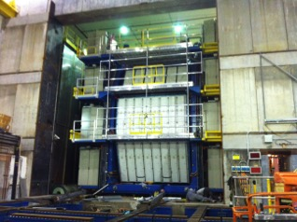
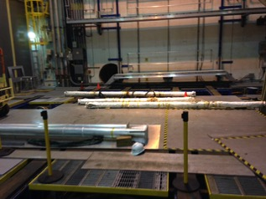
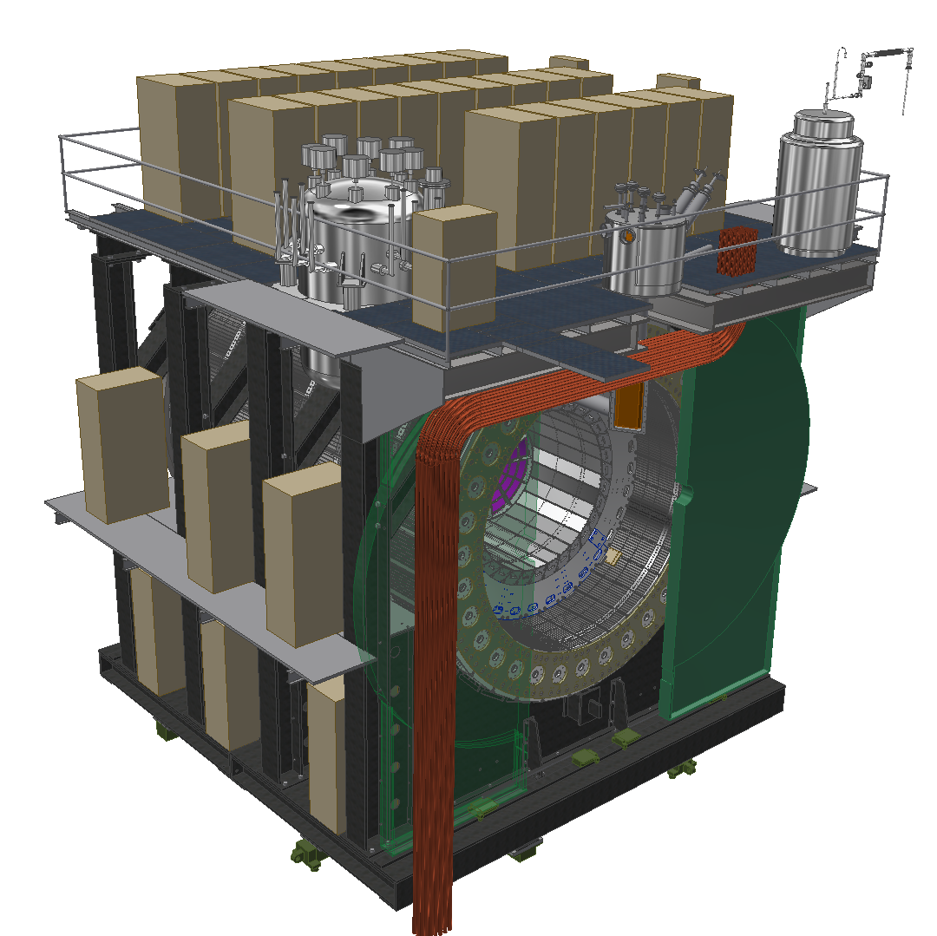
sPHENIX Planning
Weekly Planning Meeting: 1/9/2020

Slide 2
Infrastructure/1008
TASK | DATES | STATUS | NOTES
Put Beam Pipe back up | 11/4-11/15 |  | Done
Shield Wall | 11/18-11/22 | In Progress | Done
RHIC Run | 12/1? |  | In Progress
Track Repairs |  |  | Welders 80% done with gussets

Slide 3
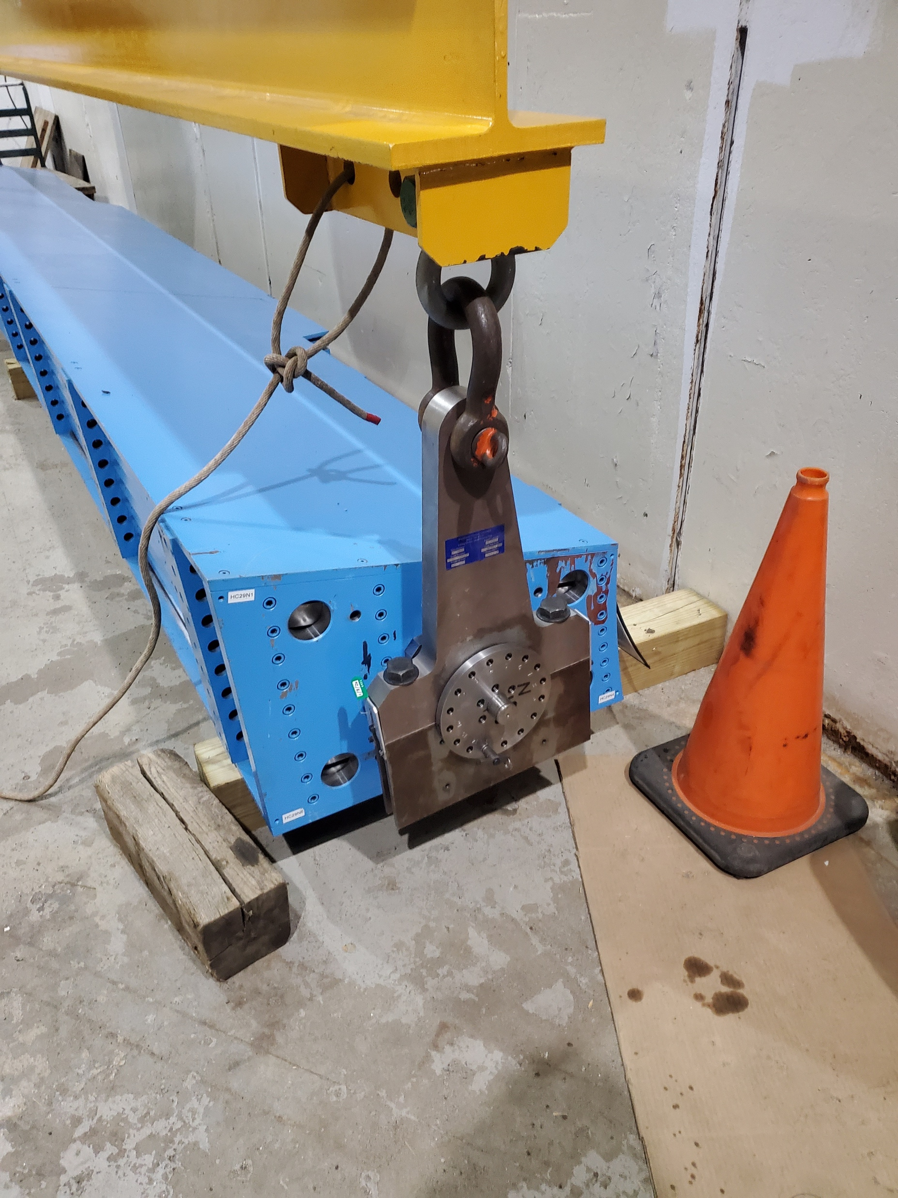
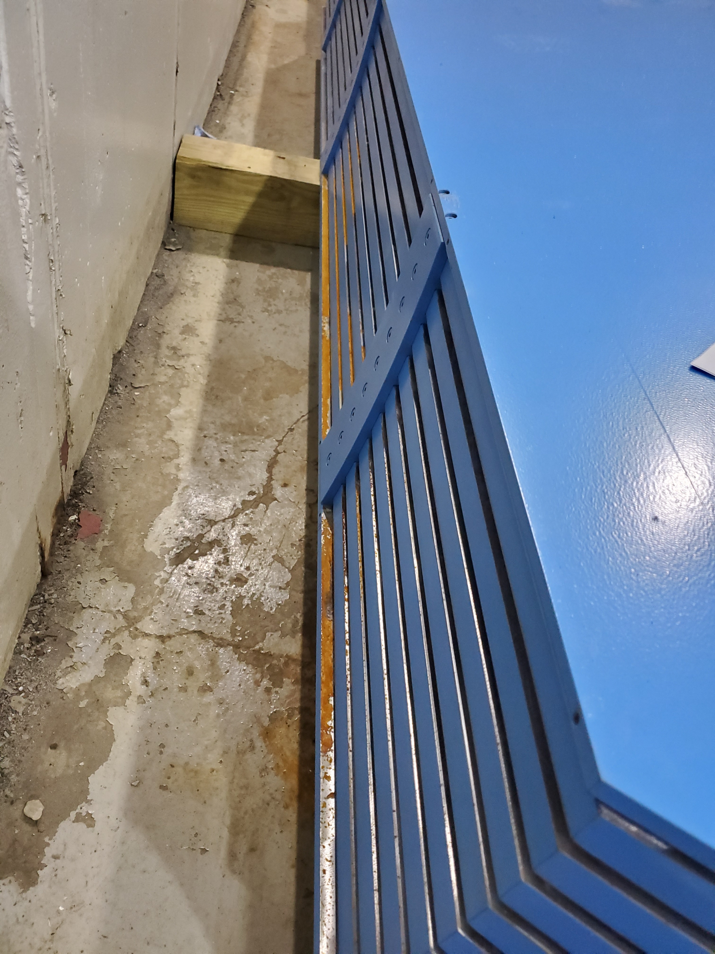
HCAL
TASK | STATUS | NOTES
OHCAL Cables, pre-amps, fibers, etc | ONGOING | Test cables are available at 912
Starting to cable 1st sector | ONGOING | Frank Completed all cabling, John H. testing
Mods to lifting fixture |  | Done, Testing now
Inner HCAL Work |  | Setup Ihcal in 912 Done. Ready for heat, space tests
3 Sector Installation Mock-up |  | Waiting for detail drawings to be signed off
Testing Sector 1 |  | Ongoing, John H.

Slide 4
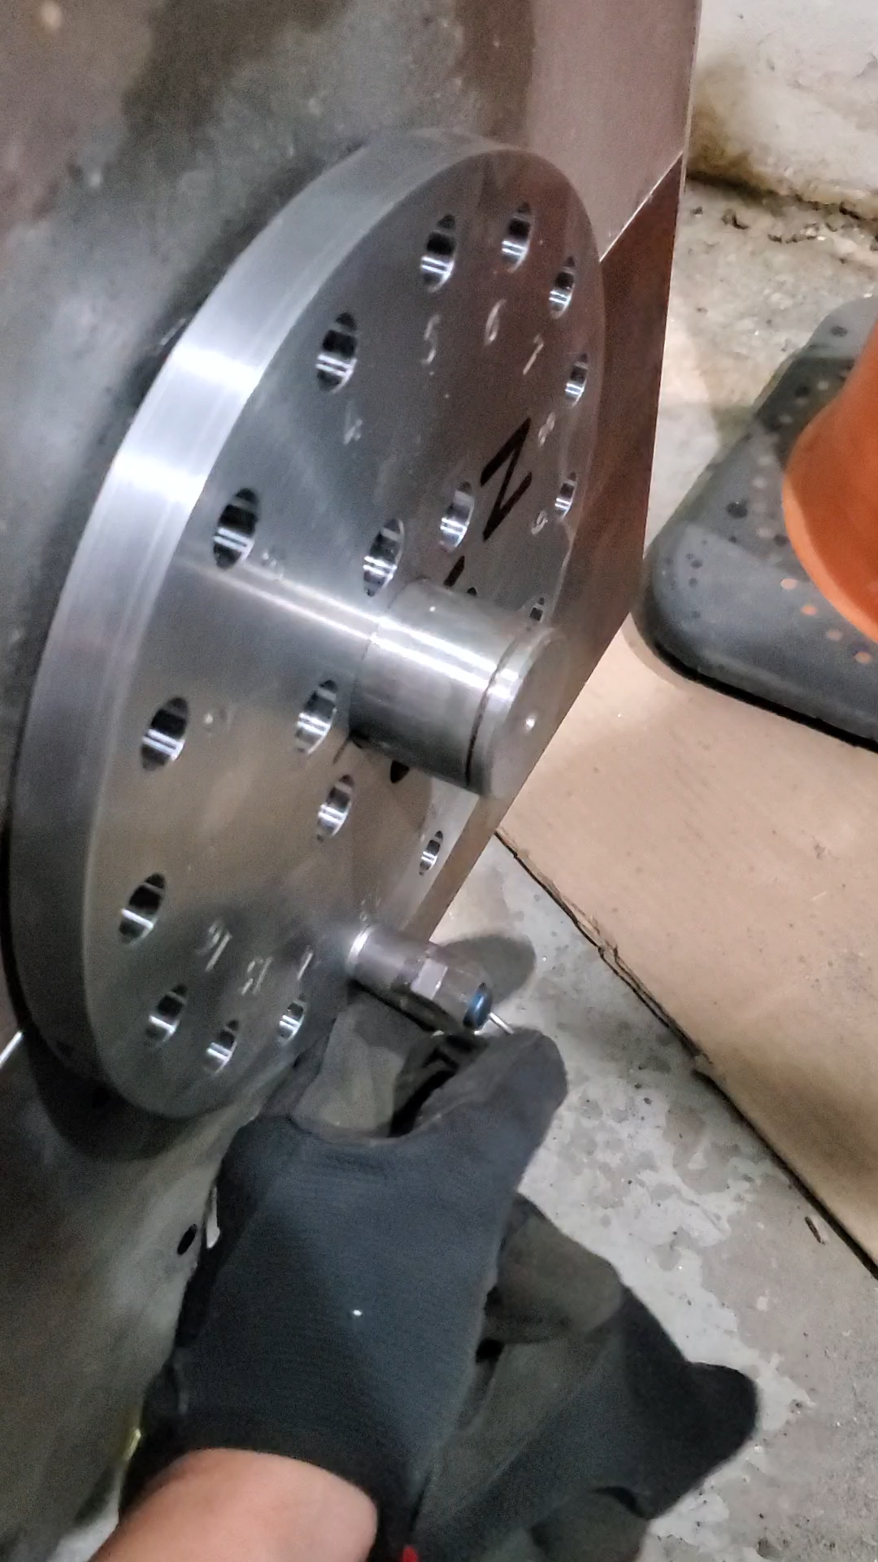

Slide 5
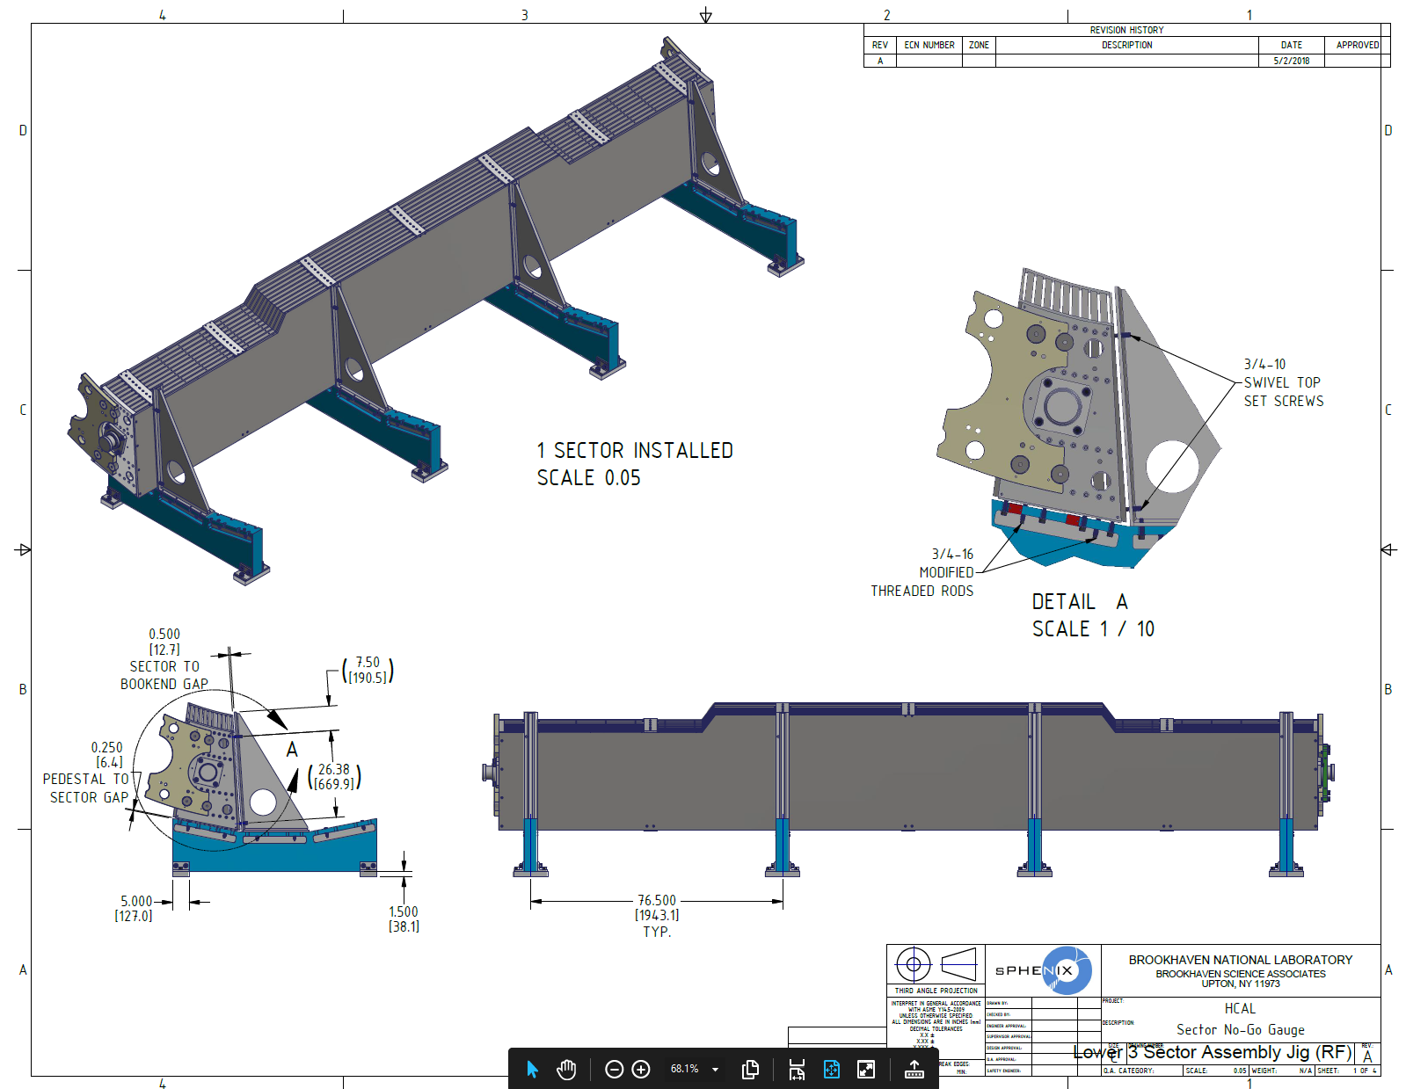
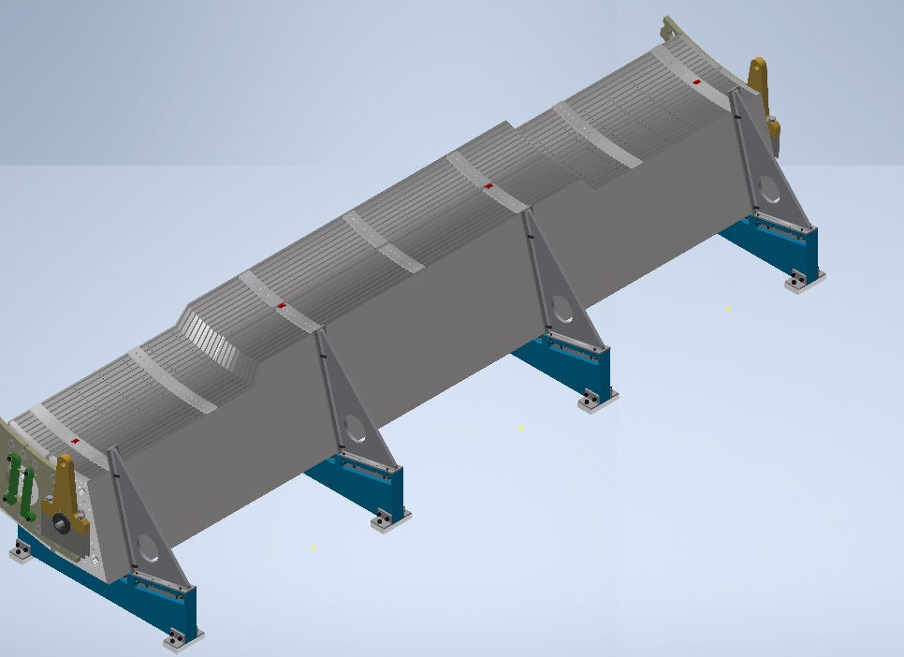
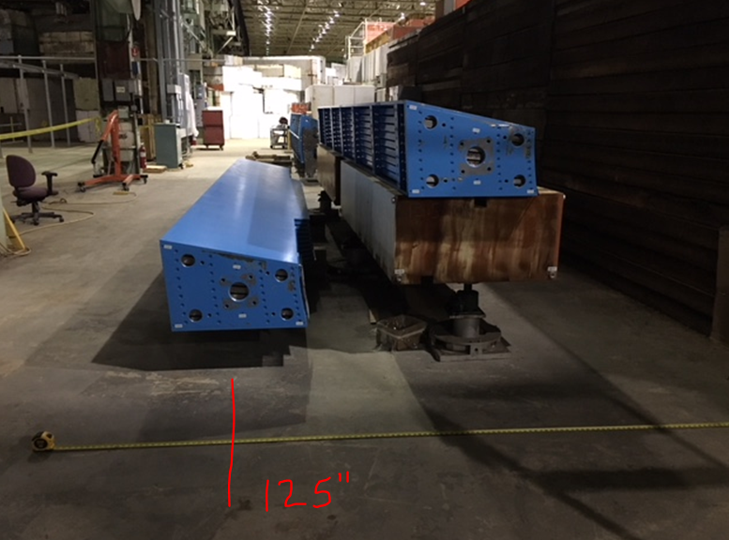
Drawings Need Approval?

Slide 6
sPhenix/EMCAL Status
Blocks 144 blocks in hand.
All w/ reflectors.
48 w/ light guides.
Plus latest shipment of 24 blocks (reflectors attached)
Waiting on next shipment of light guides to complete Sec 1 (S).
Strong backs 14 strong backs in hand .
IGUS Pallet Rails 12 rails in hand and inspected.
All rail ends de-burred for pillow block clearance.
Sec 0 (rail and pallet) already exists.
Sector Pallets Need to order and assemble Sector’s 1 – 12.
Label Sectors 1 – 12 w/ 6 (N) and 6 (S)
Note: offset of fork slots and block direction.
Enclosures Sectors 1 – 12 in hand and inspected
Note: For Sec’s 1 – 12, must use thinner
undercut 4-40’s screws for out of tolerance holes.

Slide 7
Electronics
Waiting on first shipment of populated SiPM
boards from vendor (mid – Jan ?).
Pre-amp boards for Sec 1 (S) ?
Pre-amp boards for Sec’s 2 – 12 ?
Interface boards Sec’s 1 – 12 ?
SiPM Cables, enough for Sec 0
Signal cables, enough for Sec 0
Pwr cables, have sec’s 0-12
Bias cables, have sec’s 0-12
Pulser cables, have sec’s 0-12
Cooling Final design for SiPM manifolds -
5/16” (4 dwgs, 2 north and 2 south)
Started on manifold (S) 1 (being done in house).
Pre-amp manifold design, final ! Need Dwg ?
Interface manifold design, final ! Need Dwg ?
  Insulation for all cooling established, need testing and approval!
Testing Sec 0 ongoing in present tent. Will move to 3rd
Tent when Sec 0 has been fully tested.

Slide 8
EMCAL

Slide 9
EMCAL

