Slide 1
Dynamic Aperture Simulations and Field Quality of IR Magnets
Yunhai Cai (SLAC)
Y. Nosochkov, M.-H. Wang (SLAC)
S. Fartoukh, M. Giovannozzi, R. de Maria, E. McIntosh (CERN)
LARP HiLumi LHC Meeting 7—9 May 2014, BNL, USA

Slide 2
Introduction
New large aperture SC magnets are planned for the HL-LHC lattice: Nb₃Sn 150 mm aperture IT quadrupoles, Nb-Ti 150 mm D1 and 105 mm D2 separation dipoles, 90 mm Q4 and 70 mm Q5 matching quadrupoles.
Field quality of the IT, D1 and D2 magnets have been previously optimized for SLHCV3.1b lattice layout at collision energy.
This study, first, investigates the impact of IR magnet errors on dynamic aperture (DA) of SLHCV3.1b at injection energy using tracking simulations with SixTrack.
Secondly, the DA simulations have been started for the most current lattice layout HLLHCV1.0 using the previously optimized field quality of the IR magnets.
Lattice set-up: 1) collision optics with β*= 15 cm at IP1/IP5 and E = 7 TeV, and 2) injection optics with β*= 5.5 m or 11 m and E = 450 GeV.
Tracking simulations set-up:
10⁵ turns, 60 random error seeds, 30 particle pairs per amplitude step (2σ), 11 x-y angles
Beam energy: 7 TeV (collision), 450 GeV (injection)
Initial Δp/p: 2.7e-4 (collision), 7.5e-4 (injection)
Nominal tune: 62.31, 60.32 (collision), 62.28, 60.31 (injection)
Normalized emittance = 3.75 μm-rad
Arc errors and the standard correction systems are always included
IT non-linear correctors of order n=3-6 are used in the collision optics

Slide 3
IR optics in SLHCV3.1b lattice at injection energy
Two options for β* at IP1/IP5 at injection energy: 5.5 m and 11 m.
The corresponding peak beta function in the triplet is reduced 35 or 70 times compared to collision optics. Therefore, the impact of IR magnet errors at injection energy is expected to be much smaller than in collision optics, and the use of IT non-linear correction is not required.
β* = 5.5 m
β* = 11 m

Slide 4
Estimated field quality of IT quadrupoles at injection energy used in simulations (r₀ = 50 mm)
Reference table: “IT_errortable_v66”.
skew | mean | uncertainty | random |  | normal | mean | uncertainty | random
a3 | 0 | 0.800 | 0.800 |  | b3 | 0 | 0.820 | 0.820
a4 | 0 | 0.650 | 0.650 |  | b4 | 0 | 0.570 | 0.570
a5 | 0 | 0.430 | 0.430 |  | b5 | 0 | 0.420 | 0.420
a6 | 0 | 0.310 | 0.310 |  | b6 | -16.0 | 1.100 | 1.100
a7 | 0 | 0.190 | 0.190 |  | b7 | 0 | 0.190 | 0.190
a8 | 0 | 0.110 | 0.110 |  | b8 | 0 | 0.130 | 0.130
a9 | 0 | 0.080 | 0.080 |  | b9 | 0 | 0.070 | 0.070
a10 | 0 | 0.040 | 0.040 |  | b10 | 4.15 | 0.200 | 0.200
a11 | 0 | 0.026 | 0.026 |  | b11 | 0 | 0.026 | 0.026
a12 | 0 | 0.014 | 0.014 |  | b12 | 0 | 0.018 | 0.018
a13 | 0 | 0.010 | 0.010 |  | b13 | 0 | 0.009 | 0.009
a14 | 0 | 0.005 | 0.005 |  | b14 | -0.040 | 0.023 | 0.023

Slide 5
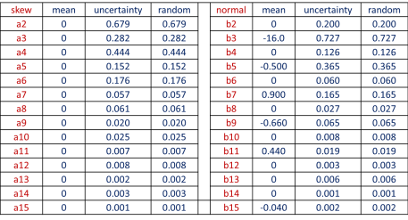
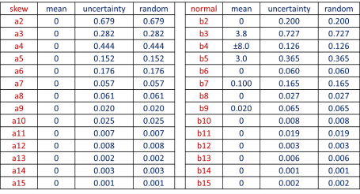
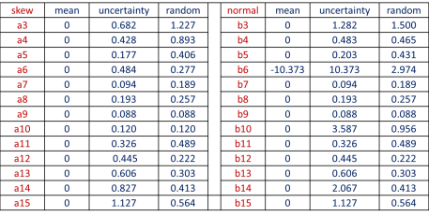
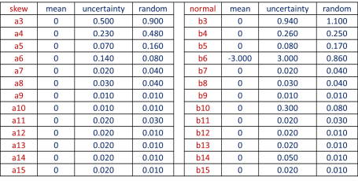
Estimated field quality of D1, D2 separation dipoles and Q4, Q5 matching quadrupoles at injection energy
D1 (r₀ = 50 mm)
D2 (r₀ = 35 mm)
Q4 (r₀ = 30 mm)
Q5 (r₀ = 17 mm)

Slide 6
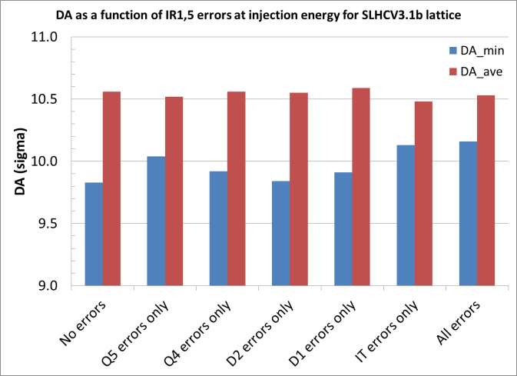
DA sensitivity to IR magnet errors in SLHCV3.1b lattice at injection energy
Arc errors and standard corrections are always included. Injection lattice with β* = 5.5 m at IP1,5.
DA is not sensitive to the IR magnet errors – the DA fluctuation is comparable to accuracy of the calculation.

Slide 7
DA at injection energy for SLHCV3.1b lattice with β* = 5.5 m
The DA at injection energy and tune of 62.28/60.31 is about 1σ smaller than for the nominal LHC. Since the DA is not limited by the IR magnet errors, then improvements to other lattice properties (e.g. arcs and tune) may need to be considered in order to recover the DA.

Slide 8
Comparison of DA for SLHCV3.1b with β* = 5.5 m and 11 m at injection energy
The DA at injection energy is about the same for β* = 5.5 m and 11 m optics at IP1/IP5, therefore β* is not a limitation.

Slide 9
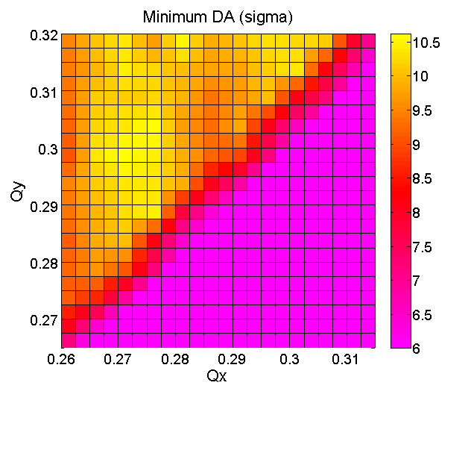
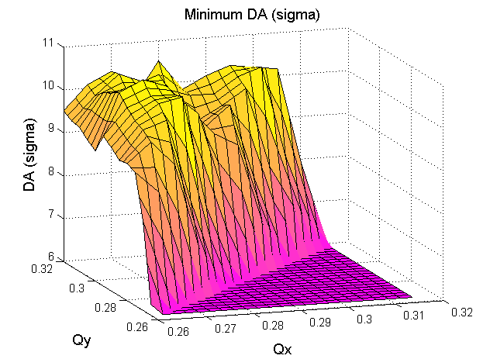
Tune scan for SLHCV3.1b lattice at injection energy – minimum DA
The minimum DA can be increased by ~0.5σ by reducing the x and y tune by 0.01.
Pink area below
Qx=Qy line was
not scanned
better DA
Nominal tune

Slide 10
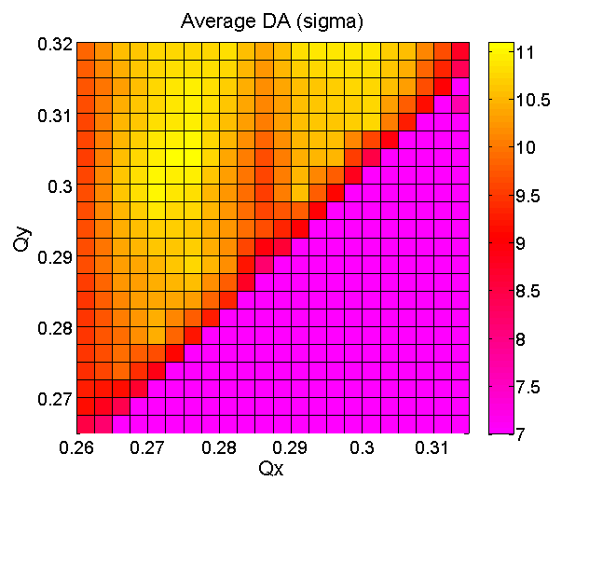
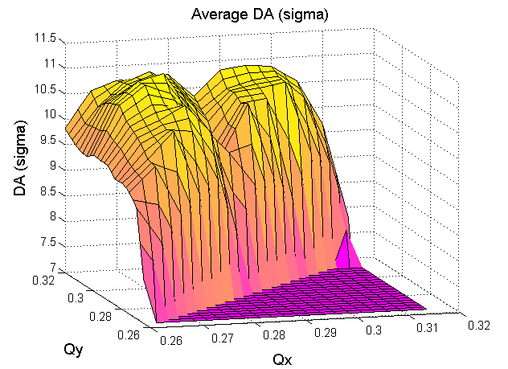
Tune scan for SLHCV3.1b lattice at injection energy – average DA
The average DA can be increased by ~0.5σ by reducing the x and y tune by 0.01.
Effect of 7th order horizontal resonance can be seen near the present tune.
7th order resonance
Pink area below
Qx=Qy line was
not scanned
Nominal tune

Slide 11
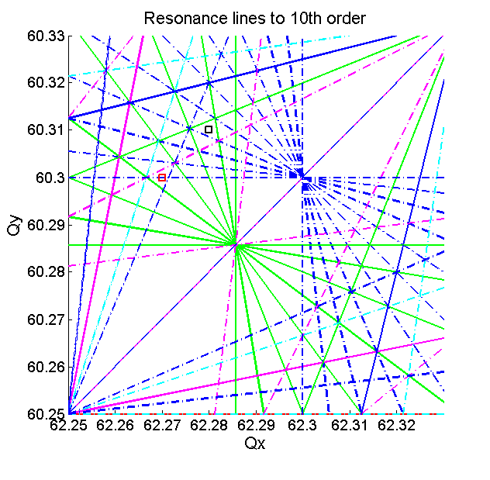
Resonance line tune diagram
□ present tune at injection energy: 62.28/60.31
□ tune area with the DA increased by ~0.5σ
10th order resonances -- blue dot-dash
7th order resonances -- green
7th order resonances seem to be reducing the DA at the nominal tune
Another way to improve the DA is to increase the integer split between the x and y tunes (S. Fartoukh)

Slide 12
HLLHCV1.0 lattice in the IR1/IR5 at collision energy
Modifications relative to SLHCV3.1b: length of the triplet is increased by 7%, peak beta function is increased by 7%, magnet orientation within cryostat is taken into account for better determining the correction of high order field errors.
β* = 15 cm

Slide 13
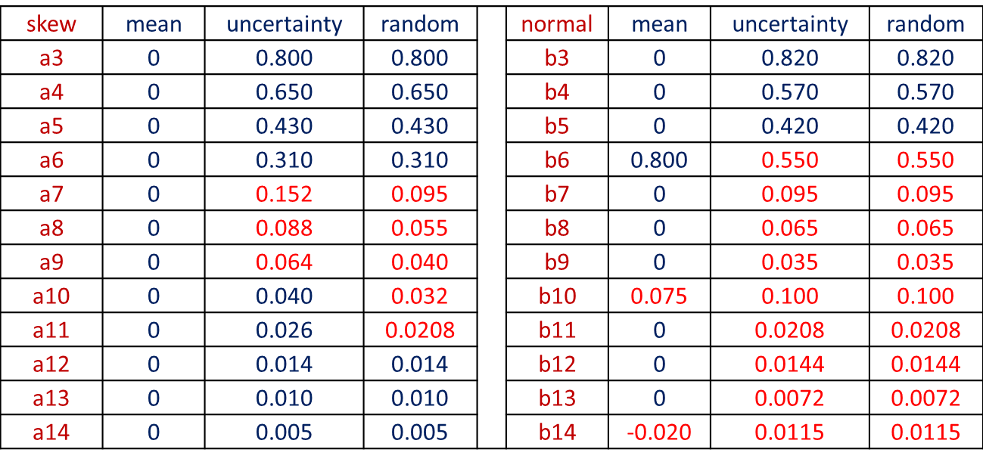
Optimized field quality of IT quadrupoles at collision energy used in simulations (r₀ = 50 mm)
Reference table: “IT_errortable_v66”.
The red values in the table are optimized in the earlier studies of SLHV3.1b lattice.

Slide 14
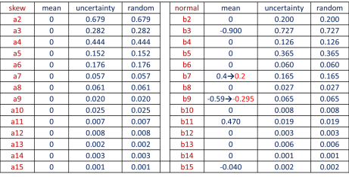
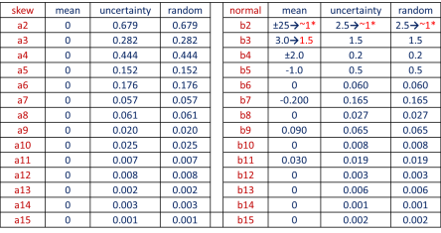
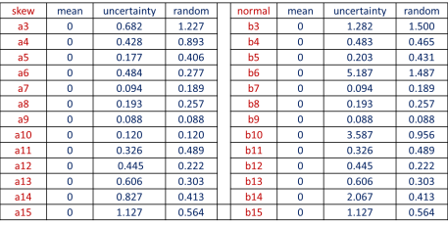
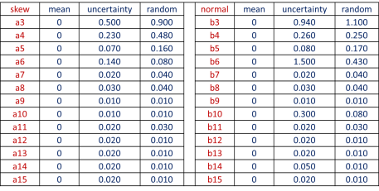
Optimized field quality of D1, D2 separation dipoles and Q4, Q5 matching quadrupoles at collision energy
D1 (r₀ = 50 mm)
optimized values shown in red
D2 (r₀ = 35 mm)
Q4 (r₀ = 30 mm)
Q5 (r₀ = 17 mm)

Slide 15
SLHCV3.1b versus HLLHCV1.0: DA at collision energy
SLHCV3.1b
HLLHCV1.0
DA of HLLHCV1.0 lattice at collision energy is reduced by ~1σ relative to SLHCV3.1b lattice

Slide 16
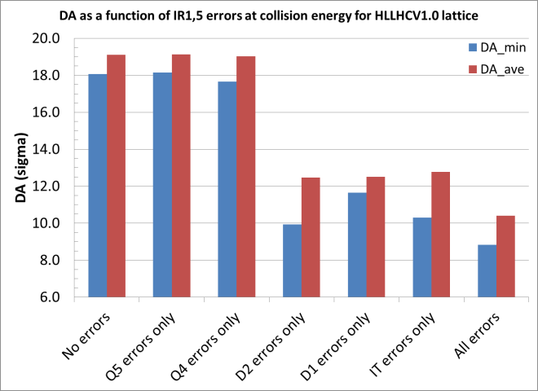
DA sensitivity to IR magnet errors in HLLHCV1.0 lattice at collision energy
Arc errors and standard corrections are always included.
Errors in the D2 separation dipoles and the IT cause the most reduction of the DA.

Slide 17
SLHCV3.1b versus HLLHCV1.0: Effect of IT errors at collision energy
When D1, D2, Q4, Q5 errors are off, the effect of IT field errors in HLLHCV1.0 lattice at collision energy is about 0.5σ smaller DA relative to SLHCV3.1b lattice.

Slide 18
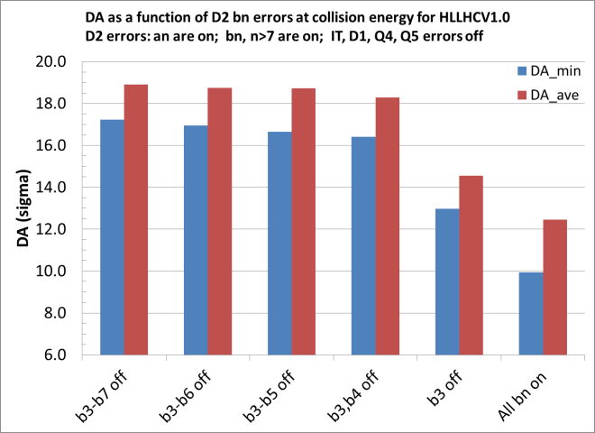
DA sensitivity to low order b_{n} terms of D2 error field for HLLHCV1.0 lattice at collision energy
The b3 and b4 terms of the D2 error field make the most impact on the DA. This effect is likely amplified by the sextupole resonances near the nominal tune.
b4
b3+b4

Slide 19
DA of HLLHCV1.0 lattice at collision energy when b4m of D2 error field is reduced to 50%
Since b3m in D2 is already optimized (reduced), the next step could be reduction of b4m by 50%.
This improves the average DA by ~0.5σ.
Still, more improvements are needed for reaching 10σ of minimum DA.

Slide 20
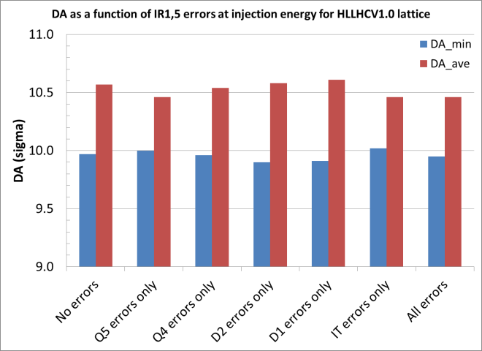
HLHCV1.0 lattice at injection energy: DA sensitivity to IR magnet errors
Arc errors and standard corrections are always included. Injection lattice with β* = 5.5 m at IP1,5.
Similar to SLHCV3.1b lattice, there is no impact from the IR magnet errors on DA of HLLHCV1.0 lattice at injection energy.

Slide 21
DA of HLLHCV1.0 lattice at injection energy and comparison to SLHCV3.1b
The DA of HLLHCV1.0 and SLHCV3.1b lattices at injection energy are comparable and acceptable.
However, it is 1σ below the DA of the nominal LHC. Hence, further improvements (e.g. tune adjustment) may need to be considered.

Slide 22
Conclusions and plans
DA at injection energy for both SLHCV3.1b and HLLHCV1.0 is not affected by the currently estimated field error quality of the IT, D1, D2, Q4, Q5 magnets in the IR1/IR5. Therefore, the field quality at injection is acceptable.
The DA at injection energy is acceptable, but it is 1σ smaller than for the nominal LHC. A tune scan shows that the DA can be increased by 0.5σ when the tune is reduced by about 0.01. Other options may include a lattice with a larger integer tune split at injection.
The DA of HLLHCV1.0 lattice at collision energy is reduced by about 1σ compared to the SLHCV3.1b. The main impact is due to D2 and IT field errors. Reduction of b4m term of the D2 to 50% value can recover about 0.5σ of the DA. Other options should be investigated for recovering the desired minimum DA of 10σ.
Near-term and longer term plans:
Investigate options for larger DA at collision energy for the HLLHCV1.0 lattice. This may include further adjustment of field quality of the IT and other magnets.
Contribute to preparation of the TDR.
Follow-up tracking studies with the measured IT field quality, when the prototype magnets are available.

