Slide 1
Wideband Slotline Kicker, Power Amplifiers, Infrastructure Upgrades
John Cesaratto (SLAC)
J. Dusatko, J.D. Fox, K. Pollock, C. Rivetta, O. Turgut (SLAC)
D. Alesini, A. Gallo, M. Zobov (INFN-LNF)
Stefano De Santis, H. Qian (LBNL)
W. Hofle, G. Kotzian, E. Montesinos, and C. Zanini (CERN)
* Work supported by the U.S. Department of Energy under contract DE-AC01-76SF00515, U.S. LHC Accelerator Research Program, and by the EU FP7 HiLumi LHC – Grant Agreement 284404

Slide 2
Progress over the last year
Optimization of slotline model for maximum bandwidth AND maximum shunt impedance, port optimization
Comparison of stripline, slotline, and cavity designs
Kicker Design Report completed and published at both SLAC and CERN.
SLAC-R-1037, http://www-public.slac.stanford.edu/SciDoc/docMeta.aspx?slacPubNumber=slac-r-1037
CERN-ACC-NOTE-2013-0047, http://cds.cern.ch/record/1639553
Two designs chosen: Array of striplines, slotline designs
Four power amplifiers evaluated, ongoing discussions with vendors to provide amplifiers with characteristics we desire.
Infrastructure improvements and additions in SPS Faraday cage and tunnel.

Slide 3
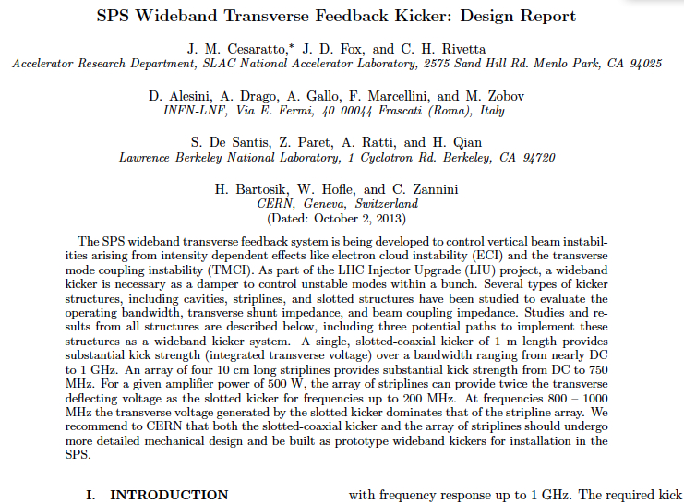
Kicker Design Report

Slide 4
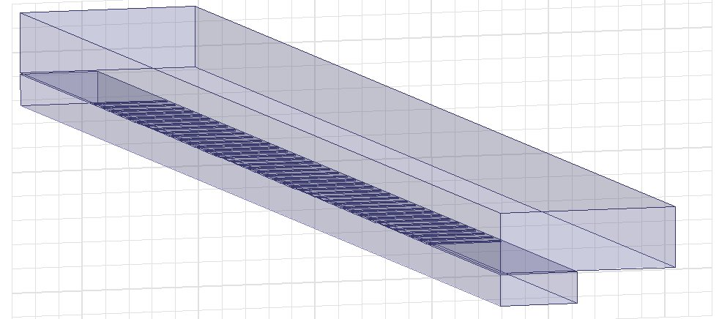
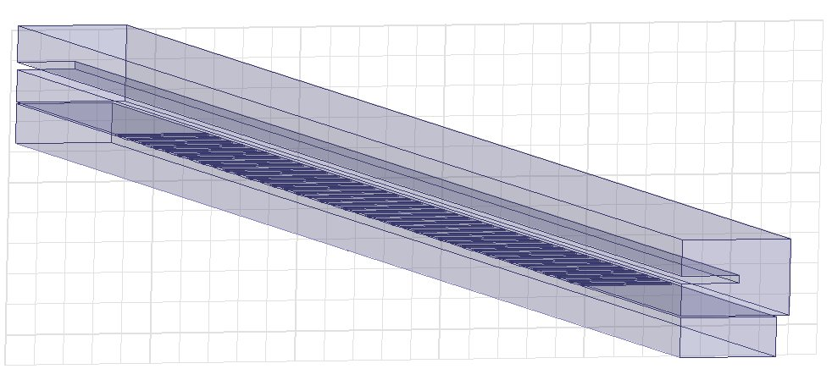
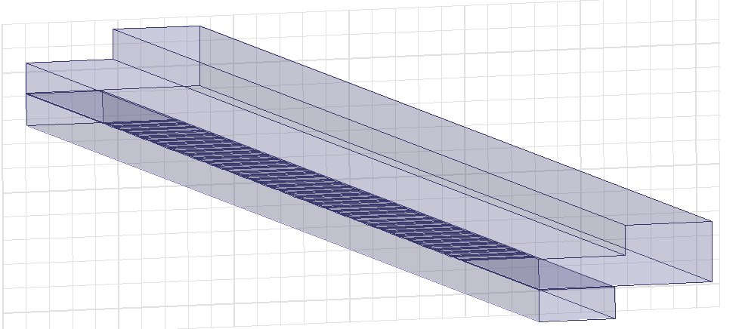
Review Slotline Characteristics
Fermilab type (McGinnis)
Coaxial type (Faltin)
Ridged type

Slide 5
Coaxial Type Slotline Kicker
Two coaxial waveguides coupled to the beam pipe by slots
Parameters of the model optimized for a bandwidth of 1 GHz
1 m long, with 40 slots, compiles with stay-clear restrictions
Acceptable amount of broadband impedance to the SPS (collaboration with INFN-LNF)
Transfer Function
Gain
Phase

Slide 6
Slotted kicker in Kicker Design Report
0°
Direction of the beam
180°

Slide 7
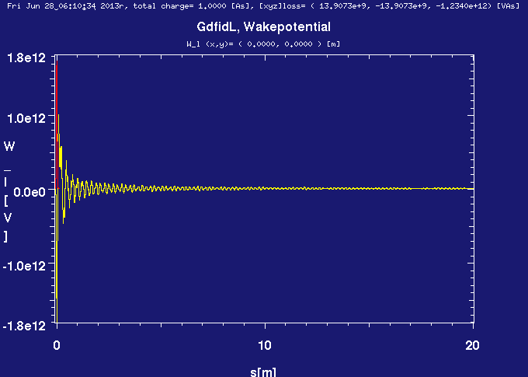
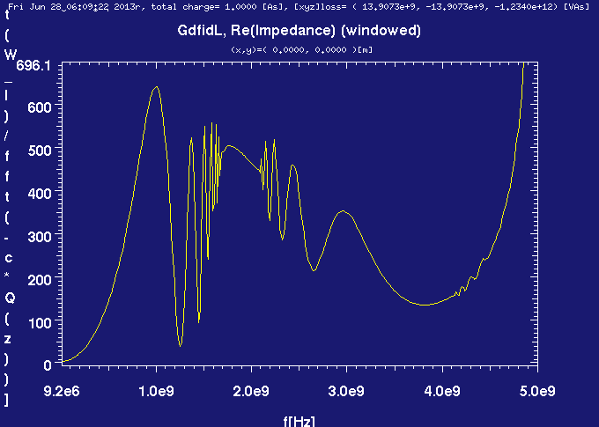
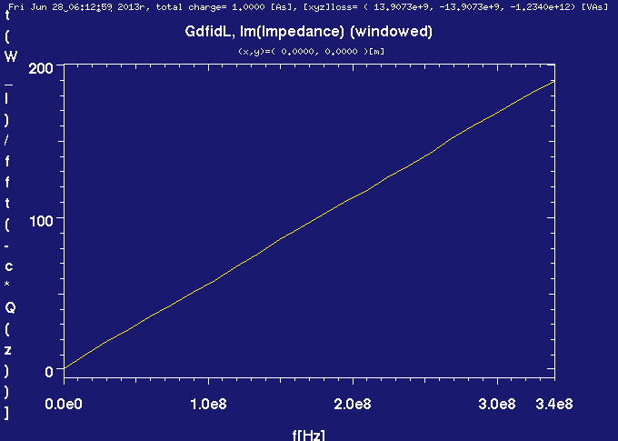
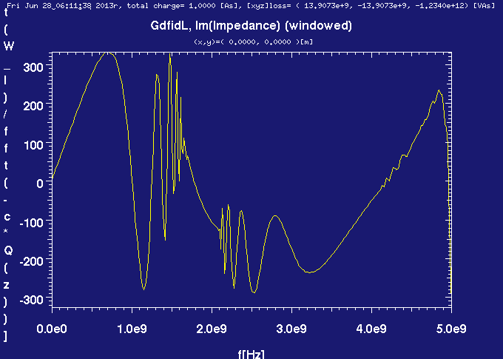
No feedthroughs – Coaxial-type
Wake Potential
Longitudinal Impedance
Gaussian bunch, σ_{z} = 2 cm
Real
25 ns
Imaginary
Courtesy of M. Zobov

Slide 8
S11 Parameter

Slide 9
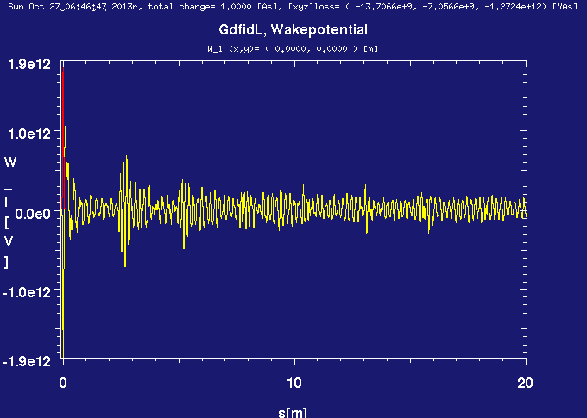
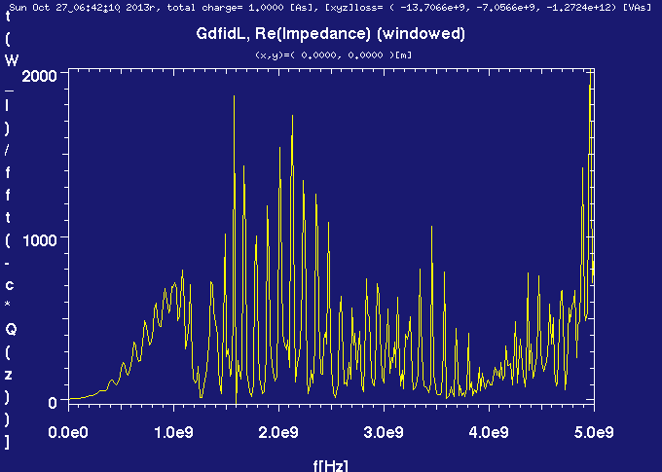
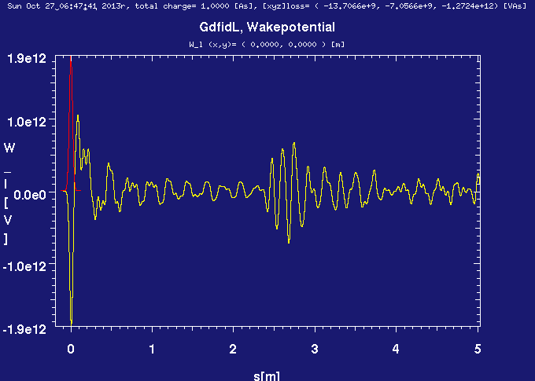
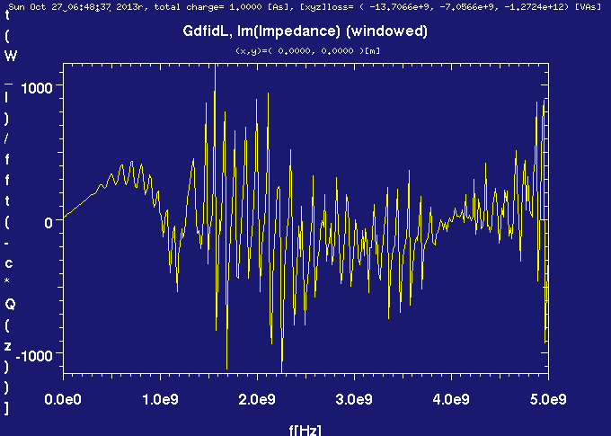
With feedthroughs
Wake Potential
Longitudinal Impedance
Real
Imaginary

Slide 10
Impedance Comparison
Without feedthroughs
With feedthroughs
Real
Imaginary

Slide 11
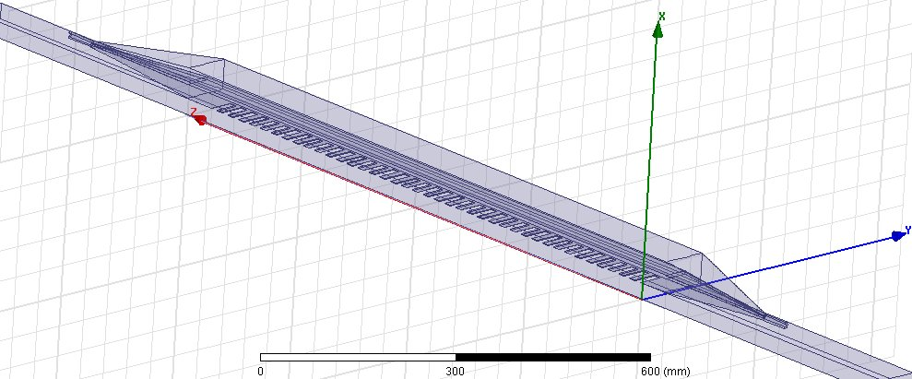
Lateral feedthrough
50 Ohm: coax and enclosed stripline
Parameters | Length (mm)
Coax diameter | 5
Coax shield | 11.5
Waveguide height | 66.4
Stripline thickness | 5

Slide 12
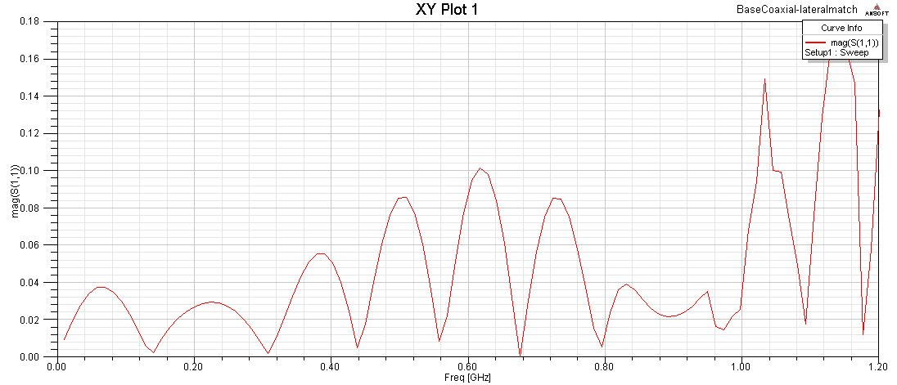
S11 Parameter
Improved matching
At stripline
At coax

Slide 13
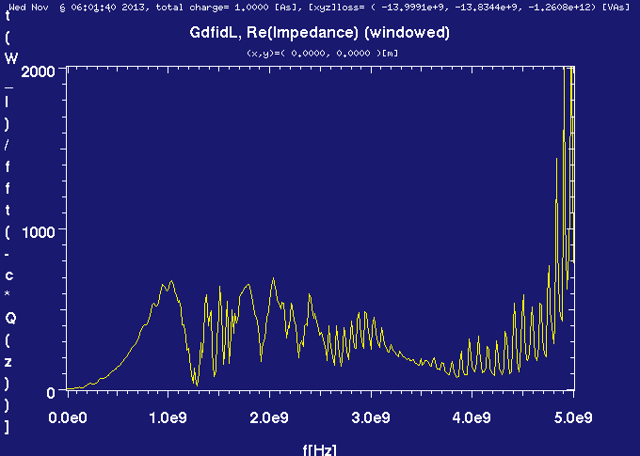
Longitudinal Impedance
No feedthroughs
90 deg feedthrough
Lateral feedthrough
Improvement in impedance spectrum
With lateral feedthrough ports
However, not mechanically desirable
Because of one degree of freedom
Concern for heating, expansion

Slide 14
Slotline Port Geometry
Down selection needed on port design
CERN mechanical engineering department to weigh in on complexity and feasibility
3 port layouts
Tapered, lateral provide best matching
Currently, waiting for ME resources, following stripline development
Once choice is made on the port layout, another round of EM optimization needed, then mechanical design can begin.

Slide 15
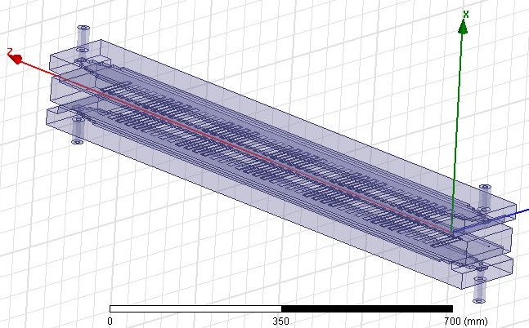
Estimating Directivity
Beam induced power important to understand and be able to handle
Initial estimates on the directivity of the beam induced power have been performed in HFSS
Plane wave excitation has been used to estimate the relative power levels in the upstream and downstream ports of the slotline kicker
Results have shown that at 1 GHz, for the power upstream to downstream is 1:300
When a port design is chosen for the slotline, additional measurements are necessary, as well as complimentary measurements in GdfidL and/or Particle Studio
Power downstream
Power upstream
Plane wave along beam axis

Slide 16
Comparison of Stripline and Slotline
CERN plans to install:
2 Striplines
1 Slotline
At low frequencies, the striplines have slightly higher kick strength.
However, the slotline can effectively cover the bandwidth up to 1 GHz.
MDs with the new kicker prototypes are ABSOLUTELY ESSENTIAL to validate and confirm the technologies, bandwidth and kick strength needed.

Slide 17
Current Efforts
Stripline
Beam induced power estimation as a pickup (common-mode)
Construction at CERN
Slotline
Mechanical design
feedthrough optimization and port matching
Striplines to be installed before initial beam startup in September 2014
Use first MD times in Fall 2014 for measuring beam induced power to validate estimation and formulate plans for protecting amplifiers.
Slotline prototype not expected until 2015

Slide 18
Power Amplifiers
Existing power amplifiers
As important as a kicker is for the feedback project, so are power amplifiers.
Existing amplifiers from AR Kalmus
Nominally 100 W, de-rated to 80W
5 amplifiers purchased in 2011
Used reliably for MDs 2011 – 2013
Non-optimal time-domain behavior
Gain (+/- 4 dB) and phase variation over operating band
Specifications:
Frequency = 20 – 1000 MHz
Power = 250 – 500 W
Instantaneous BW
100% amplitude modulation
Linear phase across band
Working with manufacturers to improve impulse response and fidelity of amplifiers
Δ = 9 dB
Gain
Δ = 90°
Phase

Slide 19
Power Amplifiers Evaluation
Evaluation of 4 power amplifiers in 2013, loaned to us by manufacturers (work by K. Pollock)
Amplifier Research 250W1000AM4
Amplifier Research KAW-2300 (modified)
MilMega 80RF1000-250
R&K GA020M102-5454R
Developed testing methods and procedure to characterize amplifiers in both time and frequency domains
Typical frequency domain measurements with network and spectrum analyzers, measure frequency response, phase linearity
Time-domain measurements performed with 4 GS/s high speed DAC with the capability of generating arbitrary signals
Burst signals, much like those needed for feedback
R&K (Japan) seemed to have most desirable characteristics in time-domain, but tests on going
Specifications:
Frequency = 20 – 1000 MHz
Power = 250 – 500 W
Instantaneous BW
100% amplitude modulation
Linear phase across band
Time-domain measurements
Time (ns)
Time (ns)
Time (ns)
Time (ns)

Slide 20
Power Amplifiers Evaluation
Evaluation of 4 power amplifiers in 2013, loaned to us by manufacturers (work by K. Pollock)
Amplifier Research 250W1000AM4
Amplifier Research KAW-2300 (modified)
MilMega 80RF1000-250
R&K GA020M102-5454R
Developed testing methods and procedure to characterize amplifiers in both time and frequency domains
Typical frequency domain measurements with network and spectrum analyzers, measure frequency response, phase linearity
Time-domain measurements performed with 4 GS/s high speed DAC with the capability of generating arbitrary signals
Burst signals, much like those needed for feedback
R&K (Japan) seemed to have most desirable characteristics, but tests on going
Specifications:
Frequency = 20 – 1000 MHz
Power = 250 – 500 W
Instantaneous BW
100% amplitude modulation
Linear phase across band
Frequency-domain measurements (Gain/phase)

Slide 21
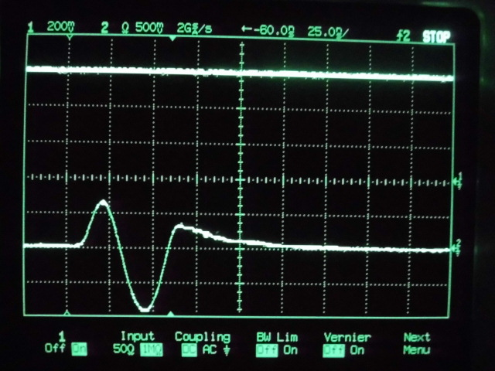
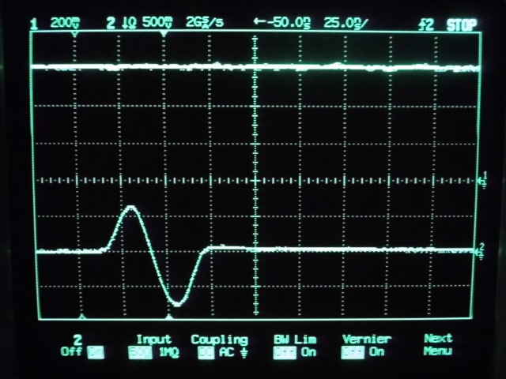
R&K (Japan)
We are working with manufacturers to improve impulse response and fidelity of amplifiers
Cater to our specifications
Expect modified amplifier to test from R&K
R&K time-domain test using a 40 MHz burst signal
Able to remove tail of signal
Many manufacturers don’t have the capability to make the time-domain measurements we do
Therefore, we need to use our equipment to fully characterize the amplifiers
Status on R&K
As of April, they’ve informed us that they need to redesign the 90 degree hybrid combiners
Seems to be a common issue using several stage amplifiers
Additional 2.5 months of development
Before
After
R&K’s impulse response measurements

Slide 22
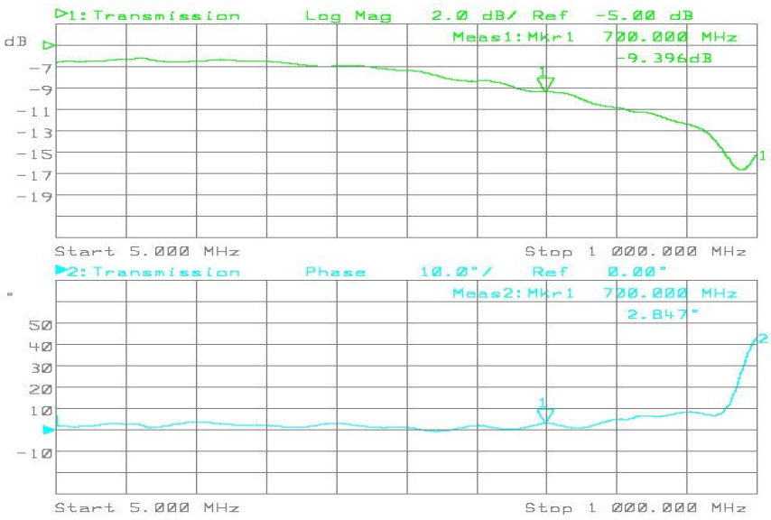
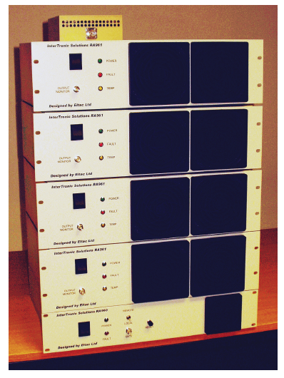
New Power Amplifier Developments
Transfer function, GaN transistor
We’ve reached out to additional amplifier vendors and have had a very positive response of interest in working with us
Additional companies
Rhode & Schwarz
AR Pennslyvania
Intertronic Solutions
Intertronic Solutions (Canada)
Use many small GaN transistors and combine them.
Built 5 – 300 MHz, 400 ultra flat phase power amplifiers for SNS
Written proposal for a 20 – 1000 MHz 25 W prototype, scale power from there.
20-1000 MHz instantaneous BW
>20 dB gain, flat to +/- 1 dB
Flat phase to +/- 10 deg
Pure class A mode of operation
SNS amplifiers

Slide 23
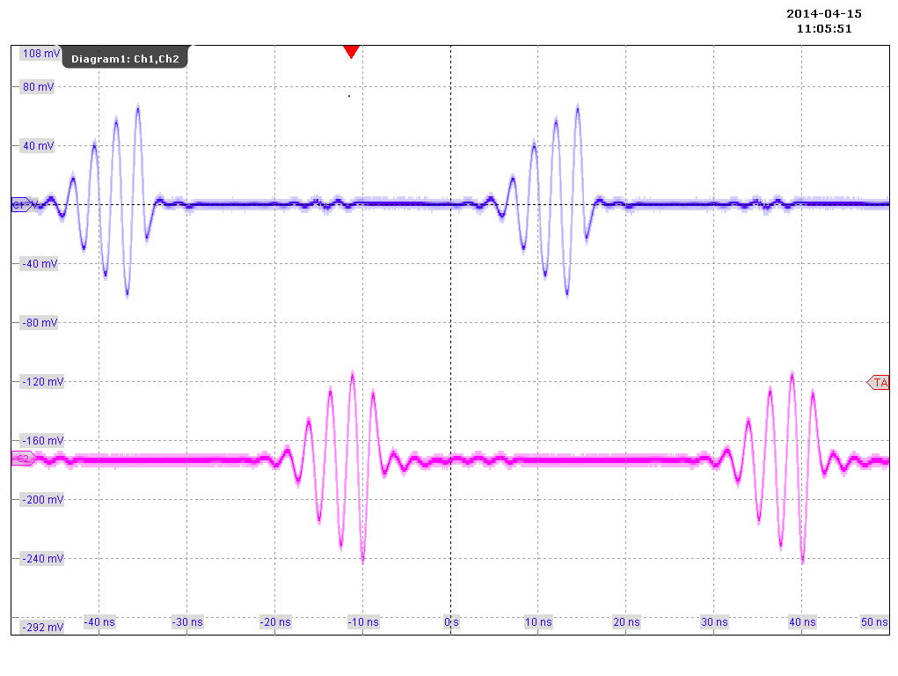
New Power Amplifier Developments
We’ve reached out to additional amplifier vendors and have had a very positive response of interest in working with us
Additional companies
Rhode & Schwarz
AR Pennsylvania
Intertronic Solutions
Rhode & Schwarz
Most amps are developed for broadcasting transmission purposes
Berlin development laboratory, a 80 – 1000 MHz, 125 W module, with goal of 1 kW in summer 2015.
Sent us preliminary result, using 200, 400, 800 MHz continuous input signals at 100 W output
Another case where the vendor does not have the equipment necessary to properly characterize the amplifier for our needs. They have invited us to Berlin to test the amplifier with our high speed DAC
Very excited to work with us, “…we will do everything humanly possible to make sure we are your amp of choice.”
Rhode & Schwarz test of BC125
400 MHz
Source Signal
Amp Output

Slide 24
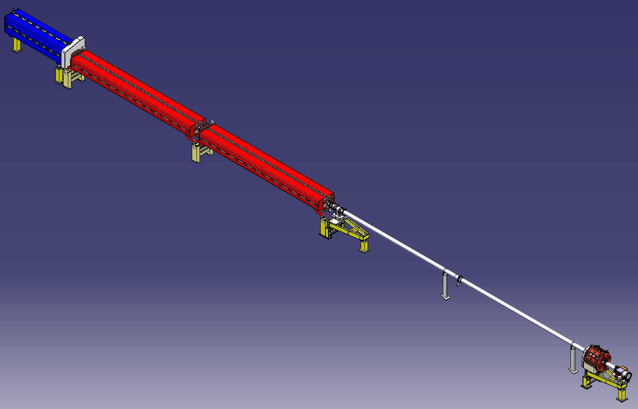
Location of Kickers, Infrastructure
SPS Sextant 3, LSS3
Housed in the second half of the 321 period of the SPS.
Approximately 8 m of usable space following the dipole magnet
8 new 7/8” cables pulled to kicker location during LS1
Power amplifiers still needed
Essential for operation of new kickers!
Critical items for post LS1 operation
Courtesy of E. Montesinos

Slide 25
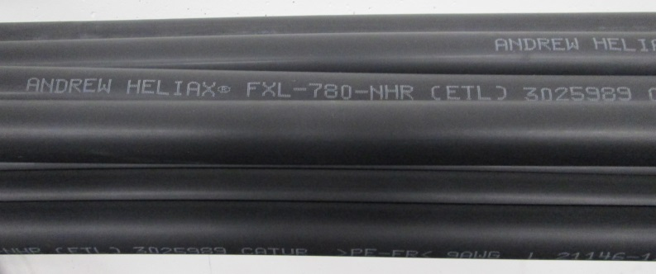
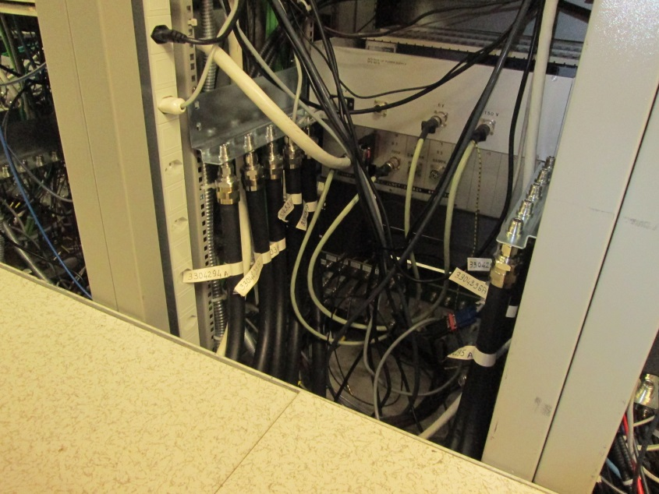
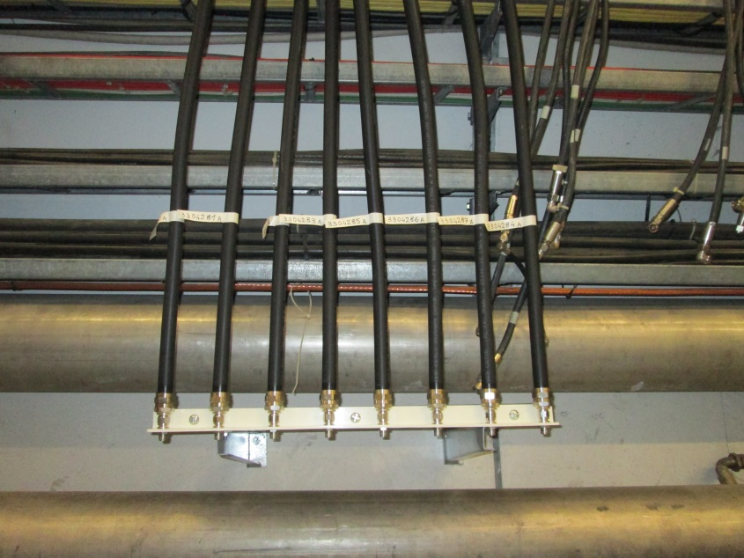
CERN’s Efforts Prepping Tunnel
new cables:
1 drive striplines
1 drive slot line
6 returns from loads
option: relay box for amplifier monitoring (needs preparations) using the three old cables to pos. 319
Courtesy of W. Hofle, G. Kotzian
Cable end in SPS Faraday cage
Cable end in SPS tunnel

