Slide 1
HBWD – Stripline Kicker
Eric Montesinos
Débora Aguilera
Sebastien Calvo

Slide 2
Contents
Global assembly
Machine integration
Spare parts
Shielding port assembly
Elliptical bellow
Circular bellow
Enamelled flanges
Summary table

Slide 3
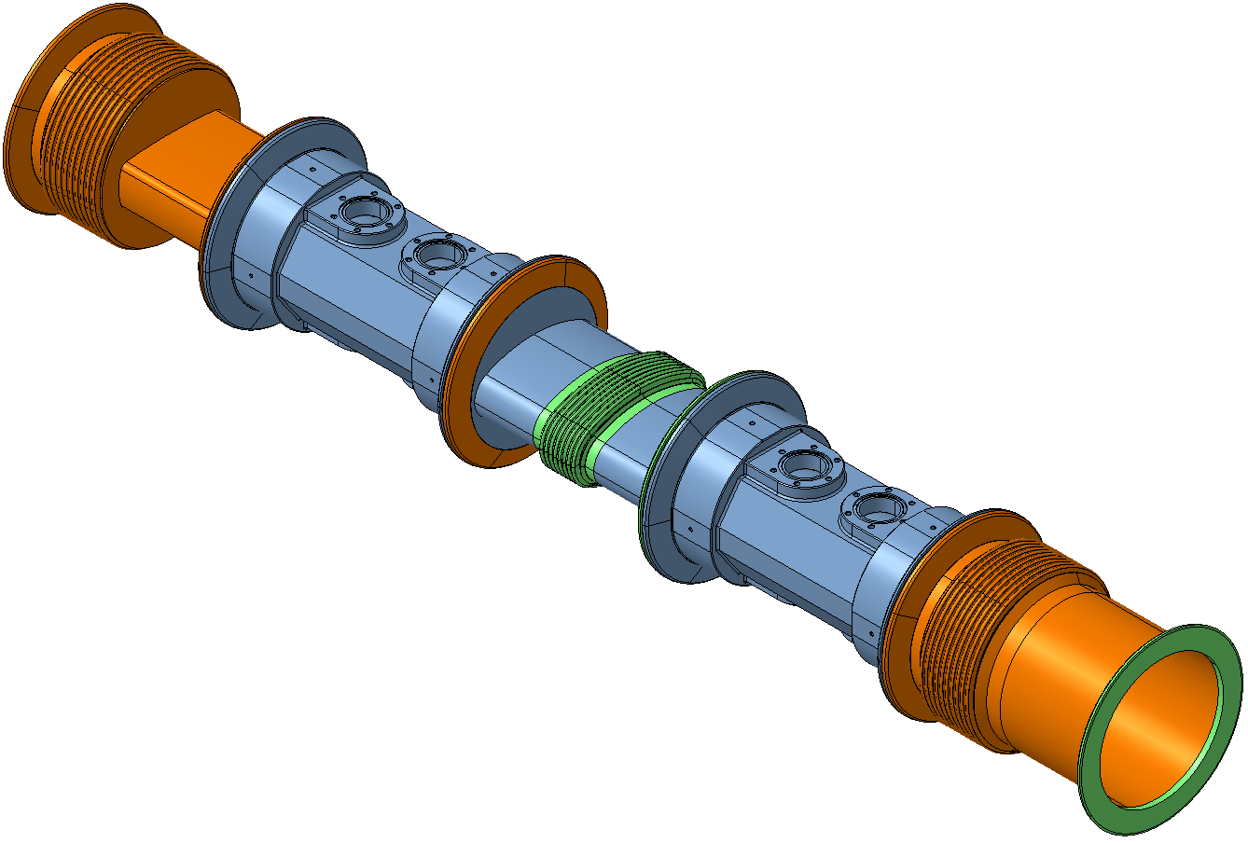
Global assembly
Key:
Available part
Standard part (provided by TE)
Non-standard part (provided by BE)

Slide 4
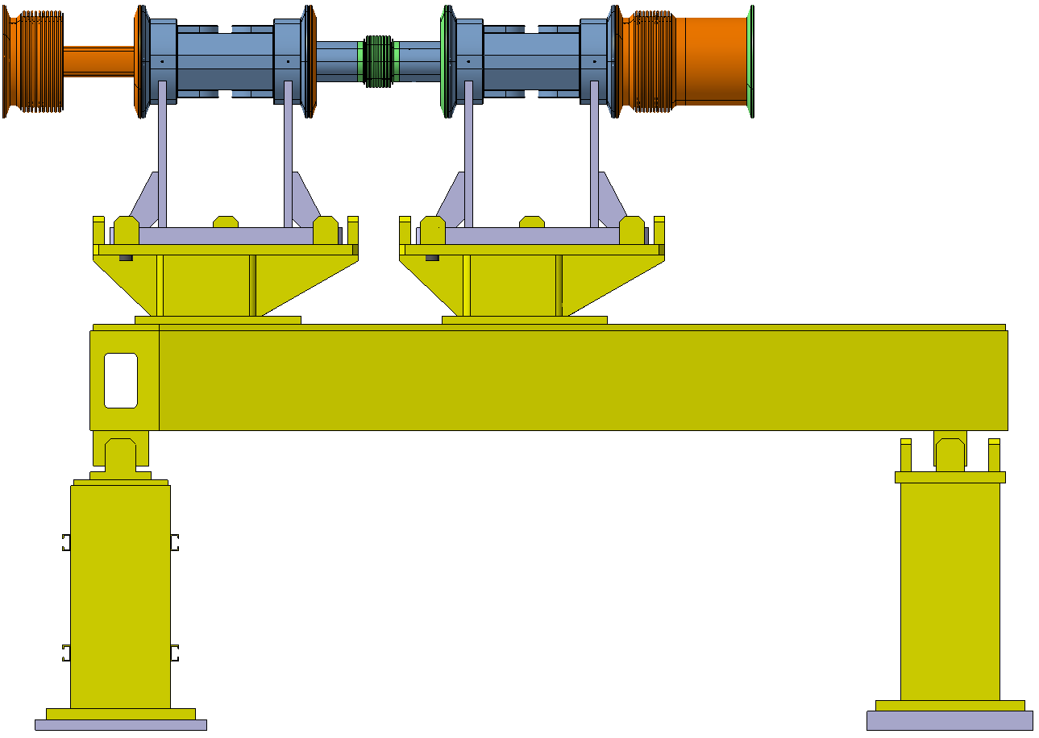
Global assembly
Key:
Available part
Standard part (provided by TE)
Non-standard part (provided by BE)

Slide 5
Machine integration
Present SPS scheme
Proposed new scheme
Magnet
6660 mm vacuum Pipe
Magnet
Pipe
+ Spares
Key:
Available part
Standard part (provided by TE)
Non-standard part (provided by BE)

Slide 6
Spare parts
Spare parts for each component will be kept unassembled
Replacement components will only be assembled if and when they are needed in the machine
TE will be in charge of the assembly of each component once all the parts are available, and of the assembly of the spare parts if and when needed
Standard parts of each component will have one replacement
Non-standard parts of each component will have two replacements

Slide 7
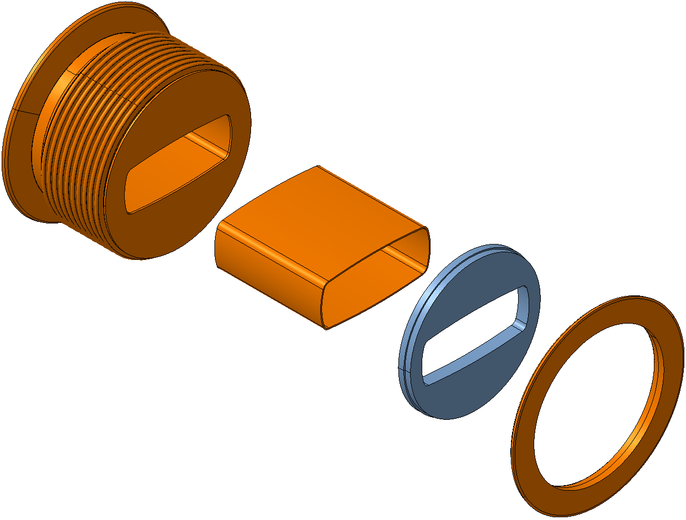
Shielding port assembly
Needed material
2x shielding port + bellow assembly
2x MBB chamber (L = 127.5 mm [to be confirmed])
3x extension*
2x enamelled flange
Key:
Available part
Standard part (provided by TE)
Non-standard part (provided by BE)
* The extension and the flange will be welded and stored assembled

Slide 8
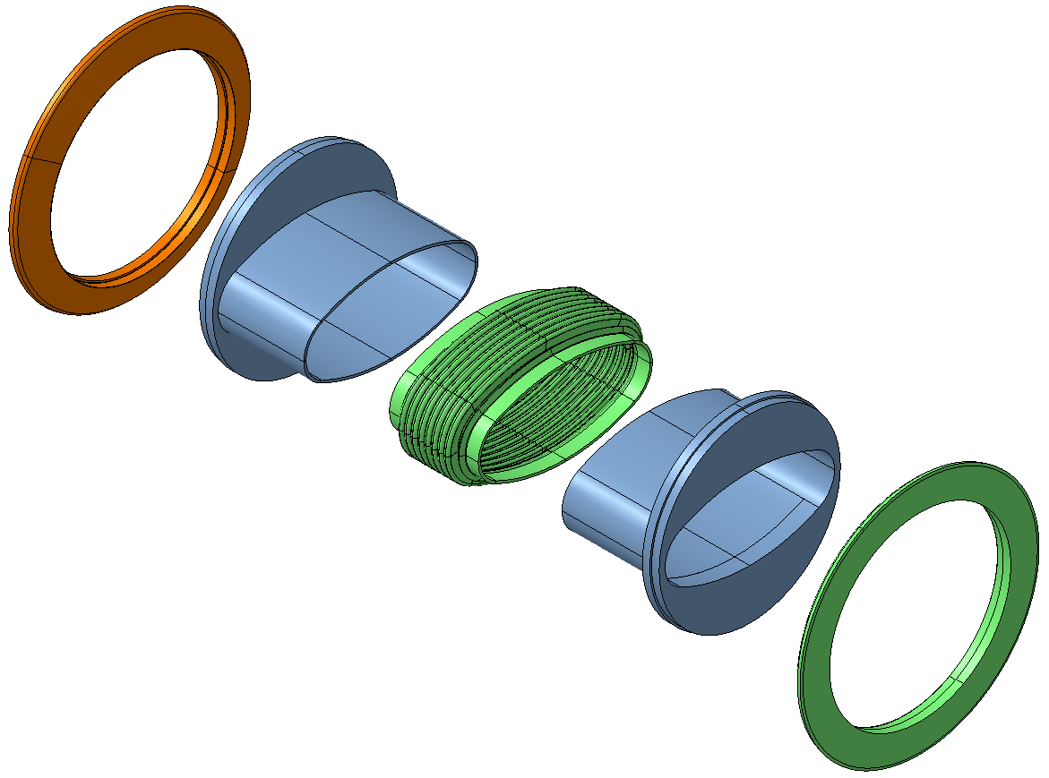
Elliptical bellow
Needed material
2x regular flange
3x extension A*
2x elliptical bellow
3x extension B*
2x enamelled flange
Key:
Available part
Standard part (provided by TE)
Non-standard part (provided by BE)
* The extensions and their corresponding flanges will be welded and stored assembled

Slide 9
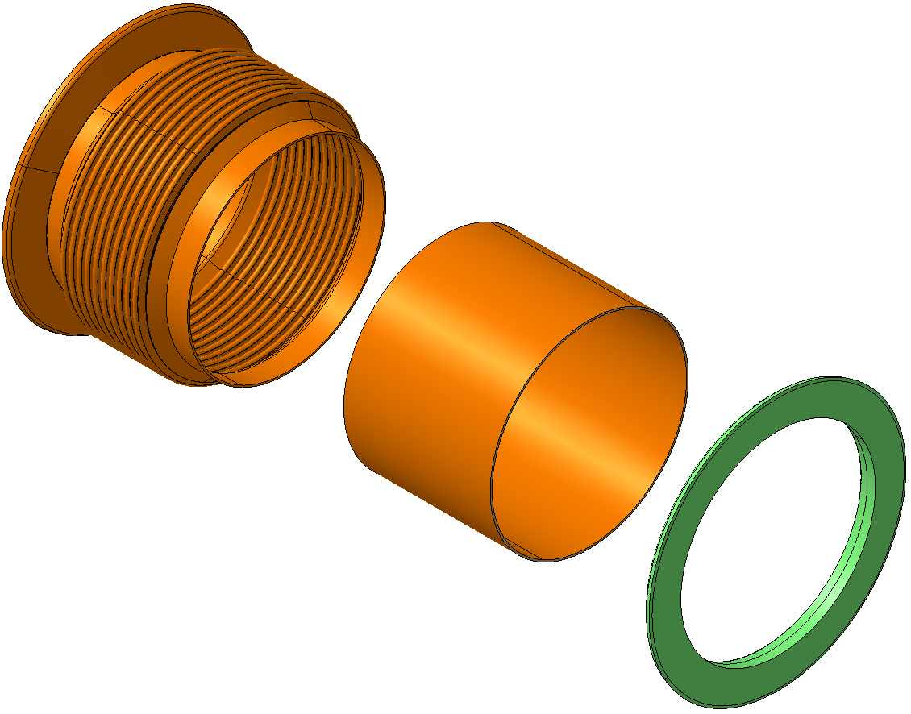
Circular bellow
Needed material
2x circular bellow
2x circular chamber (Ø_{inner} = 156 mm, Ø_{outer} = 159 mm)
(L = 117.5 mm [to be confirmed])
2x enamelled flange
Key:
Available part
Standard part (provided by TE)
Non-standard part (provided by BE)

Slide 10
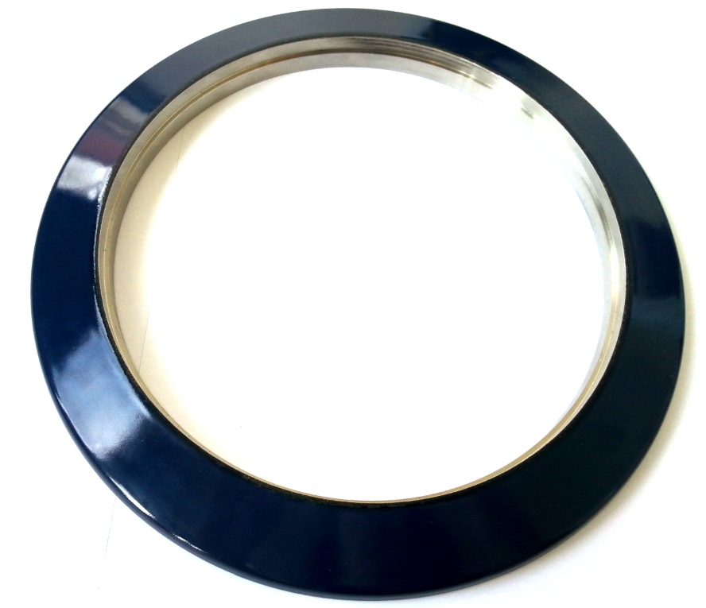
Enamelled flanges
Needed material:
Three flanges for the machine
Three spare flanges
Available material:
Four flanges that need to be checked for validity, as some have chipped enamel.

Slide 11
Summary table
BE |  | TE
Available | To be provided | Available | To be provided
Circular bellow (x1) | Shielding port extension (x3) | Elliptical bellow (x4) | Regular flange (x2)
 | Elliptical bellow extension A (x3) | Enamelled flange (x4) | Enamelled flange (x2*)
 | Elliptical bellow extension B (x3) |  | Circular bellow (x1)
 |  |  | Circular chamber (x2)
 |  |  | Shielding port + circular bellow assembly (x2)
 |  |  | MBB chamber (x2)
* At least two enamelled flanges are needed. The available ones need to be checked for validity

Slide 12
4/28/2014

