Slide 1
Cryomodule Summary & Action Items
Tom Nicol – Fermilab
May 8, 2014
It’s a group effort – Many thanks to
Jean Delayen, HyeKyoung Park, Subashini De Silva, Rocio Olave at ODU
Sergey Belomestnykh, Qiong Wu, Silvia Verdú-Andrés, Binping Xiao at BNL
Zenghai Li at SLAC
Ofelia Capatina, Luis Alberty, Rama Calaga, Giuseppe Foffano at CERN
Tom Jones, Shrikant Pattalwar, Graeme Burt at STFC and Lancaster, UK
and many others...

Slide 2
Dress Cavity and Cryomodule Highlights
Three cavity designs.
RF Dipole (Old Dominion University and SLAC)
Double Quarter Wave (Brookhaven)
4-Rod (UK)
A single vendor for all US dressed cavity assemblies.
Funding source for US dressed cavities is a $1M 2013 Phase 2 SBIR award to Niowave for the crab cavity cryomodule design and fabrication. Due to changes in the down-select process and SPS testing requirements, the original scope is not relevant.
Niowave built the prototype for all three designs.
No dressed cavities have been built.
The cryomodule for both US cavities will be designed and built at CERN. Daresbury may design and build their own cryomodule.
Goal is to have as much commonality in the three cryomodule designs as possible.

Slide 3
Dress Cavity and Cryomodule Highlights (cont’d)
Goal is at least two cryomodules tested in SPS to ensure at least one US design.
BNL is coordinating the double quarter wave cavity design.
Bare cavity design at BNL
Dressed cavity design in collaboration with CERN
ODU is coordinating the RF dipole cavity design.
Bare cavity design at ODU
Dressed cavity design in collaboration with Fermilab
The tuners will be a joint effort between BNL, ODU, and CERN.
The input coupler will be provided by CERN.
CERN will assist with pressure vessel code compliance issues.
In addition to being involved in the RF dipole dressed cavity design, Fermilab will play provide oversight of fabrication at Niowave.
Eventual need for the LHC is 32 cavities + 4 spares.

Slide 4
Preliminary high level cavity and cryomodule schedule
2013-2014 | 2015-2016 | 2017 | 2018-2021 | 2022
Cavity Testing & Prototype Cryomodule | SPS Cryomodule Fabrication | SPS Beam Tests | LHC Cryomodule Construction | LHC Installation
Current focus of all groups is installation and testing in the SPS

Slide 5
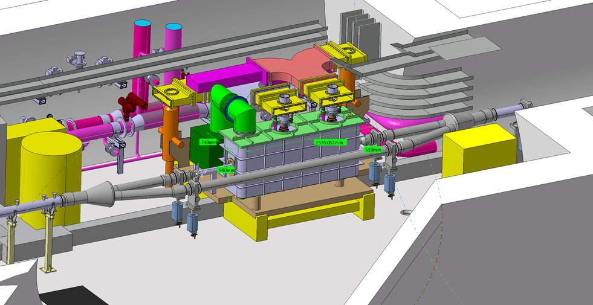
SPS tunnel location
Cryomodule
Bypass beamline

Slide 6
SPS tunnel location

Slide 7
Crab cavities in the LHC

Slide 8
Sample crab cavity cryomodule in the LHC
4 cm with 2 cavities each
2 cm with 4 cavities each
1 cm with 8 cavities

Slide 9
RFD dressed cavity (ODU) Waveguide HOM option
Helium vessel
HOM waveguide
Dummy
beam tube
Input coupler
Vertical HOM
Pickup port

Slide 10
Functional requirements specification

Slide 11
Ranking criteria (draft)

Slide 12
RFD dressed cavity (ODU) Coaxial HOM option
Coaxial HOM

Slide 13
RFD cryomodule (ODU)
Cryo jumper
Tuning system
Waveguide
FPC
Side loaded vacuum vessel
Beam gate valve
Tuning frame
Cold to warm transition
Thermal and magnetic shielding not shown

Slide 14
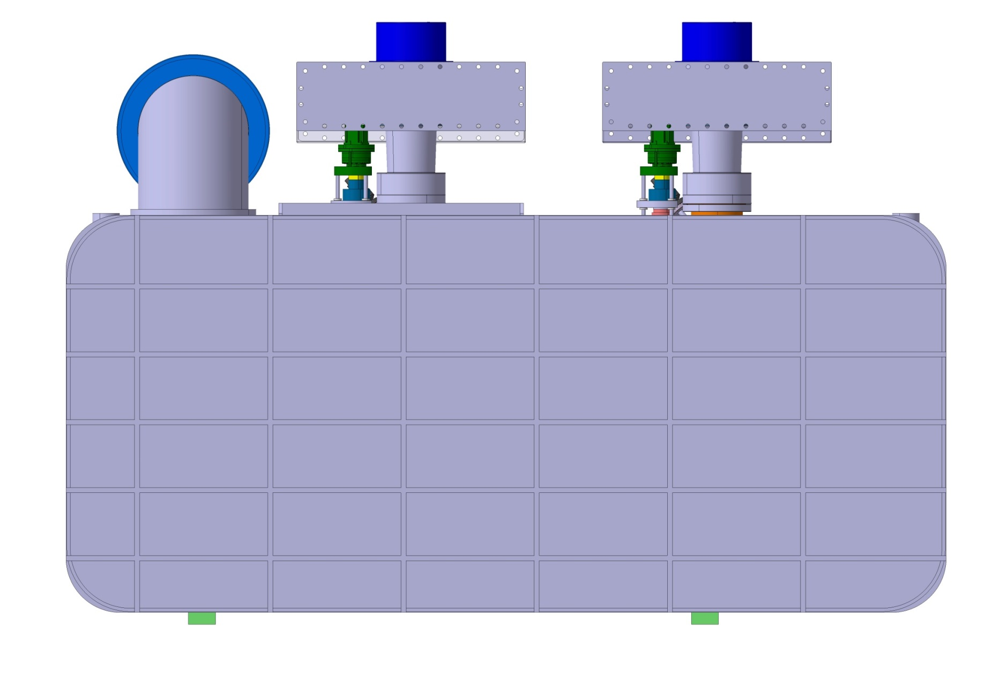
RFD cryomodule (ODU)
Vacuum vessel cover

Slide 15
RFD cryomodule (ODU)
Coaxial HOM

Slide 16
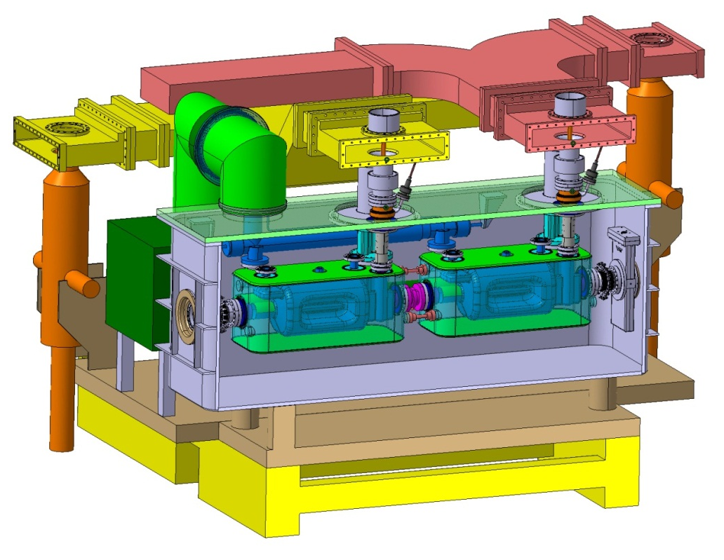
SPS integration

Slide 17
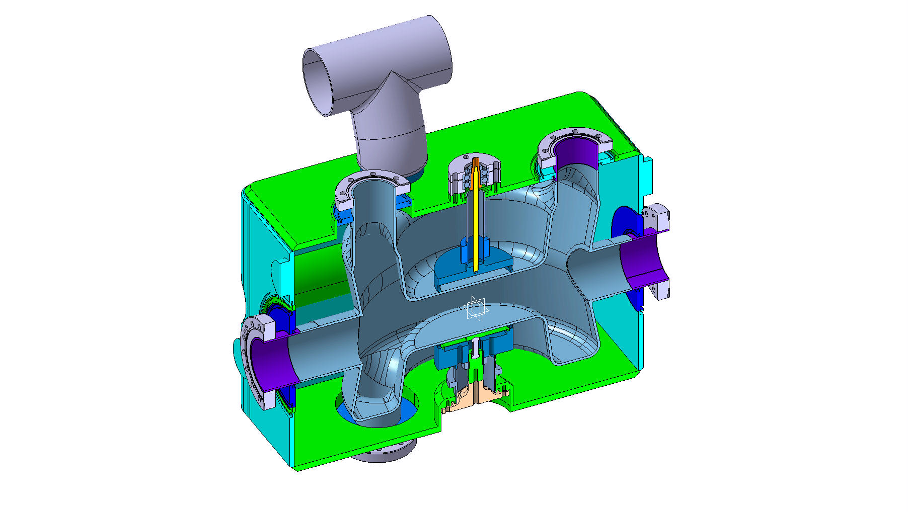
DQW dressed cavity (BNL)
Cryo jumper
362.4 mm
Tuner + reinforcement
FPC
400 mm
HOM
565 mm
beam
Space for
adjacent beam pipe
HOM
Piezo + reinforcement

Slide 18
DQW cryomodule (BNL)

Slide 19
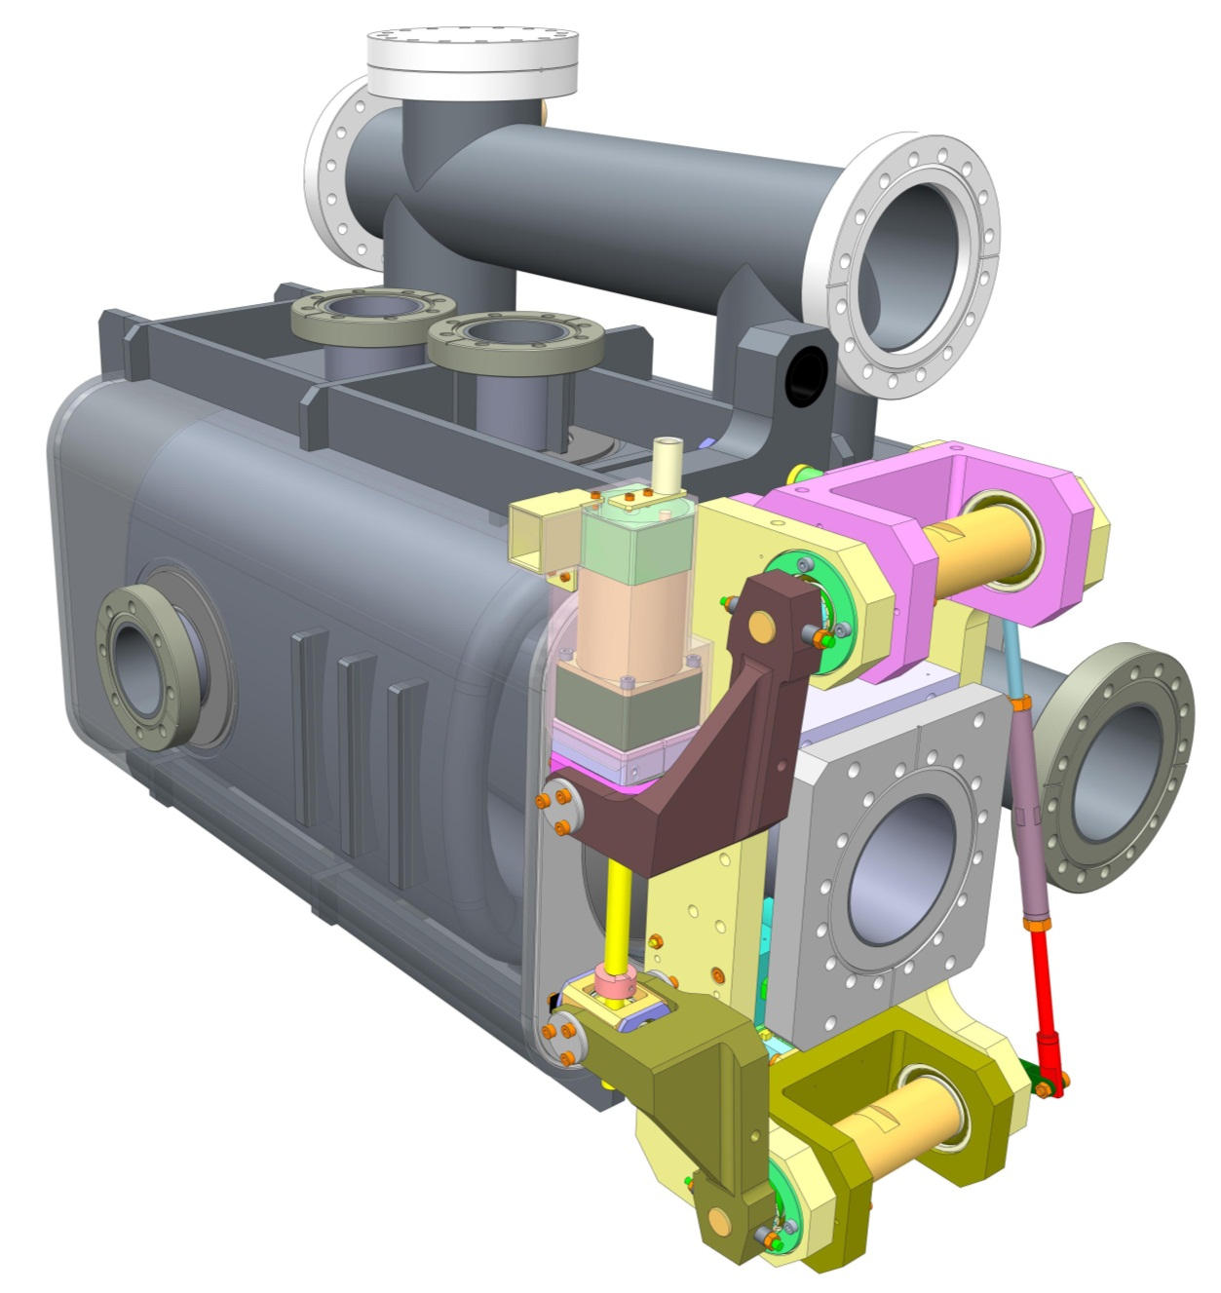
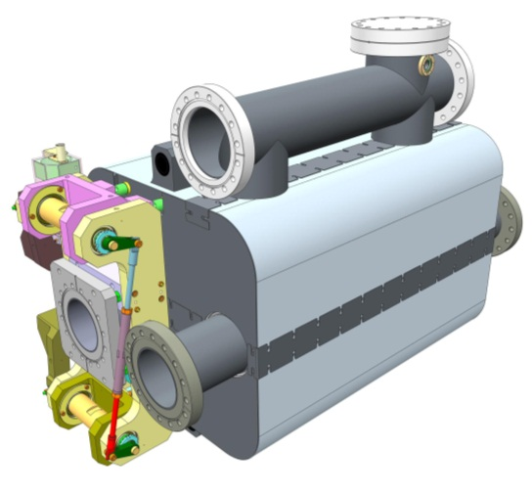
4-Rod dressed cavity (Daresbury)
Slides from Tom Jones and Shrikant Pattalwar (Daresbury)
Helium 2-Phase line
Port for He level probe
Stiffening ribs
Input coupler port
Helium Vessel made from Grade 2 Titanium
Additional beam tube required for LHC installation
312mm
550mm
194mm
Cryoperm (magnetic shield)
Modified Saclay II tuner
UK 4 Rod Cavity

Slide 20
Cryomodule Concept
December 2012
1520mm
2150mm
800mm
Design Approach
Provide sufficient and easy access to internal components during assembly and after installation
August 2013
More details in - Conceptual design of a Cryomodule for Crab Cavities for HiLumi-LHC
S. Pattalwar, et al, MOP 087, SRF 2013, Paris

Slide 21
Dress Cavity and Cryomodule Status
Final designs for the RF dipole, DQW, and 4-rod cavities are nearly complete at ODU, BNL, and Daresbury respectively.
Dressed cavity helium vessels, tuners, HOM interfaces, etc. are in process at ODU, BNL, Daresbury, CERN, and Fermilab.
The initial release of data from the US labs to Niowave took place in February.
The goal for release of the final design models is June 2014.
Solid model and drawing data is being managed through CERN’s EDMS.
Workflows consisting of inspection criteria, milestones, hold points, etc. are being developed at BNL and ODU in collaboration with Niowave.
A draft technical specs has been released to Niowave from CERN.
CERN will approve all drawings, material and fabrication specs, etc. prior to manufacture.

Slide 22
Thanks very much
From Ofelia Capatina:
“Regardless the outcome of this review, CERN strongly hopes we will continue this fruitful and nice collaboration spirit.”
and from me too...

