Slide 1



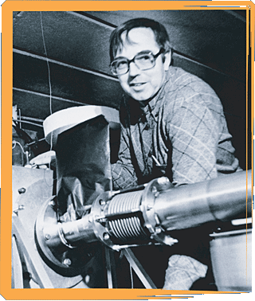
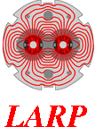
Stress Management as an Enabling Technology for High-Field Superconducting Dipole Magnets
Eddie Frank Holik III
Toohig Fellowship candidate
Wednesday, May 7th, 2014
Brookhaven National Lab 2:00 pm

Slide 2
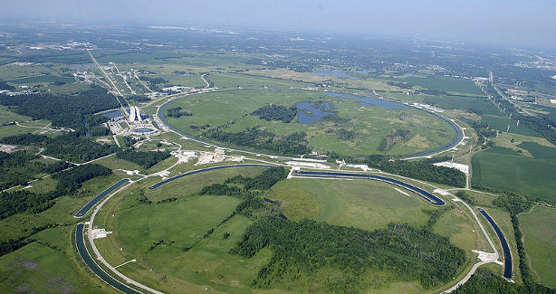
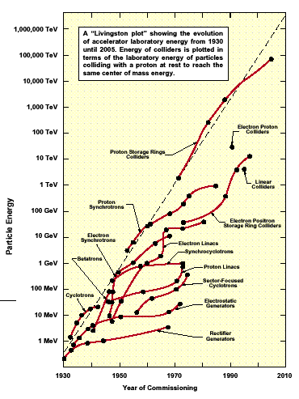
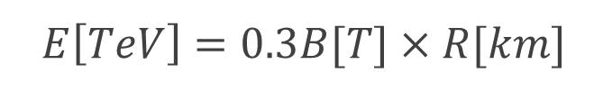
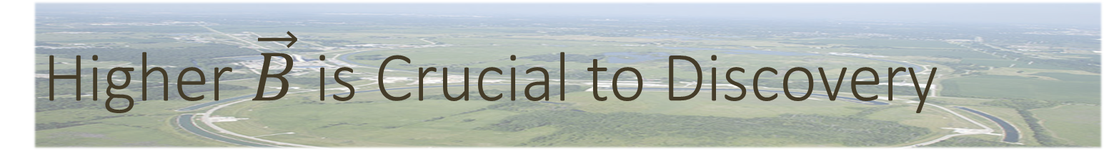
Higher $\vec{B}$ is Crucial to Discovery
10⁶ TeV
supersymmetry
?
(Chao, 2001)
top quark
Higgs boson
Energy of a synchrotron hadron collider is limited by its radius and its bend field:
10⁴ TeV
100 TeV
weak bosons
1 TeV
antiproton
Equivalent Stationary Target Energy
$E\left[TeV\right]=0.3B[T]×R[km]$
10 GeV
100 MeV
1 MeV
1930
1950
1970
1990
2010
Year of Commissioning
Notes:
M. Stanley Livingston, Particle Accelerators: A Brief History. (Harvard University Press, Cambridge, MA, 1969).
Alexander Chao, Ronald Davidson, Alexander Dragt, Gerald Dugan, Norbert Holtkamp, Chan Joshi, Thomas Roser, Ronald Ruth, John Seeman and Jim Strait, 2001 Snowmass Accelerator R&D Report, Stanford Linear Accelerator Center, SLAC-PUB-9483, (2001).
Lorentz 4-momentum product must remain invariant for the setup to be equivalent (Livingston plot)
2(E_{com_single particle})²/(m₀c²)=equivalent energy for a stationary target
LHC radius = 4.3km [5.6km from formula]
26.7km Circumference
Stanley Livingston in 1954
1971 Intersecting Storage Ring CERN
1984 Tevatron
1990 HERA at DESY
2008 LHC
plasma wakefield acceleration (PWFA): The electron plasma wave is formed by an electron bunch
laser wakefield acceleration (LWFA): A laser pulse is introduced to form an electron plasma wave.
laser beat-wave acceleration (LBWA): The electron plasma wave arises based on different frequency generation of two laser pulses.
self-modulated laser wakefield acceleration (SMLWFA): The formation of an electron plasma wave is achieved by a laser pulse modulated by stimulated Raman forward scattering instability.
Gauge fields / Supersymmetry might be reached at the fraction of a TeV to tens of TeV Mass scales. 6 free parameters for determing mass. 14 TeV collisions might reach 2-3 TeV mass range. Tripling energy should cover most of this range.

Slide 3
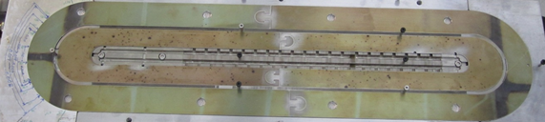
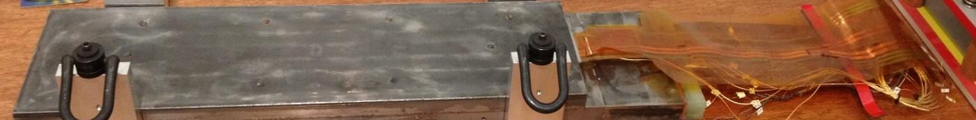
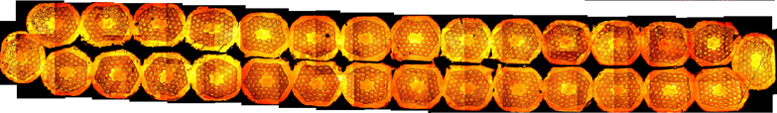
Outline
Stress Management Strategy
TAMU3 R&D
TAMU3 Analysis

Slide 4
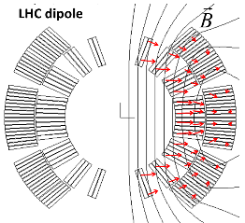
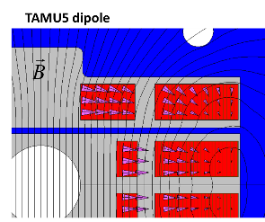
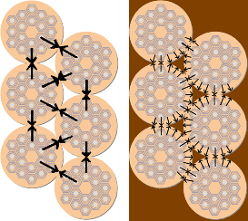
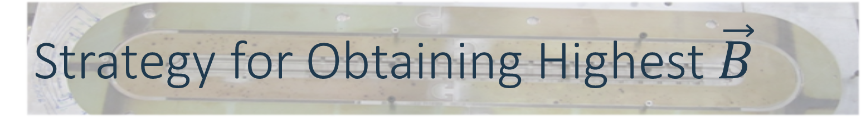

Strategy for Obtaining Highest $\vec{B}$
Adopt block coil geometry
Adopt Nb₃Sn as superconductor
Wind-and-React fabrication technique
  Control connectivity across filaments
  Create high connectivity in SC filaments
Impregnate winding with epoxy
  Distribute stress in the winding
Stress Management
  Integrate support matrix within the windings
  Intercept stress so that it cannot accumulate
VS.
Formation soak
Tin Diffusion Soak
$°$C
Solid Stabilization Soak
Hours

Slide 5

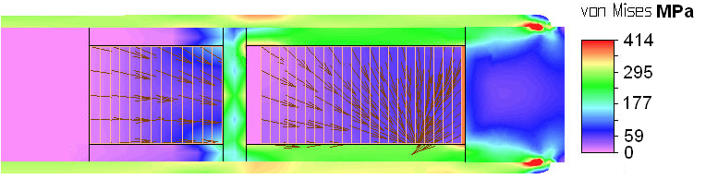
Stress Management
  Remove accumulated stress like floors in a building
  Stress management in a 14 T peak field dipole:
    Max stress in inner winding = 134 MPa ⇒ ε = 0.3%
    Max stress in outer winding = 78 MPa ⇒ ε = 0.2%
  Max Stress without SM > 190 MPa ⇒ ε = 0.4%
Notes:
In TAMU3, even though the irreversible degradation limit (look up for Titanium reducing the strain sensitivity) would be exceeded, the margin would be sufficiently large that the conductor may not quench. In essence Stress Management enables the highest fields possible by removing strain induced current degradation and by reducing strain sensitivity constraints to the conductor. The will allow conductor manufacturers to produce conductor with the highest current density possible without as much concern to strain sensitivity.

Slide 6
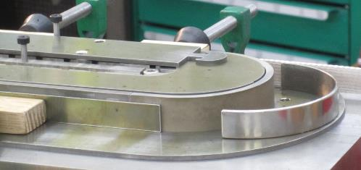
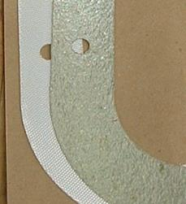
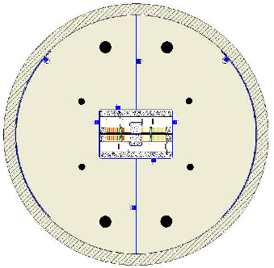
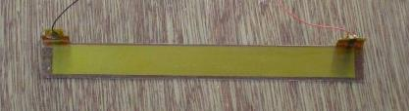
6 Pillars of Stress Management
Block Coil Configuration – face-on stress support
High-strength pier-and-beam support matrix – Intercept Lorentz force
Soft-modulus element separating the windings – Absorb matrix deflection
Mica paper between winding and beams – Provide shear release
Stainless steel, Wood’s metal filled bladders – Preload and conformity
Capacitive stress transducers – Measure the effectiveness of SM
Notes:
Cerrolow 147: 48% Bismuth, 25.6% Lead, 12.8% Tin, 9.6% Cadmium, 4% Indium

Slide 7
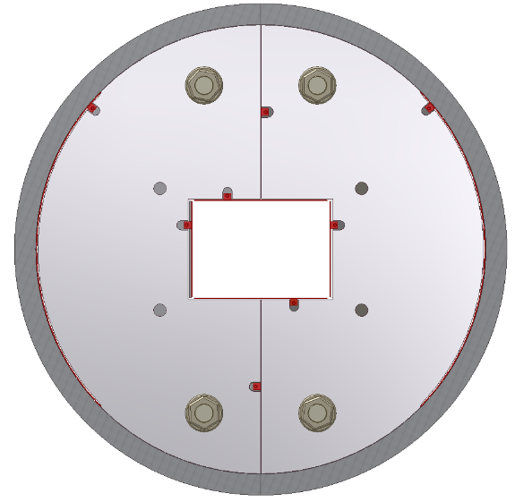
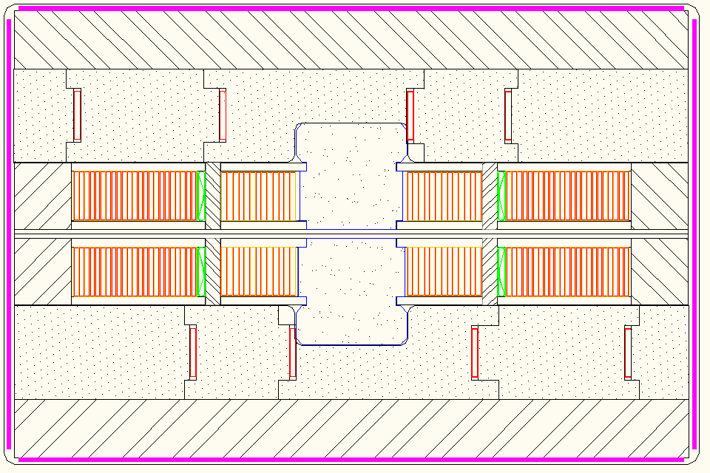
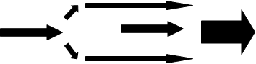
Block Coil Geometry – TAMU3
Stress Transducers
Expansion Bladders
Inconel Beams
Stress Schematic
Laminar Spring
Thick Skin
Ti / Inconel Piers
Filler Fe
Mica Shear Release
Ti Central Mandrel
Notes:
Mu-metal is a nickel-iron alloy, composed of approximately 77% nickel, 16% iron, 5% copper and 2% chromium or molybdenum,

Slide 8
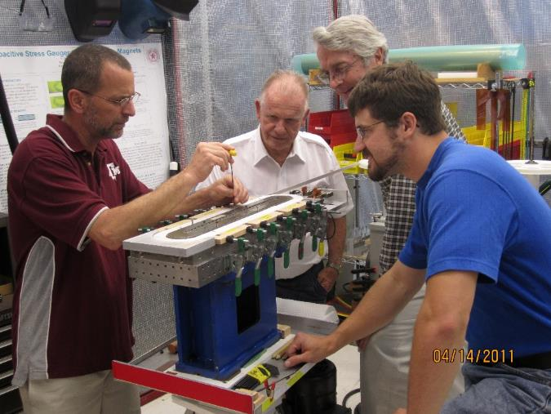
TAMU3 R&D
Magnetics
Quench Protection
Spring R&D

Slide 9
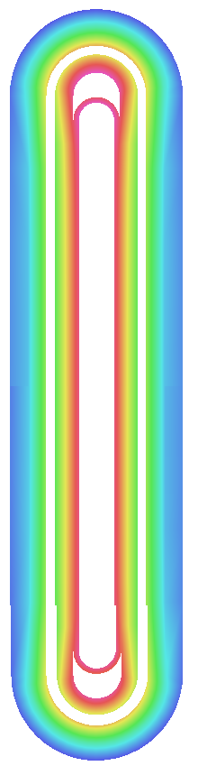
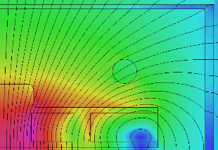
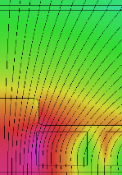
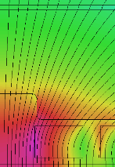
1. TAMU3 Magnetics
15.00T
15.8 T
2D & 3D Opera® VF
TAMU3 coils originally for
TAMU5
Peak Field
@ 15.8 T on inner
coil @ Tail End
Peak body field
@ 14.4 T
on pole turn
IRON MODIFICATION!!
15.8T
Bore 12.8 T
12.0 T
10.0 T
Tail End
8.0 T
Lead End
6.0 T
4.0 T
14.4T
2.0 T
14.4 T
0.0 T
12.0 T
10.0 T
8.0 T
6.0 T
4.0 T
2.0 T
0.0 T
Notes:
13.9 kA
Vs
13.7 kA

Slide 10
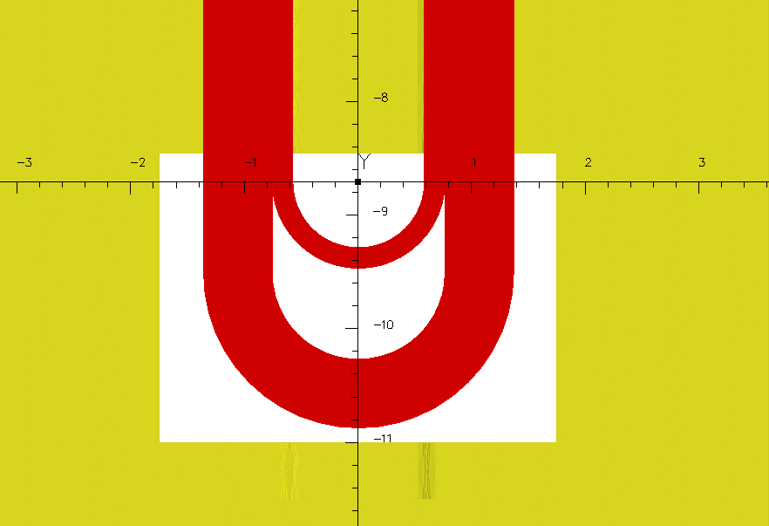
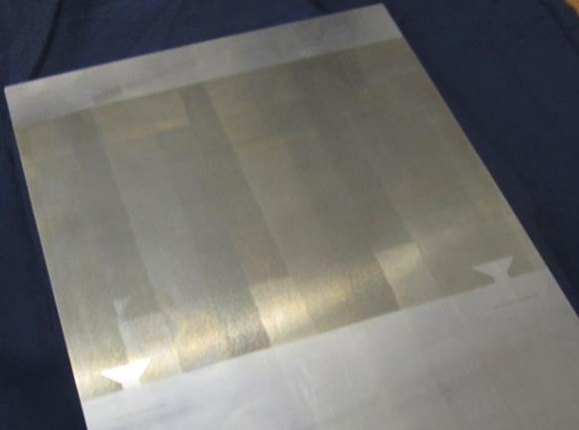
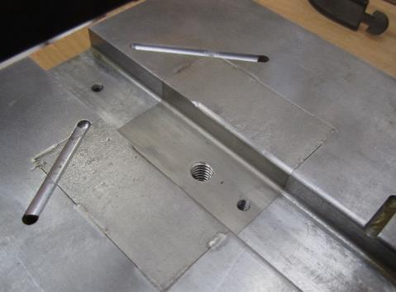
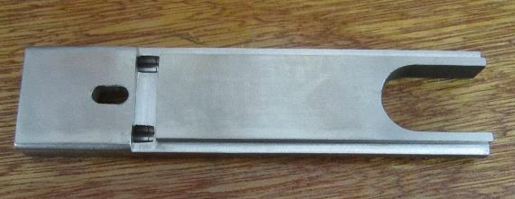
1. TAMU3 Fe Modifications
Fe → Ti
3.5”
0.25”
2.542”
Epoxy Channel
Fe → SS

Slide 11
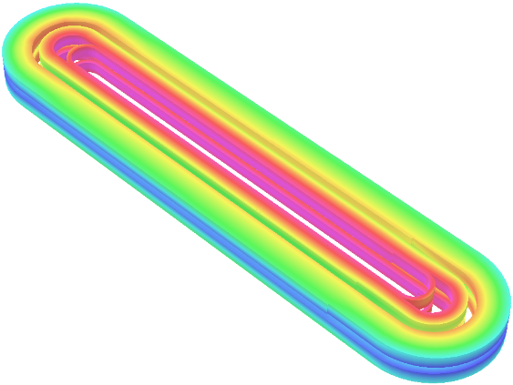
1. Results - Full 3D TAMU3 Load Line
Property |  |  |  | Value
Inner Turns |  |  |  | 13 | Turns
Outer Turns |  |  |  | 23 | Turns
Magnet Inductance |  |  |  | 2.5 | mH
I_{c} (Inner Conductor limited) |  |  |  | 13.72 | kA
B_{c} (Inner Conductor) |  |  |  | 14.36 | T
B (Outer @ Ic) |  |  |  | 11.24 | T
B_{c} (Outer @ Ic) |  |  |  | 13.22 | T
B in probe bore at Ic |  |  |  | 9.95 | T
ΔB from -1.4 T to -0.24 T
Body peak field @ 14.12 T
14.4 T
12.0 T
10.0 T
8.0 T
6.0 T
4.0 T
2.0 T
0.0 T

Slide 12
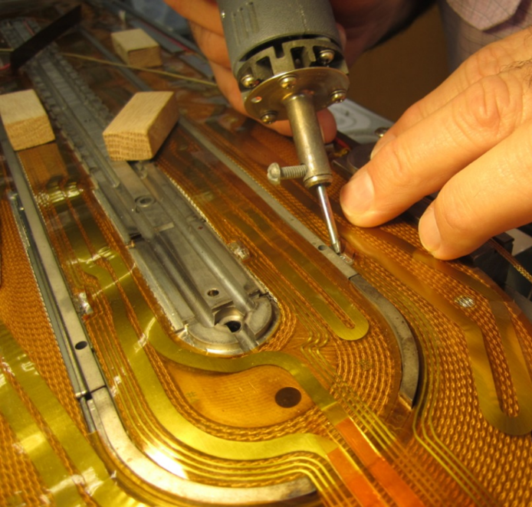
2. Quench Detection
Quench occurs when a segment of the superconducting cable becomes resistive.
Quench is electrically detected by a series of voltage taps strategically spaced near the most likely quench locations.
Quench Protection is supplied by resistive heaters

Slide 13
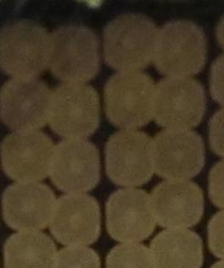
2. Quench Protection
76 μm Kapton
25 μm Stainless Foil
Warm conductor above T_{c}
Magnet energy deposited uniformly across magnet
45 W/cm² applied to heater
< 20ms heater diffusion time
25 μm Kapton
70 μm Insulation

Slide 14
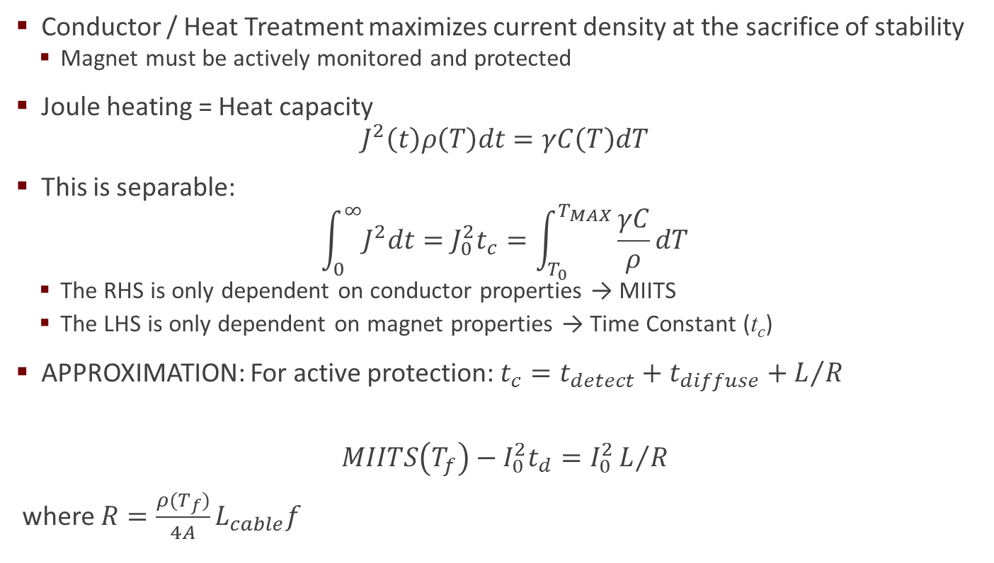
2. Quench Simulation
Conductor / Heat Treatment maximizes current density at the sacrifice of stability
  Magnet must be actively monitored and protected
Joule heating = Heat capacity
$$J^{2}\left(t\right)ρ\left(T\right)dt=γC\left(T\right)dT$$
This is separable:
$$\int_{0}^{∞}{J^{2}dt=J_{0}^{2}t_{c}}=\int_{T_{0}}^{T_{MAX}}{\frac{γC}{ρ}dT}$$
  The RHS is only dependent on conductor properties → MIITS
  The LHS is only dependent on magnet properties → Time Constant (t_{c})
APPROXIMATION: For active protection: $t_{c}=t_{detect}+t_{diffuse}+L/R$
$$MIITS\left(T_{f}\right)−I_{0}^{2}t_{d}=I_{0}^{2}L/R$$
where $R=\frac{ρ(T_{f})}{4A}L_{cable}f$
Notes:
Following the approximation of Iwasa [69] the coil resistance, R, is the resistance of the coil at Tf divided by four, where ½ comes from spatial averaging and another ½ comes from time averaging.

Slide 15
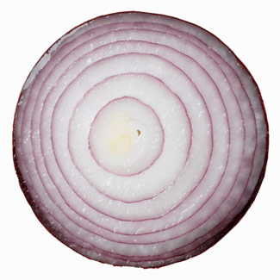
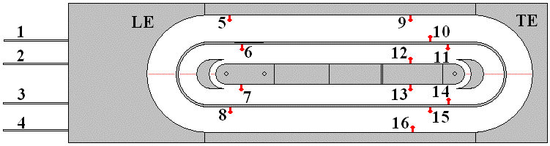

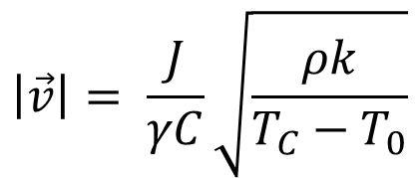


2. QUENCH Code Simulation
QUENCH conserves energy and propagates quench like layers of an onion
Each layer thickness becomes smaller as the current decreases
$$\left|\vec{v}\right|= \frac{J}{γC}\sqrt{\frac{ρk}{T_{C}−T_{0}}}$$
NbTi
Nb₃Sn
HTS
$$\left|\vec{v}\right|\sim 100 m/s$$
$$\left|\vec{v}\right|\sim 10 m/s$$
$$\left|\vec{v}\right|\sim 10 cm/s$$
QUENCH Code (Martin Wilson - 1983)
Notes:
Equation originates from where there is equilibrium between heat flow k, heat capacity C, and resistivity ρ of the conductor, along with judiciously chosen boundary conditions
Wiedemann – Franz Law [ resistivity * thermal conductivity = Lorenz number * T ]

Slide 16
2. Results - QUENCH Simulation
Characteristic time ≈ 40 ms
Protection heater at 20 ms
0.05 Ω dump resistor at 5 ms
Inner Coil Quench most likely
  Peak Temp ≈ 101 K
Outer Coil Quench not likely
  Peak Temp ≈ 171 K
Notes:
70% protection heater at 20 ms and an external 0.05 ohm dump resistor initiating at 0.005 seconds. The characteristic time is 0.04s for both an outer and inner quench. The peak internal distributed voltage is 321 volts and 281 volts for the inner and outer coils. The peak external voltage is 682 volts and 686 volts for the inner and outer coils.

Slide 17
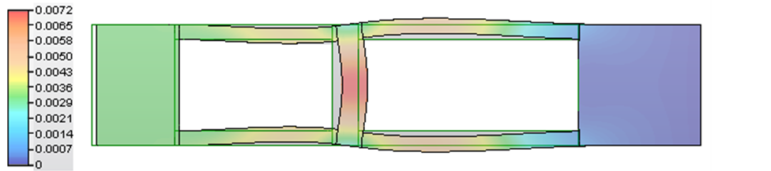

3. Spring R&D
Inches
0.066” Nom.
Sheath Enclosure
Load Spreader
Laser Weld
Spring Assembly
0.519” Nom.
Inconel X-750
  High strength at Cryogenic Temperatures (maintain pre-load)
  Precipitation hardened [730°C/8hrs fc 620°C ac RT; 18hrs total]
Post-HT TAMU3a Springs took a ‘set’ (0.004 to 0.010 inch)
  Did 670°C HT change the spring constant?
Notes:
InconelX: 70Ni, 15Cr, 7Fe, 3Ti Inconel718: 50Ni, 19Cr, 5Nb, Fe balance
AMS specification #5598 heat treatment schedule to obtain the necessary spring strength. The heat treatment is in argon to 1350ºF (732.2ºC) for 8 hours and then furnace cool and hold to 1150ºF (621.1ºC) for a total precipitation-treating time of 18 hours with a final argon cool. This heat treatment allows Ni3Al, Ni3Ti, as well as trace carbides to form creating a 32 – 42 HRC hardness and a modulus of ~30,000 ksi (207 GPa) at room temperature (34,000 ksi, 234 GPa at cryogenic temps). All test samples from the precipitation heat treatment were between 34.8 and 39.8 HRC with an average of 37.3 HRC.

Slide 18
3. Results – Spring Test
Before Heat Treatment
After Spring was Heat Treated under 300 psi at 670°C / 70 hrs
Notes:
Uncertainties in Spring size is due to fluctuation in compression fixture and half of smallest dial indicator gradation. No uncertainty in x due to high precision pressure gauge and spring cross section.

Slide 19
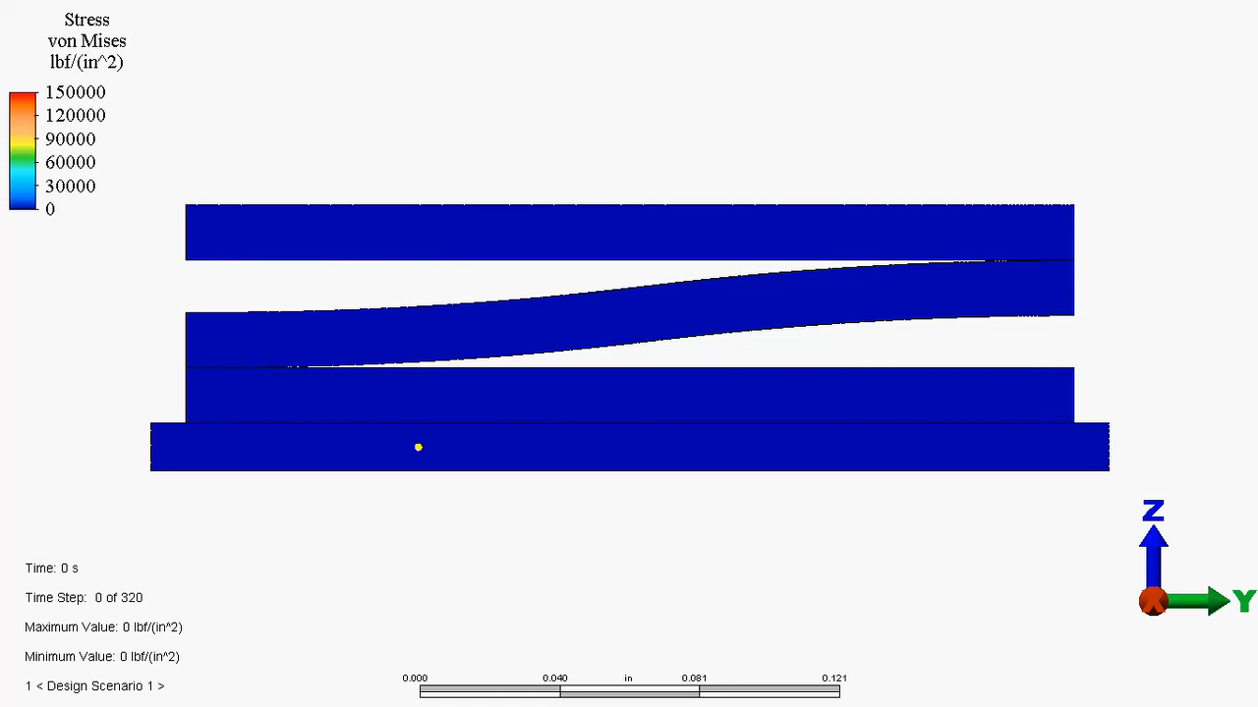
3. Results – Spring Simulation
Notes:
Mechanical Event Simulation (MES) solver with nonlinear material models. This solver employs von Mises stress with kinematic hardening. This is ALGOR®’s most advanced and computationally intensive mechanical solver for metal simulation. The von Mises yield criterion for two dimensions is given as
σ_(von Mises)=√(σ_xx^2+σ_yy^2-σ_xx σ_yy+3τ_xy^2 ) (6)
where σ_xx and σ_yy are the principal stresses and τ_xy is the shear stress. For the simulation it was assumed that there is a 300 psi force on the spring which is the target designed compression

Slide 20

3. Results – Spring Simulation
Notes:
Mechanical Event Simulation (MES) solver with nonlinear material models. This solver employs von Mises stress with kinematic hardening. This is ALGOR®’s most advanced and computationally intensive mechanical solver for metal simulation. The von Mises yield criterion for two dimensions is given as
σ_(von Mises)=√(σ_xx^2+σ_yy^2-σ_xx σ_yy+3τ_xy^2 ) (6)
where σ_xx and σ_yy are the principal stresses and τ_xy is the shear stress. For the simulation it was assumed that there is a 300 psi force on the spring which is the target designed compression

Slide 21

TAMU3 Analysis
TAMU3a Failed Coil
Electrical Tests
Transducer and Strain Gauge Calibration

Slide 22
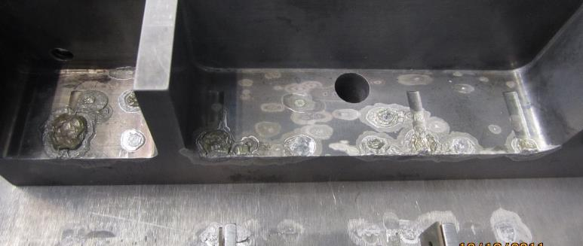
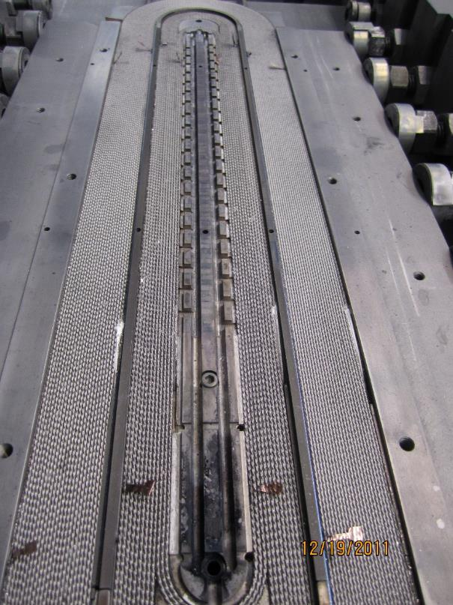
1. TAMU3a Failed Coil Analysis
TAMU3a leaked tin through the leads
Large deposits of what was thought to be carbon
Omitted 210°C solid stabilization soak!!!

Slide 23
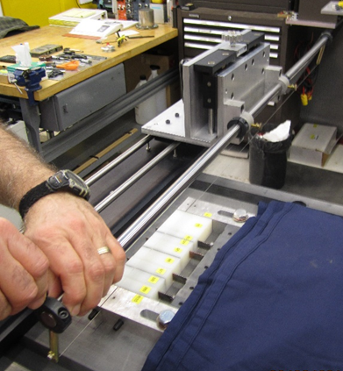
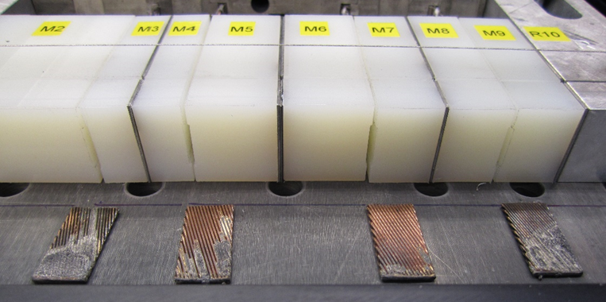
1. TAMU3a Failed Coil Analysis
Investigation lead to a series of novel non-destructive techniques for coil QC post HT
  A. Secondary Ion Mass Spectrometry (SIMS)
  B. Diamond Wire Saw

Slide 24
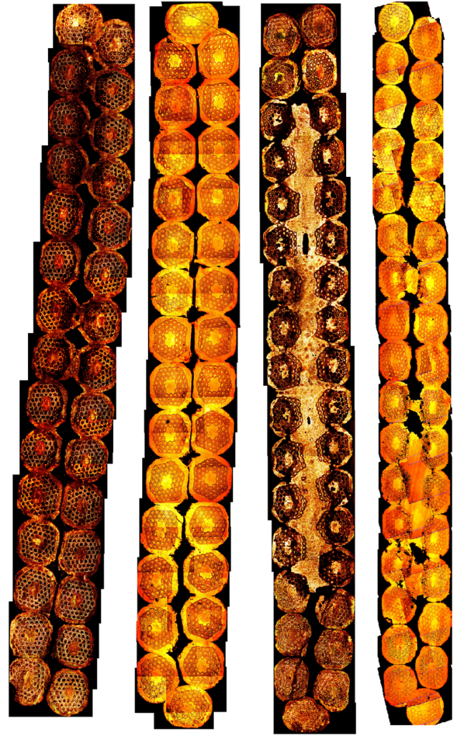
1. TAMU3a Analysis
Investigation lead to a series of novel non-invasive techniques for coil QC post HT
  A. Secondary Ion Mass Spectrometry (SIMS)
  B. Diamond Wire Saw
  C. SEM and Optical Imaging: ImageJ®
Notes:
The outer precursor SEM samples were polished to 0.02 microns and etched in 50% solution of HNO3 by swab for 8 seconds. The etching removed all elemental tin in the core of each bundle for the unreacted. The inner samples were polished to 0.02 microns and then etched in a solution of 13% HF + 37% HNO3 by swab for 10 seconds.

Slide 25
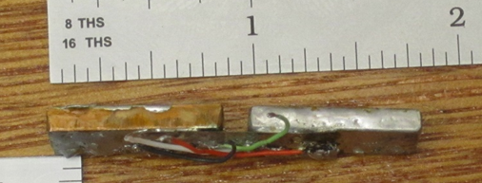
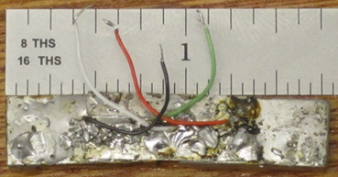
1. TAMU3a Failed Coil Analysis
Investigation lead to a series of novel non-invasive techniques for coil QC post HT
  A. Secondary Ion Mass Spectrometry (SIMS)
  B. Diamond Wire Saw
  C. SEM and Optical Imaging: ImageJ®
  D. Small short sample test

Slide 26
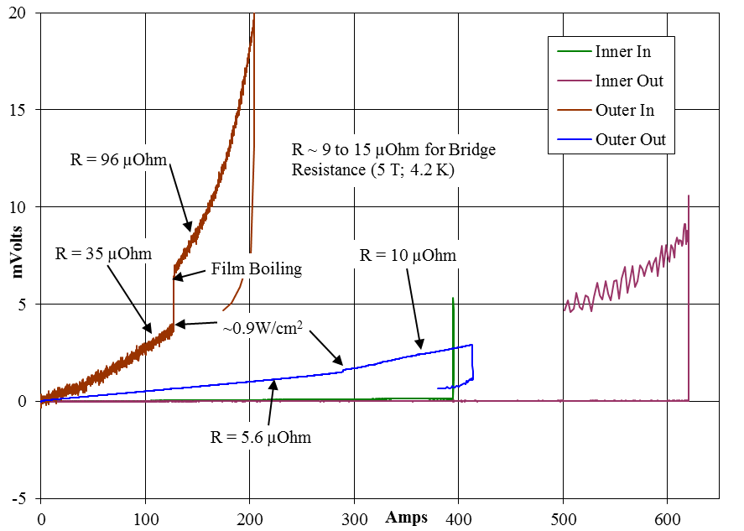
1. Results - TAMU3a Analysis
I-V curve for 2nd cut inch
R w/o supercurrent = 9 to 15 µOhm
No supercurrent in outer cable samples
Deemed irresponsible to continue the production of TAMU3a
Cost 1 year of lost progress!!!

Slide 27
2. Electrical Tests
Coil Resistance per length
  ImageJ® VS Measured
Resistance to Ground
  While winding and Impregnation

Slide 28
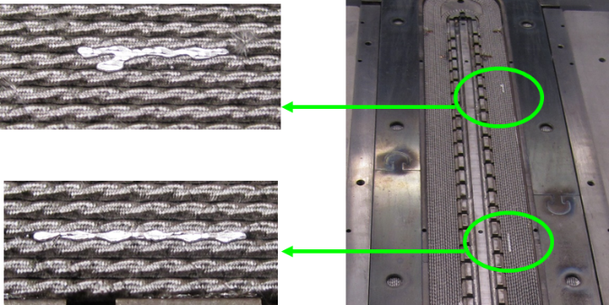
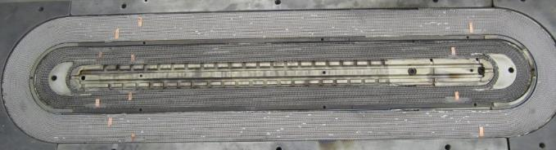
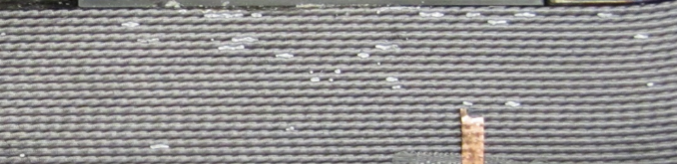
2. Results - Coil Resistance
TAMU3b
TAMU3c

Slide 29
2. Results - Coil Resistance
TAMU3b
ImageJ®
TAMU3c
(mΩ / m) | Measured
 | Inner | Outer
Unreacted | 2.03 | 2.24
Reacted | 5.08 | 3.80
(mΩ / m) | Calculated
 | Inner | Outer
Unreacted | 2.08 | 2.35
Reacted | 2.42 | 2.74
(mΩ / m) | Measured
 | Inner | Outer
Unreacted | 2.00 | 2.16
Reacted | 5.03 | 2.89
Notes:
Theory: One possible explanation for the decrease in resistance per length is that the new cabling procedure drastically weakened the integrity of the niobium barriers and allowed tin to locally burst out of the strands and through the S-Glass insulation. The S-Glass does not wick the tin and inhibits the tin from further poisoning the copper. With this localized absence of tin where the copper was previously being poisoned the resistance per length was allowed to remain low even after the heat treatment.

Slide 30

2. Resistance to Ground During VPI
Shorts to ground can destroy a magnet
Vacuum Pressure Impregnation (VPI) tends to increases the resistance to ground.
Electrical coil Isolation
TAMU3b VPI
Epoxy Flow
Cure Cycle
Cool down

Slide 31




3. Transducer Construction
Capacitance responds to Lorentz Stress
Located between outer winding and outer pier
Should only measure outer wind stress
Kapton
Stainless Steel
STRESS
TRANSDUCERS

Slide 32

3. Transducer Construction
The cyclic off-set is minimal with reproducible calibration and no measurable creep.
Stress Measurement Region
Pressure @ 7T
Pressure @ 10T
Pressure @ 14T

Slide 33
3. Results - Transducer Calibration
Calibrated in LN₂
Data taken at 1 kHz and 10 kHz
From 3D simulation – Force on each transducer
  ~ 70 ± 3.5 MPa
From Transducer calibration – Force on each transducer
  ~ 70 ± 3.2 MPa

Slide 34

Conclusion
Higher $\vec{B}$ is crucial to future discoveries in physics
Stress Management is a viable strategy to maximize the current carrying capacity of a conductor and limit degradation.
SM is accomplished by intermittently intercepting Lorentz stress before it can accumulate
The successful application of SM requires attention to detail:
  Magnet design (Materials, Mechanical, Electrical, Magnetic, Thermal)
  Fabrication technique (Tooling, QC, Winding, HT, Splicing, VPI, Flux Return)
  Component Testing (Mechanical, Electrical, Thermal)
TAMU3 coils are complete and are being installed into yolk
Planned to be cold tested at LBNL in June
  Shipped end of May and tested after LBNL PS upgrade completes

Slide 35
A little background
The Accelerator Research Laboratory at Texas A&M is small by most standards for making high field magnets.
I played a substantial role in each step in the construction of TAMU3: machining, winding, reacting, splicing, impregnating, coil handling, transducers, strain gauges…
I played a primary role in the simulation of TAMU3:
electromagnetic, mechanical, quench

Slide 36
Interests in LARP:
Superconducting magnet technology:
  HQ - Magnet Design
  Quench Simulation and Protection
  CLIQ – Coupling Loss Induced Quench
‘Provide stronger evidence that QXF structure is adequate’
  Electromechanical modeling
‘Risk Reduction’
  Winding Techniques and shimming
  Curing, Reaction, and Splicing
  Impregnation
Notes:
CLIQ – coupling loss induced quench

Slide 37


Slide 38

3. QUENCH ‘MIITS’ Curve
$$\int_{T_{0}}^{T_{MAX}}{\frac{γC}{ρ}dT}$$

Slide 39



2. TAMU3a Analysis
30 μm
3 μm
5 μm

Slide 40

3. Resistance
Large ∆L/L End effect is over ~ 10 cm
D. Bocian, G. Ambrosio, and G. M. Whitson, AIP Conference Proceedings 1435 (1), 193 (2012)
Large ∆R/R End effect is over ~ 1 m

Slide 41
3. Coil Resistance
What caused the tin leakage in the body?
  Cabling Process? How does TAMU3 cable compare with other IT RRP® cables?
$$Thickness Deformation \left(t\right)=\frac{cable thickness}{2×strand diameter}−1$$
$$Width Deformation \left(w\right)=\frac{cable width−theoretical width}{theoretical width}$$
Good Zone
Mechanically
Unstable
Damaged Zone
Notes:
Theoretical Width = Nd/ (2 cos(PA)) + .72d PA=pitchAngle
1.) Extrude Cu covered Nb rods. Do the same with Cu covered Sn rods. Everything is psychotically cleaned (etched) to get as close to metal-metal contact as possible.
2.) Draw these rods down to the diameter you want. you can't really anneal the Cu/Sn but that's your biggest element.
3.) Form your first stack of rods. Make sure that if you're using multiple extrusions to get your starting stock that you randomize the Cu/Nb array as much as possible so you won't have wide variability in your conductor. Mix in your tertiary rods (Nb47Ti or Nb-Ta(10wt%)) in whatever pattern you like as well. All of the Nb elements are arrayed around the Cu/Sn core. The whole thing gets wrapped in a diffusion barrier foil (Nb, NbTa, or Ta) then gets placed in an outer, high RRR Cu jacket and gets extruded or drawn (Probably extruded @ 6", then drawn to size) down until you reach your next restack diameter. Hex these bad boys as your last step, then cut them to restack lenght.
4.) Do your restack by arraying them in your 54/61 or higher pattern around a hex'd RRR Cu core. Whole thing goes in a high RRR Cu jacket and interstitial void spaces are filled with high RRR Cu as much as possible. Draw down to final size.This is probably a 1" or 1/2" billet when you start, it's hard to draw much more than that. You also know your own conductor's piece length (from OST) and diameter, so you can do the math and figure out at what point you have somewhere around 3' or 6' of conductor length and that tells you the rough restack diameter.
Remember that all of the drawing and extrusions of the Sn/Cu have to be done fairly cold (<200 C) or you'll end up with tough bronzes that will negatively impact your workability. I have no idea what strain you apply to each of these processes or that you end up with in the end, but I know it's fairly high. The limits on the length and filament size are based on the initial diameter (and length) of the billet you can push and still draw down to fine filament size (predominantly length issue, but also affects filament size) and the smallest diameter you can draw your 1st stack down to and still assemble a tight restacked billet (predominantly filament size issue that the higher filament count wires are addressing now, just takes the tech and art to get this done right). If you fix the final wire diameter, you can see how these are the limiting factors pretty quickly. You're also fighting the strain space the whole way, which is a fundamental limit since you can't really do an anneal with all of that Sn. This is part of the reason that the bronze route conductors could be made in longer pieces (anneal-able up to the melt temp of the bronze) and Lesh's PIT conductors with high Sn bronzes have a huge upside.

Slide 42
3A. Coil Resistance
What caused the tin leakage and resistivity difference in the body?
  Cabling Parameters? NO
  Cabling Process? Unlikely
Conductor |  | Width | Thickness | % Compression
 | New outer cable | 34 strands x 0.7mm
 | TAMU-5-O-B1029R | 110 Meters
 | Unstrained |  | 0.0551” | 0
 | First Roll |  | 0.0489” | 11.4
 | Re-Roll After Anneal | 0.5127” | 0.0475” | 13.9
 | Original outer cable | 34 strands x 0.7mm
 | T-5-O-B0943RR-1&2 | 88 Meters (total)
 | Unstrained |  | 0.0551” | 0.0
 | First Roll |  | 0.0496” | 9.9
 | Re-Roll After Anneal |  | 0.0483” | 12.3
 | Re-Roll After 2nd Anneal | TAMU3a 0.5133” | 0.0474” | 14.0
 | Re-Roll After 2nd Anneal | TAMU3b 0.5120” | 0.0477” | 13.4
Notes:
Theory: One possible explanation for the decrease in resistance per length is that the new cabling procedure drastically weakened the integrity of the niobium barriers and allowed tin to locally burst out of the strands and through the S-Glass insulation. The S-Glass does not wick the tin and inhibits the tin from further poisoning the copper. With this localized absence of tin where the copper was previously being poisoned the resistance per length was allowed to remain low even after the heat treatment.

Slide 43



A REAL accelerator?
6 MJ in NASCAR
700 MJ in beam
10 GJ in magnets!!!
Notes:
6.2 MJ in nascar
700 MJ in beam
10 GJ in magnets!!!

