Slide 1
Analysis of Dimensional Tolerances in HQ
LARP CM22/ HiLumi-LHC Collaboration Meeting
F. Borgnolutti (LBNL)
May 7th, 2014

Slide 2
Outlines
Analysis of the coil turns position uncertainty in HQ: Impact on the field quality.
2) Coil dimension uncertainty & its impact on the field quality of HQ.
3) Conclusion.

Slide 3
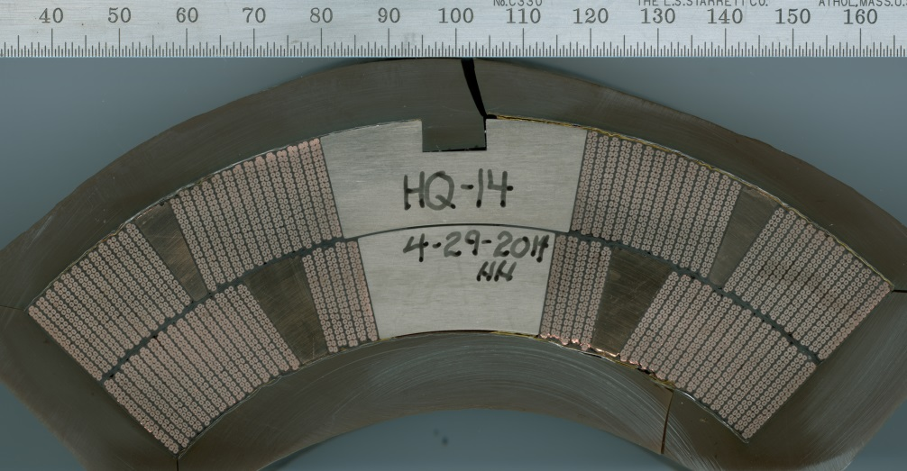
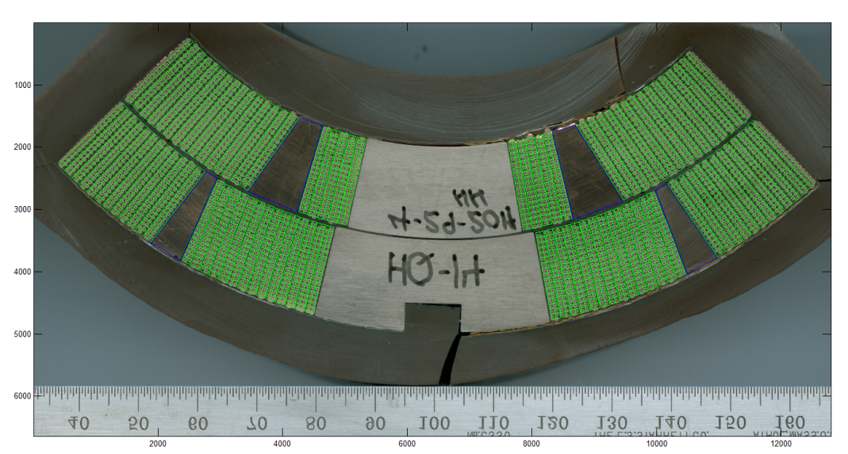
Coil Turns Position Uncertainty in HQ
We analyzed HQ coil 14 Cross-section.
HQ coil14 is a second generation coil (smaller cable). It is therefore representative of HQ02 and HQ03 coils.
Theoretical model (Roxie, uninsulated cable) superimposed to HQ coil 14:
  “best fit” of the coil model with the photo.

Slide 4
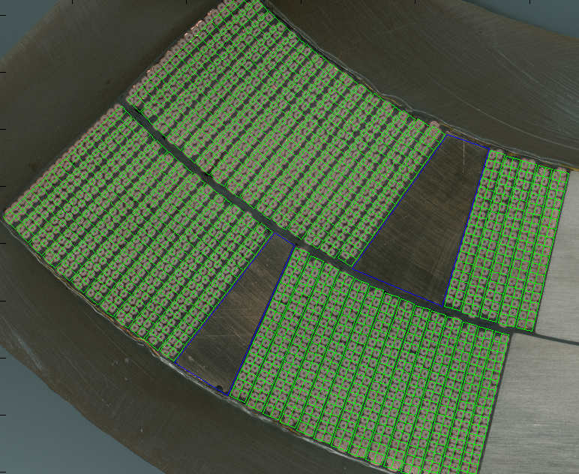
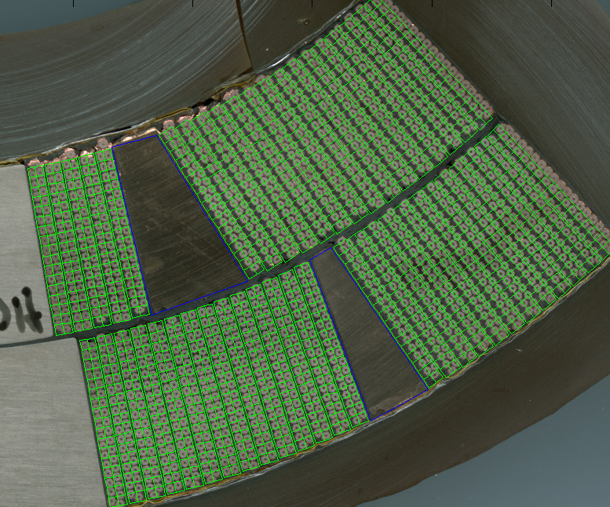
Coil Turns Position Uncertainty in HQ
The coil is not pre-loaded so we do not have azimuthal matching of the coil turns between Roxie and the coil.
  But the photo/Roxie comparison gives us information regarding the radial alignment of the turns

Slide 5
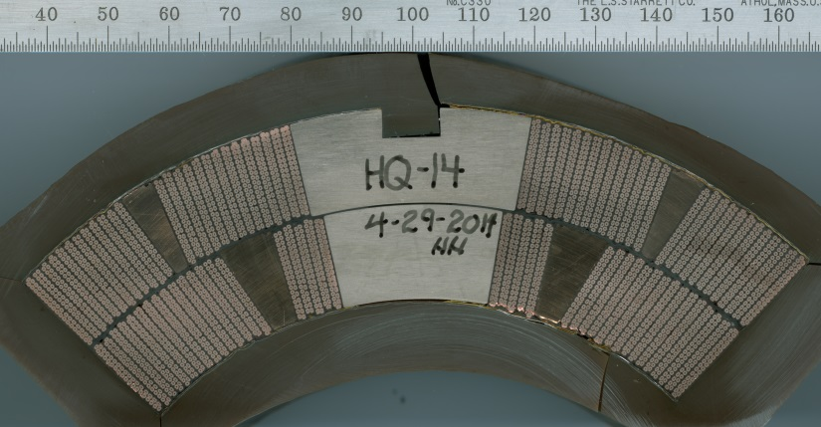
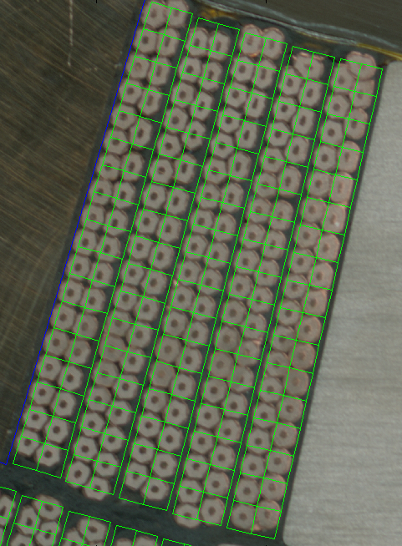
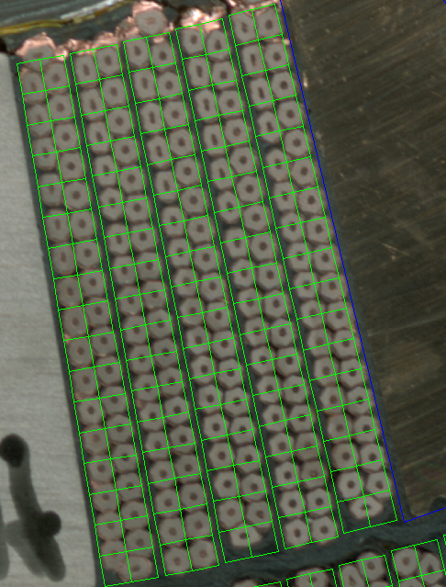
Coil Turns Position Uncertainty in HQ
Observation (1):
  Turns of the inner layer upper block appear to be less well radially aligned than in other blocks: ± 200 μm
0.2 mm

Slide 6
Coil Turns Position Uncertainty in HQ
Monte-Carlo simulation:
  Inner layer upper block turns are radially displaced. The amplitude of the displacement is randomly picked in the range [-200 um; +200 um]
  500 quadrupoles
  Rref = 40 mm
Magnified random displacement of the coil turns

Slide 7
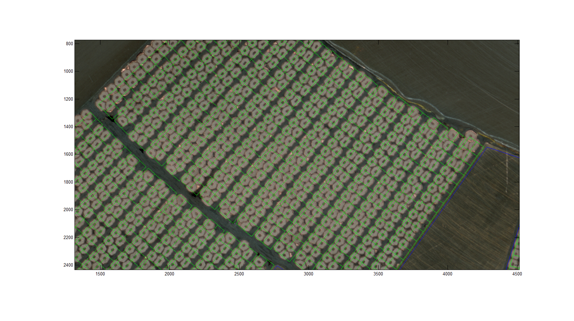
Coil Turns Position Uncertainty in HQ
Observation (2):
  Radial position of other turns is about ± 100 µm.

Slide 8
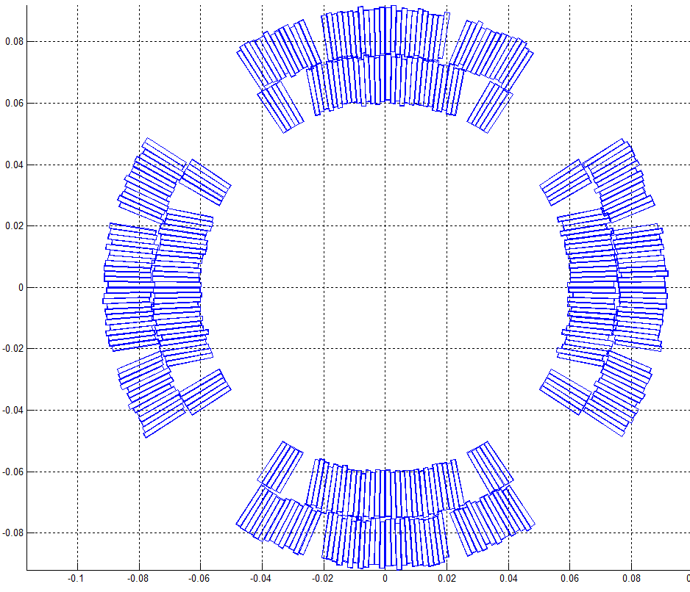
Coil Turns Position Uncertainty in HQ
Monte-Carlo simulation:
  Turns are radially displaced. The amplitude of the displacement is randomly picked in the range [-100 um; +100 um]
  500 quadrupoles
  Rref = 40 mm
Magnified random displacement of the coil turns

Slide 9
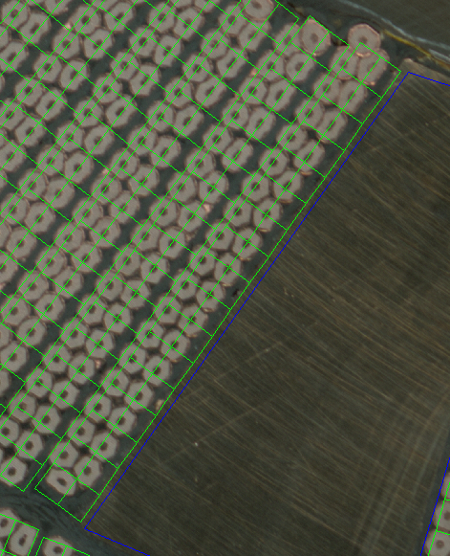
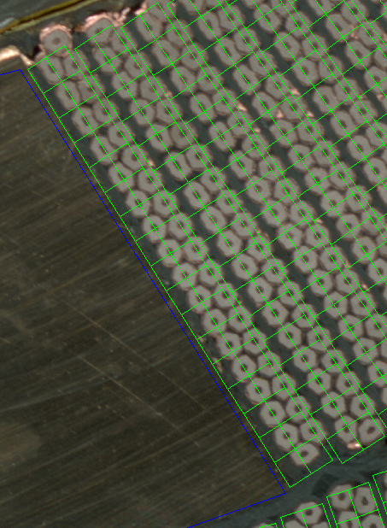
Coil Turns Position Uncertainty in HQ
Observation (2):
  The turn after the inner layer wedge appears to be radially offset by -300 μm.
If systematic error → Δb₆ = +0.76, Δb₁₀ = +0.21
→Not negligible systematic field error.
→Look at this particular turn in QXF.
0.3 mm
0.3 mm

Slide 10
Outlines
Analysis of the coil turns position uncertainty in HQ: Impact on the field quality
2) Coil dimension uncertainty & its impact on the field quality of HQ
3) Conclusion

Slide 11
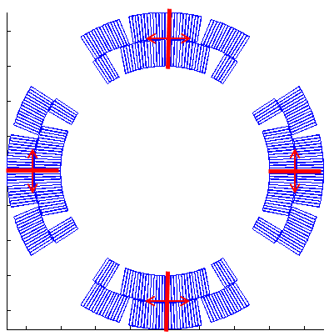
Coil dimension uncertainty in HQ
Azimuthal Coil size measurements show coil to coil reproducibility better than ±100μm (±50 μm per side)
Monte-Carlo simulation:
  Each mid-plane is displaced by an amplitude randomly picked in the range [-50 µm; + 50 µm]
  500 quadrupoles
  Rref = 40 mm
An uncertainty on the coil azimuthal dimension also translate to an uncertainty on the magnet aperture (ΔR = ± 30 µm) → negligible impact (0.03 unit on b₆)

Slide 12
Coil dimension uncertainty in HQ
Azimuthal position of the pole piece specified ± 20 µm.
It is in HQ02 ±100 um (due to undersized pins)
Pole pieces

Slide 13
Conclusion
We analyzed dimensional uncertainty in the second generation of HQ coil.
Estimated turn radial position uncertainty:
  ±200 µm for the inner layer upper block
  ±100 µm for the other turns
    Impact on the field quality acceptable
Systematic displacement (-0.3 mm) of the inner layer turn which is just before the copper wedge → not negligible effect on b₆ but can be accounted for in the coil design.
Mid-plane location known at ±50µm → possible improvement.
The pole piece azimuthal position uncertainty is not negligible (±100 µm). It was due to undersized alignment tooling. → Improvement expected.
This analysis a first step toward characterization and improvement of fabrication tolerances.

