Slide 1
LARP: Present and Future
G. Apollinari
May 7th, 2014

Slide 2
Summary
Intro
The Future: Toohig Fellowship
The Present
  Feb ‘14 DOE LARP Review
  Money
  Money
  Money
  …
  (Some) Collaboration Meeting & Technical Goals

Slide 3
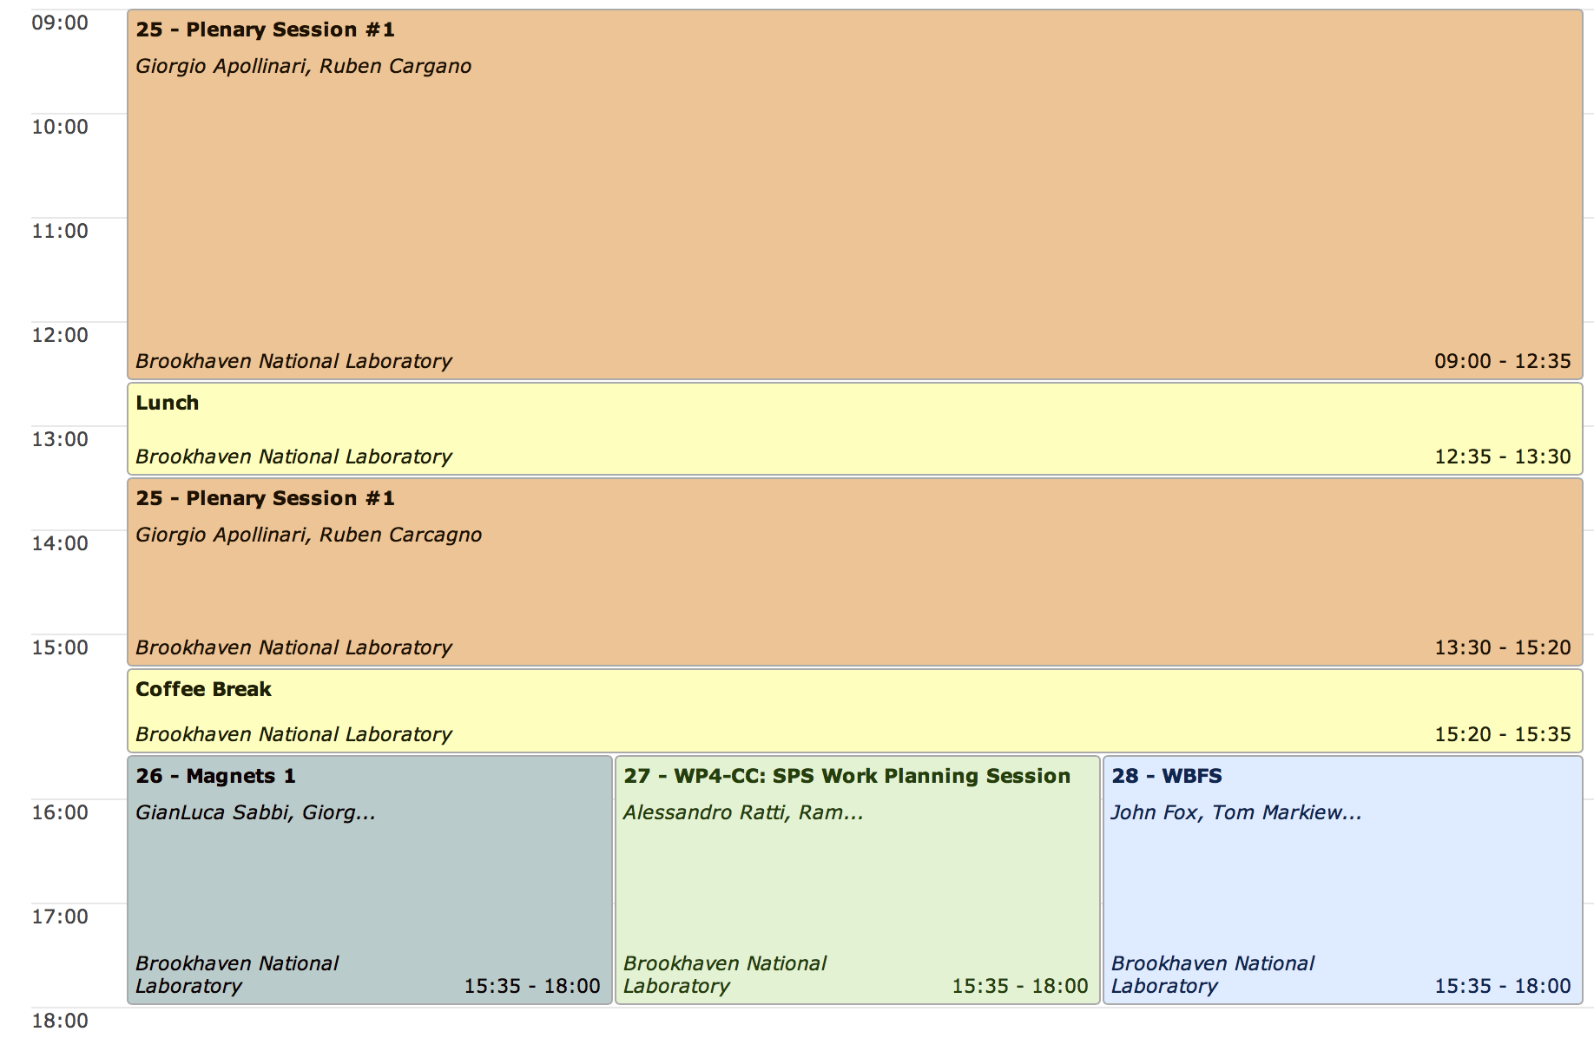
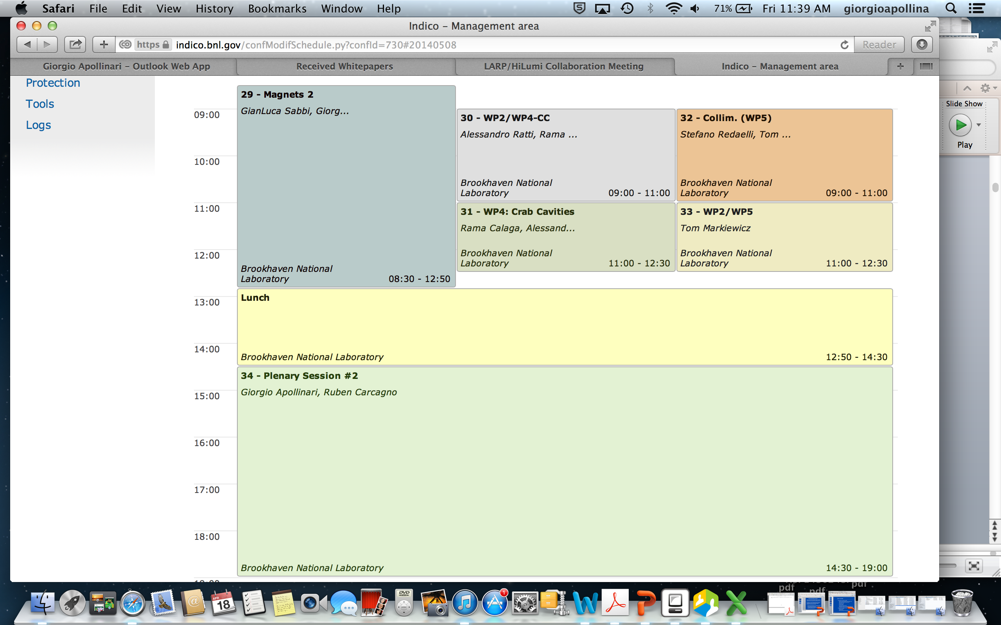
2014 CM22 Organization
Experiment:
  Collaboration Meeting over 2 days (instead of 2 ½)
2 plenary sessions, 3 parallel sessions
  3 side “meetings” already took place: CC Review, QXF Coil and WBFS Workshops
  CC Review Report in plenary session this Afternoon
Collaboration Dinner on Wednesday evening (7:00 pm @ The Fifth Season – See Peter)

Slide 4
LARP History and Transformation
The US LHC Accelerator Research Program (LARP) was formed in 2003 to coordinate US R&D related to the LHC accelerator and injector chain at Fermilab, Brookhaven, and Berkeley
  SLAC joined shortly thereafter
  Has also had some involvement with Jefferson Lab, Old Dominion University and UT Austin
LARP has contributed to the initial operation of the LHC, but much of the program is focused on future upgrades
  Increase Luminosity
  Beam Handling/Monitoring
The program is currently funded at a level of about $12-13M/year (with present needs of ~16 M$/y) divided among:
  Magnet research (~half of program)
  Accelerator research (Crab cavities, WBFS, Collimators, e-hollow lens,..)
  Programmatic activities, including support for Toohig Fellowship
FY13-FY14 Evolution
  Initial convergences on deliverables for HL-LHC
  Program to be handled like a “project” to Reduce Risk of US Contributions to HL-LHC Project

Slide 5
US in-kind Contribution to HL-LHC: a preliminary look
Various Candidates:
  150 mm aperture Nb₃Sn quadrupoles
  Crab Cavities and 11T Nb₃Sn Dipoles
  High Bandwidth Feedback System
  Collimation and hallow e-beams
  …
Process of convergence among CERN-DOE-U.S. Labs-LARP initiated in Dec ‘2012
Initial consensus on core Priorities:
  Committed to a major stake in Nb₃Sn 150 mm quads
  Crab cavities up to the SPS test and beyond to production
  High bandwidth feedback was seen as a high impact contribution for modest resources.
Back up options:
  11 T dipoles
  Hollow electron beams for halo removal
To be discontinued in FY14
  RC, Material radiation testing, HQ (FY15), ..
“Global” Simulation ?
Possibly 75% of US
Contribution to HL-LHC
“Elephant-in-the-Room” effect

Slide 6
FY14-FY17 LARP Organization
DOE Office of HEP
Laboratory Oversight Group
Fermilab Directorate
LARP Advisory Committee
LHC Accelerator Research Program:
Director: G. Apollinari
Pro. Engineer: R. Carcagno
Program
Management
Office
Nb₃Sn IR Quadrupoles
G. Ambrosio
Crab Cavities
A. Ratti
High Bandwidth Feedback
J. Fox
Accelerator Systems
T. Markiewicz

Slide 7
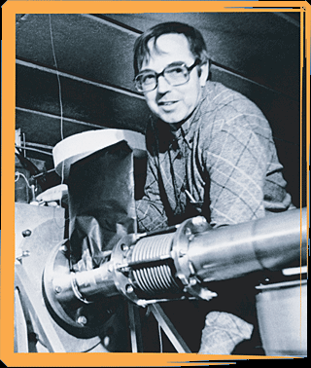
Toohig Fellowship
Named for Tim Toohig, one of the founders of Fermilab. Nursery of talent in Accelerator Technology.
Open to recent PhD’s in accelerator science or HEP to contribute to the LHC at one of the host US Labs (BNL, FNAL, LBL, SLAC).
Past
  Helene Felice, LBNL, now staff at LBL
  Rama Calaga, BNL, now CERN staff
  Ricardo de Maria, BNL, now CERN Fellow
  Themis Mastoridis, SLAC, Ass. Prof. at Cal Poly,
  SLOC
  Ryoichi Miyamoto, BNL, now ESS Staff
  Dariusz Bocian, FNAL, now Ass. Prof. at
  The Henryk Niewodniczański Institute of Nuclear
  Physics
  Valentina Previtali, now Teacher in Geneva
  Simon White, BNL Staff
Present
  John Cesaratto, SLAC
  Ian Pong, LBNL
  Silvia Verdu Andres, BNL

Slide 8
Toohig Fellowship
Commitment to maintain Toohig Fellowship, directing it to the general “risk-reduction” goals of LARP in the next ~4 years.
Fellowship posting changed to reflect emphasis on:
  Focus on Magnets, Crab Cavities and Wide Band Feedback System
Four Toohig Fellowship Candidates will present their work at this Collaboration Meeting:
  Dr. Douglas Bett (U. Oxford)
  Dr. Trey Holik (Texas A&M U.)
  Dr. Kent Wotton (U. Melbourne)
  Dr. Pei Zhang(CERN – U. Manchester)
Next Step: submission of Fellowship Proposal letter to Chair (Prof. Fox) in ~10 days after this CM and selection by June 2014.

Slide 9
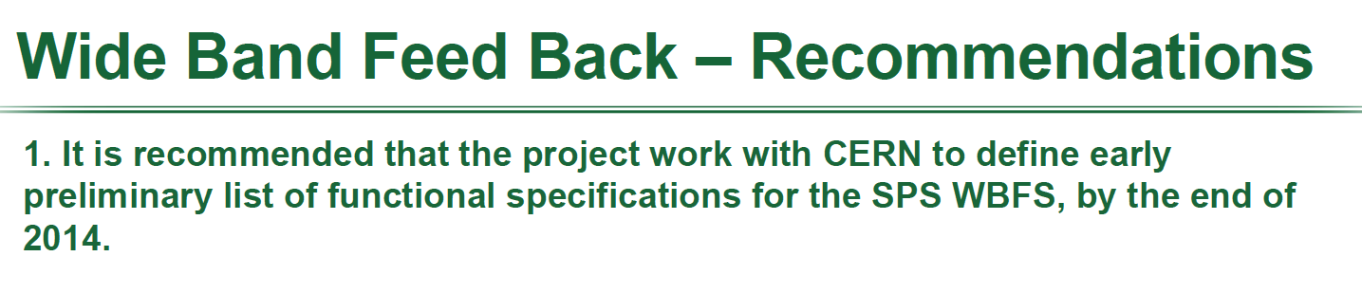
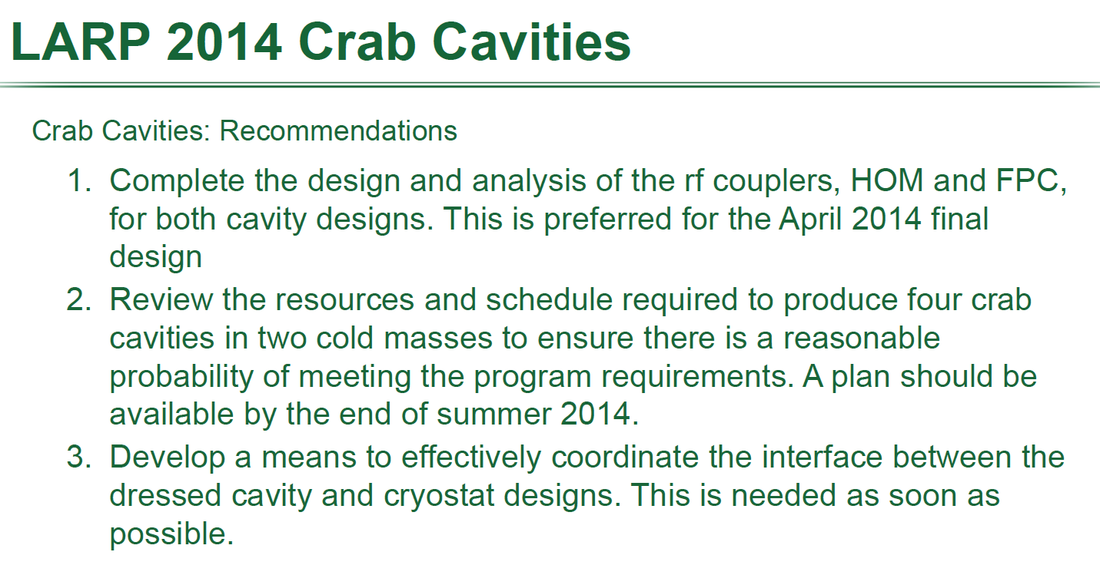
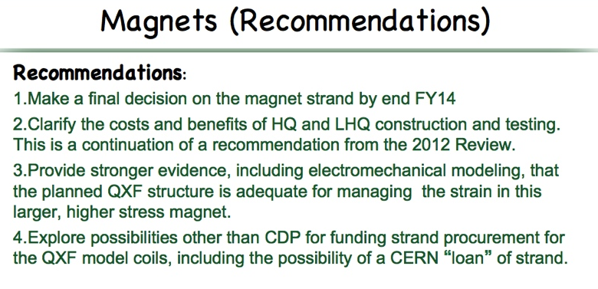
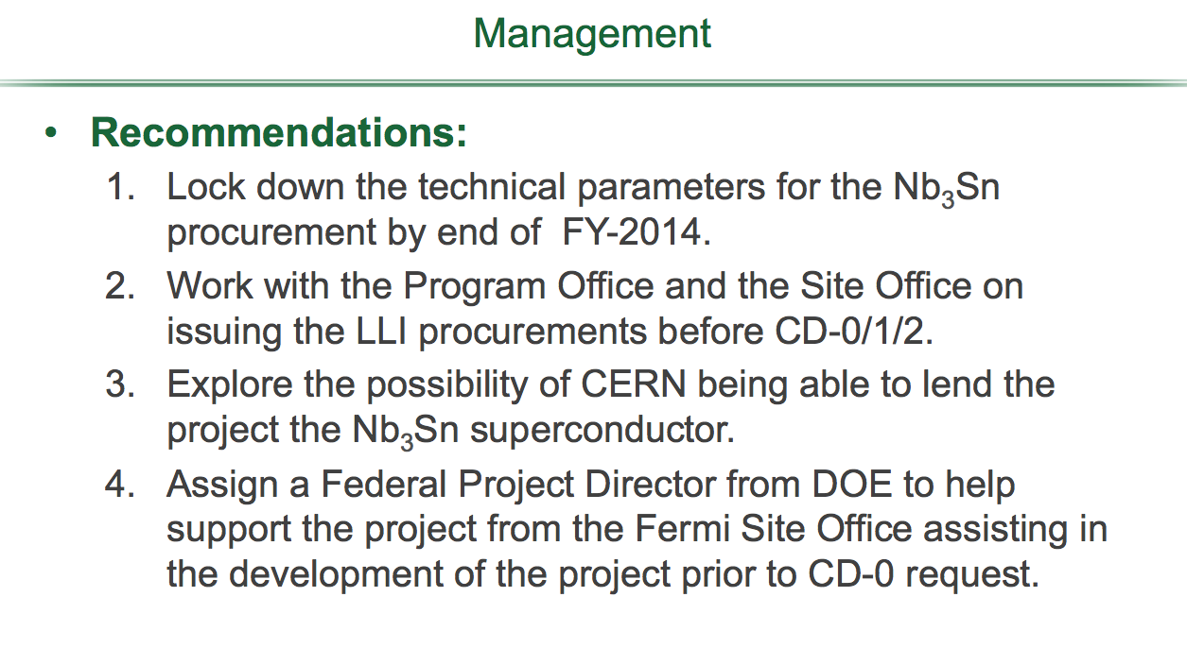
DOE LARP Review
DOE LARP Review at FNAL in February 2014.

Slide 10
What do we need in FY14-FY17 ?
L2 Requests vs. Reality
 | FY14 (M$) | FY15 (M$) | FY16 (M$) | FY17 (M$)
Needed | 15.5 | 17.1 | 15.9 | 13.8
Requested | 15.5 | 16.0 | 16.0 | 16.0
IFP | 12.4
Supplemental | 0.2

Slide 11
LARP Funding: how are we doing in FY14
 | Carry Forward (M$) | Budget (M$)
FY10 | 1.7 | 12.4
FY11 | 3.7 | 12.4
FY12 | 3.8 | 11.7
FY13 | 4.1 | 11.2
FY14 | 2.9 | 12.4(+0.2)
LARP, as a National Program, has a protected “Carry Forward” budget
“Carry Forward” will be heavily used in FY14, especially for Magnet Tooling & Strand procurement and for magnet models.
 | FY14 Budget | Plans for CF Use | Total Budget | BCWP (50% prorated) | ACWP | CPI (BCWP/ACWP)
Acc. Syst. | 0.6 | ~0.2 | 0.8 | 0.4 | 0.5 | 85%
Magn. | 7.5 | ~1.9 | 9.4 | 4.7 | 4.3 | 109%
Manag. | 1.8 | - | 1.8 | 0.9 | 1.0 | 93%
CC | 1.4 | - | 1.4 | 0.7 | 0.5 | 129%
WBFS | 1.1 | - | 1.1 | 0.6 | 0.3 | 187%
 | 12.4 | ~2.1 | 14.5 | 7.2 | 6.6 | 110%
 | FY14 Budget | Plans for CF Use | Total Budget | BCWP (50% prorated) | ACWP | CPI (BCWP/ACWP)
Acc. Syst. | 0.6 | ~0.2 | 0.8
Magn. | 7.5 | ~1.9 | 9.4
Manag. | 1.8 | - | 1.8
CC | 1.4 | - | 1.4
WBFS | 1.1 | - | 1.1
 | 12.4 | ~2.1 | 14.5
 | FY14 Budget | Plans for CF Use | Total Budget | BCWP (50% prorated) | ACWP | CPI (BCWP/ACWP)
Acc. Syst. | 0.6 | ~0.2 | 0.8 | 0.4
Magn. | 7.5 | ~1.9 | 9.4 | 4.7
Manag. | 1.8 | - | 1.8 | 0.9
CC | 1.4 | - | 1.4 | 0.7
WBFS | 1.1 | - | 1.1 | 0.6
 | 12.4 | ~2.1 | 14.5 | 7.2
 | FY14 Budget | Plans for CF Use | Total Budget | BCWP (50% prorated) | ACWP | CPI (BCWP/ACWP)
Acc. Syst. | 0.6 | ~0.2 | 0.8 | 0.4 | 0.5 | 85%
Magn. | 7.5 | ~1.9 | 9.4 | 4.7 | 4.3 | 109%
Manag. | 1.8 | - | 1.8 | 0.9 | 1.0 | 93%
CC | 1.4 | - | 1.4 | 0.7 | 0.5 | 129%
WBFS | 1.1 | - | 1.1 | 0.6 | 0.3 | 187%
 | 12.4 | ~2.1 | 14.5 | 7.2 | 6.6 | 110%
 | FY14 Budget | Plans for CF Use | Total Budget | BCWP (50% prorated) | ACWP | CPI (BCWP/ACWP)
Acc. Syst. | 0.6 | ~0.2 | 0.8 | 0.4 | 0.5
Magn. | 7.5 | ~1.9 | 9.4 | 4.7 | 4.3
Manag. | 1.8 | - | 1.8 | 0.9 | 1.0
CC | 1.4 | - | 1.4 | 0.7 | 0.5
WBFS | 1.1 | - | 1.1 | 0.6 | 0.3
 | 12.4 | ~2.1 | 14.5 | 7.2 | 6.6

Slide 12
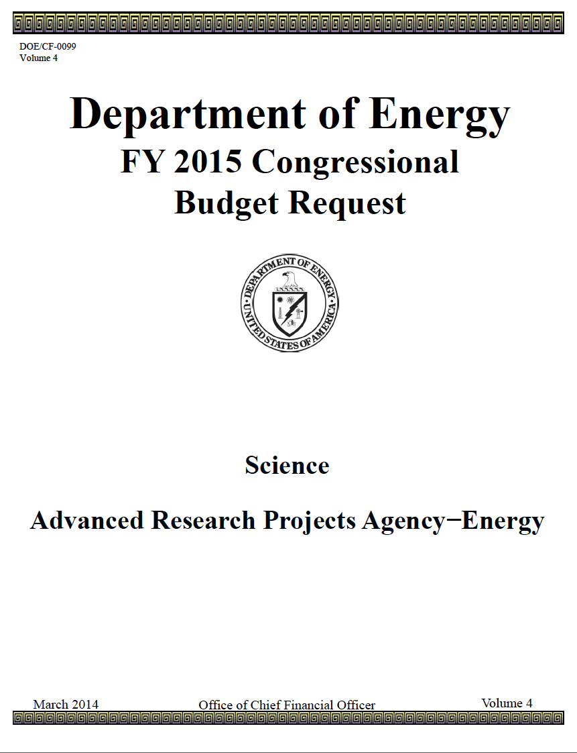
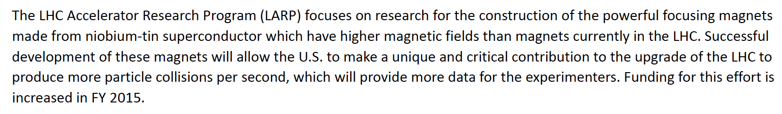
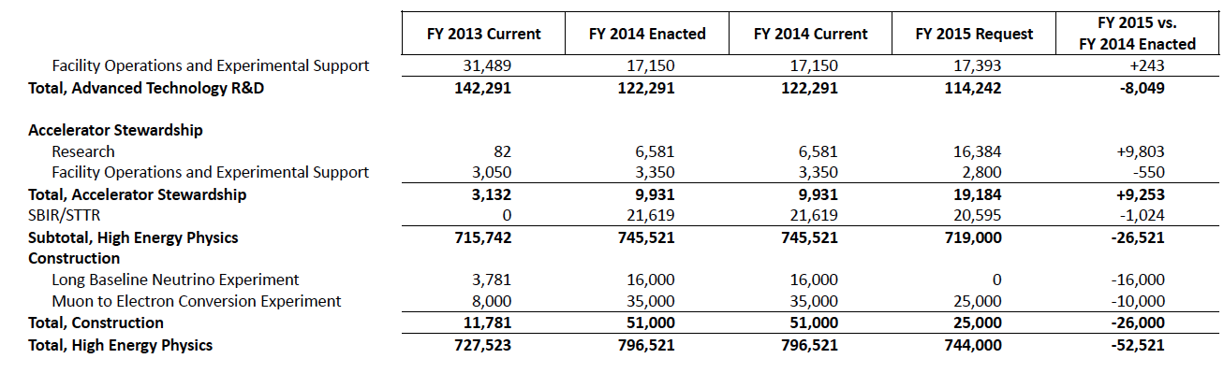
FY15 Guidance – Intro 1

Slide 13
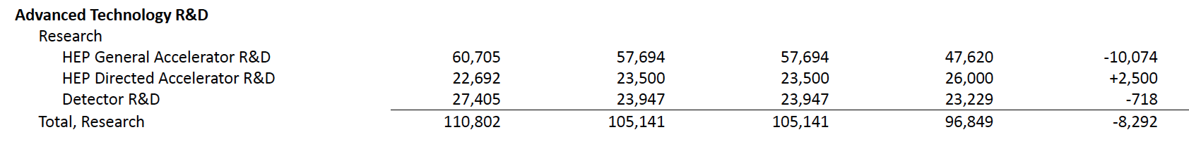
FY15 Guidance – Intro 2
FY14
FY15
With a lot of caveats and disclaimers about need to wait for what P5 will say, and need to get the report, and things might change when the report is in hand, and this is only the Presidential Budget and Congress may add/remove from it, etc. etc.
  Verbal Working Guidance for FY15 Budget is 14.0 M$ for LARP (+12% in “-6% year”)
This is not the 16 M$/y we were asking during the DOE Review in February, but is an increase over FY14 Budget of 12.4 M$.
  The glass is half-full !
13

Slide 14
What do we need in FY14-FY17 ?
L2 Requests vs. Reality
 | FY14 (M$) | FY15 (M$) | FY16 (M$) | FY17 (M$)
Needs | 15.5 | 17.1 | 15.9 | 13.8
Requested | 15.5 | 16.0 | 16.0 | 16.0
IFP/Plans | 12.6 | 14.0 | ? | ?
Supplement | ~0.2
CF | 2.1 | ~0.8 | Gone | Gone
Total Funding | 14.9 | 14.8 | ? | ?
Delta | -0.6 | -1.2
~10% reduction from requested budget if funding at ~14M$/y continues in FY16 and FY17.

Slide 15
How do we proceed in FY14-FY17 ?
3 LARP Budget scenarios discussed during DOE Review
  12.4 M$/y: “Nightmare Scenario”
  14.0 M$/y “~10% Reduction”
  16.0 M$/y
Are we in “Scenario #2” ? What was advertised as a possible way to go forward at Feb. DOE Review was:
  Upkeep Magnet Effort
  Reduce CC/WBFS Functionality and Commissioning Efforts
  Eliminate AS after FY15
Are these the correct actions to take as LARP/HL-LHC Collaboration ?
  If so, “knowledge transfer” for essential needs is a must
  If not, how do we re-prioritize US effort on preparation for HL-LHC during the LARP phase (FY14-FY17) ?
    Answer depends heavily on size of US Contribution to HL-LHC

Slide 16
US Contribution to HL-LHC
What is “monetary” size of US Contribution to HL-LHC ?
  We all expect/hope P5 to come back with an answer very close to ~200M$ in view of number of US Scientists working on the LHC.
June ’13 LARP Internal Review specified cost profile.
Feb ‘14 DOE Review looked at new schedule and LLI (pre-project) needs.
Once P5 Report comes out, LARP will have to re-assess the US contribution cost in view of latest developments/discussions:
  Q1/Q3 Deliverables
  CC Deliverables
  Etc.
CD0/CD1/CD2
Based on “Preliminary Deliverables” (June ‘13)
CD-4 by FY23
 | FY15 | FY16 | FY17 | FY18 | FY19 | FY20 | FY21 | FY22 | FY23 | LARP TOTAL | PROJECT TOTAL
LARP funding | $16M | $16M | $16M |  |  |  |  |  |  | $48M
LLI (pre-Project funding) |  | $10M | $23M |  |  |  |  |  |  |  | $33M
Project funding |  |  |  | $34M | $51M | $43M | $31M | $17M | $6M |  | $182M
TOTAL | $16M | $26M | $39M | $34M | $51M | $43M | $31M | $17M | $6M | $48M | $215M

Slide 17
Long Lead-time Items (LLI)
 | FY15 | FY16 | FY17 | FY18 | FY19 | FY20 | FY21 | FY22 | FY23 | LARP TOTAL | PROJECT TOTAL
LARP funding | $16M | $16M | $16M |  |  |  |  |  |  | $48M
LLI (pre-Project funding) |  | $10M | $23M |  |  |  |  |  |  |  | $33M
Project funding (MIE) |  |  |  | $34M | $51M | $43M | $31M | $17M | $6M |  | $182M
TOTAL | $16M | $26M | $39M | $34M | $51M | $43M | $31M | $17M | $6M | $48M | $215M
 | M&S (M$)
Superconductor (50%) | ~7.3
CMM & Wind/Curing Tooling | ~1.0
React./Impreg. Tooling | ~1.7
Handling/Storage Tooling | ~1.0
Test Facility Equipment | ~1.4
Magnet Parts | ~1.0
Labor & Contingency brings to ~33M$ in US accounting
Negotiations with DOE or US Universities for “Forward Funding”

Slide 18
Future “Technical” Goals
Magnets
  “Procurement Ready” Strand and Cable
  specs Review Sep-Oct ‘14
  Convergence on MQXF “Final” Design/Review CDR / Sum’15?
Crab Cavities
  Performing Dressed Cavities Dec ‘14
  Integrated Cavities-Cryo Assembly Assessm. ? Sum’15 ?
WBFS
  Functionalities Specs/Review Summer-Fall ‘14
Management
  US-HL-LHC “Internal” Cost Assessment ~Oct ‘14
  CERN/US-HL-LHC Negotiations (if needed)
  Readiness for “CD-0 equivalent” ~ Spring ’15

