Slide 1
Status of halo excitation studies at CERN
R. Bruce, D. Banfi, J. Barranco, O. Bruning, X. Buffat, R. de Maria, M. Fitterer, M. Giovannozzi, W. Höfle , S. Redaelli, T. Pieloni, H. Thiesen, CERN
G. Stancari, A. Valishev, Fermilab
R. Bruce, 2014.05.08
1
Notes:
1
1

Slide 2
Halo removal
Halo depletion is a possible way to mitigate spurious beam dumps at fast orbit oscillations
When do we need it in the operational cycle?
Most important during the squeeze and collision preparation, before beams are brought into collision (Run 1). Application to stable beams for increased protection during crab cavity failure
Possible methods under study for halo removal:
electron lens (studied by G. Stancari et al.)
tune modulation
Transverse damper (ADT) narrow-band excitation
R. Bruce, 2014.05.08
2
Notes:
2

Slide 3
Halo removal
Timeline:
Nothing available for 2015 startup as operational tool. Goal 2014 is to define what needs to be studied in machine studies (MDs) in Run 2. Hollow electron lens: not before LS2. What can we do before?
This talk:
Brief introduction to the alternatives to electron lens
Ongoing and planned studies
R. Bruce, 2014.05.08
3
Notes:
3

Slide 4
Tune modulation
Idea: By modulating the tunes at a fixed frequency, resonance sidebands are introduced around the existing resonance lines (Bruning, Willeke PRL 76:3719)
Use detuning with amplitude of the beam
By choosing wisely the modulation frequency, we could put a resonance line on the halo, while leaving the beam core unaffected
R. Bruce, 2014.05.08
4
Notes:
4

Slide 5
Tune footprints
Pre-study of tune footprints and resonance lines can give a first hint on which frequencies could be suitable
To know the needed modulation amplitude, we need to know also the strength of each resonance in the machine. More advanced simulations needed (frequency map, dynamic aperture)
Look at tune footprints at
injection – for MDs
flat top, end of squeeze, collision
R. Bruce, 2014.05.08
5
Notes:
5

Slide 6
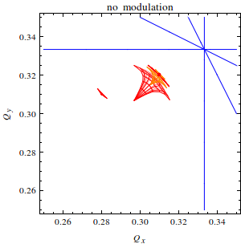
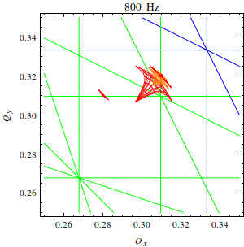
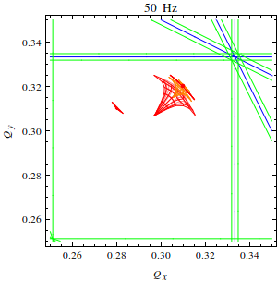
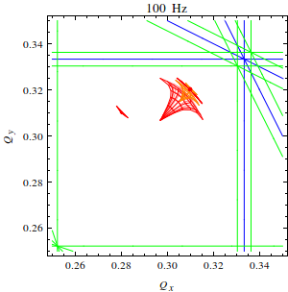
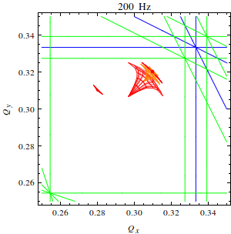
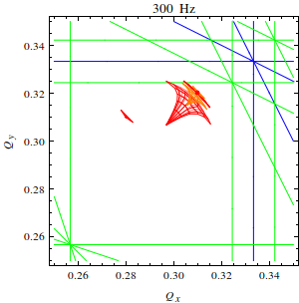
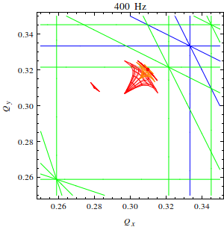
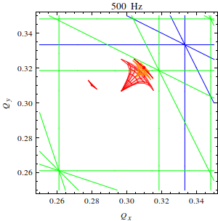
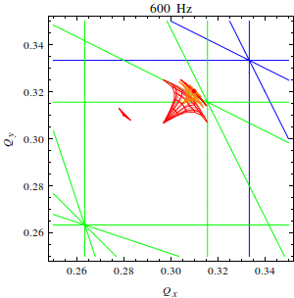
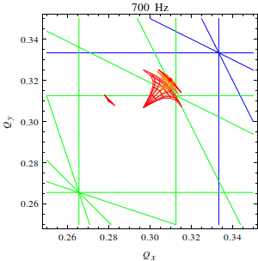
Tune footprints and resonance lines – all footprints, 5th order
Studying the resonance lines when modulation frequency is increased
Thanks to the beam-beam team for help and input!
R. Bruce, 2014.05.08
6
Notes:
6

Slide 7
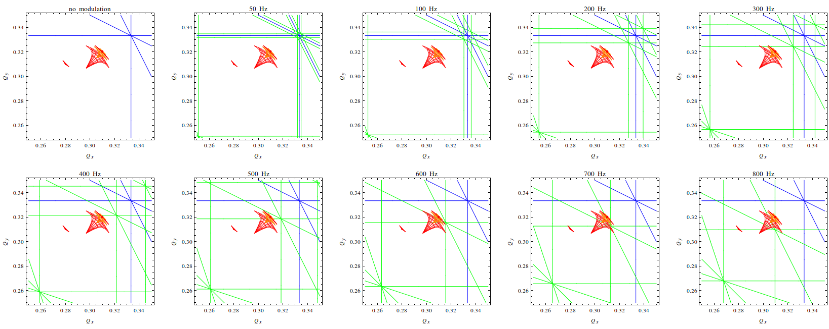
Tune footprints and resonance lines – all footprints, 5th order
Thanks to the beam-beam team for help and input!
R. Bruce, 2014.05.08
7
Notes:
7

Slide 8
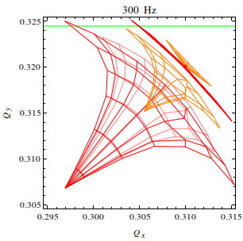
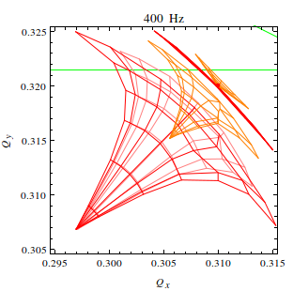
Tune footprints and resonance lines – all footprints, 5th order
Zoom on collision tunes – separated and colliding beams, 6.5 TeV, b*=55cm
No HO
HO IP1/5/8
HO IP8
HO IP1/5/8
LR IP1/5 one side only
R. Bruce, 2014.05.08
8
Notes:
8

Slide 9
Preliminary considerations on frequency
Different frequencies might be needed depending on where in the operational cycle we want to act
Depending on tune, which tune footprint we want to hit, and which resonance we want to use: big spread of possible frequencies... 50-800Hz
different bunches have different footprints depending on where they collide. Need to be careful... when hitting the halo in some bunches, we risk to hit the core in others!
R. Bruce, 2014.05.08
9
Notes:
9

Slide 10
Modulation depth
Previous guess (O. Bruning, H. Schmickler in 2013 collimation review): dQ of 1e-4 needed => with MQWB.5R7.B1, we would need about 0.6A
If we run out of strength: consider either using all MQWA, or using cold quadrupoles in arc. QPS to be verified
Starting more detailed simulation studies (SixTrack) to understand what modulation depth is needed (as well as the relative strengths of different resonance lines)
Frequency map analysis including realistic magnetic errors
R. Bruce, 2014.05.08
10
Notes:
10

Slide 11
Hardware constraints
If using warm IR7 trim quad: no hardware modifications needed
Max. frequency from power converter: 500 Hz, with 1A peak-to-peak. Measurements planned at CERN in week 21
Need to verify transfer function power converter → magnetic field inside the beam screen. High frequencies usually heavily damped by the magnet inductance and beam screen
S. Redaelli in contact with Marco Buzio – hoping to do measurements on surface using spare magnet during the year.
With all ingredients (hardware capabilities and expected behaviour from theoretical studies) our goal is to plan MDs to be carried out in the LHC in 2015
R. Bruce, 2014.05.08
11
Notes:
11

Slide 12
ADT excitation
Instead of modulating the tune with a quadrupole, we could use the transverse damper (electric field kicker) to make a narrow-band excitation
Again, rely on detuning with amplitude.
Simplest approach: Knowing the fractional tune of the halo Q_{h}, apply kick in resonance at frequency
More advanced ideas: colored noise
Hardware-wise, no modifications needed
Should do a theoretical feasibility study with SixTrack
Frequency map analysis
During 2014: plan MDs
R. Bruce, 2014.05.08
12
Notes:
12

Slide 13
Pros and cons (1)
Tune modulation affects both beams simultaneously
ADT can act on a single beam and plane, and even on single bunch
Could imagine having different excitations for different positions in the filling pattern, e.g. hit only bunches with head-on in IR1/5
Could allow for “witness bunches” which are not affected. Advantage for early detection of e.g. UFOs
R. Bruce, 2014.05.08
13
Notes:
13

Slide 14
Pros and cons (2)
Both ADT and tune modulation rely on a good knowledge of the tune and detuning with amplitude. Risk to hit the core if parameters are not carefully optimized
How well do we know the tune in the squeeze, and how well reproducible is it fill-to-fill?
Need convincing validation with beam at the LHC (in particular if these methods are needed continuously in Stable Beams)
R. Bruce, 2014.05.08
14
Notes:
14

Slide 15
Comparing with hollow e-lens
Hollow e-lens has the advantage of being completely independent on the tune. It extracts particles based only on amplitude
Robust against any changes in machine configuration, optics, filling pattern etc
The e-lens can not resolve single bunches, but it can act differently on different trains. Can have “witness trains”
Tune modulation and ADT rely on existing hardware – no major system changes needed.
Hollow e-lens cannot be available until after LS2
If we need halo excitation in the LHC before then, we have to rely on alternative methods
R. Bruce, 2014.05.08
15
Notes:
15

Slide 16
Proposed strategy
All options should be studied
Immediate goal: coordinate effort and compare results with Fermilab colleagues
Based on theoretical studies and hardware capabilities, we should plan MDs on tune modulation and ADT excitation that can be carried out in the LHC in 2015
Aiming at a quantitative feasibility assessment of halo depletion through tune ripple and ADT excitation during Run 2
In parallel, continue work on development of hollow electron lens
R. Bruce, 2014.05.08
16
Notes:
16

Slide 17
Backup
R. Bruce, 2014.05.08
17
Notes:
17

Slide 18
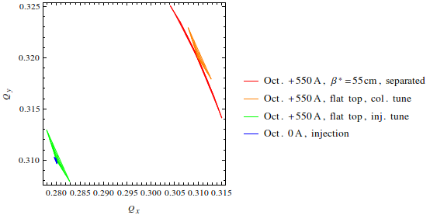
Tune footprints with separated beams
separated beams, 0.45-6.5 TeV, 25 ns, exn=3.75um
Thanks to X. Buffat and beam-beam team for help and input!
R. Bruce, 2014.05.08
18
Notes:
18

Slide 19
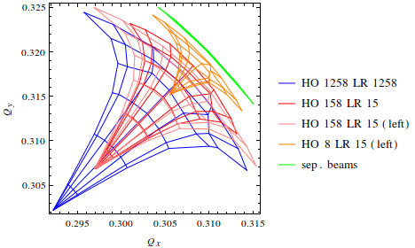
Tune footprints with colliding beams
separated and colliding beams, collision tune, 6.5 TeV, b*=55cm, 142.5 urad, 25 ns, exn=3.75um
R. Bruce, 2014.05.08
19
Notes:
19

Slide 20
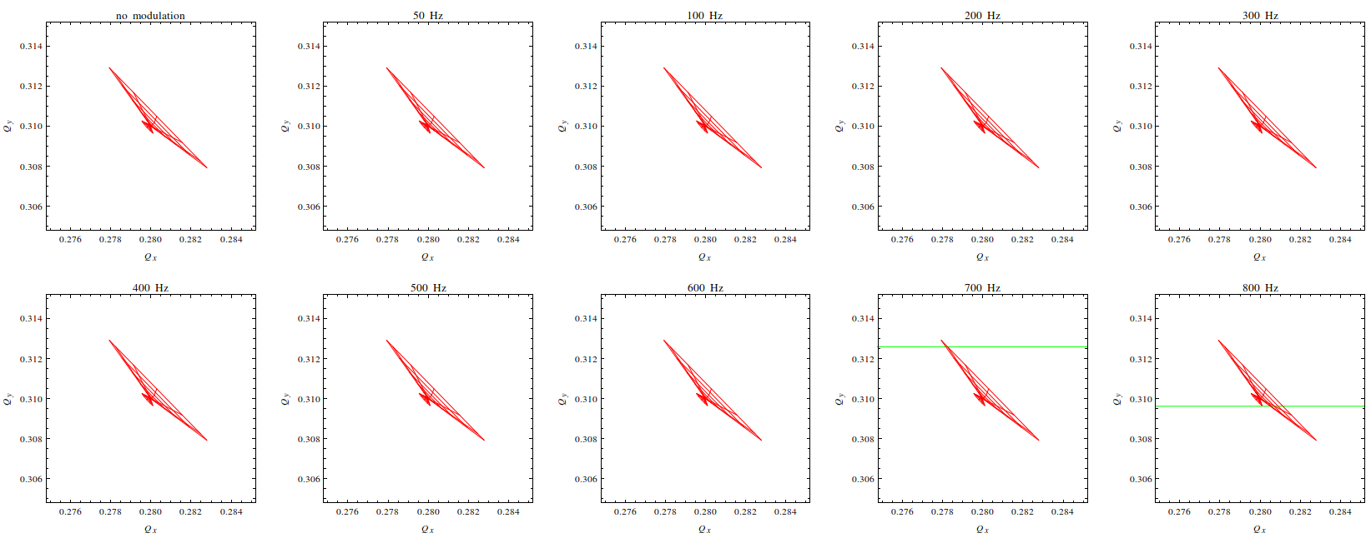
Tune footprints and resonance lines – all footprints, 5th order
Zoom on injection tunes at 450GeV and 6.5 TeV
R. Bruce, 2014.05.08
20
Notes:
20

Slide 21
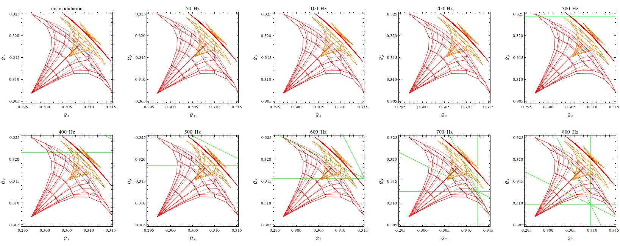
Tune footprints and resonance lines – all footprints, 5th order
Zoom on collision tunes – separated and colliding beams, 6.5 TeV, b*=55cm
R. Bruce, 2014.05.08
21
Notes:
21

Slide 22
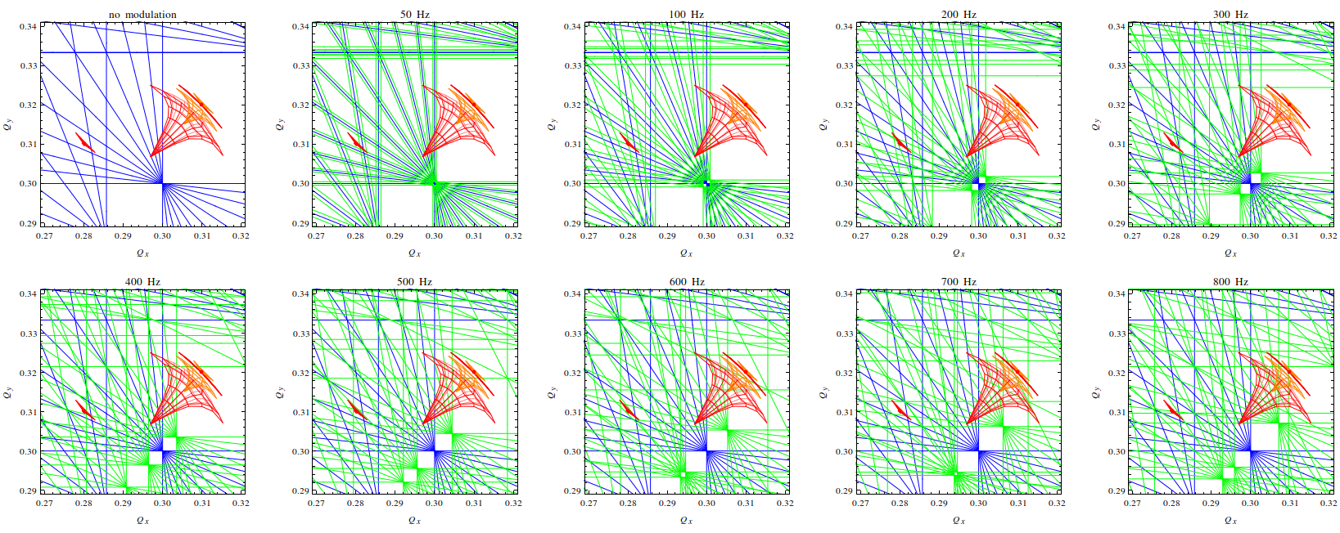
Tune footprints and resonance lines – all footprints, 10th order
R. Bruce, 2014.03.31
22

