Slide 1


The application and R&D of superconducting RF cavities
β=1 and β=0.1
Pei Zhang
(BE-RF, CERN)
LARP/HiLumi Collaboration Meeting
May 7th, 2014

Slide 2
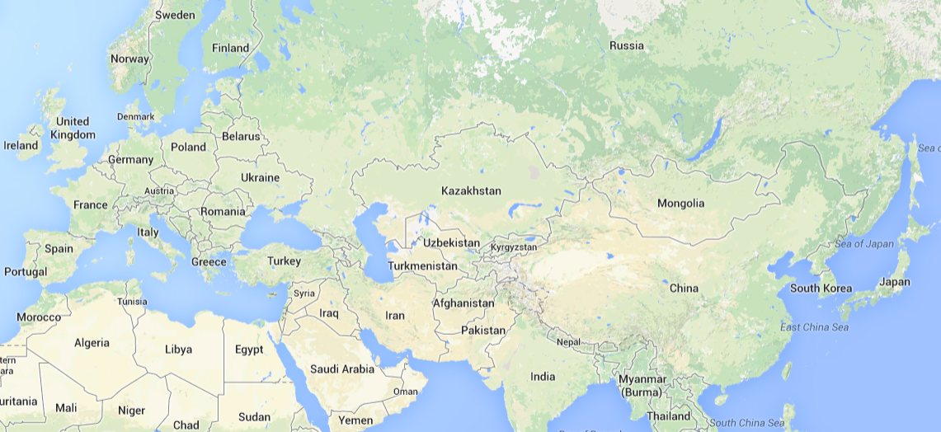




About me (HEP)
2002 – 2006 B.Sc. in Applied Physics (Uni. of Sci. & Tech. of China)
2006 – 2007 Visiting Scholar (Uni. Michigan/CERN)
2006 – 2009 M.Sc. In Particle Physics (Uni. of Sci. & Tech. of China)
Pei Zhang
Page 2

Slide 3
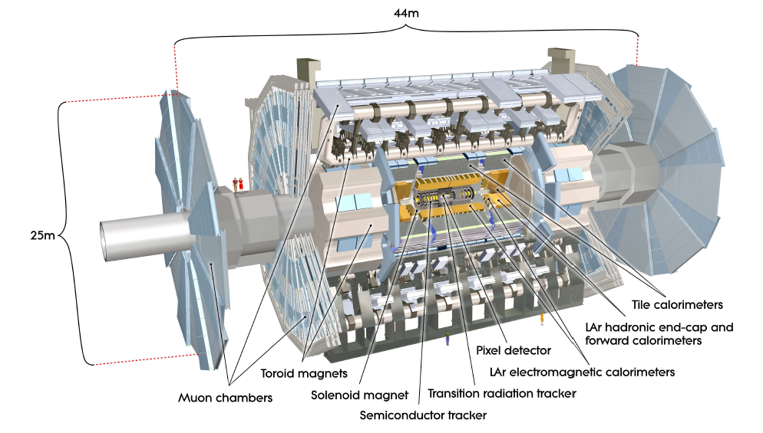
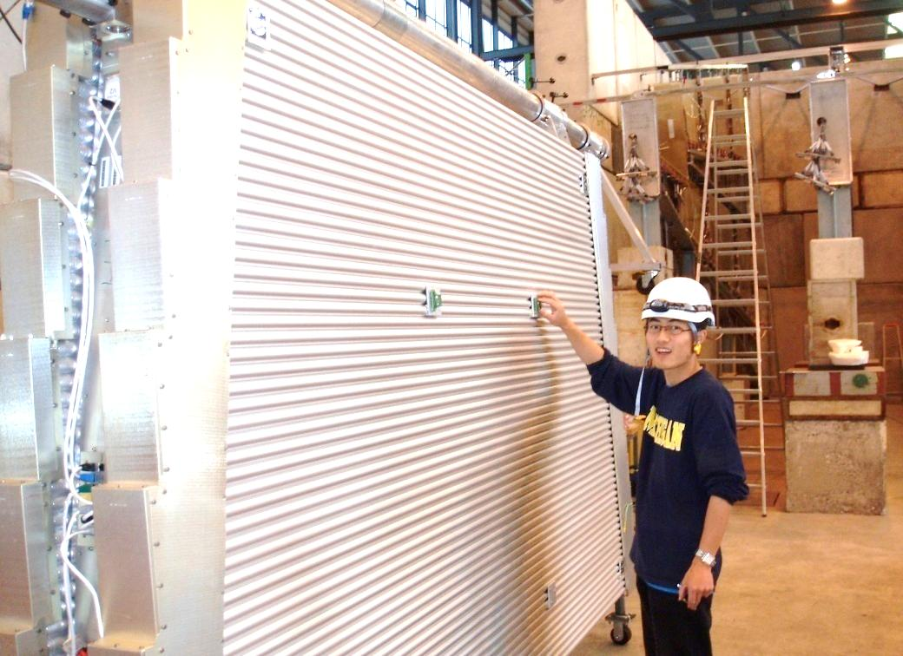
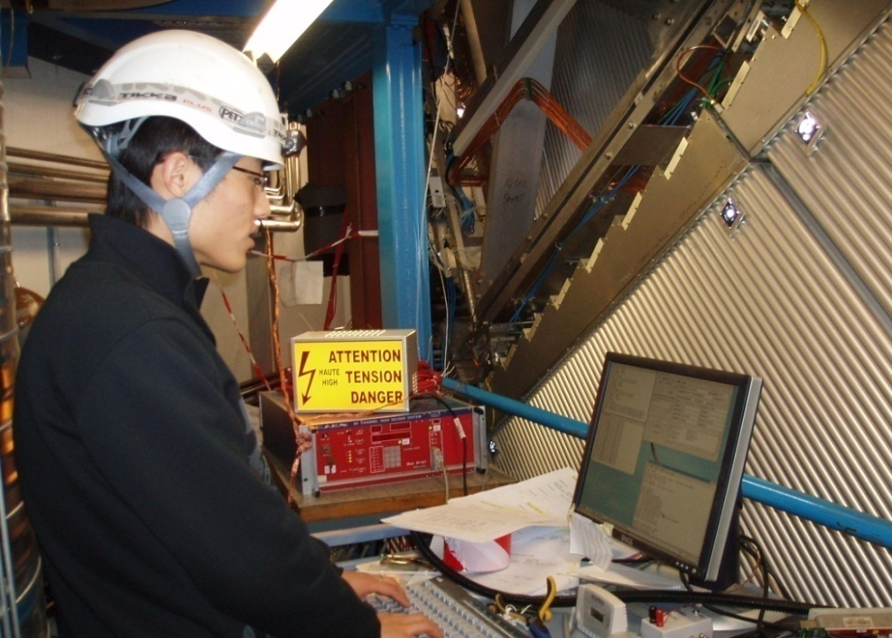
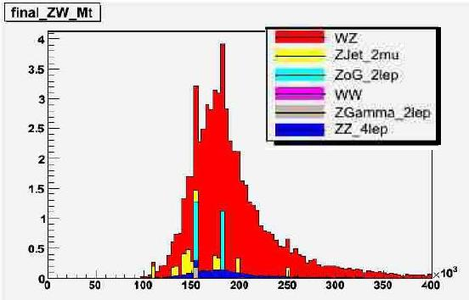
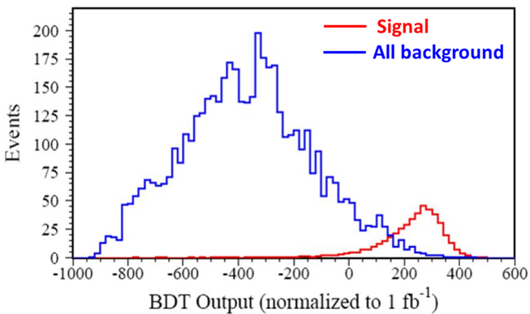
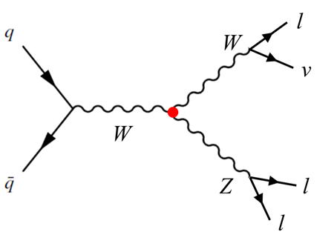
My activities in HEP
Commissioning of the muon chambers
Diboson WZ analysis
- contributed to 2 articles and 1 note
- included in the “Database of China’s
Outstanding Master’s Degree Thesis”
[1] ATLAS collaboration, ATL-COM-PHYS-2009-103.
[2] ATLAS collaboration, Nucl. Phys. B-P.S., 177-178 (2008) pp. 255-257.
[3] ATLAS collaboration, Balkan Phys. Lett. 17 (2009) pp.102-107.
Pei Zhang
Page 3

Slide 4
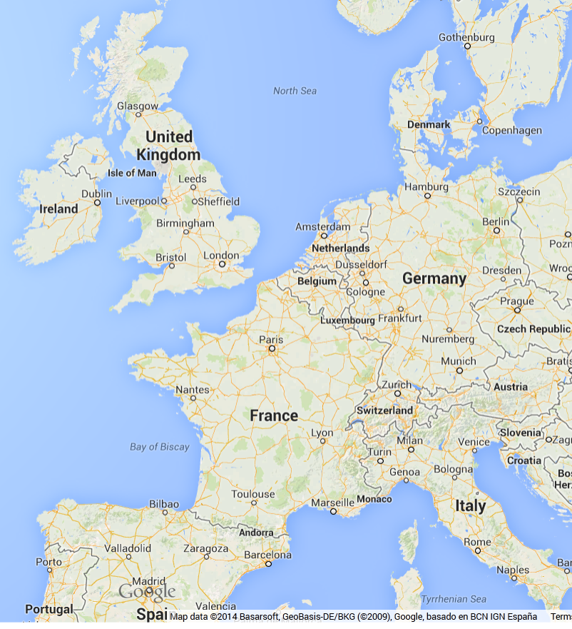



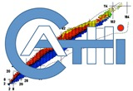


About me (Accelerator Physics)
2010 – 2012 Ph.D. in Accelerator Physics (Uni. Manchester/DESY)
2013 – now Marie-Curie fellow (CERN)
Pei Zhang
Page 4

Slide 5
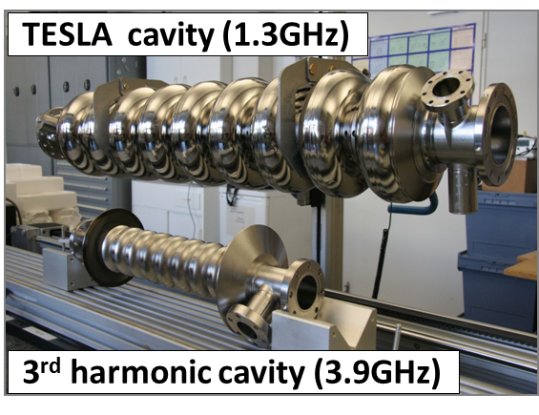
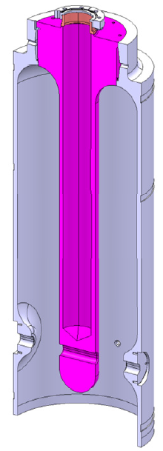
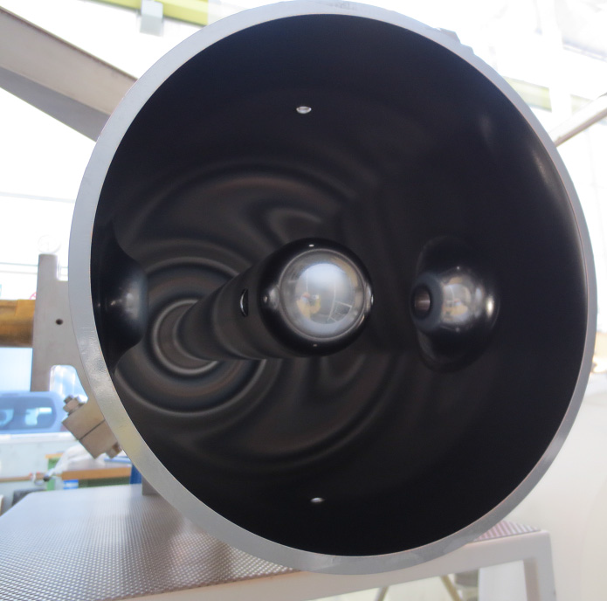
My activities in accelerator physics
β=1
Higher Order Mode
Beam Position Monitor
(HOM-BPM)
β=0.1
Frequency tuning
RF cold test analysis
Multipacting study
Pei Zhang
Page 5

Slide 6
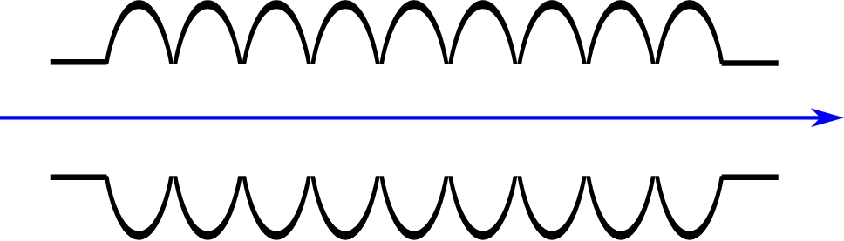
HOM-BPM
β = 1

Slide 7
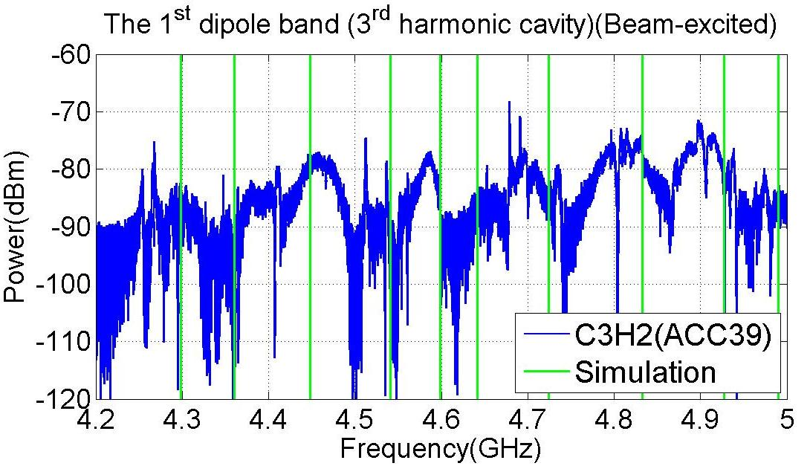
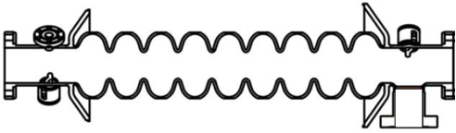
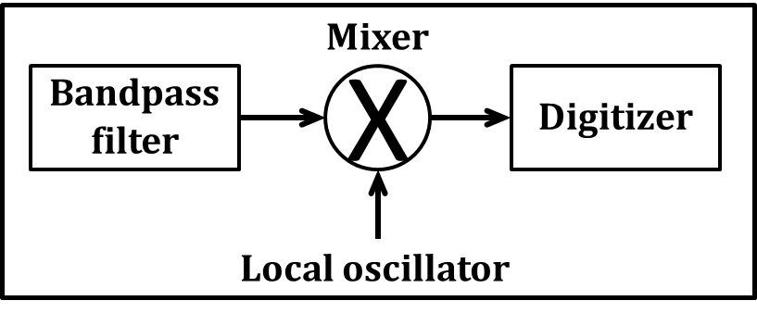
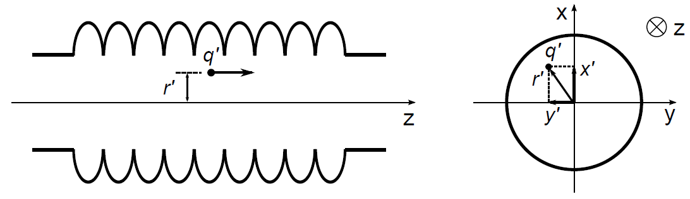

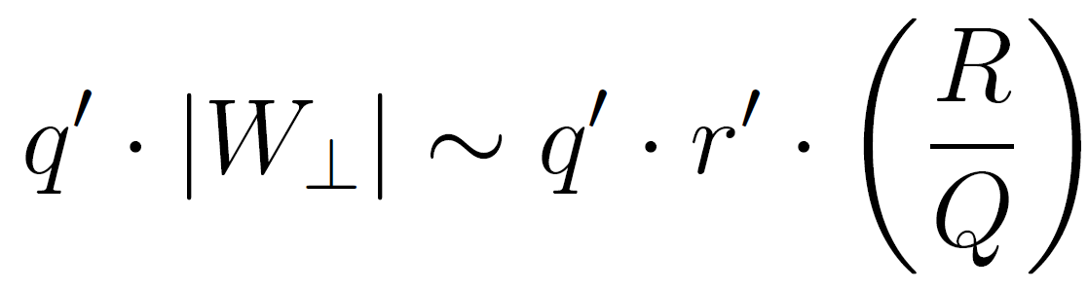
Basic Principle of HOM-BPM
HOM couplers
Electronics
Beam
A bunch pass through a cavity excites higher order modes (HOMs)
Install HOM couplers to extract HOMs
Dipole modes have linear dependence on the beam offset r’
Signal from HOM coupler ~
Bunch charge
Beam offset
Pei Zhang
Page 7

Slide 8
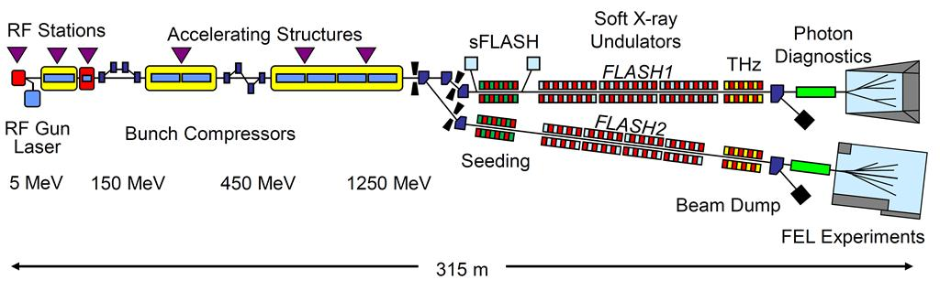
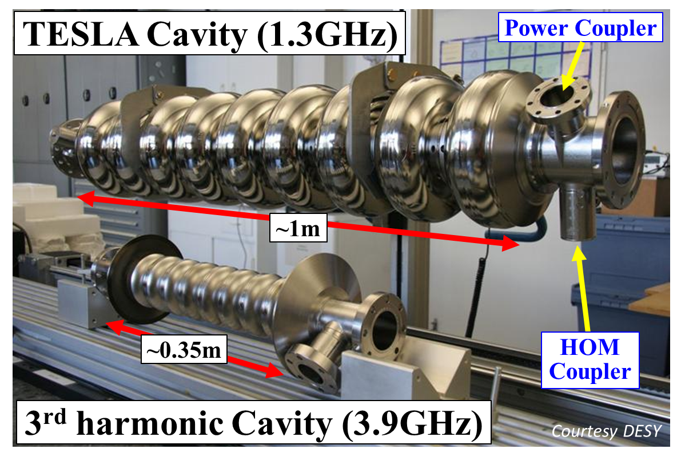
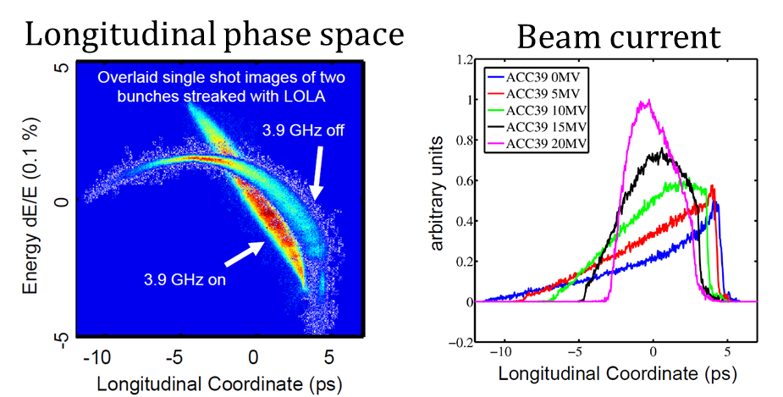
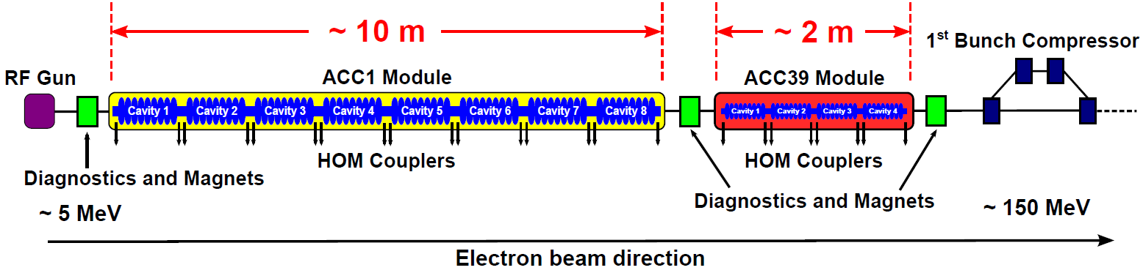
Third Harmonic 3.9GHz SC Cavities
Pei Zhang
Page 8

Slide 9
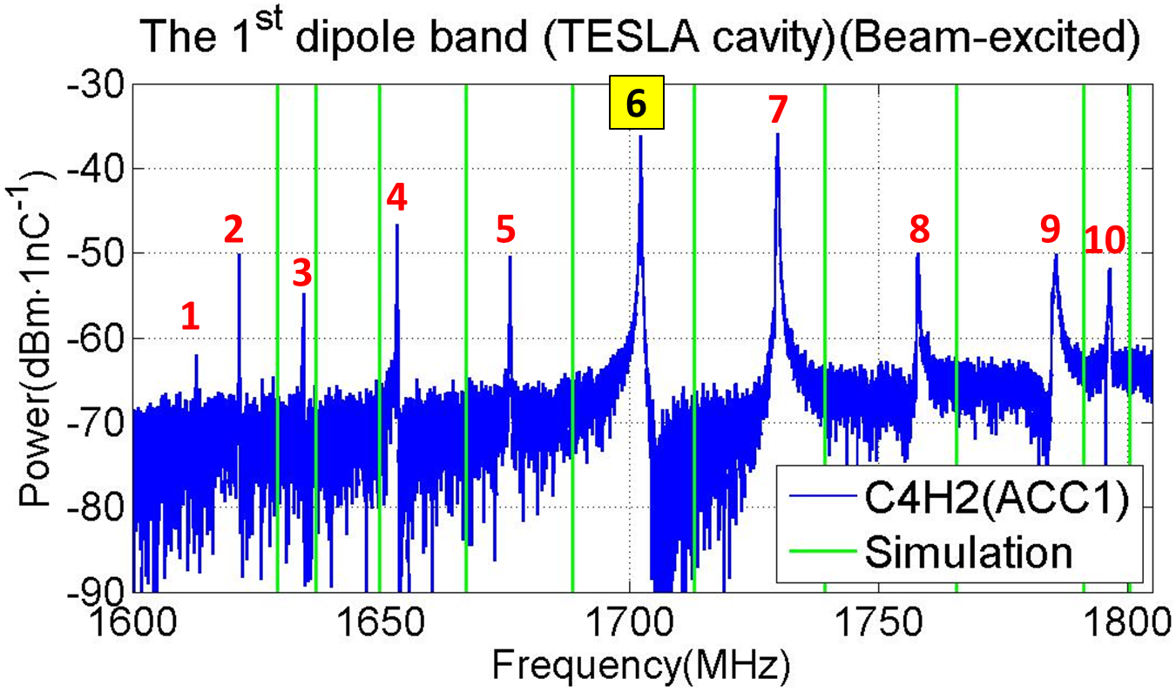


Challenges
3.9GHz cavities
Multi-cavity modes
Cavity type | Cutoff freq.
TESLA 1.3GHz cavity | 2.25 GHz
3rd harm. 3.9GHz cavity | 4.39 GHz*
*Even lower in practice
Pei Zhang
Page 9

Slide 10
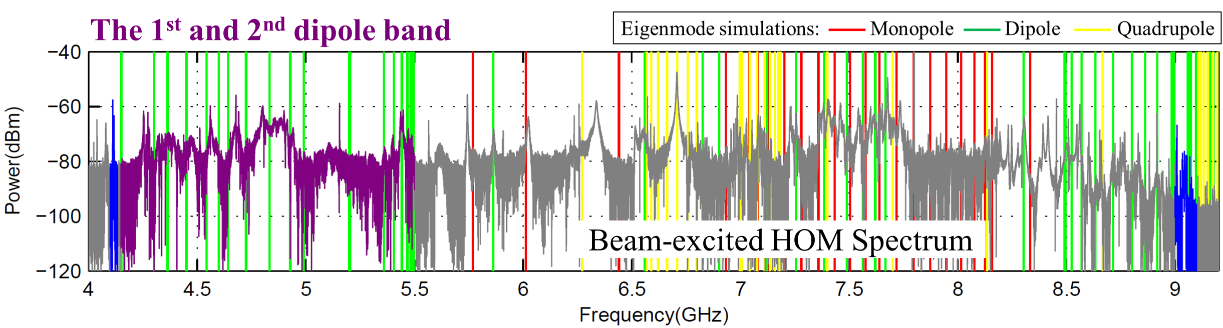
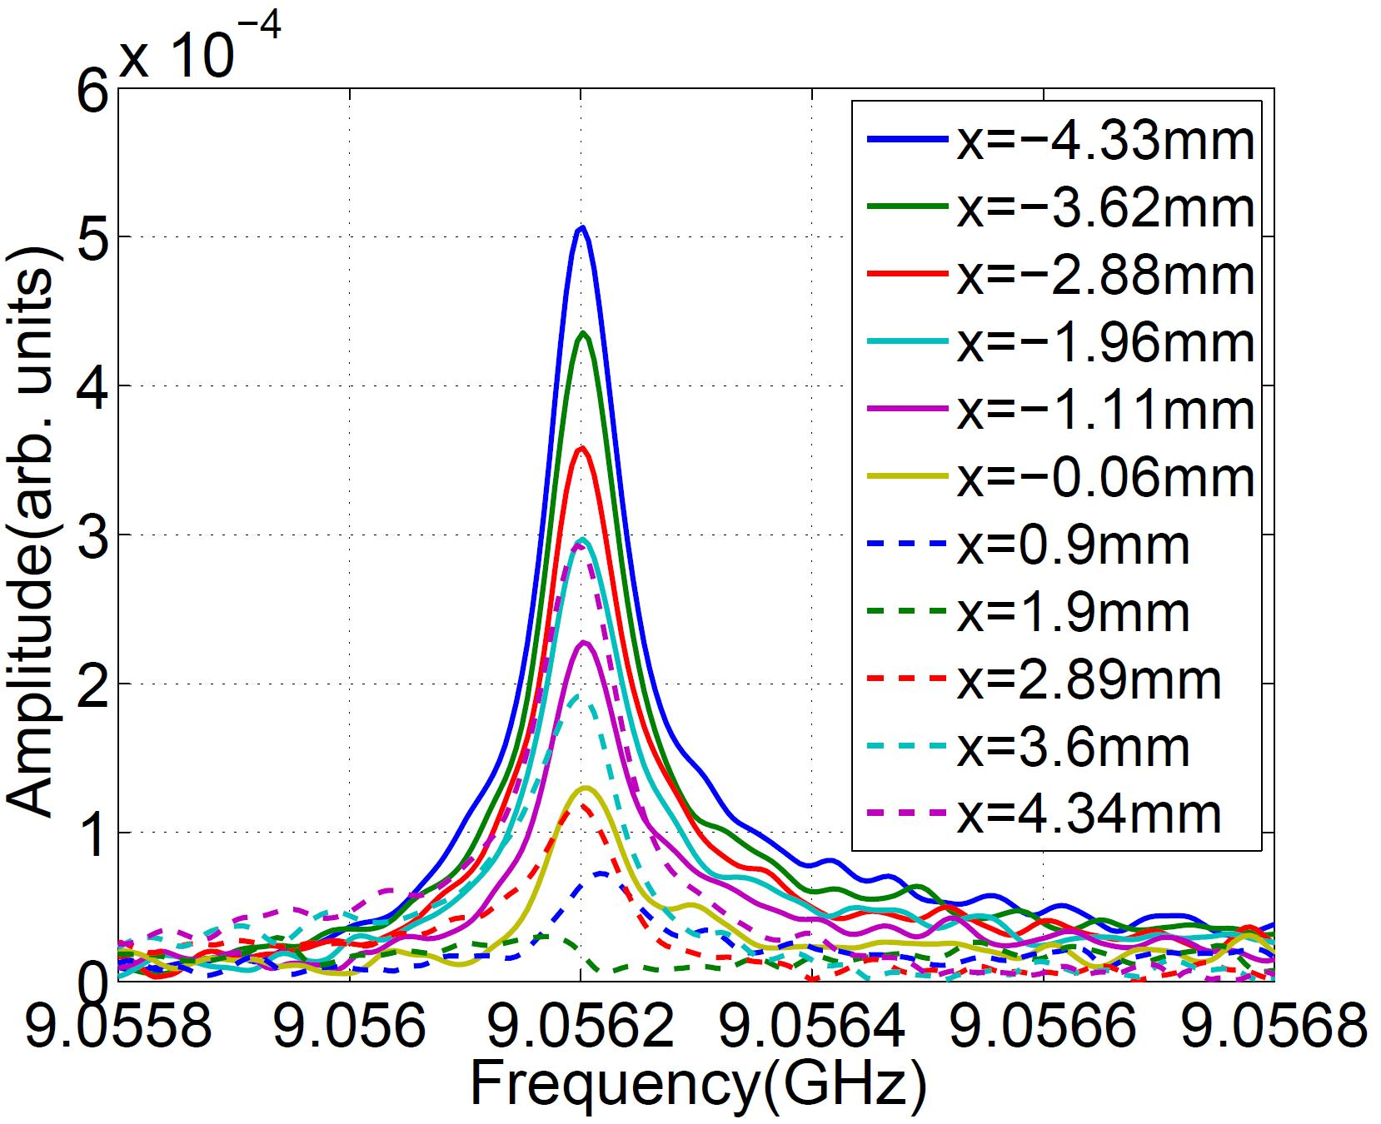
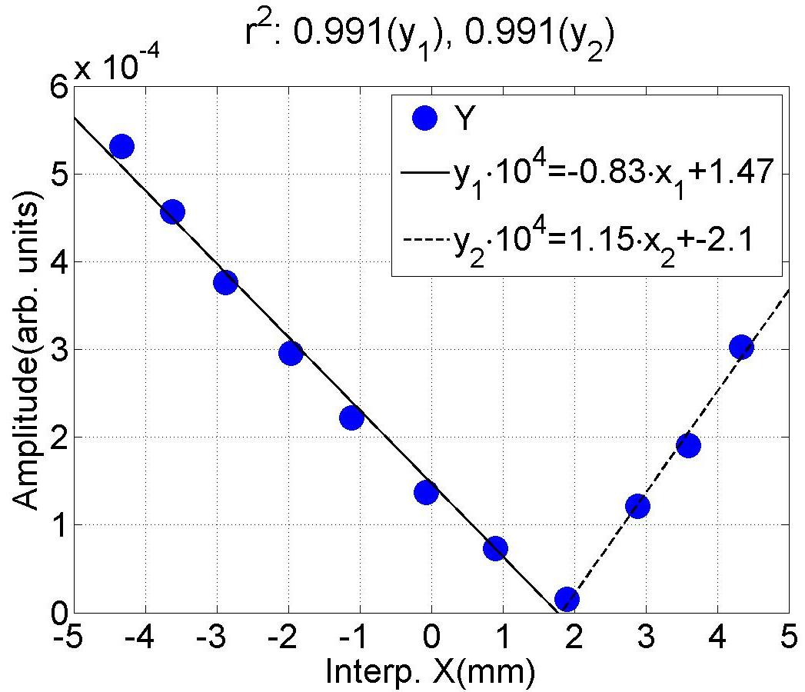
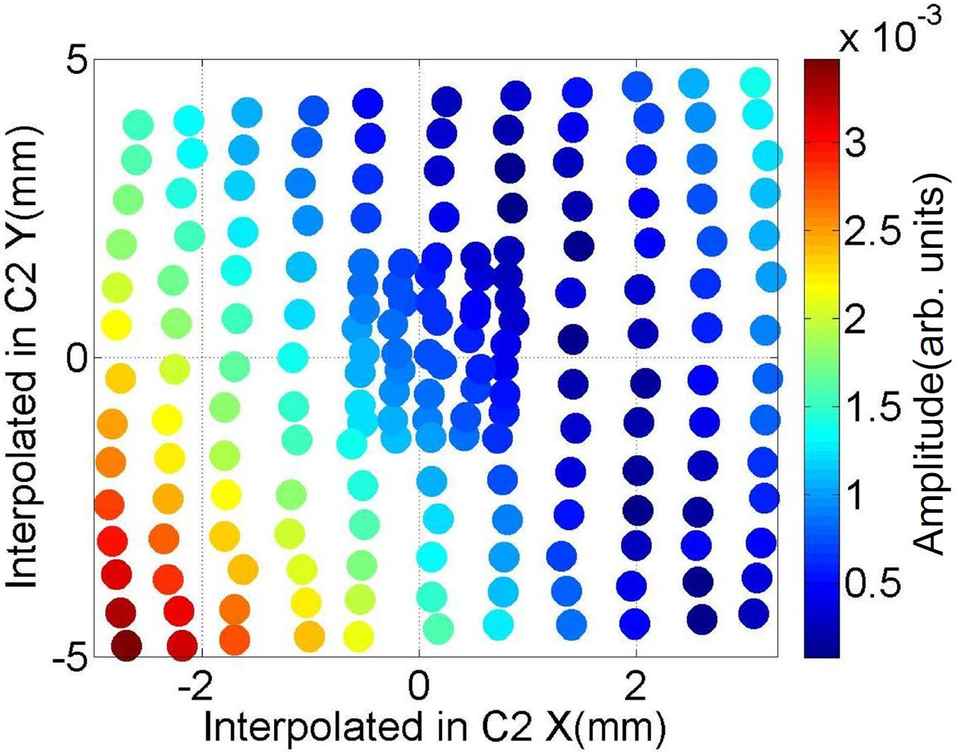
Dipole-like behavior
Strongly coupled cavity system → multi-cavity modes
Localized modes are in upper frequency band with small R/Q
P. Zhang et al., Rev. Sci. Instrum. 83, 085117 (2012)
Pei Zhang
Page 10

Slide 11
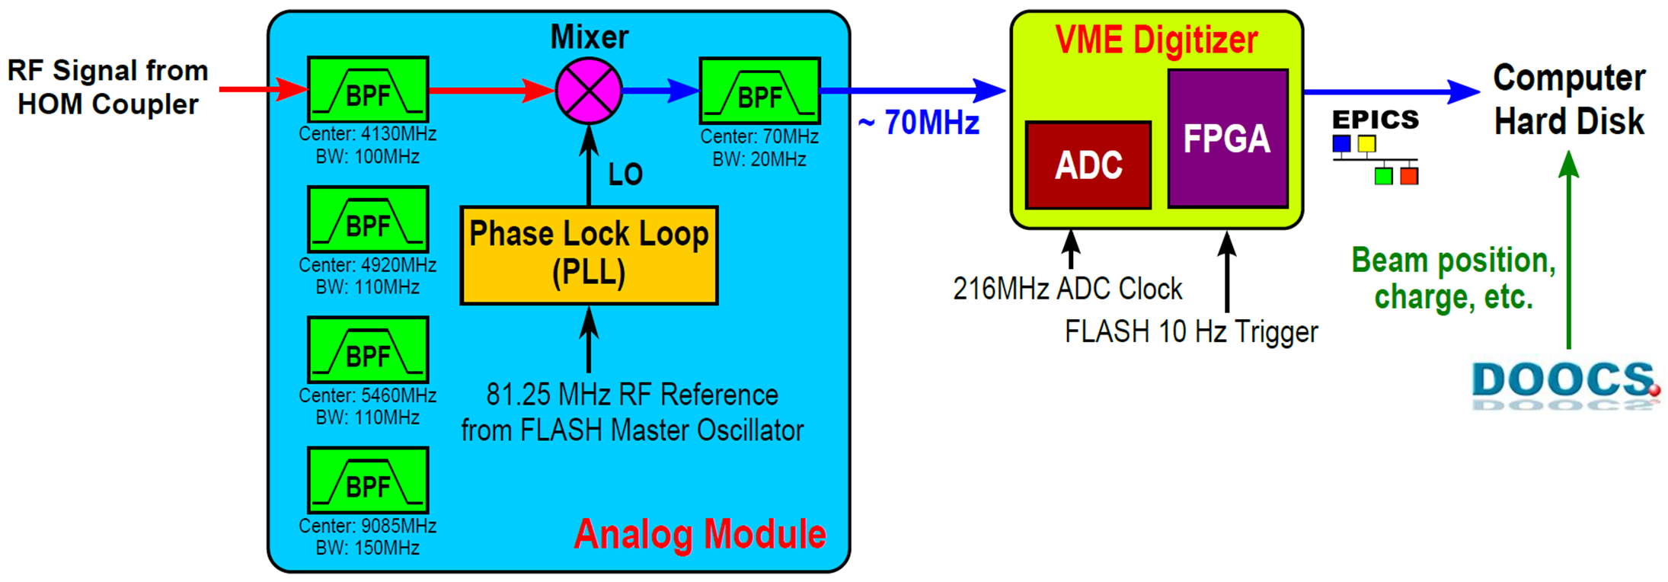
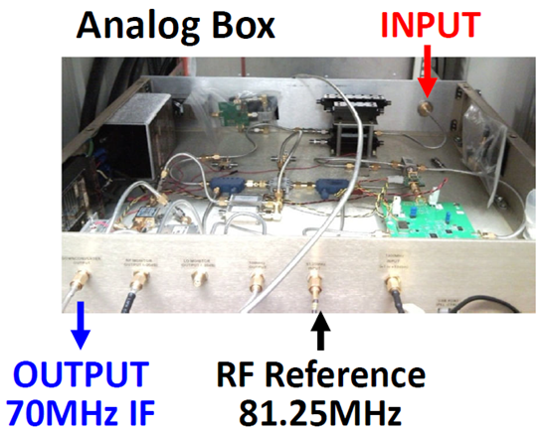

Performance of the test electronics
Position type | Resolution | # of channels to be installed
Local position in the cavity | ~ 50 μm | 6 HOM couplers
Global position over the module | ~ 20 μm | 2 HOM couplers
Fundamental limitation is thermal noise: ~200nm (including cable loss)
Pei Zhang
Page 11

Slide 12
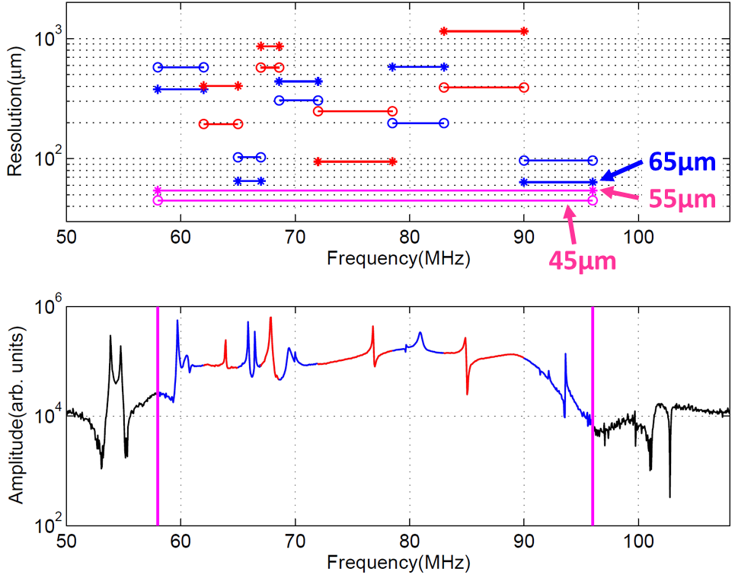
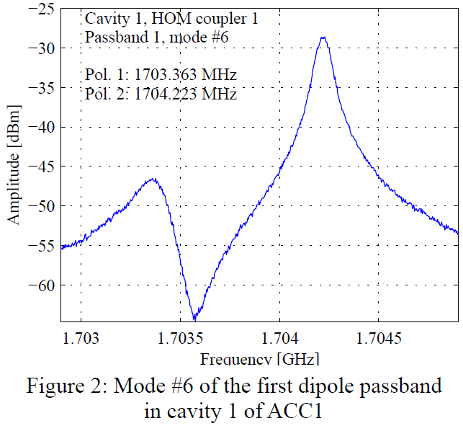
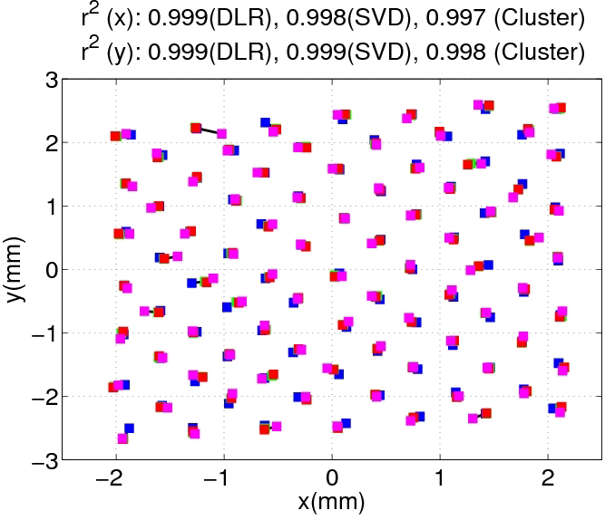
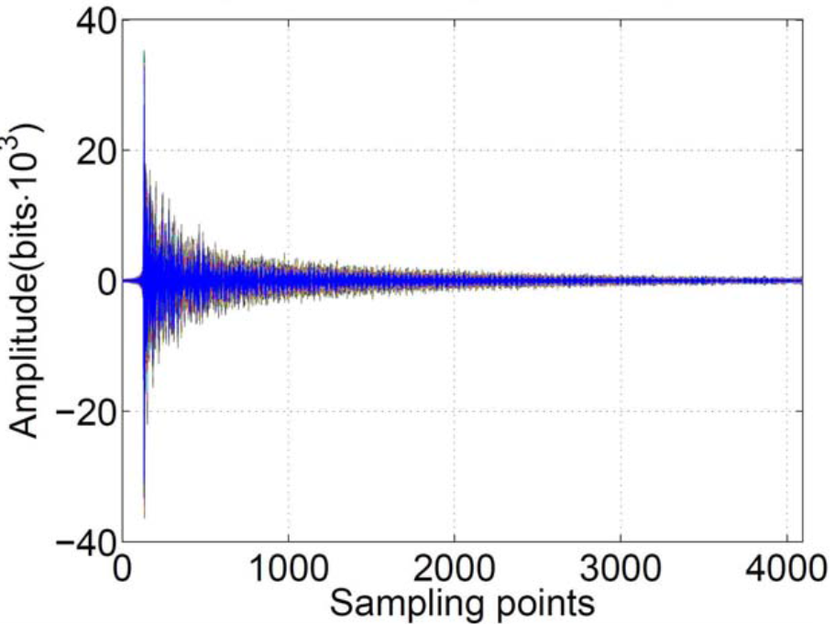
Highlights of HOM-BPM
1 mode → N modes
Challenge → Benefit
P. Zhang et al., 2012 JINST 7 P11016
Direct linear regression
Singular value decomposition
k-means clustering
P. Zhang et al., J.NIM-A 734, 84-94 (2014)
Pei Zhang
Page 12

Slide 13
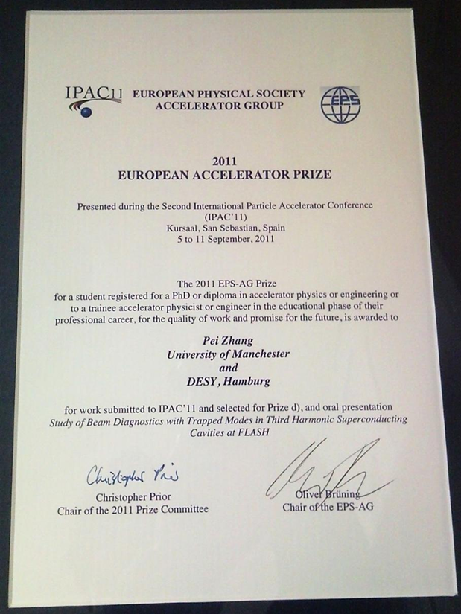
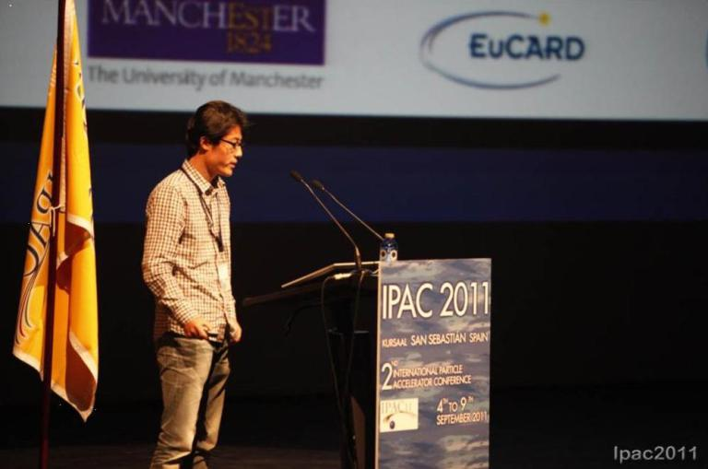
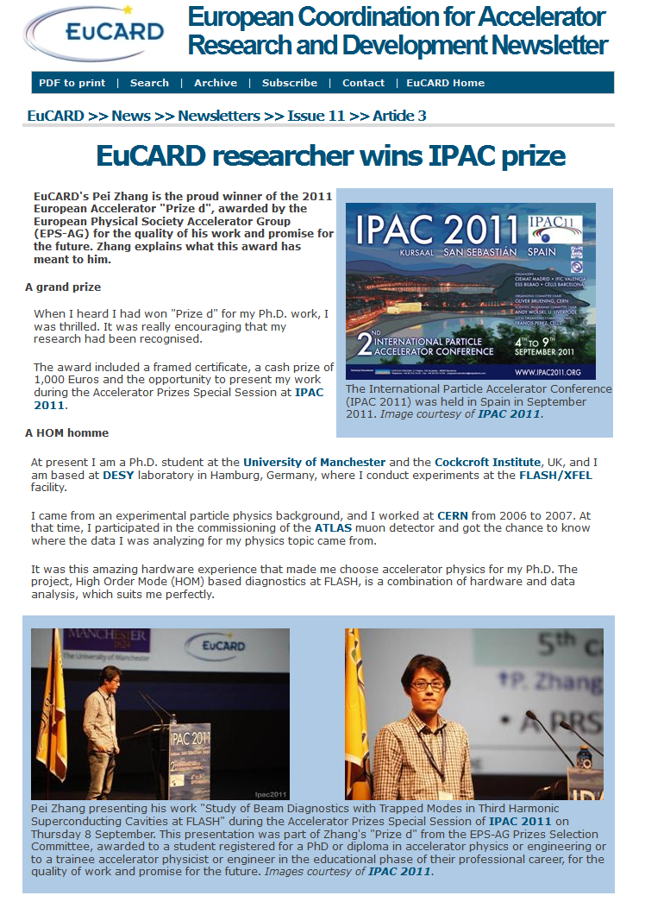
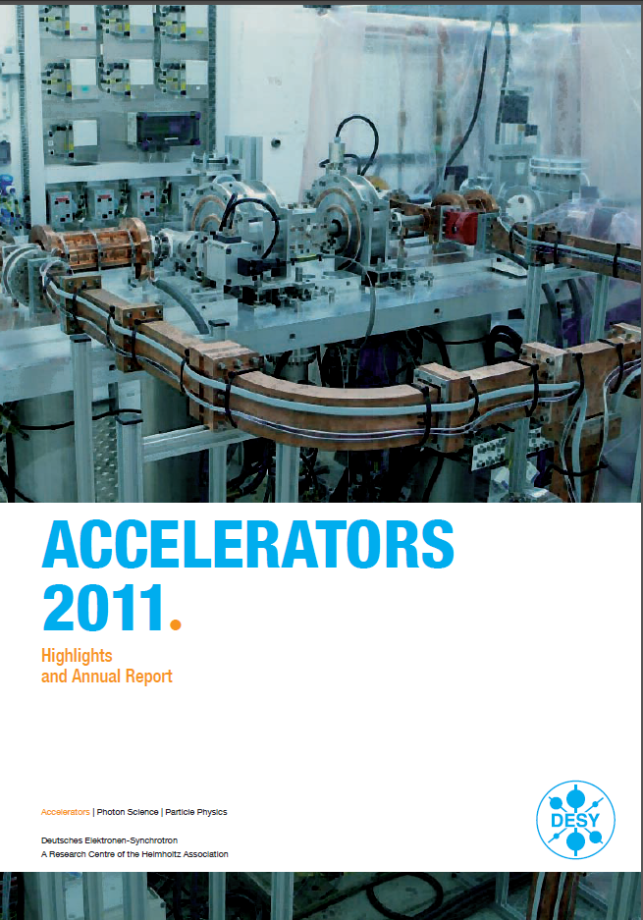
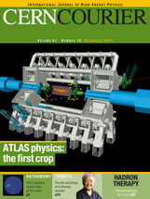
Impact in 2011
2011 EPS-AG Accelerator Prize
My first interview
Highlights
December 2011
Pei Zhang
Page 13

Slide 14
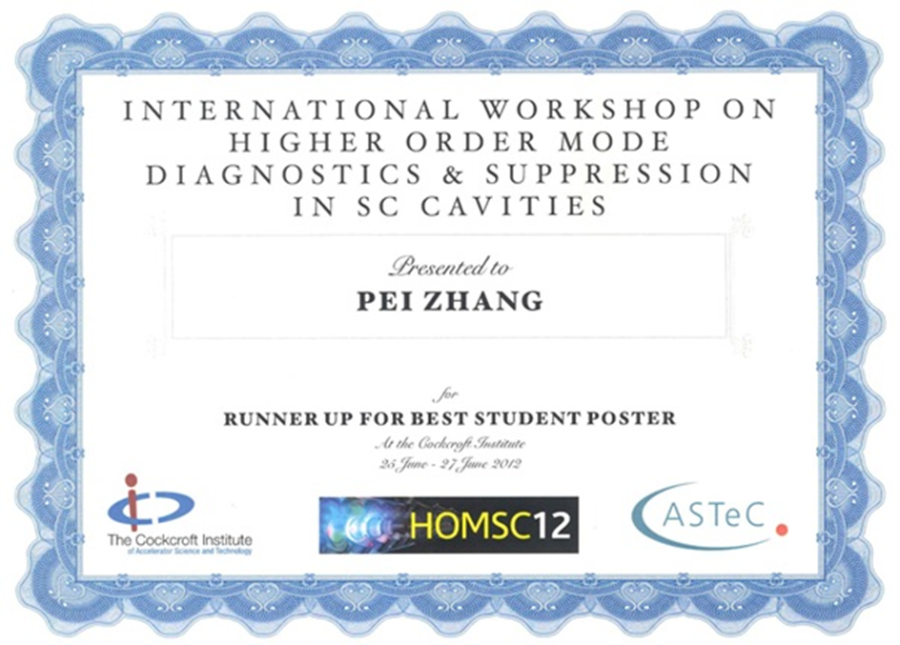
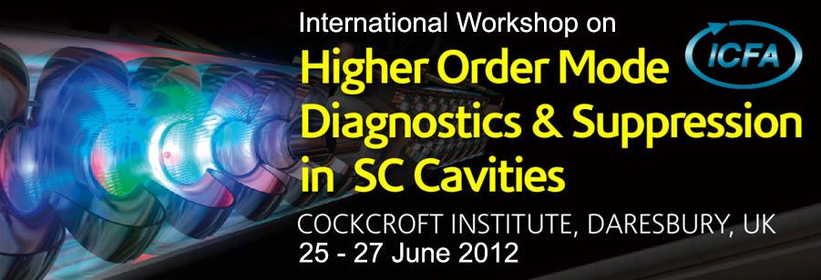
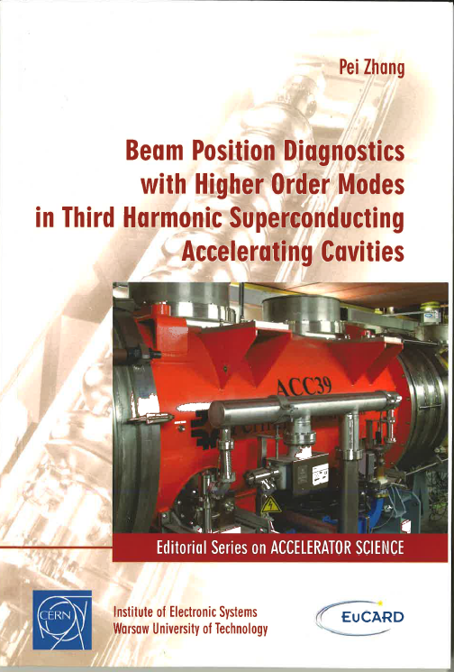
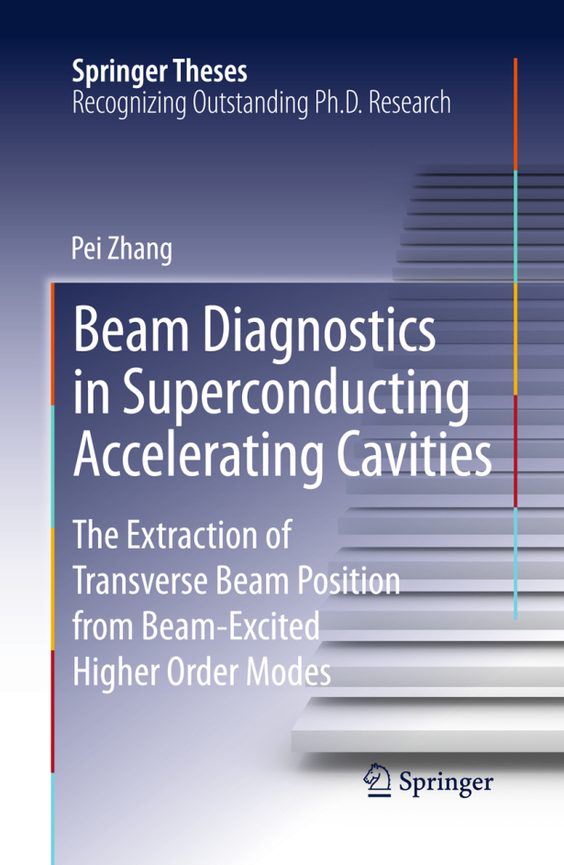

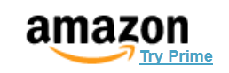
Impact in 2012
Invited plenary talk on
[1] P. Zhang et al., Rev. Sci. Instrum. 83, 085117 (2012)
[2] P. Zhang et al., 2012 JINST 7 P11016
[3] P. Zhang et al., J.NIM-A 734, pp. 84-94 (2014)
EuCARD monograph
Available on
Pei Zhang
Page 14

Slide 15
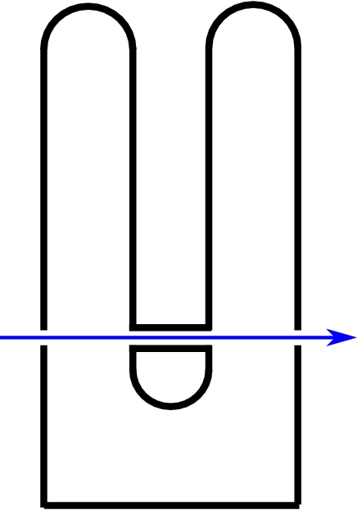
Quarter-wave Resonator
Frequency tuning
Analysis of RF cold test results
Multipacting study
β = 0.1

Slide 16
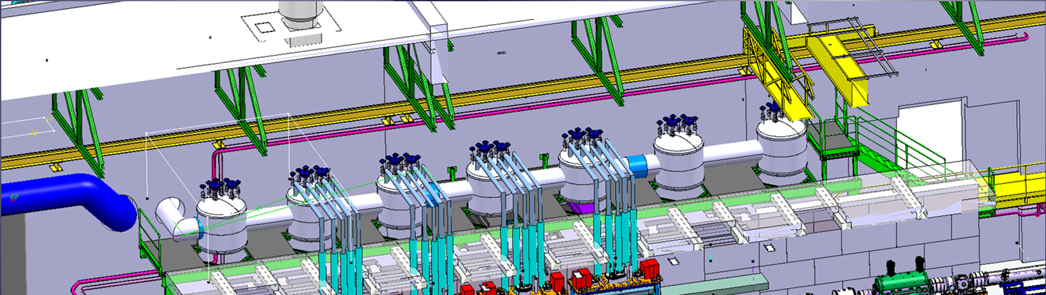
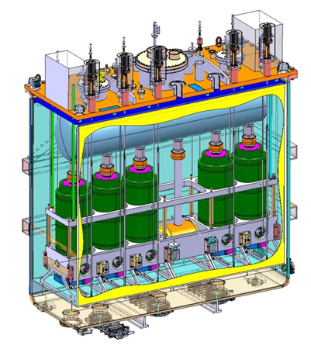
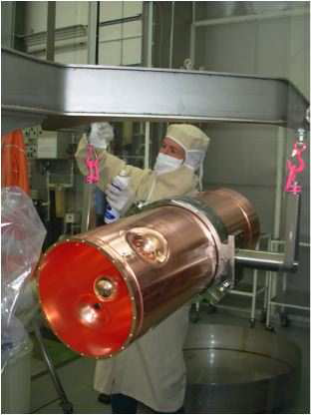
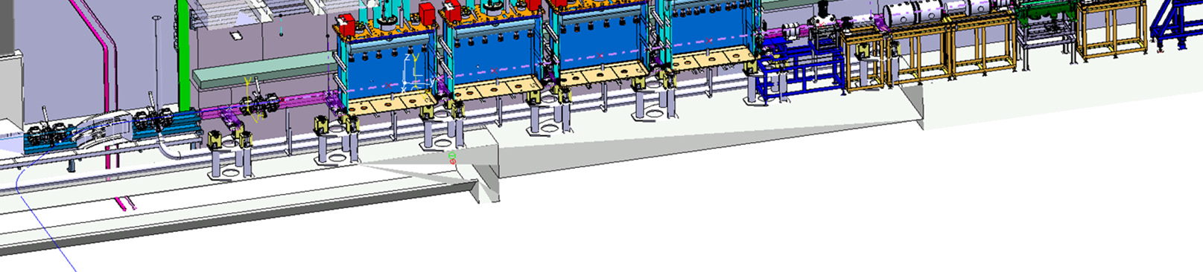
HIE-ISOLDE & QWR
Boost the radioactive beam energy from 3MeV/u to 10MeV/u by using SC linac.
SC quarter-wave resonator
Nb sputtered on Cu substrate
Pei Zhang
Page 16

Slide 17
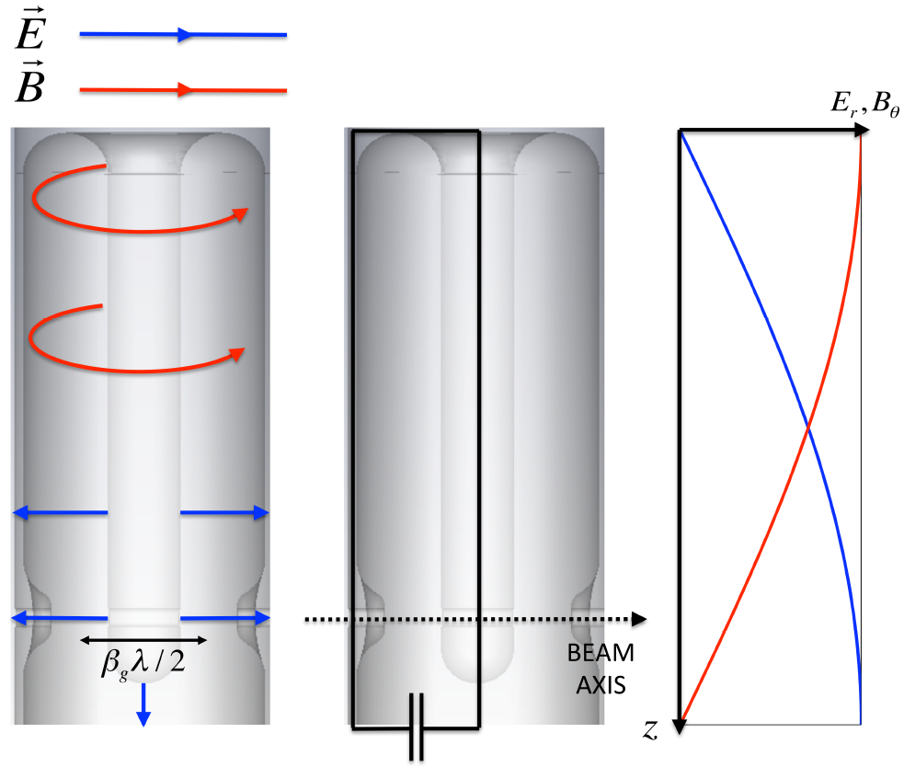
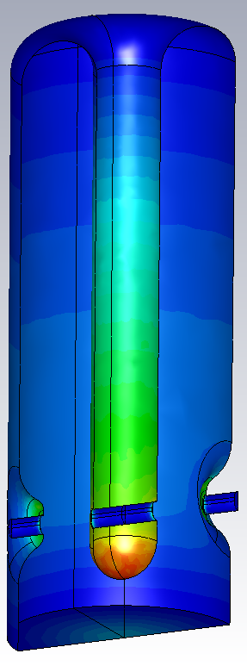


High-β QWR
|E| field
|H| field
Frequency | 101.28 MHz
E_{acc} | 6 MV/m
β_{optimum} | 10.9%
R/Q | 553 Ω
E_{peak}/E_{acc} | 5.0
B_{peak}/E_{acc} | 95.6 G/(MV/m)
G=R_{s}Q | 30.7 Ω
U/E_{acc}² | 0.207 J/(MV/m)²
P_{c} at 6MV/m | 10W
Courtesy M. Fraser
Pei Zhang
Page 17

Slide 18



Procedures
Responsible
Heavily involved
Taking more resp.
Frequency tuning
RF support
Nb coating
RF cold test
Pei Zhang
Page 18

Slide 19





Frequency tuning
Frequency pre-tuning at warm
Simplified tuning plate (€ reduction)
Lower Epeak & lower loss on the plate
0.3Hz/step
Pei Zhang
Page 19

Slide 20








The analysis of RF cold test results
Thermal gradient: ΔT = T2 – T1
Surface resistance
QP3.1 QP1.5
Pei Zhang
Page 20

Slide 21


Multipacting
Multipacting at ~1.5MV/m and lower field for almost every cavity
MP can be conditioned away
RF cold measurements
Nb 300 ̊ bakeout
SEY > 1: 80-2000eV
Pei Zhang
Page 21

Slide 22















MP by CST Particle Studio
1RF
2RF
5RF
10RF
Two MP barriers found
- Eacc ~ 1.2MV/m @ cavity top
- Eacc ~ 0.05MV/m @ cavity body
Pei Zhang
Page 22

Slide 23







MP by SLAC ACE3P suite
Two MP barriers found
- Eacc ~ 1.4MV/m @ cavity top
- Eacc ~ 0.05MV/m @ cavity body
Pei Zhang
Page 23

Slide 24
Summary
HOM-BPM
A tool comes for “free”, no interference to beam, no insertion in the linac
All you need: HOM coupler + electronics
Position resolution: 20-50µm in 3.9GHz cavities
β = 1
Quarter-wave resonator
Frequency tuning strategy established and tested
Thermal gradient has an impact on QWR performance
Multipacting study by two codes consistent with RF measurements
β = 0.1
Pei Zhang
Page 24

Slide 25
Some references
3.9GHz HOM-BPM
[1] P. Zhang, et al., “A study of beam position diagnostics …”, Rev. Sci. Instrum. 83, 085117 (2012).
[2] P. Zhang, et al., “Resolution study of higher-order-mode-based …”, 2012 JINST 7 P11016.
[3] P. Zhang, et al., “Statistical methods for transverse beam …”, J.NIM-A 734, 84-94 (2014).
[4] P. Zhang, PhD thesis, https://www.escholar.manchester.ac.uk/jrul/item/?pid=uk-ac-man-scw:185167
[5] P. Zhang, et al., “Status of Higher Order Mode Beam Position …”, IPAC2013, MOPWA055.
High-beta QWR
[1] P. Zhang, et al., “The Tuning System for the HIE-ISOLDE …”, SRF2013, THP084.
[2] P. Zhang, et al., “The Impact of Defects on Q0 for …”, HIE-ISOLDE note, to be published.
[3] P. Zhang, et al., “Frequency Sensitivity to Cavity Geometry …”, HIE-ISOLDE note, to be published.
Pei Zhang
Page 25

Slide 26
If I were a fellow, …
Beam diagnostics with higher-order-modes
Beam position measurement
- direct measurements of transverse beam position in cavities/module
- beam + cavity with HOM coupler/pickup + dedicated electronics
Beam phase measurement
- comparing beam-excited higher-order monopole mode with cavity RF
- direct measurement of relative beam phase to the RF in cavities
- proof-of-principle demonstrated at DESY, now EuCARD2 sub-task for TESLA 1.3GHz cavity for FLASH/XFEL
Beam alignment
- align the beam by simply minimizing HOMs with large R/Q’s
- Measure cavity mis-alignment in the cryo-module by mode electric center
Experiences gained, possible collaboration with FNAL (N. Eddy) and DESY (N. Baboi)
Pei Zhang
Page 26

Slide 27
If I were a fellow, …
Simulation skills
Eigenmode simulations
- CST Microwave Studio, Ansoft HFSS, SLAC Omega3p
Multipacting simulations
- CST Particle Studio, SLAC ACE3P (Omega3p and Track3p)
Cavity RF simulations
Multipacting study of the cavity and couplers
Advanced data analysis methods
- Direct linear regression (gradient descent)
- Singular value decomposition (SVD)
- k-means Clustering
- Decision Tree and regression tree
Beam orbit correction, beam instability study
Pei Zhang
Page 27

Slide 28
Backup: Challenges
Multi-cavity modes
Cavity type | Cutoff freq.
TESLA 1.3GHz cavity | 2.25 GHz
3rd harm. 3.9GHz cavity | 4.39 GHz*
*Even lower in practice
Pei Zhang
Page 28

Slide 29

Backup: Error Estimation
Thermal noise
Theoretical resolution
20dB cable loss
1 nm
200 nm
Mode energy
26dB attenuation in electronics
RMS error: ~ 20 μm
Charge normalization
@1mm offset
Resolution in a global sense
6 μm
Use Monopole
RMS
BPM resolution
10 μm
3 BPM method
LO phase noise
??
Different definition of resolution
Ref: P. Zhang et al., DESY Report: 12-143, 2012.
Pei Zhang
Page 29

Slide 30


Backup: Phase Measurement
The 2nd monopole band
Proof-of-principle
Mode phase
Two HOM couplers
Beam arrival time
RF 1.3GHz phase
Compare with
Compare
Beam phase relative to RF phase
Advantages:
Same cable and same electronics for measuring RF and beam phase
HOM couplers already exist
Signal is always present for monitoring
5 degree phase shift
Precision: 0.08 degree
S. Molloy et al., Phys. Rev. ST-AB 9, 112802 (2006)
Pei Zhang
Page 30

