Slide 1
US Magnet Deliverable Options
Ruben Carcagno
May 8, 2014

Slide 2
Why Deliverable Options?
The US magnet contribution is for Q1 and Q3 in two IRs (ATLAS and CMS)
Included: Cold masses for 10 magnets (including spares).
Each magnet requires two cold mass structures (MQXF), for a total of 20 structures
Excluded: Q1 and Q3 cryostat (CERN’s scope)
Project Constraints:
Schedule (dictated by CERN)
Q1 and Q3 ready to install in the tunnel by CERN’s Long Shutdown 3 (LS3) scheduled for 2023-2025
Budget (dictated by DOE)
Scope is the only project variable
The budget is still uncertain → need scope options
P5 report will be made public late May 2014 with a budget recommendation
P5: Particle Physics Project Prioritization Panel
Subpanel of the High Energy Physics Advisory Panel (HEPAP)
Serves the DOE’s Office of High Energy Physics and the National Science Foundation
Project must be prepared to deal with budget uncertainty and changes
A firm technical baseline to match DOE budget guideline and schedule must be ready prior to DOE Critical Decision 2, anticipated in mid-FY17
Would like to start discussions on scope definition after P5 report recommendation is made public

Slide 3
Option #1 (Preferred)
The preferred US magnet deliverable option for the HiLumi LHC upgrade is a complete Q1/Q3 cold mass assembly ready for CERN’s insertion into the Q1/Q3 cryostats
This means two MQXF cold mass structrures interconnected, with a Stainless Steel skin and end domes, a tungsten shield installed in the beam tube, fully tested and trained and delivered with a full set of magnetic measurements
Total of 10 complete cold mass assemblies
This is the tentative project baseline, however budget limitations and scope negotiation for other project deliverables (e.g. crab cavities) may force a reduction in scope

Slide 4
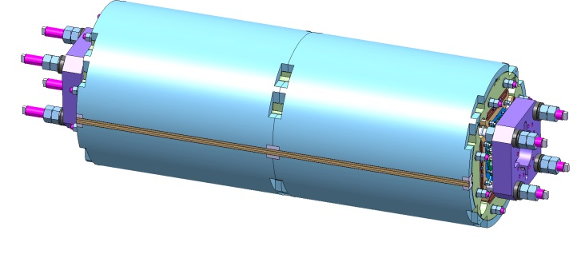
Option #2 (Minimum Deliverable)
The minimum US magnet deliverable we are considering is the single MQXF cold mass structure in the Aluminum shell, fully tested and trained
In this case, it will be part of CERN’s scope to assemble the Q1 and Q3 cold masses by interconnecting two MQXFs, installing the stainless skin and end domes, cold mass heat exchangers tubes, tungsten shield in the beam tube, etc.
Total of 20 single MQXF cold masses
Al shell

Slide 5
What is the cost differential?
Preliminary Range: $5M to $10M
More details needed to reduce the estimate range
Some Examples:
It cost about $2M more to test Option #1
It cost about $1.2M to install the stainless steel skin and end domes on a double MQXF cold mass
The tungsten shield cost fabrication and installation is not known at this point
Additional cost for Option #1 includes heat exchanger, interconnect work, electrical connections, tooling, QA and Safety documentation, interface specification, etc.

Slide 6
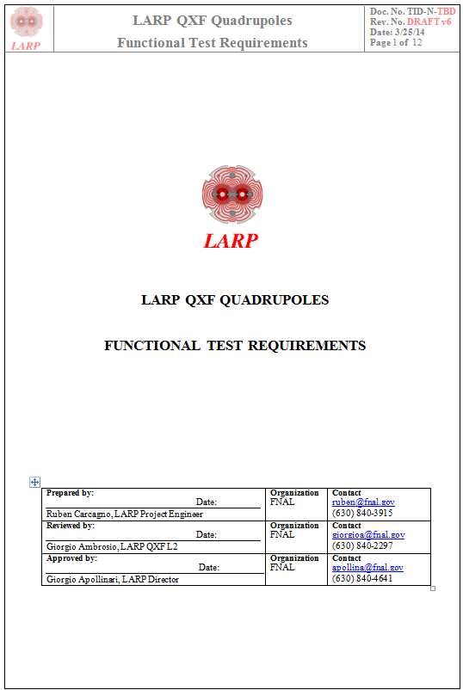
MQXF Test Requirements https://plone.uslarp.org/Workshops/qxftesting/Update/
Functional Test Requirements
Quench training up to 90% of SSL
Plan for 36 quenches on each MQXF cold mass
Thermal Cycle
Magnetic Measurements
MQXF production testing from January 2019 until May 2021
Current version does not include provisions for CLIQ

Slide 7
Test Facilities
There are no facilities in the U.S. currently available for testing LQXF/MQXF cold masses
QXF Test Facility Workshop at BNL, December 17-18 2013
Two viable proposals were presented and discussed:
BNL (Vertical Test Stand, for single LQXF/MQXF cold mass)
Plan is to use BNL facility for testing long prototypes (LQXF)
Could be used for magnet deliverable Option #2
FNAL (Horizontal Test Stand, options for single LQXF/MQXF cold mass or double MQXF cold mass assembly)
Could be used for magnet deliverable Option #1 or Option #2
With the current test requirements and assumptions, more than one test stand would be needed to meet the production schedule
Experience with LQXF testing will be important to validate assumptions

Slide 8
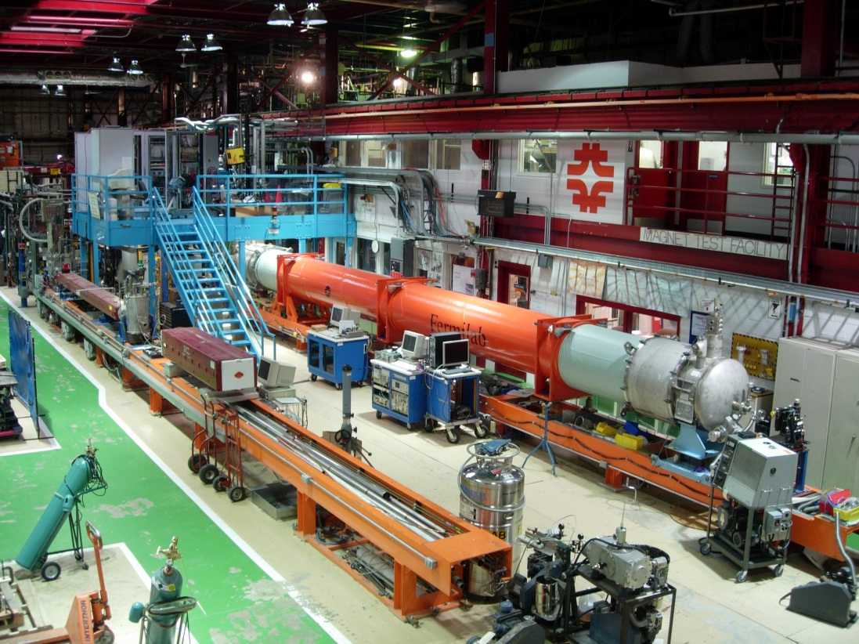
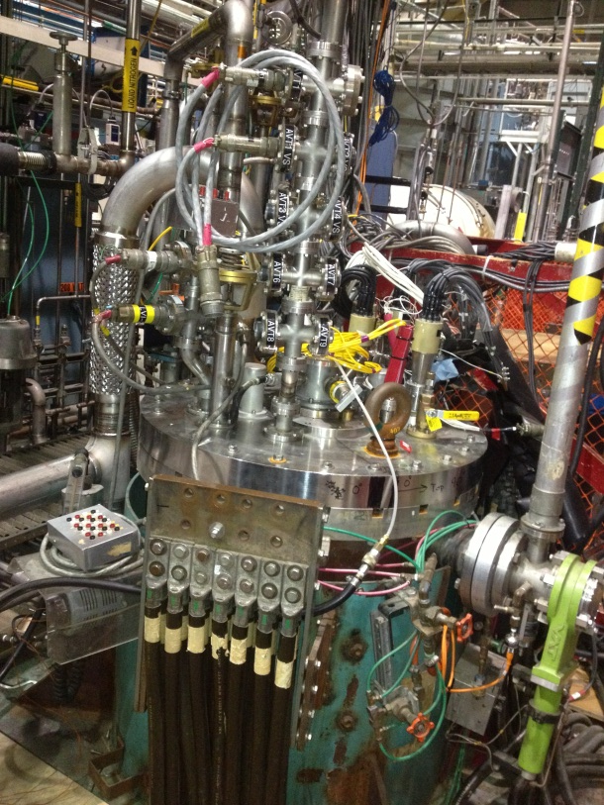
Test Facility Proposals
BNL: Vertical Test Stand (limited to testing a single MQXF cold mass)
FNAL: Horizontal Test Stand (requires reusable cryostat, but can test a double MQXF cold mass)

Slide 9
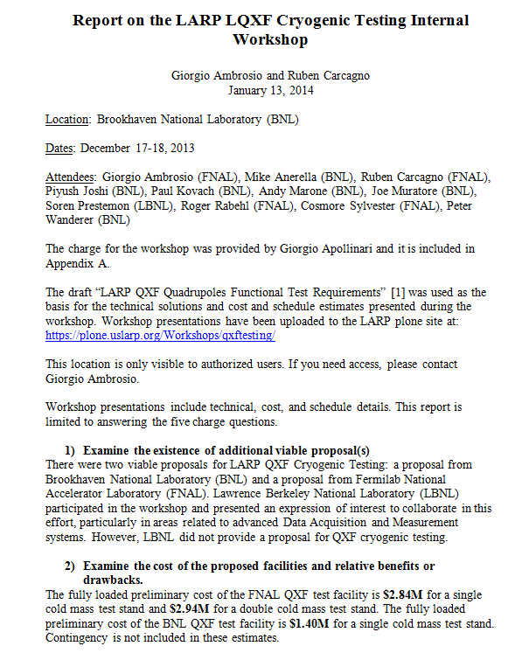
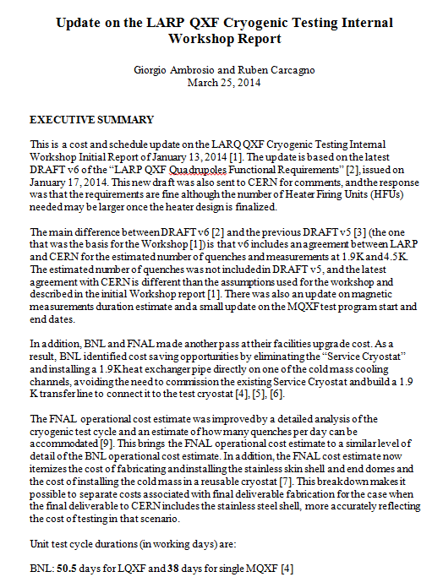
MQXF Test Facilities
More details in Workshop Reports:
https://plone.uslarp.org/Workshops/qxftesting/
https://plone.uslarp.org/Workshops/qxftesting/Update/

Slide 10
Interfaces
Deliverable Option #1 (complete Q1 or Q3 cold mass assembly) requires detailed definition of interfaces with the cryostat and with the magnet interconnect region. For example:
Mechanical Support Interfaces
Alignment Interfaces
Piping Interfaces
Beam Tube and Tungsten Shield
Heat exchanger
Helium
Electrical Connections Interfaces
Instrumentation
Buswork
Deliverable Option #2 (single MQXF cold mass with Al shell) requires much less interface definition

Slide 11
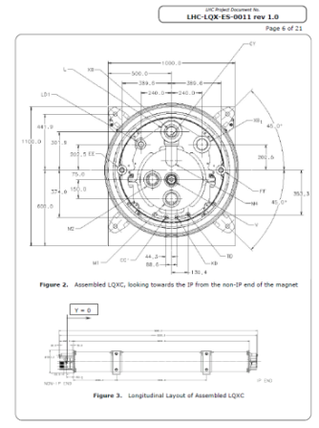
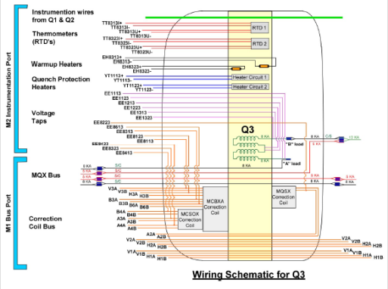
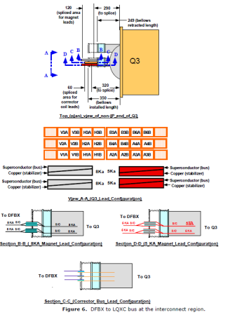
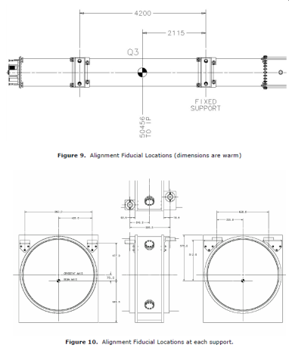
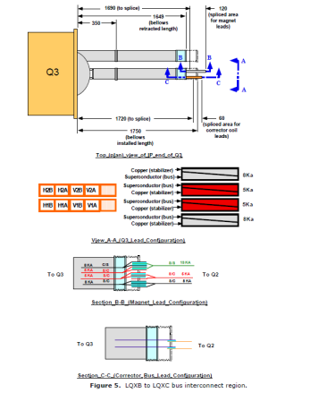
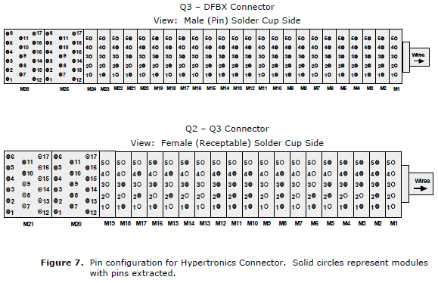
Interface Example (Present LHC Q3 Inner Triplet)

Slide 12
Summary
Two options were presented as possible US magnet deliverables
The preferred (and more expensive) option is a complete cold mass assembly for Q1/Q3, ready to be inserted into the Q1/Q3 cryostat by CERN.
Budget constraints may force a lower cost deliverable option: single MQXF cold mass structures.
A detailed cost estimate of the difference between both options needs to be done
The P5 report expected late May 2014 will provide budget guidance to start negotiation on deliverables with CERN
Work started on test facilities for MQXF cold mass training and acceptance testing
Detailed interface requirements need to be defined

