Slide 1
Brookhaven National Laboratory, – 8th May 2014
Strand design, status and plans by CERN
B. Bordini, A. Ballarino, L. Oberli
LARP CM22/ HiLumi-LHC Collaboration Meeting

Slide 2
Outline
Nb₃Sn procurement: status and plans
CERN experience with the RRP 132/169
  The 1 mm wire for the FRESCA2 magnet
  The 0.85 mm wire for the QXF magnets
  Cabling the QXF conductor
  Magnetization of the 0.85 mm wire
Scaling the Nb₃Sn critical current at 1.9 K

Slide 3
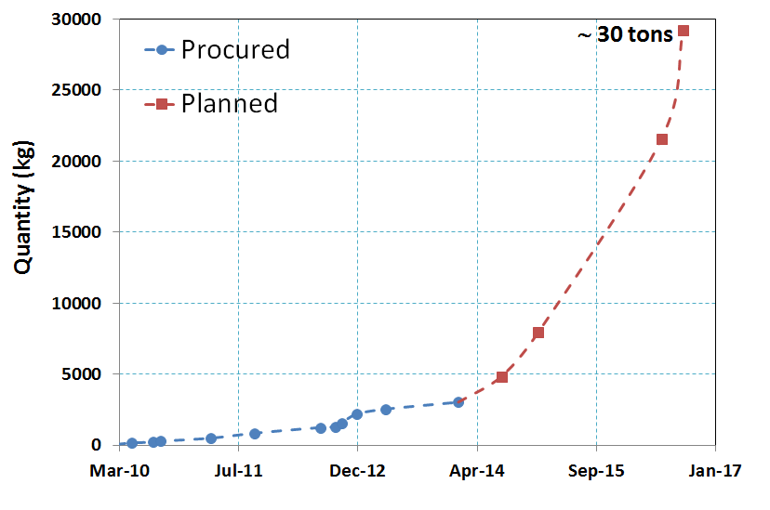
Nb₃Sn Procurement
Quadrupole
Series
Dipole
Series
1.087 t Fresca2
1.364 t Dipole
0.578 t Quadrupole
100 km PIT Dipole
20 km +20 km Quadrupole
Dipole
Series
Quadrupole
Long Prototype
Orders of conductor for prototype dipole magnets completed

Slide 4
QXF Nb₃Sn Procurement
Planned
Ordered
LP: 200+200 km
Practice coils
LMP: 30+30 km
Partially Procured
SMP: 20+20 km
Practice coils
SMP: 7+7 km
Procured
6+6 LMCs
5+5 SMCs (May 2015)
SMP: 35+35 km
Conductor
for series
Cabling trials: 5+5 km
6+6 SMCs
2012
2013
2014
2015
2016
2017
Long Prototypes
Short Model Program
The procurement is proceeding as planned – conductor review October 2013

Slide 5
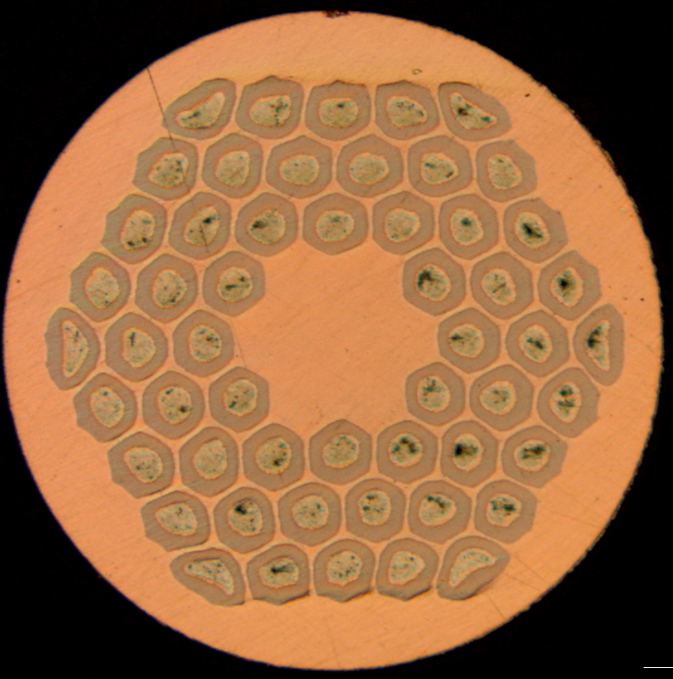
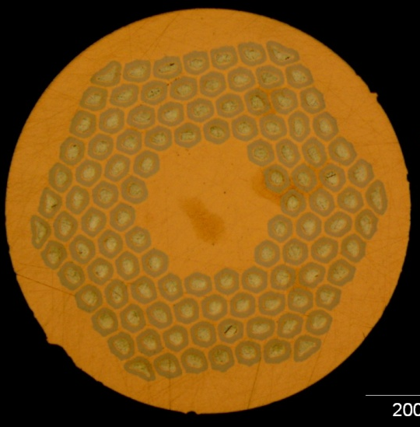
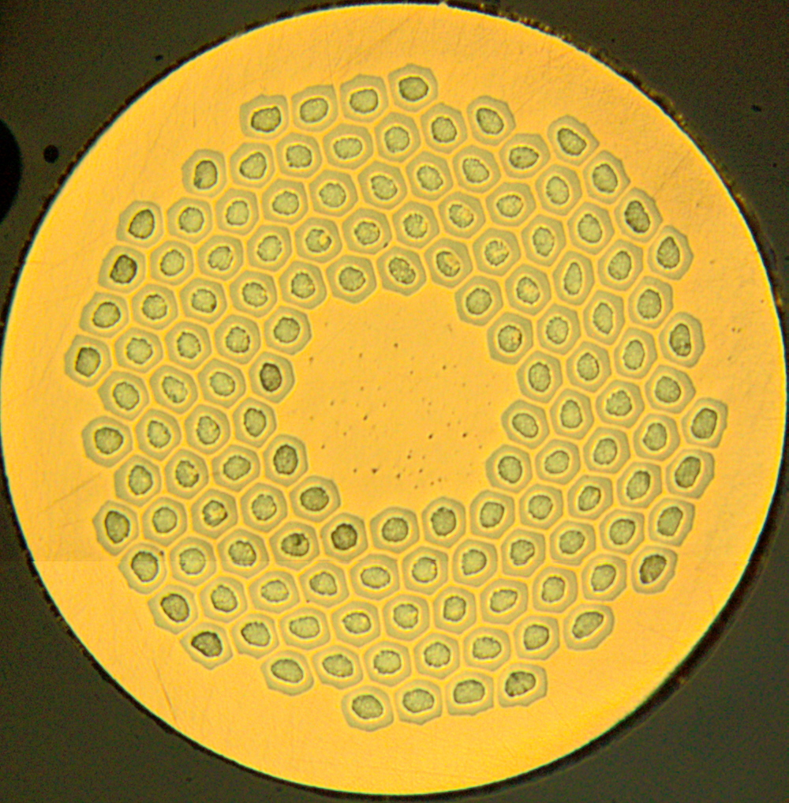
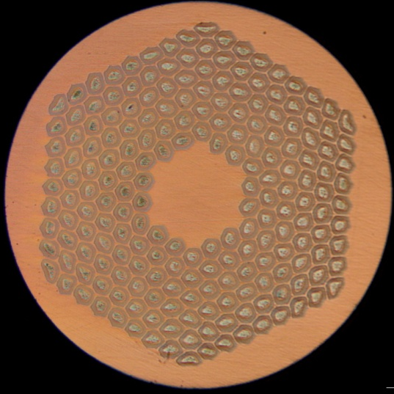
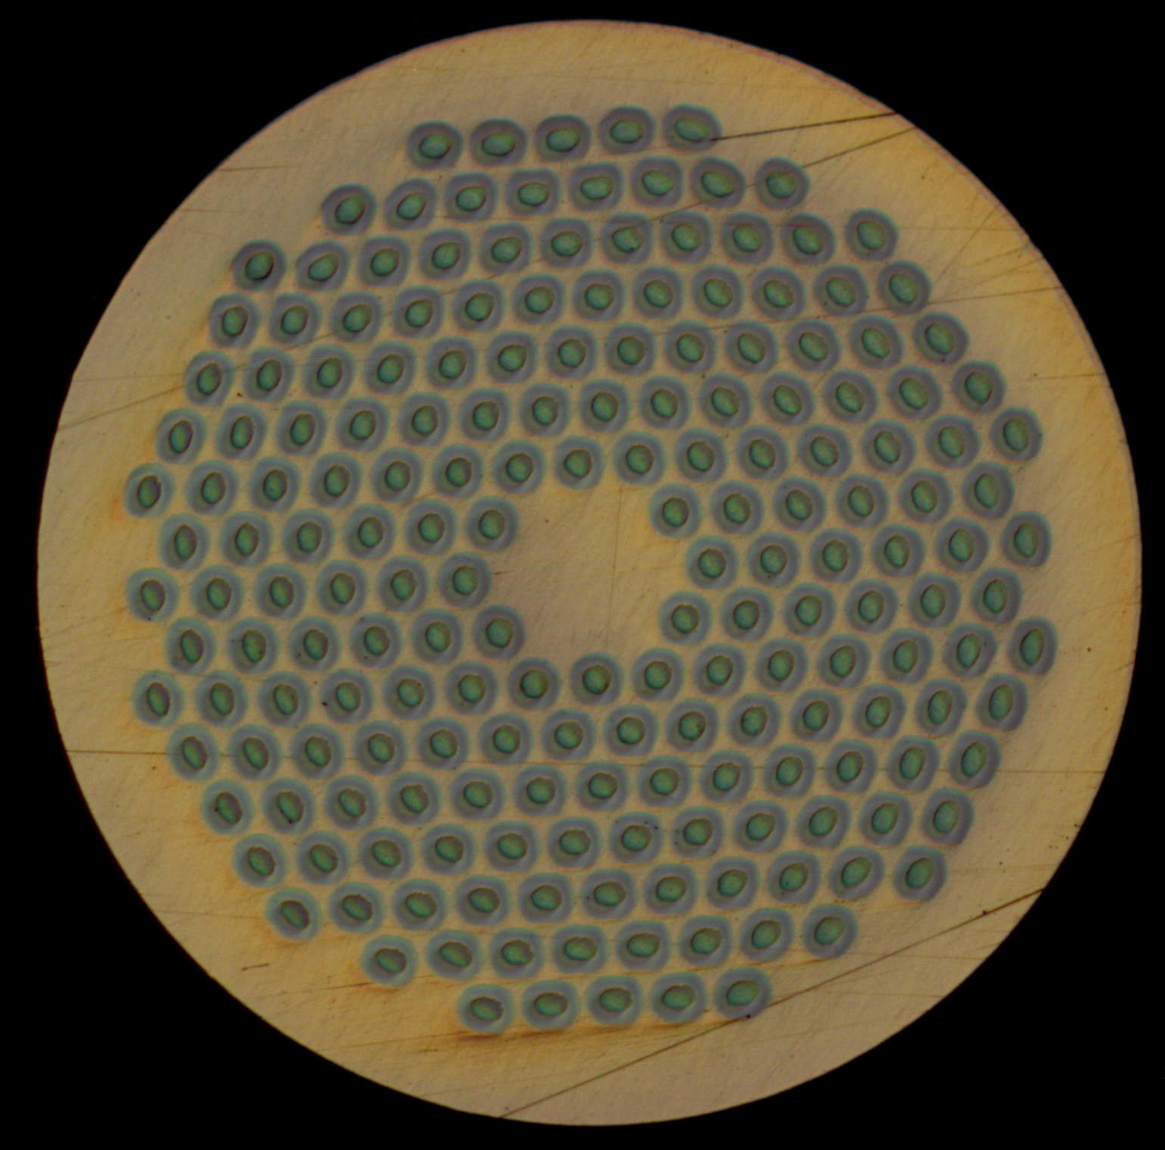
Conductor for CERN projects
 | Sub-element size (μm)
 | Wire Φ (mm) | RRP® 108/127 | RRP® 132/169 | RRP® 192/217 | PIT 114 | PIT 192
FRESCA 2* | 1 | - | 58 | - | - | 48
Hi-Lumi Quad | 0.85 | - | 48 | - | - | 41
11 T | 0.7 | 46 | 41 | 32 | 44 | -
RRP
PIT
54/61
108/127
132/169
198/217
114
192
*Fresca 2 conductor: procurement by CERN and CEA – FP7 European Project

Slide 6
Km of Wire Received at CERN
 | Quantity Procured (km)
 | Wire Φ (mm) | RRP® 132/169 | PIT 114 | PIT 192
FRESCA 2 | 1 | 10+15+18+45 | - | 1+9+15+15+45
Hi-Lumi Quad | 0.85 | 5 + 35 | - | 5 + 5 + 37
11 T | 0.7 | 30 +28+ 122 | 3 + 22.4*+43+ 7 | -
* Additional length of 12.2 km of PIT 192, 0.778 mm diameter, procured by CERN for LARP – shipped by CERN to LBNL in June 2013
Delivered
In production at OST - (total quantity by Aug. 2014)
In production at Bruker - (delivery completed in June 2014)
In production at Bruker - (delivery completed in September 2014)

Slide 7
1 mm 132/169 RRP Wire:
J_{c} @ 15 T, 4.22 K
HT: 50 hours at 650 °C
Average, (A/mm²) | 1506.0
RMS, (A/mm²) | 38.3
RMS/Ave, % | 2.5
Min, (A/mm²) | 1409.0
Average, (A/mm²) | 1612.9
RMS, (A/mm²) | 35.9
RMS/Ave, % | 2.2
Min, (A/mm²) | 1540.0
Different Nb raw material

Slide 8
1 mm 132/169 RRP Wire:
J_{c} @ 12 T, 4.22 K
HT: 50 hours at 650 °C
Average, (A/mm²) | 2858.8
RMS, (A/mm²) | 49.1
RMS/Ave, % | 1.7
Min, (A/mm²) | 2767.0
Average, (A/mm²) | 3036.5
RMS, (A/mm²) | 47.3
RMS/Ave, % | 1.6
Min, (A/mm²) | 2943.0
Different Nb raw material

Slide 9
1 mm 132/169 RRP Wire:
Copper Residual Resistivity Ratio (RRR)
HT: 50 hours at 650 °C
Average, (-) | 241.2
RMS, (-) | 25.9
RMS/Ave, % | 10.7
Min, (-) | 193.0
Different Nb raw material
Average, (-) | 286.6
RMS, (-) | 29.4
RMS/Ave, % | 10.2
Min, (-) | 224.0

Slide 10
1 mm 132/169 RRP Wire:
Piece Lengths
59 % in lengths > 2000 m

Slide 11
0.85 mm 132/169 RRP Wire:
I_{c} @ 15 T, 4.22 K
HT: 50 hours at 640 °C
Spec., (A) | 361
Average, (A) | 365.2
RMS, (A) | 7.5
RMS/Ave, % | 2.0
Min, (A) | 355.0
Min-Spec, % | -1.7
Spec., (A) | 361
Average, (A) | 368.5
RMS, (A) | 11.4
RMS/Ave, % | 3.1
Min, (A) | 353.0
Min-Spec, % | -2.2
Low Tin

Slide 12
0.85 mm 132/169 RRP Wire:
I_{c} @ 12 T, 4.22 K
HT: 50 hours at 640 °C
Average, (A) | 707.2
RMS, (A) | 10.1
RMS/Ave, % | 1.4
Min, (A) | 694.0
Average, (A) | 719.1
RMS, (A) | 14.6
RMS/Ave, % | 2.0
Min, (A) | 693.0
Low Tin

Slide 13
0.85 mm 132/169 RRP Wire:
Copper Residual Resistivity Ratio (RRR)
HT: 50 hours at 640 °C
Low Tin
Average, (-) | 204.1
RMS, (-) | 14.9
RMS/Ave, % | 7.3
Min, (-) | 172.0
Average, (-) | 309.3
RMS, (-) | 19.4
RMS/Ave, % | 6.3
Min, (-) | 285.0

Slide 14
Cabling the QXF conductor based on the 132/169 RRP wire
Several Cables with different parameters were fabricated at CERN
In order to assess the critical current degradation due to cabling, extracted wires were systematically measured
Generally the degradation was limited to less than 5 % despite the strand looked significantly deformed on the thin edge
The wire is extremely robust in term of I_{c} degradation, at the moment the cabling program is focusing on to:
  Maintain the local RRR above 100
  Manufacture a mechanical stable cable

Slide 15
Magnetization at 1.9 K of QXF wires: the 132/169 RRP vs the 192 PIT
→J_{c}(12 T, 4.2 K) =2500 A/mm²
RRR=136
→J_{c}(12 T, 4.2 K) =2800 A/mm²
RRR=189
With respect to the PIT wire, the RRP wire has:
  A significantly larger magnetization
  Bigger Flux Jumps
  A wider unstable region (2.5 T instead of 1.5 T)
Measurements by D. Richter – CERN TE/MSC/SCD

Slide 16
The 132/169 RRP wire - Summary
When passing from a 0.7 mm wire to a 0.85 mm wire, the 132/169 is the natural evolution of the 108/127 (the historical layout used by the LARP collaboration) in order to maintain similar sub-element size
  Limit the magnetization and the low field instabilities
  Similar sub-element design and heat treatments
CERN has a significant experience with the 132/169 wire: 88 Km of wire were procured for the FRESCA2 magnet and 40 km for the QXF magnets
All the wire received at CERN satisfies the current specification with significant margin for the RRR specification

Slide 17
Critical Current QXF RRP Wire
p =0.44* , q =1.85*
Fitting I_{c} data
B_{C2}(4.3 K) = 23.73 T, C(4.3 K) = 43300 A T
B_{C2}(1.96 K) = 25.93 T, C(1.96 K) = 51730 A T
T_{c}= 15.34 K
* B. Bordini, D. Richter, P. Alknes, A. Ballarino, L. Bottura, L. Oberli, - “Magnetization Measurements of High-J_{c} Nb₃Sn Strands” - IEEE Trans. Appl. Superconduc., Vol. 23, No. 3, pp. 7100806, June 2013

Slide 18
Critical Current (x strand) QXF Magnet
Table Courtesy of P. Ferracin
When fitted with the ITER Scaling Law, Transport Current Data seem confirming the reduced T_{c} observed in Magnetization Measurements
We gain 0.3 T (and 10 A), from 14.5 T to 14.8 T
Margin from
17.8 % to 19.3 %

Slide 19
Conclusions
The procurement of the Nb₃Sn wire is proceeding as planned
  Orders of conductor for prototype dipole magnets completed
  For the SMP of the QXF magnet all the orders have been placed and part of the wire already received at CERN (40 km RRP and 10 km PIT)
CERN has a significant experience with the 132/169 RRP wire: 88 Km of wire (from 18 billets) were procured for the FRESCA2 magnet and 40 km (from 10 billets) for the QXF magnets
First transport current measurements show that to scale (with the ITER scaling law) the temperature dependence of the critical current between 4.2 K and 1.9 K, we have to reduce the T_{c} at about 15.3 K
Margin from 17.8 % to 19.3 %

Slide 20
Conclusions
The procurement of the Nb₃Sn wire is proceeding as planned
  Orders of conductor for prototype dipole magnets completed
  For the SMP of the QXF magnet all the orders have been placed and part of the wire already received at CERN (40 km RRP and 10 km PIT)
CERN has a significant experience with the 132/169 RRP wire: 88 Km of wire (from 18 billets) were procured for the FRESCA2 magnet and 40 km (from 10 billets) for the QXF magnets
First transport current measurements show that to scale (with the ITER scaling law) the temperature dependence of the critical current between 4.2 K and 1.9 K, we have to reduce the T_{c} at about 15.3 K
Margin from 17.8 % to 19.3 %

