Slide 1
MQXF Conceptual Specs & Requirements
Joint LARP (CM22) HiLumi-LHC Collab Meeting
May 7-9, 2014 Brookhaven National Laboratory
Giorgio Ambrosio
Fermilab
With contributions from:
P. Ferracin, G.L. Sabbi, E. Todesco,
and many other people
The HiLumi LHC Design Study is included in the High Luminosity LHC project and is partly funded by the European Commission within the Framework Programme 7 Capacities Specific Programme, Grant Agreement 284404
Work supported by the US LHC Accelerator Research Program (LARP) through US Department of Energy contracts DE-AC02-07CH11359, DE-AC02-98CH10886, DE-AC02-05CH11231, and DE-AC02-76SF00515

Slide 2
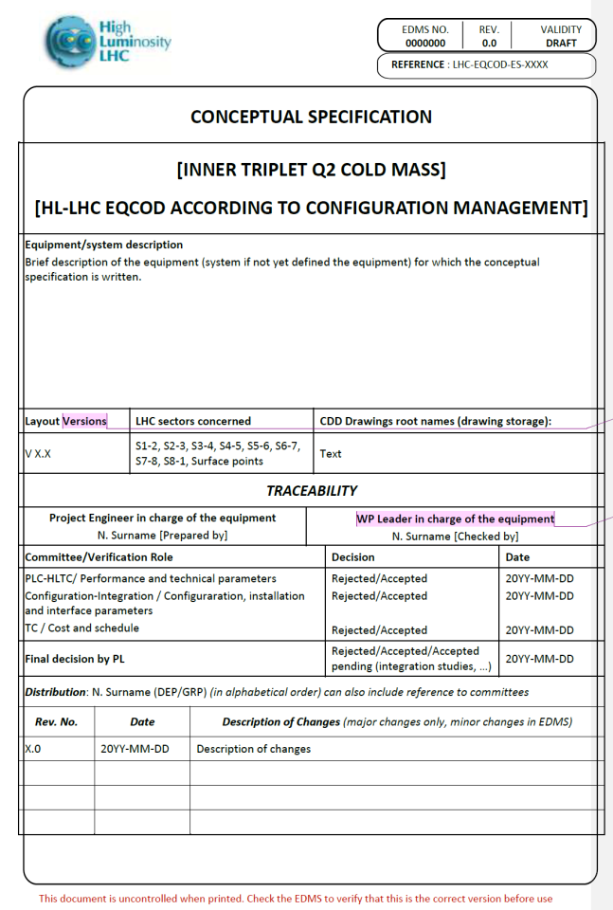
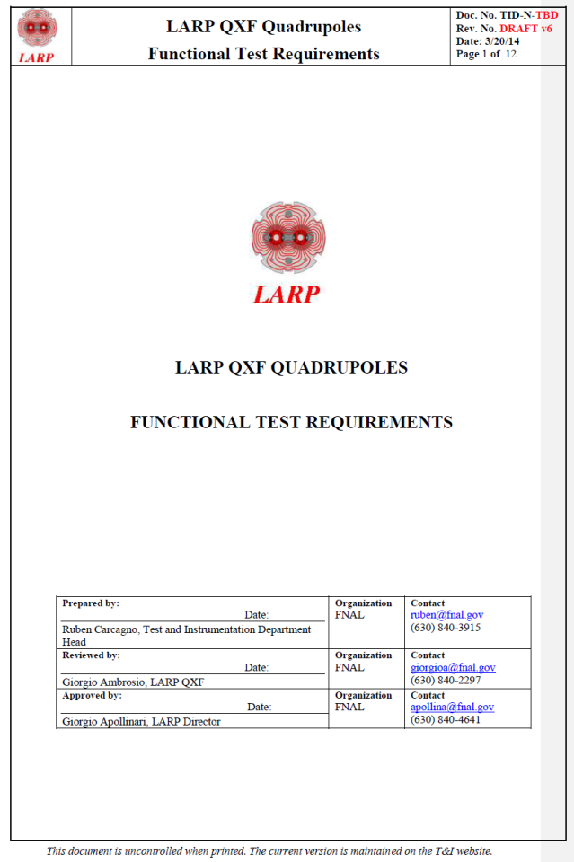
Sources
Q2 Cold Mass Conceptual Specification (CERN)
QXF Quad. Functional Test Requirements (LARP)
HiLumi LHC WP3 web site
LARP 2014 DOE Review

Slide 3
MQXF Main Parameters
150 mm aperture (at 300 K)
140 T/m gradient
8 / 6.8 / 8 m magnetic length Q1/Q2/Q3
4 + 4 with 0.5 m gap for Q1 and Q3

Slide 4
Geometrical Requirements
630 mm Cold mass outer diameter
9.5 / 7.5 / 9.5 m magnet physical length Q1/2/3
Splice box
endplate
0.5 4 0.5 4 0.5

Slide 5
Operational Requirements
< 20 kA operating current (17.5 kA)
1.9 K operating temperature
2.5 mW/cm³ peak power density (5 10³⁴ cm⁻² s⁻¹)
25 MGy peak integrated dose (3000 fb⁻¹)
175 / 350 / 175 Cooling power for Q1/2/3
20 thermal cycles
5000 power cycles

Slide 6
Field Quality Targets
Should we set higher values as requirements (i.e. cause for rejection)?
What about targets for dynamic effects?
Y. Cai (SLAC)

Slide 7
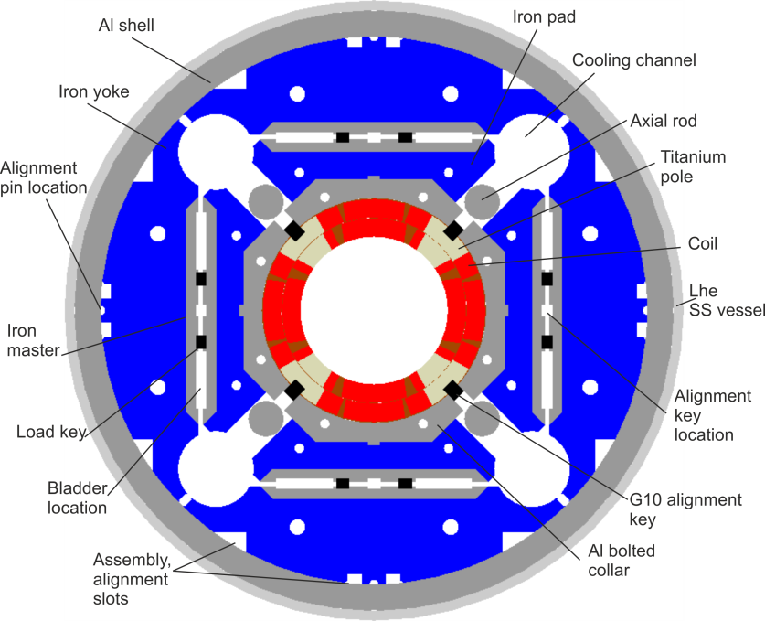
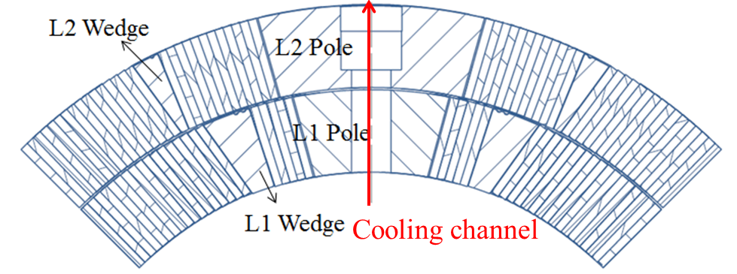
Cooling Requirements
2 heat exchangers through each magnet yoke
77 mm diameter holes for heat exchangers
+/-45° position of the heat exchangers
8 mm minimum diam. of holes through coil poles
50 mm maximum distance between pole holes

Slide 8
Electrical and Quench Protection Req.
Q1 and Q3 /Q2a and Q2b are powered in series
800 V max coil-ground voltage
46 mΩ max dump resistor
450 V max heater firing unit voltage
??? max voltage for CLIQ
??? requirements for dump + heaters + CLIQ
350 K max hot spot temperature
depends on assumptions, material properties, …

Slide 9
Test Requirements
152 T/m (90% SSL) training goal at 1.9 K
Only for S/LQXF or also MQXF?
1 max number of quenches up to 140 T/m after thermal cycle
100 K max ΔT in magnet during cooldown and warm up
1 kV max HiPot in test facility
400 A/s max ramp rate during test

Slide 10
Anything missing
… please add or comment on what is missing

Slide 11
Next Steps
Agree on values for missing requirements
Prepare CERN-LARP document with requirements list
Q1 and Q3 needed for LARP CD1 equivalent review

