Slide 1
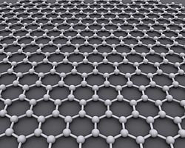

Hidden exact symmetry in graphene
Tetsuya Onogi (Osaka University)
June 27, 2014 @Lattice 2014
Wikipedia

Slide 2
This talk is based on the work in collaboration with
Masaki Hirotsu (Osaka), T.O. and Eigo Shintani (Mainz)
Nucl. Phys. B885 (2014) 61, arXiv:1303.2886(hep-lat),
Aya Kagimura (Osaka), Hirotsu, T.O. and Shintani
work in progress.

Slide 3
Appologies
There are studies on lattice Monte Carlo simulation of graphene system, which I will not cover in this talk.
Phase diagram with staggered fermion
  Drut and Lahde, Shintani and T.O.
HMC algorithm for graphene using honeycomb lattice
  Brower, Rebbi, Schaich
Studies of the phase diagram using honeycomb lattice
  Buivdovich and Polikarpov, Ulybyshev et al., Smith and von Smekal
  [121] Ulybyshev, [144] Nikolaev, [99] Smith, [438] Valgushev

Slide 4
Instead, I will talk about a very elementary theoretical question:
Is there exact “chiral-flavor” symmetry for fermion on honeycomb lattice in graphene?

Slide 5
Introduction

Slide 6
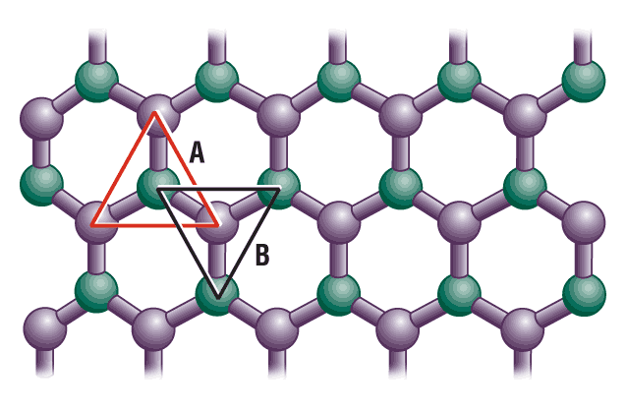

What is graphene?
2 dimensional sheet of Carbon atoms
Carbon atom has orbit with 4 valence electrons.
3 of them are used for bond for 3 neighboring Carbon atoms and 1 of them can hop freely on graphene sheet.
Honeycomb lattice
1 electron per site.

Slide 7
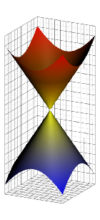

Band structure of Graphene
Dirac point
Dispersion relation：
E
Gap energy ~ 0
k
Very high electron mobility
The most conductive material on earth.
(more conductive than Ag!)

Slide 8
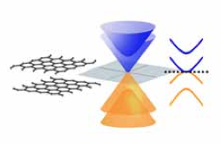
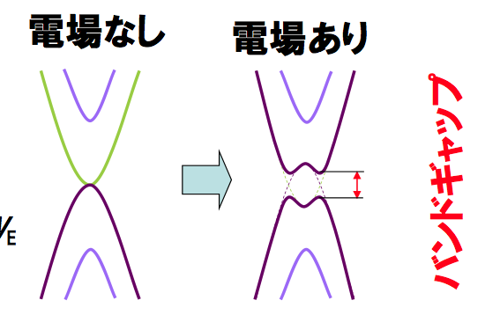

It is also known that bi-layer graphene is also gapless with quadratic dispersion.
Band gap
Applications: Transistor on bi-layer graphene
Band gap can be controlled by external electric field perpendicular to the plane.
This switch is already realized in experiment.

Slide 9
Key property of graphene: gapless mode
Mono-layer : massless Dirac fermion
Bi-layer : gapless mode with quadratic dispersion
From lattice point of view, one naturally expects exitence of “flavor-chiral” symmetry to prohibit the gap.
However, no such study can be found in the literature.
Instead, there is a discussion on the absence of a gap based on Z2 symmetry.

Slide 10
Stability of massless mode in graphene
Conventional understanding in free theory:
Z2 symmetry
  Hatsugai-Aoki-Fukui 2006
  Creutz 2008
If gapless mode exists for a Hamiltonian, it is stable against any small changes of the Hamiltonian which preserves the Z2 symmetry.

Slide 11
However, our electron has gauge interaction!
Unless there is some symmetry, radiative correction can give mass shift of cutoff order, which may not be small
Radiative
correction

Slide 12
Original Hamiltonian
Radiative
Correction
Small deformation
in free theory
Small Z2-preserving and Z2- violating change
Large mass shift of cutoff order
Z2 symmetry
“flavor-chiral” symmetry?
Complementary

Slide 13
Goal of our work
Find hidden exact “flavor-chiral” symmetry in the Hamiltonian for graphene (in free theory as a first step).
To do so, we apply the position space formalism, which was first used for staggered fermion.

Slide 14

Outline
Introduction
Tight-binding Model
  Theoretical basis and Dirac points
Stability of gapless mode against deformation
  Z2 symmetry
Position space formulation
Hidden exact symmetry
Summary

Slide 15
Tight-binding model

Slide 16
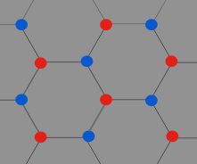
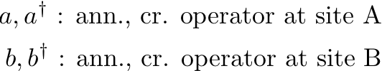
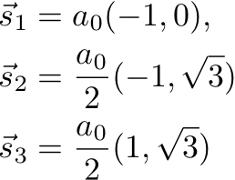
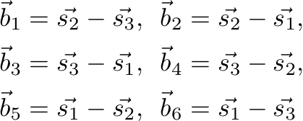
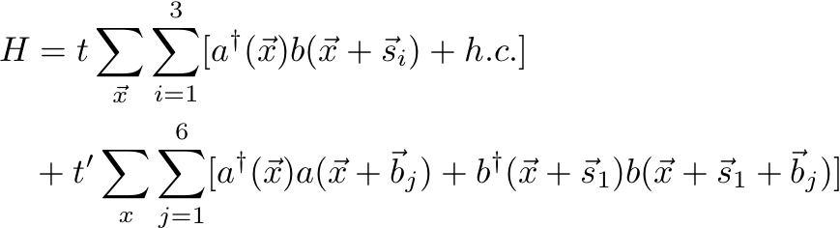
Nearest-neighbor bond
・ A site
・ B site
Fundamental lattice vector

Slide 17



Energy spectrum
Fourier transformation of H (t’=0 case)
G. W. Semenoff, (1984)
One electron per site (= half-filled)
→ all negative energy states are filled(=Dirac sea) .
If there is a gap, the system is insulator .
If no gap, the system can be metallic.

Slide 18
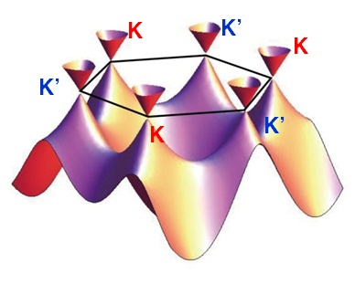
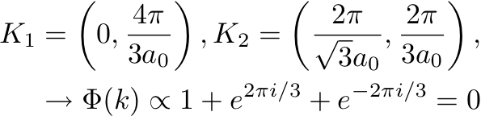
  Dirac point : the lowest energy state of graphene
Two Solutions:

Slide 19
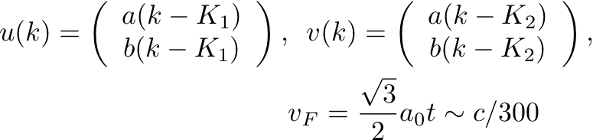
LOW ENERGY APPROXIMATION
  Leading order of expansion near K point
Emergence of massless Dirac fermion

Slide 20
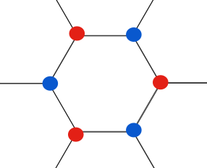
AB stacked bilayer graphene
Upper layer
Lower layer
sites sit on top of
Inter-layer hopping Hamiltonian

Slide 21
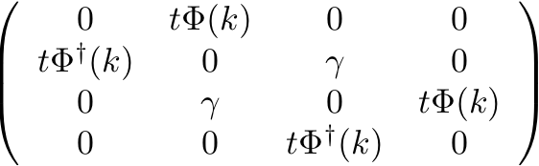


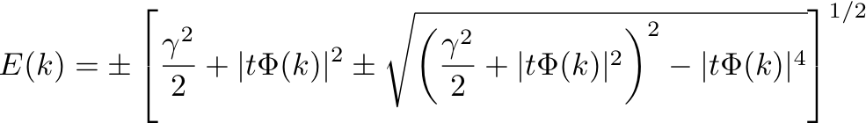

Total Hamilonian matrix for bi-layer graphene
Energy Eigenvalue E(k)
Near Dirac point, behaves as
Energy
k
Gapless mode with quadratic dispersion

Slide 22
Stability of the zero gap

Slide 23


Stability against small de-tuning
Hatsugai-Fukui-Aoki 2006
Let us consider the free Hamiltonian on more general lattice with A-, B- sites.
c.f. graphene
Energy eigenvalue

Slide 24



Consider the map from the Brillouin zone (BZ) to
Mapped surface
Energy gap is the minimum distance between the mapped 2 dimensional surface and the origin.
gap
Fine-tuning is needed for zero gap.
One cannot expect the stability.

Slide 25


However, when Hamiltonian has Z2 symmetry
Then, is automatically satisfied.
The map is restricted to x-y plane, which includes the origin.
Zero gap can be achieved without fine-tuning.
Zero gap occurs at 2 points.
Any small deformation which keeps Z2 symmetry preserves zero gap.
However, for large deviation zero gap can disappear.
We need some symmetry to protect against it.

Slide 26
4. Position space formulation

Slide 27
Graphene system looks similar to staggered fermion.
Two approaches in staggered fermion
Momentum space approach
Susskind ‘77, Sharatchandra et al.81, C.v.d. Doel et al.’83, Golterman-Smit’84
Position space formulation … Kluberg-Stern et al. ’83
Split the lattice sites into “space” and “internal” degrees of freedom.
Exact chiral symmetry is manifest.
This approach is absent in graphene system.
We try to construct similar formalism in graphene system.

Slide 28
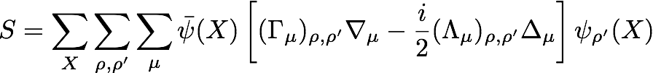



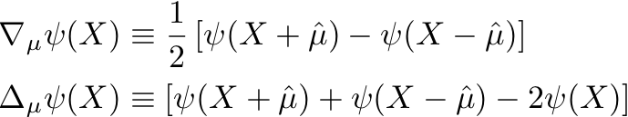

c.f. Staggered fermion in 2dimension
where
Exact chiral symmetry on the lattice

Slide 29
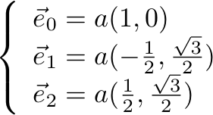

Position space formulation for graphene
We relabel the honeycomb lattice ● as the fundamental lattice.
6 sites in hexagonal unit cell is now the internal degree.
Fundamental vectors are those connecting ●.
（a：lattice spacing）

Slide 30

Central coordinate of hexagonal lattice is labeled by
I=A,B are the index for sublattices A,B
is the index for the 3 vertices (counter-clockwise)
are creation/annihilation operators
Each lattice point has 6=2x3 dof.

Slide 31


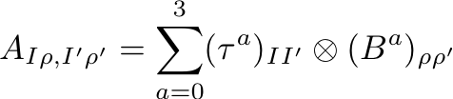

The Hamiltonian involves 6x6 matrices. Corresponding to the indices , we express 6x6 matrix using the tensor product of 2x2 matrix and 3x3 matrix.
6x 6
2x2
3x3

Slide 32
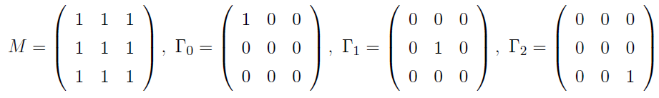
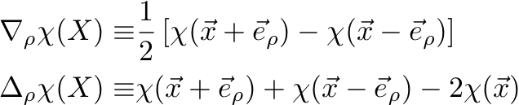

New formulation of tight-binding Hamiltonian
Mass term
Locality is manifest.

Slide 33
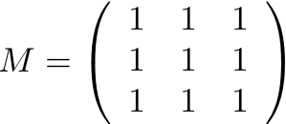
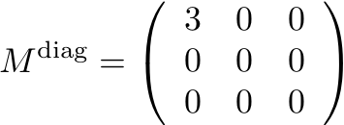


The mass term has 1 massive mode and 2 zero modes.
Democratic matrix
Massive mode
Change of basis
Massive mode can be integrated out
Zero modes

Slide 34



Comment: exact discrete symmetry
Z3 symmetry: cyclic rotation
Parity

Slide 35




Possible global symmetry of Heff
“Flavor-Chiral” symmetry
Parity conserving mass term is prohibited by the last two symmetries
However, these could be violated by lattice artifacts.

Slide 36
Hidden exact symmetry

Slide 37


Hidden symmetry in graphene
We look for an exact symmetry as
Expanding in powers of k, we look for solution to order by order.
Series starting from failed at 2nd order in k.
Series starting from survived at 3rd order in k
→ All order solution may exist for the latter?

Slide 38




To 3rd order in momentum expansion, only terms of the form (A,B: 3x3 martix ) appeared.
➔ We take the following anzats for the symmetry
Require that Hamiltonian is invariant under the symmetry.
A set of algebraic equations for and matrices in Hamiltonian

Slide 39
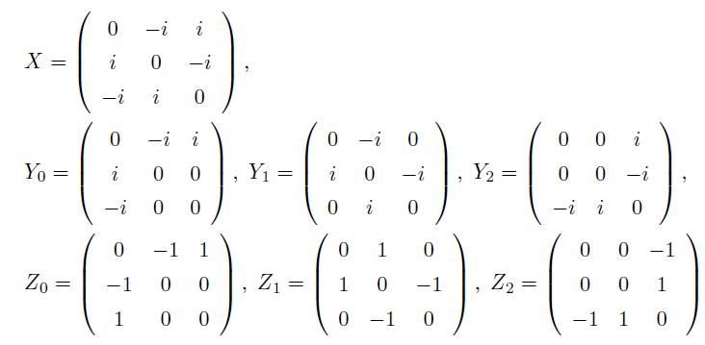
Unique solution for X, Y, Z exists!
Continuum limit (mass diagonal basis)
Coincide with
“flavor-chiral sym.”

Slide 40
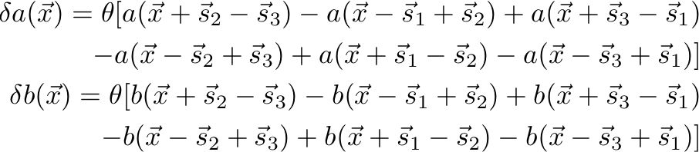
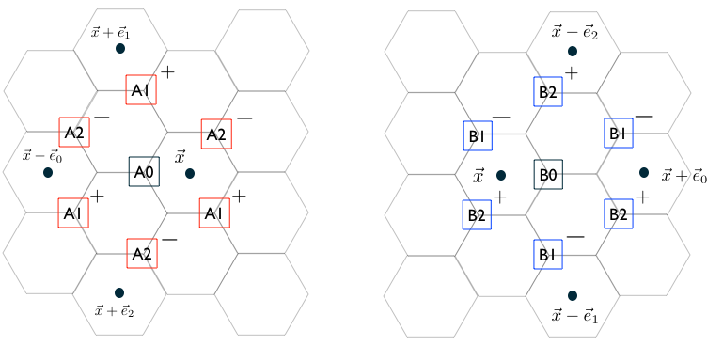
Symmetry in terms of conventional labeling

Slide 41


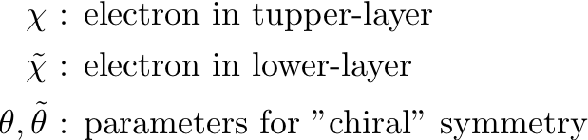
What about AB-stacked bi-layer graphene?
When interlayer interaction is absent, each layer has the symmetry :
One can show that the interlayer interaction Hamiltonian is invariant under transformation with
Exact symmetry in bilayer graphene !
Gapless mode in bi-layer graphene is also protected by ”flavor-chiral” symmetry.

Slide 42

Remark 1
What about the case including non-nearest neighbor hopping or higher?
→ No problem, “chiral-flavor” symmetry remains exact.
Due to the discrete rotational symmetry and parity, non-nearest neighbor hopping Hamiltoninan is
expressed as ( P: some polynomial)
Only our exact symmetry can explain the gapless mode.
Similar arguments hold also for inter-layer hopping Hamiltonian.

Slide 43

Remark 2
Example of physical interpretation:
(Non-chiral) carbon nanotube can be metallic or semiconductor depending on the radius L of the cylinder.
In position space formalism, this is understood simply as
periodic boundary condition for Dirac fermion.

Slide 44
Summary

Slide 45
We studied the position space formulation
of graphene
Results
Spin-flavor structure
  Identified the spin-flavor degrees of freedom in position space
Manifest locality of the low energy Dirac theory
Discovery of exact “flavor-chiral” symmetry on the lattice
Gapless mode is understood by “flavor-chiral” symmetry
Gapless mode for bi-layer graphene is also understood by “flavor-chiral” symmetry
The symmetry also holds with non-nearest hopping.

Slide 46
What is next?
Symmetry with gauge interaction.
  Whether it is exact at interacting level is yet to be seen.
Nonperturbative lattice studies on graphene including gauge interaction.
  Phase structure
  Quantum Hall effect
  Effect of impurities and boundaries
  Atomic collapse
Our position space formalism will be helpful to give a clear physical interpretation of low energy excitation as massless Dirac particle.

Slide 47
Thank you for your attention.

Slide 48
Backup Slides

Slide 49
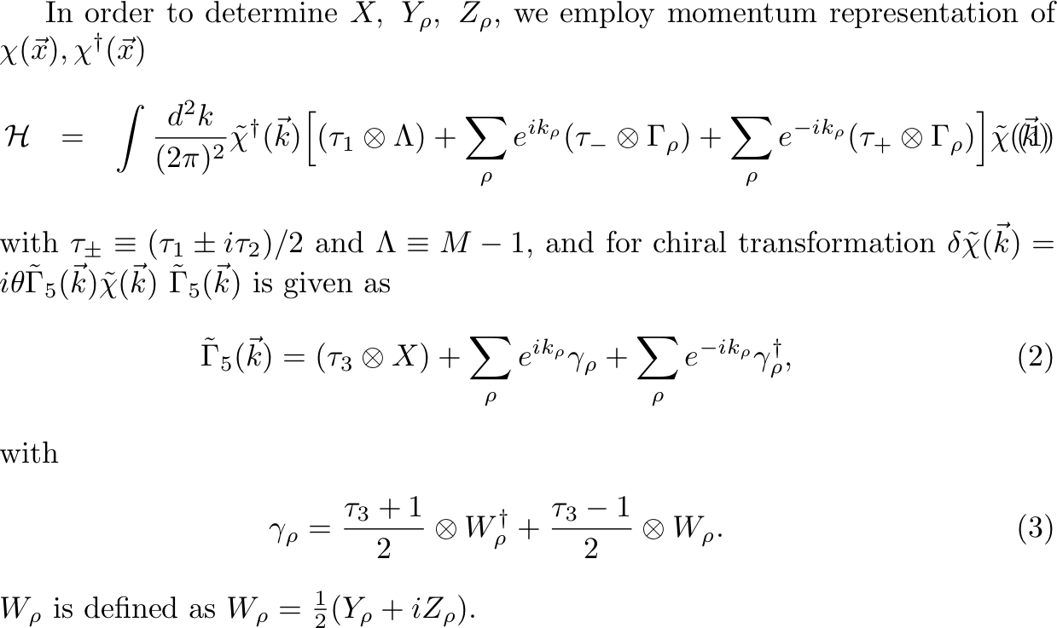

Slide 50
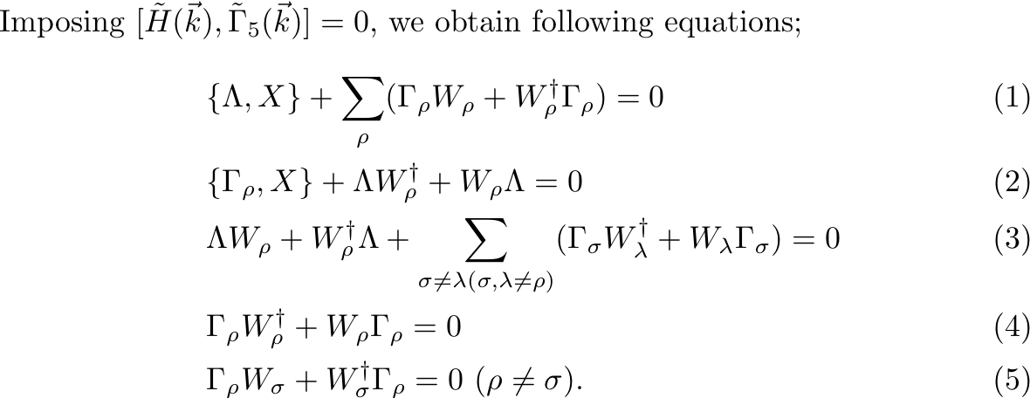

Slide 51
4. Our new formalism
Graphene system looks similar to staggered fermion.
What is the case for staggered fermion?
Position space formulation … Kluberg-Stern et al. ’83
Re-labeling of the staggered fermion
Unit cell ➔ internal degrees

