Slide 1
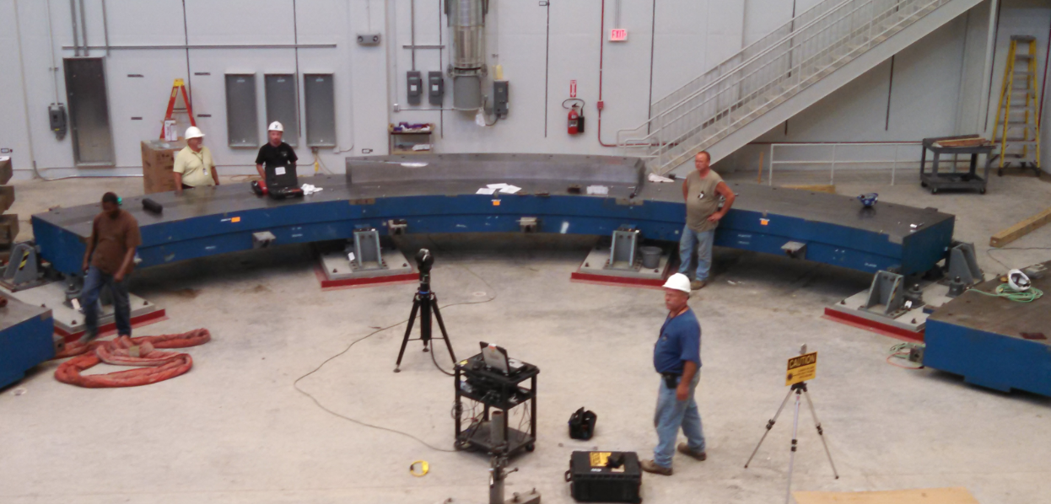
The muon g-2 experiment
June 19, 2014
muon g-2 experimental hall
Brendan Casey
Lattice 2014
June 26, 2014

Slide 2
The g-factor in one slide
Relationship between spin and angular momentum of an elementary particle
Theory | g | Why?
Classical mechanics |  | No
Non-relativistic quantum mechanics | 1 | Classical +
Relativistic quantum mechanics | 2 | Antimatter degrees of freedom
Quantum field theory | 2+ε | Radiative corrections
Chronic disagreement between predicted and measured values has played a central role in the history of particle physics

Slide 3
Expectations for muon g-2
Sub ppm measurement is sensitive to corrections beyond the weak scale
Have to add all radiative corrections to get it correct
spin
(g-2)/2 = 0
B
e⁺
(g-2)/2 ~ 1x10⁻³
e⁻
q
spin
(g-2)/2 ~ 1 x 10⁻⁷
q
W⁺
B
(g-2)/2 ~ 1 x 10⁻⁹
Z
??
W⁻
(g-2)/2 ~ ?
3

Slide 4


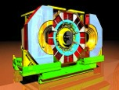




Predicted value: LO QCD
QCD
e
γ
γ
hadrons
μ
μ
e
π
BaBar
Theoretically clean, experimentally hard
Problem:
  Absolute cross section well below % level
Solution:
  Get several experiments to measure the same cross section
KLOE

Slide 5
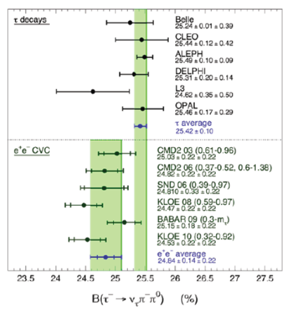
Predicted value: tau data
QCD
e
π ⁺
τ
π ⁺
γ
γ
W
e
π ⁻
π ⁰
μ
μ
ν
π
Can also use tau data to estimate LO QCD
  Experimentally cleaner, theoretically dirtier mainly due to isospin breaking
Hasn’t agreed well with e⁺e⁻ in the past but getting better agreement with more data and better understanding

Slide 6
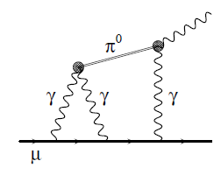
Predicted value: hLbL
Several model-based calculations exist
  Common concern is that the uncertainty is not well defined
Expected to be dominant error after the current round of e⁺e⁻ experiments
  Selling a very different experiment if this is the dominant term required to interpret the data
New program at KLOE to measure dominant contributions to this diagram with 2 photon physics at very low Q²

Slide 7
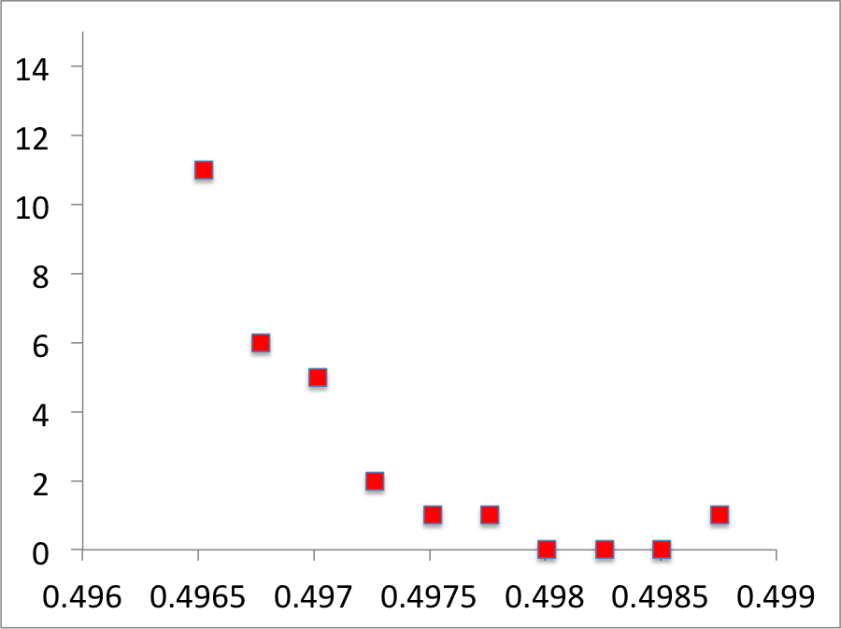
Muon g-2 on the lattice
We want a full calculation of muon g-2 from basic principles.
Only possible on the lattice.
muon g-2
Lattice Symposium talks on
1/t
(1/year)x10⁴
2014
2005

Slide 8
HVP on Monday
Kim Maltman
Extrapolation bias from low stats at low Q²
Anthony Francis
Upper limit on contribution from disconnected diagrams
Bipasha Chakraborty
Strange and charm quark contributions
Comparison of different techniques

Slide 9
More HPV

Slide 10
hLbL on Monday
Luchang Jin
Using 1 exact photon and 2 stochastic photons
Benchmarking with QED LbL

Slide 11
Muon g-2 at Snowmass
Lattice | precision | timescale | benchmark
HVP | 1-2% | Few years | τ -- e+e⁻ discrepancy
HVP | sub-% | This decade | Competitive w/ e+e⁻
hLbL | any | soon | Course Verification of models
hLbL | ~30% | 3-5 years | Competitive with models
hLbL | ~10% | Ultimate goal | Replace models

Slide 12
Measurement technique
e⁺ (R)
Weak decay so
positron direction follows muon spin
μ⁺
ν_{e} (L)
ν_{μ} (R)
Highest energy positrons occur when muon spin and momentum are aligned
momentum
spin
# high energy positrons versus time

Slide 13
Physics requirements
Experimental goal:
  100 ppb statistical uncertainty: must reconstruct 1.8x10¹¹ positrons
  70 ppb systematic uncertainty on ω_{a}: must remove several ppm level biases
Dominant feature:
φ is the phase between the spin and momentum at the beginning of the fit.
BNL 2001 run
# high energy positrons versus time

Slide 14
Physics requirements
Leading systematics come from time dependence in the phase
Taylor expansion:
Things that change “early to late” in the fill typically lead to a time dependence in the phase of the accepted sample that directly biases the extracted value of ω_{a}

Slide 15
Physics requirements
φ₁
φ₂
Pileup: two low energy positrons fake a high energy positron
(happens early, not late)
φ_{early} ~ φ₁ + φ₂
φ_{late} ~ φ₁
momentum
spin
calo
Gain change:
example: saturation (happens early, not late)
φ_{early} ~ φ₁
φ_{late} ~ φ₂
φ₁
φ₂
Above thresh. early
Above thresh. late
calo
Δω ~ Δφ
Design not driven by absolute performance, but relative stability early to late
Know how well we did on these for BNL experiment. Need to do better by a factor of 4. Detector package designed to contain the tools to enable this.

Slide 16
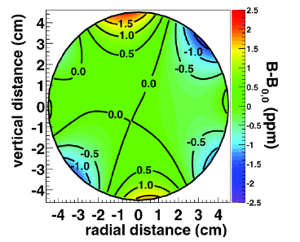
Physics requirements II
Beam parameters: acceptance is different when the beam is breathing (big effect early).
not all muons are on the ideal (magic) orbit. Leads to ppm level corrections
extended and off-center beam sees non-uniformities in the field
Power spectrum of residuals to a simple cos(ωt+φ) fit
Must be able to measure beam parameters in different locations as a function of time to validate our model of the beam.

Slide 17
Required systems
Required systems:
  Calorimeters to measure positron time and energy
    Segmented to maximize spatial segmentation of pileup
    Fast to maximize temporal separation of pileup
    Digitized waveforms to fit for remaining pileup
    Controls and calibration to stabilize and measure gain stability
  Trackers to measure stored muon beam parameters
    In vacuo because there is nowhere else
  DAQ
    Input rate = 18 GB/s
    Desired output rate = 80 MB/s

Slide 18
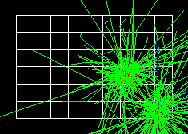
Calorimeters
6 x 9 crystal array
16cm
14 cm
22 cm
1 calo every 15°
= 24 calorimeters
Prototypes already pass performance specs in beam tests
Geant 4 simulation

Slide 19
Trackers
5 mm straws
UV doublets at 7.5°
9 independent tracking modules
Prototypes already pass performance specs in beam tests

Slide 20
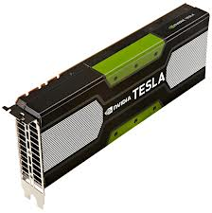
DAQ
GPU based DAQ to do online pulse finding

Slide 21
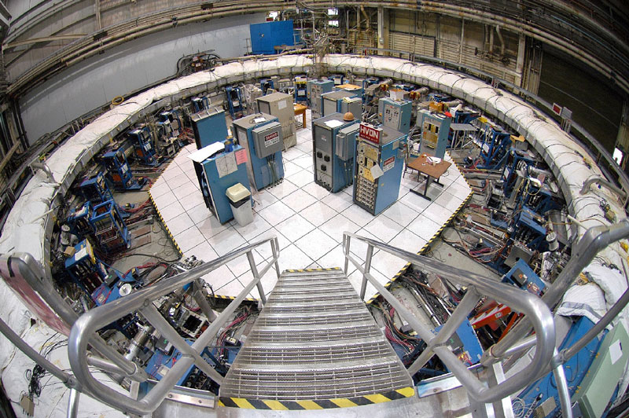
Disassembly
storage ring at the end of the last experiment

Slide 22
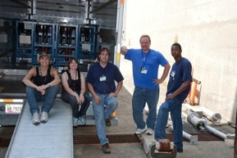
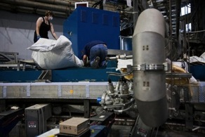
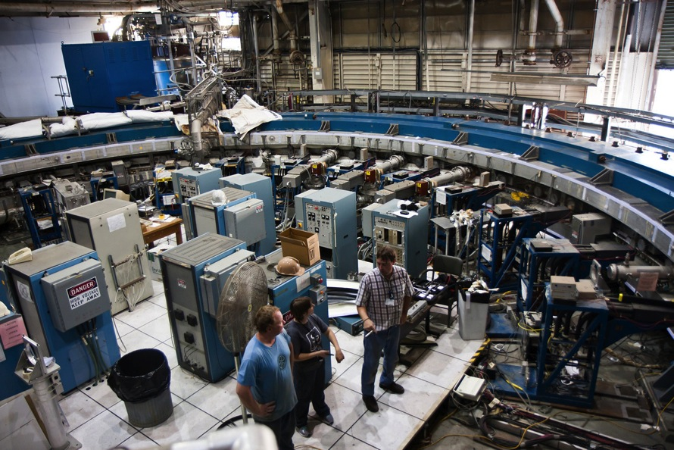
Disassembly
Summer 2011

Slide 23
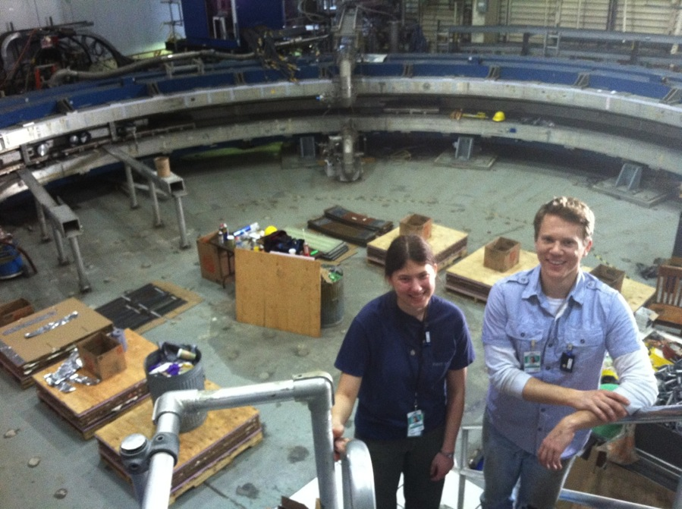
Disassembly
Summer 2012

Slide 24
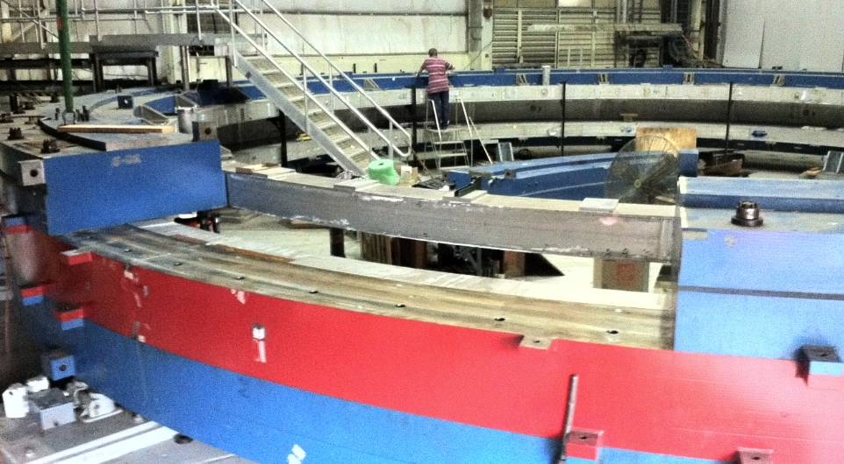
Disassembly
Fall 2012

Slide 25
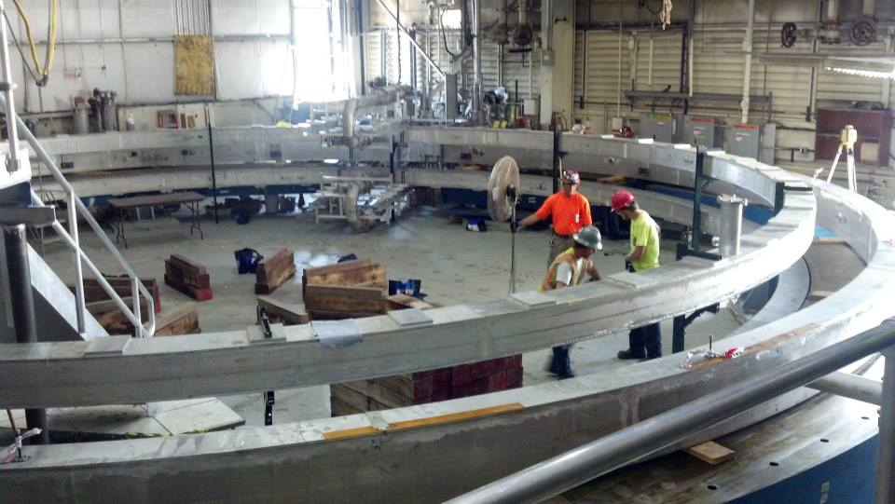
Disassembly
Spring 2013

Slide 26
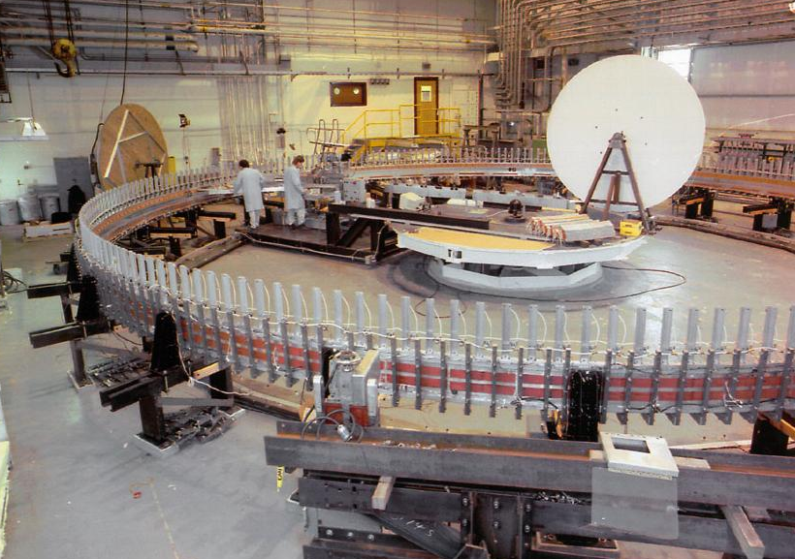
The problem
Original winding of the coils

Slide 27
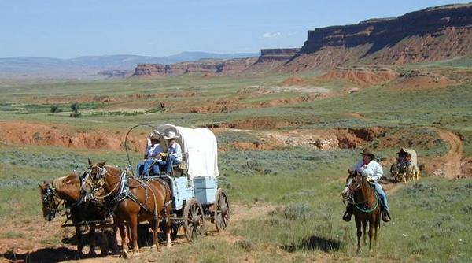
Transportation
What do you do when FedEx is not an option

Slide 28
Transportation
Took about 3 months for professionals to find a route
Land->barge->land
About 9 months of tweaking design and route
Helicopters ruled out on Chicago side due to population density
Northern sea route shorter but ruled out because of North Atlantic seas
Took southern route

Slide 29
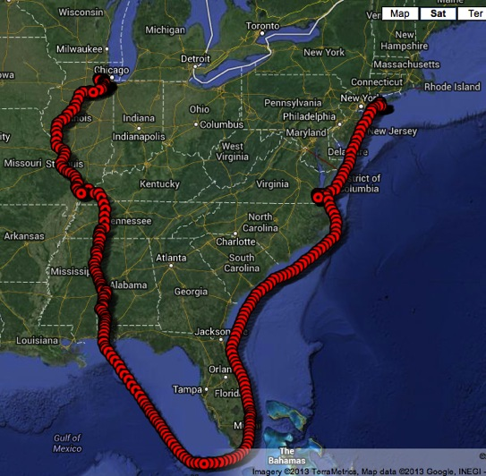
The big move
6/22: BNL
6/24: Great South Bay
6/25: Atlantic
6/27: Norfolk, Va
7/2: Atlantic
7/3: Graveyard of the Atlantic
7/7: Bermuda Triangle
7/9: Gulf of Mexico
7/13: Mobile Bay
7/14: Tombigbee River
7/15: Tennessee-Tom Waterway
7/16: Tennessee River
7/17: Ohio River
7/18: Mississippi River
7/19: Illinois River
7/20: Des Plains River
7/21: Lemont, IL
7/24: Costco
7/25: Hidden Lake
7/26: Fermilab

Slide 30
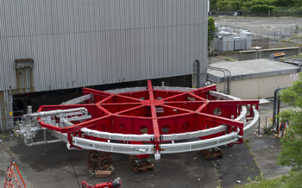
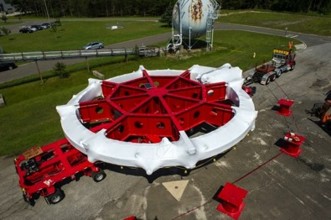
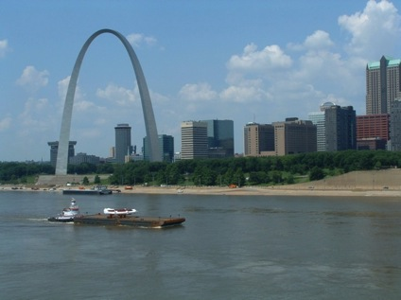
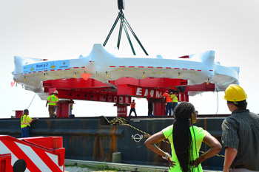
The big move

Slide 31
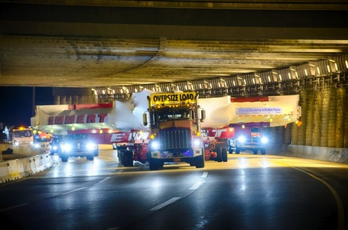
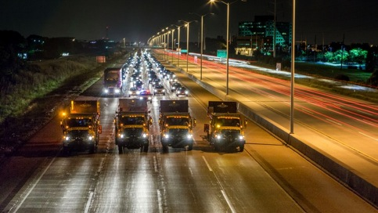
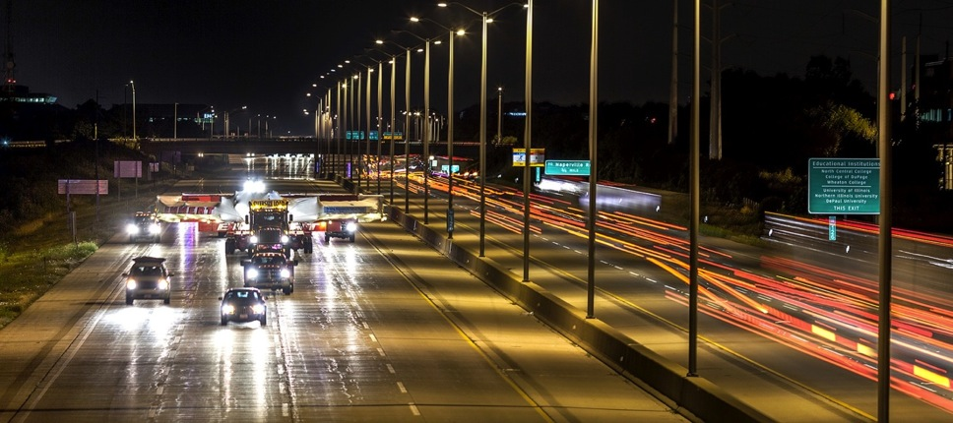
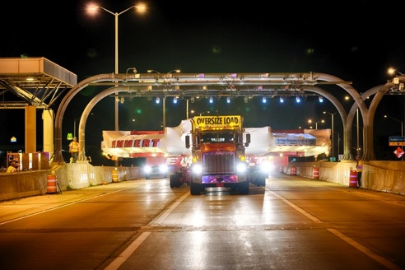
The big move

Slide 32
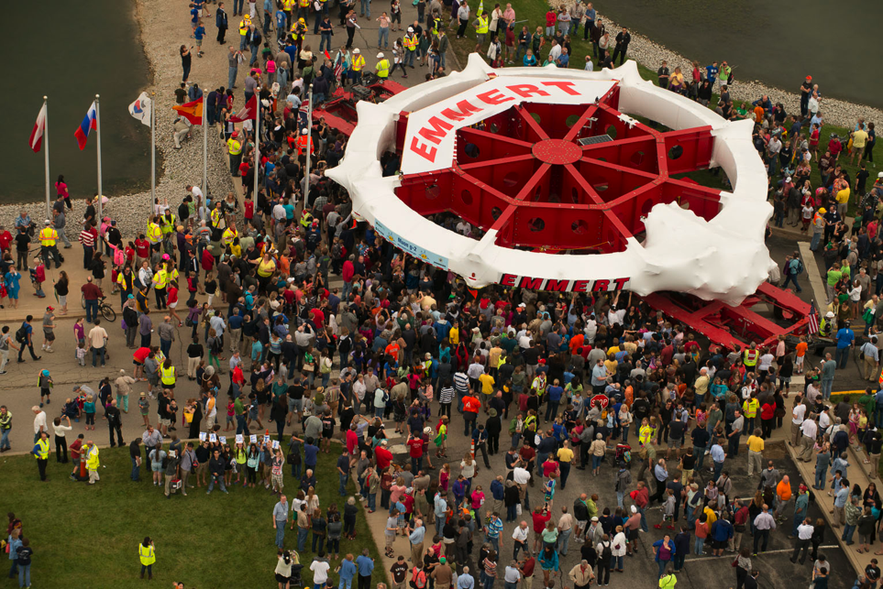
The big move

Slide 33
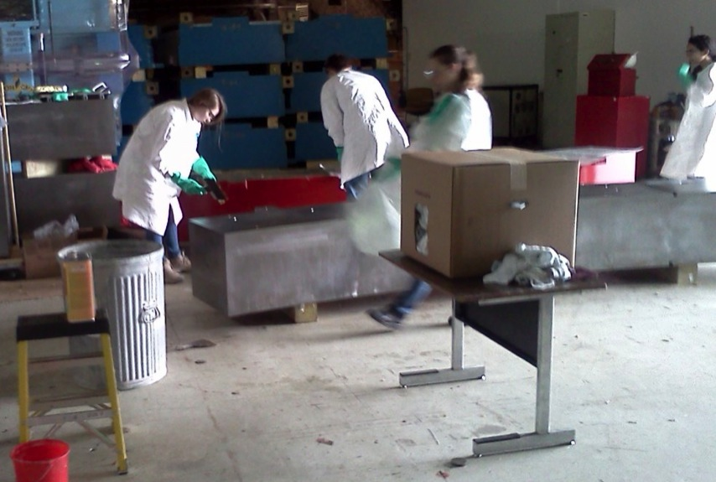
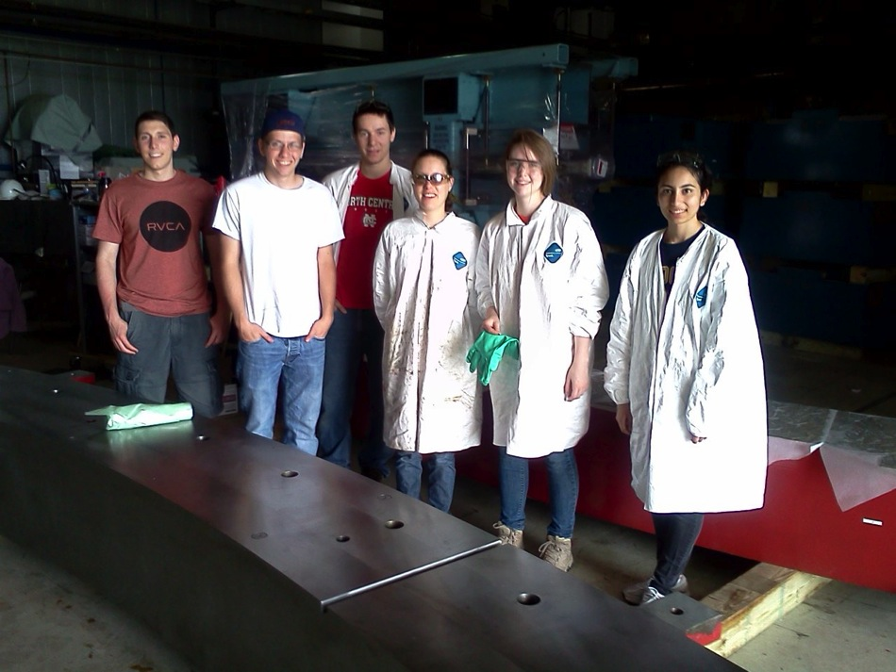
Cleaning up

Slide 34
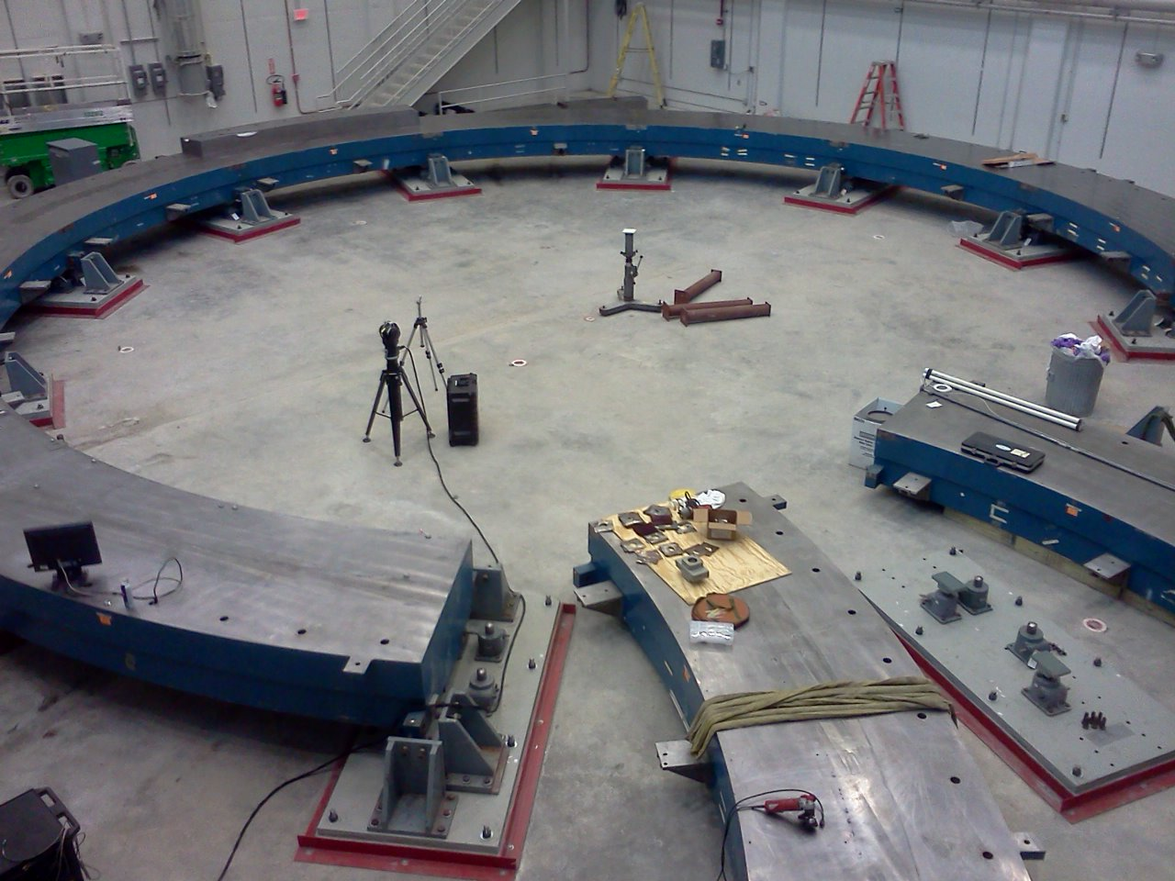
Installation
June 24, muon g-2 experimental hall

Slide 35
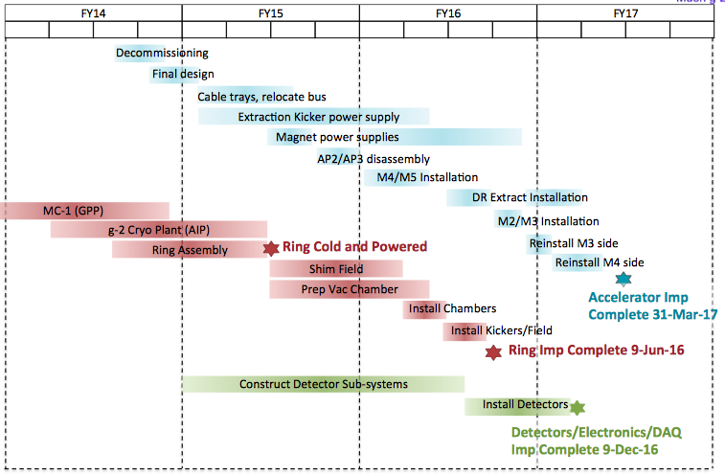
Schedule

Slide 36
Conclusions
Muon g-2 remains a key benchmark for SM and BSM physics
Using it as such in the future requires
  Better experiments (FNAL E989)
  Better predictions (Lattice)
Both the experiment and lattice are on track to have exciting results before the end of the decade

