Slide 1
Causal Space-Time on a Null Lattice with Hypercubic Coordination
Lattice 2014
Martin Schaden
Rutgers University - Newark
Department of Physics

Slide 2
Outline
Introduction: Two discretizations of causal manifolds
  Causal Dynamical Regge Triangulation (CDT) of Ambjørn and Loll
  or on a topological lattice
Topological Null Lattice
  Discretization of a causal 2,3,and 4 dimensional manifold
The Manifold Constraint
  Construction of the Topological Lattice Theory (TLT)
    for tetrads
    for spinors
Outlook
  Invariant integration measures and observables
  Regularization
Notes:
Generating Functional of a Roughness Profile
Then discuss the first attempt people try to include the roughness to the original theory is so called PFA app
Then I will talk about the contradiction between the perturbative correction and the scattering theory.
second

Slide 3
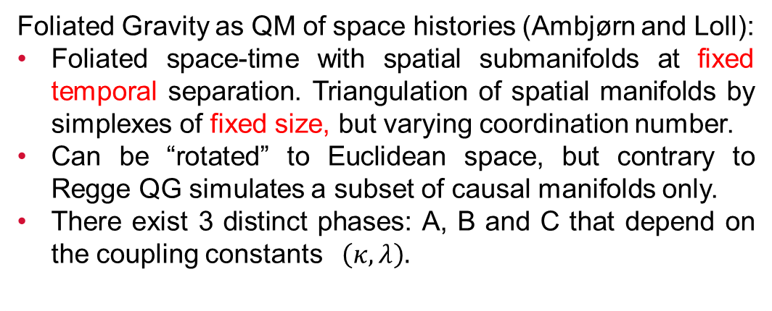
Causal Dynamical triangulation (CDT)
  Foliated Gravity as QM of space histories (Ambjørn and Loll):
Foliated space-time with spatial submanifolds at fixed temporal separation. Triangulation of spatial manifolds by simplexes of fixed size, but varying coordination number.
Can be “rotated” to Euclidean space, but contrary to Regge QG simulates a subset of causal manifolds only.
There exist 3 distinct phases: A, B and C that depend on the coupling constants$\left(κ, λ\right).$
A
t
Critical Continuum Limit ?
local # d.o.f. ?
C
B
Too restrictive ?
  Ambjørn,Jurkiewicz, Loll 2010

Slide 4
Null Lattice Combinatorics
Light-like signals naturally foliate a causal manifold:
The (future) light cones of a spatial line segment (in d=1), a spatial triangle (in d=2) and of a spatial tetrahedron (in d=3) intersect at a unique point:
d=3
d=1
d=2
Each spatial triangle (tetrahedron) maps to a point on a spatial (hyper-)surface with time-like separation
- if each vertex is common to 3 (4) otherwise disjoint triangles (tetrahedrons), the
mapping between points of two timelike separated spatial surfaces is 1 to 1 !!!!
- the (spatial) coordination of a spatial vertex in d=1,2,3 dimensions thus is 2,6,12.
In 2 (3) spatial dimensions the (spatial) triangulation is hexagonal (tetrahedral) and fixed!
LENGTHS ARE VARIABLE: LATTICE IS TOPOLOGICALLY (HYPER)CUBIC ONLY

Slide 5
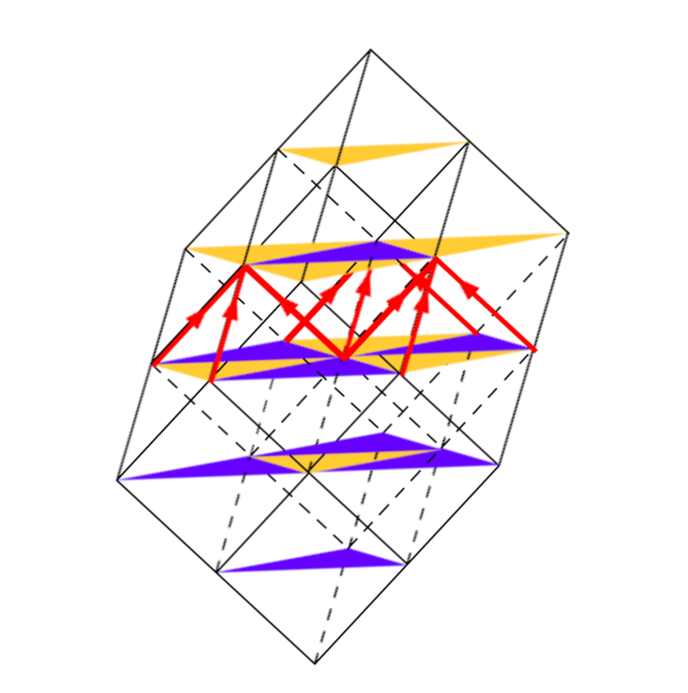

Null Lattices in 1+1 and 2+1 dimensions
$$E_{μ},ξ_{μ};U_{μ}$$
t
d=1
d=2
d=3
Deformed: Actual geometry determined by “fields” $E_{μ}(n),ξ_{μ}(n);U_{μ}(n)$ on lattice.
Notes:
The first reliable measurement of the casimir force was conducted by Mohideen and Roy in 1998. 50 years after casimir predicted it. They measured the casimir force between a gold-coated styrofoam sphere and a gold-coated plate
The sphere is mounted on a cantilever whose deflection is monitored with a laser. They use a sphere and plate configuration because it is hard
to experimentally have parallel plates and to avoid finite-size corrections. The roughness amplitude on both surface is about 35nm

Slide 6
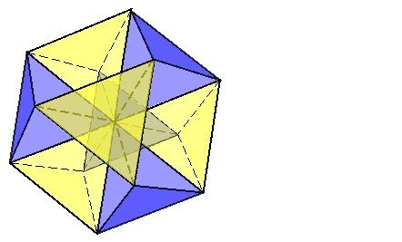
Spatial Triangulation in d=1,2,3
Coordination=d(d+1)
Linear in d=1
Coordination=2
Tetrahedral in d=3
Coordination=12
The tetrahedra in this triangulation of spatial hypersurfaces in general are neither equal nor regular !
Hexagonal in d=2
Coordination=6

Slide 7
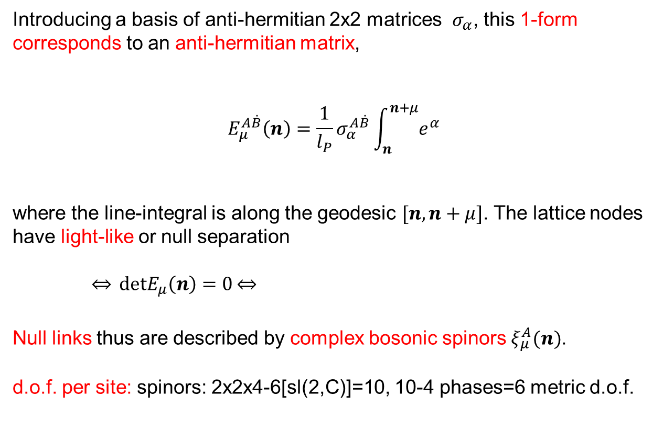
Null Coframes
Co-frame,
is a 1-form
Introducing a basis of anti-hermitian 2x2 matrices $σ_{α}$, this 1-form
corresponds to an anti-hermitian matrix,
$$E_{μ}^{A\dot{B}}\left(n\right)=\frac{1}{l_{P}}σ_{α}^{A\dot{B}}\int_{n}^{n+μ}{e^{α}}$$
where the line-integral is along the geodesic $[n,n+μ]$. The lattice nodes
have light-like or null separation
$\overset{⇔}{} detE_{μ}\left(n\right)=0\overset{⇔}{}$
Null links thus are described by complex bosonic spinors $ξ_{μ}^{A}(n)$.
d.o.f. per site: spinors: 2x2x4-6[sl(2,C)]=10, 10-4 phases=6 metric d.o.f.

Slide 8
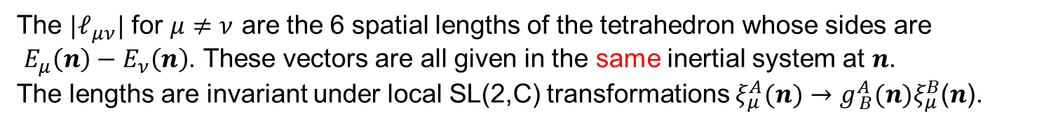
The Metric and a Skew Spinorial Form
Local (spatial) lengths on the null lattice are given by the scalar product :
with the SL(2,C) invariant skew-symmetric tensor
and the invariant skew product
The latter algebraically satisfies:
The ${|ℓ}_{μν}^{}|$ for $μ≠ν$ are the 6 spatial lengths of the tetrahedron whose sides are
$E_{μ}\left(n\right)−E_{ν}\left(n\right)$. These vectors are all given in the same inertial system at $n$.
The lengths are invariant under local SL(2,C) transformations $ξ_{μ}^{A}(n)→g_{ B}^{A}(n)ξ_{μ}^{B}$($n$).
Since $Pf\left[f_{μν}(n)\right]=0, ∃$ two vectors $ξ_{A}^{μ}$ for which
skew form: 2x6-2constraints=10,10-4 =6 only $|f_{μν}$| related to metric

Slide 9
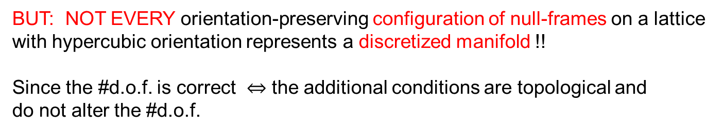
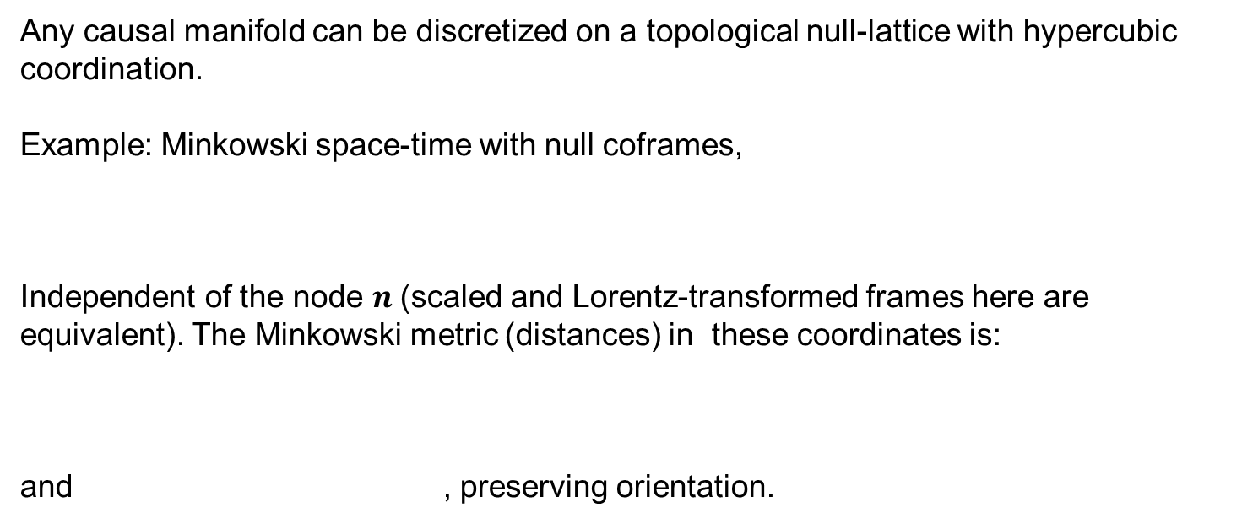

The Manifold Condition
Any causal manifold can be discretized on a topological null-lattice with hypercubic coordination.
Example: Minkowski space-time with null coframes,
Independent of the node $n$(scaled and Lorentz-transformed frames here are equivalent). The Minkowski metric (distances) in these coordinates is:
and , preserving orientation.
$$−ℓ_{μν}^{2}=$$
BUT: NOT EVERY orientation-preserving configuration of null-frames on a lattice
with hypercubic orientation represents a discretized manifold !!
Since the #d.o.f. is correct $⇔$ the additional conditions are topological and
do not alter the #d.o.f.
Notes:
Instead of directly modeling or evaluating the roughness profile h(x), in our theory we ch……….
So these are the the definitions for all correlation functions 1 point 2 points…..until n points.
And here we also assume that the plate is translational invariance so all these correlation functions only depend on the differences in the transverse coordinates.
so In other words we do not need to know roughness profile at every point on the plate, but we need to know or measure (all) its correlators.
Then because we want to have a field description for the roughness profile so we collect all correlation functions in a single generating functional Zh
and model it as a Gaussian form with D2=

Slide 10

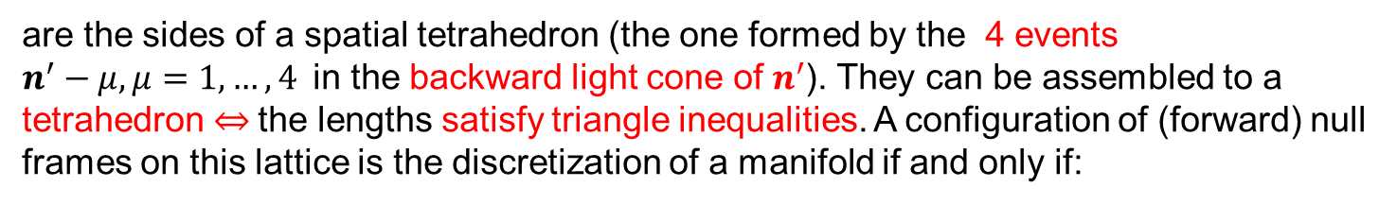
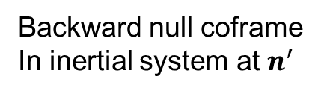
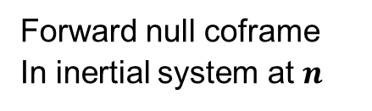
The Manifold Condition for Coframes
For a lattice configuration to be the triangulation of a manifold, distances between events common to two inertial systems (“overlapping atlases”) must be the same:
$${{−E}_{μ}(n)∙E_{ν}(n)\text{=}ℓ}_{μν}^{2}={−\tilde{E}}_{μ}(n^{′})∙{\tilde{E}}_{ν}(n^{′})$$
Forward null coframe
In inertial system at $n^{}$
Backward null coframe
In inertial system at $n^{′}$
For a fixed event $n^{′},$ the six spatial lengths $μ≠ν$
$${0<ℓ}_{μν}^{2}\left(n^{′}\right)={−E}_{μ}(n^{′}−μ−ν)∙E_{ν}(n^{′}−μ−ν)$$
are the sides of a spatial tetrahedron (the one formed by the 4 events
$n^{′}−μ, μ=1,…,4$in the backward light cone of $n^{′}$). They can be assembled to a tetrahedron $⇔$the lengths satisfy triangle inequalities. A configuration of (forward) null frames on this lattice is the discretization of a manifold if and only if:

Slide 11
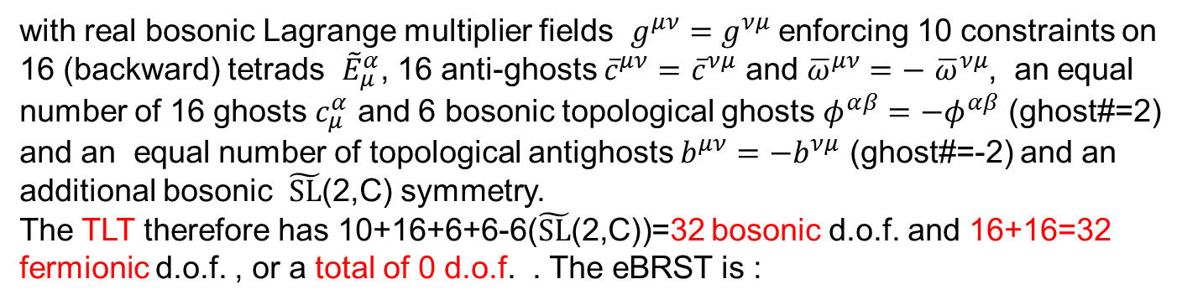
The eBRST and TLT of the Manifold Condition
The manifold condition can be enforced by a local TLT with an equivariant BRST.
The action of this TLT is:
with real bosonic Lagrange multiplier fields $g^{μν}=g^{νμ}$ enforcing 10 constraints on 16 (backward) tetrads ${\tilde{E}}_{μ}^{α}$, 16 anti-ghosts ${\overline{c}}^{μν}=$ ${\overline{c}}^{νμ}$ and ${\overline{ω}}^{μν}=−$ ${\overline{ω}}^{νμ}$, an equal number of 16 ghosts $c_{μ}^{α}$ and 6 bosonic topological ghosts $φ^{αβ}=−φ^{αβ}$ (ghost#=2) and an equal number of topological antighosts $b^{μν}=−b^{νμ}$ (ghost#=-2) and an additional bosonic $\tilde{SL}$(2,C) symmetry.
The TLT therefore has 10+16+6+6-6($\tilde{SL}$(2,C))=32 bosonic d.o.f. and 16+16=32 fermionic d.o.f. , or a total of 0 d.o.f. . The eBRST is :
The additional fields of the TLT can in fact be integrated out to give the triangle
inequality constraints:

Slide 12
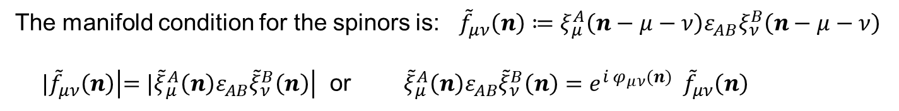
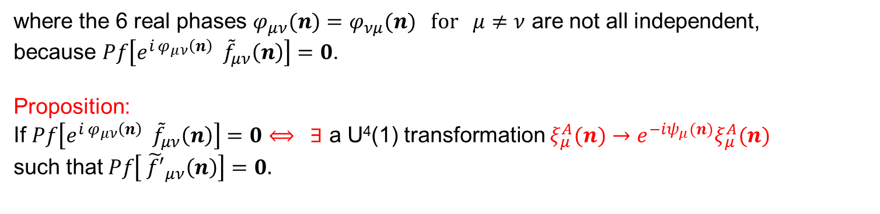
The Manifold Condition for Spinors
The manifold condition for the spinors is: ${\tilde{f}}_{μν}\left(n\right)≔ξ_{μ}^{A}\left(n−μ−ν\right)ε_{AB}ξ_{ν}^{B}\left(n−μ−ν\right)$
${|\tilde{f}}_{μν}\left(n\right)\left|={|\tilde{ξ}}_{μ}^{A}\left(n\right)ε_{AB}{\tilde{ξ}}_{ν}^{B}\left(n\right)\right|$ or ${\tilde{ξ}}_{μ}^{A}\left(n\right)ε_{AB}{\tilde{ξ}}_{ν}^{B}\left(n\right)={e^{{i φ}_{μν}(n)} \tilde{f}}_{μν}\left(n\right)$
where the 6 real phases $φ_{μν}(n)=φ_{νμ}(n) for μ≠ν$ are not all independent,
because $Pf\left[{e^{{i φ}_{μν}\left(n\right)} \tilde{f}}_{μν}\left(n\right)\right]=0$.
Proposition:
If $Pf\left[{e^{{i φ}_{μν}\left(n\right)} \tilde{f}}_{μν}\left(n\right)\right]=0⟺ ∃$ a U⁴(1) transformation $ξ_{μ}^{A}(n)→e^{−iψ_{μ}(n)}ξ_{μ}^{A}(n)$
such that $Pf\left[{ \tilde{f′}}_{μν}\left(n\right)\right]=0.$
Proof: Choose $ψ_{1}\left(n\right)=−ψ_{2}\left(n\right) ; ψ_{3}\left(n\right)=−ψ_{4}\left(n\right)$ and denote${ ψ}_{1}\left(n\right)±ψ_{3}\left(n\right)=ψ_{±}\left(n\right)$
The 2 relations decouple and can be solved uniquely (modulo b.c.):
$$ψ_{+}\left(n−2−4\right)−ψ_{+}\left(n−1−3\right)=φ_{12}\left(n\right)+φ_{34}\left(n\right){−φ}_{13}\left(n\right)−φ_{42}\left(n\right)$$
$$ψ_{−}\left(n−2−3\right)−ψ_{−}\left(n−1−4\right)={φ_{12}\left(n\right)+φ_{34}\left(n\right)−φ}_{14}\left(n\right)−φ_{23}\left(n\right)$$
manifold condition $⟺ ∃ U^{4}\left(1\right) transformation ∋ Pf\left({\tilde{f}}_{μν}\left(n\right)\right)=0$

Slide 13
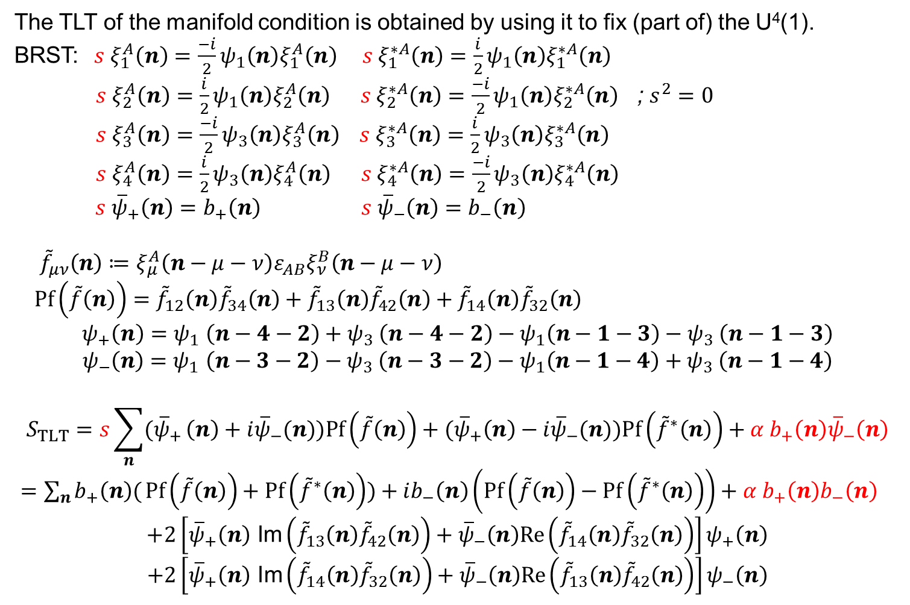
The Manifold TLT for Spinors
The TLT of the manifold condition is obtained by using it to fix (part of) the U⁴(1).
BRST:$s ξ_{1}^{A}\left(n\right)=\frac{−i}{2}ψ_{1}\left(n\right)ξ_{1}^{A}\left(n\right) s ξ_{1}^{∗A}\left(n\right)=\frac{i}{2}ψ_{1}\left(n\right)ξ_{1}^{∗A}\left(n\right)$
$s ξ_{2}^{A}\left(n\right)=\frac{i}{2}ψ_{1}\left(n\right)ξ_{2}^{A}\left(n\right) s ξ_{2}^{∗A}\left(n\right)=\frac{−i}{2}ψ_{1}\left(n\right)ξ_{2}^{∗A}\left(n\right)$ ; $s^{2}{=0 }_{}$
$s ξ_{3}^{A}\left(n\right)=\frac{−i}{2}ψ_{3}\left(n\right)ξ_{3}^{A}\left(n\right) s ξ_{3}^{∗A}\left(n\right)=\frac{i}{2}ψ_{3}\left(n\right)ξ_{3}^{∗A}\left(n\right)$
$s ξ_{4}^{A}\left(n\right)=\frac{i}{2}ψ_{3}\left(n\right)ξ_{4}^{A}\left(n\right) s ξ_{4}^{∗A}\left(n\right)=\frac{−i}{2}ψ_{3}\left(n\right)ξ_{4}^{∗A}\left(n\right)$
$s {\overline{ψ}}_{+}\left(n\right)=b_{+}\left(n\right) s {\overline{ψ}}_{−}\left(n\right)=b_{−}\left(n\right)$
${\tilde{f}}_{μν}\left(n\right)≔ξ_{μ}^{A}\left(n−μ−ν\right)ε_{AB}ξ_{ν}^{B}\left(n−μ−ν\right)$
$Pf\left(\tilde{f}\left(n\right)\right)={\tilde{f}}_{12}\left(n\right){\tilde{f}}_{34}\left(n\right)+{\tilde{f}}_{13}\left(n\right){\tilde{f}}_{42}\left(n\right)+{\tilde{f}}_{14}\left(n\right){\tilde{f}}_{32}\left(n\right)$
$$ψ_{+}\left(n\right){=ψ}_{1}\left(n−4−2\right){+ ψ}_{3}\left(n−4−2\right)−ψ_{1}\left(n−1−3\right){− ψ}_{3}\left(n−1−3\right)$$
$$ψ_{−}\left(n\right){=ψ}_{1}\left(n−3−2\right){− ψ}_{3}\left(n−3−2\right)−ψ_{1}\left(n−1−4\right){+ ψ}_{3}\left(n−1−4\right)$$
$$S_{TLT}=s\sum_{n}{({\overline{ψ}}_{+}}\left(n\right)+i{\overline{ψ}}_{−}(n))Pf\left(\tilde{f}\left(n\right)\right)+({\overline{ψ}}_{+}\left(n\right)−i{\overline{ψ}}_{−}(n))Pf\left({\tilde{f}}^{∗}\left(n\right)\right)+{α b}_{+}\left(n\right){\overline{ψ}}_{−}\left(n\right)$$
$=\sum_{n}{b_{+}\left(n\right)(}Pf\left(\tilde{f}\left(n\right)\right)+Pf\left({\tilde{f}}^{∗}\left(n\right)\right))+ib_{−}\left(n\right)\left(Pf\left(\tilde{f}\left(n\right)\right)−Pf\left({\tilde{f}}^{∗}\left(n\right)\right)\right)+{α b}_{+}\left(n\right)b_{−}\left(n\right)$
$$+2\left[{\overline{ψ}}_{+}\left(n\right) \text{Im}\left({\tilde{f}}_{13}\left(n\right){\tilde{f}}_{42}\left(n\right)\right)+{\overline{ψ}}_{−}\left(n\right)Re\left({\tilde{f}}_{14}\left(n\right){\tilde{f}}_{32}\left(n\right)\right)\right]ψ_{+}\left(n\right)$$
$$+2\left[{\overline{ψ}}_{+}\left(n\right) \text{Im}\left({\tilde{f}}_{14}\left(n\right){\tilde{f}}_{32}\left(n\right)\right)+{\overline{ψ}}_{−}\left(n\right)Re\left({\tilde{f}}_{13}\left(n\right){\tilde{f}}_{42}\left(n\right)\right)\right]ψ_{−}\left(n\right)$$

Slide 14
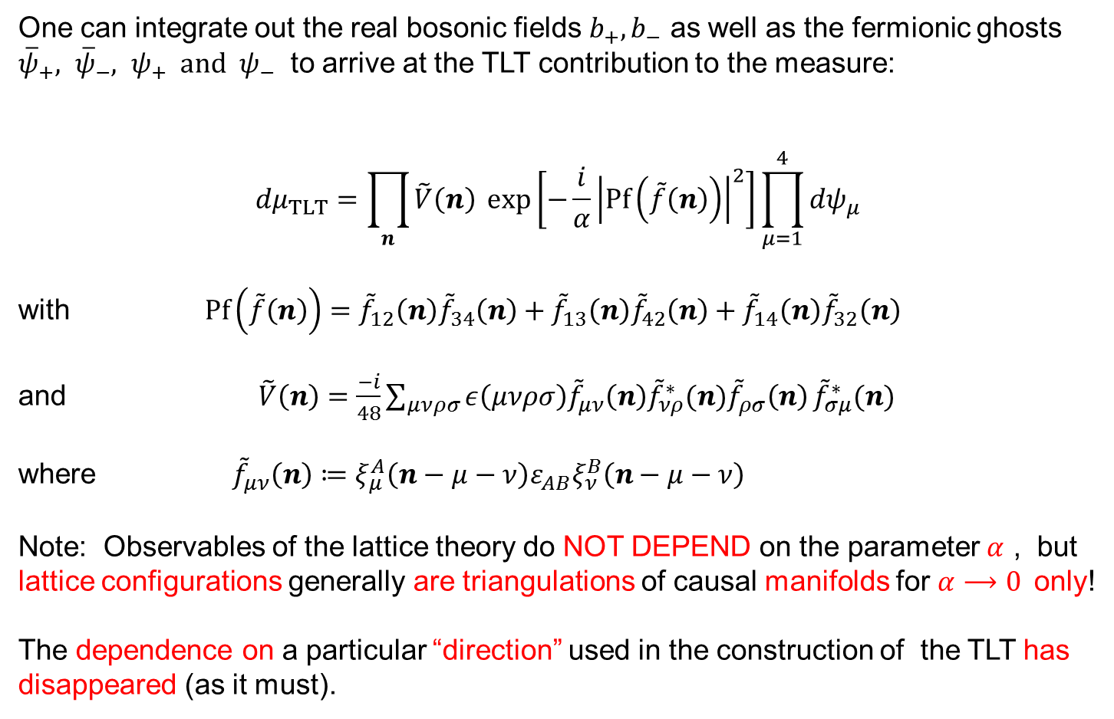
The TLT measure
One can integrate out the real bosonic fields $b_{+}, b_{−}$ as well as the fermionic ghosts ${\overline{ψ}}_{+}, {\overline{ψ}}_{−}, ψ_{+} and ψ_{−}$ to arrive at the TLT contribution to the measure:
$${dμ}_{TLT}=\prod_{n}{\tilde{V}\left(n\right) }exp⁡\left[−\frac{i}{α}{\left|Pf\left(\tilde{f}\left(n\right)\right)\right|}^{2}\right]\prod_{μ=1}^{4}{dψ_{μ}}$$
with $Pf\left(\tilde{f}\left(n\right)\right)={\tilde{f}}_{12}\left(n\right){\tilde{f}}_{34}\left(n\right)+{\tilde{f}}_{13}\left(n\right){\tilde{f}}_{42}\left(n\right)+{\tilde{f}}_{14}\left(n\right){\tilde{f}}_{32}\left(n\right)$
and $\tilde{V}\left(n\right)=\frac{−i}{48}\sum_{μνρσ}{ε\left(μνρσ\right){\tilde{f}}_{μν}\left(n\right){{\tilde{f}}_{νρ}^{∗}(n)\tilde{f}}_{ρσ}\left(n\right)}{\tilde{f}}_{σμ}^{∗}(n)$
where ${\tilde{f}}_{μν}\left(n\right)≔ξ_{μ}^{A}\left(n−μ−ν\right)ε_{AB}ξ_{ν}^{B}\left(n−μ−ν\right)$
Note: Observables of the lattice theory do NOT DEPEND on the parameter $α$ , but lattice configurations generally are triangulations of causal manifolds for $α⟶0$only!
The dependence on a particular “direction” used in the construction of the TLT has disappeared (as it must).

Slide 15
Conclusion and Outlook
Summary:
Causal description of discretized space-time on a null lattice with fixed hypercubic coordination.
Local eBRST actions that encode the topological manifold condition.
Outlook:
Integration Measures and Regularization
Invariants and Observables
eBRST localization to compact SU(2) structure group of spatial rotations.
Hope You Enjoyed the Talk. Thank You.

Slide 16
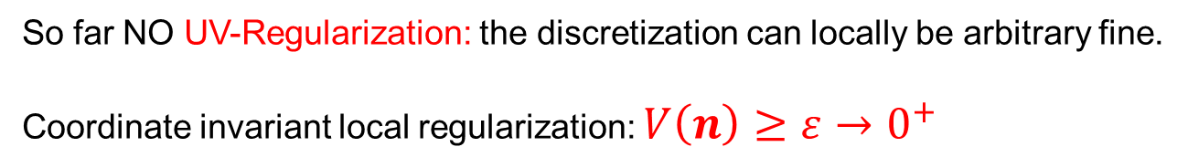
Invariant Integral Measures & Regularization
The integration measures for the spinors and SL(2,C) transport matrices are
dictated by SL(2,C) invariance:
or
Parameterizing:
The SL(2,C) invariant measure for the tetrads is:
The invariant measure of SL(2,C) matrices:
is the (non-compact) SL(2,C) Haar measure:$dμ\left[U_{μ}\left(n\right)\right]=dμ_{SL(2,C)}$
So far NO UV-Regularization: the discretization can locally be arbitrary fine.
Coordinate invariant local regularization: $V\left(n\right)≥ε→0^{+}$

Slide 17
Invariants and Observables
Basic SL(2,C) invariants
Closed loops:
Open strings:
SL(2,C) parallel transport
Most local
examples:
Observables are real scalars of SL(2,C) invariant densities. Some are:
4-volume
Hilbert-Palatini term

Slide 18
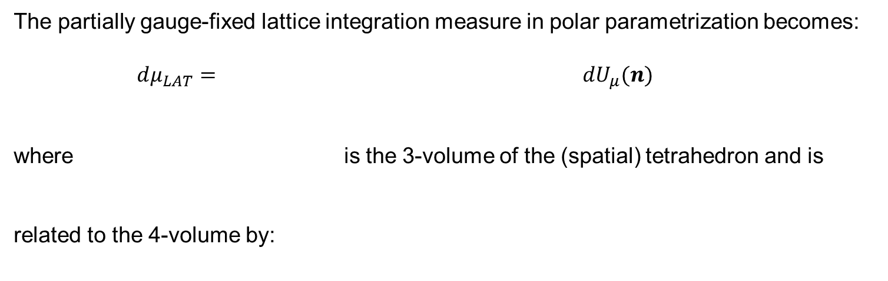

Partial Localization
No matter what the invariant action, we must factor the infinite volume of the
non-compact SL(2,C) structure group!
We localize to the compact SU(2) subgroup of spatial rotations by requiring:
Physically we are choosing a local inertial system at n where the 4 non-collinear events on the forward light cone are simultaneous. This local inertial system always exists and is unique up to spatial rotations.
The partial gauge fixing is local and ghost-free. It is unique and the Jacobian can be evaluated explicitly. The residual SU(2) structure group is compact !
The partially gauge-fixed lattice integration measure in polar parametrization becomes:
$dμ_{LAT}=$ $dU_{μ}(n)$
where is the 3-volume of the (spatial) tetrahedron and is
related to the 4-volume by:
$$\overset{→}{p.g.f.}τ^{4}(n)\hat{V}(n)$$

Slide 19
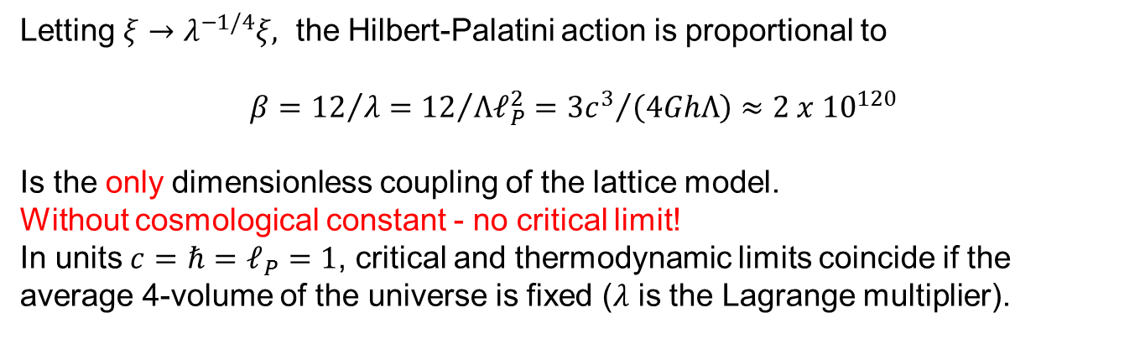
Lattice Actions
volume
Hilbert-Palatini
Holst
Letting $ξ→λ^{−1/4}ξ,$ the Hilbert-Palatini action is proportional to
$$β={12}/λ={12}/{Λℓ_{P}^{2}}={{3c}^{3}}/{\left(4GhΛ\right)}≈{2 x 10}^{120}$$
Is the only dimensionless coupling of the lattice model.
Without cosmological constant - no critical limit!
In units $c=ℏ=ℓ_{P}=1$, critical and thermodynamic limits coincide if the average 4-volume of the universe is fixed ($λ$ is the Lagrange multiplier).

Slide 20
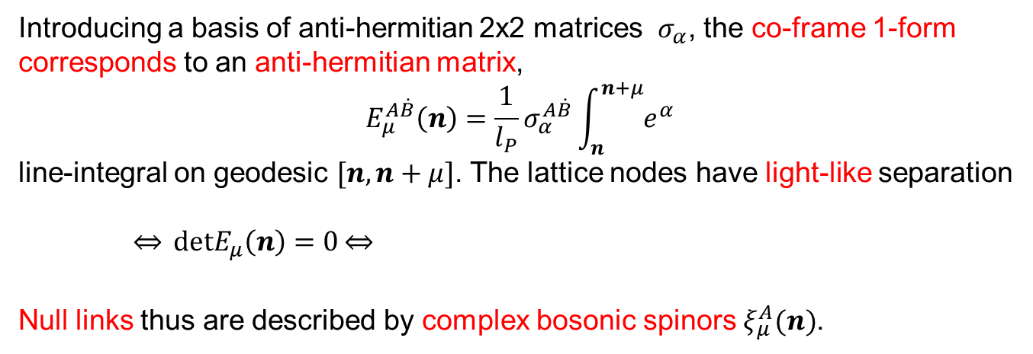
Hilbert-Palatini GR with Null Co-Frames
Co-frame,
is a 1-form
so(3,1) curvature
is a 2-form
constructed from an SL(2,C) connection 1-form
Introducing a basis of anti-hermitian 2x2 matrices $σ_{α}$, the co-frame 1-form
corresponds to an anti-hermitian matrix,
$$E_{μ}^{A\dot{B}}\left(n\right)=\frac{1}{l_{P}}σ_{α}^{A\dot{B}}\int_{n}^{n+μ}{e^{α}}$$
line-integral on geodesic $[n,n+μ]$. The lattice nodes have light-like separation
$\overset{⇔}{} detE_{μ}\left(n\right)=0\overset{⇔}{}$
Null links thus are described by complex bosonic spinors $ξ_{μ}^{A}(n)$.

Slide 21
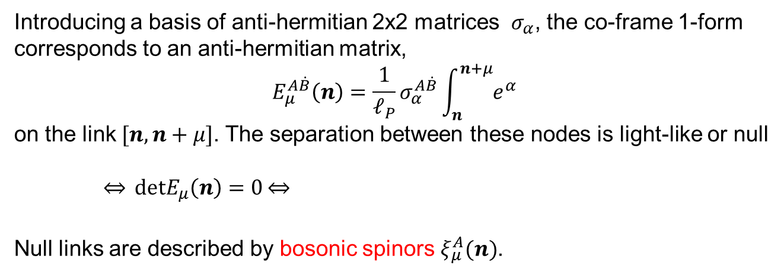
Hilbert-Palatini GR with Null Co-Frames
First order formulation of electromagnetism:
First order formulation for a scalar:
and a spinor:
Upon shifting the auxiliary field${ B}_{}^{αβ}$ ,
Co-frame,
is a 1-form
so(3,1) curvature
is a 2-form
constructed from an SL(2,C) connection 1-form
Introducing a basis of anti-hermitian 2x2 matrices $σ_{α}$, the co-frame 1-form
corresponds to an anti-hermitian matrix,
$$E_{μ}^{A\dot{B}}\left(n\right)=\frac{1}{ℓ_{P}}σ_{α}^{A\dot{B}}\int_{n}^{n+μ}{e^{α}}$$
on the link $[n,n+μ]$. The separation between these nodes is light-like or null
$\overset{⇔}{} detE_{μ}\left(n\right)=0\overset{⇔}{}$
Null links are described by bosonic spinors $ξ_{μ}^{A}(n)$.

