Slide 1
Deconfinement transition in two-flavour lattice QCD with dynamical overlap fermions in an external magnetic field
Oleg Kochetkov (Uni Regensburg)
in collaboration with
V.G.Bornyakov, P.V. Buividovich, N.Cundy, A.Schäfer

Slide 2
Outline
Motivation
Magnetic Catalysis Tc(B)>Tc(0)
vs
Inverse Magnetic Catalysis Tc(B)<Tc(0)
Simulation details(algorithm, parameters)
Effects of magnetic field at T~Tc and T>Tc
Polyakov loop
Chiral condensate
Eigenvalue density
Summary
Notes:
Catalysis is the shift of the phase transition

Slide 3
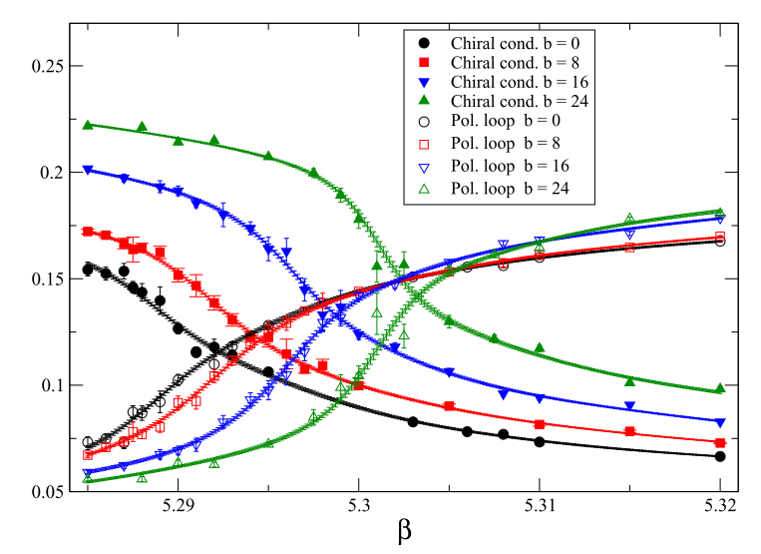
Magnetic catalysis scenario:
D‘Elia et al(ARXIV:1005.5365v2) with stagerred action
Notes:
Magnetic field can have an influence on the results of heavy-ion collision experiments.
Also, it can shift a deconfinement phase transition.
Intensive studies of external magnetic field effects has been performed on the lattice.

Slide 4
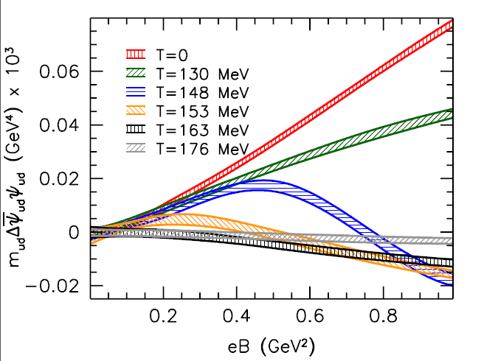
Inverse magnetic catalysis scenario:
G.Bali et al(ARXIV:1303.1328v2) stout stagerred fermions with physical mass
Notes:
Pion mass+ action!!!!!!!

Slide 5
Simulation parameters
3-color QCD with dynamic overlap fermions
- truly chiral lattice fermions( 2 light quarks with charges +1/3 and -2/3)
Tadpole improved Lüsher-Weisz gauge action
Lattice size: ${16}^{3}$×6
Gauge coupling β=7.5 … 8.3
Pion mass: ~500 MeV on ${12}^{3}$×24 lattice and β=8.1
Hermitian overlap operator:

Slide 6
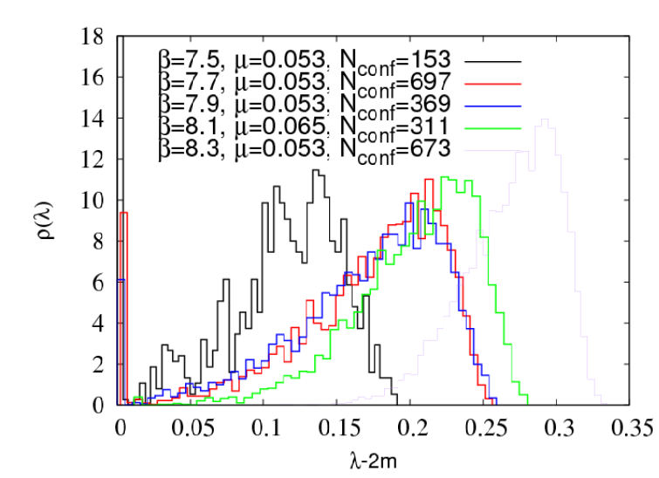
Shift of eigenvalue density with zero magnetic field

Slide 7
Algorithm
Supports topological tunneling between topological sectors
Reduces autocorrelation length of topological charge
Disadvantage: density of $γ_{5}D_{w}$ eigenvalues near zero increases with the physical volume
Notes:
This is the first algorithm with dynamical overlap and topological tunneling.

Slide 8
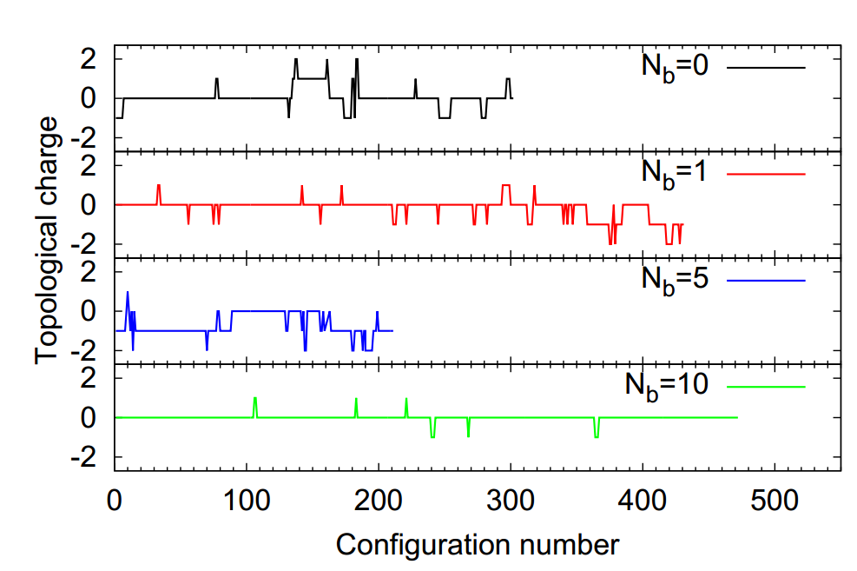
History of topological charge in confinement regime

Slide 9
Total statistics with non-zero magnetic field:
B, β | 7.5 (T~Tc,T=220MeV) | 8.3 (T>Tc,T=280MeV)
0 | 302 | 1333
1 | 443 | 750
5 | 378 | 762
10 | 774 | 778

Slide 10
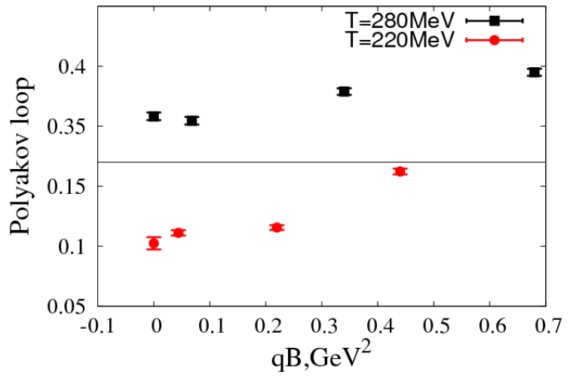
Non-renormalized Polyakov loop dependence on magnetic field

Slide 11
Start from path integral expression for chiral condensate:
“Sea” quarks effect:
Determinant will suppress configurations with large number of zero modes!!!

Slide 12
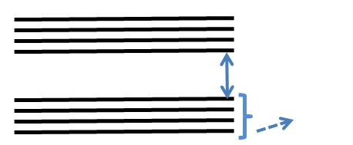
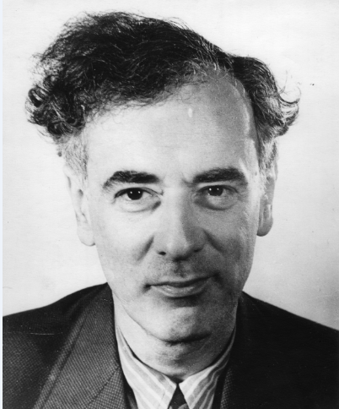
“Valence” quarks effect:
Magnetic field shifts the low-lying Dirac modes closer to zero!!!!
~$\sqrt{B}$
~B
Landau levels!!!

Slide 13
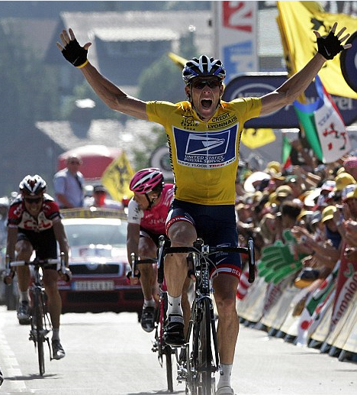
Competition between valence and sea quarks: who is the winner?
Sea
Valence

Slide 14
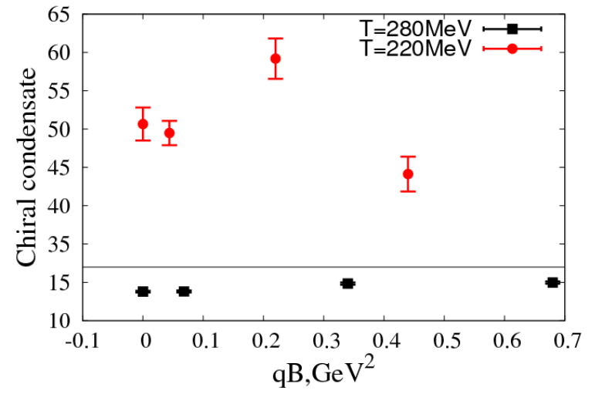
Chiral condensate dependence on magnetic field
OK,PB et al (ARXIV:1312.5628) G.Bali,F.Bruckmann et al (ARXIV:1303.1328v2)
Notes:
Формулу
Plot …, plot with lines для нашего рисунка
Можно написать для каждого рисунка T=… текстом.

Slide 15
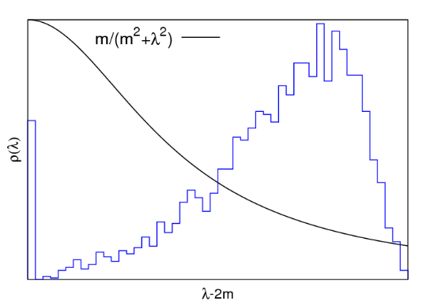
A-la Banks-Casher relation:
m
Notes:
Chiral condensate and dirac spectra are related via Banks-Casher.

Slide 16
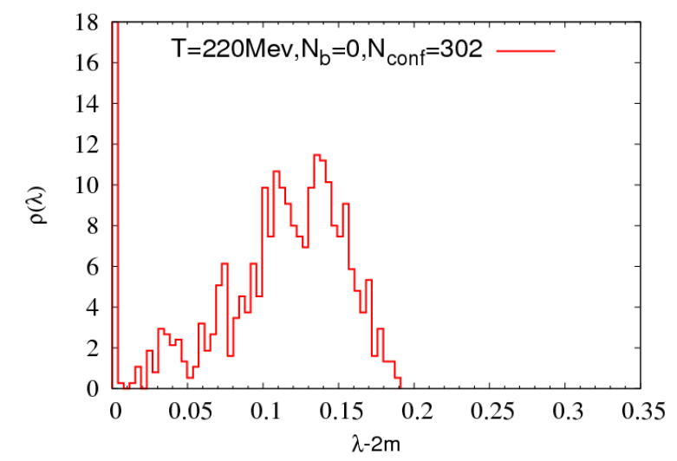
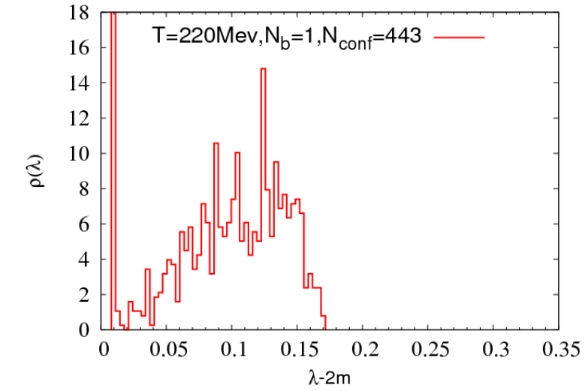
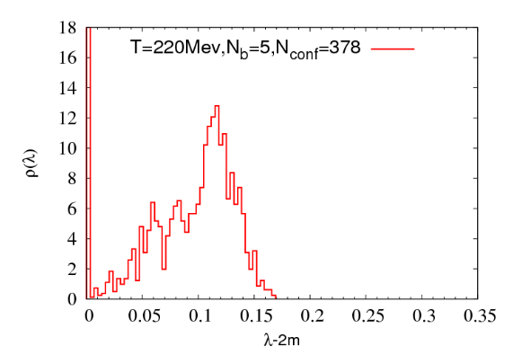
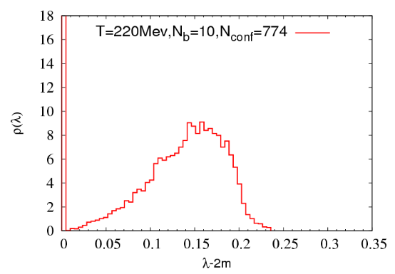
Histograms of eigenvalues of Hermitian Overlap operator at T=220Mev
Notes:
20 lowest eigenmodes for each histogram.

Slide 17
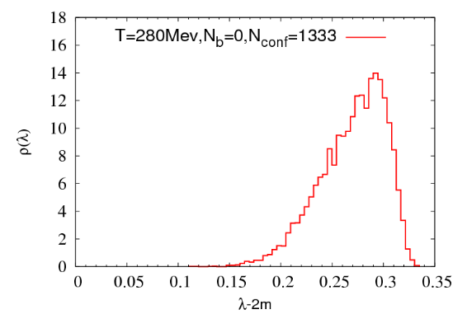
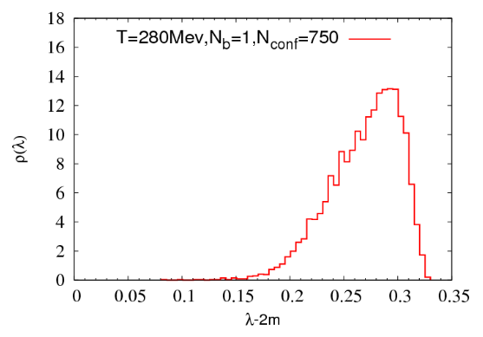
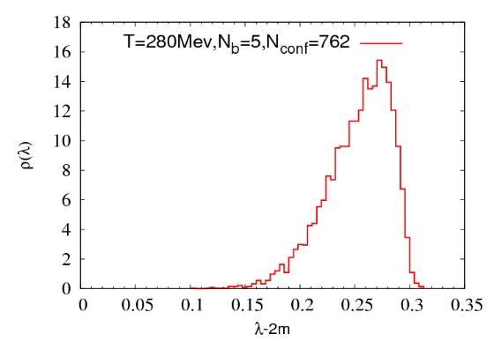
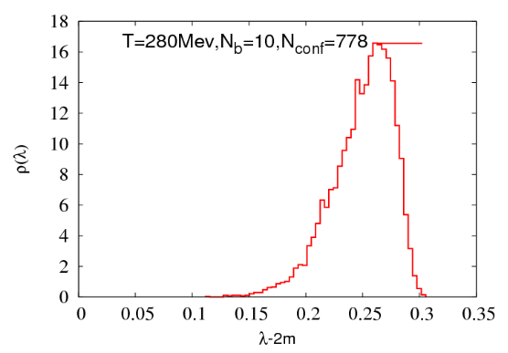
Histograms of eigenvalues of Hermitian Overlap operator at T=280Mev
Notes:
Eigenvalues almost does not move with magnetic field and at deconfinement phase chiral condensate stays nearly at the same level.

Slide 18
Conclusions:
Observed Inverse Magnetic Catalysis ( decrease of the deconfinement temperature) with true chiral fermions even with sufficiently large pion mass.
Also, overlap fermions seems to be advantageous for magnetic field studies

Slide 19
Thanks for attention!

