Slide 1
Fermion mass generation without a chiral condensate?
Venkitesh Ayyar, Shailesh Chandrasekharan
Duke University
Lattice 2014 NYC, 6/27/2014
Work supported by DOE grant #DEFG0205ER41368
Computational work done using the Open Science Grid (OSG) and local Duke cluster.

Slide 2

Introduction
Symmetries can forbid the inclusion of mass terms.
Chiral symmetries $⟹$ massless fermions.
Can interactions that preserve these symmetries generate fermion masses dynamically ?
Conventionally by Spontaneous Symmetry Breaking signaled through a non-zero chiral condensate
Can we achieve fermion mass generation without a chiral condensate ?
We have a lattice model in 3D in which a 4 fermion interaction makes this is possible

Slide 3
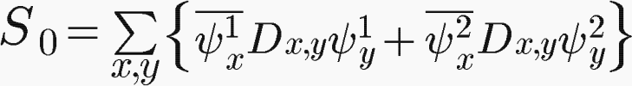
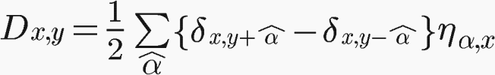
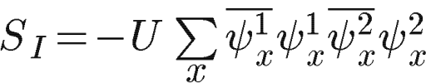
Our Lattice model
Staggered fermion action for two flavors $ψ^{1}$and $ψ^{2}$ in 3D :
All fields are Grassmann fields.
Notice the similarity to the Dirac Action !
where,
Four-fermion Interaction :
In addition to the usual discrete space-time symmetries*, the action has a continuous SU(4) symmetry.
Maarten F.L. Golterman and Jan Smit. Selfenergy and Flavor Interpretation of Staggered Fermions. Nucl.Phys., B245:61, 1984.

Slide 4
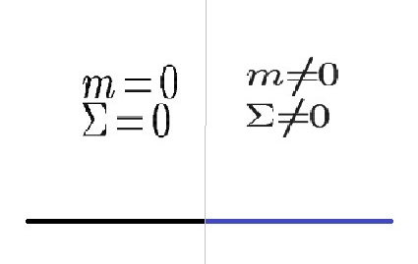
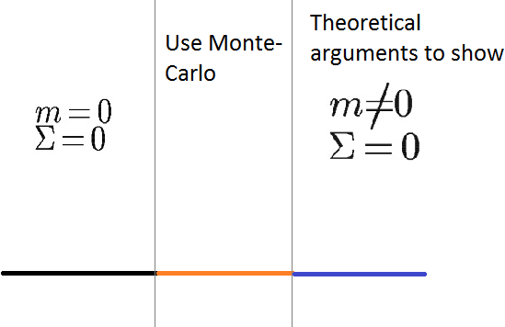
For four-fermion interactions, we expect*
We get
*NPB388, 1992, page 243 Bock, De and Smit
*NPB344, 1990, page 207 Bock et. al.,

Slide 5
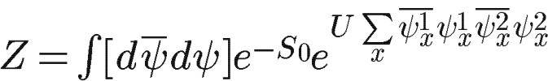
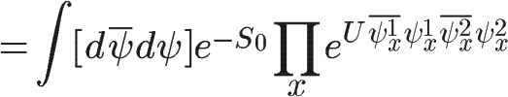
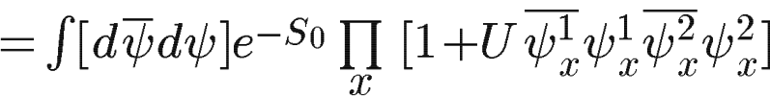
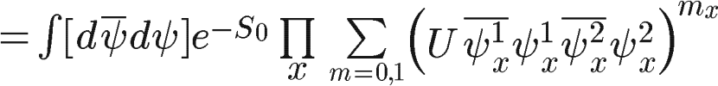
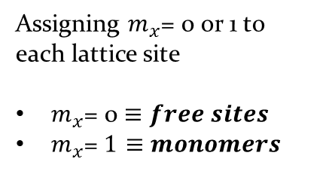
*The Fermion Bag approach
Fermion Bag configuration
Assigning $m_{x}$= 0 or 1 to each lattice site
$m_{x}$= 0 $≡free sites$
$m_{x}\text{= }1≡$ $monomers$
*S Chandrasekharan and Anyi Li. The generalized fermion-bag approach. Procd of Sc., LATTICE2011:058, 2011.
Shailesh Chandrasekharan. The Fermion bag approach to lattice field theories. PRD 82:025007, 2010.
Notes:
Fix the interaction tern

Slide 6
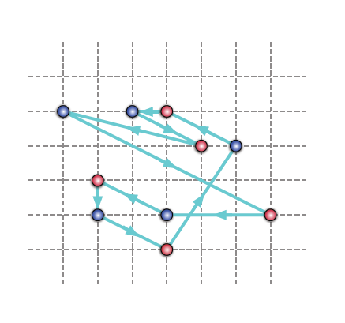
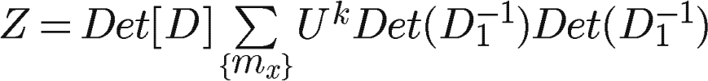
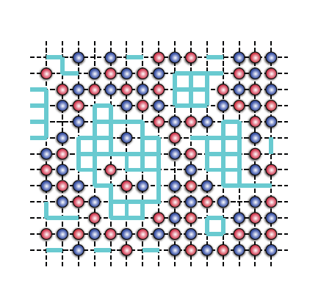
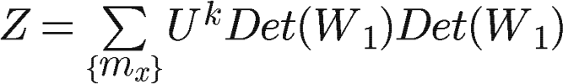
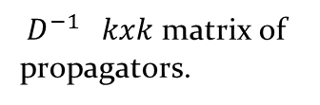
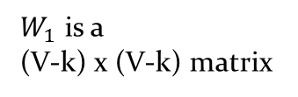
Weak coupling limit
${ D}^{−1} kxk$matrix of propagators.
Strong coupling limit
$W_{1}$ is a
(V-k) x (V-k) matrix
Can show that each determinant can be expressed as a square of smaller determinants.

Slide 7

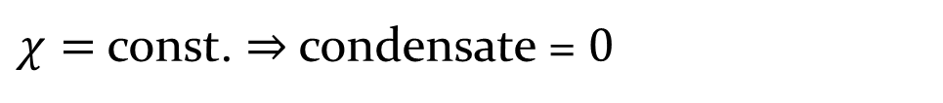

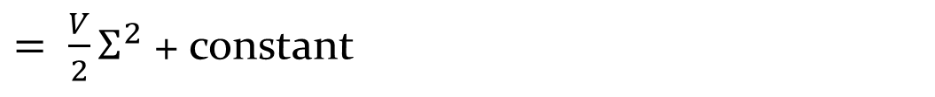
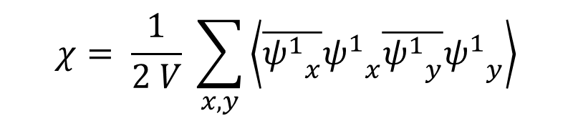
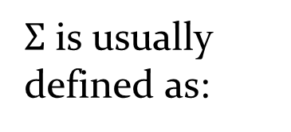
Extracting the condensate $Σ$
$Σ$ is usually defined as:
With massless fermions, we can instead compute the bosonic susceptibility :
$$χ= \frac{1}{2 V} \sum_{x,y}{\left\langle \overline{{ψ^{1}}_{x}}{ψ^{1}}_{x}\overline{{ψ^{1}}_{y}}{ψ^{1}}_{y}\right\rangle }$$
$= \frac{V}{2}Σ^{2}$ + constant
$χ=$const. $⇒$condensate = $0$
Notes:
In a massless theory for infinite V there are singularities.

Slide 8
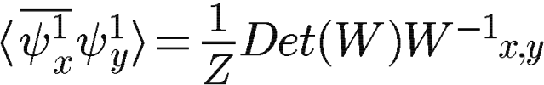
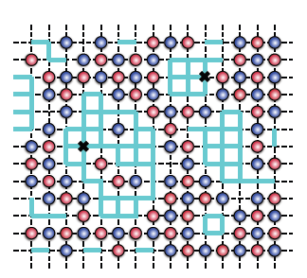

Fermionic correlator
W can be written in terms of bags in block diagonal form.
Can show that the correlator is zero unless x and y belong to the same bag.
$W and W^{−1}$ are block diagonal
A | 0 | 0 | 0
0 | B | 0 | 0
0 | 0 | C | 0
0 | 0 | 0 | D
Need for a path of free sites connecting 0 & t for a non-zero correlator G(x,y) !

Slide 9
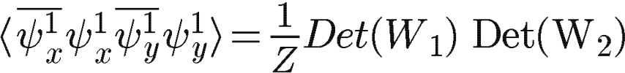
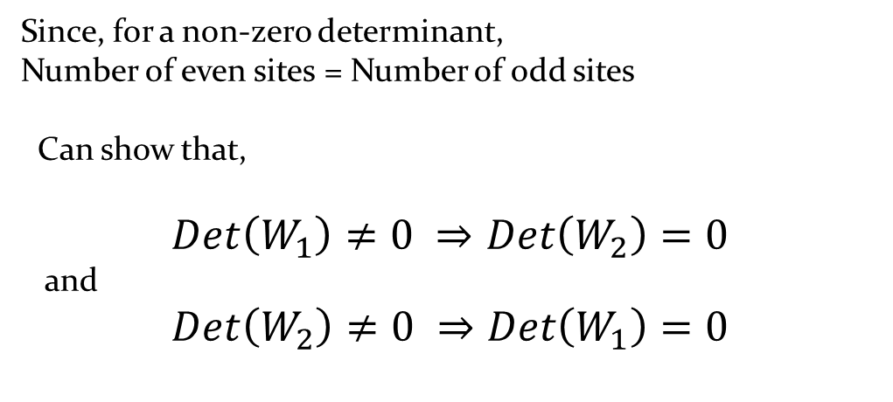
Bosonic correlator
Since, for a non-zero determinant,
Number of even sites = Number of odd sites
Can show that,
$$Det\left(W_{1}\right)≠0 ⇒Det\left(W_{2}\right)=0$$
and
$$Det\left(W_{2}\right)≠0 ⇒Det\left(W_{1}\right)=0$$
The two flavors ensure :
Need for a path of free sites connecting 0 & t for a non-zero correlator G(0,t) !

Slide 10
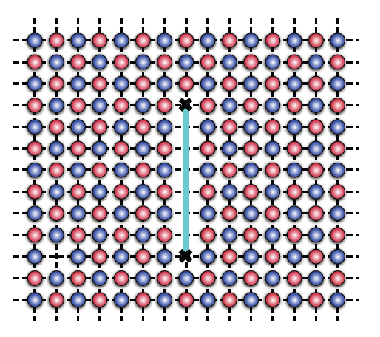
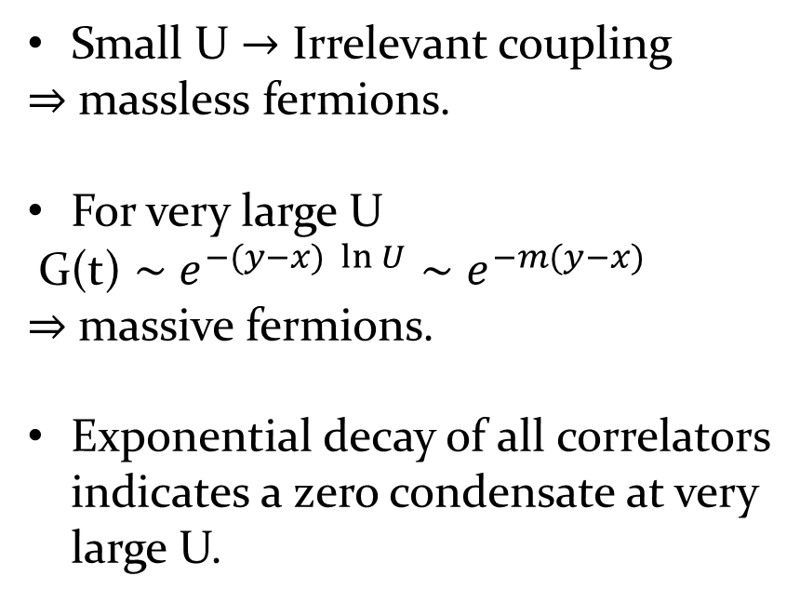
Fermion Mass
Small U $→$ Irrelevant coupling
$⇒$ massless fermions.
For very large U
G(t) $∼$ $e^{−(y−x) \ln{U}}{∼e}^{−m(y−x)}$
$⇒$ massive fermions.
Exponential decay of all correlators indicates a zero condensate at very large U.

Slide 11
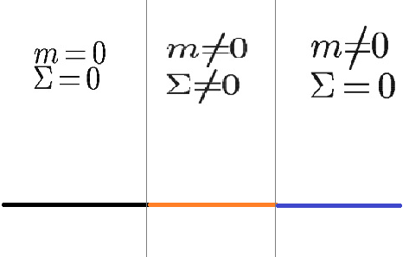
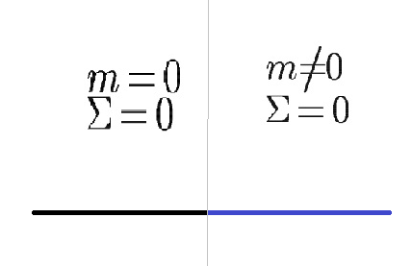



Phase Transition
Expectation from traditional
understanding
$$U_{c1}$$
$$U_{c2}$$
U
We seem to observe
$$U_{c}$$
U
Notes:
Make new slide with 2 figs

Slide 12
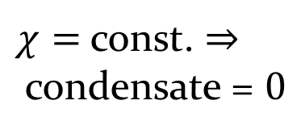
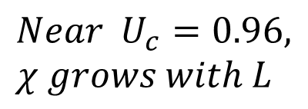
Preliminary results
Have used Open Science Grid (OSG) for computations
$χ=$const. $⇒$condensate = $0$
$$Near { U}_{c}=0.96, χ grows with L$$
Susceptibility saturates indicating a zero condensate

Slide 13
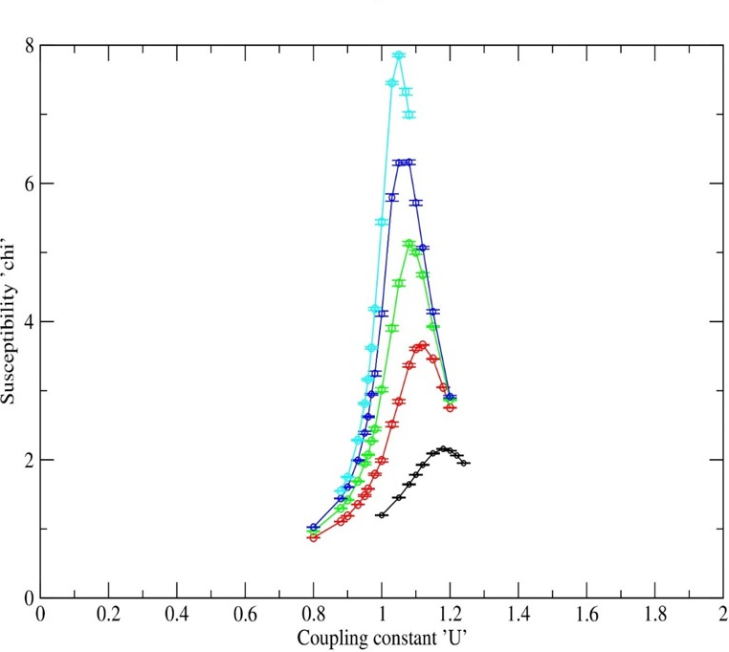
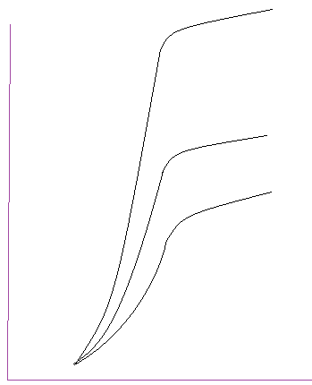



Results contd.
Susceptibility reaches a maximum for intermediate U
Then decreases and then saturates.
Instead of
$$L^{3}$$
$$χ$$
susceptibility vs coupling U for cubical lattices of length 8,12,16,20,24
$$U$$

Slide 14
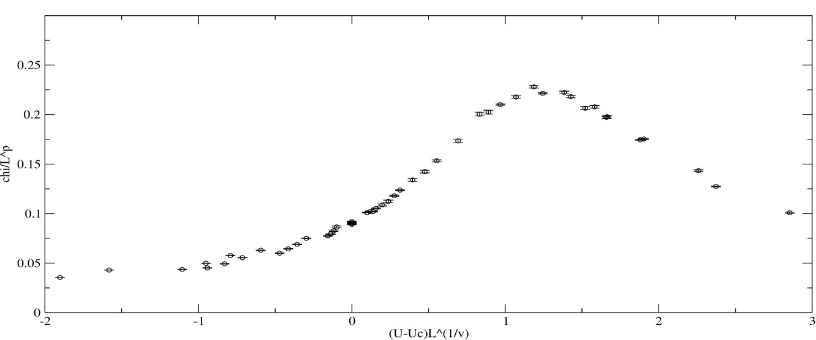

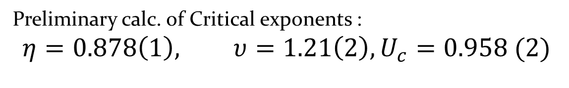

Evidence that Uc is a 2nd order critical point
For a second order transition we expect : $χ=L^{p} f\left[ \left(U−U_{c}\right)L^{\frac{1}{υ}}\right]$
Plot of $χ / L^{p}vs (U−U_{c})L^{\frac{1}{υ}}$
Preliminary calc. of Critical exponents :
$$η=0.878\left(1\right), υ=1.21\left(2\right), U_{c}=0.958 (2)$$
Errors too small ?
14

Slide 15
Caveats
We do observe some rare large fluctuations in data for large U. Are these statistically significant ?
Results using two very different Monte-Carlo algorithms seem to give consistent results.
Considering the unconventional nature of the result, we are trying to develop another algorithm that gives results without fluctuations.

Slide 16
Conclusions
We have found a lattice model in 3D, in which fermions acquire a mass at large couplings, but without a fermion bilinear condensate.
Possibly no spontaneous symmetry breaking ?
The transition from massless to massive phase seems second order. If true, we could have an interesting 3D continuum field theory.
Similar result in 4D could be exciting for particle physics.

Slide 17
Thank You

Slide 18
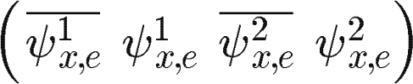
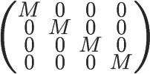

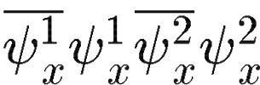



Back up slides
$S_{0}$ can be written as :
${⇒S}_{0}$invariant under SU(4)
At every site,
$S_{I}$ invariant under SU(4)
Thus the SU(4) symmetry is preserved by the interaction.

