Slide 1
Accelerator Safety Workshop (ASW) 2014: Implementation of DOE Order 420.2C Safety of Accelerator Facilities
Timothy S. Stirrup
Industrial Facilities Safety Basis
Sandia National Laboratories, New Mexico
SAND2014-16485PE

Slide 2
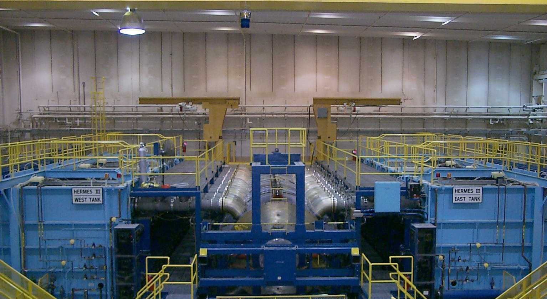
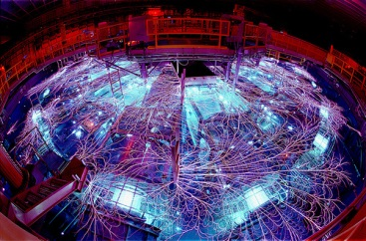
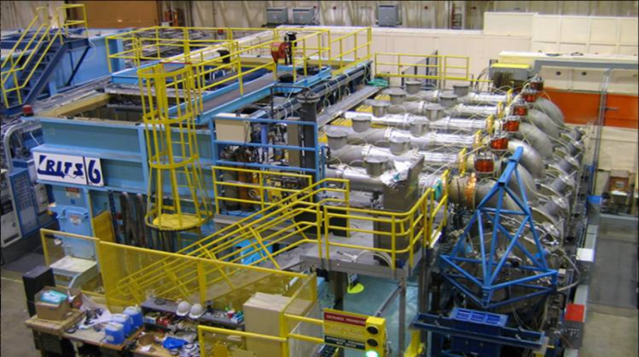
ASO Guide Awareness, Consideration, & Implementation
Exempt Devices And Accelerator Listing/Inventory

Slide 3
Background
DOE Order 420.2C Revisions Included:
Accelerator Definitions
Approval Authorities
Minimum Program Requirements
Exemptions/Equivalencies
Removed Duplications
No New Significant Requirements for Applicable/Regulated Accelerators
High Energy Radiation Megavolt Electron Source [HERMES-III]
Radiographic Integrated Test Stand [RITS-6]
No Change to Identified/Number of “Regulated” Accelerators At Sandia

Slide 4
Background
Exemptions/Equivalencies for DOE O 420.2C. Accelerators and accelerator facilities or modules thereof that meet at least one of the criteria in paragraph 3.c.(1) or as specifically provided in 3.c.(2) are exempt from the requirements in paragraph 4 [e.g., Requirements] of this Order.
Order is Still Applicable to Exempt Accelerators
Except No Paragraph 4 Requirements for Exempt Accelerators.
Draft Guide Reflects Order
Any questions of ASO applicability should be discussed between the DOE field organization and the contractor.

Slide 5
Background
Paragraph 4 Requirements
(1) Accelerator Safety Envelope
(2) Safety Assessment Document
(3) Clearly Defined Roles & Responsibilities (Training)
(4) Unreviewed Safety Issue
(5) Accelerator Readiness Review
(6) Current Listing of [Regulated] Accelerators & Exemptions/Equivalencies
Including 3.c.[2] Exemptions
Including 3.c.[3] Equivalency
Does Not Specifically Require List of 3.c.[1] Exempt Accelerators

Slide 6
Background
Applicability Changed How to Look at Definition of Accelerator
Accelerator: A device [e.g., RGD] employing electrostatic or electromagnetic fields to impart kinetic energy to molecular, atomic or sub-atomic particles and capable of creating a radiological area [DOE O 420.2C]
Radiological Area: Any area within a controlled area defined in 10 CFR 835 as a radiation area, high radiation area, very high radiation area, contamination area, high contamination area, or airborne radioactivity area [10 CFR 835]
Controlled Area: Any area to which access is managed by or for DOE to protect individuals from exposure to radiation and/or radioactive material [10 CFR 835]
Radiation Area: Any area, accessible to individuals, in which radiation levels could result in an individual receiving an equivalent dose to the whole body in excess of 0.005 rem (0.05 mSv) in 1 hour at 30 centimeters from the source or from any surface that the radiation penetrates [10 CFR 835]
The Order Now Includes Radiation Generating Devices (RGDs), Not Traditionally Considered Accelerators Under The Old Order

Slide 7
Background
Meant to Establish Minimum Criteria Where 420.2C Applicable
“Exempt” Accelerators ~ No Paragraph 4 Requirements
“Regulated” Accelerators ~ Paragraph 4 Requirements
Meant to Exempt Devices Already Addressed Other Directives (e.g., RGDs)
Meant to Allow Flexibility with 10 CFR 830 Compliance
How Determine Which Accelerators Are Exempt?
How Document Determination?

Slide 8
Implementation
Need Process to Determine/Document Exemptions
Two Types of Exemptions
3.c.[1] Non-Complex & Local Area Impacts
Majority of RGDs
Contractor Approved
Internally Maintain List
3.c.[2] DOE Local Field Office Approval
Limited # of Accelerators
DOE Site Office Approval
Provide List to Site Office

Slide 9
Implementation – Applicability
Applicability Logic Step #1 (Accelerator Definition)
Applicability: RGD Create A Radiological Area
Radiation Area, High Radiation Area, or Very High Radiation Area
Accessible to Individuals
Define Accessible to Individuals
Likely Site Specific
Area Within Shield Walls ~ Yes
Area Within Equipment ~ No
Applicability: RGD Create an Airborne Radiological Area
No Radiological Area or Airborne Radiological Area – Then Not Accelerator

Slide 10
Implementation – 3.c.[1] Exemption
Applicability Logic Step #2 (Non-Complex & Local Area Impacts)
Define Non-Complex (site specific)
Equivalent to a device in a “single-room” or defined area with access control that can be operated by a single operator either proximate to the device or from a single control area
Define Local Area Impact (site specific)
Area within 100 m of the facility
Corresponds with “low hazard classification”
3.c.[1] Exemption Applies Only If Non-Complex AND Local Area Impacts

Slide 11
Implementation – 3.c.[1] Exemption
Listed Examples – Order Lists As Examples Only
3.c.[1] (a) (#1) Current Generating Device
Device’s primary function is to generate electrical current
3.c.[1] (a) (#2) Exempt RGD
Device is an exempt-shielded or shielded class radiation generating device (RGD). An exempt-shielded or shielded class RGD may be considered as one of the following examples:
Inherently safe
Certified cabinet
X-ray diffraction or fluorescence analysis equipment
Other shielded RGD
Portable or mobile radiography RGD not using a radiological source

Slide 12
Implementation – 3.c.[1] Exemption
Listed Examples (cont.)
3.c.[1] (c) (#1) X-ray <10 MeV
Device is a single beam, “bench-top” sized, x-ray generator, with an accelerating potential below 10 MeV and may be operated by a single operator in accordance with American National Standards Institute (ANSI) N43.3 or other consensus standard.
3.c.[1] (c) (#2) Neutron Generator < 600 keV (accelerating potential)
Device is a “bench-top” sized, neutron generator, with an accelerating potential below 600 keV and may be operated by a single operator in accordance with the National Council on Radiation Protection and Measurements (NCRP) or other consensus standard.

Slide 13
Implementation – 3.c.[1] Exemption
Listed Examples (cont.)
3.c.[1] (b) Single Room Device
Device is a room-sized accelerator with a single external and/or extractable beam, an active safety system, and the room has a single point of entry
3.c.[1] (d) Unmodified Commercially Available
Device is unmodified and commercially available
Examples include, but are not limited to, electron microscopes, ion implant devices, and x-ray generators; additional equipment may also include other types of semiconductor equipment and commercially available research accelerators

Slide 14
Sandia Implementation
Use of Existing Primary Hazard Screen (PHS) System/Process
Logic Based Question & Answer Hazards Identification Tool
Used to Evaluate and Assign Hazard Classification
Additional Question Added
Question 1k. Does the operation involve a device capable of creating a radiological area?
Note: By definition, radiological areas must be accessible to individuals - otherwise the area is not a radiological area.
Answers
If “no,” then not an accelerator.
If “yes,” then fill out logic table to determine applicability.

Slide 15
Sandia PHS Question Logic
RGD creates Radiation Area?
Non-complex & Local?
C(1) Exempt?
(SNL)
Y
Y
N
Y
OK
N
C(2) Exempt?
(SSO)
C(2) Exempt
Accelerator
Y
C(1) Exempt
Accelerator
N
Accelerator

Slide 16
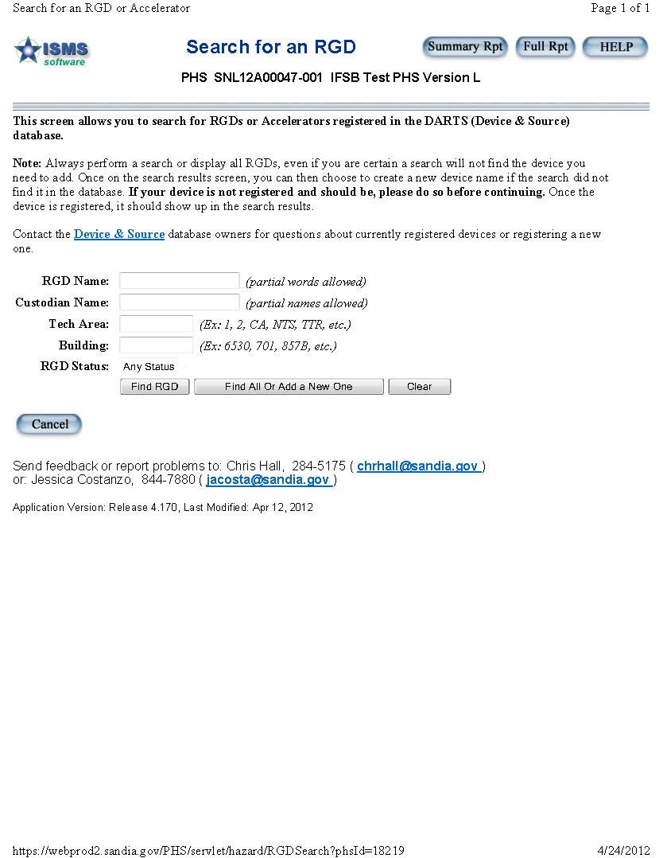
Sandia Implementation

Slide 17
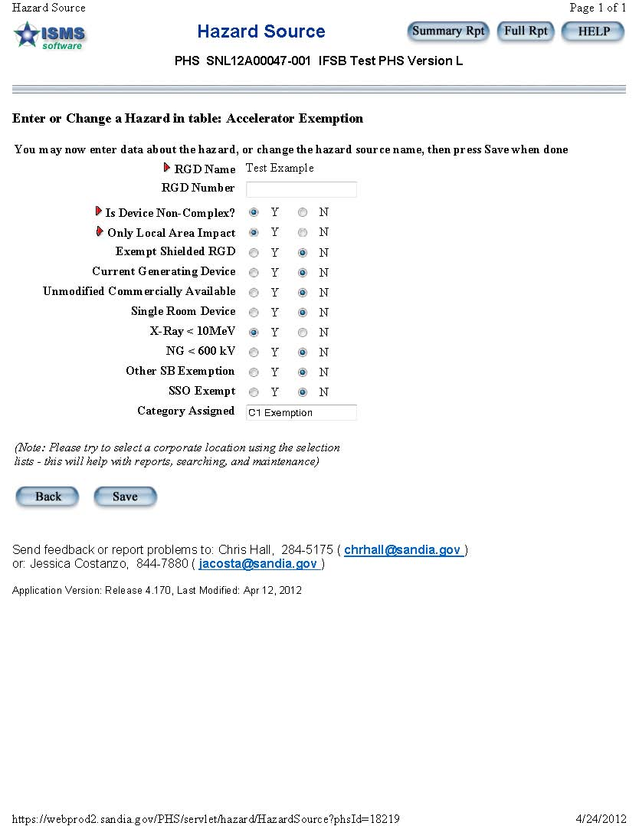
Sandia Implementation

Slide 18
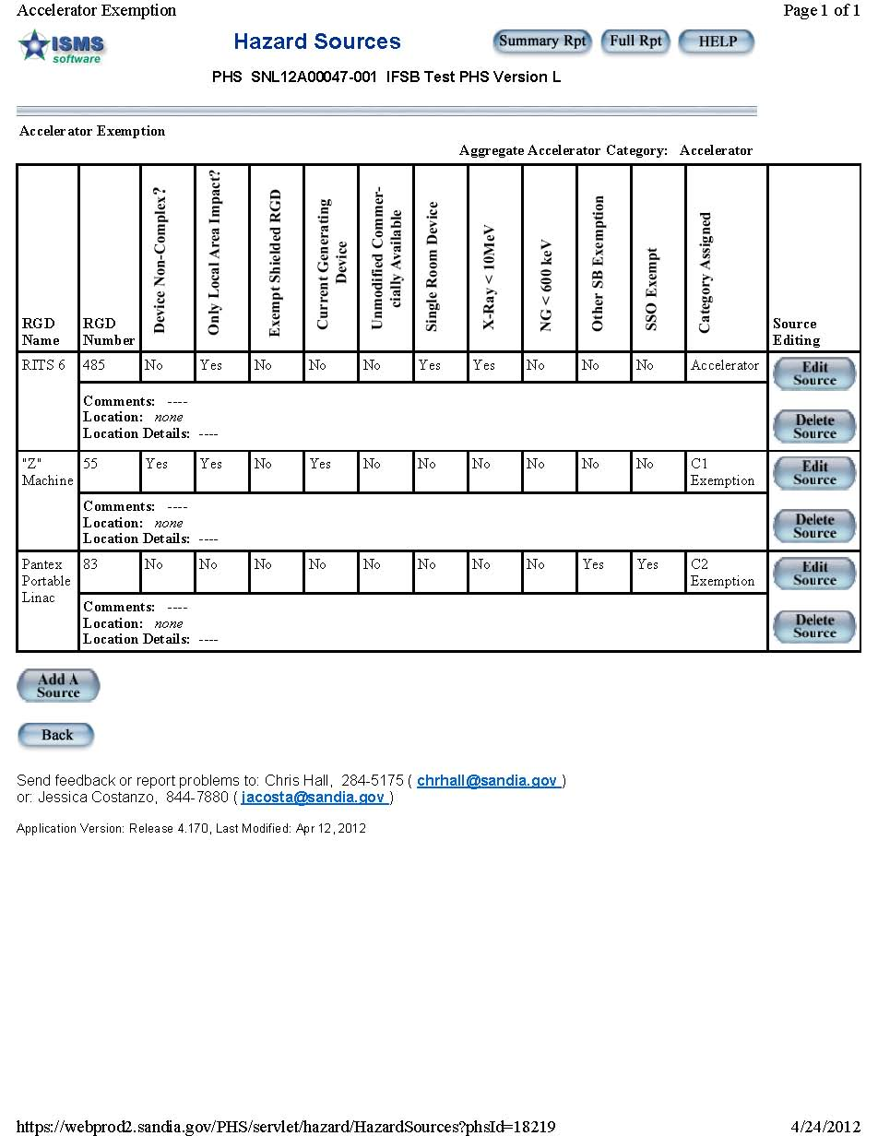
Sandia Implementation

Slide 19
Sandia Implementation
One Year Implementation for Incorporation of Annual PHS Updates
PHS Documents Decision Process
PHS Maintains 3.c.(1) Exempt List
Not Required
PHS Maintains Required List
Regulated Accelerators
3.c.[2] Exemptions
3.c.[3] Equivalency

Slide 20
Questions?
Timothy S. Stirrup
Safety Basis Engineer
Nuclear and Industrial Facilities Safety Basis
PO Box 5800 MS 0794
Sandia National Laboratories
Albuquerque, NM 87185
(505) 845-7155
tsstirr@sandia.gov

