Slide 1
Clearance of Personal Property from Accelerator Facilities Draft DOE Technical Standard
Sayed Rokni for Technical Standard Working Group
DOE Accelerator Safety Workshop, Germantown, MD, August 5-7, 2014

Slide 2
Outline
Background
Purpose, Scope
Clearance Protocols
Clearance Criteria
Volumetric, Surface
Key Technical Issues
Measurement Methods
Summary

Slide 3
Clearance of Metals from Accelerators: Roadmap
Secretarial Moratorium (January 2000)
Prohibits the release of volumetrically contaminated metals … into commerce
NNSA/SC Joint Working Group: 2009-2010
DOE review of accelerator facilities starting in 2009
Radiological Clearance of Property Workshop, Las Vegas, Nevada, 2010
Accelerator Safety Workshop, 2010, 2011, 2012
Peer review of Material Release Program, 2011
First clearance of accelerator metals from PEP-II& BaBar, D&D Progress
Development of the DOE Technical Standard for Clearance of Materials from Accelerators
Notes:
Show some photos from SLAC

Slide 4
Technical Standard Working Group
Ryan Ford SLAC National Accelerator Laboratory (SLAC)
James Liu SLAC National Accelerator Laboratory (SLAC)
Elaine Marshall Sandia National Laboratories (SNL)
Sayed Rokni SLAC National Accelerator Laboratory (SLAC), Chair
Scott Schwahn Oak Ridge National Laboratory (ORNL)
Keith Welch Thomas Jefferson National Accelerator Facility (TJNAF)

Slide 5
Purpose of Technical Standard
Provides criteria and guidance for DOE accelerator facilities to develop site-specific programs (including management, technical, and operational aspects) that are in compliance with DOE Order 458.1*
Serves as acceptable approach for the technical basis document and implementation guide for clearance of personal property under DOE O458.1 for accelerator facilities
*Radiation Protection of the Public and the Environment

Slide 6
Scope of Technical Standard
Materials and equipment (M&E) defined as personal property in DOE Order 458.1
Unrestricted release and restricted release
Non-routine releases of materials from a decommissioned facility
Routine releases of materials from an operating facility
Both volumetric radioactivity and surface contamination
Mainly accelerator facilities, but can be applicable to non-accelerator facilities where there is potential for volumetric activation
Notes:
Clearance: Removal of personal property that contains or may contain residual radioactive material from DOE radiological control.
Release: Transfer of control or ownership of property from DOE to a non-DOE party.
62 pages

Slide 7
Standard Table of Content
Purpose and Scope
Introduction
Material Clearance Protocols
Documentation and Reporting Requirements
DOE Independent Verification and Approval, Stakeholder Communication
References
Acronym and Definitions
Appendix A: Process Knowledge for Accelerator Facilities
Appendix B: Rationale and Use of ANSI N13.12 (2013)Volume SLs as DOE Pre-Approved Authorized Limits
Appendix C: Technical Basis for Volumetric Activation at Electron Accelerator Facilities
Appendix D: Technical Basis for Volumetric Activation at Proton Accelerator Facilities
Appendix E: Technical Basis for Measurements of Volumetric Radioactivity and Determination of Detection Capabilities

Slide 8
Clearance Protocols
A 3-tiered set of clearance criteria for release of materials with potential volumetric radioactivity
Evaluation of potential volumetric activation and surface contamination and the characteristics of radioactivity profiles based on process knowledge
Measurement methods with sufficient detection capabilities for the radionuclides of interest and the selected clearance criteria

Slide 9
Clearance Criteria in Technical Standard
For volumetric radioactivity the 3-tiered criteria are related to ANSI N13.12 (2013) Screening Levels (SLs in pCi/g)
For surface contamination, the criterion is expressed in surface radioactivity (in dpm /100 cm²) as referred to in DOE Order 458.1

Slide 10
Clearance Criteria for Surface Contamination
Radionuclide | Allowable Total Residual Surface Contamination (dpm/100 cm²)
 | Average | Maximum | Removable
Beta-gamma emitters, except ⁹⁰Sr and others noted in Figure IV-1 | 5,000 | 15,000 | 1,000
DOE Order 5400.5 Figure IV-1

Slide 11
Clearance Criteria for Volumetric Radioactivity
Indistinguishable from Background (IFB)
material has no detectable radioactivity other than natural background
a level lower than the ANSI N13.12 (2013) Volume Screening Levels
> IFB and ≤ ANSI SLs
dose constraints of 1 mrem (0.01 mSv) per year
> SL and ≤ 100 SL

Slide 12
IFB Clearance Criterion for Volumetric Radioactivity
Basis, Requirements, Usage | DOE Approval
Measurements are IFB (material has no detectable radioactivity other than natural background) IFB is the preferred criterion No radiological control is warranted and is already ALARA | Releases are covered by the scope of the approved program Approval for releases is not needed

Slide 13
ANSI (2013) SL Clearance Criterion
Basis, Requirements, Usage | DOE Approval
Measurements meet ANSI SLs SLs satisfy DOE Order 458.1 dose constraint of 1 mrem/y ALARA analysis is required since materials with detectable radioactivity may be released | Field Element approval of each release plan, which includes a qualitative ALARA analysis

Slide 14
>ANSI SL Clearance Criterion
Basis, Requirements, Usage | DOE Approval
> SL and ≤ 100SL Follow DOE Authorized Limit process to obtain approval for release Recommended for restricted release only | HQ approval of the clearance criterion Field Element approval of each release plan, which includes a quantitative ALARA analysis

Slide 15
Key Technical Issues
Induced activity in an object is volumetric and presents its maximum at the surface that faces beam loss points
This supports surface measurements
Radioisotopes that are difficult to detect are generally accompanied by “proxy” radioisotopes that can be clearly measured
This supports measurements for proxy radioisotopes
Generally, alpha emitters are not produced
This justifies the measurements of beta-gamma radionuclides.
Minimal surface contamination due to beam operations
For decommissioning projects most abundant radioisotopes are those with a half-life of the order of the irradiation time
15

Slide 16
Main and Proxy Radioisotopes
Material | Radionuclide | Half-life
Carbon steel (Fe, C) and Cast iron (Fe, C, Si, Mn) | ²²Na (proxy) | 2.6 y
 | ⁵⁴Mn (proxy) | 312 d
 | ⁵⁵Fe (5.9 keV x-ray) | 2.73 y
 | ⁵⁷Co | 272 d
Aluminum | ²²Na | 2.6 y
Copper | ⁵⁵Fe (5.9 keV x-ray) | 2.73 y
 | ⁵⁷Co | 272 d
 | ⁶⁰Co (proxy) | 2.6 y
Concrete | ³H (pure beta) | 12.3 y
 | ²²Na (proxy) | 2.6 y
 | ⁵⁴Mn (proxy) | 312 d
 | ⁵⁵Fe (5.9 keV x-ray) | 2.73 y
 | ⁵⁷Co | 272 d
 | ⁶⁰Co | 5.26 y
 | ¹⁵²Eu, ¹⁵⁴Eu | 13.5 y, 8.59 y
Radioisotopes with long half-lives are of interest.
Hard-to-measure radioisotopes (⁵⁵Fe) emit only beta or low-energy X rays
Proxy radioisotopes (²²Na, ⁵⁴Mn, ⁶⁰Co) emit high-energy and high-intensity gamma rays
ANSI SL:
²²Na, ⁵⁴Mn, ⁶⁰Co: 3 pCi/g
⁵⁵Fe: 30,000 pCi/g
Requirements:
∑_{i} (Ai / SLi) ≤ 1

Slide 17
Measurement Methods (Appendix E)
Use survey instruments with sufficient sensitivity in a sufficiently low ambient background environment to achieve the required detection capability
Detection capability shall be estimated and documented
Many survey instruments that are commercially available have detection capability less than the ANSI N13.12 (2013) Volume Screening Levels (SL) values
For example, 1”x1” NaI detector operated in surface scanning mode can be less than the ANSI volume SLs of 3 pCi/g for Group 1 radionuclides

Slide 18
Standard Table of Content
Purpose and Scope
Introduction
Material Clearance Protocols
Documentation and Reporting Requirements
DOE Independent Verification and Approval, Stakeholder Communication
References
Acronym and Definitions
Appendix A: Process Knowledge for Accelerator Facilities
Appendix B: Rationale and Use of ANSI N13.12 (2013)Volume SLs as DOE Pre-Approved Authorized Limits
Appendix C: Technical Basis for Volumetric Activation at Electron Accelerator Facilities
Appendix D: Technical Basis for Volumetric Activation at Proton Accelerator Facilities
Appendix E: Technical Basis for Measurements of Volumetric Radioactivity and Determination of Detection Capabilities
Standard draft was submitted to DOE for review on April 2014

Slide 19
Thank You

Slide 20
Joint Activation Working Group
Co-Team Leads
Scott Davis – SC-31.1 HQ
Major David Pugh – NA-171.2 HQ
SC Representatives
Dennis Ryan BNL
Sayed Rokni SLAC
Don Gregory ORNL
NNSA Representatives
Michael Duran LANL
Todd Sundsmo LLNL
Todd Culp SNL

Slide 21
NNSA/SC joint Accelerator Working Group
Develop… “Technical Position that will support the release of equipment and material from accelerator facilities and operations where there is potential for induced radioactivity or activated material”
“This effort shall include all available facility, equipment, material, survey and detection information needed to derive criteria that can be used to determine the areas of and extent of activation”
“Criteria being developed should be reasonable and detection activities should be based on current techniques used within the Department and private industry”
Volumetric Activation
<< Back to slide 3

Slide 22
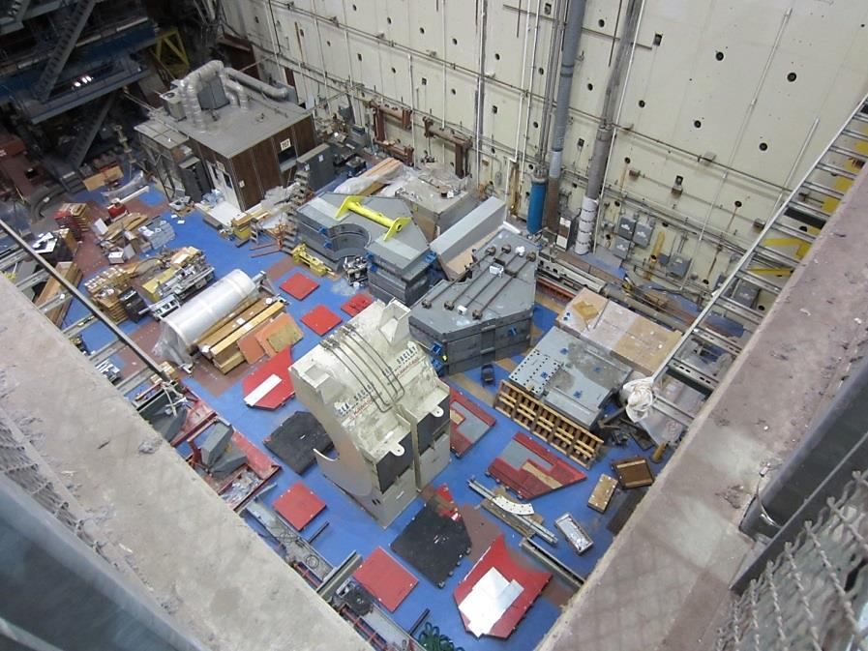
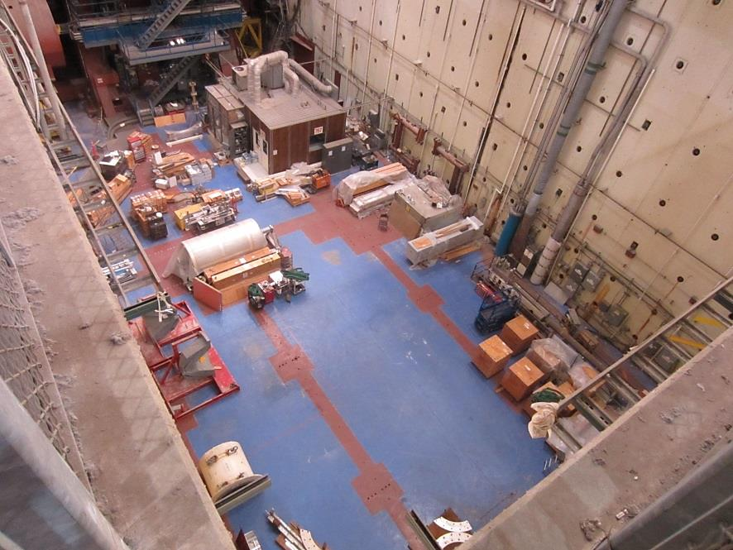
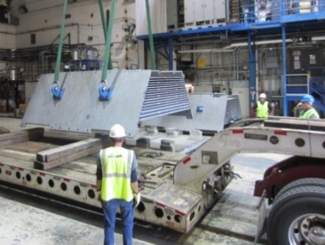
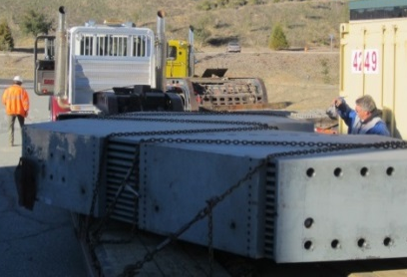
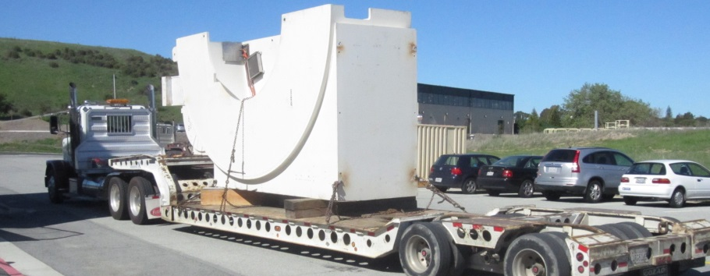
BaBar D&D Progress
Clearance of BaBar materials from B750 Pit
BaBar has recycled >1200 tons of metal
Empty hall leaves room for future experiments
Flatbeds capable of transporting 40 ton loads
BEFORE
AFTER
End Plug
DIRC
Door

Slide 23
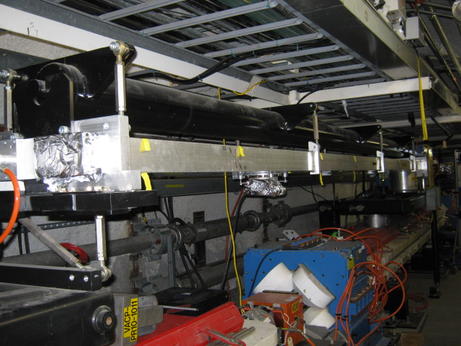
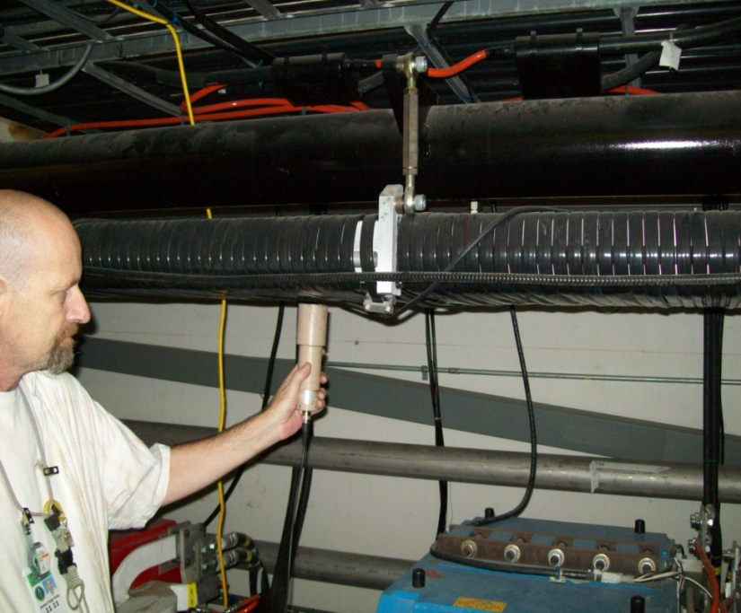
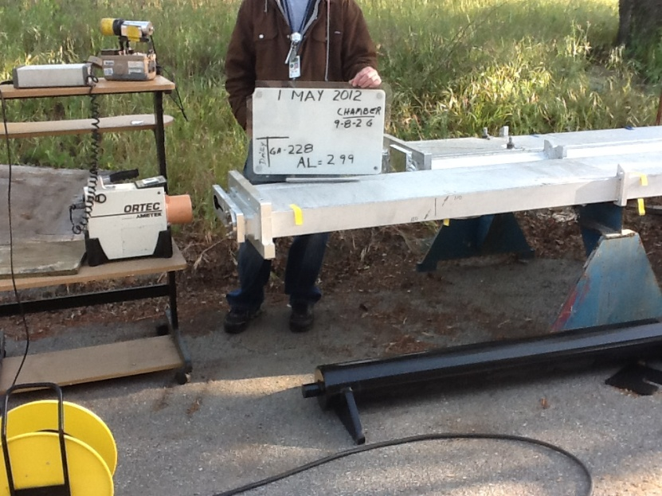
Material Removal, Survey: PEP-II

Slide 24
SLAC Metals Recycling Progress (FY2011 – FY2014)
2500 tons, $1.3M revenue

Slide 25
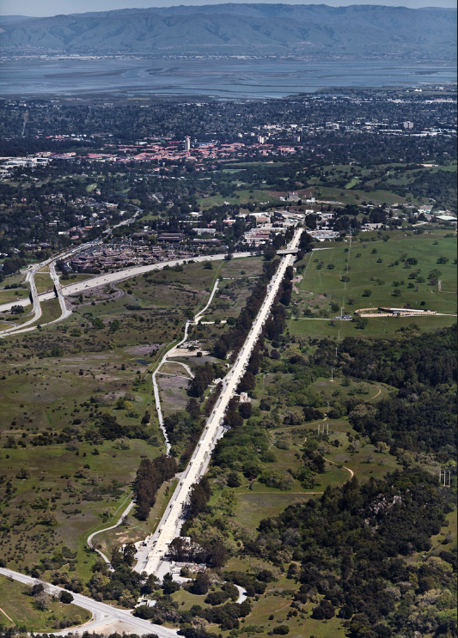
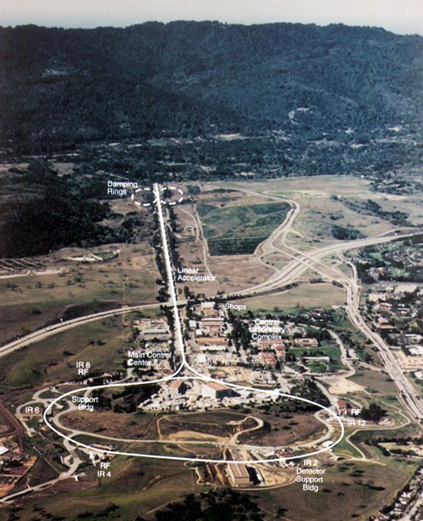
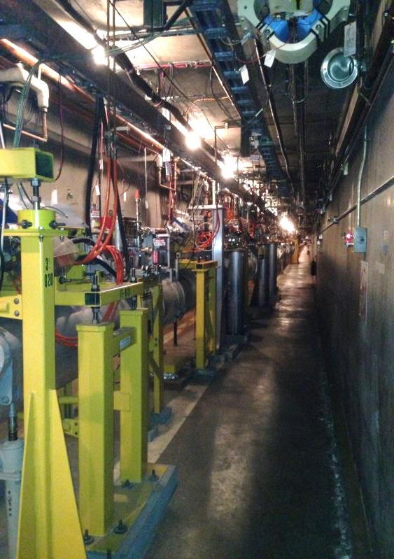
SLAC 2 Mile Linac : Need to make room for the new LCLS-II Linac
<< Back to slide 3

Slide 26
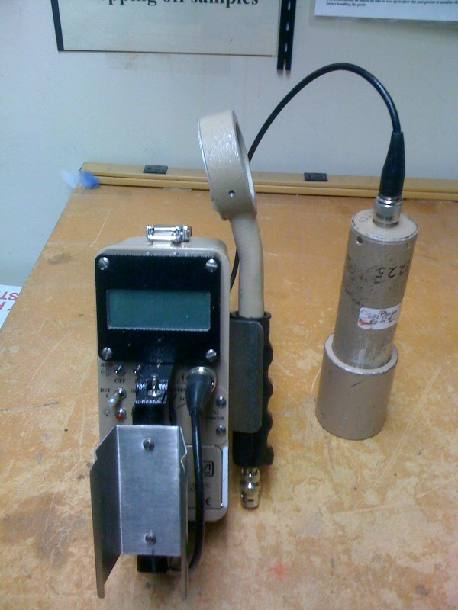
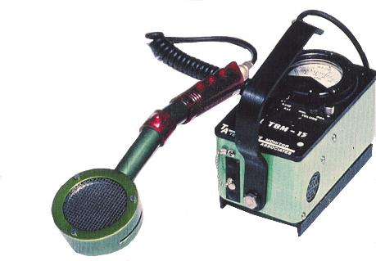
Examples of Hand-held Survey Instruments
Ludlum Model 2241 with a 44-2 detector (1”x1” NaI) and a GM pancake
Ludlum Model 18 with 44-2 detector
TBM P15
<< Back to slide17

Slide 27
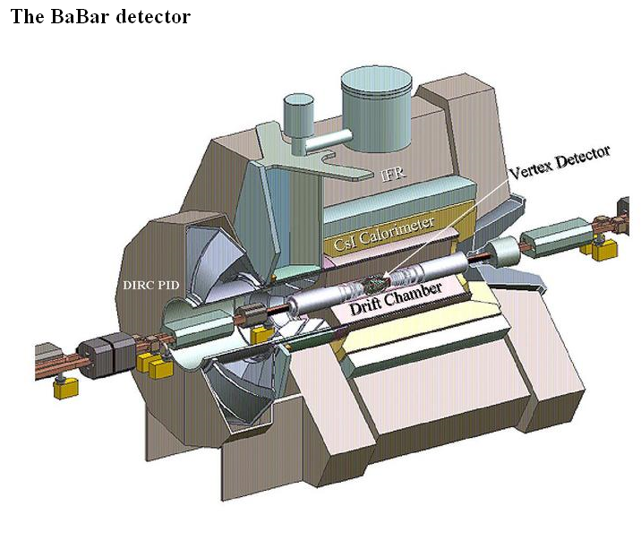
BaBar Detector at SLAC
Three Floors High,
Thousands of Pieces
27

Slide 28
Volumetric Activation Profile in Accelerators
The activity profile of each BaBar component has its maximum on the side that faces the source (e⁺ and e⁻ collision point)
<< Back to slide 15
SLAC Radiation Protection Dept. Note 09-04, 2009

Slide 29
Why IFB is the Preferred Clearance Criterion?
IFB is the current practice in most releases at DOE sites
IFB below ANSI SLs can be achieved with state-of-the-art hand-held survey meters (e.g., 1”x1” gamma scintillator or micro-rem meter)
Straight-forward measurements
If IFB, no need for radioisotope identification
If not IFB, radioisotope identification and activity estimation are needed (i.e., spectrometer measurements)

Slide 30
Key Differences between ANSI N13.12-2013 and Technical Standard
N13.12 provides volume and surface SLs. Technical Standard endorses the volume SLs as Pre-Approved Authorized Limits but retain the DOE 5400.5 surface activity guideline (because the latter is still the regulations).
N13.12 gives SLs as single clearance criterion. Technical Standard adopts a three-tiered set of clearance criteria for volumetric activity: IFB, SLs and 100SL.
To minimize the public perception risk, IFB is recommended as the preferred one.
N13.12 provide general process knowledge. Technical Standard provides specific process knowledge to support clearance at accelerator facilities:
Section 3.2 gives details for the use of process knowledge.
Appendix A provides general process knowledge that may allow the evaluation of induced radioactivity and its characteristics in accelerator facilities.

Slide 31
Key Differences between ANSI N13.12-2013 and Technical Standard
N13.12 provides general measurement methods and requirements. Technical Standard provides technical basis to support appropriate selection and use of measurement methods and the estimation of associated detection capabilities. In addition to survey measurements, confirmatory measurements, e.g., gamma spectrometry or portal gate monitor, are recommended as warranted.
N13.12 provides technical requirements. Technical Standard provides also programmatic requirements such as program and measurement documentation and reporting, as well as DOE approval and independent verification.
There are no contradictions between ANSI N13.12 – 2013
and the Technical Standard.

Slide 32
ANSI N13.12-2013 Screening Levels (SLs)
Radionuclide Groups | Surface SL (dpm / 100 cm²) | Volume SL (pCi/g)
Group 1: High-energy gamma, radium, thorium, transuranics, and mobile beta-gamma emitters (e.g., ²²Na, ⁴⁶Sc, ⁵⁴Mn, ⁵⁶Co, ⁶⁰Co, ⁶⁵Zn, ¹²⁵Sb, ¹³⁴Cs, ¹⁵²Eu, ¹⁵⁴Eu) | 600 | 3
Group 2: uranium and selected beta-gamma emitters (e.g., ⁵⁷Co, ⁵⁸Co, ⁵⁹Fe, ¹¹³Sn, ¹²⁴Sb) | 6,000 | 30
Group 3: General beta-gamma emitters (e.g., ⁷Be) | 60,000 | 300
Group 4: Low-energy beta-gamma Emitters (e.g., ³H, ⁴⁵Ca, ⁶³Ni) | 600,000 | 3,000
Group 5: Low-energy beta emitters (e.g., ⁵⁵Fe) | 600,000 | 30,000

Slide 33
Main and Proxy Radionuclides in Common Metals
Material | Radio- nuclide | Half-life | Main production | Major γ energy | Proxies
Carbon steel (Fe, C), Cast iron (Fe, C, Si, Mn) | ²²Na | 2.6 y | Fe, Si, Mn spallation | 1.27 MeV (100%)
 | ⁵⁴Mn | 312 d | ⁵⁵Mn(γ,n) | 835 keV (100%)
 | ⁵⁵Fe | 2.73 y | ⁵⁶Fe(γ,n) | 5.9 keV x-ray | ²²Na
 | ⁵⁷Co | 272 d | ⁵⁸Fe(p,2n) | 122 keV (86%) 133 keV (10%)
Austenitic stainless steel (Fe, C, Cr, Ni) & Copper | the same radionuclides as carbon steel and cast iron, plus:
 | ⁶⁰Co | 5.26 y | ⁶⁰Ni(n,p), Cu spallation | 1.17 MeV (100%) 1.33 MeV (100%)
 | ⁶³Ni | 100 y | ⁶⁴Ni(γ,n), Cu spallation | no γ | ⁶⁰Co
Superaustenitic, Ferritic, Martensitic SS (Fe, C, Cr, Ni, Mo) | the same radionuclides as austenitic SS and copper, plus:
 | ^{93m}Nb | 16.3 y | Mo spallation | 31 keV x-ray | ⁶⁰Co
 | ⁹⁰Sr | 28.8 y | Mo spallation | no γ | ⁶⁰Co
 | ⁸⁵Kr | 10.8 y | Mo spallation | 514 keV (0.4%) | ⁶⁰Co
 | ⁶⁵Zn | 244 d | Mo spallation | 1116 keV (51%)
Aluminum | ²²Na | 2.6 y | Al spallation | 1.27 MeV (100%)

Slide 34
Measurement Methods and Typical Detection Limits for Volumetric Radioactivity for Proxy and Hard-to-Measure Radionuclides
Method | Radionuclides of Interest | Instrument & Method | Detection Limit
Surface Survey | Proxies (²²Na, ⁵⁴Mn, ⁶⁰Co, ¹⁵²Eu) | Surface survey for gross beta-gamma counting rate using 1”x1” scintillator-based meter in scanning or fixed-position measurement mode | < 3 pCi/g
Field Gamma Spectrometry | Gamma emitters with energy > tens of keV | Surface measurements using a gamma spectrometer in a fixed position measurement mode | < 1 pCi/g
Laboratory Core Sample HPGe Measurements | Gamma emitters with energy > tens of keV | At least one core sample collected per item and counted using low-background HPGe system with an environmental counting protocol | < 0.1 pCi/g
Laboratory Core Sample LSC Measurements | Beta or low-energy x-ray emitters (⁵⁵Fe, ³H) | At least one powdered sample collected per item and counted using LSC with an environmental counting protocol | ³H in concrete: 10 pCi/g
Laboratory Surface Swipe Sample LSC Measurements | ³H in concrete | At least one surface swipe sample collected per item and counted using LSC with an environmental counting protocol | 15 dpm / 100 cm²

Slide 35
Confirmatory Measurements
Surface survey methods may be supplemented by one of the confirmatory measurements (as warranted):
may include gamma spectrometry, laboratory sample analysis, portal gate monitor, or bulk monitoring systems
Confirmatory measurements should be conducted in a graded approach, based on process knowledge and field survey results
A protocol should be developed when confirmatory measurements identify materials with detectable radioactivity, which are not detected by the surface surveys

Slide 36
Chapter 4: Documentation and Reporting Requirements
General Program Documentation
Relevant regulations and standards
Site-specific material clearance and release program documentation
Documents concerning accelerator and facility parameters and operation history
Documents concerning evaluations for both surface contamination and induced volumetric radioactivity
Procedures and records for Radiological Area classification, radiation survey and posting
Clearance criteria selected
Descriptions of concept and approach of proxy radionuclides and hard-to-measure radionuclides
Procedures for clearance measurements, particularly for proxy radionuclides,
Detection capabilities for proxy radionuclides
Procedures and records for instrument calibration and testing
Procedures and records for personnel training and qualification for the use of instruments and the conduct of measurements, and
Procedures and records for material storage on-site prior to release
Stakeholder communication plan

Slide 37
Chapter 4: Documentation and Reporting Requirements
Clearance and Release Specific
Specific process knowledge used to support or supplement clearance measurements
Description of facility and item(s) surveyed,
Radiological survey report: clearance measurement conditions and results, including date and location of measurements, instrument models and serial numbers, calibration date, background signals, response check results, and measurement conditions and results,
Confirmatory measurement reports such as gamma spectroscopy and portal gate monitor records, if applicable.
Comments and other correction factors that have effects on the results,
Date and name of surveyor, as well as the name and signature of the reviewer/approver,
Records of release or disposal decisions (e.g., no potential reuse) and authorization, and
Records of stakeholder communication (if any), including reporting to management and regulators.

Slide 38
Chapter 4: Documentation and Reporting Requirements
The documents and records shall be managed and maintained for accountability and in a manner that is auditable.
Large items should be individually identified, labeled, surveyed and recorded.
Small items may be surveyed individually or as a group, collectively identified and labeled, and collectively recorded.
A database should be used for large-scale projects.
Information shall be reported in the site’s Annual Site Environmental Report (ASER).
When IFB clearance criterion is used, the types and quantities of material shall be reported.
When non-IFB clearance criteria are used, the types and quantities of residual radioactive material, as well as their specific radioactivity and total radioactivity for the radionuclides, shall also be reported.

Slide 39
Appendix A: Process Knowledge for Accelerator Facilities
Physics of radionuclide production
Accelerator and beam line characteristics
Material and component characteristics
Accelerator and facility operation history
“general” and “specific” process knowledge, though non-quantitative in many cases, may still be used to identify the areas, conditions and operations that potentially can contaminate and/or activate materials, as well as to set graded approach for the measurement methods, including the need of confirmatory measurements.

Slide 40
Key Terms
Clearance: Removal of personal property that contains or may contain residual radioactive material from DOE radiological control.
Release: Transfer of control or ownership of property from DOE to a non-DOE party.
Detection Limit (DL): The smallest amount of radioactivity (in pCi/g for volumetric radioactivity measurements, or dpm / 100 cm² for surface contamination) that can be detected and quantified by a measurement method.
Detection Threshold (DT): The instrument signal level (in cpm, μR/h, etc.) associated with a determination that a measurement is different than background
Indistinguishable from Background (IFB): The absence of detectable radioactivity, as determined by measurement methods.
Process Knowledge: A collective, objective description of the physical, operational, administrative, and radiological conditions associated with material being considered for clearance such that a reasonable and defendable decision can be made regarding whether the material could or could not have become activated or contaminated.
Notes:
Clearance: Removal of personal property that contains or may contain residual radioactive material from DOE radiological control.
Release: Transfer of control or ownership of property from DOE to a non-DOE party.

