Slide 1
B865 Return on Investment Project Update
August 7, 2014
Miguel Castro
Craig Fish
Kathy Shingleton
Mark Costella
Notes:
For those that I have not met over the last couple of days, my name is Miguel Castro. I am a health physicist with ES&H Team 2 at Lawrence Livermore National Laboratory. In that capacity I serve by providing support to the Institutionally Managed Facilities program. The program manages and maintains facilities at LLNL that have no current programmatic use, are encumbered with legacy process contamination, or that are slated for demolition. One such facility is B865.
Talk is an update to the broader DOE community on an ongoing project in the works for a few years now. The goal of which is to conduct targeted decommissioning of B865.
The ultimate goal of the project is to mitigate current legacy issues, leaving a reusable building structure for future programmatic needs.
History of how project got started:
2009 Tech Assist Visit with Rich Meehan
Provided potential path for B865 and its metals
DFB methodology
Todays talk will not be a technical talk by any means but is meant to give the DOE community ideas on how previously mothballed facilities may be re-appropriated for future missions.
I would like to start off with a disclaimer. I am a health physicist and a project of this scope touches on many subject areas. This presentation is meant to be at the 10,000’ level. I can speak with you and answer questions regarding the methodology for the radiological release of material. For other matters such as property management, contract procurement, and historic preservation I defer to my colleagues at LLNL whose contact information can be provided.

Slide 2
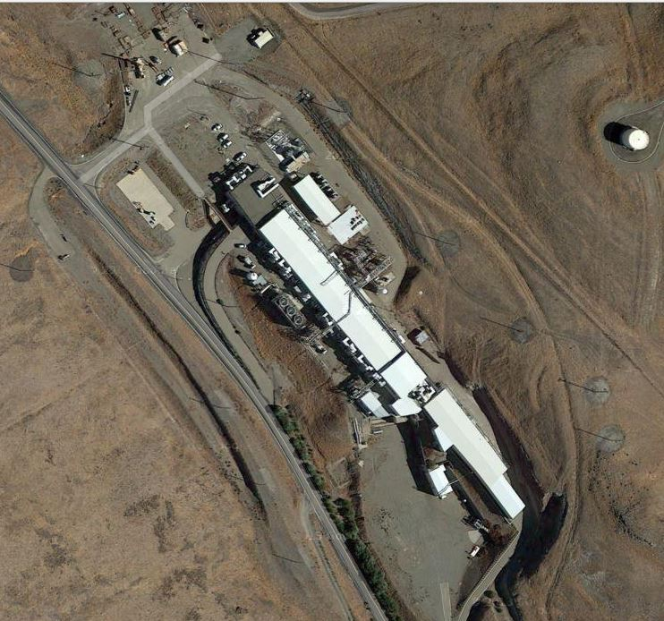
Presentation Outline
Project Overview and Scope
B865 information
DOE funding and collaboration
Project Coordination
Project Management
Targeted decommissioning vs. demolition
Government Property Management
Contracted Work
Project implementation
Historic Preservation Compliance
NEPA Compliance
Radiological Survey Methodology
Notes:
Well start off with a project overview and scope
Specific and unique aspects of B865 which had significant impact on the project
The invaluable cooperation with DOE
Project coordination
Next I will talk about some unique project management aspects
Including government property management
Contracted work
Evaluation of targeted decommissioning vs. wholesale demo
Next well talk about some of the major ticket items we have worked on so far
Historic preservation compliance
NEPA compliance
Radiological release survey

Slide 3
B865 Project Scope
Current status:
Facility has been unused for close to 20 years.
Most of the accelerator beam line has been dismantled and reused or disposed.
Power conditioning/transport infrastructure, vacuum pumps, and a small amount of accelerator components remains.
Final end state:
All internal and external legacy programmatic materials removed.
Intact and securable building shell .
Services left intact and in safe condition.
Notes:
The current status of B865 is a facility that has sat largely unused and dormant for close to 20 years.
Most of the accelerator beam line has been dismantled and disposed
However, some accelerator-related items remain as well the entire power conditioning/transport infrastructure
Racks, vacuum pumps, cable, & conduit
The goal then is to remove all internal and external legacy equipment and leave a
Intact and securable structure with
Utilities and services intact and available for future programmatic work
The end state then is large void rooms ready for new mission
All internal and external Programmatic materials removed (Racks, beam line, pumps, process piping, cabling, other similar). Building proper to be left intact (Roof, roof mounted equipment, exterior building envelope, structure members, emergency lights, area lights, alarms, fire suppression, general service duplexes). Services to facility left intact and in safe condition (water, electrical – sewer leach field has been backfilled, no natural gas). Final end state – intact and securable building shell with basic services functioning. Visual, giant void rooms ready for a new mission.

Slide 4
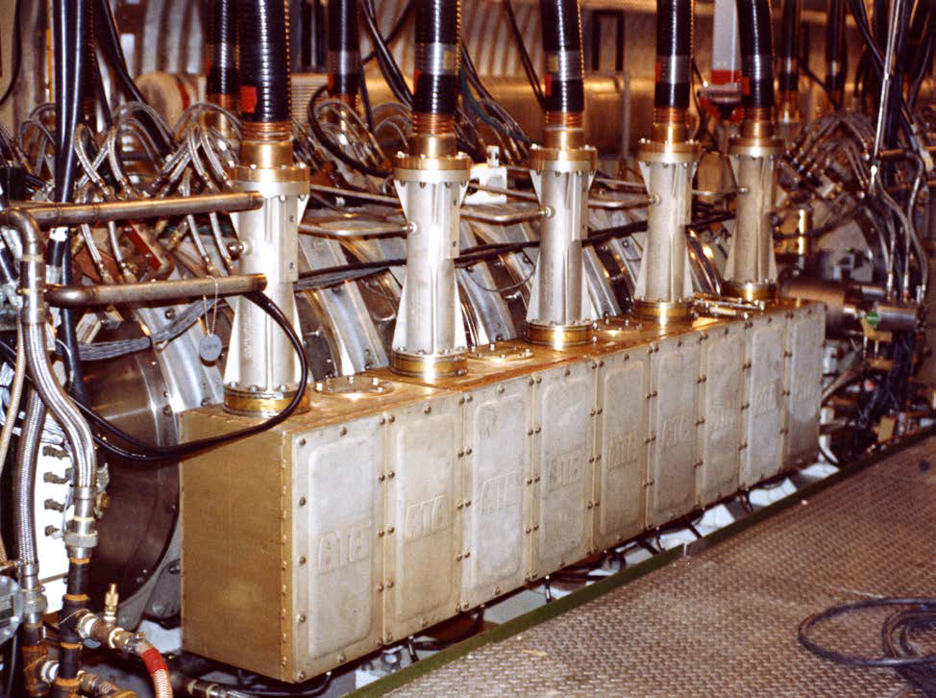
B865 Overview
Cold War-era experimental electron accelerator facility
50 MeV at 700 mA average current (10 kA, 70 ns, 1 kHz)
10¹³ neutrons/m²-pulse
Experiments focused on understanding the physics of electron beam propagation in free air.
Component of the Strategic Defense Initiative (Star Wars) program.
Operated between 1983 and 1995.
Notes:
B865 housed the Advanced Test Accelerator
Device built to run experiments to understand the physics of electron beam propagation. Goal was to develop a free air electron gun that would be a component of the Strategic Defense Initiative program, otherwise known as Star Wars.
Due to relation to the Cold War the facility is deemed to be historically significant

Slide 5
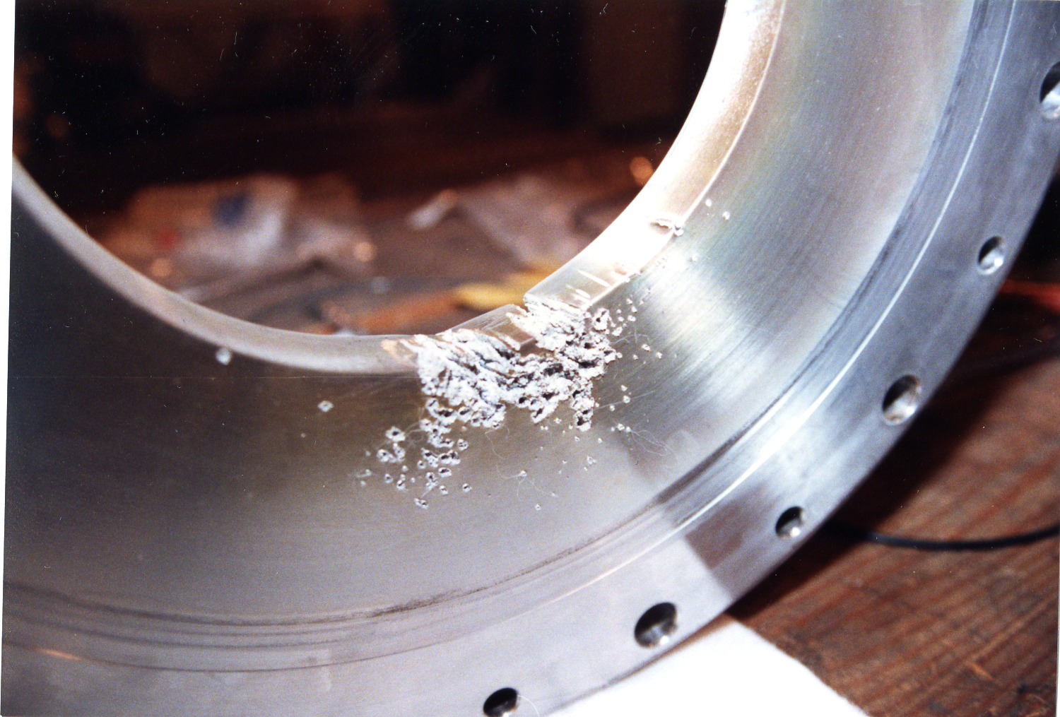
B865 Overview
Notes:
Picture of injector
Picture of accelerator cell component. Corkscrew electron beam.

Slide 6
DOE HQ and LFO are key partners
Coordinated initial efforts with NNSA Champions
Rich Meehan
Tim Cooper
Consultation with headquarters
Lessons on what has worked in the past
Requested input on our approach
Livermore Field Office
Provides conduit for status reports
Notes:
As mentioned in my introduction this whole project has come to fruition in no small part due to work with partners within DOE and more specifically NNSA.
We have consulted with headquarters to learn from similar projects previously conducted within the complex and to request their opinions on how we are approaching the project.
Additionally, having a DOE field office right on our campus has also been conducive in establishing strong communication pathways.

Slide 7
Value of Seed Money from DOE HQ
Enabled pre-contractual work to be performed.
Preparatory work such as electrical LO/TO, temporary power grid, and radiological surveys.
Must be performed long before sale of materials.
Approximately $117K may be provided by DOE HQ to fund this prep work.
Return on initial investment to come from sale of materials and equipment (M&E) harvested from facility.
Notes:
In addition to the technical expertise provided by DOE we have also received monetary support from DOE to conduct and complete some of the pre-project work.
Electrical LO/TO
Establishment of temporary power grid
Radiological surveys
Funds are essential because several items must be performed long before the final sale of materials is conducted.
Up to $117K may be provided by DOE to do this work.
The return on investment to DOE and the American taxpayer is expected to come from funds recouped by the contractors from the sale of equipment and material harvested from the facility.

Slide 8
Project Coordination is accomplished via Bi-weekly phone calls
Participants include:
DOE
Headquarters
Livermore Field Office
LLNL Stakeholders
Property Owner (Site 300)
Property Manager (Institutionally Managed Facilities program)
Institutional Property Management
Procurement
ES&H (Health Physics and Environmental)
Minutes are distributed to wider audience.
Notes:
As part of the coordination and collaboration with DOE a biweekly conference call is held that includes
DOE HQ and LFO &
LLNL Stakeholders including
Site 300
IMF
Institutional Property Mgt.
Procurement
ES&H
Minutes are also distributed to a broader audience of interested parties

Slide 9
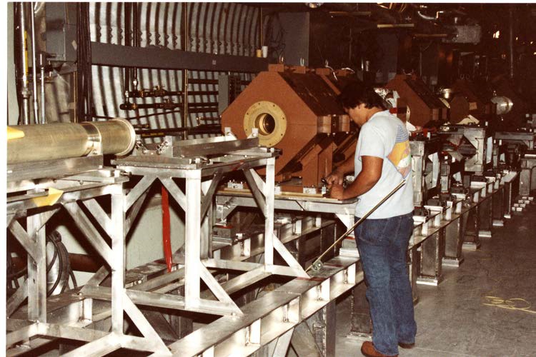
Management of Unique Project Aspects
Maximizing benefit to DOE, LLNL, and the taxpayers
Government Property Management
Subcontractor solicitation and selection
Notes:
This project is unique because it incorporates some rather unique and difficult aspects to address
Due to the fact that the goal is to recoup some monetary funds to off-set the costs associated with the project property management is a key issue.
Additionally finding and hiring a contractor that has the expertise in this type of project will also be essential as we will rely on bids to acquire a baseline of the costs that might be expected.
Ultimately the goal of the project is to maximize the benefits to DOE, LLNL, and the American taxpayer.

Slide 10
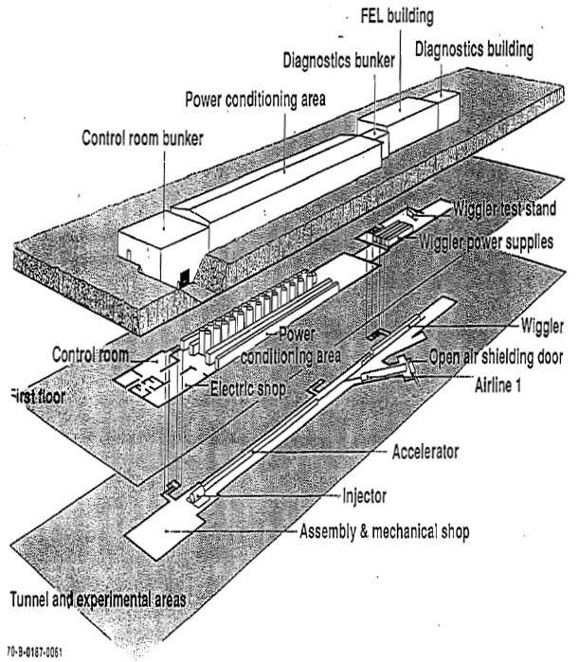
Decommissioning vs Demolition
Unique shielded structure including accelerator tunnel will be available for re-occupancy within the DOE complex.
Hazard risks will be mitigated through this investment recovery effort.
Notes:
In determining how to maximize the benefit to all stakeholders we had to weight option of wholesale demolition versus targeted decommissioning.
In the end the unique physical aspects of B865 namely the shielded structure with an underground tunnel made the decision relatively easy when considering the costs associated to build a new structure.
Additionally, by conducting the final decommissioning of the facility the hazards risks associated with the facility will be mitigated without losing valuable square footage.

Slide 11
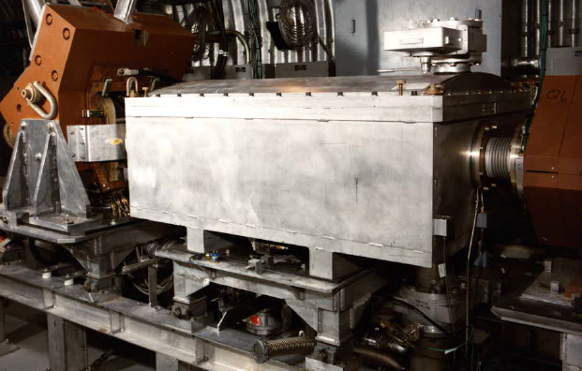
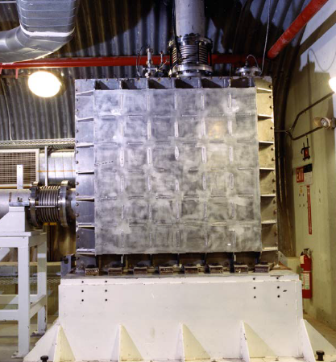
Property Management
Regulations and requirements impact property disposition and the sale of property and material.
Reconcile accountable assets.
Marketing and screening assets for reuse opportunities within the federal community.
Evaluating potential return on investment of property.
Notes:
As I mentioned earlier, I am not a property management expert and so these points are very general but they give you an idea of the types of issues that have to be addressed when attempting to sell government property to a third party.

Slide 12
Contracted Work Aspects
Need inventory and estimate of value of all materials to be sold by subcontractor.
Will the sale value cover 100% of the contractor charges?
Can LLNL receive funds back from the subcontractor in order to offset up front costs?
Identify prequalified vendors
Experience with DOE and work to be performed
Good safety record
Notes:
In choosing the best contractor to conduct the work we have to consider the issue of trying to maximize the return on the sale of the materials.
Complicated because the contractors are the experts and most qualified to quantify the amount of recyclable material and how to maximize its value.
How will work be conducted to reduce costs.
Additionally, questions have to be answered as to how any surplus funds will be reallocated.
Our approach will be to identify prequalified contractors with DOE experience and good safety records

Slide 13
Leveraging subcontractor expertise
Competition will drive the cost down.
Collaboration – Multiple subcontractors may team together.
LLNL intends to interview subcontractors individually and collectively.
Informing our approach through discussions with subcontractors.
Notes:
The goal is to get a good pool of contractors that will compete and drive costs down
The contract will also allow for contractors to work together increasing the pool of candidates
We intend to interview contractors individually and collectively to leverage their expertise with this type of work
The goal is gather as much information as possible which will aid in verifying our approach and assumptions regarding the project costs

Slide 14
Project Implementation
Long lead-time elements:
Historic Preservation Compliance
NEPA—Site Wide EIS coverage verified
Property assessment to determine available options for property disposition
Funding sources
Shorter lead-time elements:
Radiological survey plan development and execution
Soliciting and selecting contractor(s)
Notes:
The implementation of the project produced a long to-do list which was split up into long lead-in and short lead-in items including.
Today I will briefly touch on three items which have either been completed or are currently underway.

Slide 15
Historic Preservation Compliance
B865 was deemed historically significant in 2005 due to its association with Star Wars/Cold War.
Requires compliance with Section 106 of national Historic Preservation Act of 1966 (NHPA):
Consultation with State Historic Preservation Officer (SHPO) and Federal Advisory Council on Historic Preservation (ACHP)
Preparation of Historic American Building Survey/Historic American Engineering Record (HABS/HAER)
Six months to obtain the funding for this report
DOE proposes mitigation for adverse effects
Final consultation results in mitigations documented in memorandum of agreement with SHPO
Notes:
As I mentioned earlier B865 was a facility that played a significant role during the Cold War era and was deemed historically significant in 2005
Significant leg work to comply including consultation and historical surveys and reports
DOE has proposed mitigation for any adverse historical effects from decommissioning of the facility
May include preservation of items and documents and/or photographic account of the facility
Final agreement between LLNL and SHPO

Slide 16
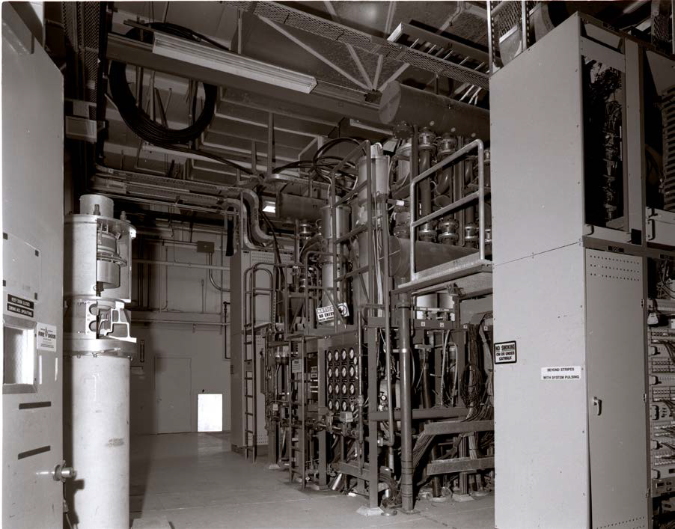
National Environmental Policy Act (NEPA)
Decommissioning and Demolition previously analyzed in 2005 Site-wide Environmental Impact Statement (DOE-1348).
Notes:
Another item that has been completed is the EIS for the decommissioning and demolition of B865.

Slide 17
Radiological Survey Methodology
Applies statistical sampling and counting methods in MARSAME
Application of NIF Distinguishable from Background (DFB) modeling and isotopic information to LLNL accelerator facilities
First large-scale application of (DFB) methodology outside of NIF
Conducted according to LLNL procedure, Release of Items from Radiological Control (HP-FO-450)
Goal: Free-release all M&E remaining in facility as non-radiologically impacted
M&E is retained as radioactive material if radioactivity is distinguishable from background at the 95% confidence level.
Notes:
An item that is currently underway is the release of potentially impacted materials within the facility.
This involved the development of a MARSSIM-type survey plan.
The plan leveraged modeling and isotopic information from a programmatic TBD and a bridging document applying it to accelerator facilities
Applies statistical sampling and counting methods detailed in MARSAME

Slide 18
Project is Model for Operational Stewardship at LLNL
Eliminates hazards such as chemical storage and residual process contamination.
Minimizes unproductive facility space.
Recover value of investment by material sale.
Past LLNL investment recovery and hazard mitigation projects
B851 Accelerator Decommissioning
B419 RCRA Closure
D&D: B412, B212, B431.

Slide 19
Project Contacts
Craig Fish
Environmental Functional Area
Rad Materials Release Environmental Lead
(925) 424-4988
fish2@llnl.gov
Kathy Shingleton
Radiation Protection Functional Area
Technical Lead
(925) 422-5172
shingleton2@llnl.gov
Mark Costella
Legacy Facility Risk and Stewardship Manager
(925) 422-8999
costella2@llnl.gov

Slide 20
Questions…

