Slide 1
UNCLASSIFIED
Implementation of DOE Order 420.2c
at the Los Alamos Neutron Science Center (LANSCE) and
the Dual Axis Radiographic Hydro Test Facility (DARHT)
Kurt Schoenberg
Deputy Associate Director
Experimental Physical Sciences
Keith Ealy
Accelerator Safety Analyst
August 6, 2014
UNCLASSIFIED
LA-UR-14-25839

Slide 2
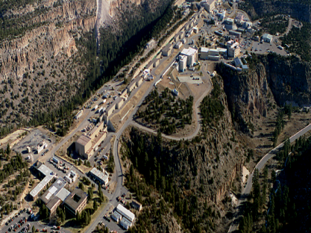
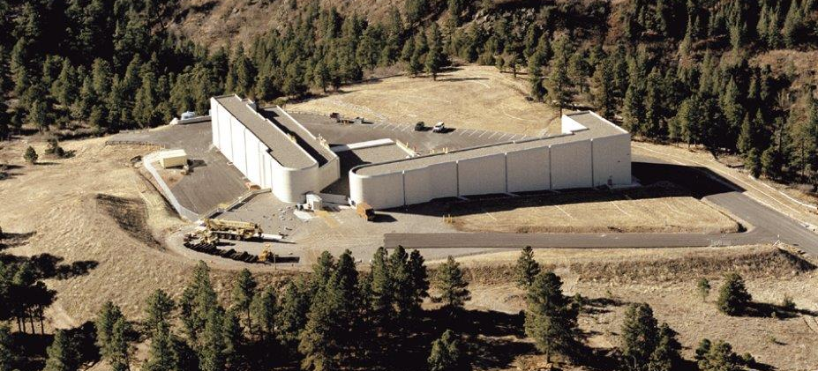
At Los Alamos, LANSCE and DARHT are two principal accelerator-based facilities that operate under DOE Order 420.2c
LANSCE
DARHT
800 MeV proton LINAC
2 linear-induction electron beam accelerators with an included angle of 90º

Slide 3
LANSCE facilities provide unique capabilities for DOE and NNSA programs and the US research communities
Lujan – Moderated Target
Materials, bio-science, and nuclear physics
National security research
National user facility
WNR – Un-moderated Targets
National security research
Nuclear physics
Neutron irradiation
LANSCE
Ultra Cold neutrons
Fundamental Nuclear physics
Proton Radiography
National security research
Dynamic materials science
Hydrodynamics
Isotope Production Facility
Medical radioisotopes
24/7, highly flexible beam delivery, simultaneous to multiple experiments

Slide 4
DARHT provides high-resolution radiographic capability to perform hydrodynamic tests and dynamic experiments in support of stockpile stewardship.
The DARHT facility houses 2 linear-induction electron beam accelerator machines with an included angle of 90º, which produce intense electron beams that are converted to x-ray pulses.
The x-ray pulses are delivered to the R-312 firing site to radiograph high density materials during very short durations (e.g., 10 to 100 nanoseconds).

Slide 5
LANSCE Work Control
Work control procedures derive principally from O420.2c (SAD/ASE) and the 5-step Integrated safety Management (ISM) process that defines the Work, identifies Hazards, implements Controls, Performs Work safely, and Provides Feedback for Improvement.
Plan of the Day (POD) coordinates work activities
All proposed new activities, including hardware and procedural changes, are evaluated using the USID screening process against the SAD/ASE.
USID process identifies activities and types of procedural changes that can be screened out (i.e., no potential impact to the SAD)
Screens are independently reviewed

Slide 6
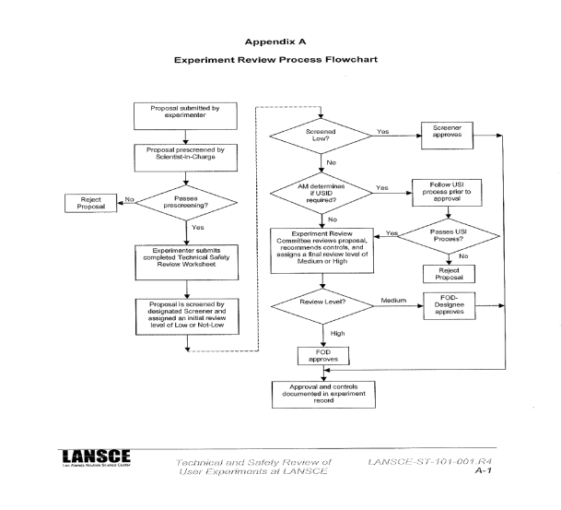
Example: USID process in Experimental Safety Reviews

Slide 7
LANSCE SAD/ASE
1st implemented for all LANSCE specific activities in the early 2000s. Expanded to cover all of TA-53 (geographic) in the most recent revision (4).
Dedicated SAD volumes for each major area - 8 overall
LINAC
Isotope Production (IPF)
Proton Radiography (Area C)
Ultra Cold Neutrons (Area B)
High Power beam delivery hall (Area A)
WNR(Targets 2 and 4),
Lujan(Target 1L)
Balance of Plant
Single ASE volume documents controls - credited engineering controls (CECs),
credited administrative controls (CACs), and Safety Management Programs (SMPs)
Major active CECs: PACS/EPACS access control system; Lujan mercury
shutter fire protection.
Major passive CEC: radiation shielding

Slide 8
LANSCE SAD/ASE (continued)
Shielding design and configuration managed under a TA-53 Shielding policy which is credited as an SMP.
Beam target radioactive inventory control (Lujan/1L, IPF, UCN, WNR) managed under a TA-53 Target Inventory Control Policy, which is credited as an SMP.
Other credited SMPs are LANL programs: Radiation Protection, High Explosives, Radioactive Sources
Linac CACs embodied in an extensive Accelerator Operations Manual (AOM)
Experimental Area CACs implemented via local procedures and/or IWDs.
USID process implemented via LANL USID

Slide 9
LANSCE USID Process is compliant with DOE Order 420.2C and is implemented per DOE G 420.2-1 using a LANL-wide USID Procedure
LANL Procedure SBP113-3, Unreviewed Safety Issue Process, specifically addresses changes at Accelerator and High Hazard nonnuclear facilities at LANL.

Slide 10
LANSCE USID Form
I. Title of USID:
USID for (mention the proposed activity or discovered condition) …
II. Description of Proposed Activity (or discovered condition) (use attachments if necessary):
III. Does the proposed activity or discovered condition affect information presented in the SB, e.g., regarding equipment, administrative controls, or safety analyses. [ ] Yes [ ] No
If ”Yes”, specify the applicable SB Document and relevant sections.
IV. Does the proposed activity or discovered condition require an amendment to the control set (e.g., ASE, OSRs)? [ ] Yes [ ] No
If “No” proceed to Step V.
If ”Yes”, then the USID process is not applicable. A modification to the control set and DOE/NNSA approval are required. List the affected control set elements:
V. Does the issue involve any element of the control set or supporting the control set? [ ] Yes [ ] No
If “No” proceed to Approval Signatures.
If “Yes”, then continue with next question.
Is the proposed change completely enveloped by a previous USID? [ ] Yes [ ] No
If “Yes”, then USID is not required. Go to Approval Signatures.
If “No”, then continue to Step VI and answer all six questions.

Slide 11
LANSCE USID Evaluation Criteria
1. Could the change significantly increase the probability of occurrence of an accident previously evaluated in the SB? [ ] Yes [ ] No
Justification: (use attachment if necessary)
2. Could the change significantly increase the consequences of an accident previously evaluated in the SB? [ ] Yes [ ] No
Justification: (use attachment if necessary)
3. Could the change significantly increase the probability of occurrence of a malfunction of equipment important to safety previously evaluated in the SB?
[ ] Yes [ ] No
Justification: (use attachment if necessary)
4. Could the change significantly increase the consequences of a malfunction of equipment important to safety previously evaluated in the SB? [ ] Yes [ ] No
Justification: (use attachment if necessary)
5. Could the change create the possibility of a different type of accident than any previously evaluated in the SB that would have potentially significant safety consequences? [ ] Yes [ ] No
Justification: (use attachment if necessary)
6. Could the change create the possibility of a different type of malfunction of equipment important to safety than any previously evaluated in the SB?
[ ] Yes [ ] No
Justification: (use attachment if necessary)
VII.USI Determination: A USI is determined to exist if the answer to any of the 6 questions above (Section V) is “Yes.” If the answer to all 6 questions is “No”, then no USI exists.
a. Does the proposed activity (or discovered condition) constitute a USI?
___Yes—DOE/NNSA or other approval authority approval is required before implementing.
___No—Proposed activity may be implemented with appropriate internal
review.

Slide 12
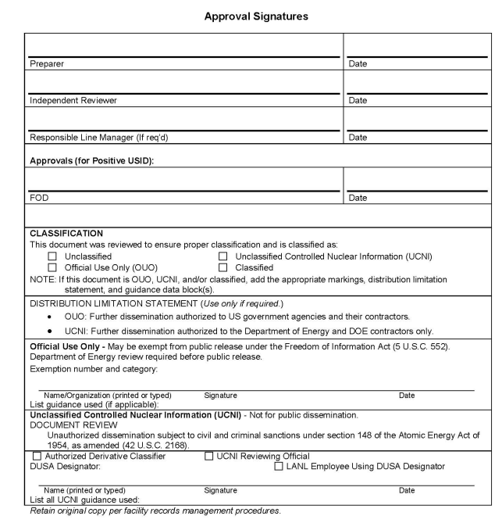
LANSCE USID Approval Process

Slide 13
DARHT Safety Assessment Document (SAD) is compliant with DOE O 420.2c
DARHT SAD: 1 Volume – 7 Chapters; 10 Appendices; and 1 Attachment
Chapter | Title and Description
1 | Introduction (Presents the mission and summarizes the remaining chapters.)
2 | Summary and Conclusions (Provides an over of the results and conclusions.)
3 | Site, Facility, and Operations Description (Adjoined to the a HE firing site; Electron beam is not continuously generated: 4 Modes of operation; coordinate ops with firing site.)
4 | Safety Analysis (Summary of the analysis is in the appendices but presents the controls to prevent / mitigate the accidents.)
5 | Accelerator Safety Envelope (Provides an overview of the controls and explicitly includes the controls in Chp. 4.)
6 | Quality Assurance (Provides a summary of the quality assurance plan.)
7 | Decontamination and Decommissioning (Not near end of life – little information provided.)

Slide 14
DARHT Work Control
Plan of the Day coordinates work activities and requires DARHT Operations Manager approval to be on the POD
Activities have approved work control documents that specifies the activities, hazards, and controls
All activities, including procedural changes, are evaluating using the USID screening process
Screening process identifies activities and types of procedural changes that can be screened out (i.e., no potential impact to the SAD)
Screens are independently reviewed
USIDs are performed as necessary on items to evaluate potential impacts on the DARHT SAD

Slide 15
CONCLUSIONS
Los Alamos has successfully implemented DOE O420.2c to operate its two largest accelerator facilities DARHT and LANSCE
The flexibility of 420.2c allows the SAD and ASE at each facility to be customized to best align with specific facility operations and scope of research.
Plan of the day and Plan of the week meetings are an integral part of facility work control.
The USID process is built into work authorization, be it maintenance, construction, or research.
O 420.2c will form the operational basis for the future MaRIE facility at Los Alamos

