Slide 1
General Plenary Session Part 1
ARR & USI in ASO Guide
Doug Paul
Aug 5, 2014

Slide 2
Overview
Accelerator Readiness Reviews (ARR)
  Purpose
  Changes/Improvements/Emphasis in Draft ASO Guide
Un-Reviewed Safety Issues (USI)
  Purpose
  Changes/Improvements/Emphasis in Draft ASO Guide
ASO Guide Comments & Questions

Slide 3
ARR Purpose
To provide a means to verify that an accelerator facility’s Personnel, Documentation, & Equipment are adequate to support Commissioning and/or Routine Operations.
Conducted by the Contractor and requires that DOE ensure that it was conducted in a manner of appropriate scope and depth to provide a basis for approval for starting commissioning or routine operations activities.
An ARR is not a method for achieving readiness, but for verifying it.

Slide 4
ASO Guide ARR Section 2.10
4 Areas of Emphasis Over the 2005 Guide
  Preparing for an ARR in order to achieve readiness
  Conducting a Performance Based ARR
  Conscientious determination between single and combined Commissioning & Routine Operations ARR
  During Operations, conditions or facility modifications justifying conducting an ARR

Slide 5
  Preparing for ARRs
New paragraph 2.10.3 added to ARR Section
  Contractor should develop internal-readiness plan/process to help achieve readiness
  Covers activities completed by the contractor (findings closed)
  Captures preparing for ARR, planning for commissioning, and for transitioning to operations

Slide 6
  ARRs’ are Performance Based
  DOE added renewed emphasis for ARR to include Performance based verifications of readiness
  LL from Miss-Steer Beam Loss Event at NSLS-II
  JLAB, FERMI, BNL had ARR’s Scheduled for Near Term
  Peer Review w/ DOE/HQ Oversight
Emphasis added that Contractors Internal Readiness Plan not a substitute for ARR verification

Slide 7
  Conscientious determination of Commissioning vs. Routine Operations
  ARRs always precede Commissioning Activities
  Commissioning Activities can be done in phases or modules for large accelerators as long as the ARRs are incremental
  At the end of incremental Commissioning the accelerator is ready for final ARR for Routine Operations.
  Alternately, for less complex facilities, contractor may request a combined commissioning/routine operation ARR w/ DOE agreement.

Slide 8
  Conditions or Facility Modifications Justifying Conducting an ARR
  More guidance is provided on When to conduct an ARR
    A new module to an existing facility is constructed
    A substantial upgrade or change to an existing facility
    Resuming operation of an existing facility that has be shut down for extended period of time
  In general major additions or modifications require an ARR
  Contractor focused reviews to support minor modifications (Instrument Upgrades, etc.) through Instrument Readiness Reviews (IRRs) with prior agreement and process review.

Slide 9
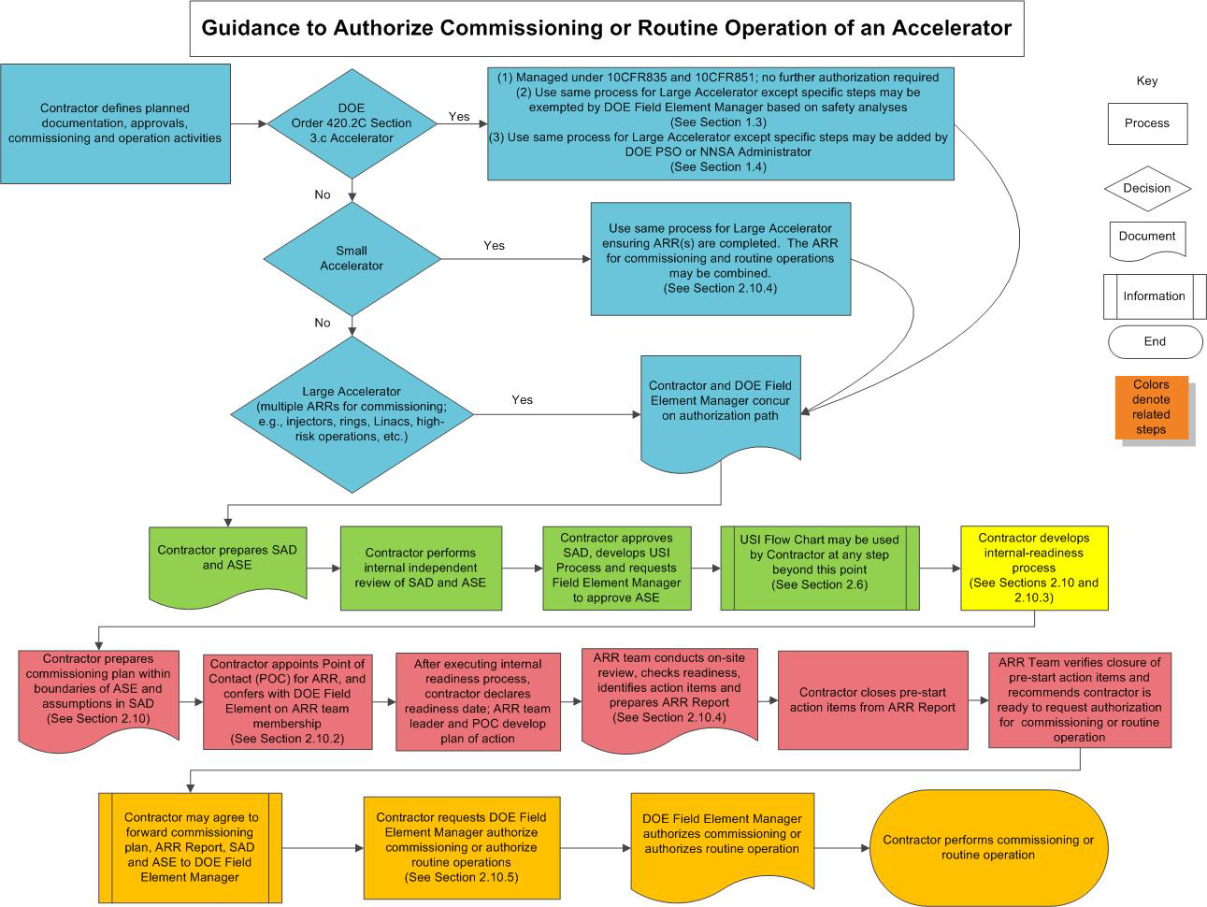

Slide 10
Unreviewed Safety Issue (USI) Process
The USI :
  Evaluates activities with potential to significantly impact safety.
  Ensures appropriate hazards analysis conducted
  Ensures appropriate controls to safely manage hazards
  Ensures appropriate documentation
  Ensures proper approvals

Slide 11
Guide Emphasis Areas on USI Process
3 Areas of Emphasis Over the 2005 Guide
  USI process should be in place early
  USI process is not a substitute for a Safety Analysis
  USI determination that address modification or discovered condition should include an evaluation or screening

Slide 12
  USI process should be in place early
The Hazard Analysis, Contractor Assurance, SAD, ASE, and ARR processes are all critical elements of an effective accelerator program.
These critical elements may all interface with the USI
Guide recommends:
  USI process should be in place prior to commissioning
  USI process should be reviewed as part of the ARR

Slide 13
  USI process is not a substitute for a Safety Analysis
Purpose of USI process
  Is to ensure the DOE is aware of proposed changes or discoveries that significantly increase risk
  Does not determine determine the safety of proposed change or discovery. This is done through a Safety Analysis
USI process rather provides a structured approach for decision making
  Allows accelerator management flexibility to make changes to facilities if do not significantly affect the risk conclusions of the existing safety analysis and ASE

Slide 14
  USI determines whether planned modifications or a discovery can affect the ASE
USI process to address facility modification should involve an evaluation or screening of changes in accelerator ops, credited controls, or safety programs if they have potential to significantly affect safety
Personnel involved in USI evaluation or screening process should be knowledgeable in ASE requirements and assumptions in SAD

Slide 16
Summary and Conclusions
New ASO Guide provides more definitive guidance in the USI and ARR process
Changes incorporated in the Final ASO Guide based on Accelerator Community Input/ Formal Comments

Slide 17
Questions ?

