Slide 1
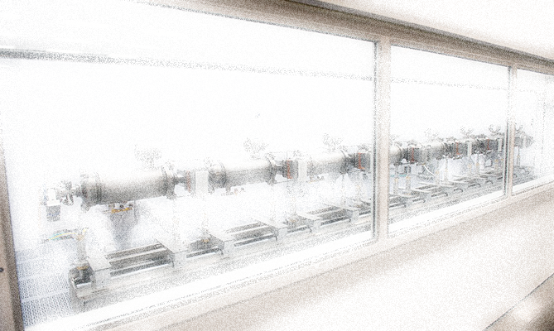
SAD and ASE Development Single Purpose/Few or One Accelerator
R. May
Thomas Jefferson National Accelerator Facility
Work performed under DOE Contract: AC05-06OR23177

Slide 2
Overview
Recent and Current Jefferson Lab SADs
SAD Structure
Hazard Assessment Methodology
SAD Review Process
ASE
Summary

Slide 3
Recent and Current SAD
Currently Revision 7 (August 27, 2012)
Changes from Revision 6 include
Updated the SAD for 12 GeV operations,
Provided a more detailed description of accelerator related equipment in Technical Areas
Extended hazard analysis rigor to Technical Areas
Consequence evaluation linked to ANSI/ASSE Z590.3 – 2011, Prevention through Design… 01/23/2012.
Decoupled the ASE from the SAD - helped delineate what was being approved by our Site Office
Decoupled Shielding Policy; now stand-alone

Slide 4
Recent and Current SAD, cont’d.
Previous Revision 6 (March 1, 2009)
Changes from Revision 5 based on 420.2b
Further revision, 6a (Oct. 1, 2010)
Clarifications to ASE w/r/t beam power, addition of certain defense-in-depth measures, clarification of terms and units, typo corrections, etc.
Further Revision 6b (May 1, 2012)
Lab organizational change
Update of geographical area to account for new experiment hall construction
Update to ASE “Beam On” definition clarified

Slide 5
SAD Structure
Single SAD Document
Provides a description of the entire facility, including ancillary support facilities, and analysis of associated hazards
Lists two accelerator (CEBAF and LERF)
Analysis focuses on accelerator specific hazards (standard industrial hazards)
Risks are clearly understood and necessary controls identified
Developed in partnership with TJSO
Assisted by Integrated Support Center

Slide 6
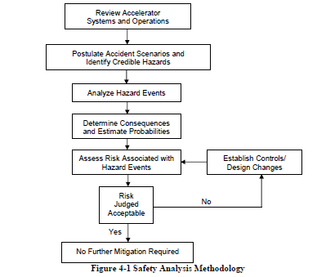
Hazard Assessment Methodology
Assessment focuses on accelerator specific hazards
hazard unique to accelerator equipment or direct support equipment
applied to indirect support equipment if it can produce an accelerator specific hazard
Standard industrial hazards identified but detailed hazard analysis and mitigation discussion not in SAD
are adequately addressed by DOE approved programs related to federal regulations

Slide 7
Hazard Assessment Methodology, cont’d.
No standard methodology or industry guidance for quantitative comparison of risk from fundamentally different hazards considered “accelerator specific”
Typically, a qualitative assignment of risk supported by professional experience is used to bridge such a gap

Slide 8
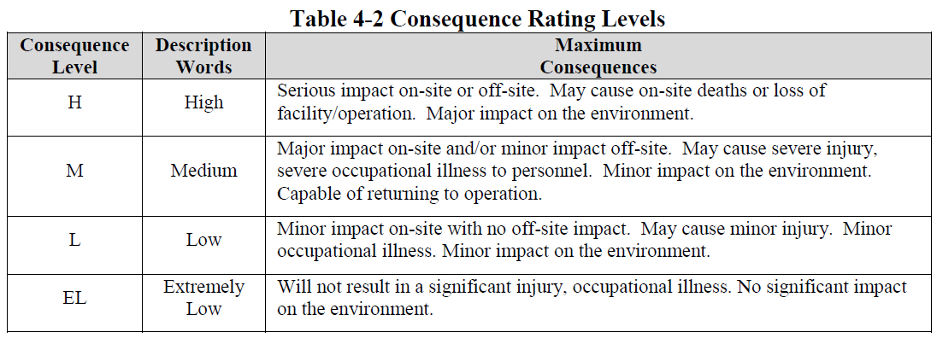
Hazard Assessment Methodology, cont’d.
The consequences (health effects) of credible hazards grouped in Table 4-2 and binned into consequence levels
The binning is based on the methodology used in FSAD, Rev. 7 which was revised to better align with a recent consensus standard that addresses occupational hazards and risks in process design

Slide 9
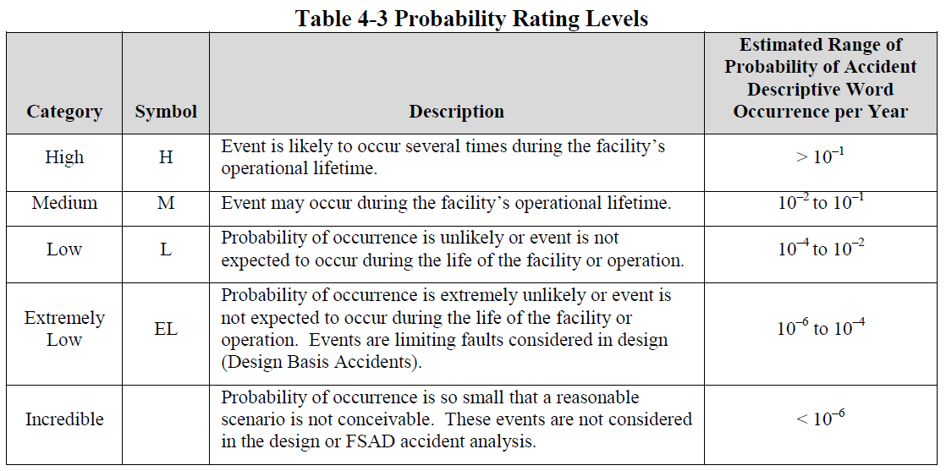
Hazard Assessment Methodology, cont’d.
The five categories, their estimated range of occurrence probability (per year), and their description provide the basis for qualitative assessment of the likelihood of a hazardous event

Slide 10
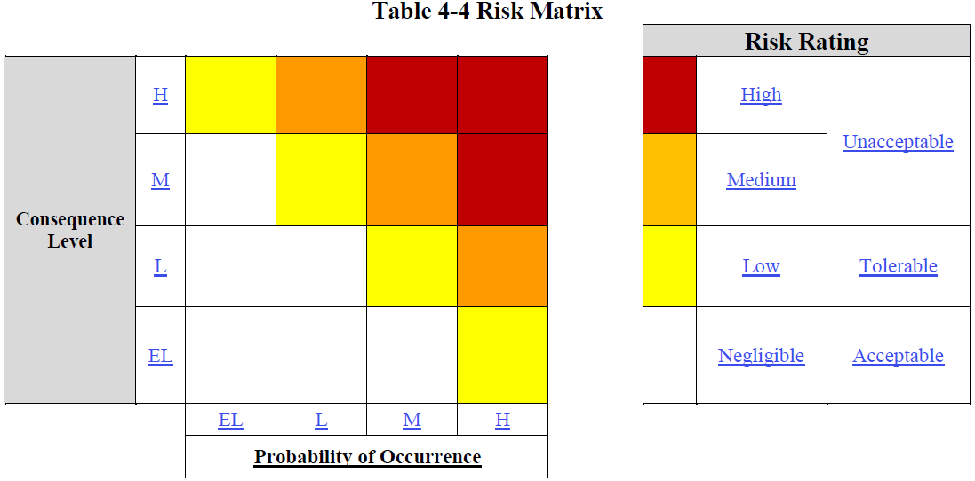
Hazard Assessment Methodology, cont’d.
Risk matrix in Table 4-4 combines consequence and probability for determination of acceptability of risk

Slide 11
Hazard Assessment Methodology, cont’d.
Credible hazards evaluated for Risk Rating
“Unacceptable” Risk Rating gets Credited Control
Credited Passive Engineered Controls
Permanent Shielding and Labyrinths
Credited Active Engineered Controls
PSS Critical Devices
Access Controls
Credited Administrative Controls
Locked Doors and Gates
“Tolerable” Risk Rating still mitigated by Defense-In-Depth Controls

Slide 12
Hazard Assessment Methodology, cont’d.
Sample from the SAD Summary Table for Mitigated Risk Rating
Specific events
Maximum Consequence Level of “High” is addressed in the ASE with mitigation as a prerequisite for accelerator operation

Slide 13
SAD Review Process
Each SAD Chapter review by Safety Configuration Management Board (SCMB)
Each SAD Chapter distributed electronically to System/Subject Matter Experts for review and comment
All comments resolved before distribution to Lab management for review and comment
Lab management final signature
On-going and annual review by SCMB
Documented review and resolution of safety issues
Determine the need for SAD revision

Slide 14
ASE
Simple layout and content
Document description
Discussion of what constitutes a violation
List of Credited Controls
Developed in partnership with TJSO and Integrated Support Center
Internally reviewed and approved - same electronic process as SAD
Approved by TJSO
Annually review by SCMB for continued technical accuracy and relevance

Slide 15
ASE, cont’d.
SCMB administers USI Process
Structured process for revaluating hazards in light of planned changes against ASE
Maintains safety configuration management
Key to identifying and managing emerging issues

Slide 16
Summary
SAD Credible Hazards under review based on new fault studies conducted on 12 GeV CEBAF
Will be combined with annual and SCMB review on USI to evaluate need for SAD revision
No anticipated need for ASE revision
Process thorough, systematic, defensible
Meets 420.2C and consistent with DRAFT safety order guidance document

