Slide 1
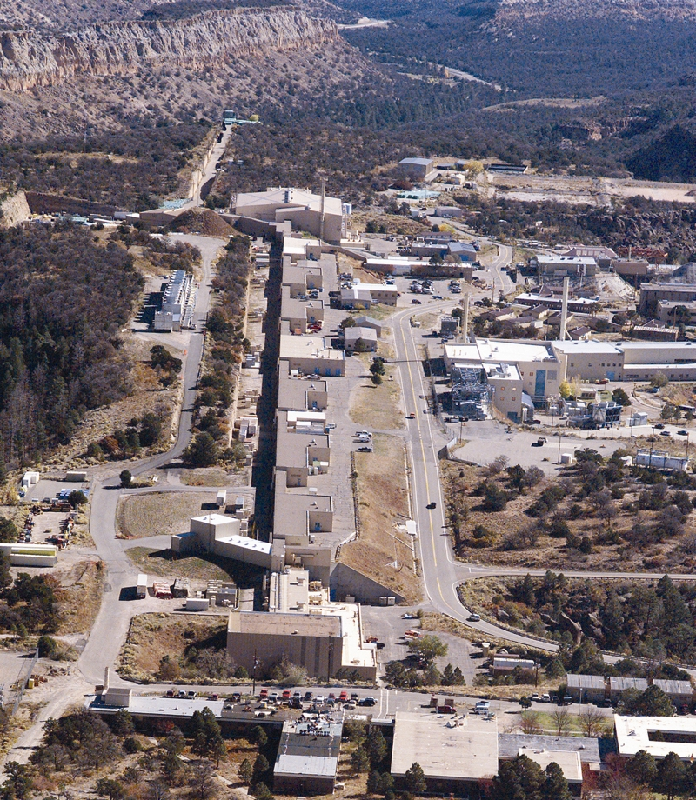
SAD/ASE Development at Los Alamos National Laboratory: an NNSA Facility (LANSCE and DARHT)
LA-UR-14-25925

Slide 2
Los Alamos Neutron Science Center (LANSCE) Linear Accelerator at TA-53
LA-UR-14-25925
Notes:
One-line drawing of the LINAC and Experimental Areas:
Isotope Production Facility
Area C – Proton Radiography
Area B – Ultra-cold Neutron (UCN)
Lujan Center
1L Target
Actinide scattering
Weapons Neutron Research (WNR)
Area A
Materials Test Station (MTS – future)
Area A East - Storage of Activated Components

Slide 3
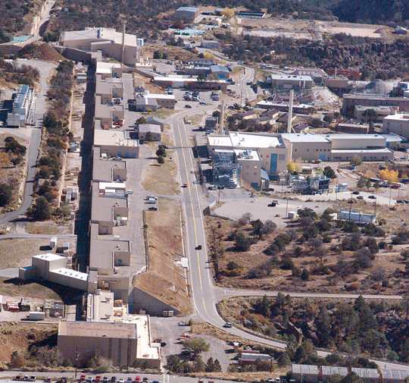
LANSCE (TA-53) Experimental Areas
Area A
Materials Test Station (MTS) [in the future]
Area A East Storage
Area B
UCN
WNR
National security research
Nuclear Physics
Neutron Irradiation
Lujan Center
National security research
Materials, bio-science, and nuclear physics
National user facility
Area C: Proton Radiography
National security research
Dynamic Materials science,
Hydrodynamics
Isotope Production Facility (IPF)
Medical radioisotopes
LA-UR-14-25925

Slide 4
LANSCE (TA-53) Safety Basis
Compliant with DOE O 420.2C
TA53-SB-SAD-VOL. I-113-004 – LINAC & BEAM Delivery
TA53-SB-SAD-VOL. II-113-004 – Isotope Production Facility
TA53-SB-SAD-VOL. III-113-004 – Area C
TA53-SB-SAD-VOL. IV-113-004 – Area B
TA53-SB-SAD-VOL. V-113-004 – Area A
TA53-SB-SAD-VOL. VI-113-004 – Manuel Lujan Neutron
Scattering Center
TA53-SB-SAD-VOL. VIII-113-004 – Balance-of Plant
TA53-SB-ASE-113-005 – Accelerator Safety Envelope
TA53-SB-SAD-VOL. VII-113-004 – Weapons Neutron Research
Facility (WNR)
8 Volume SAD
ASE
LA-UR-14-25925
Notes:
As you gentlemen are well aware,
LANSCE 420.2b-compliant Safety Assessment Document (SAD) is:
Modular, addressing the respective experimental area, which
reflects the operational model of how we actually operate.
Thus, when a SB change is made (for example) to Area C that affects the Control Set, only two volumes are affected:
Volume III, Area C, and
ASE

Slide 5
TA-53 SAD: Volume Contents
Chapter 1 Introduction
Chapter 2 Summary and Conclusions
Chapter 3 Site, Facility, and Operations Description
Chapter 4 Safety Analysis
Chapter 5 Credited Controls and Bases for Accelerator Safety Envelope (ASE)
Chapter 6 Quality Assurance
Chapter 7 (Volume I Only: Beam Interface)
LA-UR-14-25925

Slide 6
TA-53 Accelerator Safety Envelope (ASE): Volume Contents
Definitions, Acronyms, Frequency Notations, Logical Connectors Completion times
General Operations and Surveillance Requirements:
Credited Engineered Controls (CECs), Credited Administrative Controls (CACs), and Surveillances addressing:
Primary Beam Transport
IPF
Area B
Area C
Area A
Lujan Center
WNR
Administrative Controls
Procedures
Safety Management Programs
Training and Qualifications
LA-UR-14-25925
Notes:
Similar elements to TSRs governing a DSA

Slide 7
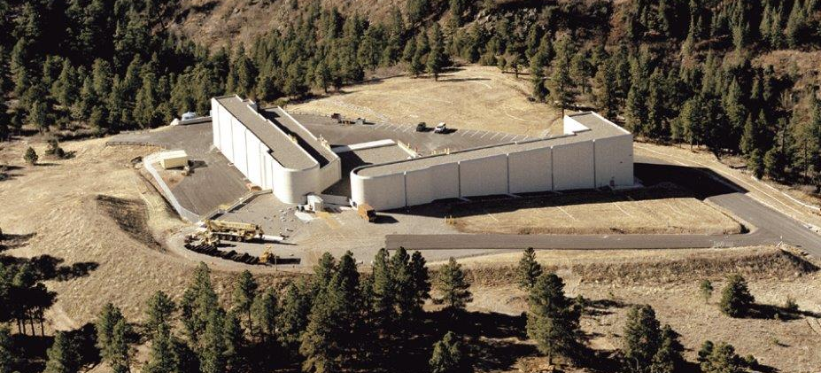
Dual Axis Radiographic Hydro Test Facility (DARHT) Mission
Mission
Provide high-resolution radiographic capability to perform hydrodynamic tests and dynamic experiments to support of stewardship of the nuclear weapons stockpile.
The DARHT facility houses 2 linear-induction electron beam accelerator machines with an included angle of 90º, which produce intense electron beams that are converted to x-ray pulses. The x-ray pulses are delivered to the R-312 firing site to radiograph high density materials during very short durations (e.g., 10 to 100 nanoseconds).
LA-UR-14-25925

Slide 8
DARHT SAD Compliant with DOE O 420.2C
1 Volume – 7 Chapters; 10 Appendices; and 1 Attachment
Chapter | Title and Description
1 | Introduction (Presents the mission and summarizes the remaining chapters.)
2 | Summary and Conclusions (Provides an over of the results and conclusions.)
3 | Site, Facility, and Operations Description (Adjoined to the a HE firing site; Electron beam is not continuously generated: 4 Modes of operation; coordinate ops with firing site.)
4 | Safety Analysis (Summary of the analysis is in the appendices but presents the controls to prevent / mitigate the accidents.)
5 | Accelerator Safety Envelope (Provides an overview of the controls and explicitly includes the controls in Ch. 4.)
6 | Quality Assurance (Provides a summary of the quality assurance plan.)
7 | Decontamination and Decommissioning (Not near end of life – little information provided.)
LA-UR-14-25925

