Slide 1
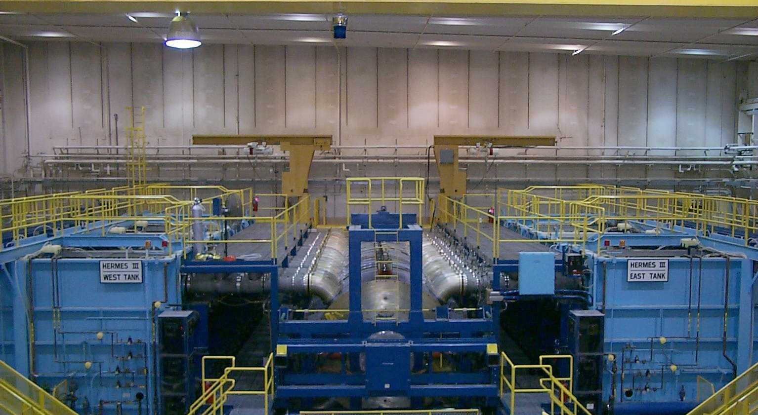
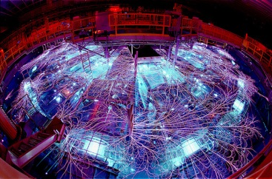
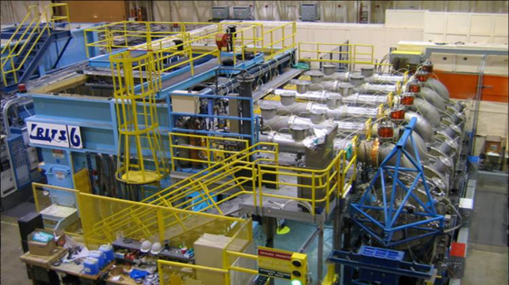
SAD and ASE Development
Overview of Sandia Process

Slide 2
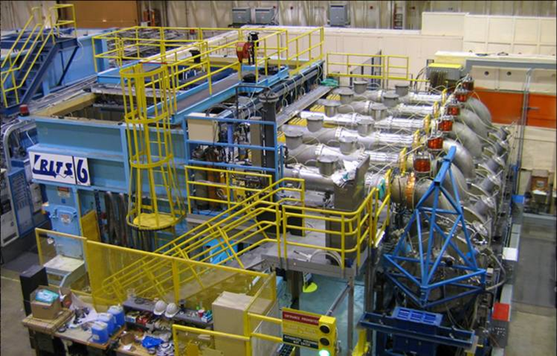
Sandia Regulated Accelerators
High Energy Radiation Megavolt Electron Source [HERMES-III]
Radiographic Integrated Test Stand [RITS-6]

Slide 3
Sandia SAD/ASE Process
Order is Programmatically Implemented Through The Safety Basis Department
Maintain Corporate Requirements
Review USIs
Review/Concur SAD Updates
Line Organizations Implement Corporate Requirements
Operate Within Safety Envelope
Maintain SAD
Maintain Compliance to ASE
Complete USI Process
NNSA Sandia Field Office
Approval Authority for ASE
Approval Authority for Positive USI

Slide 4
Sandia SAD/ASE Process
SAD/ASE Prepared Per Sandia Safety Basis Manual Requirements
Reflect Standard for Nuclear DSA and/or Moderate Hazard
Format/Content
Methodologies
ASE Is Part of SAD
Preparation Through Joint Effort
Line Organization
Safety Basis Organization
Other SME Organizations
Safety Engineering
Industrial Hygiene
Radiation Protection
Facilities

Slide 5
Sandia SAD/ASE Process
SAD Content
Executive Summary
Site Description
Physical
Environmental
Natural Phenomena Events
Facility Description
Physical
Process Descriptions
Control System Descriptions
Hazards Analysis
Identification
Screen
Evaluation
Control Identification
Control Evaluation
Hierarchy Analysis
Control Selection
Accelerator Safety Envelope
Engineering Controls
Administrative Controls
Safety Management Programs
Appendices
Hazard Identification Table
Hazard Evaluation Tables

Slide 6
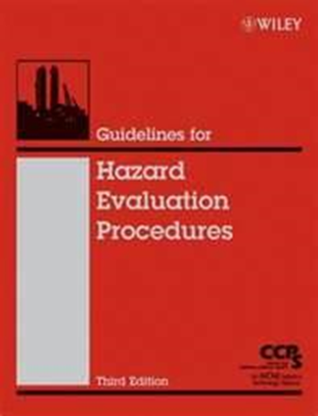
Sandia SAD/ASE Process
Hazards Analysis Methodologies
Requirements in Safety Basis Manual
Chapter Specific to Accelerators
Methodologies Common with Moderate Hazard Facilities
Center for Chemical Progress, Guidelines for Hazard Evaluation Procedures, Third Edition, Wiley, ISBN: 978-0-471-97815-2, April 2008.
Preferred Methodologies
What-If/Checklist Analysis
Screen Standard Industrial Hazards
Formal Facilitator, Scribe, & SME Process
Qualitative Risk Binning
Unmitigated versus Mitigated Evaluation
Identify Primary & Defense In Depth Controls
Control to Acceptable Risk

Slide 7
Sandia SAD/ASE Process
Safety Basis & Line Work Closely on Development
Iterative Draft and Review Process
Internal Line Drafts
External Safety Basis Review
Formal Independent Review Team (IRT)
Following Documented Plan
Using Formal Comment Response
Final Comment Resolution
Sandia Approvals
Line Organization
Safety Basis
Upper Management
SFO Review/Approval
Review/Comment of SAD
Approval of ASE ~ Safety Evaluation Report

Slide 8
Sandia SAD/ASE Process
Annual Reviews
Line Organization Review of USIs
Determine if Annual Update Required
Inform Safety Basis Department
No Annual Update
Schedule of Annual Update
Periodic Updates
As Determined Through Assessment/Analysis
Agreed Depth & Breadth of Update
Content
HE Analysis
ASE Update
Re-Approval & Authorization

Slide 9
Questions?
Timothy S. Stirrup
Safety Basis Engineer
Nuclear and Industrial Facilities Safety Basis
PO Box 5800 MS 0794
Sandia National Laboratories
Albuquerque, NM 87185
(505) 845-7155
tsstirr@sandia.gov

