Slide 1
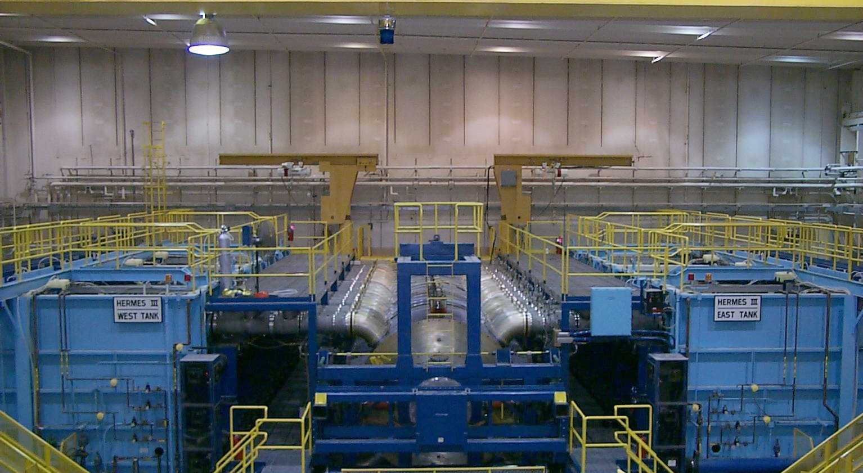
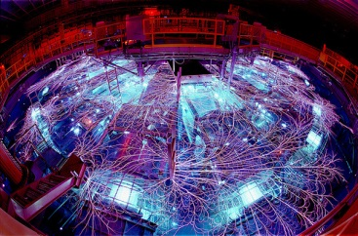
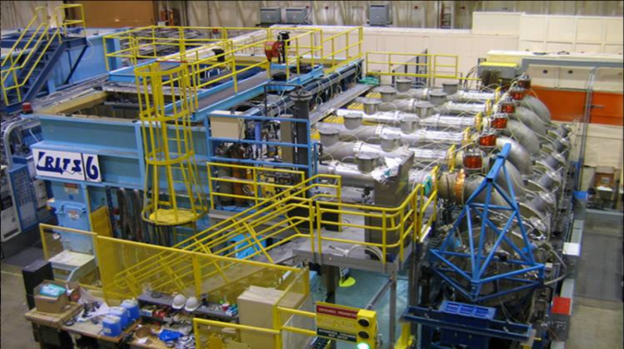
Accelerator Safety Management Program: Contractor Assurance Processes & Program Review
Overview of Sandia Process

Slide 2
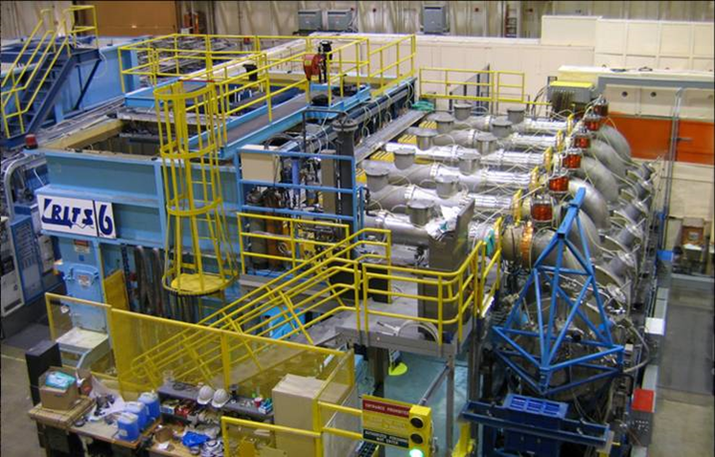
Sandia Regulated Accelerators
High Energy Radiation Megavolt Electron Source [HERMES-III]
Radiographic Integrated Test Stand [RITS-6]

Slide 3
Sandia Assurance Process - Compliance
Order is Programmatically Implemented Through the Safety Basis Department
Maintain Corporate Requirements
Review USIs
Review/Concur SAD Updates
Line Organizations Implement Corporate Requirements
Operate With In Safety Envelope
Maintain SAD
Maintain Compliance to ASE
Complete USI Process
NNSA Sandia Field Office
Approval Authority for ASE
Approval Authority for Positive USI

Slide 4
Sandia Assurance Process
Line Organization Assurance Beyond Compliance
Complete USI Process
Basis of Immediate Management Review & Approval
Annual Reviews of SAD/ASE & Aggregate USIs
Required Implementation of Conduct of Operations per DOE O 422.1
Identify & Implement 18 Requirements
Assess All 18 Requirements Over 3 Year Period
Internal Management Self Assessments
Management Walkthroughs

Slide 5
Sandia Assurance Process
Safety Basis Assurance Beyond Compliance
Complete USI Reviews
Basis of Safety Basis SME Review & Concur
Required Assessments of USI Process
Quality of USIs
Accuracy of USI Determinations
Compliance to Written Procedure
Annual Reviews of SAD/ASE & Aggregate USIs
Work with Line Organizations on Update Requirements/Schedules
Required 3 Year Assessments of Conduct of Operations per DOE O 422.1
Safety Basis SME Training
USI Training
HE Training
Safety Basis SME Walkthroughs
Informal versus Formal

Slide 6
Sandia Assurance Process
Sandia Corporate Assurance Beyond Compliance
Corporate Program Support/Assessments (Examples)
Radiological Program
Industrial Hygiene
Safety Engineering
Fire Protection
Corporate Implementation of Lessons Learned
Corporate Implementation of Work, Planning, & Controls
Corporate Implementation of Occurrence Reporting

Slide 7
Sandia Assurance Process
NNSA SFO Assurance Beyond Compliance
Implementation of Facility Representative (FR) Program
Review of USIs
Review of Procedures
Oversight/Walkthroughs
Assessments
Periodic Programmatic Meetings
Safety Basis
Fire Protection
Industrial Hygiene
Radiological Protection
Periodic Oversight Assessments
DOE HQ Audits/Assessments

Slide 8
Questions?
Timothy S. Stirrup
Safety Basis Engineer
Nuclear and Industrial Facilities Safety Basis
PO Box 5800 MS 0794
Sandia National Laboratories
Albuquerque, NM 87185
(505) 845-7155
tsstirr@sandia.gov

Slide 9
Supporting Slides

Slide 10
Definitions
Radiation Generating Device: A device that generates ionizing radiation (e.g., neutrons, x-rays, or bremsstrahlung) intentionally or incidentally when energized.
Accelerator: A device [e.g., RGD] employing electrostatic or electromagnetic fields to impart kinetic energy to molecular, atomic or sub-atomic particles and capable of creating a radiological area [DOE O 420.2C].
Radiological Area: Any area within a controlled area defined in 10 CFR 835 as a radiation area, high radiation area, very high radiation area, contamination area, high contamination area, or airborne radioactivity area [10 CFR 835].

Slide 11
Definitions
Controlled Area: Any area to which access is managed by or for DOE to protect individuals from exposure to radiation and/or radioactive material [10 CFR 835].
Radiation Area: Any area, accessible to individuals, in which radiation levels could result in an individual receiving an equivalent dose to the whole body in excess of 0.005 rem (0.05 mSv) in 1 hour at 30 centimeters from the source or from any surface that the radiation penetrates [10 CFR 835].
Airborne Radioactivity Area: (1) The concentration of airborne radioactivity, above natural background, exceeds or is likely to exceed the derived air concentration (DAC) values listed in appendix A or appendix C of this part; or (2) An individual present in the area without respiratory protection could receive an intake exceeding 12 DAC-hours in a week [10 CFR 835].

Slide 12
Definitions
Accelerator Operations: Those activities of an accelerator and any associated accelerator facilities that are bounded by the Safety Assessment Document. Accelerator operations (and post operations) include the production, dispensing, analysis, movement, processing, handling and other uses, and storage of radioactive material within the accelerator facility.
Radiation: Ionizing radiation (alpha particles, beta particles, gamma rays, X-rays, neutrons, high-speed electrons, high-speed protons, and other particles) capable of producing ions.

Slide 13
Definitions
Accelerator Facility: The accelerator and associated roads within site boundaries, plant and equipment utilizing, or supporting the production of, accelerated particle beams and the radioactive material created by those beams to which access is controlled to protect the safety and health of workers, the public or the environment.
The term facilities includes injectors, targets, beam dumps, detectors, experimental halls, non-contiguous support and analysis facilities, experimental enclosures and experimental apparatus utilizing the accelerator, etc., regardless of where that apparatus may have been designed, fabricated, or constructed, including all systems, components and activities that are addressed in the Safety Analysis.

Slide 14
Background
Exclusions Are Now Exemptions
All “Accelerators” Are Now In
Device/Facility Exemption from Section 4 Requirements
Meant to Establish Minimum Criteria Where 420.2C Applicable
Meant to Exempt Devices Already Exempted in Other Directives (e.g., RGDs)
Exemptions May Create Potential 10 CFR 830 Implications
Exempted Devices are Still Accelerators
10 CFR 830 Definition of Nonreactor Nuclear Facility “…Does Not Include Accelerators And Their Operations…”

Slide 15
Background
Equivalency (to Address 10 CFR 830 Implications)
The DOE PSO/NNSA Administrator may specify alternate safety standards, requirements or DOE Directives that provide equivalent (or greater) protection in lieu of or in addition to the requirements of this Order
These alternate standards would be primarily for those accelerator facilities or modules thereof and their operations when they contain, use or produce fissionable materials in amounts sufficient to create the potential for criticality based on the configuration of the materials
Primary NNSA/DNFSB Issue During RevCom
If Accelerator Begins to Reach Potential for Criticality – Then Discuss with Site Office to Determine Course of Action

