Slide 1
Contract Assurance Processes and Program Review for LBNL’s Accelerators
Amy Ecclesine
EWRD
Accelerator Safety Workshop, Germantown, MD
8/6/2014

Slide 2
Overview of Contractor Assurance for Accelerator Safety
The DOE Accelerator Safety Order (ASO) 420.2C establishes requirements for the safe operations of accelerators at LBNL.
Section 2.9 of the Implementation Guide for DOE Order 420.2C suggests a systematic approach to a Contractor Assurance System (CAS) and safety Review
“Accelerator managers should assure the CAS is integrated with the requirements in the ASO and include a periodic assessment of DOE O 420.2C CRD requirements.”

Slide 3
And now the fine print…
2.9 Contractor Assurance System (CAS) and Safety Reviews
The Accelerator Safety Order (ASO) when supplemented by other applicable safety and health requirements such as a CAS, promotes safe operations to ensure protection of workers and the public. Accelerator managers should consider employing a CAS that provides reasonable assurance to meet accelerator mission objectives, to protect workers, the public and the environment, and to operate the accelerator facility effectively and efficiently. Accelerator managers should assure the CAS is integrated with the requirements in the ASO and include a periodic assessment of DOE O 420.2C CRD requirements.
Managers of an accelerator facility should consider operating the accelerator such that management systems for identifying deficiencies, performing assessments, conducting peer reviews and oversight, completing corrective actions, and sharing lessons learned are consistent with and support the overall CAS system. To that end, accelerator managers could implement the following CAS related practices for operating an accelerator facility:
• Define performance goals, metrics, and targets;
• Periodically evaluate performance that includes a robust review for identifying deficiencies and negative performance trends;
• Ensure timely completion and effective implementation of corrective actions based on a reasonable priority system;
• Share lessons learned; and
• Identify a means to foster continuous feedback and improvement for meeting performance metrics.
For external CAS safety-related processes, accelerator managers should consider employing peer reviews and assessments that include accelerator subject matter experts from other accelerator facilities. For internal CAS safety-related processes, accelerator facility managers should consider using CAS programs for operational concerns as they relate to facility specific hazards such as hazardous waste, radioactive emissions, shielding, training and qualification, etc. The following list shows example topics for external and internal reviews:
• External Accelerator Safety Related Reviews o ALARA practices
o Radiation safety practices
o Assessment tracking system, action closure, and effective implementation
o Occurrence reporting practices
o Lessons learned programs
o Implementation of 10CFR851 and 10CFR835
o Implementation of DOE Order 420.2C, Safety of Accelerator Facilities
o If implemented, ISO 14001, OHSAS 18001 or similar ESH management systems
• Internal Accelerator Safety-Related Reviews o Safety review programs for experiments and modifications
o Safety review programs for accelerators and accelerator facilities and modifications
o Shielding inspection program
o Training and qualification program
o Accelerator safety envelope related procedures and associated training programs
o Work planning and control program
o Accelerator operator training programs
o Quality assurance program
o Unreviewed Safety Issue process
LBNL Accepts
X

Slide 4
LBNL had to develop how to do this….
DOE Order 420. 2C requirement:
“…A Contractor Assurance System that maintains an internal assessment process”
LBNL EHS Procedure 703 (Institutional Assurance of Accelerator Safety)states: 5.3.4…” Every three years the accelerator program’s division must demonstrate that their self assessment processes provide an adequate review their facilities’ safety systems and compliance with the ASO by documenting a triennial accelerator safety review report… the results of the programs’ self assessments,…EHS surveillance, and a summary of institutional assurance activities reviewed by the ARSC during the previous three years.

Slide 5
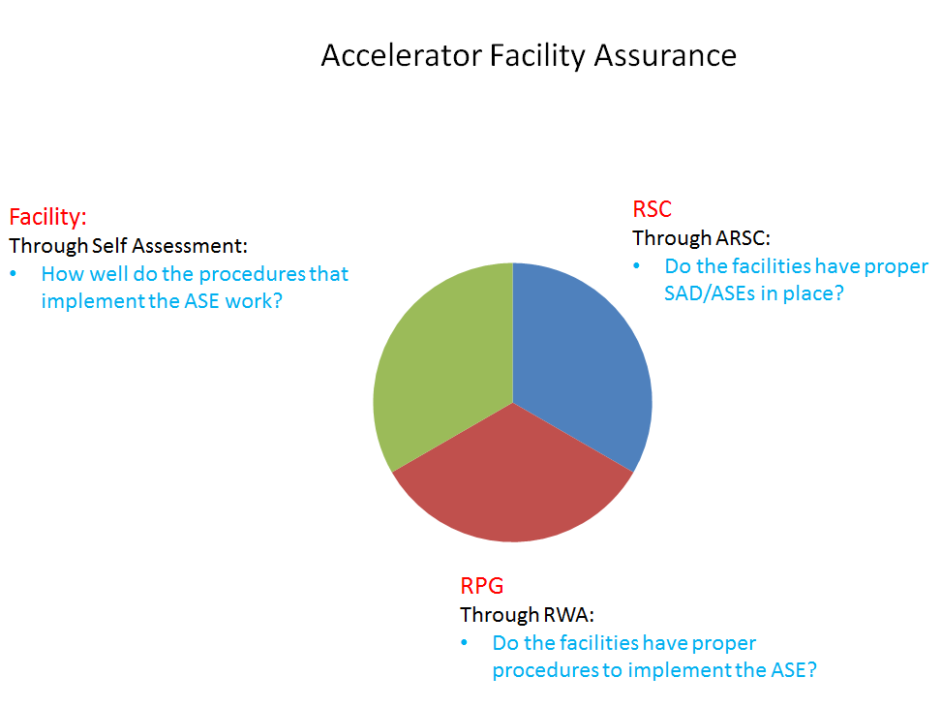
How LBNL has translated the Guidance:
Section 1: Berkeley Lab Mission
SUBTITLE HERE IF NECESSARY

Slide 6
Programmatic Analyses
Institutional RSC focus:
  SAD/ASE development, review, approval process
EHS/Radiation Protection Group (RPG)
  Radiological Work Authorization (RWA) oversight
    Surveys, monitoring, training, procedures, etc.
Facility, e.g.: Advanced Light Source (ALS)
  ASE procedure implementation
    Self assessments of shielding, interlock, Beamline Review process, Training, USI process, energy limits of e-beams/laser
Other
  USI, Exemptions, etc.

Slide 7
EHSs 703.1: Documentation for Accelerator Safety Order Compliance Activities
Ongoing throughout each accelerator facility and every three years the accelerator program’s division must :
-Demonstrate that their self assessment processes provide an adequate review their facilities’ safety systems.
Prove compliance with the ASO by documenting a triennial accelerator safety review report.
“…accelerator program divisions developing and maintaining documentation to ensure compliance with DOE O 420.2B [at the time]”

Slide 8
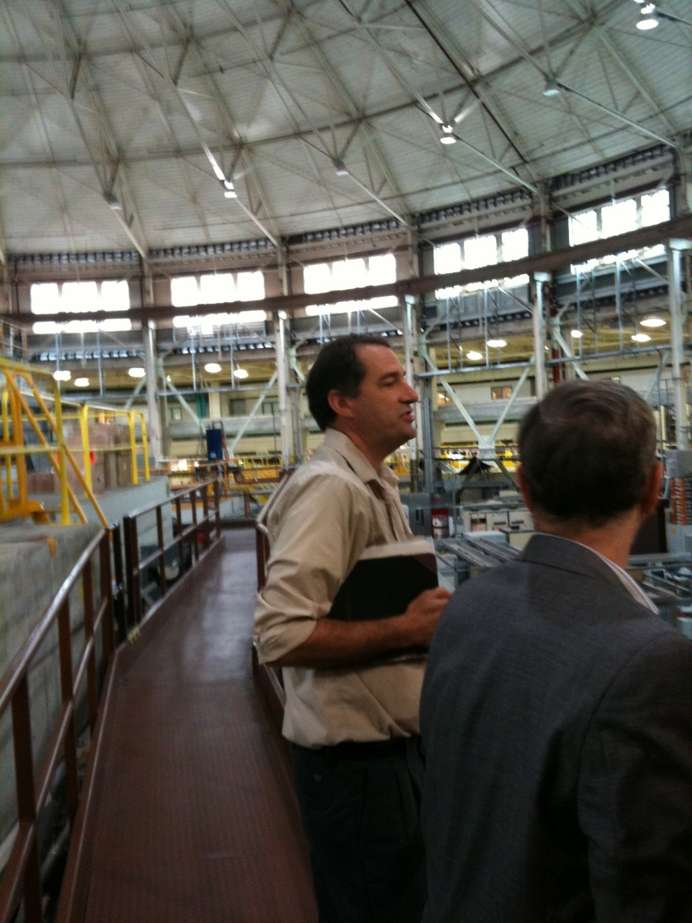
ALS’s first safety walkaround programmatic review
And here’s Jim Floyd, explaining what ALS can do
Scott Davis, in awe

Slide 9
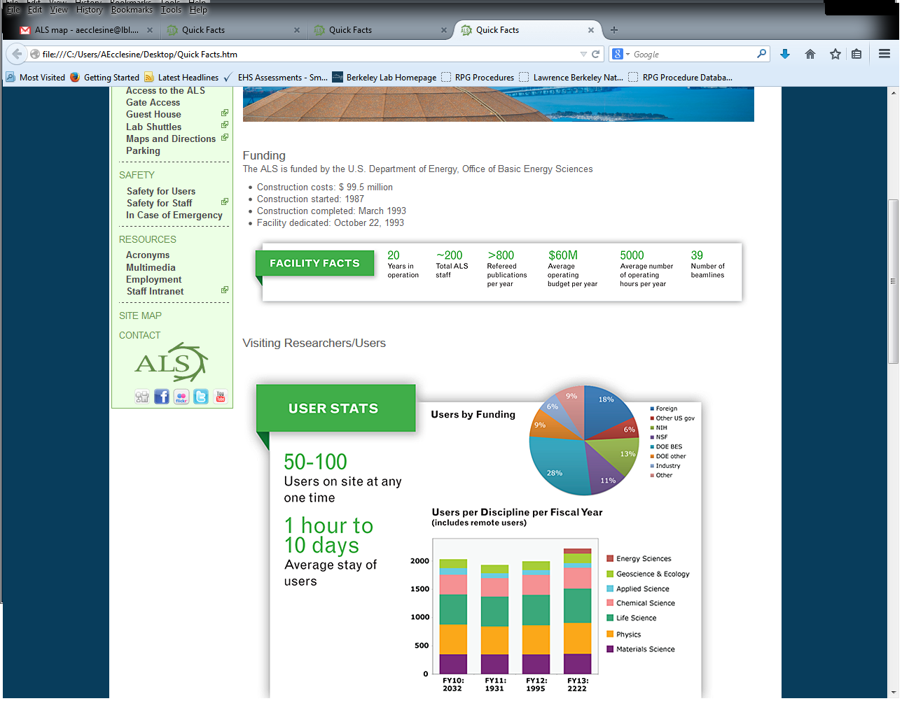
The Advanced Light Source (ALS) is located in Berkeley, California. The original building, situated in the East Bay hills overlooking San Francisco Bay, was completed in 1942. Designed by Arthur Brown, Jr. (designer of the Coit Tower in San Francisco), the domed structure was built to house Berkeley Lab's namesake E. O. Lawrence's 184-inch cyclotron, an advanced version of his first cyclotron for which he received the Nobel Prize in Physics in 1939. Today, the expanded building houses the ALS, a third-generation synchrotron and national user facility that attracts scientists from around the world.

Slide 10
ALS was the first of the three facilities to have their triennial review
So we (RPG-HP/ ALS Safety Operator/CQA) determined:
  Integrate all institutional assurance components
    On-going enterprise
  Risk based
  Double-check against independent ASO Compliance checklist
  Keep in mind scaleability
And presented it to the RSC as first agreement in principle, and then, the details of the report

Slide 11
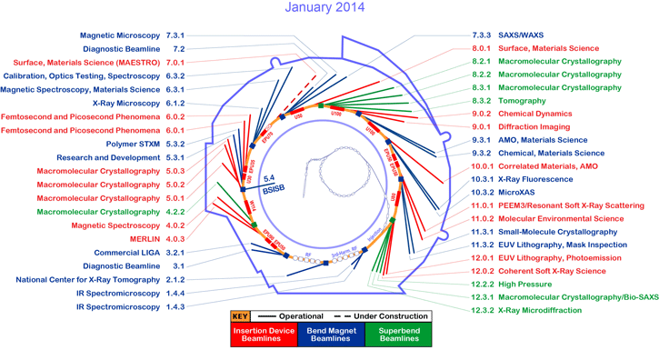
ALS’s operating beams=user facility

Slide 12
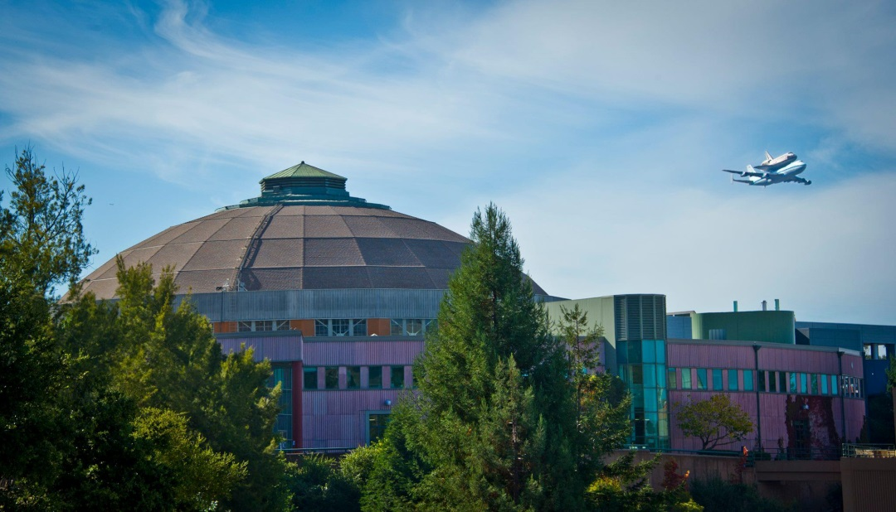
ALS Triennial Review
James Floyd
(now) EHS Division Director

Slide 13
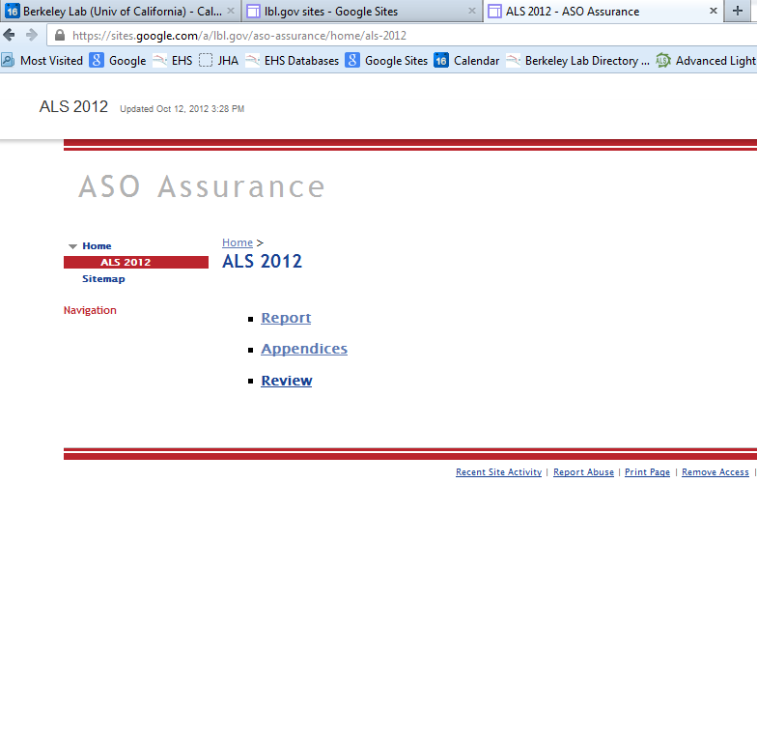
Report Structure
Preface
Section 1: Executive Summary
Section 2: Programmatic Analyses
  RSC
  RPG
  Accelerator: e.g. ALS
  Other
  Section 3: Appendices
  Compliance Checklist

Slide 14
Assessments should be ongoing at the accelerator facility
Assurance is a vital element of safe operations and LBNL has committed to ensuring continuous improvement and feedback on accelerator safety.
Self assessments are performed by accelerator program divisions and routine surveillance performed by the EHS division.
SAMPLE:

Slide 15
Triennial Accelerator Reports include:
The results of EHS surveillance,
Summary of institutional assurance activities reviewed by the ARSC during the previous three years,
A presentation to the RSC,
Participation with site office (DOE)
The approval from RSC.
Notes:
Along with this first report of its kind, knowing it was the template for the other two much less complicated accelerators, we put in place the infrastructure, via Google Docs, in which to hang the subsequent documents for this report, and then the other two accelerator reports.
This was just when Google docs was beginning to have a toehold in LBNL. So it wasn’t really intuitive, nor pretty, and it improved with each if the next accelerator reports. ALS was our cutting of many a teeth. And it helped refine the roles between the three organizations comprising Accelerator safety Assurance.

Slide 16
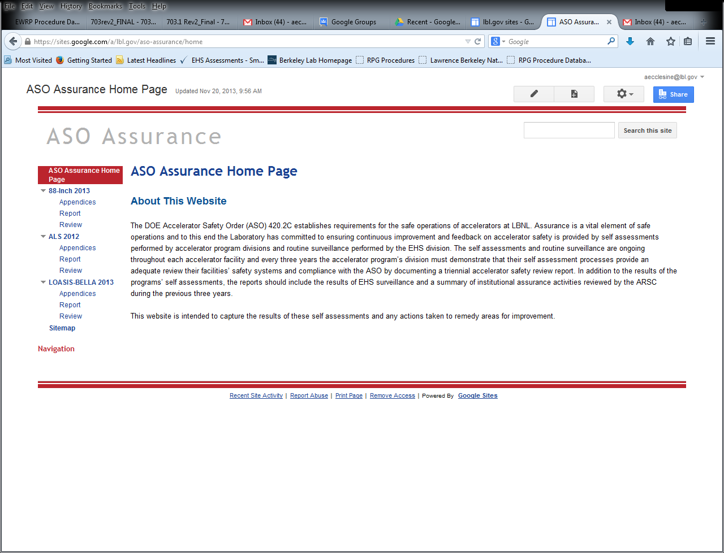
      https://sites.google.com/a/lbl.gov/aso-assurance/home

Slide 17
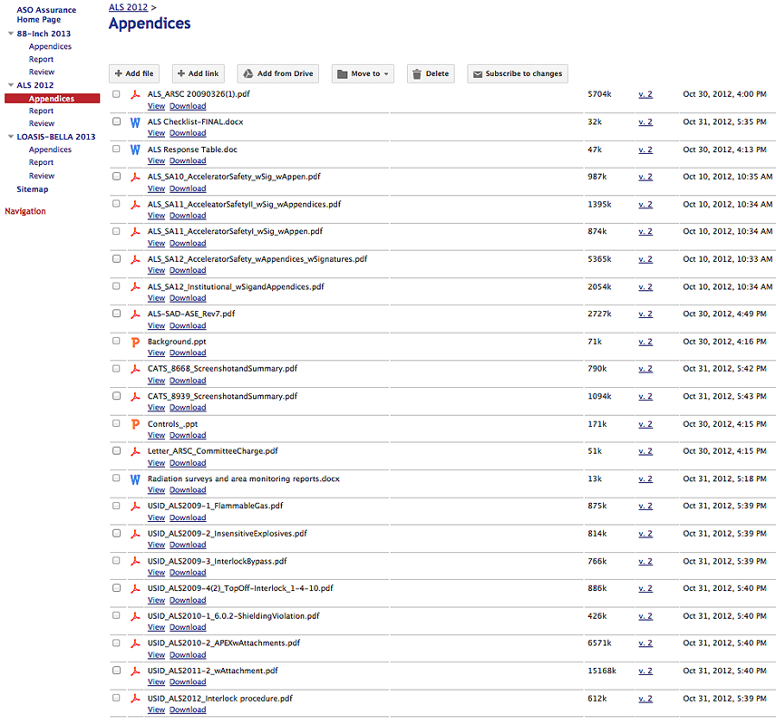

Slide 18
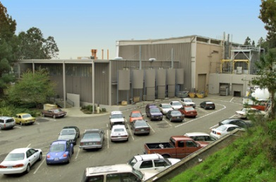
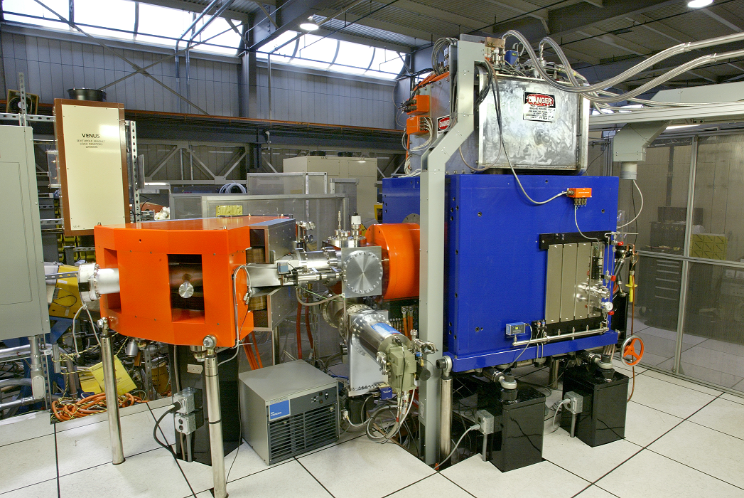
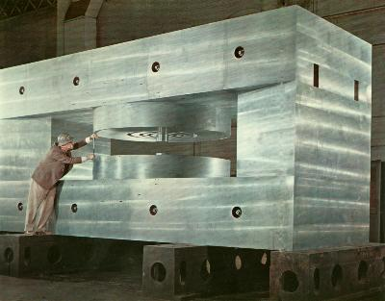
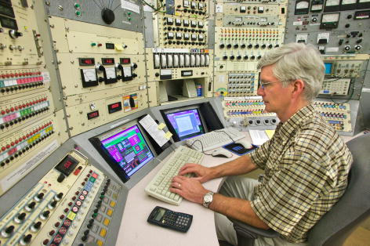
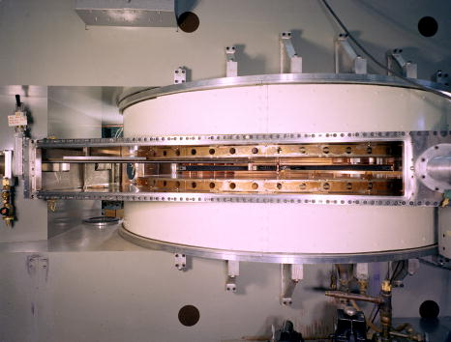
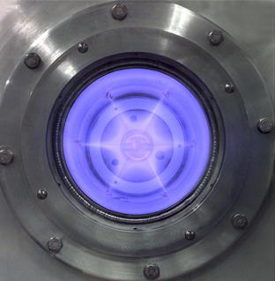
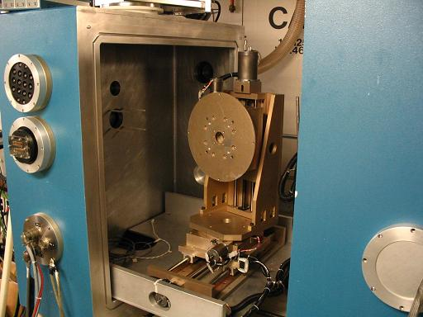
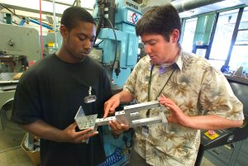
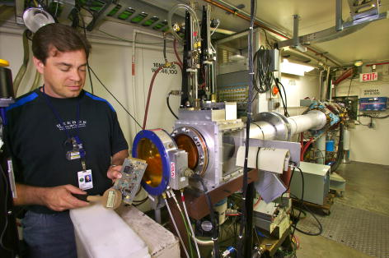
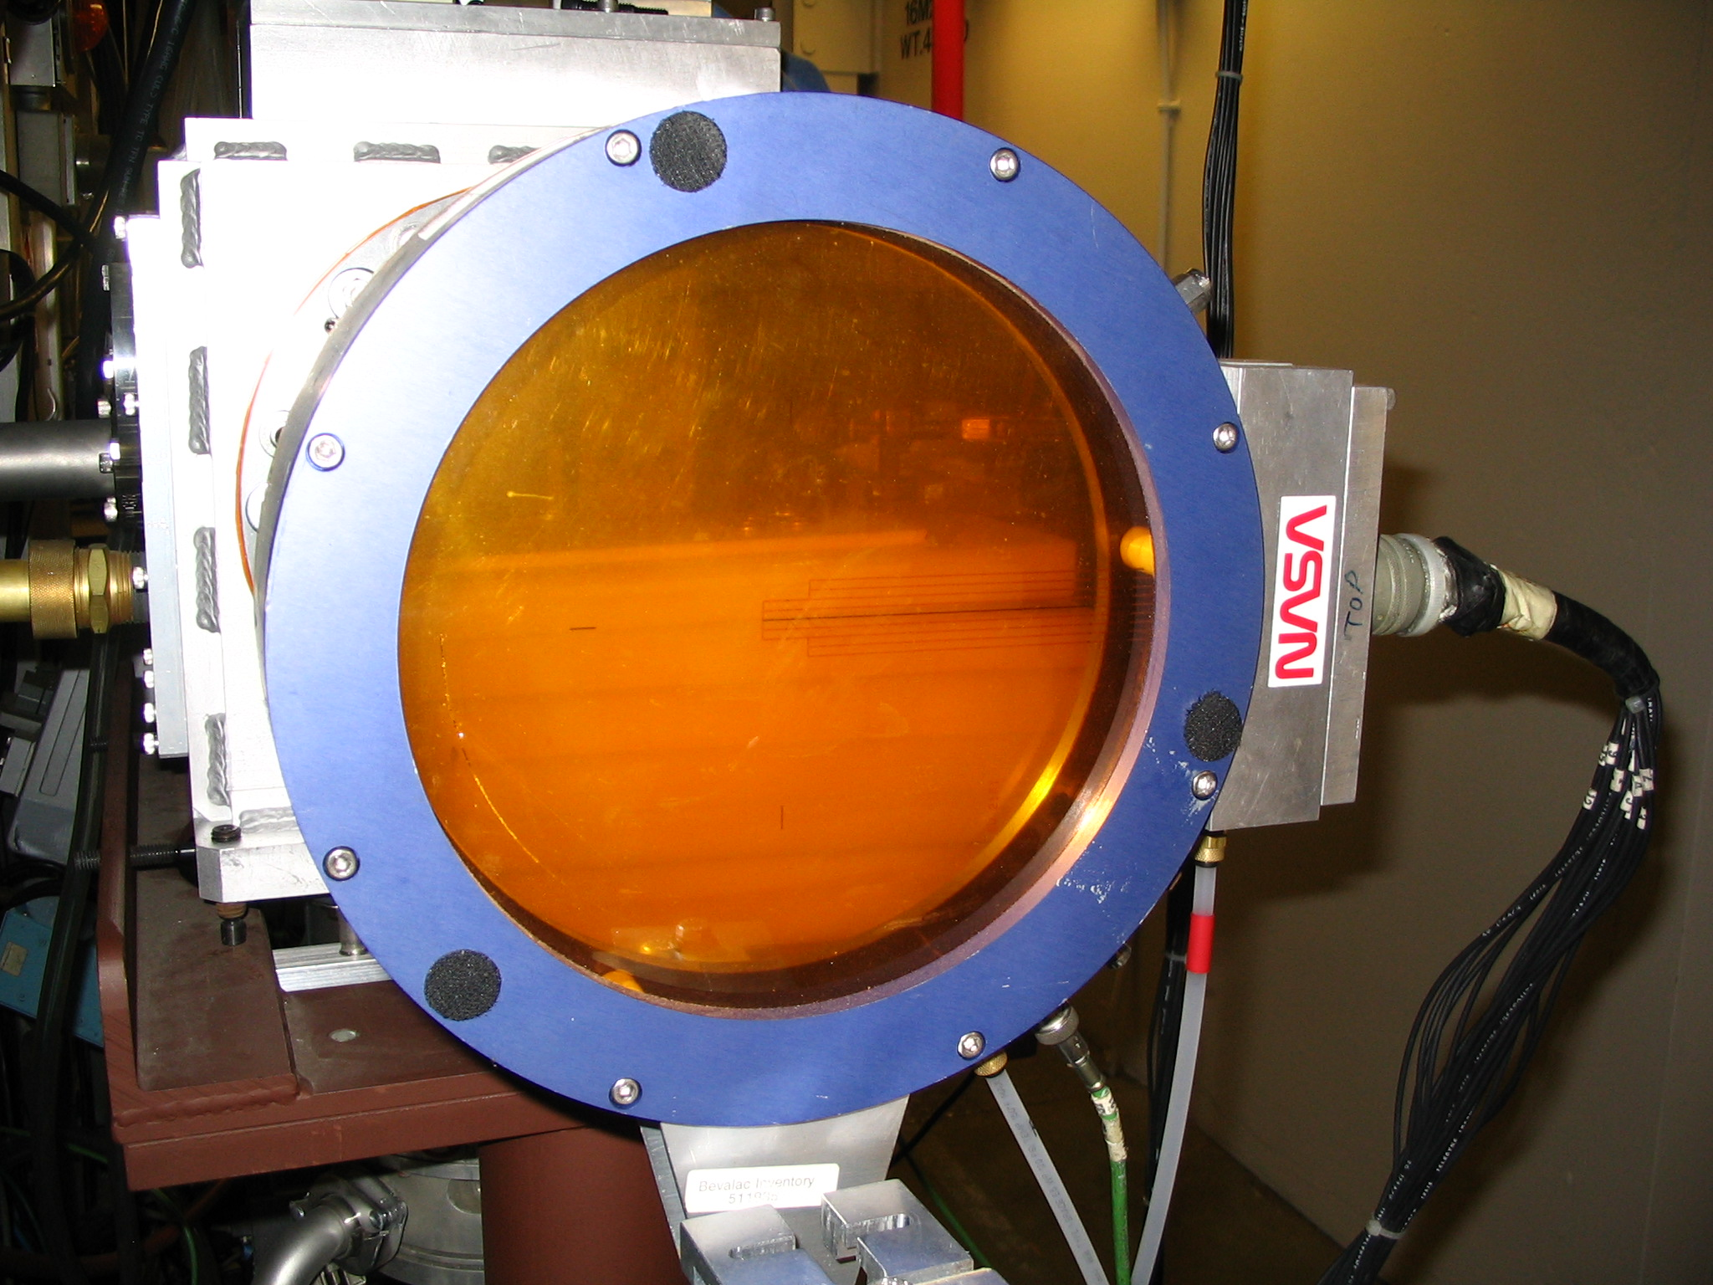

The 88-Inch Cyclotron
Triennial Report
Mike Johnson
Research Coordinator
Notes:
Light ions
Get rid of transition

Slide 19
Csaba Tóth
LOASIS/BELLA Program Deputy Head for Operations
&
Program Safety Coordinator
Building 71
November 6, 2013

Slide 20
Summary of accelerator assurance
Review all operation functions
Re-look at ASE and credited controls, check:
  E beam parameter limits
  Radiation Shielding
  Engineered safety systems including interlocks
  Access Control
  Beamline Review Process
Integrate processes with clear roles and responsibilities
Partner with the institution, facility and EHS/RPG functions
Double check against compliance checklist to ensure facility is on the right track

Slide 21
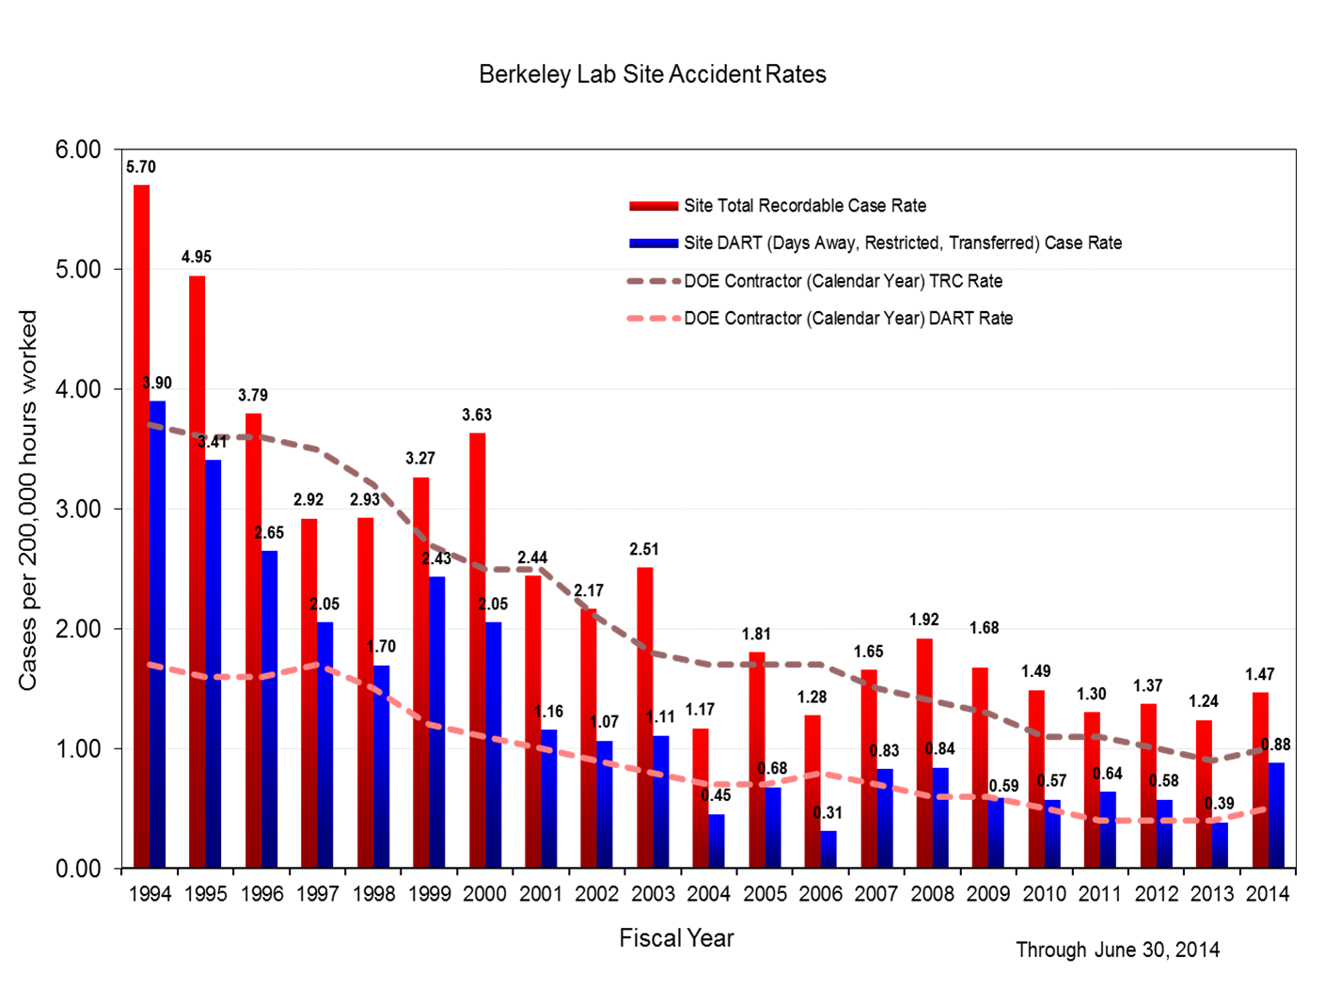

Slide 22
CAS in perspective at LBNL
 | 2014 (rem) | 2013 (rem) | 2012 (rem) | 2011 (rem) | 2010 (rem)
Deep Dose (γ&η) | 0.039 | 0.623 | 0.497 | 0.759 | 1.075
Internal Dose | 0.000 | 0.000 | 0.000 | 0.000 | 0.000
TED (internal + external) | 0.039 | 0.623 | 0.497 | 0.759 | 1.075
Extremity | 10.758 | 27.97 | 31.56 | 21.67 | 30.44

Slide 23
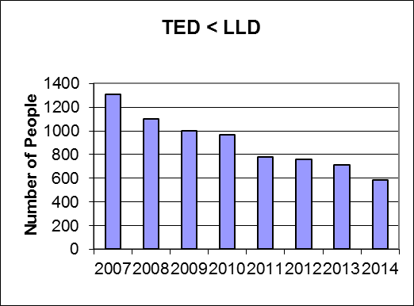

Slide 24
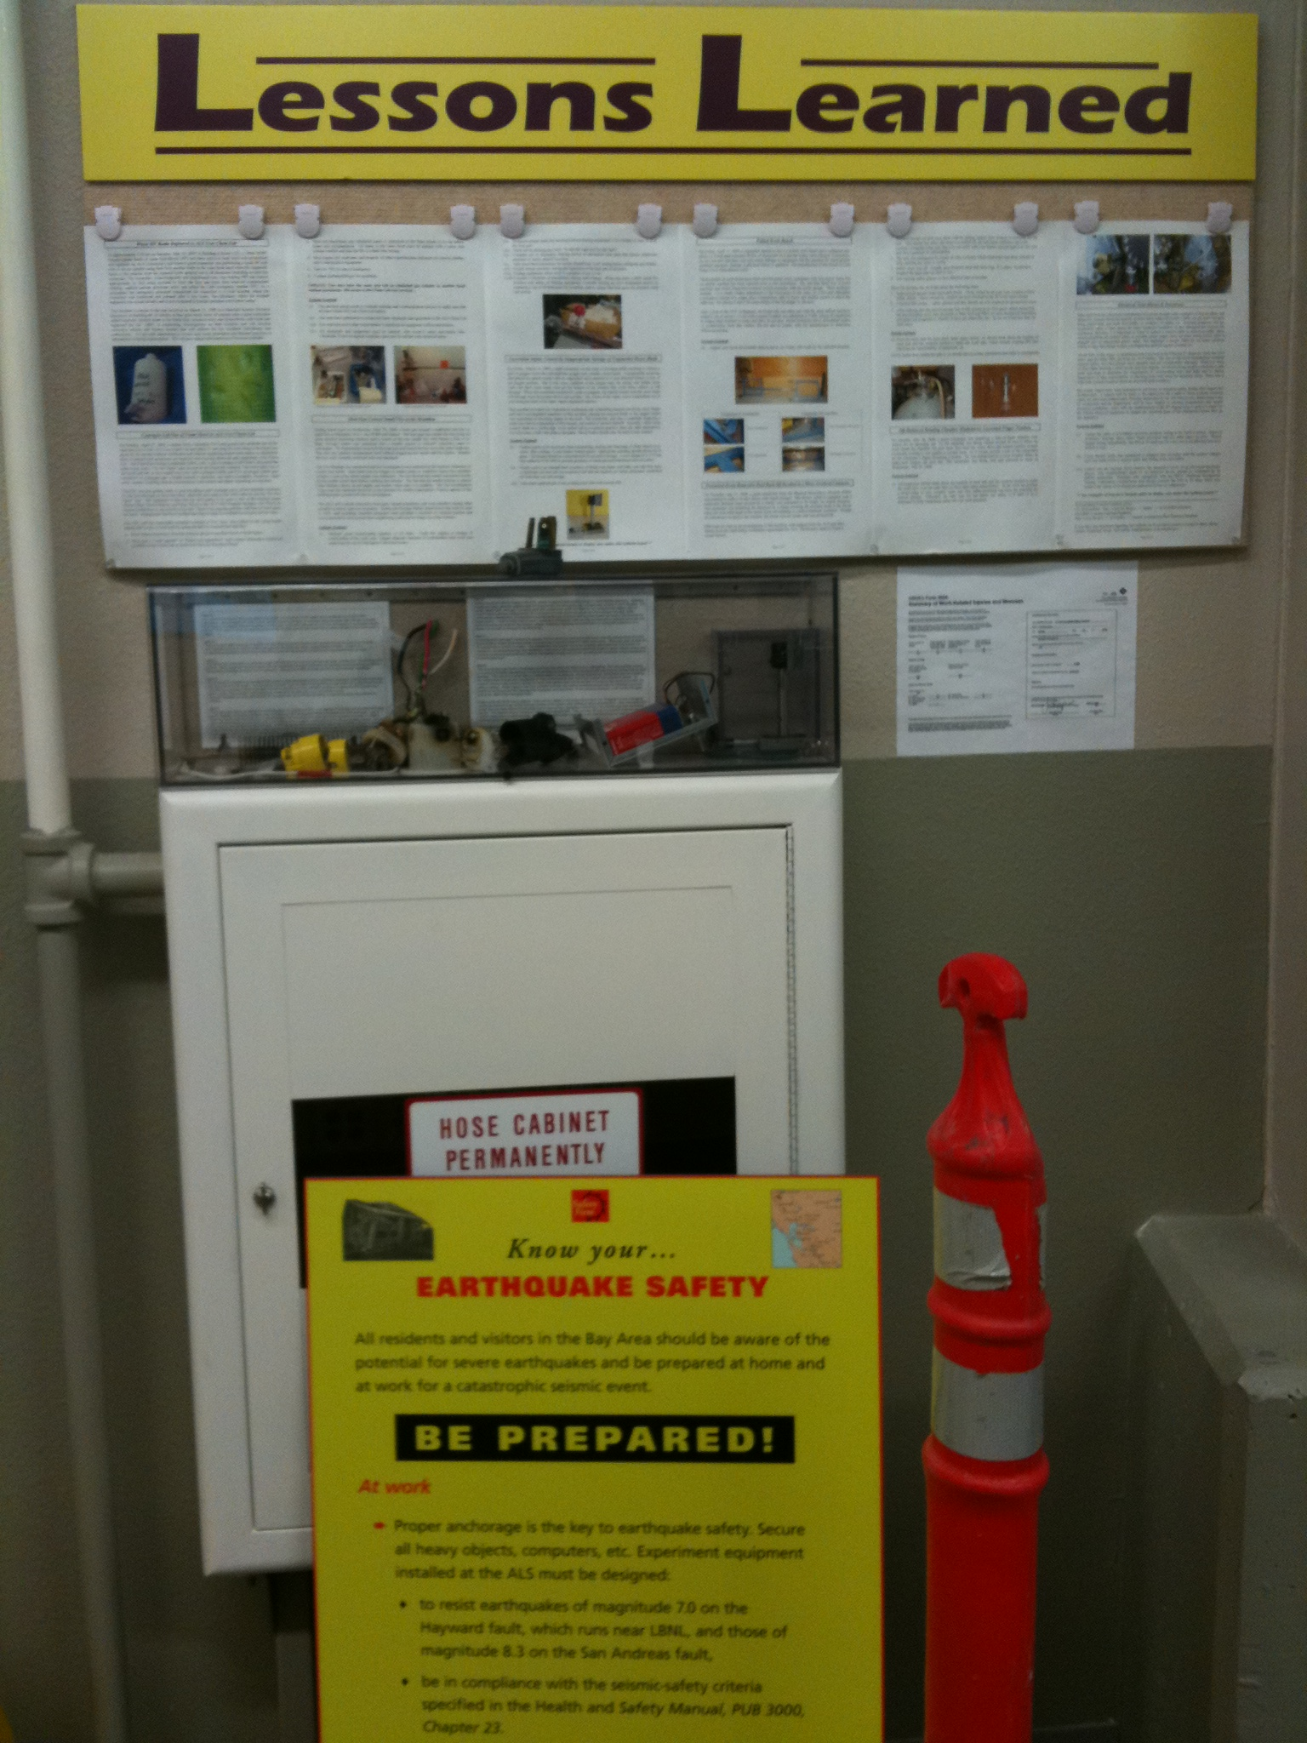
ALS’s homegrown display of assurance components:

Slide 25
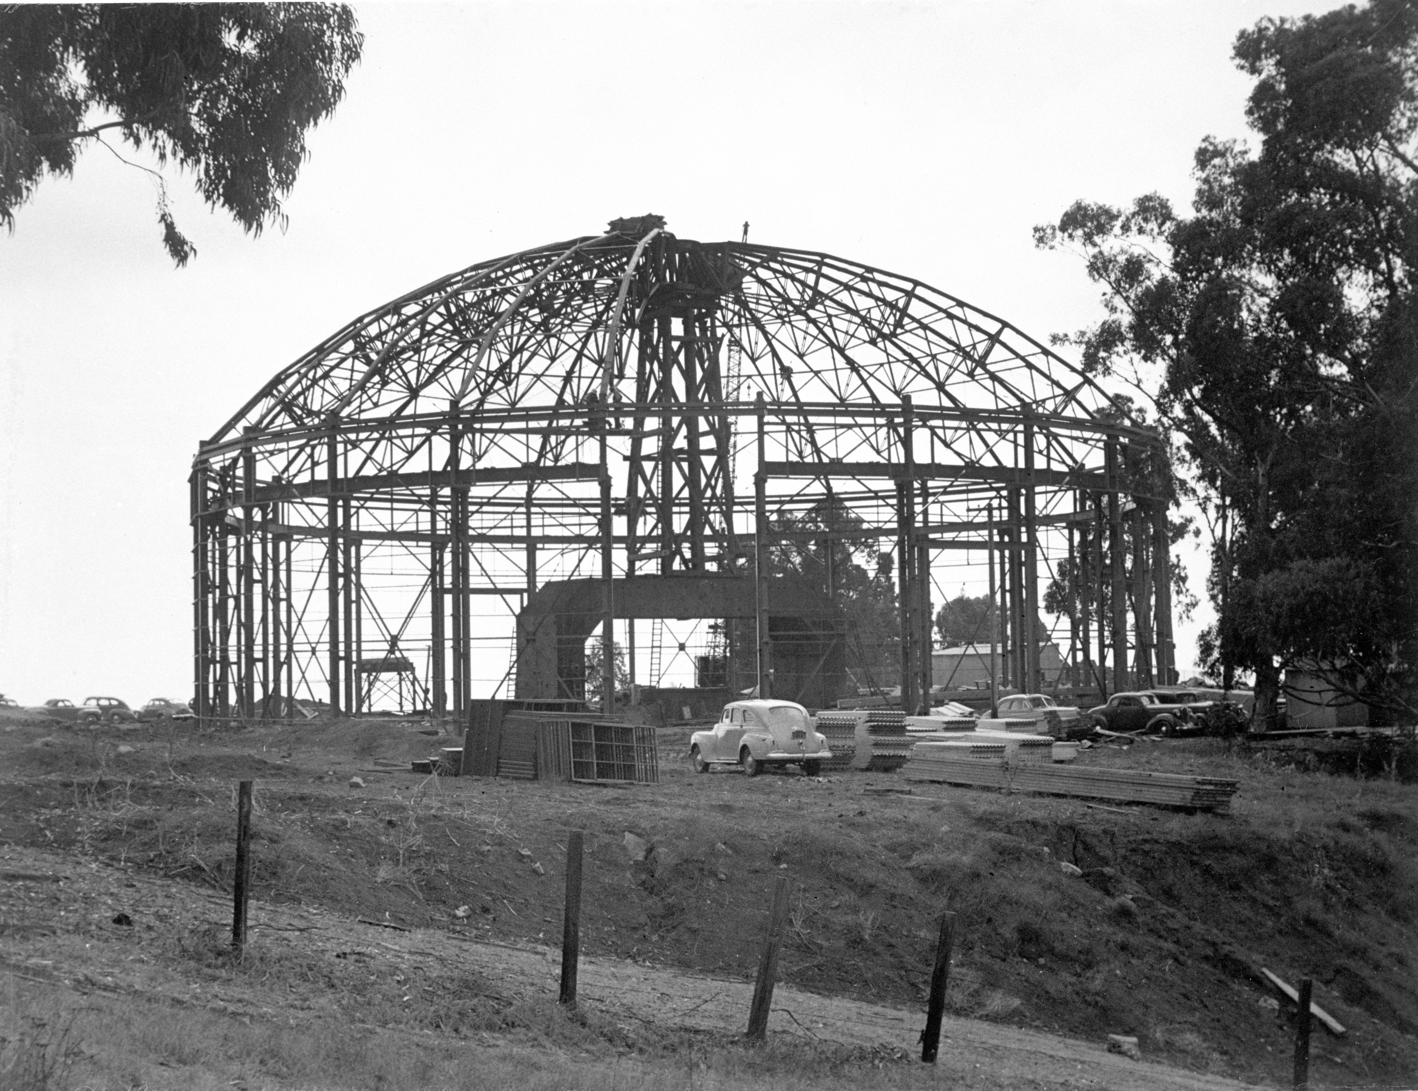
Notes:
Magnet yoke for the 184-inch cyclotron around early 40s, was set in place and the building and iconic dome erected around it.

Slide 26



UNIVERSITY OF
CALIFORNIA

