Slide 1
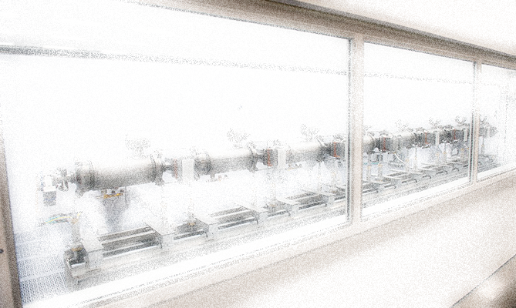
Accelerator Readiness Review Process ARR Experiences and Lessons Learned
R. May
Thomas Jefferson National Accelerator Facility
Work performed under DOE Contract: AC05-06OR23177

Slide 2
Overview
How Jefferson Lab prepared for the ARR process
Summary of experience during ARR start and first two phases
Recommendations

Slide 3
Overview, cont’d.
Phased approach
Phase 1a (Aug 2013)
Principally a review of key JLab supporting programs and processes
Phase 1b (Oct 2013)
Accelerator Commissioning
Phase 2 (Jan 2014)
Hall A full and Hall D partial Commissioning,
Phase 3 (Aug 2014)
Hall D: full Commissioning, Hall B: HPS cont’d.

Slide 4
How Jefferson Lab prepared
Conducted gap analysis of existing process against 420.2C
Compared current Guidance Document and the August 2013 draft as well as ASO
Point-by-point comparison of both Guides – wanted to be ready for Draft Guide publication and transition
GAP analysis of existing process against 420.2C
Redrafted existing JLab ARR Procedure
Internal instruction to meet ASO requirements, current, anticipated Guide expectations
Placed it in our global document control system to make sure it was firmly in CAS

Slide 5
How Jefferson Lab prepared, cont’d.
Read available documentation on recent ARR’s
BELLA, including CRAD/LOI documents
Light Source II, including beam mis-steering event report
Read event reports, chatted with colleagues
Determined basic Lessons Learned and crafted an approach that would avoid repeating the actions that generated concerns at other labs
Sought “single point of contact” for ARR actions and activities with our Site Office

Slide 6
How Jefferson Lab prepared, cont’d.
Communicated early and often with our Site Office
Made early request for and obtained approval for a phased ARR approach
Provided for comment:
DRAFT ARR Team Charge
DRAFT Specific overall plan including details for the specific ARR Phase about to be undertaken
DRAFT Criterion for what constituted “readiness” in key ARR Topical Areas
DRAFT Lines of Inquiry (while still under development) for addressing the Criteria
List of prospective ARR Team Members

Slide 7
How Jefferson Lab prepared, cont’d.
Communicated early and often with line organizations
Provided for comment:
DRAFT ARR Team Charge
DRAFT Specific overall plan including details for the specific ARR Phase about to be undertaken
DRAFT Criterion for what constituted “readiness” in key ARR Topical Areas
DRAFT Lines of Inquiry (while still under development) for addressing the Criteria
List of prospective ARR Team Members

Slide 8
How we prepared, cont’d.
Very visible senior management involvement
Lab Director conducted an External Review of the Integrated Commissioning Plan and the ARR Plan
6 months ahead of the Phase 1 ARR and was considered the official start of the ARR
TJSO and HQ attendance and full participation in Director’s Review
External Review began with a presentation that had a thorough analysis of all domestic and international events related to accelerators and actions we took to avoid similar outcomes
Also discussed lessons learned and mitigative actions
Principle finding from external review was that preliminary ARR Plan needed more emphasis on “performance based” demonstration of readiness
Also concern about timing of Phase 1 ARR

Slide 9
How we prepared, cont’d.
Next two slides abstracted from External Review of the Integrated Commissioning Plan and the ARR Plan
Common themes identified from all events
How Jefferson Lab applied that knowledge

Slide 10
How we prepared, cont’d.
Notes:
Redundancy on visual?

Slide 11
How we prepared, cont’d.

Slide 12
How we prepared, cont’d.
The need for a “performance based” approach became a guiding principle for JLab ARRs
Solicited support and input of colleagues and our Site Office on their perspectives on what “performance- based” meant
No one seemed to have a clear idea initially but we did achieve consensus
Best indication came from colleagues who had recent ARR experience and discussions with them about what had not worked well
This communication informed the selection of the ARR Team

Slide 13
Summary of experience
Addressed key lab infrastructure topics supporting the ARR Process in Phase 1
Principally a review of key JLab supporting programs and processes
Safety Assessment Document (SAD), Accelerator Safety Envelope (ASE), CAS, Safety Configuration Management, Un-reviewed Safety Issues (USI), Beam Commissioning Plan, Work Planning and Controls
Once thoroughly reviewed, we planned to review consistent implementation of the programs within the Phase 2 through 4 ARRs

Slide 14
Summary of experience, cont’d.
The JLab Hot Checkout Process was found to be robust and was used to close out ARR findings
Actions to complete ARR Phase 1b and 2 findings were monitored by local “liaisons” appointed by the ARR Team
Site Office member and JLab ARR Team Member
Team Liaisons reviewed the Hot Checkout results and obtained verification checks
Provided closure evidence and recommendations to ARR Chair
ARR Chair made closure recommendation to Lab Director consistent with the ARR Charge
Lab Director subsequently made request to Site Office regarding approval for commissioning

Slide 15
Summary of experience, cont’d.
ARR Phase 1 became Phase 1a and Phase 1b
Phase 1A reviewed key JLab supporting programs/processes
Phase 1B reviewed people, hardware, activities
ARR External Review Team requested a performance-based approach that placed them in the “field”
Presentations at or near the facilities and equipment to which the presentations referred
Presentations by or in the presence of systems or subject matter experts
Extensive time spent in the Control Room with Operators
Talking about their training and procedures
Looking at GUIs for applications, alarms, etc.
Questioning/dialogue about authorities and responsibilities

Slide 16
Summary of experience, cont’d.
ARR Phase 2 Developments
The ARR Team was by this point partnering and communicating very effectively
After Phase 2,
The ARR Team requested input on their Charge in order to focus efforts on specific criteria of interest and establish an effective set of LOIs
Charge for ARR Phase 3 drafted after team Phase 2 review and input
The ARR Team asked for the opportunity to review the Lines of Inquiry (LOI) for Phase 3 as well
One ARR Team Member agreed to be the collection point for review comments on the Charge and LOIs

Slide 17
Recommendations
Do your homework – communicate with all involved parties
Find out what has and hasn’t worked well and learn from all who have experienced ARRs
Involve the Site Office early and throughout in deliberations, plans, lines of inquiry, correspondence
Involve your ARR Team as early as possible
They have done this before
Be clear about what constitutes readiness and what needs to be “touched” by reviewers in the field
Move the ARR to “where the action is” early in process

