Slide 1
UNIVERSITY OF
CALIFORNIA

Slide 2
Accelerator Readiness Review for the Berkeley Laboratory Laser Accelerator (BELLA)
Keith Heinzelman
Health Physicist, LBNL Radiation Protection Group
August 6, 2014

Slide 3
Outline
BELLA accelerator and program descriptions
Instrument readiness review
Preparation for ARR
Review structure
ARR
Lessons learned

Slide 4
BELLA Total Exclusion Area (TEA)

Slide 5
BELLA
Limited scale facility and program: Laser plasma accelerator (LPA)
LPA with 3 Watt, 10 GeV electrons
Ionizing radiation produced in and confined to a single room with a single entrance (15’ x 75’)
Limited duty cycle: about 1 shift per week
Small, experienced group

Slide 6
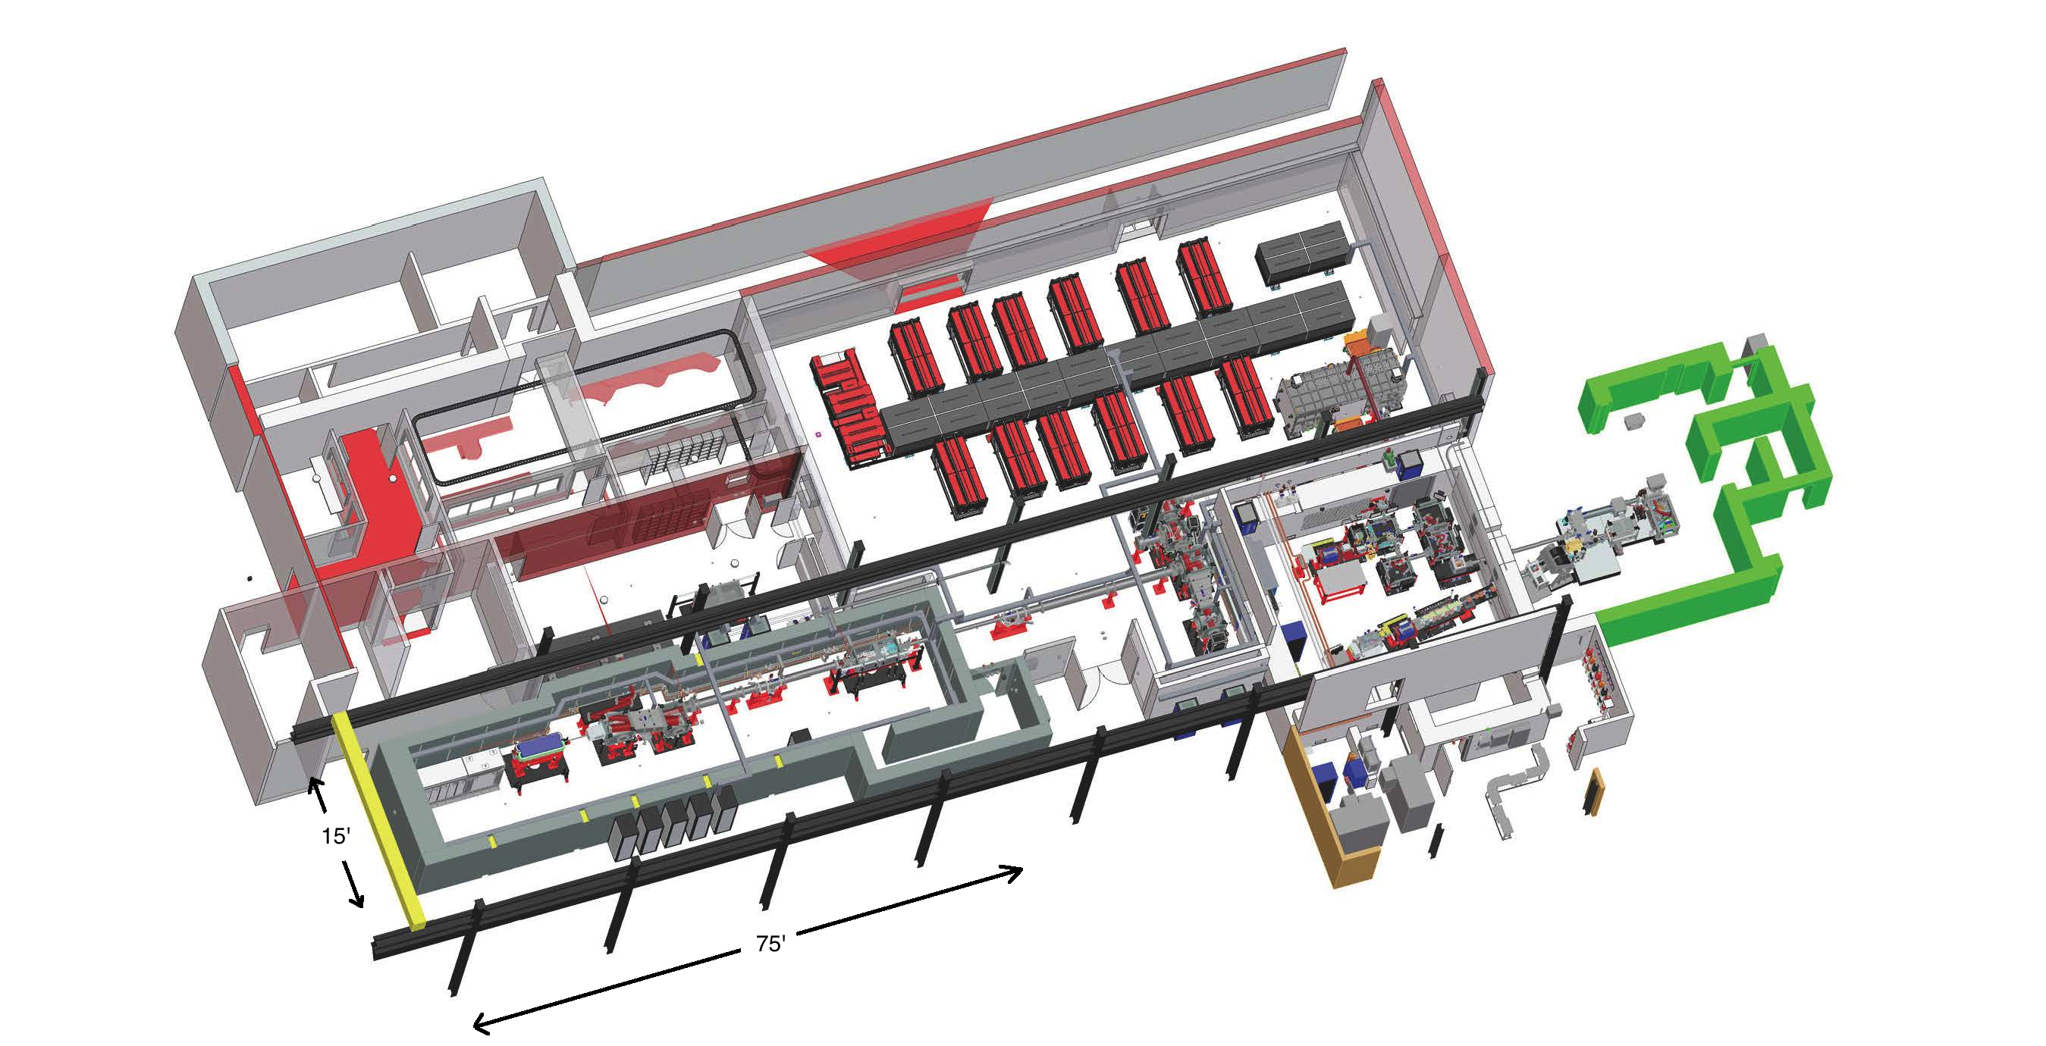
BELLA Facility

Slide 7
Laser Instrument Readiness Review (IRR)
Initial plan: laser testing would be part of accelerator commissioning
ARR was delayed; laser testing was a KPP with a deadline
BELLA pushed to proceed with laser “commissioning”
Change of schedule + flawed terminology lead to concerns and confusion
Laser testing performed under 10 CFR 835, 10 CFR 851 and LBNL RPP
Notes:
Should have been straight forward but was complicated by two factors:
The project planned to conduct the ARR before testing the laser. But, because of delays in preparation for the ARR, the ARR could not be conducted before the laser acceptance testing was required (key performance parameter).
The IRR was described as “laser commissioning.”
The combination of these two factors was the cause of some concern from our site office and some in RPG

Slide 8
Preparation for ARR
RPG worked with BELLA to ensure the expectations were clear and preparation was complete
Worked with site office to develop CRADs
Checklists developed for each topical area
Notes:
CRADS = criteria review approach documents
State the criteria
State the review approach
List the lines of inquiry
Useful to communicate to the facility what they will need to demonstrate to the team
A good framework for the review and a starting point for discussions

Slide 9
ARR Team
Staffed to include a range of independence and expertise
Affiliation | Expertise
SLAC | Accelerator Operations
SLAC | Accelerator Program Administration
Argonne | Health Physics/Accelerator Safety
LBNL (88” Cyclotron) | Accelerator Program Administration
LBNL (ALS) | Research/Safety Review
LBNL (Radiation Safety Committee) | Research
LBNL RPG | Health Physics/Accelerator Safety
DOE/BSO | Observer
DOE/Headquarters | Observer

Slide 10
Review Team Preparation
Relevant documentation provided to review team
Teleconference conducted in advance of the review
Document review performed in advance of the ARR
Notes:
Documentation included: CRADs; safety basis documents; interlock requirements; shielding design requirements; interlock reviews; BELLA procedures; BELLA commissioning plan; LBNL accelerator safety program documents, BELLA presentations

Slide 11
Review Structure
Topical Areas:
Credited controls
Facility management
Documentation readiness
Contractor assurance
Commissioning plan
Training and qualifications
Presentations
Discussions
Interviews
Tours
Demonstrations

Slide 12
ARR
All agreed the review was thorough
Seven “limited scope” pre-start findings
Several recommendations
Included assigning additional resources to ASO assurance

Slide 13
Lessons Learned
CRADs were useful tool
IRRs should be planned early
Preparation is key

