Slide 1
Fermilab 700 kW Upgrade Accelerator Readiness Review (ARR)
John E. Anderson Jr.
2014 Accelerator Safety Workshop
6 August 2014

Slide 2
Overview
700 kW Upgrade Background
ARR Scope
ARR Review Team
ARR CRADs and LOIs
ARR Plan and Results
ARR Lessons Learned and Observations

Slide 3
Fermilab 700 kW Upgrade Background
Started a yearlong upgrade shutdown in 2012
Changes were to increase protons per hour on target to the NuMI neutrino experimental area
Previously approved for 514 kW Operations
~40% increase in average beam power
Major Upgrade Items
Repurposed the Recycler Ring (RR) to reduce cycle time of the Main Injector (MI) accelerator (1.87 s → 1.33 s)
RR previously used for anti-proton storage in support of the Tevatron collider experimental program
Upgraded to perform proton manipulations (Slip-Stacking) previously done in the MI

Slide 4
Fermilab 700 kW Upgrade Background
Moved proton injection and extraction lines
Removed the anti-proton injection and extraction lines
Decommissioned anti-proton equipment no longer needed
Added proton abort kickers
Upgraded instrumentation in MI, RR, and NuMI experimental areas
Added additional RF cavities to support the higher beam power
Revised the Radiation Shielding Assessments for the MI, RR and NuMI experimental areas
Developed new SAD Chapters for the MI/RR, and NuMI
Revised the ASE for the new beam power limits
Credited Controls with the exception of beam power limits remained the same

Slide 5
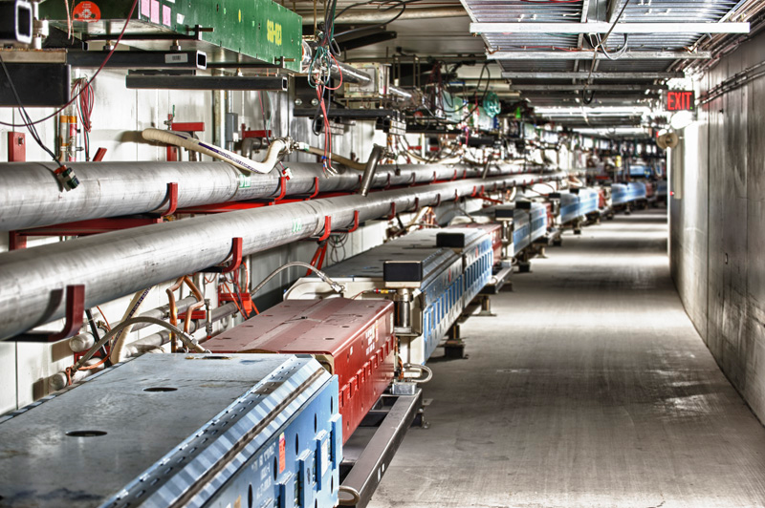
Main Injector and Recycler Ring

Slide 6
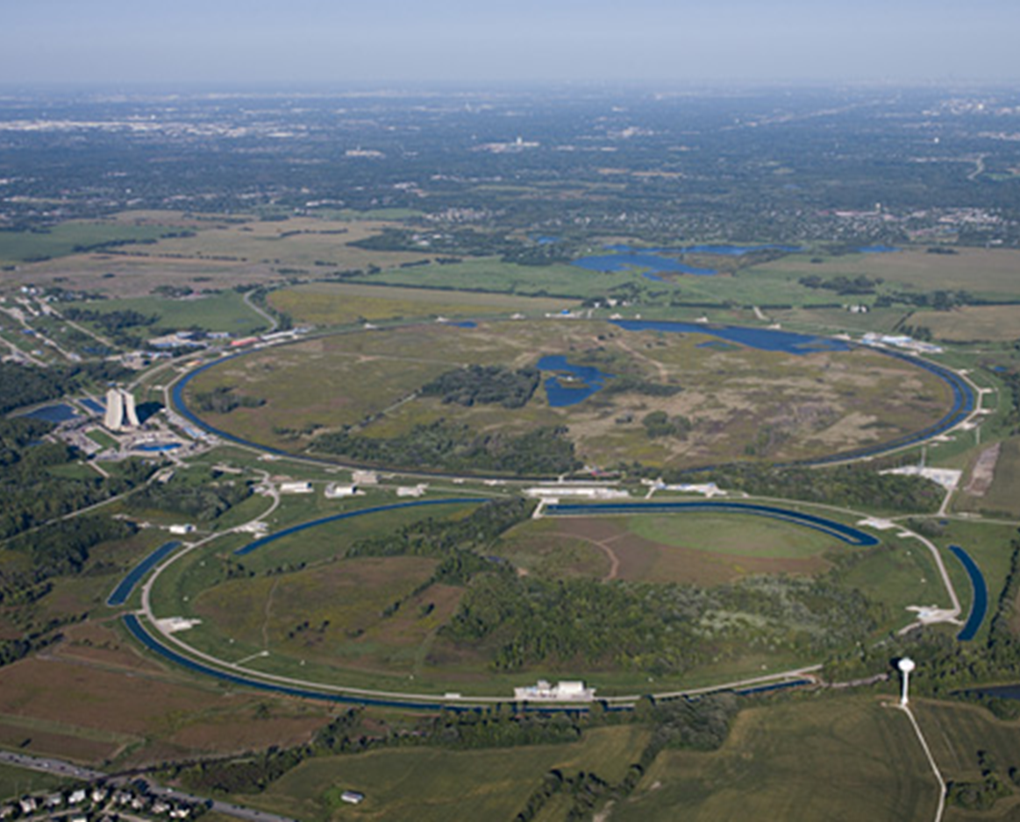
Fermilab Limited Scope ARR
Modifications to
Main Injector (MI)
Recycler
Neutrinos at the MI (NuMI) areas
Readiness to support 700 kW Operations for the NuMI Experimental Areas
Facility was operating under ASE Revision 3 during the ARR
MI & NuMI Beam power limit of 514 kW

Slide 7
Limited Scope ARR Review Team
Team consisted of 5 External and 1 Internal Reviewers
SLAC, JLab, LBNL participants
Two consultants formerly employed within accelerator community
Fermilab participant
3+ DOE Observers
Office of Science
Fermi Site Office
Jefferson Lab Site Office

Slide 8
Limited Scope ARR CRADs and LOIs
CRADs and LOIs developed to facilitate the review
Required documentation derived from in DOE O 420.2C Safety of Accelerator Facilities Contractor Requirements Document (CRD)
Safety Assessment Document (SAD)
Accelerator Safety Envelope (ASE)
Unreviewed Safety Issues (USI) process
Accelerator Safety and the Fermilab Contractor Assurance System (CAS)
Safety Configuration Management (SCM)

Slide 9
Limited Scope ARR CRADs and LOIs
Accelerator Systems
Accelerator Operator Training
Accelerator Operator Qualification Program
Accelerator Operations Procedures
Work Planning and Control Related to Accelerator Safety
Radiological Safety for 700 kW Operations
Accelerator Credited Controls

Slide 10
Limited Scope ARR Plan
Limited Scope ARR was a 2 ½ Day Review
Plenary Sessions were held and well received
Overview of Fermilab Programs
Technical Breakout Sessions were keyed to individual team members
Explore each CRAD through LOIs
Two Parts
Overview presentation on how CRAD is implemented
Performance-based program review
Discussions with management and staff
Demonstrations of systems
Implementation of programs and procedures

Slide 11
Limited Scope ARR Plan & Results
Performance-based site visits
Main Control Room (MCR)
Booster & Linac Galleries
MI-60 and MI-65 Service Buildings
Discussions held with ARR Team were productive
4 Pre-start Recommendations
DOE FSO Approve ASE Director Approve NuMI SAD Chapter Approve 700 kW Operations Dept. Operating Permits Complete operator required reading for 700 kW operations
Nothing that wasn’t expected

Slide 12
Limited Scope ARR Results
16 Post-start Recommendations
Review ASE and streamline the document
Expand USI training and look at USI integration into SCM
Several recommendations regarding COO
Several recommendations regarding CAS
Useful recommendations to assist with improving and strengthening existing programs
Laboratory and DOE representative liaisons were empowered to verify completion of pre-start actions and report completion to ARR Team chair
Final report issued
Post start recommendations tracked to completion

Slide 13
Limited Scope ARR Results
Limited Scope ARR provided some significant results for Fermilab
ASE was clarified and streamlined
Beam Intensity Limits clarified
Operating limits and surveillance limits were removed
Common industrial hazard controls were removed
SCM Program Improved
Developed a movable shielding database
COO Program Improved
Re-worked the Operations Department COO Guide

Slide 14
Limited Scope ARR Lessons Learned and Observations
Lessons Learned from Fermilab experience
Planning and dialogue with ARR Team must be started well in advance of the review
Preparations are resource consumptive and can be chaotic
ARR is competing with construction, installation or modification activities
Many times competing with project milestones
Projects reluctance to move milestones to make room for ARR
ARR should be included in the project milestones
Observations
Broad scope ARRs may duplicate other self-assessment efforts when looking at established facilities
Limited or modified scope ARRs make sense for established facilities

Slide 15
Limited Scope ARR Lessons Learned and Observations
The ARR process at the various laboratories has accumulated valuable lessons learned
Some form of periodic focused Accelerator Safety Implementation reviews as part of the Self-Assessment process likely very useful
Builds a basis for the use of limited scope ARRs for significant modifications to an existing facility
Program elements are already established
Need to verify modification has been integrated into the facility
Look at the lessons learned regarding ARR program implementation and discussing the ARR topic at this workshop is a step forward in improving the ARR process

