Slide 1
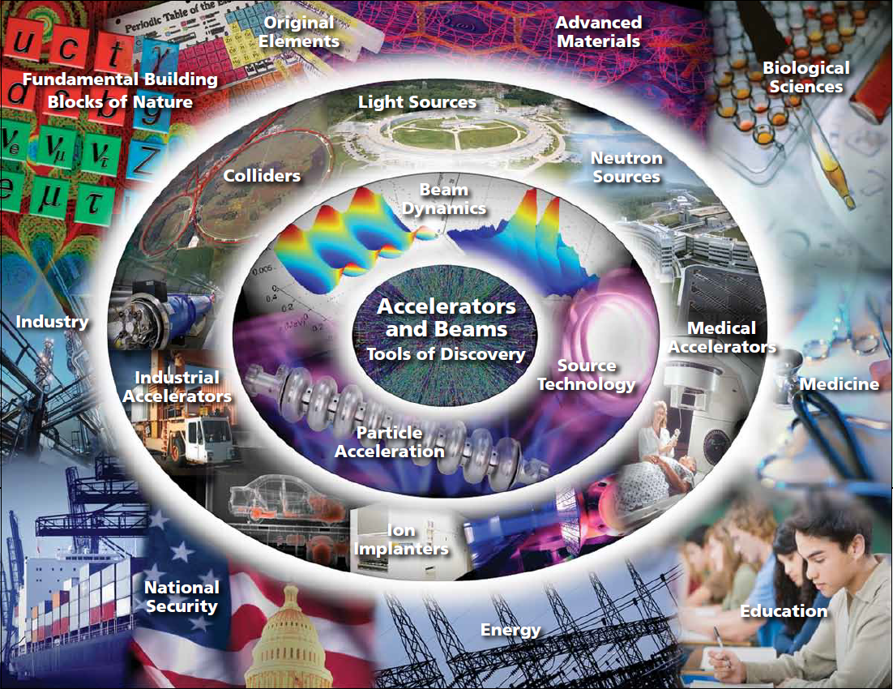

Long-Term Accelerator R&D Stewardship
Office of High Energy Physics
Office of Science
U. S. Department of Energy
Eric R. Colby
Accelerator Safety Workshop
August 5-7, 2014
Program Contacts: Eric.Colby@Science.DOE.GOV , Michael.Zisman@Science.DOE.GOV

Slide 2
Image courtesy of Oak Ridge National Laboratory

Slide 3
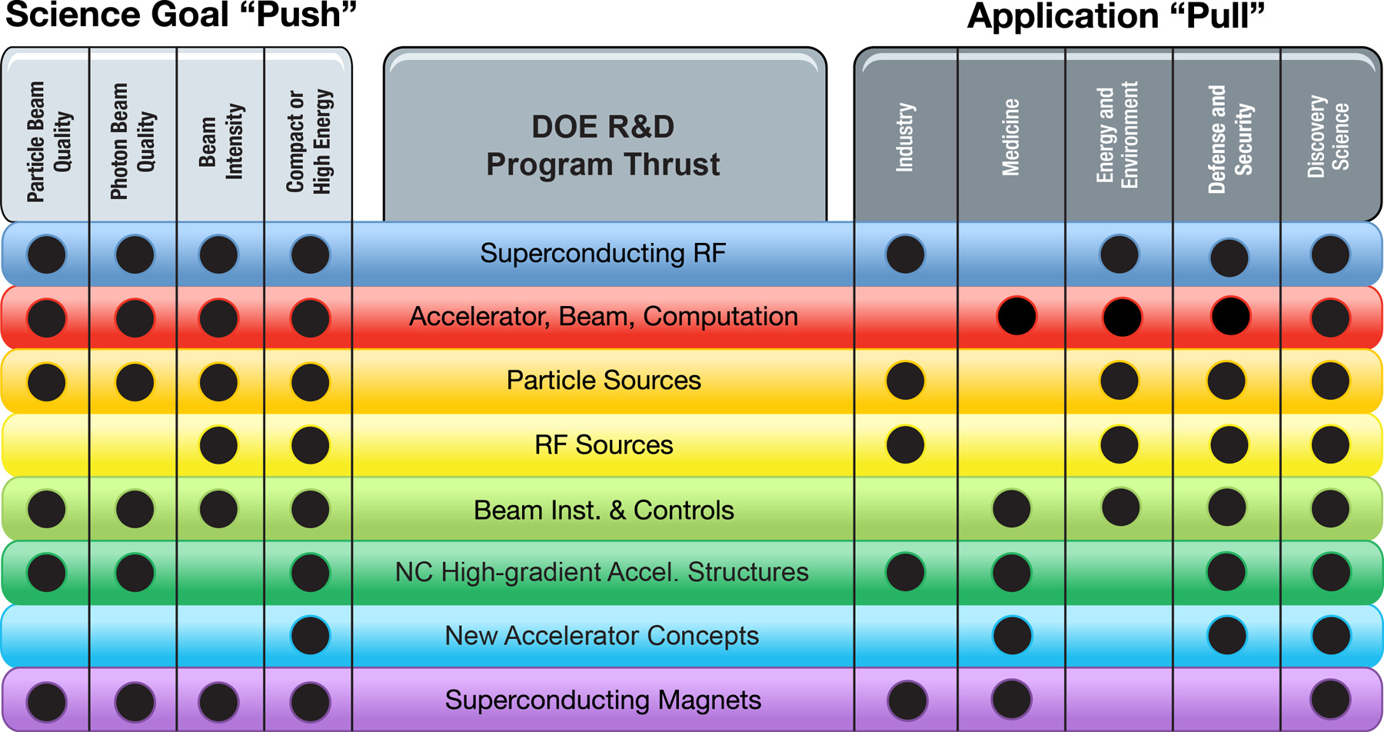
Connecting Accelerator R&D to Science and to End-User Needs

Slide 4

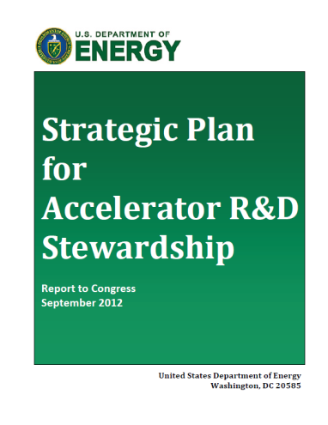
In 2011 the Senate noted the interest generated by the Accelerators for America’s Future Workshop, and asked DOE to develop a plan
“The [SEWD] Committee directs the Department to submit a …
10-year strategic plan … for accelerator technology research and development …”
The strategic plan should be based on the results of the Department's 2010 workshop study, Accelerators for America's Future, …”
Senate Report 112-075, p. 93. (Ordered to be printed September 7, 2011)
DOE responded with a strategic plan for Accelerator R&D Stewardship
Accelerator R&D Stewardship Mission:
  Support fundamental accelerator science and technology R&D
  Disseminate accelerator knowledge and training
Program Implementation:
  Facilitate access to national laboratory accelerator facilities and infrastructure for industrial and U.S. government agency users/developers of accelerators and related technology
  Develop innovative solutions to critical problems, to the benefit of both the broader user communities and the DOE discovery science community
  Serve as a catalyst to broaden and strengthen the community that relies on accelerators and accelerator technology

Slide 5
Goals of Long Term Accelerator R&D Stewardship
Enhance the accelerator technology capabilities of U. S. industry by engaging the U. S. accelerator R&D ecosystem in a manner that also enhances the ability of the DOE Office of Science and other federal agencies to carry out their missions
Drive a limited number of specific accelerator applications towards practical, testable prototypes in a 5-7 year timeframe
Foster collaboration between developers of accelerator technology and experts who apply accelerator technology
Support basic R&D, necessary for sustained innovation across a broad range of accelerator applications

Slide 6
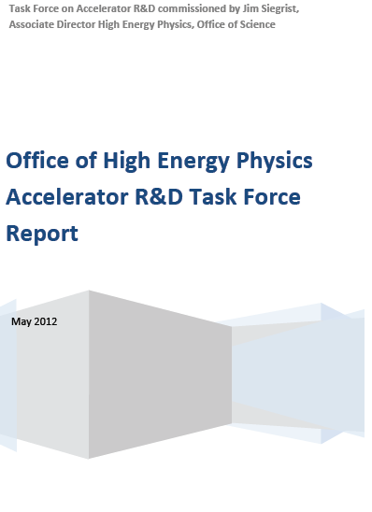
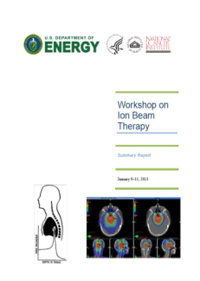
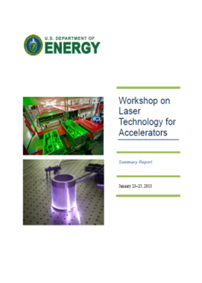

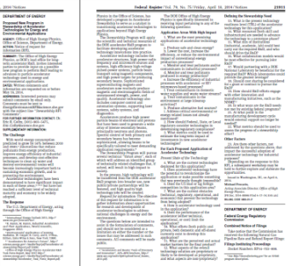
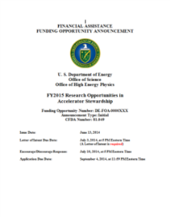
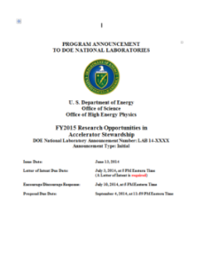
Formulating a National Accelerator Stewardship Program
2012 Accelerator R&D Task Force
Identified initial stewardship opportunities and potential impediments
2013 Ion Beam Therapy Workshop (with )
Identified the role of accelerator technology and facilities in further cancer therapy
2013 Laser Technology for Accelerators Workshop
Identified high average power “ultrafast” lasers as key enabling technology for discovery and applied sciences
2014 Energy & Environment RFI
RFI has identified key accelerator R&D needed to advance energy and environmental applications of accelerators
FY2015 Funding Opportunity Announcement
Posted June 13, 2014
2015 Facilities Pilot Program Kickoff Meeting; Energy & Environment Workshop
Will identify the initial cohort of test facility users, and identify the basic research needs for Energy & Environmental application of accelerator technology
Reports & RFI responses available at:
http://science.energy.gov/~/media/hep/pdf/accelerator-rd-stewardship

Slide 7
Accelerator R&D Stewardship Program Elements
Facilitate access to national laboratory accelerator facilities and infrastructure
  Brookhaven Accelerator Test Facility (open now!)
  Accelerator Test Facility Pilot Program (coming in 2015)
    Accelerator R&D Infrastructure (not national user facilities)
Develop innovative solutions to critical problems
  Accelerator R&D Stewardship FOA and LAB PA
    Applied R&D – solutions to specific accelerator application challenges
    Basic R&D – tools and concepts for the future
  SBIR/STTR FOA (coming fall 2014)
Serve as a catalyst to broaden and strengthen the community
    Basic Research Needs Workshops to identify critical R&D areas
    Structured grant opportunities strongly encourage teaming and cost sharing
Developing Future Focus Areas
  Additional Energy & Environment topic(s) (formulated based on recent RFI)
  Additional topics (depending on good ideas and available resources)

Slide 8
Accelerator Test Facility Stewardship Programs
Brookhaven ATF is now a dedicated Accelerator Stewardship facility
  ATF currently supporting 19 experiments
    13 support long-term R&D of interest to federal agencies beyond HEP
  Use criteria has broadened to enable fulfillment of Stewardship mission
Accelerator Test Facilities Pilot Program will make SC accelerator R&D infrastructure more available
  Will begin with a one year pilot program
  Strong partnership model
  Designed to test extent/type of demand; user logistics
  Intended to increase visibility of, and access to facilities
  May become a permanent part of Stewardship program

Slide 9
Applied R&D Topics
Solutions to specific accelerator application challenges
Medicine
  Make ion beam cancer therapy faster, better, cheaper
  Enable fast, flexible facilities that provide multiple ion species
  Help re-launch the U. S. into this field
Laser Technology
  Ultrashort pulse lasers that can drive science 1000x faster
  New materials for high power, different wavelengths
  Help revitalize U. S. industry
Energy & Environment
  Reduce accelerator power consumption through innovations in power conversion technology
  Evaluating innovative new applications in: waste & water treatment, flue gas treatment, sterilization, materials processing, in-situ measurement and remediation, high power wind turbines, and others
  Create new markets

Slide 10
Conclusion
The Office of Science, working through HEP, has initiated a program in long-term accelerator R&D stewardship that will
  Continue to invest in basic R&D, the source of new machine capabilities and the conceptual tools needed to design them
  Support broader use of SC accelerator R&D infrastructure
  Support collaborative R&D that enables new applications of accelerator technology to industrial, medical, security, defense, and energy and environmental applications of accelerators
In the process Accelerator Stewardship will
  Strengthen connections with other science funding agencies and industry
  Initiate new directions of collaborative research
  Increase visibility and broaden awareness of the value of accelerator science and technology investments

Slide 11
For more information:
Eric R. Colby SC-25 301-903-5474 Eric.Colby@Science.DOE.GOV
Michael Zisman SC-25 301-903-2817 Michael.Zisman@Science.DOE.GOV
http://science.energy.gov/hep/research/accelerator-rd-stewardship/

Slide 12
Supplementary Materials

Slide 13
Accelerator R&D Stewardship Is Always a ≥3 Body Interaction
U.S. Customers
R&D Performers
Other Offices of Science
Academia
Industry
Labs
Other Federal Agencies
HEP Test Facilities
Non-HEP Test Facilities
CARTs
Stakeholder Boards
Topical Workshops
DOE-HEP
Landlord Federal Agency
(BES, NP, etc.)
Topical Areas
FOAs
CARTs=Collaborative Accelerator R&D Teams
Synergy with HEP

Slide 14
Funding Trajectories of GARD, Stewardship, and SBIR
$
10⁹
Large Facility Projects
(Mu2e, LBNE)
10⁸
CD-0
Facilities Development
(LARP, MAP)
CD-4
10⁷
New concepts for OFAs
Commercial Products
GARD
10⁶
Accelerator Stewardship
SBIR Phase II
handoff
conversion
10⁵
SBIR Phase I
Track 2
Basic R&D
Track 1
Applied R&D
TRL0
TRL1
TRL2
TRL3
TRL4
TRL5
TRL6
TRL7
TRL8
TRL9

Slide 15
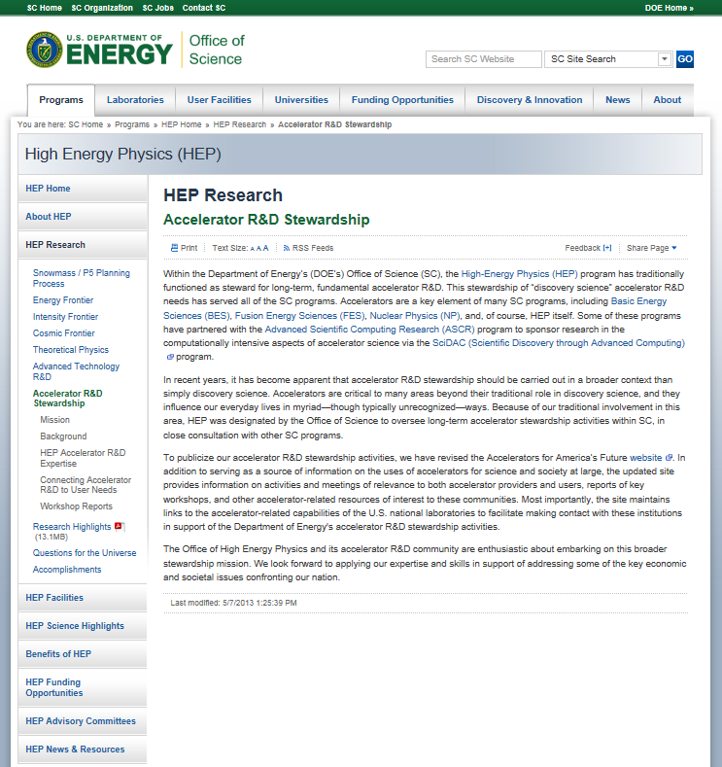
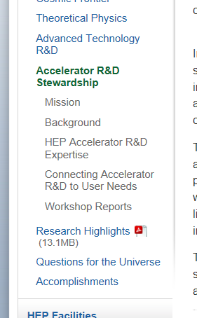
HEP Accelerator R&D Stewardship Web Site

Slide 16
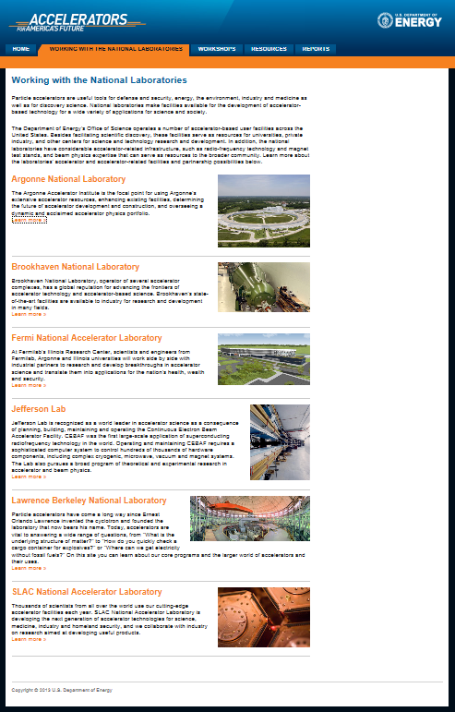
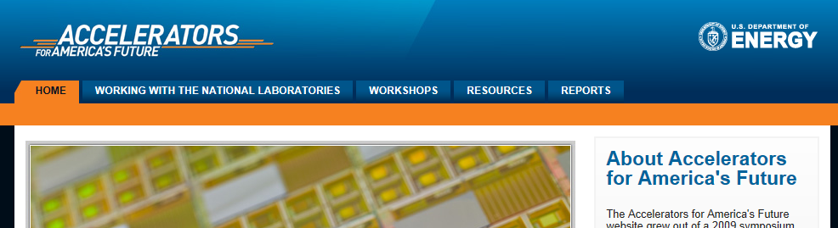
Accelerators for America’s Future Web Site
The nation’s portal for new users to browse lab capabilities and identify a contact person for more information.

