Slide 1
BES Light Sources
Accelerator Safety Workshop
August 5, 2014
Peter Lee
Office of Science
Basic Energy Sciences

Slide 2
Outline
Introductory Remarks
BES Light Sources
  Storage Rings
  Free Electron Lasers
What’s next?
Summary Remarks

Slide 3
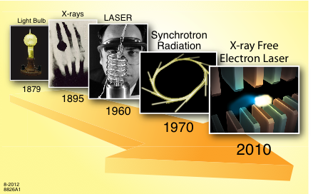
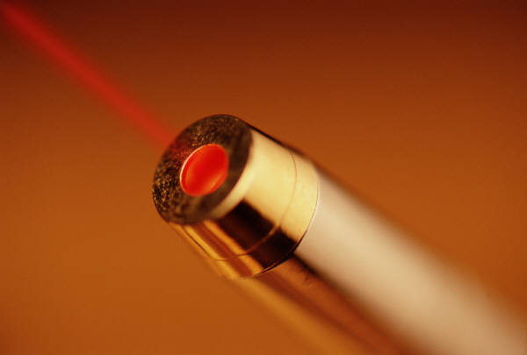
The Evolution of the Light Revolution
Visible light, X-rays, laser light & synchrotron light are all just forms of Electromagnetic Radiation
Some of the key differences are the frequency & intensity of the radiation and how it is created.
Low Brightness Source
High Brightness Source
We’ll explore the last two sources which use accelerated electrons to generate
high brightness X-rays!

Slide 4
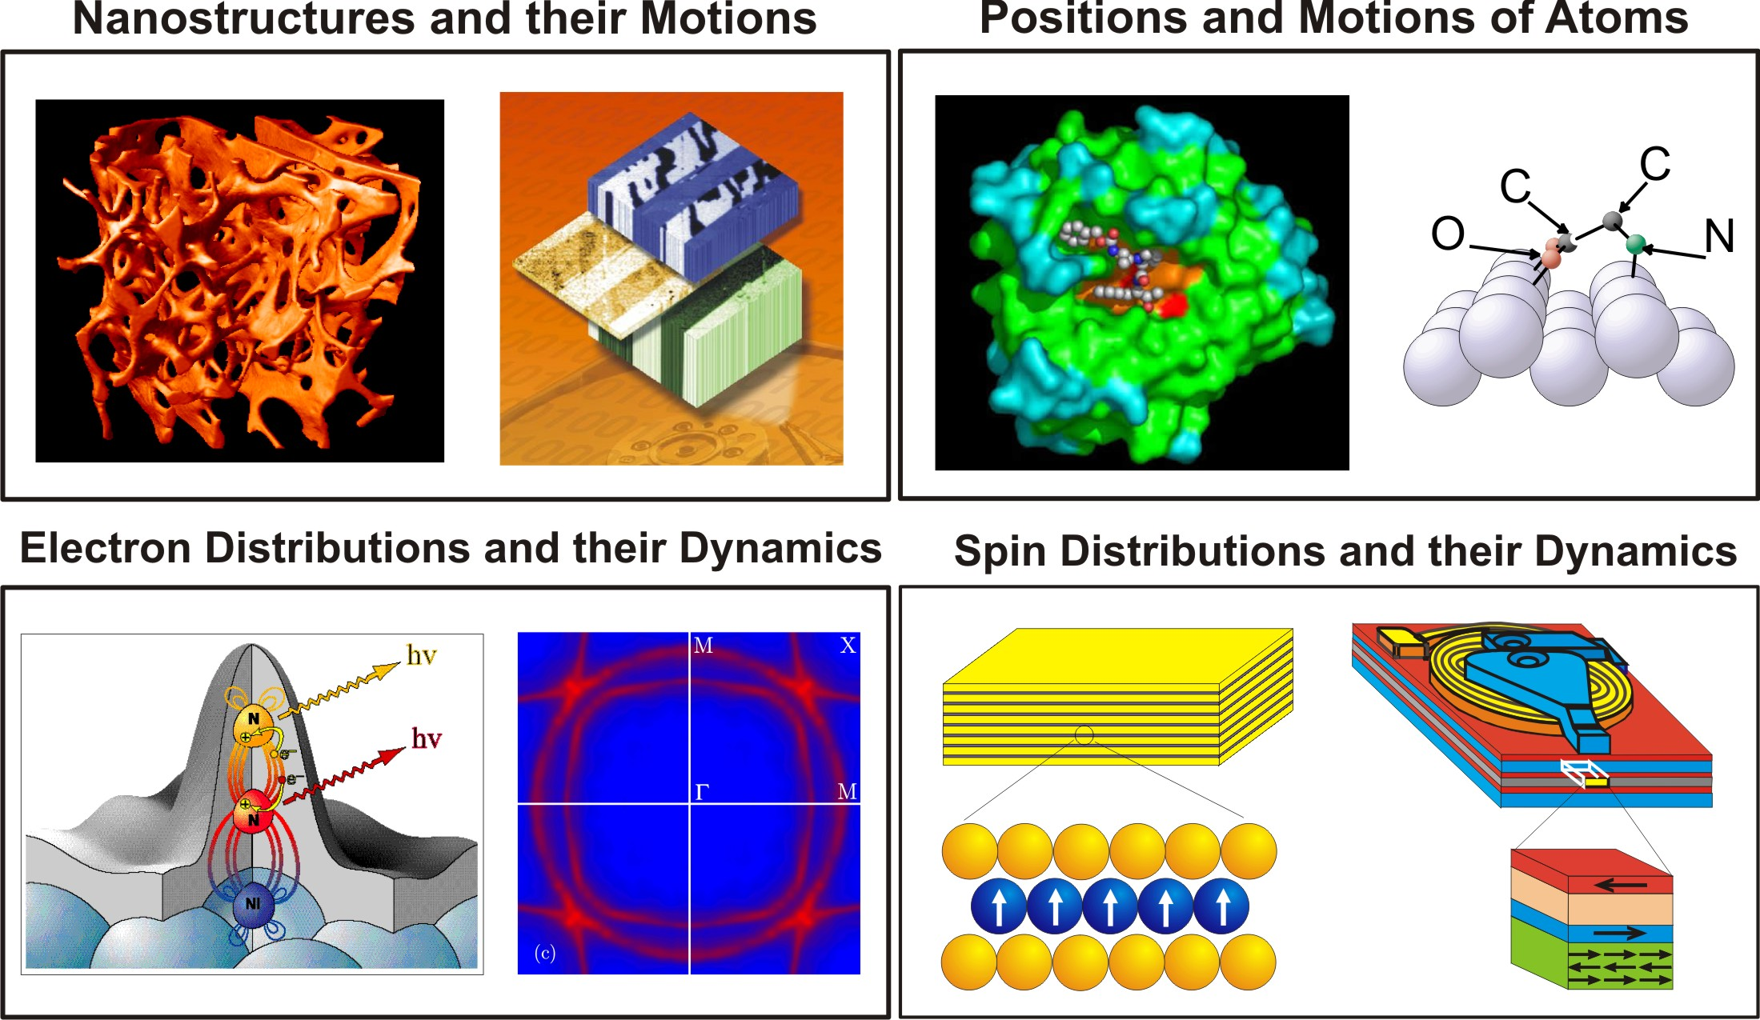
X-Rays Can See the Invisible: Provide Static & Dynamic Info
Imaging
Diffraction
EXAFS
Photoemission
X-ray absorption
X-ray emission
X-ray magnetic dichroism
spin pol. photoemission

Slide 5
What Do We Care Most About in Light Sources?
Wavelength Range
  Determines the kind of science you can access—atomic or electronic structure and dynamics
Brightness: Average and Peak
  Determines sensitivity of measurements
Pulse Width
  fs pulses opens the window on ultrafast dynamics and ‘probe before destroy’ technology
Coherence
  Allows new techniques (e.g. coherent imaging)
  Leads to high brilliance of the beams (transform limited pulses)
Stability
  Source stability in energy, position, time, intensity
Number of Undulators/Beamlines/Endstations
  Determines the number of users in parallel that can be accommodated and ultimately how much science gets delivered

Slide 6
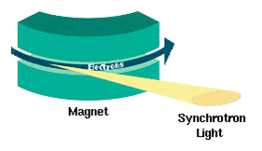
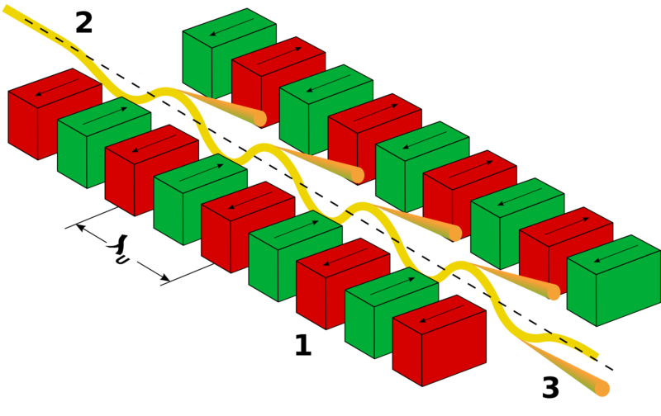
How to Produce Photons?: Accelerate Electrons in a Magnetic Field
Specially designed magnets or arrangements of magnets produce radiation with specific, desired properties.
Synchrotron Radiation (Storage Ring)
Undulator Radiation (Storage Ring or FEL)
B-Field with
N_{u} Periods
e⁻
Uniform
B-Field
Broad Band
Intensity
Intensity
Narrow Band, Δω/ω ~ 1/N_{u}
6

Slide 7
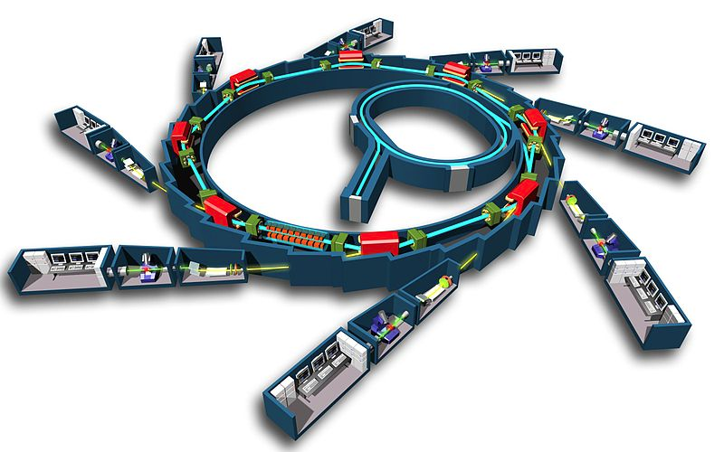
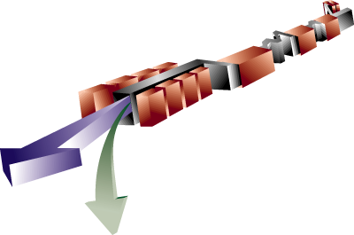
BES Light Sources: Storage Ring & FEL
Storage Ring
FEL Amplifier
LCLS

Slide 8
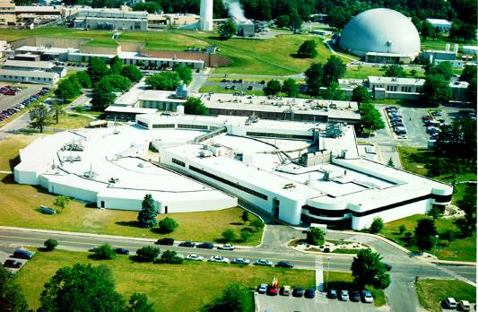
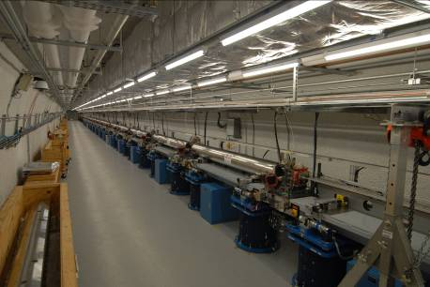
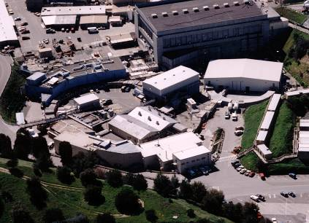
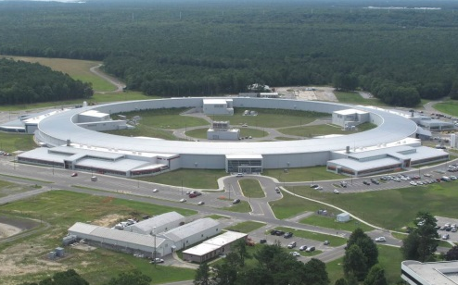
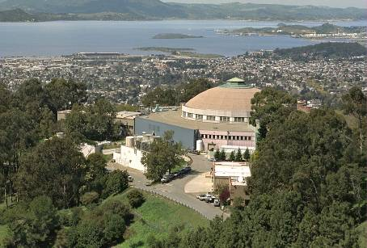
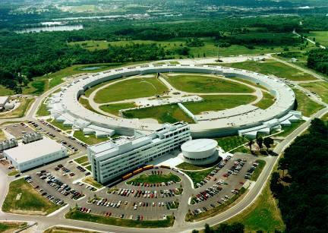
Users by Facility at the Light Sources
> 11K Users
SSRL
NSLS
LCLS
NSLS-II
4 Rings
1 FEL
ALS
APS

Slide 9
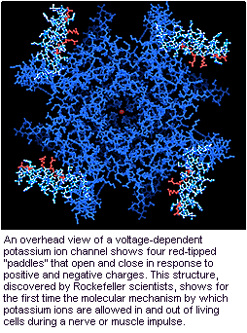
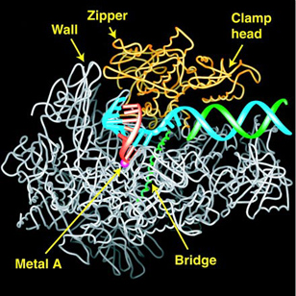
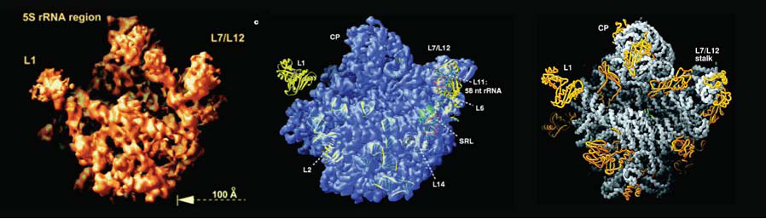
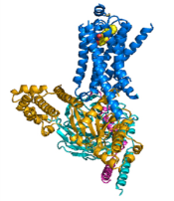
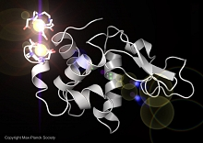
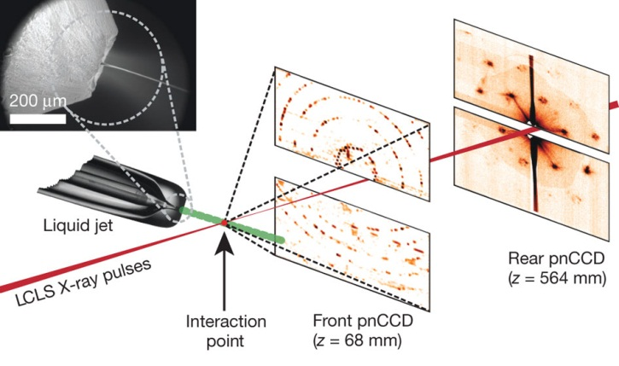
4 Nobel Prizes in Biochemistry with SC Storage Ring Light Sources
& the Prospect of Single-Molecule, Single-Shot Imaging with FELs
 | Roderick MacKinnon (Chemistry) for “structural and mechanistic studies of ion channels.”
 | Roger Kornberg (Chemistry) "for his studies of the molecular basis of eukaryotic transcription.”
 | Venkatraman Ramakrishnan, Thomas A. Steitz, and Ada E. Yonath (Chemistry) "for studies of the structure and function of the ribosome.”
 | Robert J. Lefkowitz and Brian K. Kobilka (Chemistry) "for studies of G-protein-coupled receptors.”
The overall view of a voltage-dependent potassium ion channel.
2003
The visualized transcription process.
2006
Nobel Prizes with SC storage rings in protein structures
2009
The structure of the β2AR-Gs complex.
2012
The 50S subunit at 2.4Å resolution.
HN Chapman et al. Nature 470, 73-77 (2011)
Early experiments in single-molecule, single-shot imaging at LCLS
The structure of the β2AR-Gs complex.
Single Shot Diffraction Pattern
Reconstructed Image
The Experiment
FY14: First de novo 3D
structure of lysozyme

Slide 10


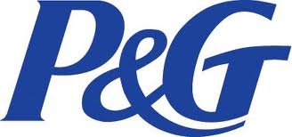


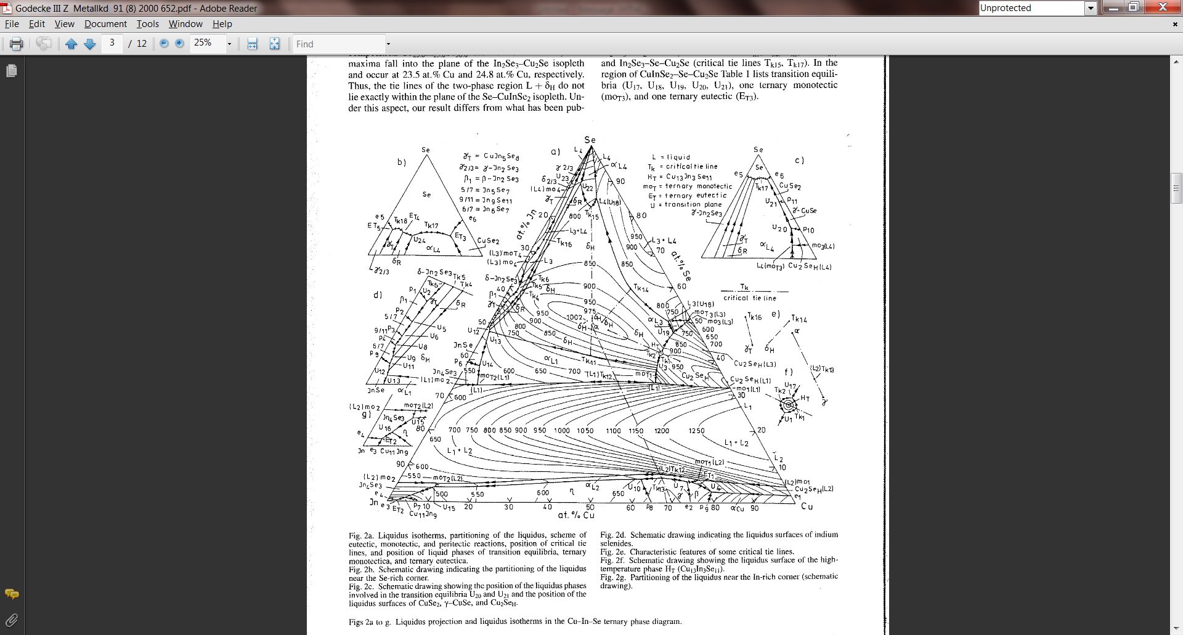
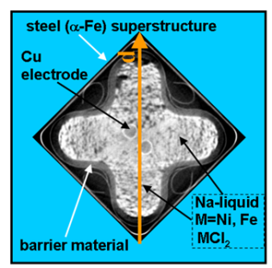
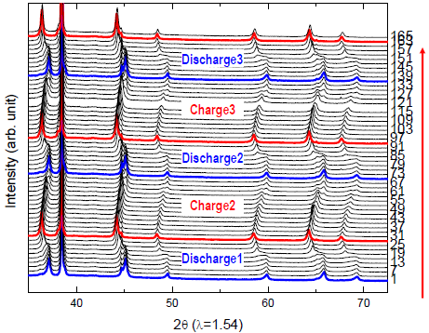
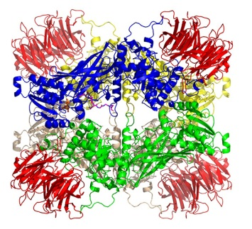
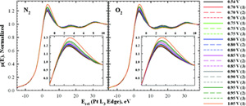
Industrial R&D at BES Light Source Facilities
Sodium Metal Halide Battery
From Protein Structures to Drugs
Solar Shingle
Lithium Battery
Fuel Cell
Investigating the process, structure, and property relationships in CuInGaSe (the active material in the first “solar shingles”) with x-ray techniques at synchrotron light sources
Understanding the distribution of reaction products within the battery to improve the performance using high energy x-ray diffraction
Conducting in situ x-ray diffraction studies at synchrotron light sources to tailor crystal structure of high voltage spinel cathode materials with high capacity and long cycle life
Using x-ray absorption spectroscopy to understand the influences of neighboring oxides on platinum surfaces to obtain vital information on the oxygen reduction reactions in fuel cells
Developing potential life saving drugs by examing the protein structural information, for example, important methylation enzymes that play important roles in cell signaling

Slide 11
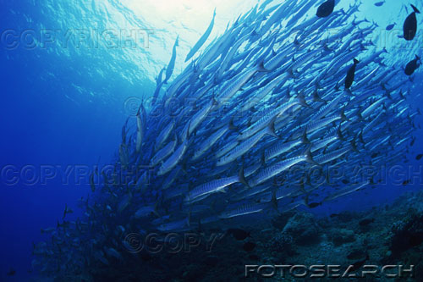

Light Source Metrics: Photons Inherit Electron Properties
Photons
  Ave & Peak Brightness
  Photons/Pulse, Flux
  Coherence
  Rep Rate
  Pulse length
Electrons
  Emittance
  Pulse Length
  Energy Spread
  Peak Current
Low Brightness Beam
High Brightness Beam
Low Brightness Beam
High Brightness Beam

Slide 12
DOE Light Sources & Key Worldwide Competitors
Circa 2014
MAX IV
PSI SLS
PETRA III
PAL XFEL
SWISSFEL
XFEL
ALS
ESRF,U
FLASH-I,II
NSLS-I,II
APS,U
SPRING8,U
SSRL
LCLS-I
SACLA XFEL
LCLS-II
SIRIUS
Storage Rings in Blue
FELs in Red

Slide 13
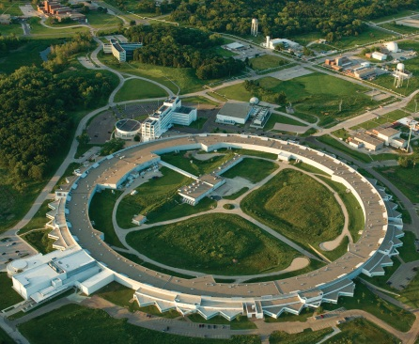
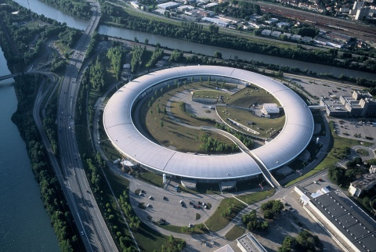
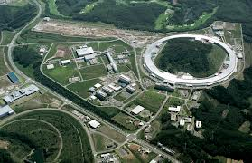
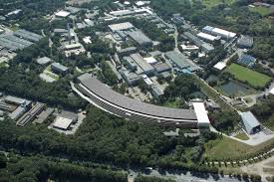
High Energy, Hard X-ray Ring Upgrade Plans
APS, ESRF & SPring-8 are all designing upgrades to incorporate multi-bend achromat lattices to reduce the emittance towards the diffraction limit to enhance brightness.
Double Bend Achromat
Seven Bend Achromat
APS 7 GeV
ESRF 6 GeV
Spring-8 8 GeV
PETRA-III 6 GeV

Slide 14
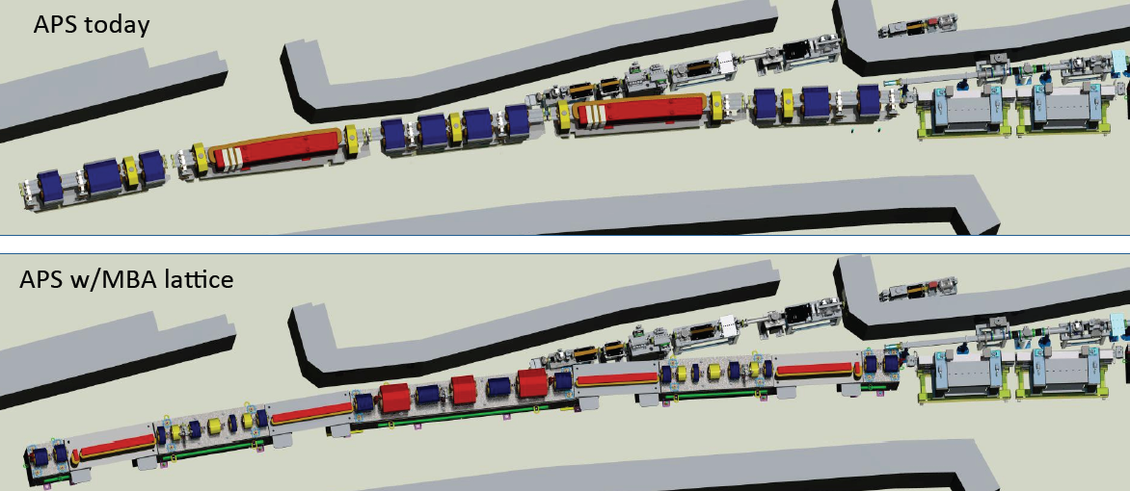
APS-U: 7 Bend Achromat will Replace the 2 Bend Achromat
M. Borland 4/2014

Slide 15
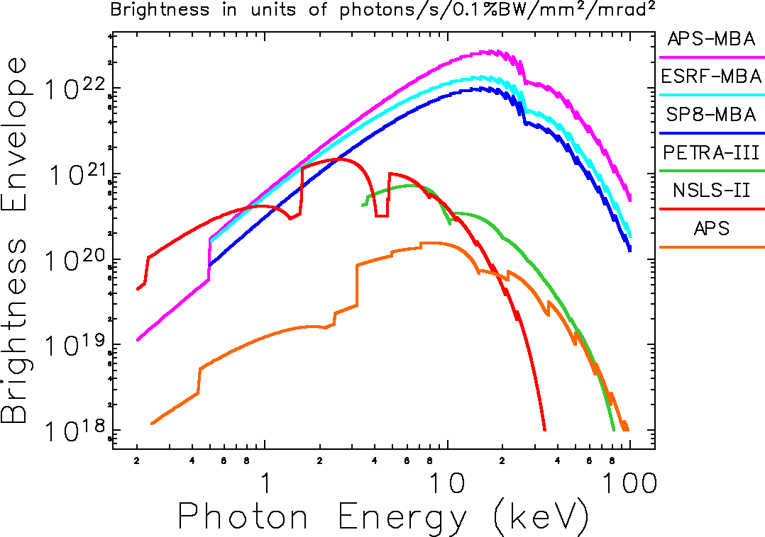

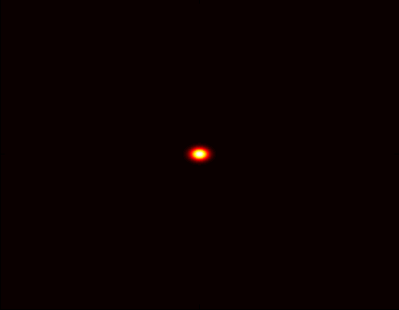
APS-U MBA Brightness Improvement
Dramatically enhance the performance of the APS as a hard x-ray source
3100 pm
natural
emittance
at 7 GeV
APS Now
MBA
67 pm
natural
emittance
at 6 GeV
Particle Beam
Profiles
1 mm
M. Borland 4/2014

Slide 16
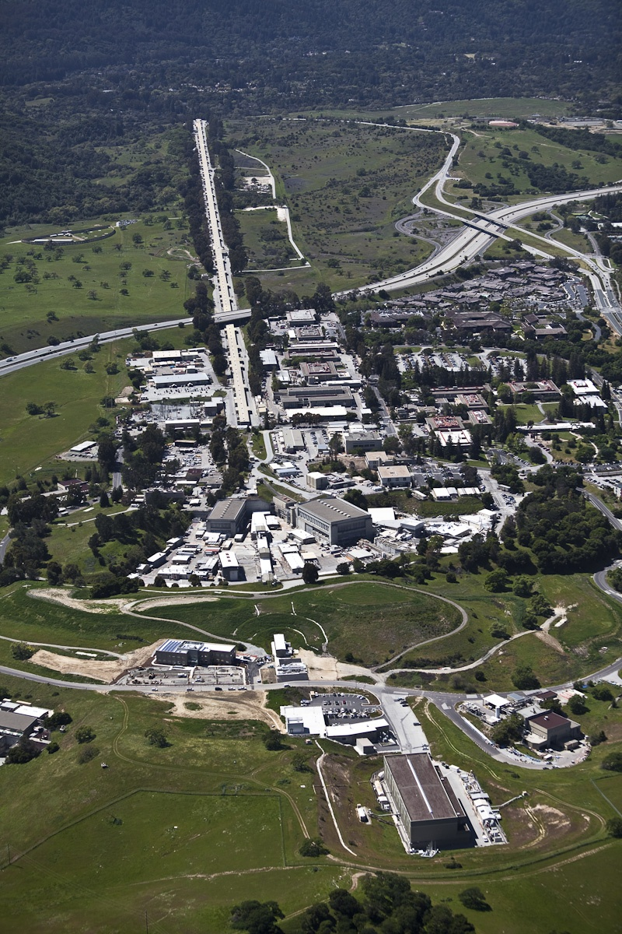
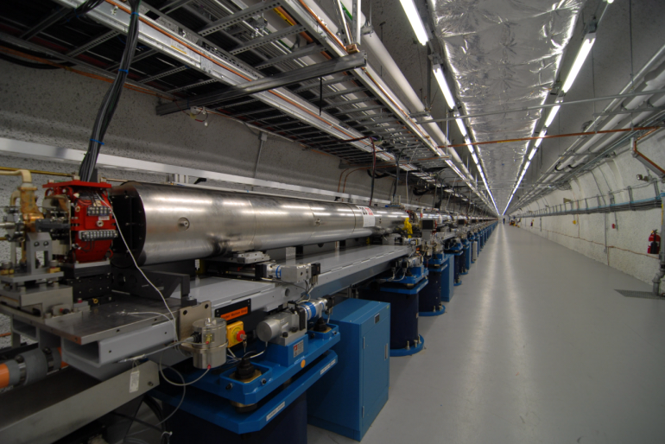
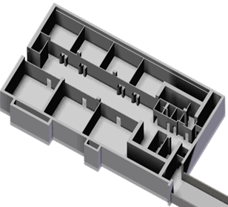
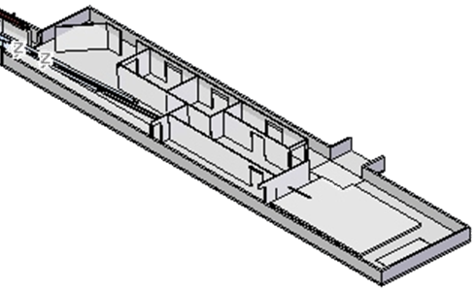
Linac Coherent Light Source (LCLS)
The World’s First X-ray Free Electron Laser
Injector
electron beam
1km linac 14GeV
AMO
Undulator hall
SXR
XPP
Near-hall: 3 stations
x-ray beam
XCS
CXI
Far-hall: 3 stations
MEC

Slide 17
LCLS-II: CW High Rep & High Pulse Energy FEL
 | Recommendation | Implementation
✔ | High Repetition Rate | CW Linac with MHz Capability
✔ | Broad Energy Range | SC & Cu linacs with variable gap undulators
✔ | Transform Limited | Self seeding narrow bandwidth monochromator
✔ | Ultra-Bright | 14.7 GeV linac & high K undulator
✔ | Multiple Undulator Sources | Two undulators
keV

Slide 18
Summary Remarks
The BES strategic plan, developed with input from the BESAC Future X-ray Light Sources report, will ensure that the USA light sources will maintain world leadership for decades to come
Strong competition from Asia & Europe on light source facilities will require exceptional quality science to be performed at the USA light sources as the facilities alone will not be sufficient to set the USA apart from the pack
Robust R&D programs on accelerator physics/technology, detectors & optics will be needed to fully leverage the new sources and provide a pathway to the future
Operational excellence (robust Accelerator Safety Program at the BES Light Sources) is a key component enabling quality science to be performed

