Slide 1
Status of the 12 GeV and FRIB and NP's Investments in Accelerator R&D
August 5, 2014
Germantown, MD
M. Farkhondeh, PhD
Program Manager
Advanced Technology Research and Development
DOE Office of Science
Office of Nuclear Physics

Slide 2
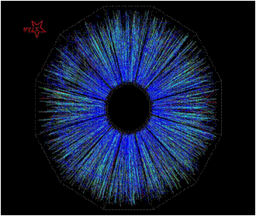
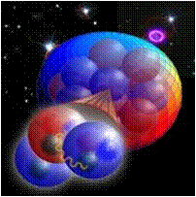
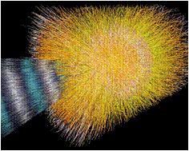
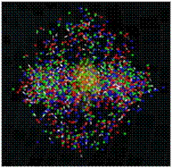
Contents:
NP Mission Statement
12 GeV upgrade project at TJNAF
Facility for Rare Isotope Beams
NP Accelerator R&D

Slide 3
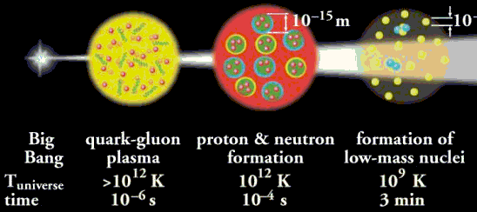
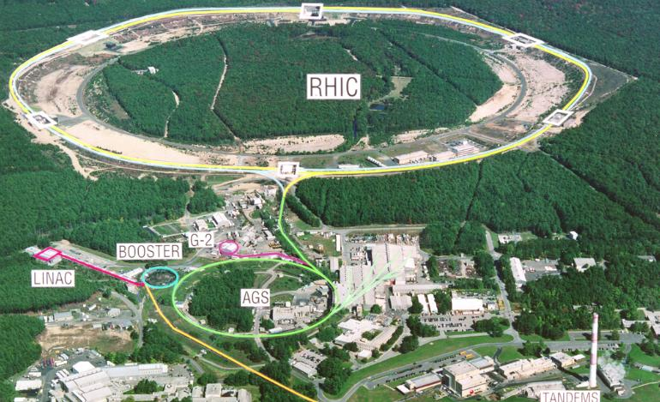
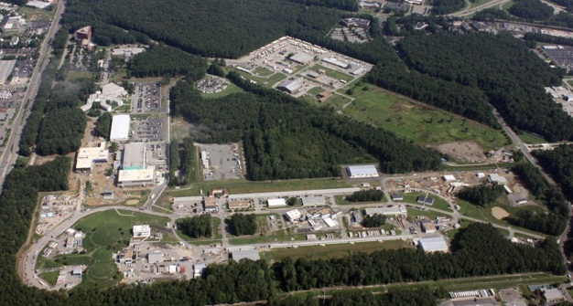
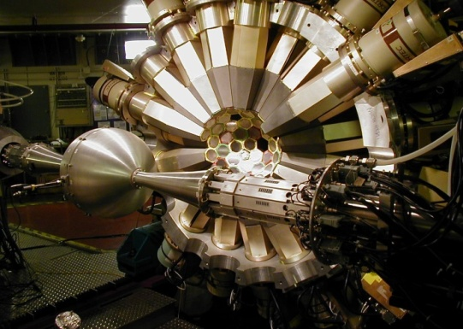
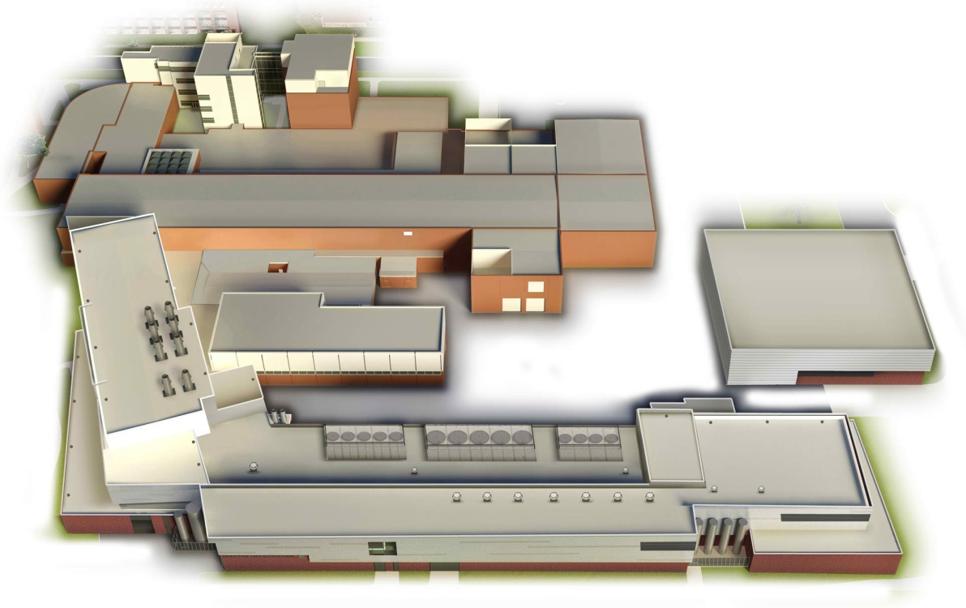
Mission Statement: Office of Nuclear Physics
Mission: To discover, explore and understand all forms of nuclear matter; to understand how the fundamental particles, quarks and gluons, fit together and interact to create different types of matter in the universe, including those no longer found naturally.
Nuclear Physics
RHIC collider at BNL.
CEBAF at TJNAF and 12-GeV upgrade project
FRIB
Argonne Tandem Linac Accelerator System
Facility for Rare Isotope Beam at MSU

Slide 4
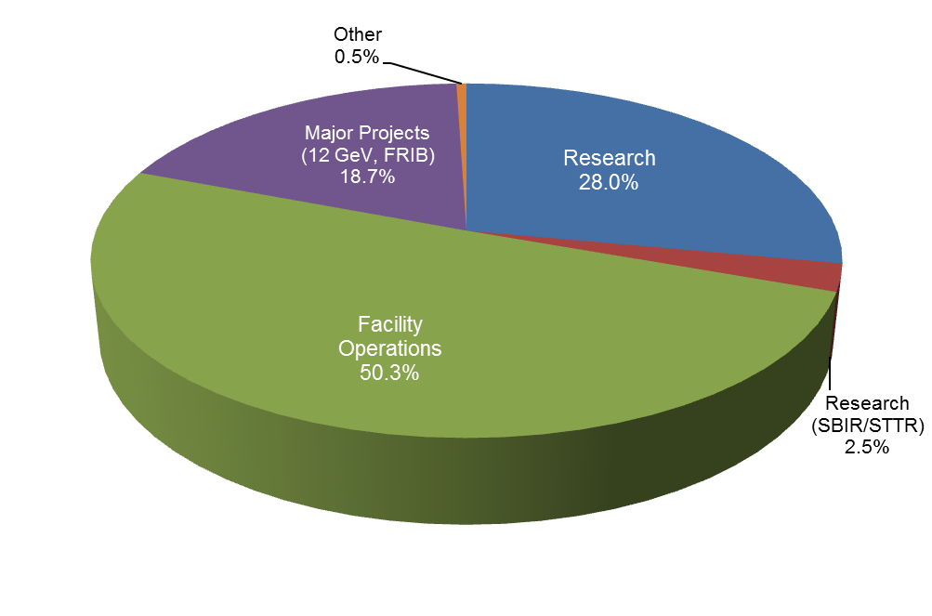
Nuclear Physics
FY 2015 President’s Request – By Function
~69% of the FY 2015 NP budget supports operations or construction of facilities
The percentage devoted to major projects is almost 19% in FY 2015
FY 2015 President’s Request
Total = $593.6M

Slide 5
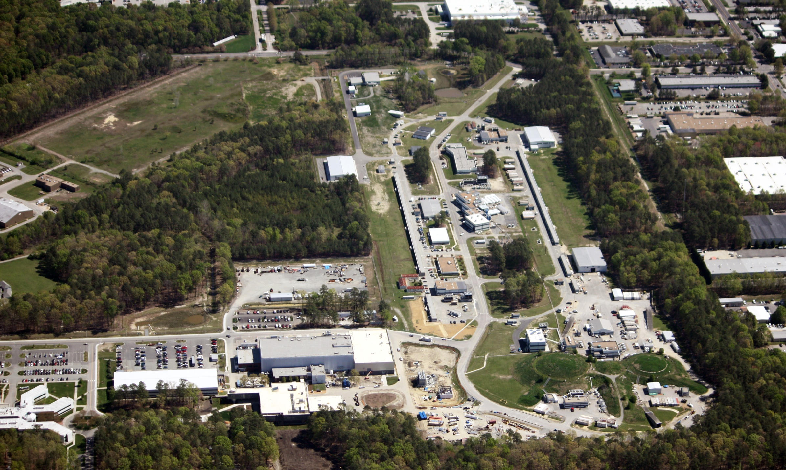
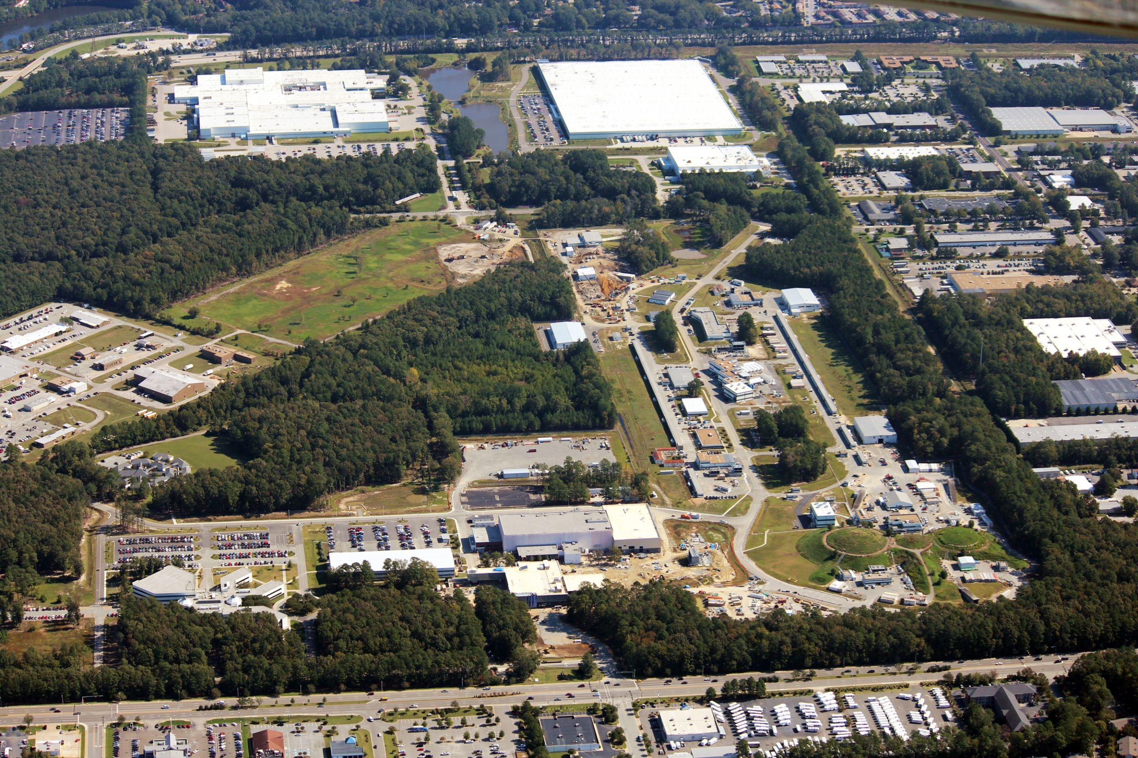
Jefferson Lab
12 GeV Upgrade
Presentation to DOE-ONP
July 9, 2013

Slide 6
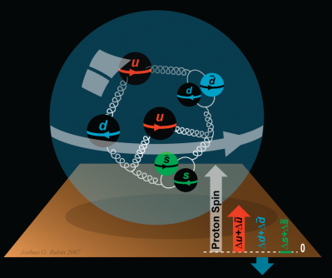


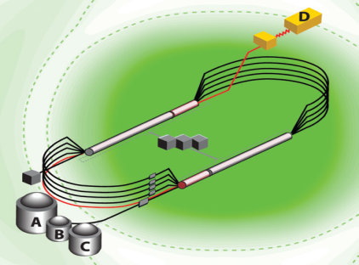
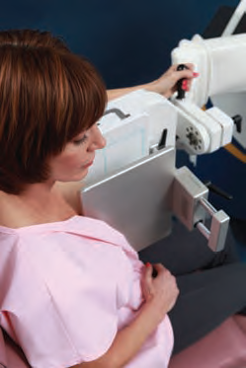
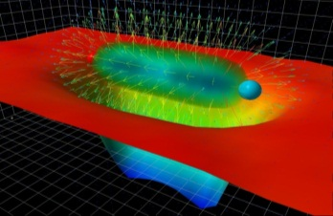
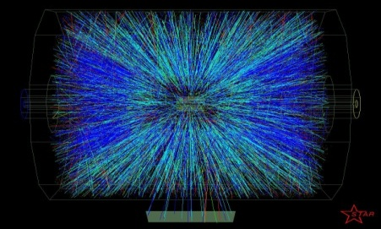
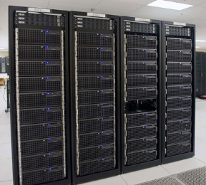

JLab: Medium Energy Nuclear Science and Its Broader Impacts
Nuclear Structure
Structure
of Hadrons
Fundamental
Forces & Symmetries
Medical
Imaging
Quark Confinement
Accelerator S&T
Hadrons from QGP
Theory and Computation

Slide 7


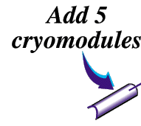




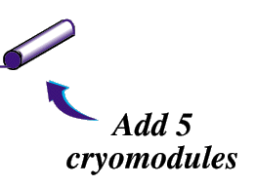
12 GeV Upgrade
CD-4A Scope
  Upgrade is designed to build on existing facility
Hall D Refrigerator
New cryomodules with New RF Zones
Add Beamline
Upgrade magnets and power supplies
CHL-2
CEBAF: a 1 MW CW srf based electron linac with recirculation and multi Experimental Halls
CD-4A scope includes doubling the accelerator beam energy and adding a new experimental Hall and associated beamline

Slide 8
12 GeV Upgrade Project status
PROJECT STATUS (31 May 2014 DATA):
Project Type Line Item
CD-1 Planned: Feb 2006 Actual: Feb 2006
CD-2 Planned: Dec 2007 Actual: Nov 2007
CD-3 Planned: Sep 2008 Actual: Sep 2008
CD-4A Planned: Dec 2014 Actual: July 2014
CD-4B Planned: Sep 2017
TPC Percent Complete: Planned: 89.2% Actual: 88.3%
TEC: $310.5M TPC: $338M
Contingency Cost $18.5M
Contingency Schedule: 15 months (CD-4B); 6 months (CD-4A)
A rebaseline plan implemented with a 1-Sep-2013 start date with Total Project Cost (TPC) of $238M
Civil 93%, Accelerator 98%, Physics 75% (as of April 2014)
  Accelerator commissioning is in progress:
    All CD-4A Key Performance Parameters demonstrated: 2.2 GeV per pass, 5.5 passes to Hall D dump.
The SC Magnets for Halls B & C are on Critical Path
  15 months of schedule contingency remains
TPC $000s | PYs | FY13 | FY14 | FY15 | FY16 | FY17 | FY18 | FY19 | FY20 | FY21 | TOTAL
12 GeV | 230,928 | 43,072 | 30,000 | 21,000 | 12,000 | 1,000 | – | – | – | – | 338,000

Slide 9
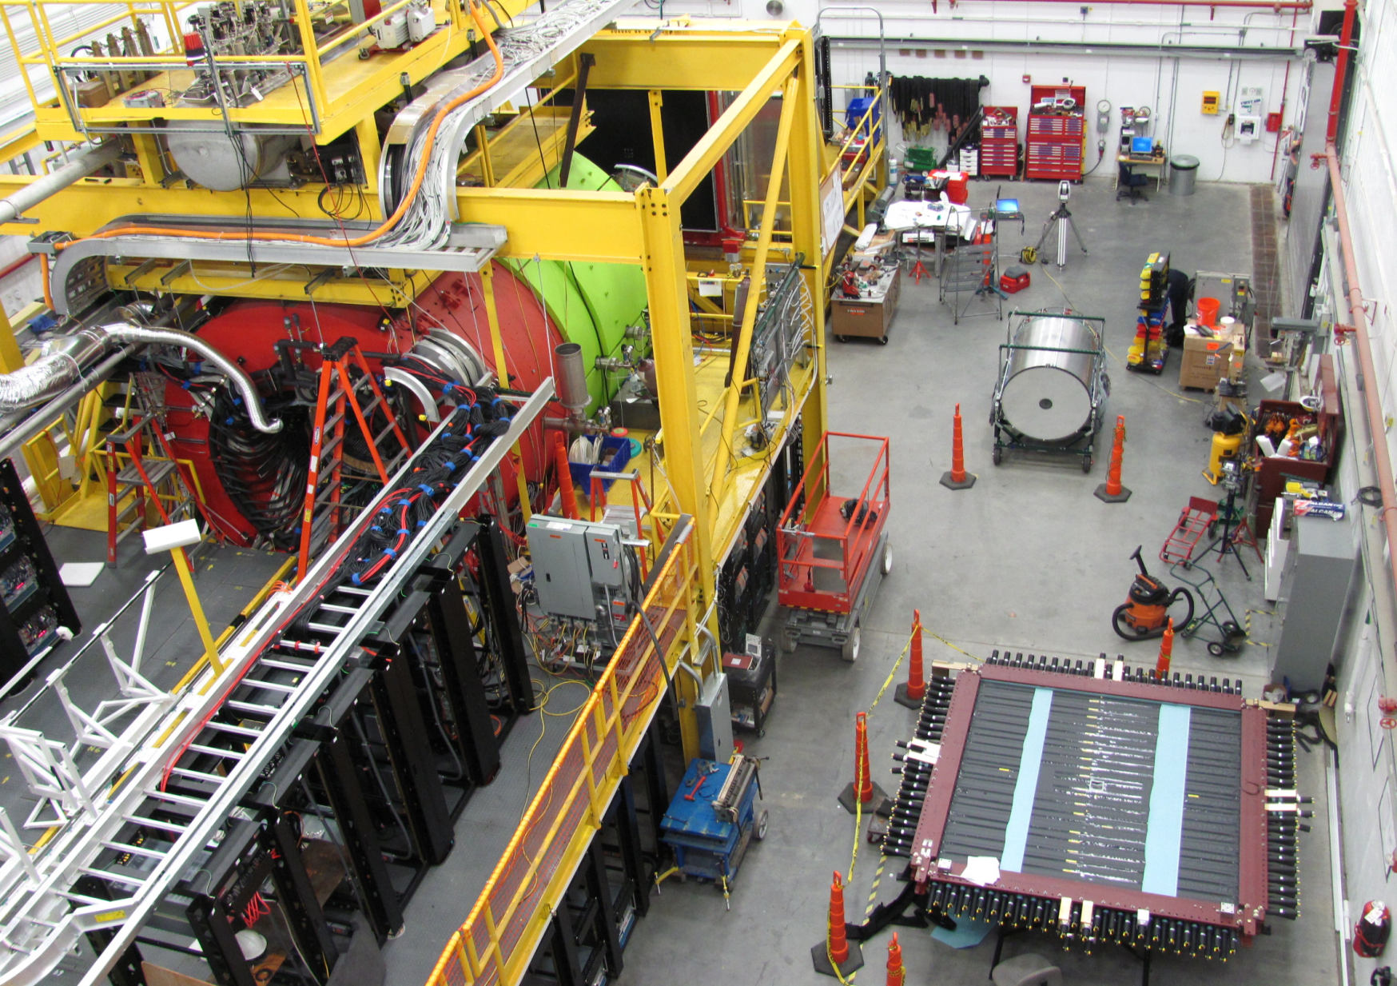
HALL D INTERIOR: SOLENOID & DETECTORS
April 2014 Photo
FCAL
CDC
TOF
BCAL
FDC
SOLENOID

Slide 10
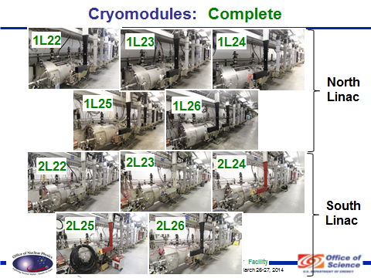
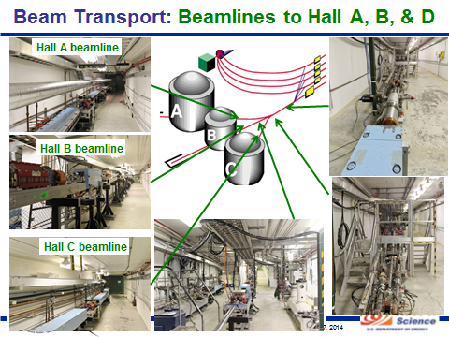
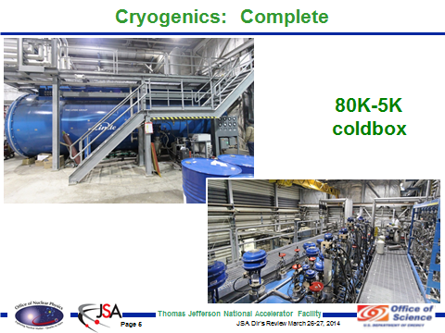
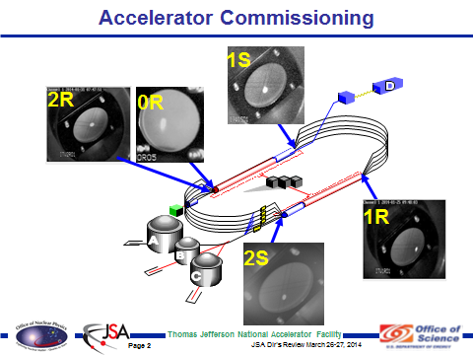
Accelerator Equipment
10

Slide 11
Accelerator Readiness
Review (ARR)
Meets the requirements of 420.2C, Safety of Accelerator Facilities. Some of the required elements include:
  An approved Accelerator Safety Envelop (ASE)
  Safety Assessment Document (SAD/FSAD)
  An ARR program to include an ARR Plan
  Contractor Assurance System (CAS)
  Configuration Management
Used the most recent guide - Accelerator Facility Safety Implementation Guide for DOE O 420.2C, SAFETY OF ACCELERATOR FACILITIES
Incorporated Lessons Learned from internal and external sources
  Thorough system checks including configuration management of safety systems
  Performance-based ARR process
Slide: Courtesy of Mike Epps
11

Slide 12
Contents:
NP Mission Statement
12 GeV upgrade project at TJNAF
Facility for Rare Isotope Beams, FRIB
NP Accelerator R&D

Slide 13
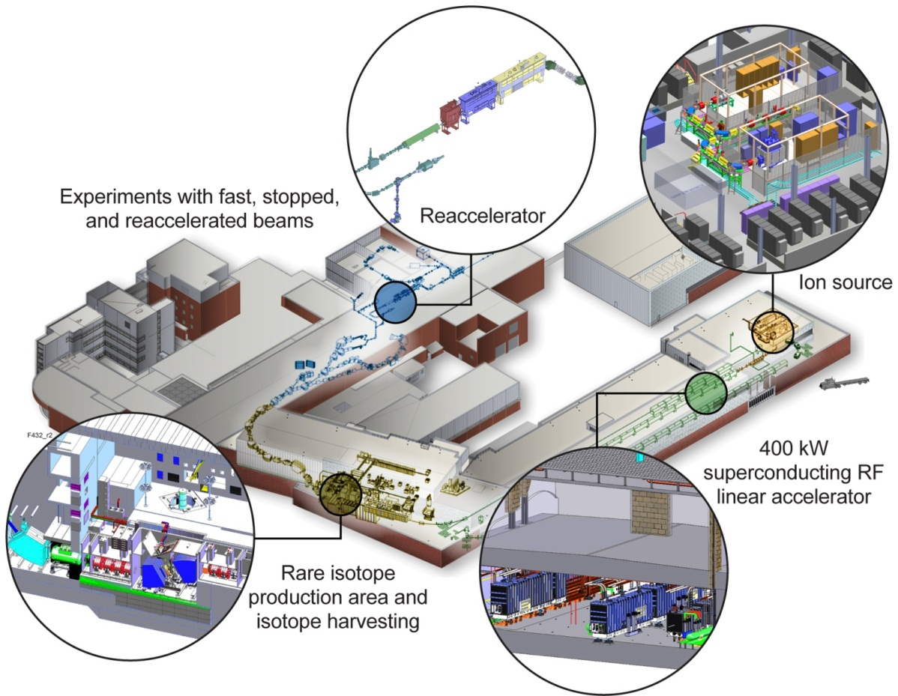
Facility for Rare Isotope Beams
A future DOE-SC National User Facility
FRIB
Funded by DOE–SC Office of Nuclear Physics with contributions and cost share from Michigan State University and State of Michigan
Serving over 1,300 users
Key feature is 400 kW
beam power for all ions
(e.g. 5x10¹³ ²³⁸U/s)
Separation of isotopes
in-flight
will increase the number of
isotopes with known properties from ~2,000 observed over the last century to ~5,000
Slide courtesy of T. Glasmacher
13

Slide 14
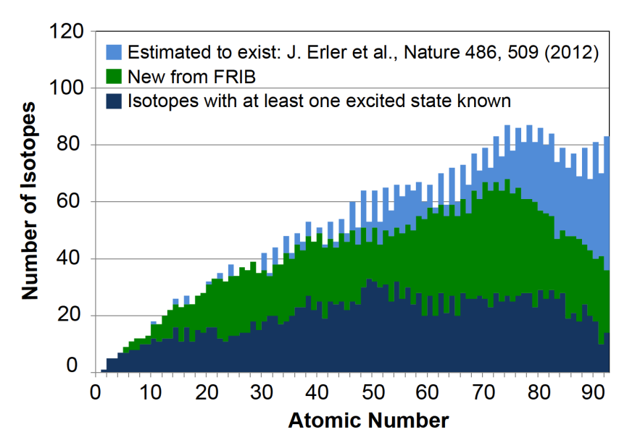
FRIB
Number of isotopes with known properties from current 2000 to 5000
FRIB Linear Accelerator
FRIB will provide world-leading capabilities for research on:
  Nuclear Structure
  Nuclear Astrophysics
  Fundamental Symmetries
  This research will provide the basis for a model of nuclei and how they interact.
Timeline:
8 June 2009 – DOE-SC and MSU sign Cooperative Agreement
September 2010 – CD-1 approved, DOE issues NEPA FONSI (Finding of No Significant Impact)
August 2013 – CD-2 approved (baseline), CD-3a approved (start civil construction)
October 2014 – Start technical construction
December 2020 – early completion goal
June 2022 – CD-4 (project completion)

Slide 15
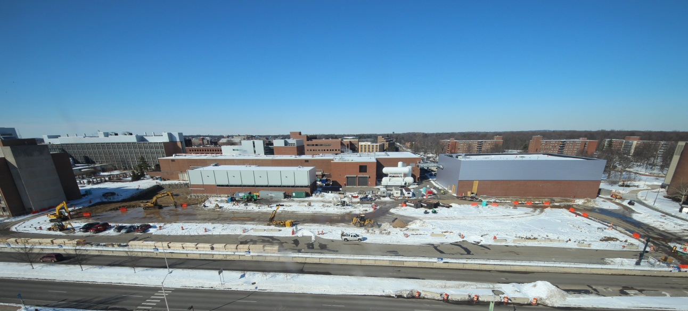
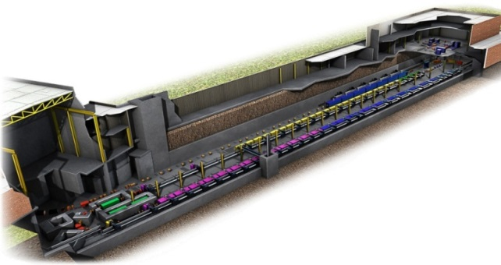
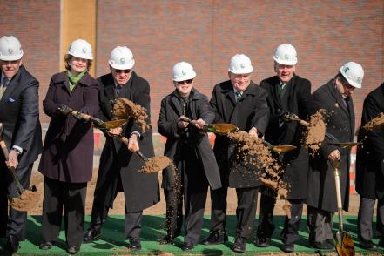
FRIB
FRIB Site March 2014
Based on a 200 MeV/u, 400 kW super conducting accelerator
  The Total Project Cost for FRIB is $730M, of which $635.5M will be provided by DOE and $94.5M will be provided by MSU.
  The project will be completed by June 30, 2022.
Start of civil construction was authorized January 22, 2014.
Excavation activities began late February 2014.
ESH&Q ready to proceed, no ESH issues to report
Ground breaking ceremony was held on March 17, 2014.
October 2014 – Start technical construction
June 2022 – CD-4 (project completion)
TPC $000s | PYs | FY13 | FY14 | FY15 | FY16 | FY17 | FY18 | FY19 | FY20 | FY21 | TOTAL
FRIB | 51,000 | 22,000 | 55,000 | 90,000 | 100,000 | 100,000 | 97,200 | 75,000 | 40,000 | 5,300 | 635,500

Slide 16







Collaboration with other Institutions worldwide
20 Work-for-Others Agreements
ANL (1+4*)
  Liquid lithium charge stripper;
  Stopping of ions in gas; Fragment
  separator design; Beam dynamics; SRF
BNL (3)
  Radiation resistant magnets; Plasma charge stripper*
Fermilab (1)
  Diagnostics
TJNAF(2+2*)
  Cryogenics; SRF
LBNL (1+2*)
  ECR ion source; Beam dynamics*
ORNL (2)
  Target facility; Beam Dump R&D;
  Cryogenic Controls
SLAC (2*)
* complete
Budker Inst. of Nuclear Physics (Russia)
  Production target, diagnostics
GANIL (France)
  Production target
GSI (Germany)
  Production target
INFN Legnaro (Italy)
  SRF
KEK (Japan)
  SRF technology, SC solenoid magnets
RIKEN (Japan)
  Charge strippers
Sandia
  Production target*
Soreq (Israel)
  Production target*
Tsinghua University & CAS (China)
  RFQ
TRIUMF (Canada)
  SRF, beam dynamics
Slide courtesy of T. Glasmacher

Slide 17
ES&H System Milestones for FRIB Project
Develop NEPA compliance documents – FONSI
Actions that result from the NEPA documents – None
Develop ES&H Policy – Completed
Apply NSCL ISO 14001 to the FRIB project – Completed
ISM and FRIB OHSAS 18001 Crosswalk – Completed
Application of OHSAS 18001 to the FRIB project – Completed
FRIB Safety Assessment Document – June 2017
FRIB Accelerator Safety Envelope – July 2016
FRIB Shielding Policy – Completed
Develop a FRIB ISO 9001 registered QMS – Completed
FRIB Accelerator Readiness Review – September 2020
FRIB analyses required by MSU insurance underwriter – Completed
Slide courtesy of T. Glasmacher

Slide 18
Contents:
NP Mission Statement
12 GeV upgrade project at TJNAF
Facility for Rare Isotope Beams
NP Accelerator R&D

Slide 19
NP Accelerator R&D
NP Accelerator R&D
  Short Term Accel R&D: Investment towards improving Existing NP Facilities
  Mid Term Accel R&D: Investment towards Next Generation NP facility
    Electron-ion collider (eRHIC @ BNL, MEIC @ JLab) risk reduction
    This is done through publishing FOA for Labs and universities
  SBIR/STTR: supports short through long term Accelerator R&D goals but with commercialization in mind.
All long term (or generic) Accelerator R&D at Office of Science are supported by office of High Energy Physics (HEP).

Slide 20
Accelerator R&D at NP supported Labs
Accelerator R&D at TJNAF is directed to improve the performance of SRF cavities, the CEBAF accelerator, and high performance polarized injectors.
R&D at RHIC is directed to improve collider performance through various types of cooling including stochastic cooling, Coherent electron cooling and electron cooling.
Both TJNAF and BNL/RHIC are involved in R&D toward next generation NP Facility, the Electron Ion Collider (EIC).
Accelerator R&D at ATLAS is at a small to modest level directed to improve ion source efficiencies and low-to- medium beta SRF cavity development.

Slide 21
Back up Slides

Slide 22
Schedule (Level 1 Milestones)
CD-0 | Approve Mission Need | March 2004 (A)
CD-1 | Approve Alternative Selection and Cost Range | February 2006 (A)
CD-2 | Approve Performance Baseline | November 2007 (A)
CD-3 | Approve Start of Construction | September 2008 (A)
CD-4A | Approve Accelerator Project Completion and Start of Operations | December 2014
CD-4B* | Approve Experimental Equipment Project Completion | September 2017
*Includes 15 Months of Schedule Contingency

Slide 23
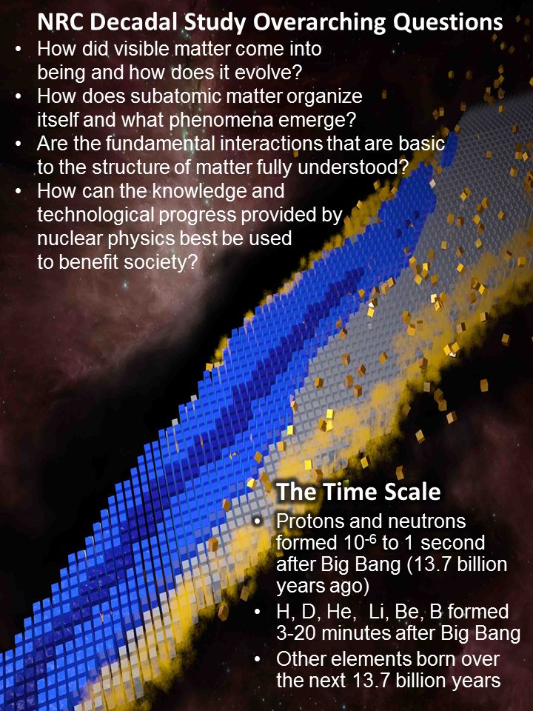

FRIB: 21st Century Science Questions
FRIB physics is at the core of nuclear science:
“To understand, predict, and use”
FRIB provides access to a vast unexplored terrain in the chart of nuclides

Slide 24
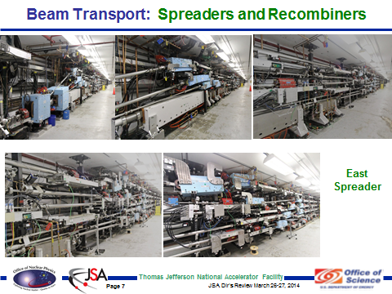
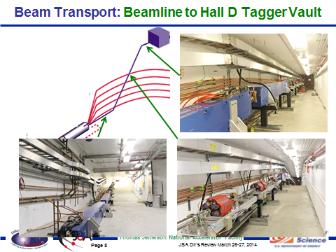
Accelerator Equipment

Slide 25
Facility for Rare Isotope Beams
FRIB Site March 2014
FRIB will provide world-leading capabilities for research on:
  Nuclear Structure
  Nuclear Astrophysics
  Fundamental Symmetries
  This research will provide the basis for a model of nuclei and how they interact.
FRIB Linear Accelerator
Based on a 200 MeV/u, 400 kW super conducting accelerator
Timeline:
8 June 2009 – DOE-SC and MSU sign Cooperative Agreement
September 2010 – CD-1 approved, DOE issues NEPA FONSI (Finding of No Significant Impact)
August 2013 – CD-2 approved (baseline), CD-3a approved (start civil construction)
October 2014 – Start technical construction
December 2020 – early completion goal
June 2022 – CD-4 (project completion)

Slide 26
FRIB
  The Total Project Cost for FRIB is $730M, of which $635.5M will be provided by DOE and $94.5M will be provided by MSU.
  The project will be completed by June 30, 2022.
Start of civil construction was authorized January 22, 2014.
Excavation activities began late February 2014.
ESH&Q ready to proceed, no ESH issues to report
Ground breaking ceremony was held on March 17, 2014.
October 2014 – Start technical construction
June 2022 – CD-4 (project completion)
TPC $000s | PYs | FY13 | FY14 | FY15 | FY16 | FY17 | FY18 | FY19 | FY20 | FY21 | TOTAL
FRIB | 51,000 | 22,000 | 55,000 | 90,000 | 100,000 | 100,000 | 97,200 | 75,000 | 40,000 | 5,300 | 635,500

