Slide 1
Controlling Fugitive Emissions at DOE: SF₆ Management and Sustainability
Bill Fortune
Office of Sustainability Support (AU-21)
Office of Environment, Health, Safety and Security

Slide 2
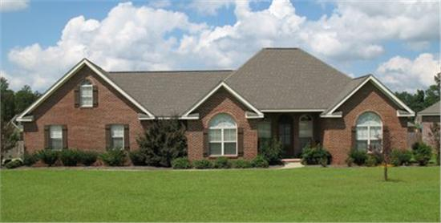
High Impact Gases
Greenhouse Gas | Global Warming Potential (GWP)
Sulfur Hexaflouride (SF₆) | 22,800
Hydroflourocarbons (HFC) | 12 – 11,700
Perflourocarbons (PFC) | 0 – 17,340
1 unit of CO₂
1 unit of SF₆

Slide 3
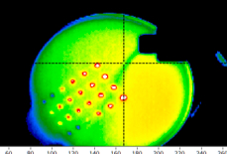
Emissions Reduction Implementation Plan
Establish Fugitive Emissions Working Group
Reduce releases from maintenance and operations actions
Stop intentional/avoidable venting
Strengthen leak detection and repair programs
Integrate into preventive maintenance
Conduct opportunity assessments
May require system modification
Evaluate environmentally preferable alternatives
FLIR A20 / Small SF₆ leak from valve

Slide 4
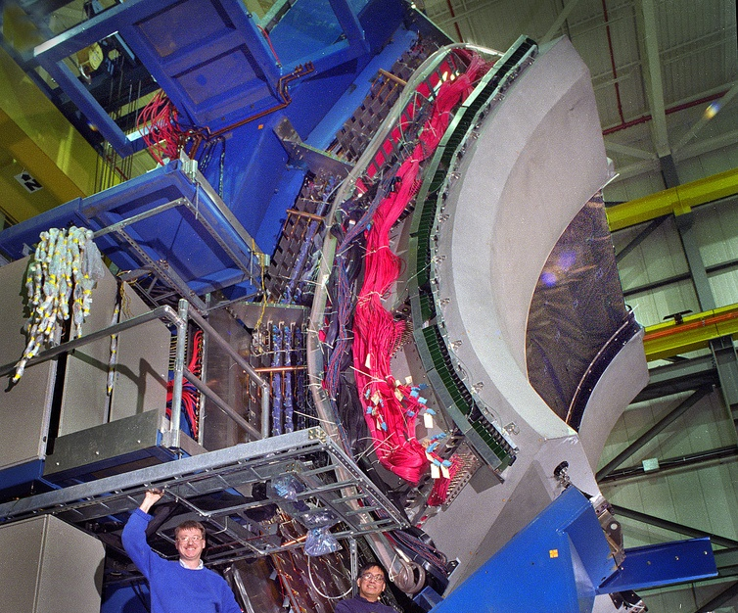
Maintenance and Operations
DOE uses flourinated (F-) gases in experimental systems
Opportunities to ensure the recirculation/ recapture of F-gases
Closed-loop systems
Gas recovery carts
(Ring Imaging Cherenkov Detector at BNL courtesy of BNL)

Slide 5
Recirculation and Recapture
SF₆ release risks every time the gas is handled:
During transfers between operations and storage.
While in storage (slow and continuous or sudden release).
During gas recovery operations.

Slide 6
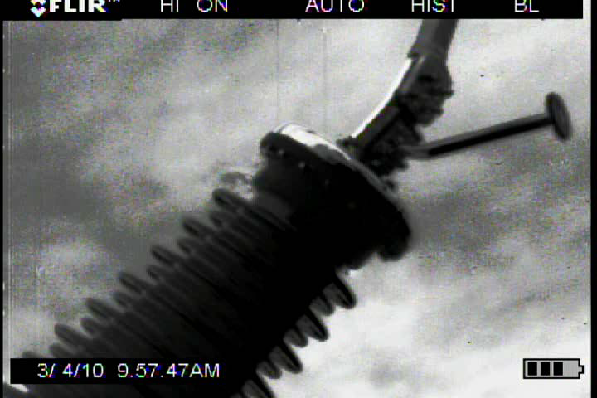
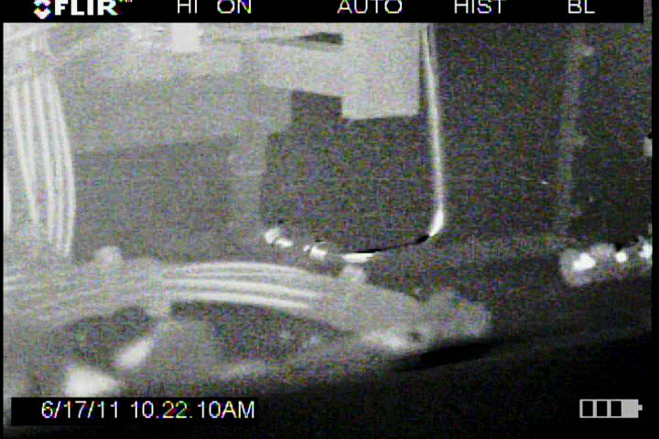
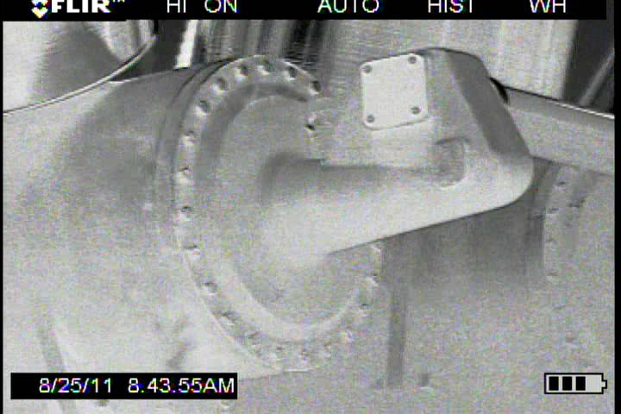
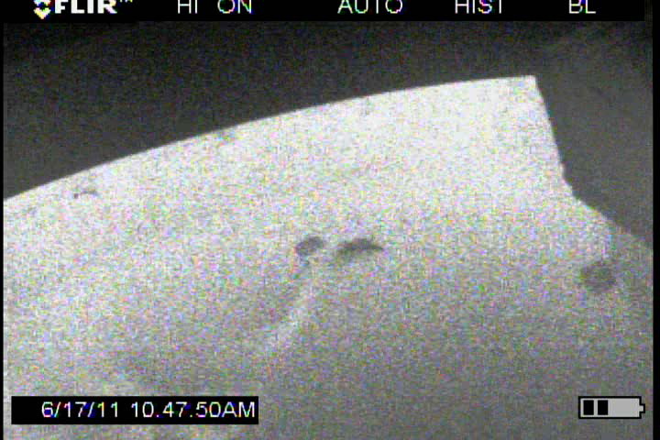
Leak Detection and Repair
Corrosive Flange
Leaky Piping
Defective O-ring
Porous Casting
Photos courtesy of Bonneville Power Administration

Slide 7
Storage Tank Releases
Slow and continuous leaks are similar to transfer leaks:
Tank seals or pressure release valves may be old or ill-fitting.
Relatively easy to identify with gas-sniffing equipment or infra-red cameras.
Sudden releases:
Hard to predict.
Often built into storage tank as safety mechanism.

Slide 8
Sudden Storage Tank Release: Example
Site had new distributed SF₆ storage system.
During extreme hot weather, pressure built up in most exposed tank and burst disk ruptured.
Released entire contents of one tank, ~1,940 pounds.

Slide 9
SF₆ Recovery Release: Example
Lab wanted to recover SF₆ from decommissioned accelerator.
Recovery was unsuccessful:
Last analysis of gas composition was over 2 years old
Analytical Lab incorrectly presented analysis results
During the subsequent 2 years, additional SF₆ was lost during transfer and from tank leakage, changing the gas composition
Gas recovery subcontractor workplan was based on inaccurate assumptions.
Approximately 1,600 pounds of SF₆ accidentally released to the atmosphere.

Slide 10
SF₆ Recovery Release: Lessons Learned
Primary risk of loss due to use of inappropriate equipment or process
As a result of incorrect gas characterization information.
Need to know:
Purity of SF₆.
Quantity of SF₆.
Equipment capabilities.

Slide 11
Potential SF₆ Alternatives
Regularly review market and operations to identify any appropriate SF₆ substitutes.
One company developed a fluorinated C-5 ketone and a fluorinated nitrile for use as SF₆ substitutes in switchgear.
Same company is interested in working with DOE to develop specialized SF₆ substitutes.

Slide 12
A word about HFCs
Several DOE labs use large quantities of HFCs in accelerators
These also have a high GWP and should be managed to minimize release
The President’s Climate Action Plan (June 2013) targets HFC emissions reduction
The Federal sector is asked to lead by example in minimizing HFC use and emissions
“Phase-down” of HFC use is expected

Slide 13
Conclusions
Identify vulnerabilities in managing F-gases:
Loss during transfer and recovery activities.
Reduce controllable releases:
Strengthen leak detection and repair.
Assess systems for potential sudden release issues/scenarios.
Provide current and accurate gas characterization information to all involved parties.

Slide 14
Contact Information
Bill Fortune
Office of Sustainability Support (AU-21)
Environment, Health, Safety and Security
202-586-7302
William.Fortune@hq.doe.gov

