Slide 1
Fermilab Tevatron Status
John E. Anderson Jr.
2014 Accelerator Safety Workshop
7 August 2014

Slide 2
Tevatron Facts
Fermilab Tevatron
Once the most powerful particle accelerator in the United States and the second most powerful particle accelerator in the world
Used for 800 GeV fixed target and ~1 TeV proton-antiproton colliding beam experiments
Machine comprised of over 1,000 superconducting magnets
Tunnel is buried 25 feet belowground has a radius of 1,000 m circumference of 6,283 m or ~ 4 miles
Tunnel size is 10 feet wide and 8 feet high
Machine credited with the discovery of Top Quark in 1995

Slide 3
Tevatron Status
Tevatron is effectively mothballed
Machine has been made safe by
Removing cryogens
Removing connections to the six main power supplies
Removing all voltage from instrumentation sources
Magnets are in place being purged with dry air
Some equipment has been removed for new experiments or used as spares for other accelerator systems
A portion of the enclosure is used to support the 120 GeV Fixed Target Program
Utilities maintained as a low priority
Lighting, sump pumps, etc.
Although difficult, machine could be restarted

Slide 4
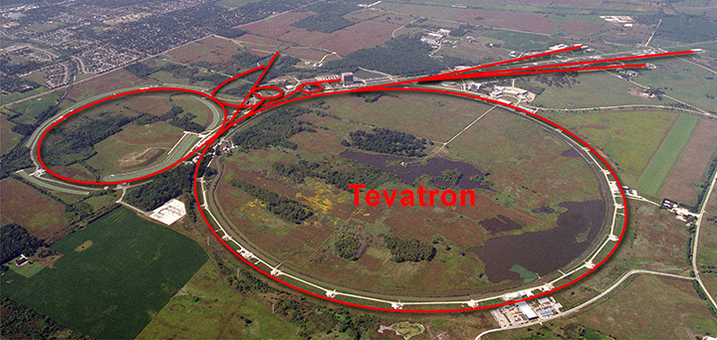
Fermilab Accelerator Facility

Slide 5
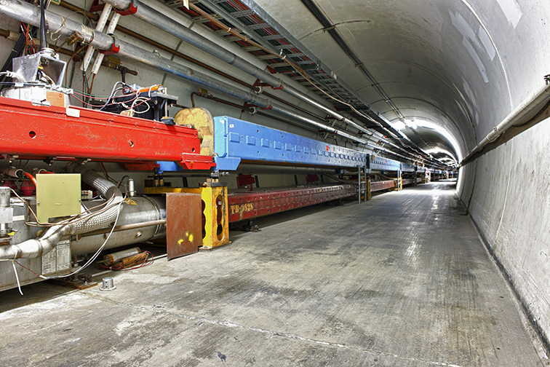
Tevatron Enclosure

Slide 6
Tevatron SAD and ASE
Tevatron covered under its existing SAD
Tevatron SAD scheduled for migration into new chapter format in FY15
Plan is to document current state of the machine
ASE was modified in April 2013 to remove the Administrative Credited Control for the Beam Intensity Limits
Tevatron is not authorized for any beam operations
Radiation Safety Interlock Systems still in place
Routine surveillance suspended until needed
ODH Monitoring systems decommissioned
Hardware has been left in place

Slide 7
Future Use
Numerous physics proposals for future experiments continue to be submitted to use portions of the enclosure including kaon decay, muon and e+e- research
Repurposing
C0 Collision and Assembly Hall being repurposed for radioactive target and horn repair and storage
Short term storage bays for hot components
Hot cell for repairs and disassembly of components
Long term storage area for items awaiting disposal
Repurposing process represents a significant opportunity for the accelerator community
Notes:
ORKA: Ultra-rare Kaon Decay Experiment
nuSTORM: Neutrinos from Stored Muons “Sterile Neutrinos”
Higgs Factory: e+e- collider

