Slide 1
Oak Ridge Electron Linear Accelerator (ORELA) Clean Out, Stabilization, and Deactivation Project
Accelerator Safety Workshop
August 7, 2014

Slide 2
ORELA History/Background
ORELA was constructed from 1966-69 and is housed in Building 6010.
The primary purpose was reactor R&D, with only limited nuclear physics activities.
However, ORELA has been a versatile asset throughout its 40+ year history, funded by, and associated with, multiple divisions and programs.
The last operation/experiments were conducted in September 2008 and the facility is in operational standby.

Slide 3
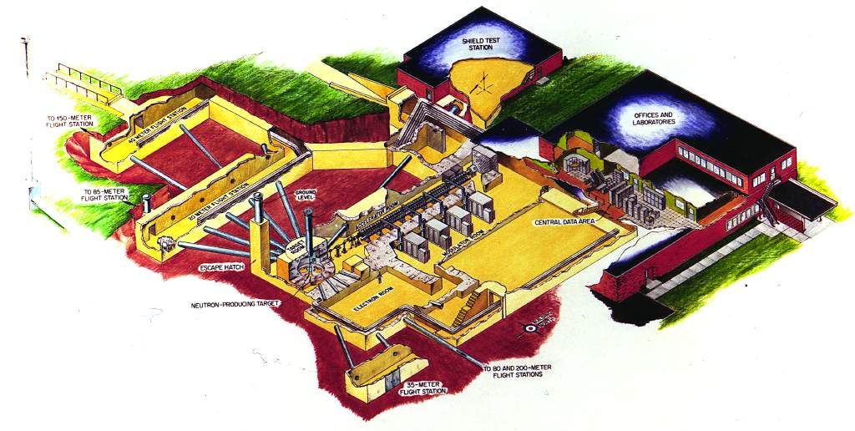
ORELA Consisted of:
A 180-MeV, 20 amp, 60 kW maximum electron accelerator with 1cm dia beam,
Neutron producing targets,
Eleven flight paths up to 200 m long the led to 18 underground detector locations in “flight stations”
A wide variety of sophisticated detectors, and
Data acquisition and analysis systems.

Slide 4
Overall ORELA COSD Project Objectives
Complete actions required to address imminent ES&H issues.
Complete actions to support transfer of the facility from Physics Division to Facilities and Operations Directorate for S&M.
Place the Facility 6010 in a safe and stable condition for continued S&M until transfer to EM.
Complete actions to support transfer of the facility from ORNL to EM for D&D.

Slide 5
Clean Out and Stabilization Activities Include:
Clean out and disposition of excess materials and equipment, including accountable materials, lead shielding, and PCB oils.
Disposition of waste materials.
Deactivation of utility systems to the extent practicable under the revised facility safety requirements.
Development and implementation of a surveillance and maintenance plan to be executed until final transfer of the facility to EM for D&D.

Slide 6
FY 14 Focus of Actions
Address Imminent ES&H Hazards
Electrical Safety/Flooding Issues in the 150 Meter Flight Station (MFS) and 85 MFS
Fire Safety Issues
Characterize/Identify Hazards and Clean Out Remote Flight Stations
Develop COSD Plan for ORELA to Meet DOE Orders
Refine cost estimates for out-year large scale actions
Assess utility separation requirements

Slide 7
Legacy Issues Impacting COSD
Lead
Beryllium
Radioactivity
PCBs
Utility and infrastructure issues

Slide 8
Facility Status
Safety documentation is not fully compliant with DOE O 420.2C requirements but is approved for “non-operational status”
Determining inventory in facility with objective of downgrading to a radiological facility
Homes for the accountable materials inventory have been identified and materials will be transferred by 9/30/14.

Slide 9
Planned Out-year Actions
Complete characterization and clean out of the Basement Area
Modulator Room
Electron Room
20 MFS
40 MFS
165º FS
Inventory Room
Accelerator Room
Complete utility re-routes

