Slide 1
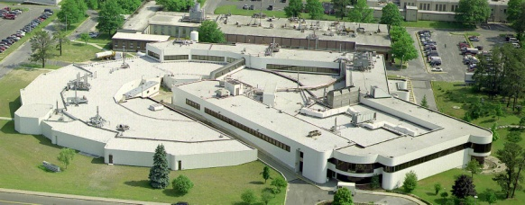
NSLS Stabilization and Transition
Les Hill
Accelerator Safety Workshop
August 2014

Slide 2
Background
The National Synchrotron Light Source (NSLS) is a major national user facility devoted to the production and utilization of synchrotron radiation
Operations commenced in 1982
NSLS-II startup is well underway
ARR for routine operations recently completed
Readiness assurance reviews for first wave of beamlines in progress
NSLS will continue to operate through the end of this fiscal year
With the startup of NSLS-II, NSLS will cease operation at that time

Slide 3
Facility Overview
Accelerator complex consists of two electron storage rings and associated injection system
X-ray ring operates at an energy of 2.8 GeV
UV ring operates at 800 MeV
Extensive user program built around NSLS beamlines; 48 and 11 beamlines on the X-ray and UV rings, respectively
Accelerators and beamlines are housed in sole purpose facility (Building 725)
Building 725 also houses research and support equipment/functions
Laboratory space
Control Room
Electrical and mechanical equipment
Office space
Other…..

Slide 4
Path Forward
Comprehensive plan for guiding NSLS from “operating phase” through facility re-purposing
Formal hand-offs of facility stewardship
Clear lines of accountability for safety and execution
NSLS ceases operation on September 30 @ 4:00
BSA stabilization and transition plan
Stabilization to be completed with facility turnover to BNL “vacant facility pool” by 3/31/15
Complete transition activities including the removal of hazardous and radioactive materials by the end of FY16
Facility turnover for re-purposing in FY16, possibly sooner under a phased approach

Slide 5
Stabilization Overview
Safe shut-down of accelerators, beamlines and support systems
Removal of excess materials, systems and equipment, etc. for potential reuse
Removal of chemicals, cylinders, laboratory and research equipment, etc.
Isolation of electric power distribution and other systems not needed for follow-on transition activities
Controlled, orderly transfer of NSLS to vacant facility pool including appropriate revisions to facility safety requirements

Slide 6
Transition and Hazard Removal
Characterize facility to identify hazardous materials/conditions and residual contamination resulting from NSLS operation
Perform hazard analyses and detailed work planning
Remove hazardous materials
Remaining beamline and accelerator lead shielding, activated components and residual radioactive contamination (if any)
Components warranting special control (e.g. DU shutters and Be windows)
Evaluation or cleanup of loose lead contamination

Slide 7
Transition and Hazard Removal
Address other hazardous materials/conditions found during characterization
Disposition of removed materials/waste
Determine/document as-left conditions
Validation to ensure that transition end-state objectives have been achieved

Slide 8
Use of NSLS Operating Experience
NSLS staff and SMEs extensively involved in earlier D&D studies which have been used in preliminary transition planning
Needed facility characterization efforts will rely on extensive engagement of PS operations and support staff
Transfer of operating/process history and facility data and information
Facility walk-throughs
Transfer of ESH and radiological data and information
Direct use of former or current PS staff (e.g. activation analyses)

Slide 9
Use of NSLS Operating Experience
Collaboration of Transition and Stabilization teams throughout all phases of the work
Prompt completion of Transition work optimizes the availability of NSLS operations, support staff, SMEs, etc. that possess relevant operating experience and facility knowledge
Transition Project Manager has worked as a member of PS’ team for the last two years….knows who to call

Slide 10
Project Uncertainties/Risks
Starting point
As-left state following Stabilization
Characterization has yet to be performed
Confirmation of equipment activation
Evaluation against DOE policies and potential impacts to waste disposal assumptions
Extent/nature of survey requirements needed for equipment release
Location and extent of loose lead contamination and needed response actions, if any
Profile of available funds

Slide 11
Status
Stabilization
Fully funded
Almost all detailed planning is complete
Transition
Conceptual cost estimate and schedule in hand
Working with DOE on funding
Near term (FY14) actions
Project mobilization
Acquire subcontracted resources need for facility characterization
Benchmark complex experience with the analysis/disposition equipment from electron accelerators
Launch NSLS activation analysis needed for Technical Basis Document

