Slide 1
Lessons Learned:
JPARC & BNL Target Incidents
Accelerator Safety Workshop, Germantown, 5-7 Aug 2014
Philip Pile.
Collider-Accelerator Department

Slide 2
Outline
The Incident – May 2013
  JPARC, Gold Kaon Production Target
  Related target incident – March 1995
    BNL, B5 Platinum Kaon Production Target
Lessons Learned
  Common Ground
  Going forward

Slide 3
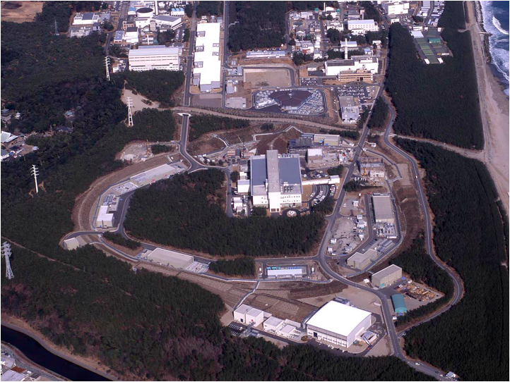








LINAC
181 → 400 MeV
J-PARC Facility
(KEK / JAEA)
Rapid Cycle
Synchrotron
Energy: 3 GeV
Repetition: 25 Hz
Design Power: 1 MW
Main Ring
Synchrotron
Maximum Energy: 30 GeV
Design Power (Fast X): 0.75 MW
Expected Power (Slow X): 0.1 MW

Slide 4
(Thanks to Shin'ya Sawada for some slides and updates)
The JPARC Target Incident

Slide 5
Significant Background Event in Japan
….11 March 2011
Tohoku earthquake triggered a tsunami resulting in Fukushima Daiichi nuclear disaster
  catastrophic failure at the Fukushima I Nuclear Power Plant on 11 March 2011, resulting in a meltdown of three of the plant's six nuclear reactors
  The Fukushima Nuclear Accident Independent Investigation Commission found the nuclear disaster was "manmade" and that its direct causes were all foreseeable.
Public became highly critical of government
and everything associated with nuclear power/radiation

Slide 6
Two Years Later at the JPARC facility
(~ 1 year after JPARC recovery from the March 2011 earthquake damage)
At around 11:55 on May 23, 2013 the power supply system of a special magnet in the 50 GeV Synchrotron malfunctioned.
→ 2x10¹³ protons were extracted in a very short period of 5 milliseconds, while in normal operation 3x10¹³ protons should have been slowly extracted over 2 seconds.
Abnormal beam
250 times of peak intensity
Normal beam
Malfunction
Number of protons
2 second
Number of protons
1/200 of a second
Time
Time

Slide 7
Japan Times Article, 27 May 2013 (first 3 paragraphs)
(4 days after the target incident) http://www.japantimes.co.jp/news/2013/05/27/national/j-parc-leak-signals-poor-sense-of-crisis/#.U9qNOrHN3ps
J-PARC leak signals poor sense of crisis
The release of radioactive material from a Japan Atomic Energy Agency facility in Tokai, Ibaraki Prefecture, last week suggests scientists still lack a sense of crisis and urgency about radiation dangers despite the 2011 Fukushima disaster.
At least 30 researchers at the Hadron Experimental Facility of the Japan Proton Accelerator Research Complex (J-PARC) sustained internal radiation exposure in Thursday’s accident.
An alarm went off at 11:55 a.m. Thursday in a radiation-controlled part of the Hadron facility when an experiment to generate elementary particles by aiming a proton beam at a target made of gold went haywire. After halting the experiment for the alarm, a researcher in charge decided there was no danger and restarted the equipment just 13 minutes later.

Slide 8
Some Details

Slide 9
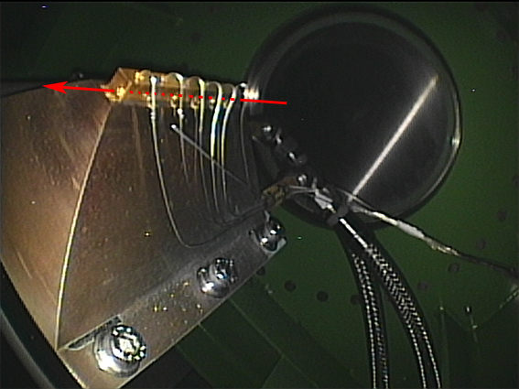
金標的のビーム下流方向に向かって左側の側面
The Target in question – located in air
Proton Beam
(σ_{x}=0.6mm, σ_{y}=0.6mm) 20TP/spill
in March 2013
Hole drilled by beam
Bits of gold

Slide 10
Chronological Sequence of Events
May 23, 2013
11:55 Delivery of proton beam from 50 GeV Synchrotron (MR) was halted by Machine Protection System (MPS).
12:08 MPS was reset following the regular resetting procedure after discussing with relevant people and delivery of
proton beam for users’ experiments was resumed.
13:30 Increase in radiation dose rate of an area monitor in the HD hall was acknowledged. The maximum value of
4 μSv/h is ten-fold of the normal value.
15:15 Ventilation fans were turned on. Further decrease in ambient dose rate was acknowledged.
17:00 Radiation survey of the HD hall found areas with high dose rate were localized.
17:30 Ventilation fans were turned on to reduce airborne radiation dose rate in the HD hall.
23:30 Completed evacuation and full-body radiation surveys of all workers in the radiation controlled area. Access to
the HD Facility was restricted.
May 24, 2013
10:00 Members on the right held a meeting to discuss the situation. It was not considered this incident to be one for escalated reporting.
17:30 J-PARC Center received inquiry from Nuclear Fuel Engineering Laboratories (off the JPARC Site) concerning increased radiation levels recorded by their monitoring posts
18:00 Data logs of gamma-ray area monitors on the boundaries of the controlled area of the HD Facility were
examined. Found increased radiation levels at around15:00 and 17:30 on May 23. Found that the increased
dose rates coincide with the operations of ventilation fans in the HD hall.
21:10 Reported to an emergency post of the Nuclear Science Research Institute. Response headquarters was
established.
22:40 As required by law, the first report to Nuclear Regulation Authority was transmitted by facsimile transmission.
22:40 As required under the terms of relevant agreements, the first report was faxed to Ibaraki Prefecture, Tokai
Village and other authorities.
May 25, 2013
01:00 Found out that the maximum total exposure dose of the workers in the HD hall was 1.7 mSv.

Slide 11
Short list of major mistakes
Release of radioactive material to the outside of the radiation controlled area and to the environment outside of the Hadron experimental hall.
Delays in reporting to the relevant authorities, the local communities and the media
Internal radiation exposure on workers who inhaled contaminated air in the HD hall
Failure in timely disclosure of information

Slide 12
Fallout from the incident
Put priority to safety over research activities
Develop culture among staff and users to respect safety over experiments
JPARC Organizational Changes
  New position of Deputy Director for Safety
Safety Management System is revised
  New manuals, procedures are established
Local Government Review
  On-site inspection and Committee meeting
Review of Hadron Hall Renovation Design
  October 8-9, 2013 (I helped with this review)
  Follow-up in January, 2014
  Basic strategy endorsed by the committee was to prevent contamination spread by hermetically sealing and monitoring target chamber, sealing beam line enclosures with double-airtight layers with monitoring and implement beam monitoring and control to shutdown abnormal beam.
International Advisory Committee, 11-12 March 2014
  Some concern about continued use of gold target
  Understood approach to seat target chamber and beam line shielded areas
  Recommended a reevaluation of slow extraction program and communicate to users realistic expectations
Report to Ministry of Education, Culture, Sports, Science and Technology (MEXT), review by External Expert Panel
Report to Governor of Ibaraki Prefecture
Meetings with local residents to explain JPARC’s efforts to improve safety

Slide 13
Resumption of operations
User operation of Materials and Life Science Experimental Facility (MLF) resumed on February 21, 2014, 9 months after the incident, already had robust target protection systems in place, i.e. victim
Neutrino facility ready for resumption in May 2014, 1 year after the incident, already had robust target protection systems in place, i.e. another victim
Hadron Slow Extracted Beams, restart to be determined, 15 months and counting

Slide 14
What’s left to do to restart slow extraction to the JPARC hadron hall
Complete renovations to the experimental hall
Get approval from the local governments
Get approval from the Japan Nuclear Regulation Agency

Slide 15
Blast from the past
AGS B5 Target Failure, March 1995

Slide 16
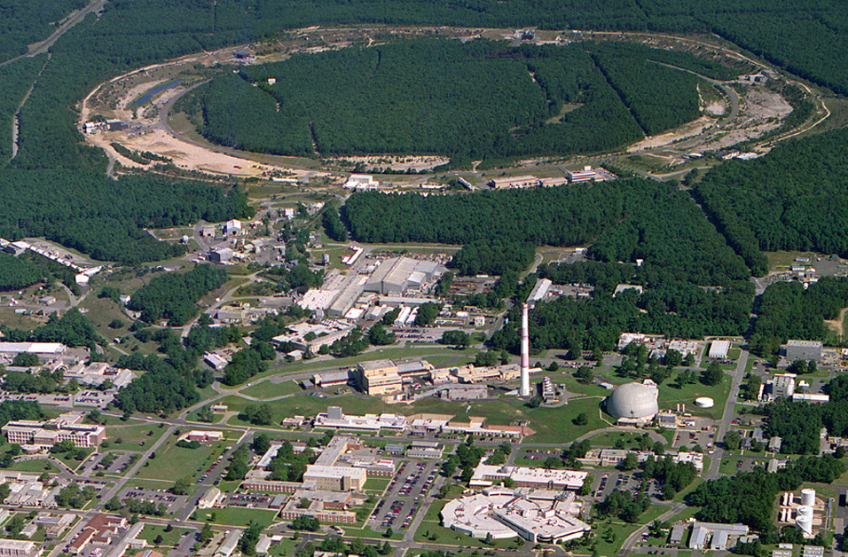
C-AD Accelerator Facilities, today
eLens
10:00 o’clock
LEeC/CeC
2:00 o’clock
Jet Target
12:00 o’clock
RHIC
PHENIX
8:00 o’clock
STAR
6:00 o’clock
RF
4:00 o’clock
LINAC/EBIS
NSRL
Booster
ERL
BLIP
AGS
AGS Fixed Target Experiments
(1960-2002)
RRPL
ATF
Tandems

Slide 17
The AGS target incident – March 1995
The Experiment – E871, Molzon, Ritchie, Wojcicki, Kane, K_{L}⁰→ μe, One of 8 experiments running at the time
The Target: 12.8 cm long platinum brazed to a beryllium water cooled base
The incident – abbreviated chronology
  The target failed on 17 March 1995 due to excessive beam, lost target segments, AGS beam to this beam line was turned off, all other beam lines (A,C and D) continued to run
  New target installed and beam back on 24 March
  Contamination found 27 March outside beam cave in the Test Beam Users area and in logbooks that were in use at the time of the incident
  Investigation into cause and recommendations for improvement commenced with all AGS beams still operational

Slide 18
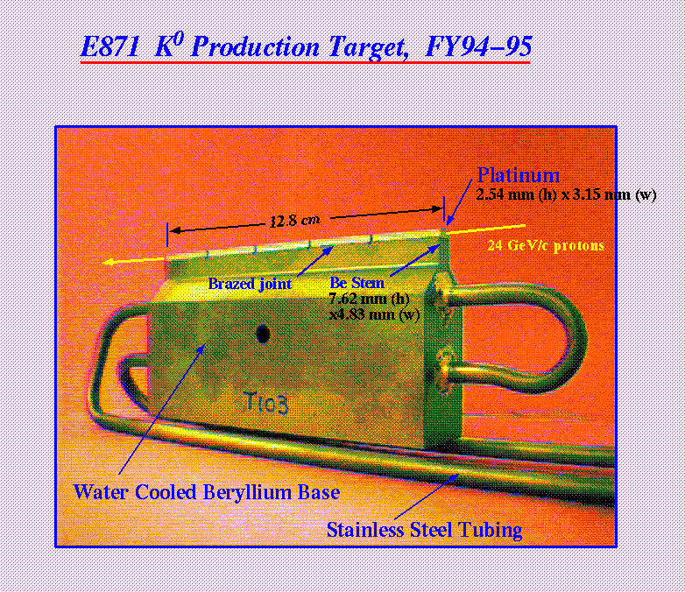
Lost these two segments

Slide 19
Cause of failure
Beam and target conditions
  No interlocks to prevent target overtemp
  Beam intensity and target temperature were administratively monitored by the experiment with nominal limit of ~1.5E13 protons per 3.6 sec spill (~1.6 sec flat top beam), no interlocks
  No provisions to detect or abort a “short” spill from the AGS
  Target in air
  Beam cave not air tight with wire mesh gate entrance
Probable Cause of failed target
  Excessive beam heating causing:
    Brazing alloy to melt and flow out of the joint between the platinum target and the beryllium base, lost first two platinum target segments
    Cracks in the water cooled beryllium base
    Contamination to spread outside the beam cave into Test Beam experimenters area

Slide 20
Contamination issues/recommendations
Contamination issues:
  Target cave clean-up cost 2 man-Rem
  Contamination spread outside cave into the B target Test Beam area used by experimenters
Some of the recommendations from investigation committee
  Plan for another failure (fortunately did not happen)
  Station “pig” in target area to contain target/target parts that fail - Done
  Place catch bucket below targets - Done
  Routine smears should be taken and analyzed with each access to target area.- Done
  Target area should be better enclosed with air recirculated and monitored through a filter, consider enclosing the target – Action: targets remained in open air, wire mesh entry gates were covered to inhibit spread of contamination

Slide 21
Recommendations (cont’)
Target Design
  More segments to reduce stress
    Action: increased segmentation from 5 to 15
  Consider gold rather than platinum, better heat conduction
    Unable to find way to bond Au to Be base and inconclusive engineering studies as to performance improvement of Au over Pt
  Cut deeper slots in the beryllium base to reduce stress - Done
  Look for alternate bonding materials of target to base – None found
Target Monitoring
  Place multiple thermocouples on target segments to monitor temperature and shut off beam on over temp -Done
  Active monitor on primary beam with interlock – Done, but not until 1997, C10 SEC instrumented to trip beam within 30 msec if delivered beam >150TP/sec (~X10 normal rate)

Slide 22
Postscript
Had this AGS target incident happened today the consequences would likely be closer to the script following the JPARC target incident last year….especially given the fact that the discovery of the decade old BNL HFBR tritium leak came in 1997, 2 years after our target incident, and with this came a heightened community and governmental agency awareness of radiological issues.

Slide 23
Lessons Learned
The AGS target failure and the JPARC target failure have much common ground. A big difference comes with the sensitivity of governmental officials and the public to accidental release of radiation into uncontrolled areas in 1995 vs 2013. The AGS machine keep running while a new target was prepared, with causal analysis and remediation coming along after. The JPARC facility was shut down and is still not fully operational… Times have indeed changed.
Accidents at accelerator facilities should be widely publicized to the world-wide accelerator community. If this had been done following the AGS target failure in 1995 it is possible that the JPARC target failure would never have happened

Slide 24
JPARC Supplemental

Slide 25
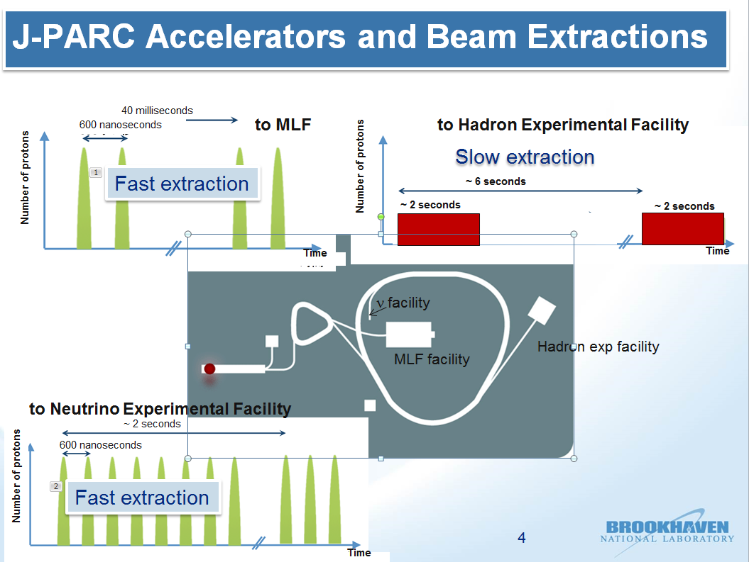

Slide 26
Japan Times Article (cont’ from slide 6)
“The safety device went off correctly and there wasn’t a malfunction,” the senior researcher was quoted as saying later.
Soon after, radiation readings in the facility spiked alarmingly to 4 micro Sieverts per hour — 10 times normal — and officials shut down the equipment. They then ventilated the facility and the internal readings dropped.
But despite the fact that the fan had no radiation filters, it wasn’t until late Friday afternoon that they checked radiation levels outside the facility. “It was not an appropriate move,” a J-PARC official conceded.
The 1½ days it took the JAEA to report the accident to the Nuclear Regulation Authority, at 10:15 p.m. Friday night, angered both the prefectural and central governments.

Slide 27
Japan Times Article (cont’)
“The prefecture is taking the incident seriously. People living nearby are feeling very anxious about the external radiation leak and the internal exposure (of the researchers),” said Shuichi Matsumoto, an official at Ibaraki’s nuclear safety steps division who helped search J-PARC Saturday to probe the incident.
Mitsuhiko Tanaka, a science journalist, said researchers experienced in working with radioactive material generally view leaks of that level as “not a big deal” — a somewhat different perspective from the average citizen since the core meltdowns at the Fukushima No. 1 plant in March 2011.
But in the case of the J-PARC accident, Tanaka said the researchers, who were not used to handling radioactive substances, may have caused them to underestimate the severity of the situation.

Slide 28
Japan Times Article (cont’)
It is paramount to find out why they failed to assume that radiation probably leaked from the facility, Tanaka, a member of a Diet panel that probed the Fukushima disaster, said. “Either the researchers saw the need to take further measures but felt they couldn’t say anything out loud, or they simply thought that nothing more needed to be done,” he speculated.
Meanwhile, Hiroaki Koide, an associate professor at Kyoto University’s Research Reactor Institute, criticized the carelessness of the atomic energy agency. “It was a result of designing the facility under the assumption that an accident would never happen,” he said.
A senior official at the education ministry, which oversees J-PARC, was also highly critical. “I can’t believe they failed to report the incident (immediately) when the public is so sensitive to such matters. I’m not sure if they could handle a bigger accident on their own.”

Slide 29
Japan Times Article (cont’)
Education minister Hakubun Shimomura is also concerned. “They lacked a sense of urgency and crisis when the public is harboring strong feelings of distrust toward nuclear power,” he said.

Slide 30
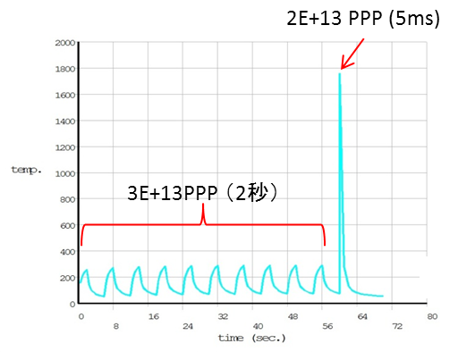
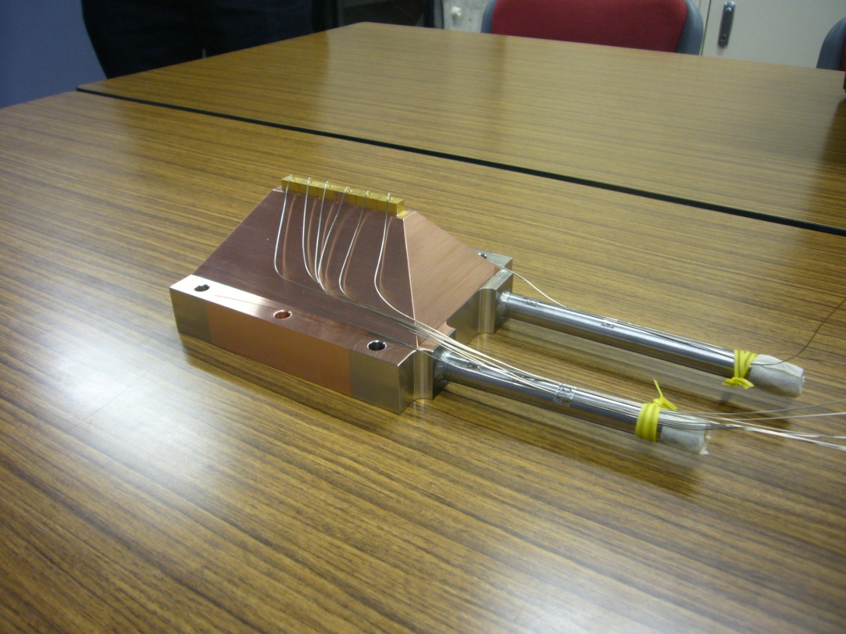
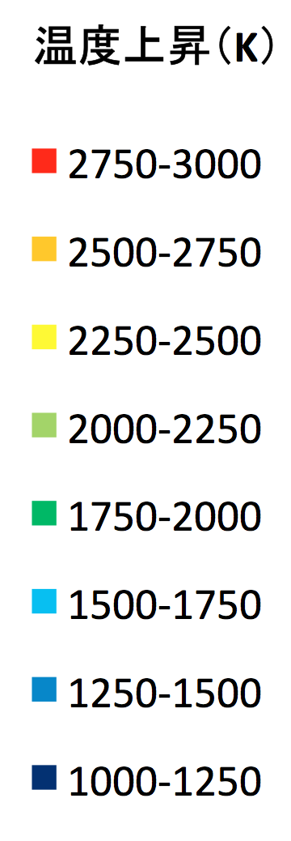
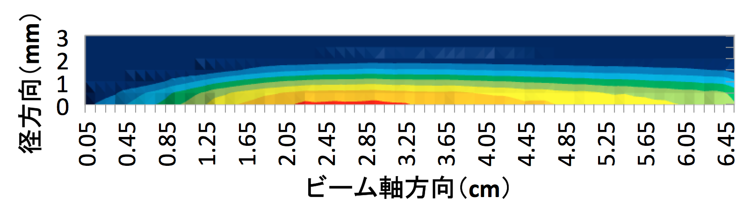
Target Temperature （Simulation Results）
2x10¹³ protons/pulse
(5 milliseconds)
temperature
gold
Proton beam
thermocouples
( 2 seconds )
3x10¹³ protons/pulse (2 seconds)
copper base
Temperature rise ( K )
cooling water
Time
radial direction (mm)
beam axis direction (mm)

Slide 31
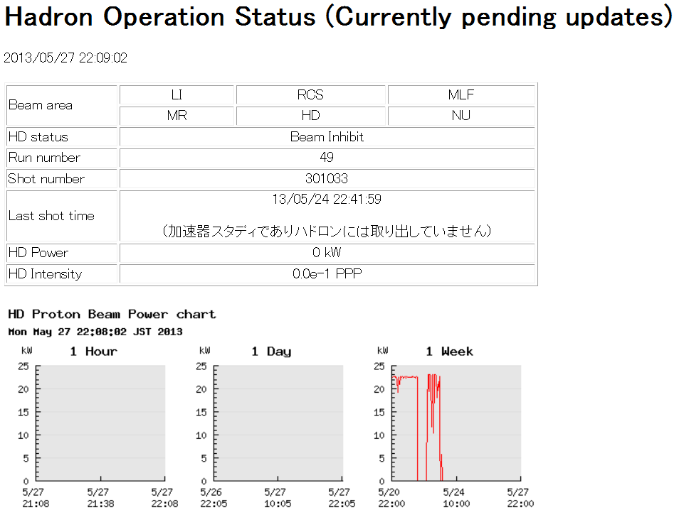
From JPARC Website, today
Last beam operations for the
hadron facility was on 23 May 2013

Slide 32
JPARC Trail to Renovation
Working to strengthen the airtightness of the primary beam line and to complete the renovation work by the end of this year – a big deal!
Planning to remove the failed target and install the new gold target around September. Power limit will be ~50kW (~60Tp/pulse @ 30 GeV with 6 sec rep rate and ~2 sec spill length with beam size σ_{x}=~2.5mm and σ_{y}=~1.0mm). This power limit is ~same as the failed target but with larger beam size. The new target will still fail with errant short pulse if the machine protection fails.
The design target is improved and upgraded from the previous one and enclosed in an airtight target chamber to prevent escape of radioactive contaminates in the event of a failed target. The design provides for two targets in the chamber with provision to select the other target in the event one should fail.
Beam controls added to interlock beam in the event of suspected errant beam

Slide 33
JPARC Radiation Exposure
Measurement on internal and external radiation exposure doses of all the persons who entered the radiation controlled area of the HD Facility after the accident:
Total number of personnel：102
Number of personnel with detectable dose：34
Note: All are registered radiation workers. Individual doses are in the range of 0.1−1.7 mSv.
Number of personnel with no detectable dose：66
The remaining two, who were from overseas, had their whole body counter measurements at home later, and have been found to have no detectable dose.

Slide 34
JPARC Effects on the Environment 1/2
Evaluations based on measurements:
Increases of the radiation dose rates at monitoring stations of Nuclear Fuel Cycle Engineering Laboratories
Nuclides and radioactivities found in the airborne sample from the HD hall
Direction and velocity of the winds at the time of release of radioactive material on May 23
Two kinds of calculation methods used in estimations:
Analytical method based on diffusion equations for radioactive material
The WSPEEDI−II code
nuclei | half life | radioactivities (Bq)
⁴³K | 22.3 hours | 64.0
²⁴Na | 15.0 hours | 63.5
^{199m}Hg | 42.6 min. | 61.0
¹⁹⁷Hg | 64.9 hours | 39.5
⁷⁶Kr | 14.8 hours | 32.4
¹³¹I | 8.02 days | 28.6
⁸²Br | 35.3 hours | 19.5
^{195m}Hg | 41.6 hours | 18.4
¹²³I | 13.3 hours | 17.2
⁹⁵Nb | 35.0 days | 9.10
total amount |  | 353
Radioactive material in the 500 ml airborne sample collected from the Hadron experimental hall.

Slide 35
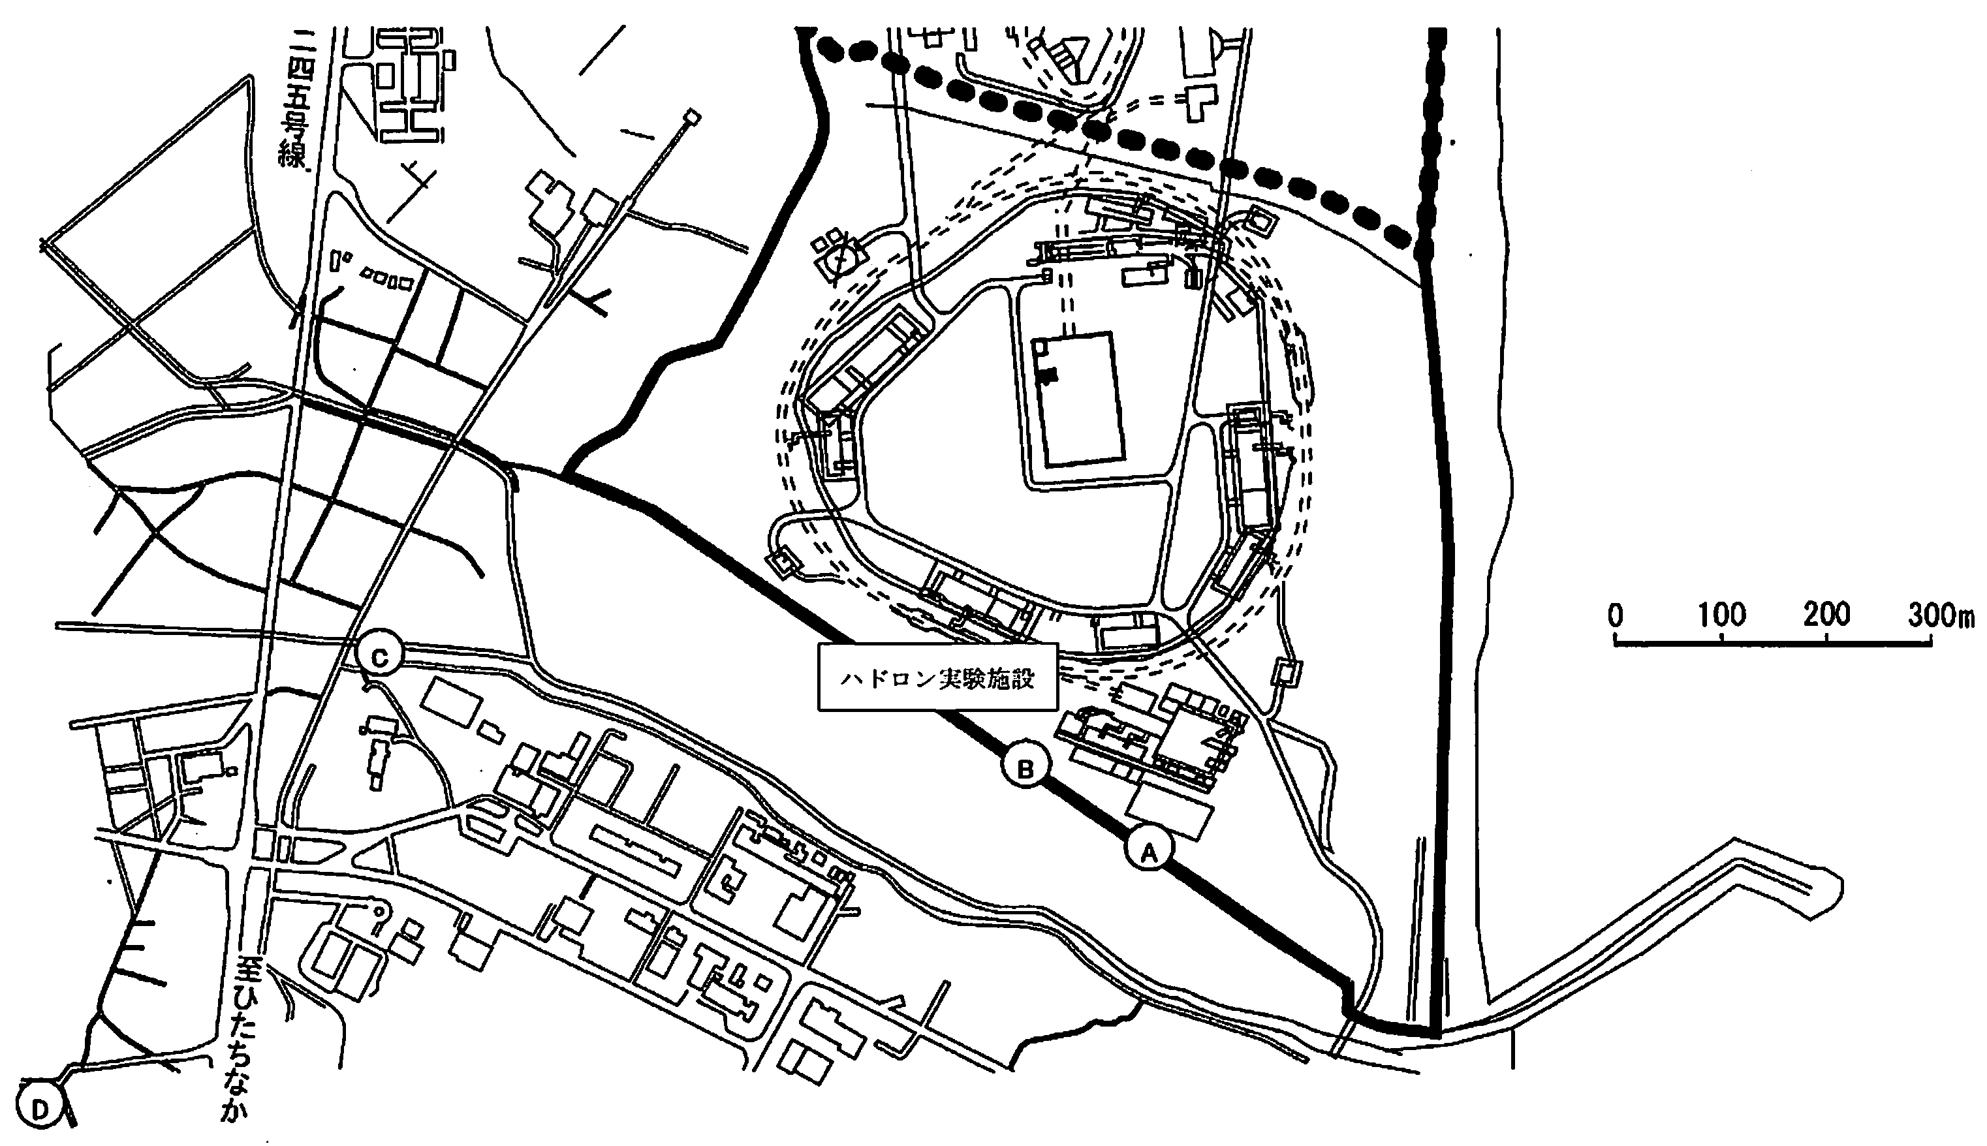
JPARC Effects on the Environment 2/2
The released radioactive material distributed within a narrow area of the west from the HD hall.
The maximum integrated radiation dose at the site boundary is estimated to be 0.17 μSv at a location close to the HD hall.
Examination of soil samples from four locations.
→ No radioactive material originating from the accident was detected at any of these locations.
Hadron Experimental Hall
The point shows the maximum value of radiation dose from the calculation results.
monitoring posts that observed momentary increases of radiation dose rate on May 23.
locations where soil samples were taken on May 26
Nuclear Fuel Cycle Engineering Laboratories

Slide 36
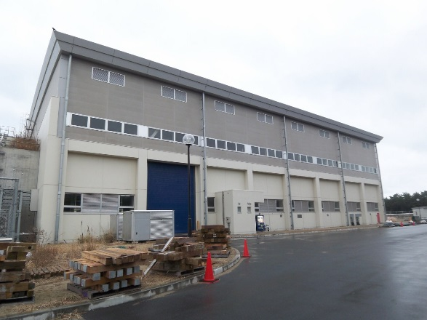
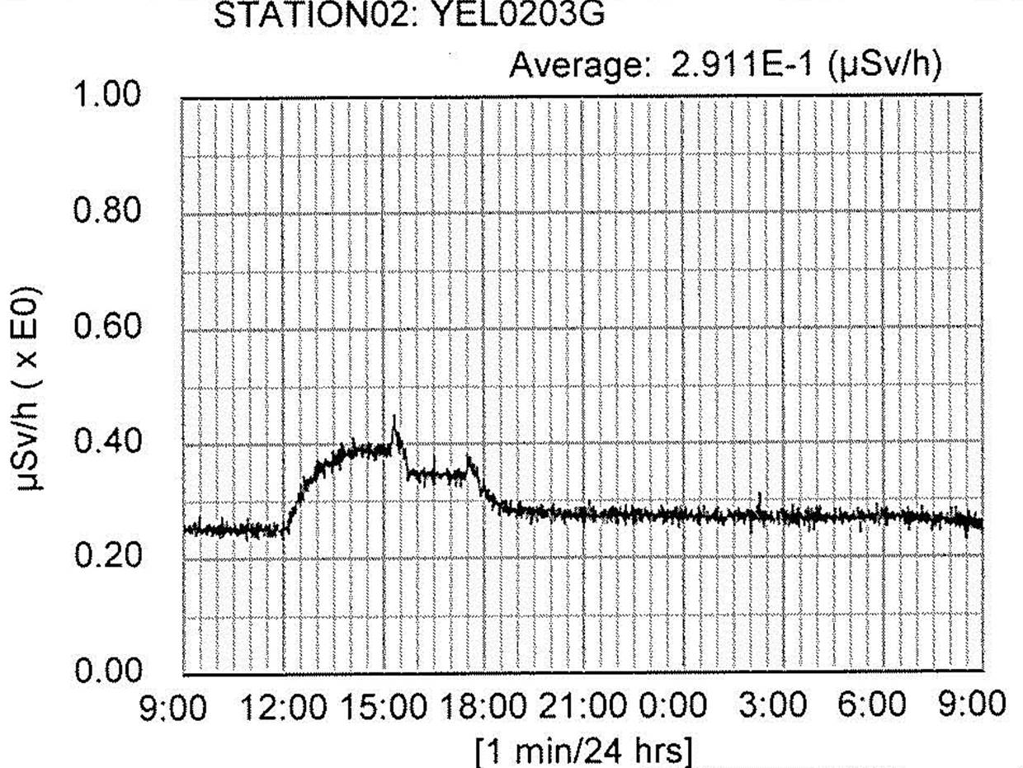
2. Main causes the radioactive material leakage
Stage 5: Leakage of radioactive material into
the environment outside the HD Facility
Radioactive material leaked out to the environment outside the building.
Delivery of proton beam was halted by MPS
Ventilation fans
Operation of ventilation fans
Operation of ventilation fans
Cause: The leakage is resulted from operations of
ventilation fans
Operation of ventilation fans
  1st instance: to confirm the soundness of area monitors in the HD hall
  2nd instance: to reduce radiation exposure to users
Since the radiation dose rate in the HD hall was below the legal limit, the environmental effect associated with operation of ventilation fans was considered negligible.
Lack of integration of information including data from radiation monitors in the hall and those at other facilities for adequate assessment of the situation.
Failure in making rational and logical judgment, leading to personnel’s radiation exposure and delays in reporting.

Slide 37
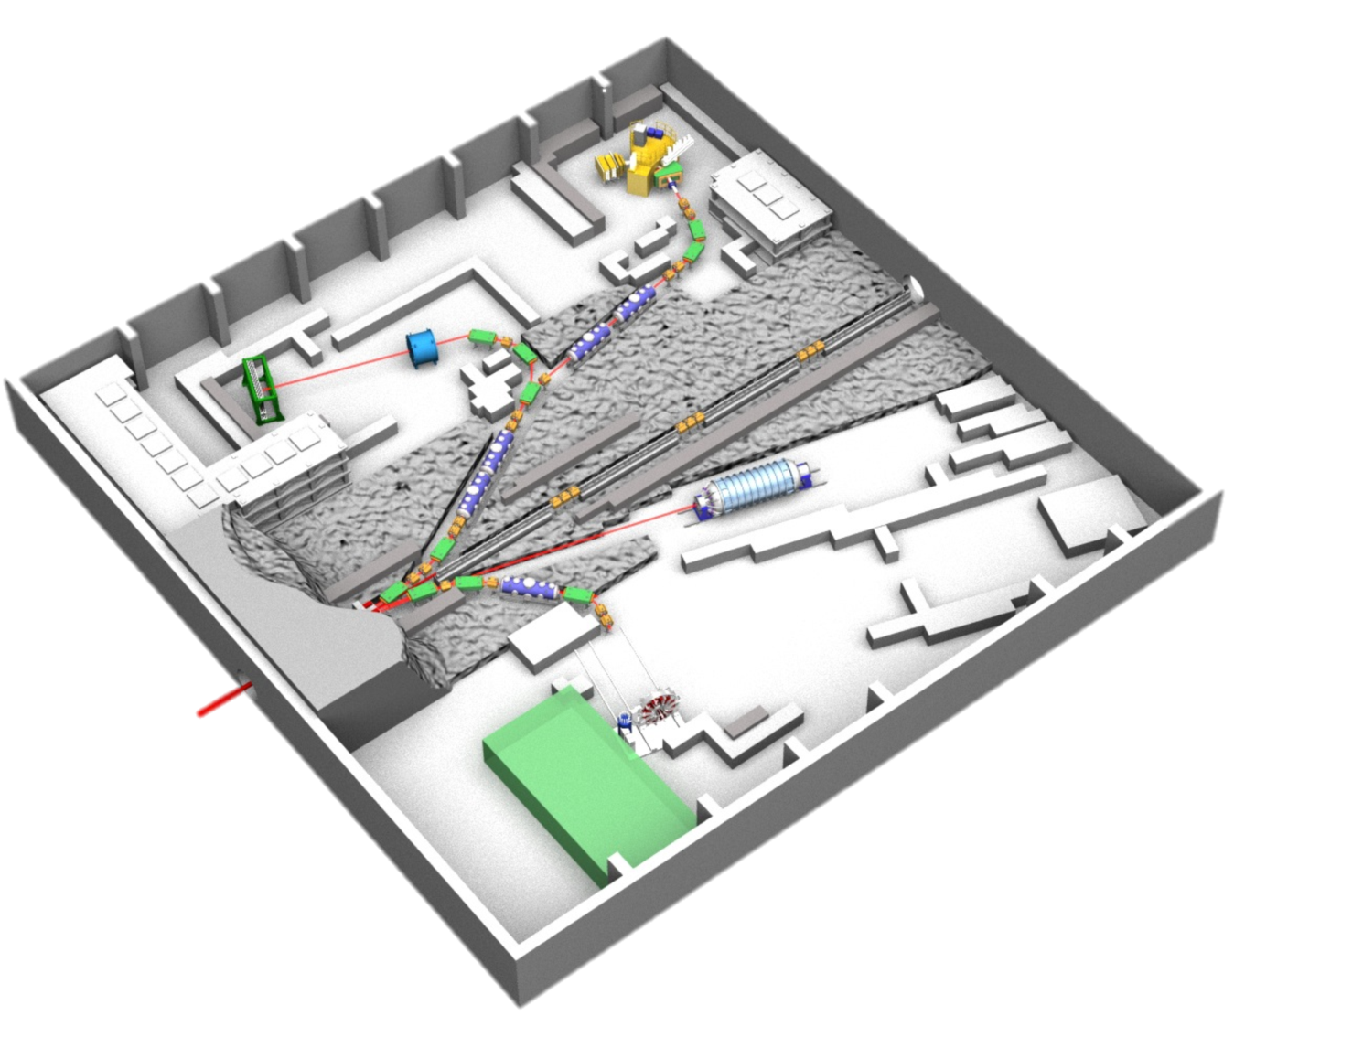
the Accident at HD Experimental Hall
11:55 on May 23
34 rad-workers had detectable dose
(0.1-1.7 mSv)
An abnormal proton beam was injected to the gold target.
The target heated up to a extraordinarily high temperature.
Radioactive material was released from the target.
The radioactive material was leaked into the HD hall.
→ Workers were exposed to radiation.
The radioactive material was released to the outside of the radiation controlled area and to the environment outside of the HD hall.
Proton beam
6.6 cm
Proton beam
gold target

Slide 38
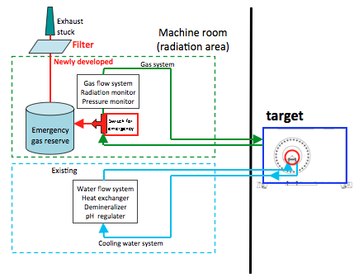
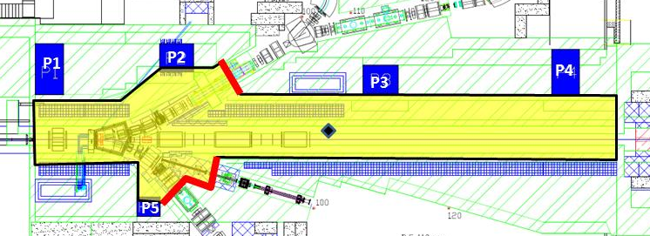
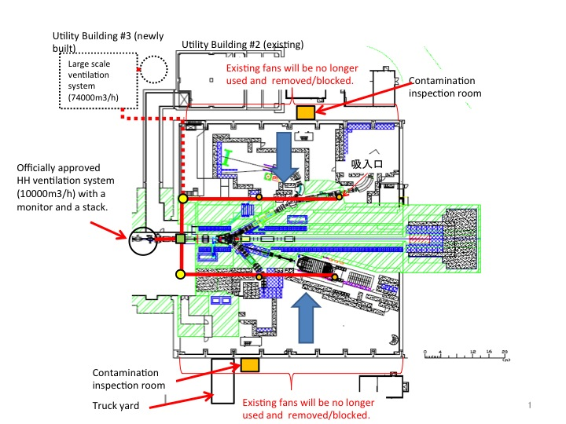
HEF safety improvements
improving air-tightness
Primary Beam Line
air-tight target chamber
Experimental Hall
Exhaust fans were removed and sealed.
The exhaust is filtered while watching it.
radiation
monitoring
inside the Hall

Slide 39
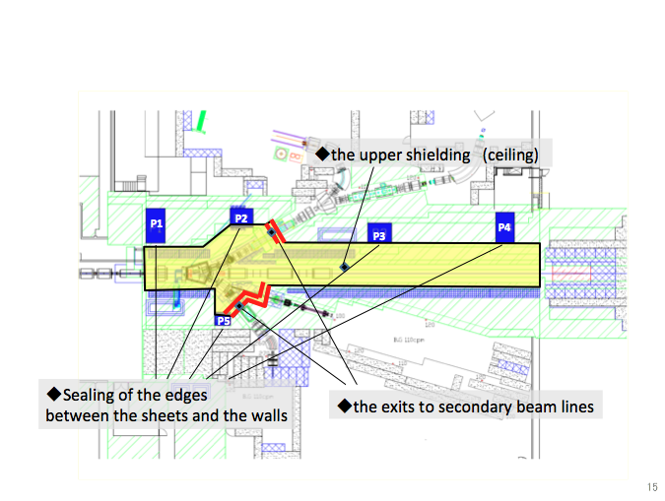
Primary beam line:
improving air-tightness
to be ready by autumn 2014

Slide 40
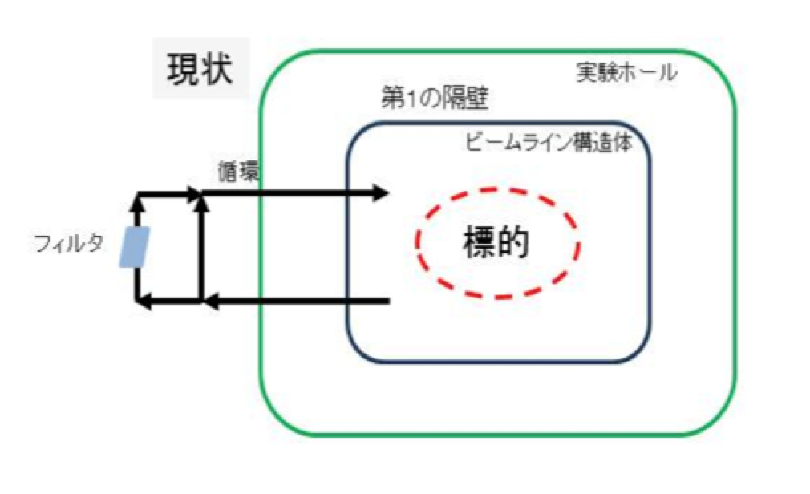
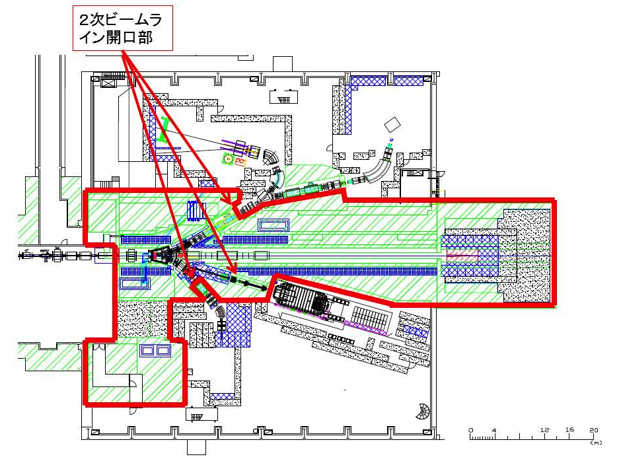
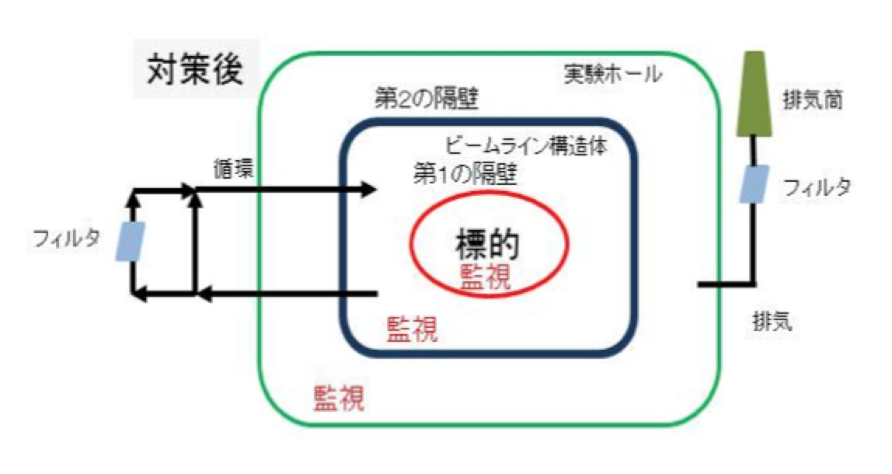
Hadron Experimental Hall
Present status
HD Hall
Aperture areas for secondary beam transport lines
First bulkhead
circulation
Primary beam area
Target
filter
Target
Ventilation
fans
Status after proposed revision
Exhaust stack
（案）
Experimental Hall
Second bulkhead
circulation
Primary beam area
First bulkhead
filter
filter
Target
monitoring
monitoring
Exhaust ventilation
monitoring

Slide 41
BNL AGS Supplemental

Slide 42
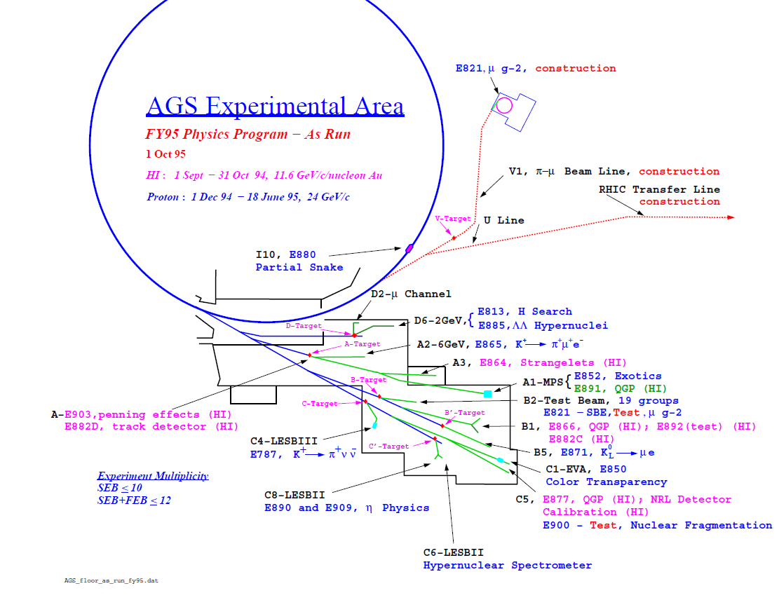
B’ Target

Slide 43
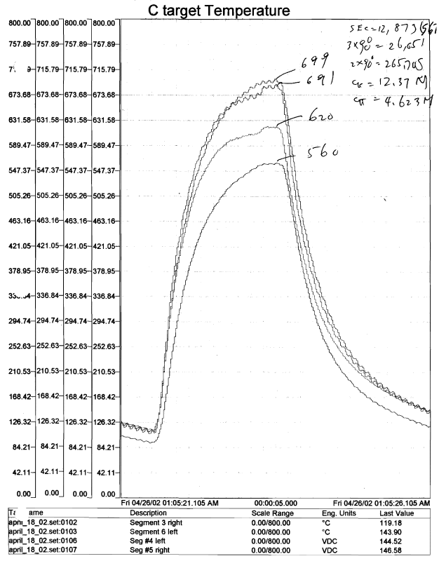
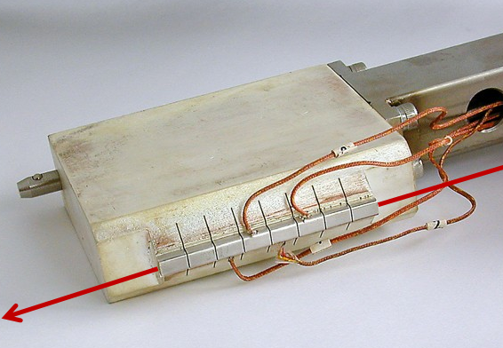
(as measured with type k thermocouples, drilled and peened into platinum)
5R
18 April 2002
22 GeV protons
56 x 10¹² protons per spill
2.2 sec spill every 5.4 sec (41% DF)
Maximum rate on this target was
~70 TP/2.2 sec flat top = 32 TP/sec
Avg Power ~ 45 kW, peak ~110 kW
4L
3R
6L
5R
3R
2.2 sec
6L
4L

Slide 44
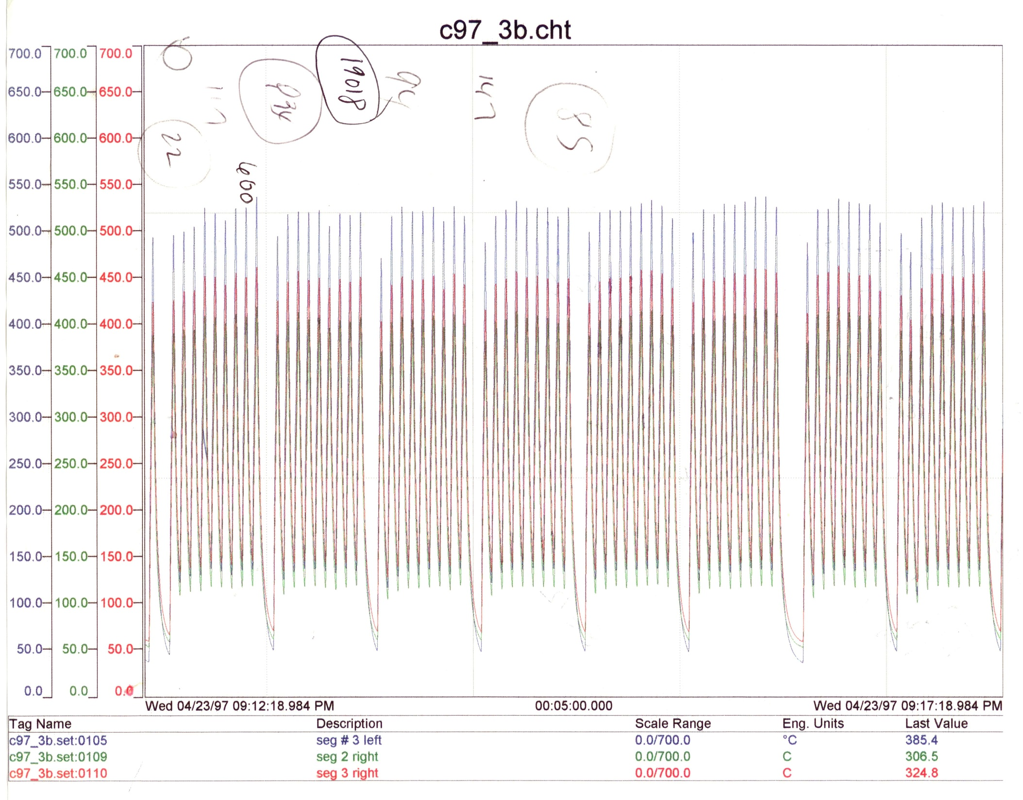
~ 30-40 TP/spill with interruptions for FEB pulse on demand to the
g-2 experiment, 23 April1997

Slide 45
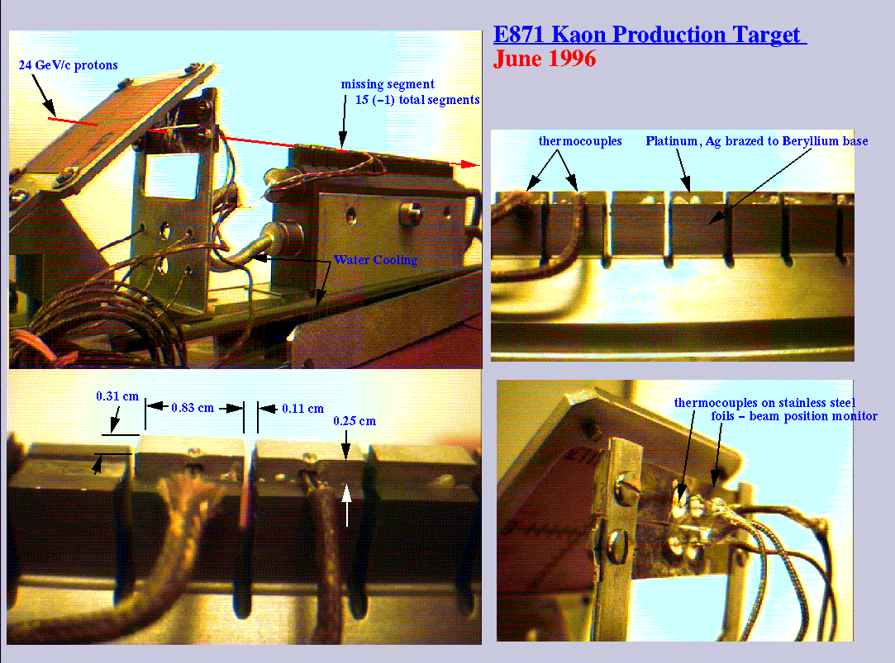
Post B’ target failure Target

Slide 46
Some “Dirty” Laundry from
AGS Fixed Target era…….

Slide 47
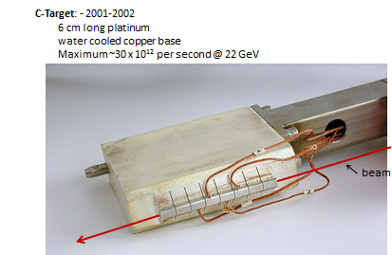
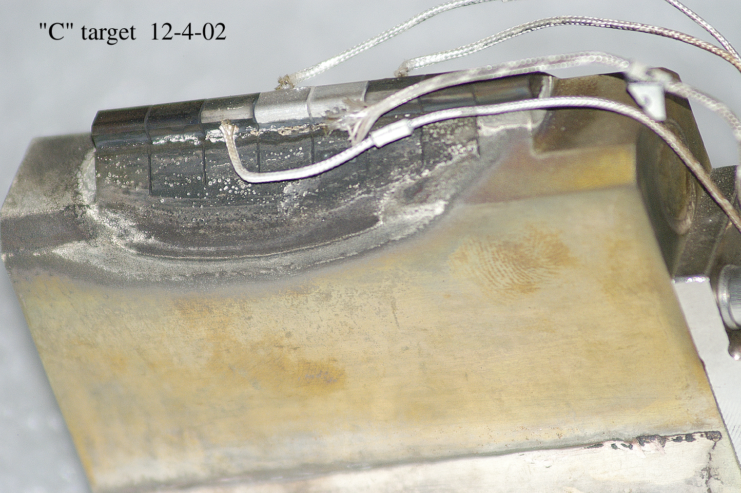
E949 (K⁺→π⁺νν_{bar} ) experiment,
latest target design, 2002
“BEFORE”
~0.5 x 10¹⁹ protons
~30-70 x 10¹² protons per 2.2 sec spill
“AFTER”

Slide 48
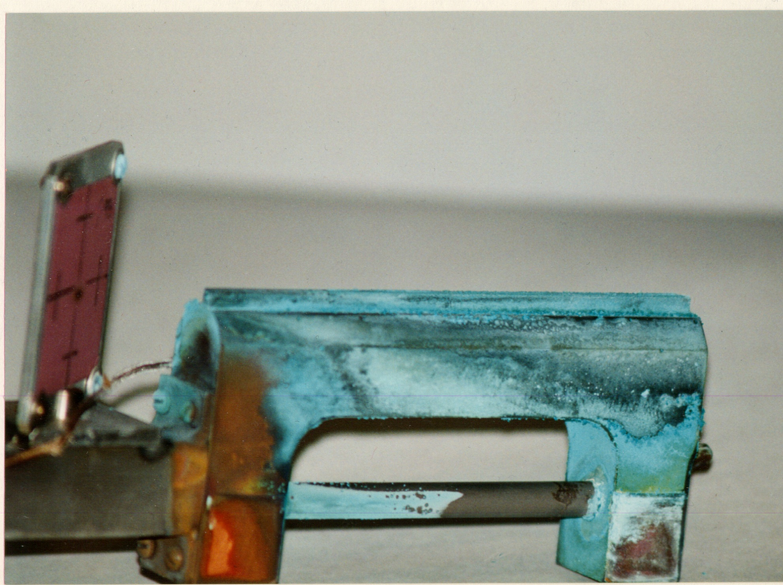
A-Target (E865 – Zeller, K⁺→ π⁺μ⁺e⁻) after ~10-20TP/spill for a few years
15 cm long copper target and water cooled base

