Slide 1
Variable Voltage Substation Fire
Unofficial!
DOE Accelerator Safety Workshop
John Seabury, Accelerator Directorate Quality and Safety Manager
5 August, 2014

Slide 2
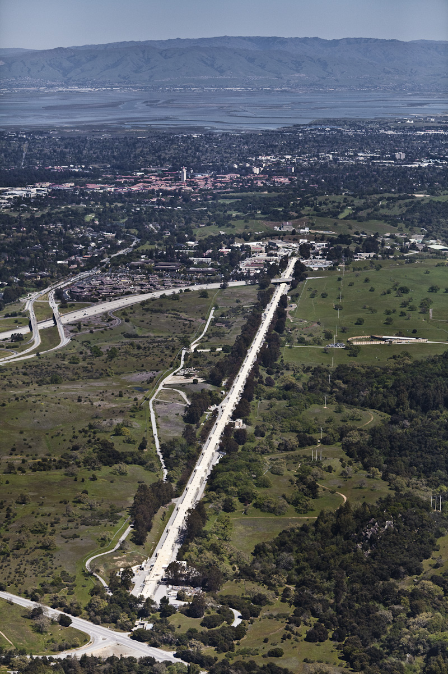
Background
Original SLAC 3 km electron Linac was constructed in the mid-1960’s
Based upon 30, 100-m sectors, each of which has 8 klystrons (except at injectors) providng RF power to the accelerator
Mid-2000’s Sectors 21-30 were separated from Sectors 0-20
Sectors 21-30 got a new injector and provide electrons to the Linac Coherent Light Source (LCLS)
Sectors 0-20 provide electrons to Facility for Advanced Accelerator Experimental Tests (FACET)
In 2016 the “guts” of Sectors 0-10 will be demolished and the space repurposed as LCLS-II (new cryogenic accelerator modules)
Sectors 11-20 are under discussion for additional experiments
Sectors 21-30 will remain as LCLS
Linac klystron AC power distribution system is essentially unchanged since the 1960’s

Slide 3
AC Power Distribution to Linac Klystrons
230 kV
Variable Voltage Substation
(typ of 15)
Master Substation (A/B)
12.47 kV
12.47 kV switchgear
transformer
60 kV
600 V switchgear
300-600 V
Klystron
Modulator
Modulator
Klystron
Klystron
Modulator
Modulator
Klystron
Klystron
Modulator
Modulator
Klystron
Klystron
Modulator
Modulator
Klystron
250 kV pulse
250 kV pulse
Klystron
Modulator
Modulator
Klystron
Klystron
Modulator
Modulator
Klystron
Klystron
Modulator
Modulator
Klystron
Klystron
Modulator
Modulator
Klystron
Sector (typ of 30)
Sector (typ of 30)

Slide 4
12.47 kV Power Distribution to VVS Subs
Master Substation
Linac
VV1
62
VV2
40
VV3
36
VV4
76
VV5
61
VV6
64
VV7
30
VVS 15
VVS 14
VVS 13
VVS 12
VVS 11
VVS 10
VVS 9
VVS 8
VVS 7
VVS 6
VVS 5
VVS 4
VVS 3
VVS 2
VVS 1B
VVS 1A
LCLS
FACET

Slide 5
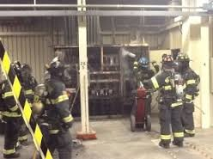
Incident Response and Initial Assessment
6/25 Wednesday
2145 VVS13 tripped. Vesda system alarmed. Onsite electrician reported that VVS13 was on fire.
Second alarm, 22 apparatus from sheriff and local fire departments responded
So did news crews from three local television stations
2225 12kV locked off, suppression commences. EOC activated, notifications made.
2300 fire is out
2345 PPS is interrupted, locked out
Linac East (Sectors 0-20)
6/26 Thursday
~0200 EOC deactivated
News report went viral
During day: assess damage to 12kV
Notes:
Outline scope of work (won’t change often)
Highlight any scoping decisions or changes
Keep drawings and photos to a minimum

Slide 6
AC Power Distribution to Linac Klystrons
230 kV
Variable Voltage Substation
(typ of 15)
Master Substation (A/B)
12.47 kV
12.47 kV switchgear
transformer
6/25 Fire
VVS13
60 kV
600 V switchgear
300-600 V
Klystron
Modulator
Modulator
Klystron
Klystron
Modulator
Modulator
Klystron
Klystron
Modulator
Modulator
Klystron
Klystron
Modulator
Modulator
Klystron
250 kV pulse
250 kV pulse
Klystron
Modulator
Modulator
Klystron
Klystron
Modulator
Modulator
Klystron
Klystron
Modulator
Modulator
Klystron
Klystron
Modulator
Modulator
Klystron
Sector (typ of 30)
Sector (typ of 30)

Slide 7
12.47 kV Power Distribution to VVS Subs
Master Substation
Linac
VV1
62
VV2
40
VV3
36
VV4
76
VV5
61
VV6
64
VV7
30
VVS 15
VVS 14
VVS 13
VVS 12
VVS 11
VVS 10
VVS 9
VVS 8
VVS 7
VVS 6
VVS 5
VVS 4
VVS 3
VVS 2
VVS 1B
VVS 1A
LCLS
FACET

Slide 8
Recovery
6/27 Friday
Inspect other VVS on affected 12 kV legs, PPS bypass VVS13
Problems found with four of five other VVS, repairs made
Restored 12kV ~1700, modulators ~2200
6/28 Saturday
Early am, LCLS and FACET user beams restored (LCLS at reduced power) ~50 hours user interruption
6/29 Sunday
Beam tuning continues, experiments in progress
6/30 Monday
Accepted subcontractor bid. Suspected asbestos in arc chutes, sampled debris
News of fire had become yesterday’s news, little further interest
7/1 Tuesday
Asbestos confirmed, abatement crew brought in, begin prep of VVS4
7/4 Friday
Abatement completed, began installation of replacement VVS
7/9 Wednesday
VVS13 on line, full LCLS power restored, ~14 days recovery
Notes:
Outline scope of work (won’t change often)
Highlight any scoping decisions or changes
Keep drawings and photos to a minimum

Slide 9
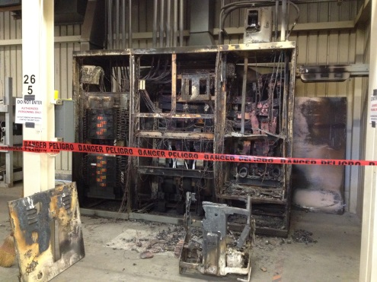
VVS13 Repair - Replacement Project
…containment
Notes:
Outline scope of work (won’t change often)
Highlight any scoping decisions or changes
Keep drawings and photos to a minimum

Slide 10
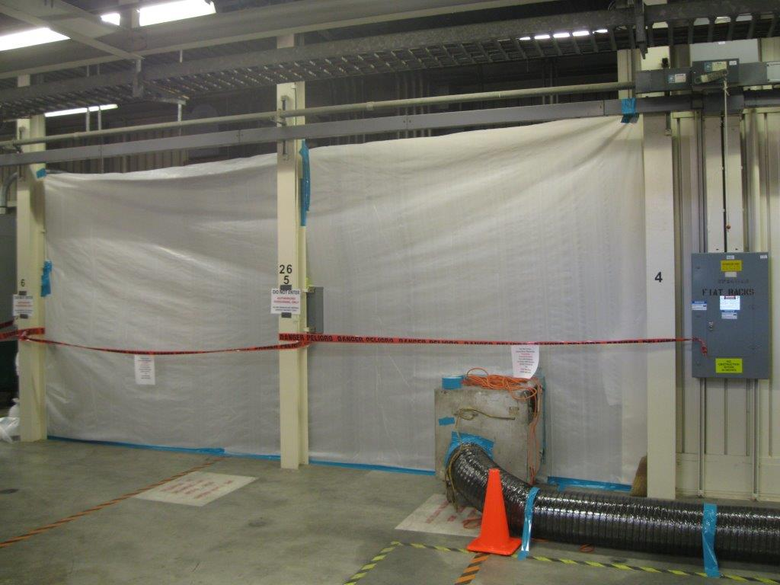
VVS13 Repair - Replacement Project
…containment
Notes:
Outline scope of work (won’t change often)
Highlight any scoping decisions or changes
Keep drawings and photos to a minimum

Slide 11
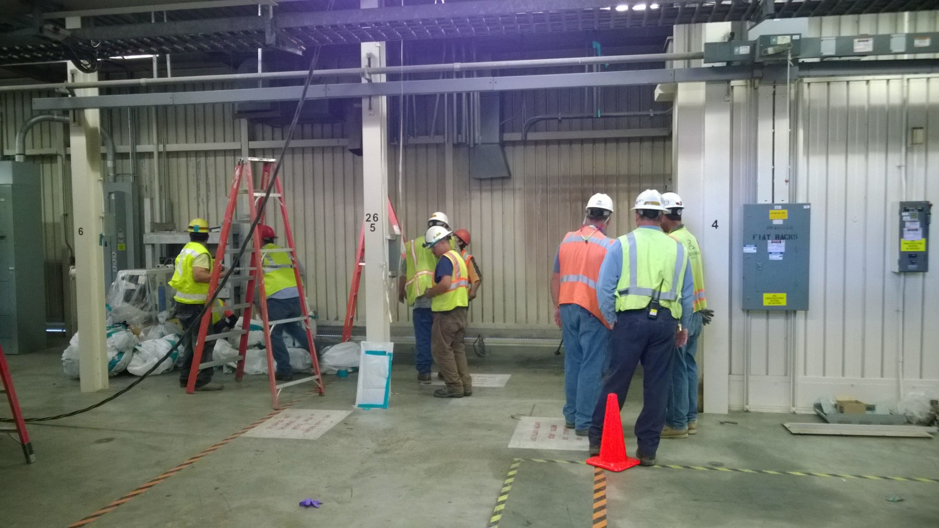
VVS13 Repair - Replacement Project
…abatement complete, clearance received, containment removed, VVS removed.
Notes:
Outline scope of work (won’t change often)
Highlight any scoping decisions or changes
Keep drawings and photos to a minimum

Slide 12
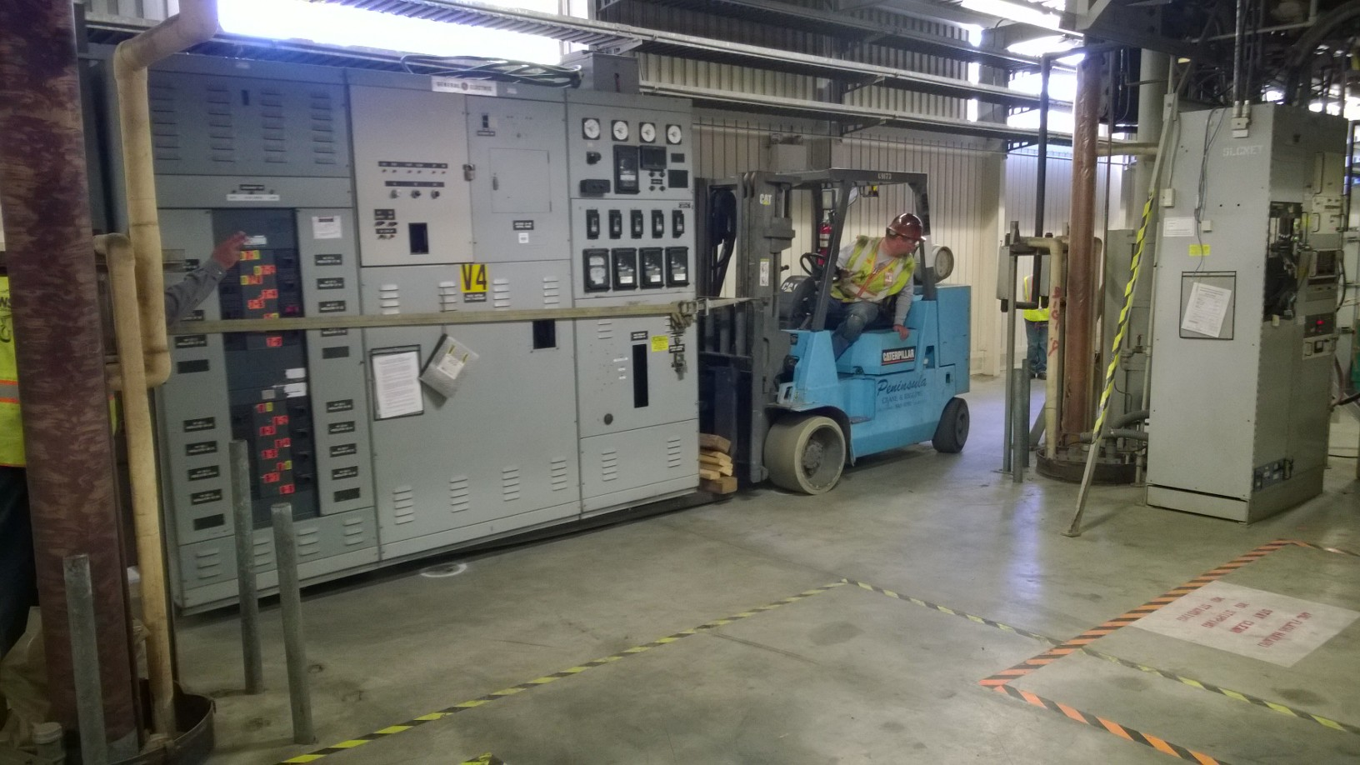
VVS13 Repair - Replacement Project
…VVS4 riding down the gallery
Notes:
Outline scope of work (won’t change often)
Highlight any scoping decisions or changes
Keep drawings and photos to a minimum

Slide 13
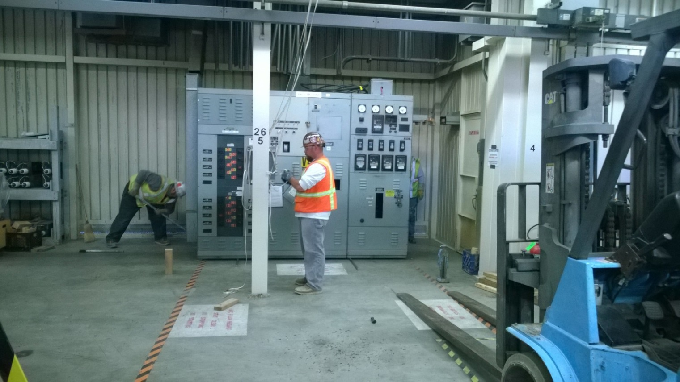
VVS13 Repair - Replacement Project
…VVS4 at its new home in S26
Notes:
Outline scope of work (won’t change often)
Highlight any scoping decisions or changes
Keep drawings and photos to a minimum

Slide 14
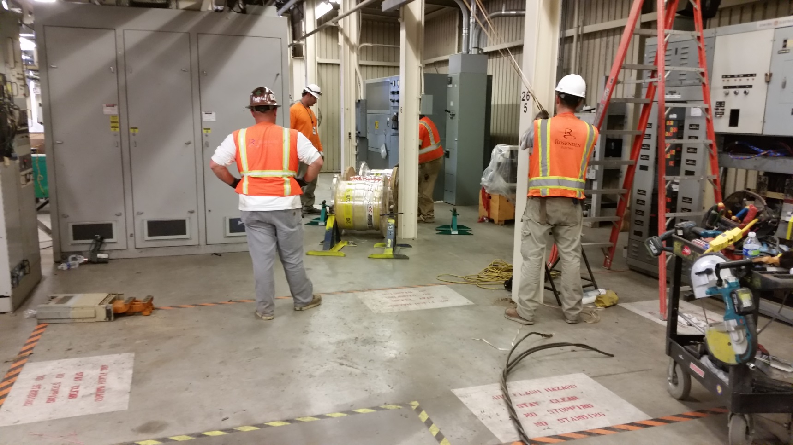
VVS13 Repair - Replacement Project
…new modulator conductors readied for pull
Notes:
Outline scope of work (won’t change often)
Highlight any scoping decisions or changes
Keep drawings and photos to a minimum

Slide 15
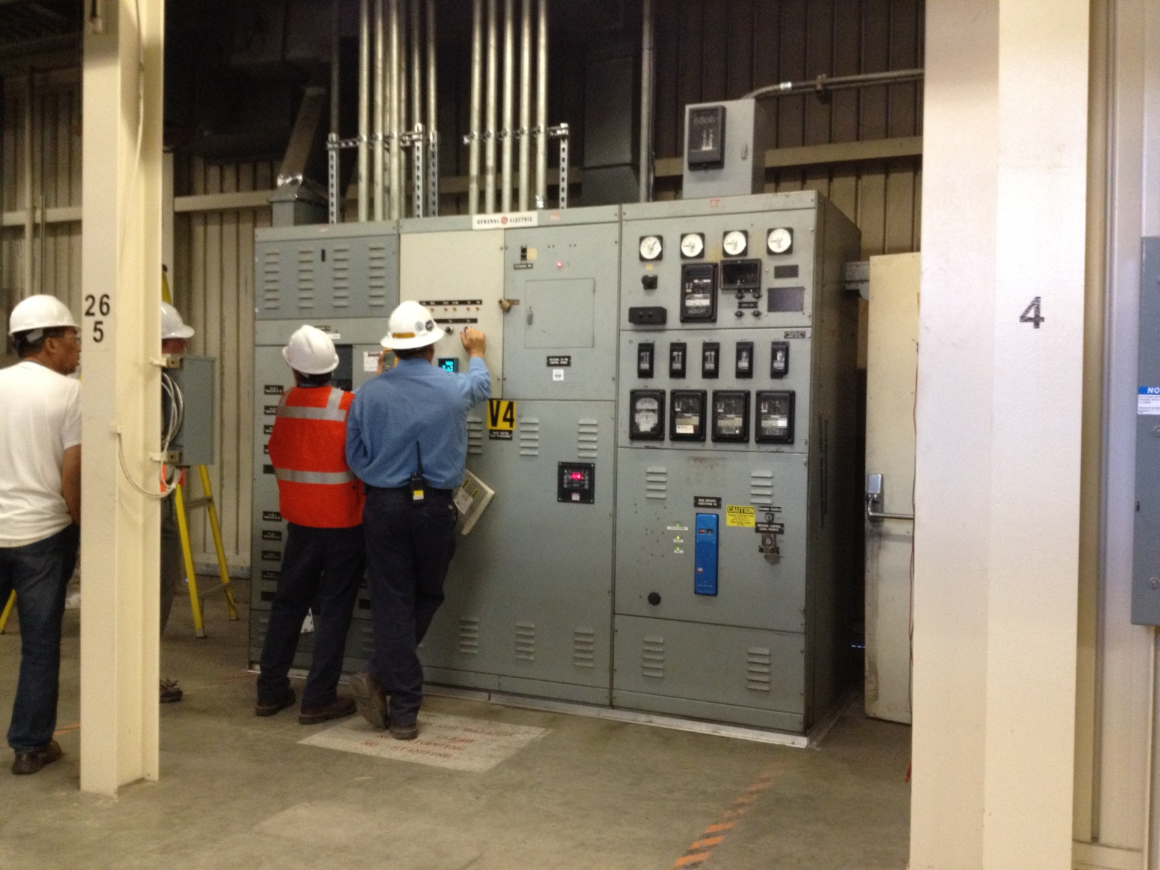
VVS13 Repair - Replacement Project
…complete!!!
Notes:
Outline scope of work (won’t change often)
Highlight any scoping decisions or changes
Keep drawings and photos to a minimum

Slide 16
Where do we go from here?
Investigation is underway, report with recommendations is being prepared
August/September downtime includes detailed inspection and maintenance on all VVS
Right now we have no spare VVS
We do have designs and could have additional ones fabricated, but that likely would be weeks offline
After 2016 there will be spare VVS available from the demolition of Sectors 0-10 for LCLS-II
Notes:
Outline scope of work (won’t change often)
Highlight any scoping decisions or changes
Keep drawings and photos to a minimum

