Slide 1



UNIVERSITY OF
CALIFORNIA

Slide 2
Interlocks, Access Controls, and Configuration Management
Patrick Bong
LBNL Interlock Subject Matter Expert

Slide 3
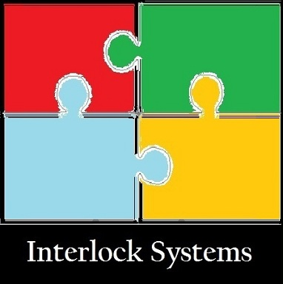
LBNL Interlock Program
An institutional gap analysis of policies identified a need for a centralized interlock policy to be managed by the Radiation Protection Group.
The RGD Interlock Program is the document that contains the regulatory requirements;
  10 CFR 835, Occupational Radiation Protection
  DOE o 420.2B, Safety of Accelerator Facilities
  ANSI N43.1, Radiation Safety for the Design and Operation of Particle Accelerators
  NFPA 101, Life Safety Code
  and others…

Slide 4

Facility Gap Analysis
A gap analysis of each LBNL accelerator facility was performed to determine the level of compliance to the interlock program.
  LOASIS
  88 Inch Cyclotron
  Advanced Light Source
A report was generated for each facility and deficiencies were logged in CATS for resolution.
The report was forwarded to the Office of Quality Assurance to check for PAAA issues.

Slide 5
Primary Deficiency
The deficiency cited at most of the facilities was the lack of an interlock requirements document or a system specification.
  DOE G 420.2-1, II.B.3.a.3
  10 CFR 835.704(b)
Requirements documents are being written to capture the regulatory requirements along with a functional description of the system.

Slide 6
Configuration Management
The configuration management of the interlock system is controlled through the work planning process (ISM incorporated) defined at each accelerator.
Changes to interlock systems are discussed in planning meetings to determine the scope of work, feasibility and costs.

Slide 7

Interlock System Change Control
The proposed interlock system change is captured in the Interlock System Requirements document.
A revised Interlock System Requirements document is reviewed and approved.
  The size of the review is based on a tailored approach.
USI screening is recommended for modifications or unanticipated failures.
Supporting documentation is revised and reviewed against the approved requirements document.
  Schematics
  Test procedures

Slide 8

Targeted Review Process
Interlock systems are reviewed using a targeted approach method.
The purpose of a targeted review process is to focus the attention of the reviewers analyzing a system by breaking the system into manageable study elements.
Each of the Personnel Protection System elements is reviewed as the documentation become available;
  Requirements
  Logic/Software
  Wiring/Hardware
  Quality Assurance testing
The requirements are reviewed for contract compliance.
Subsequent elements are evaluated to meet the requirements.

Slide 9
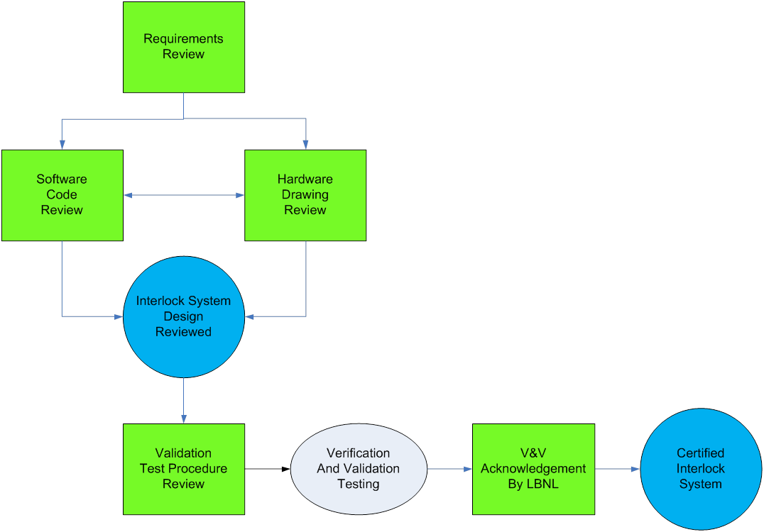
Review Cycle

Slide 10

Software Change Control

Slide 11
Software Change Control
Software changes are proposed then evaluated prior to being documented in the interlock requirements document.
The software label is changed identify the new version.
Software is revised to meet the interlock requirements.
V&V is performed;
  Verification
    Debug occurs during a physical verification of each safety function.
    A software design review verifies the logic against the interlock requirements.
  Validation
    The software is tested using the procedure that was reviewed against the interlock requirements.

Slide 12
Document Control
Software is being transitioned to a cloud repository hosted by Atlassian.
Requirements documents are managed through the Engineering Division document control system.
System schematics are managed as paper copies (official version) with an electronic version that is continuously updated.

