Slide 1
Interlocks, Access Controls, and Configuration Management: JLab and SNS
Rev. 1
2014 Accelerator Safety Workshop
Kelly Mahoney,
mahoneykl@ornl.gov
ORNL/SNS
(Nee Jlab)

Slide 2
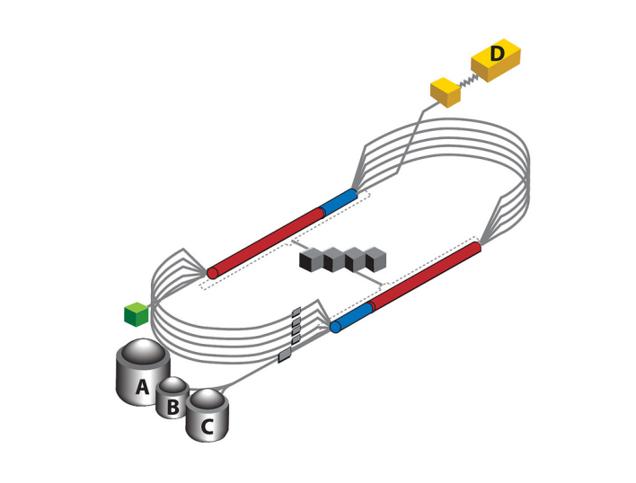
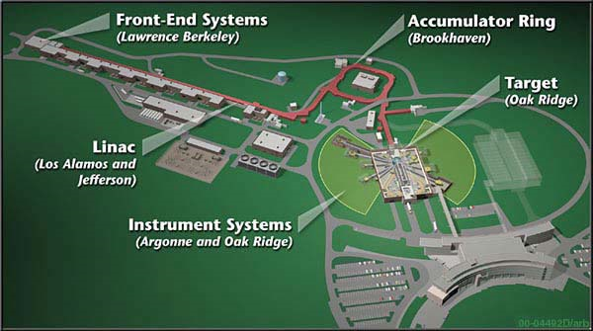
A Tale of Two Accelerator Facilities
JLab
SNS
Single Purpose Lab
JLab Mission: Nuclear Physics
Recirculating Linac
  Superconducting
  CW (Duty Factor 100%)
Recent Milestones:
  10.5 GeV beam
  CD4A Completion of Accelerator and Experimental Hall D
Multipurpose Lab (ORNL)
SNS Mission: Neutron Science
Linac → Accumulator Ring
  Warm RFQ/DTL; SC Linac
  Pulsed (Linac Duty Factor ~ 6%)
Recent Milestones:
  Sustained 1.4 MW Operation
  Completion of baseline instrument suite

Slide 3
A Tale of Two Accelerator Facilities
JLab
SNS
Beam: e⁻
Energy: 12 GeV
Power: 1 MW
Fixed Target
Experiment Beamlines: 4
Long-term Experiments
Future:
  12GeV Commissioning/Operations
  ELIC Design
Beam: H⁻ → H⁺ → N
Energy: 1 GeV
Power: 1.4 MW
Fixed Target
Experiment Beamlines: 18
Short-term Experiments
Future
  High Power (Flux) operations
  Ion Source Upgrades
  Inner Reflector Plug Replacement
  STS Design

Slide 4
Common Approach to Safety Systems
Accelerator Safety Envelope Credited Controls and Defense in Depth Controls
Primarily active engineering controls for ionizing radiation safety
Additional Safety Functions Include:
  Oxygen Deficiency Monitoring
  Non-ionizing radiation
  High Voltage Interlocks
  Magnet Interlocks
  Explosive Gas Monitoring
  Beam Envelope Monitoring
PLC Based Safety Systems
  Older areas Industrial PLCs
  New units use Safety PLCs
    New SNS Instruments use ‘one-box’ safety PLCs

Slide 5
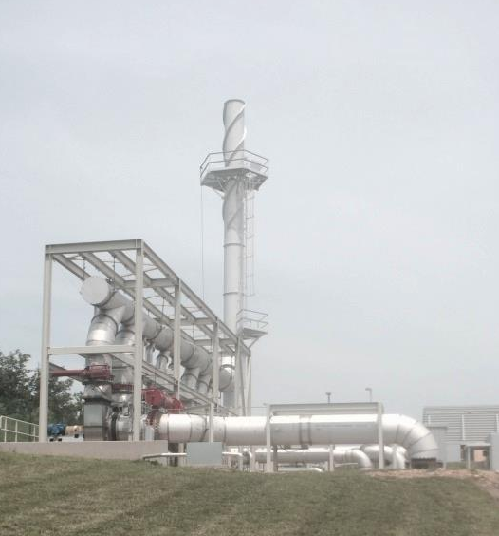
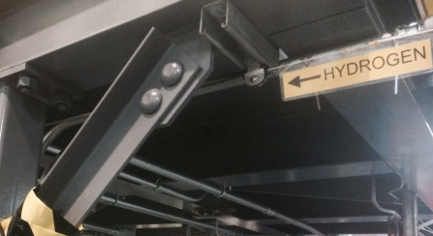
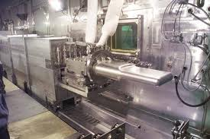
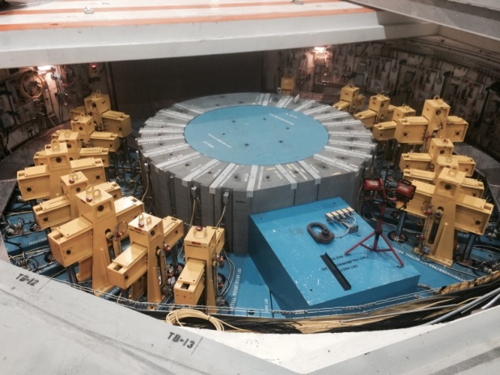
SNS Specific
Environmental Monitoring
  Transfer Bay Differential Pressure
  Stack Radiation Monitoring
Toxic Gas Monitoring
Target Protection System
  Process Controls
SNS Stack
SNS H₂ Used in Experiment
SNS lHg Target in Hot Cell
SNS 18 Primary Neutron Shutters

Slide 6
Common Concerns
Management of safety systems other than credited controls
  Excluded/Exempt Systems; Systems other than radiological protection
    Rise to level of defense-in-depth at most
  Still perform safety functions
    Must meet regulatory and best practices
  Tend to not get the level of attention of Credited Controls (CCs)
    May be included in FSAD but not ASE
    Not accountable through the ASO/ASE Process
      Internal configuration control process must be able to manage these systems
  Examples:
    Non-Accelerator Test Facilities
    Non-ionizing equipment facilities
      Laser Labs
      High Power RF
    High Field Magnets
    Hazardous/Explosive Gases not managed under ASE Process
    Environmental Compliance Monitoring

Slide 7
Common Concerns - Cont’d
Management of Safety System Configuration During Construction, D&D, and Major Maintenance
  Problem:
    Intentional change to accelerator systems, facilities, and infrastructure (SFI); Unintentional change to safety systems.
    Construction/D&D to upgrade existing facilities, systems containing safety systems
      Presumption on workers’ part that safety systems can be altered with other infrastructure during construction or D&D
      Gap in work planning information and communication
    Configuration management (Integrity Management) must ensure continuity of safety system integrity throughout lifecycle
      What lifecycle model includes mini D&D !!?
    Not adequately addressed in standards and guidance
    Collection minor incidents at JLab and SNS

Slide 8
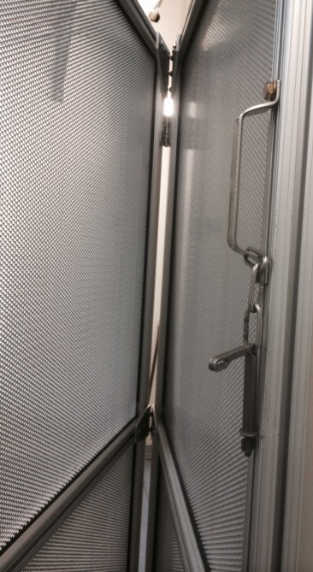
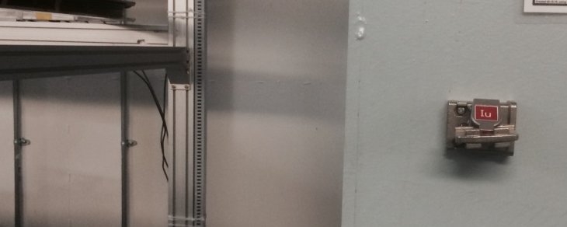
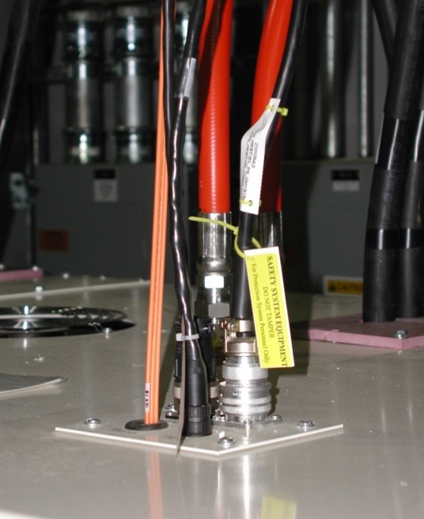
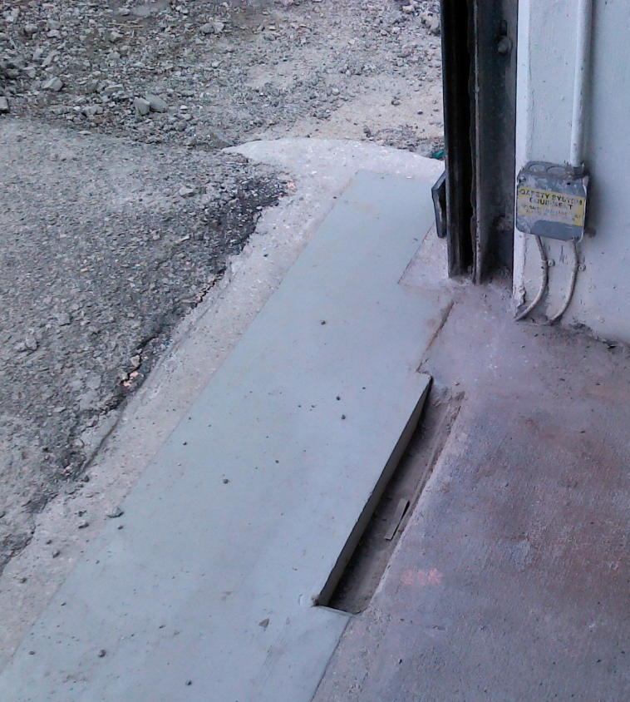
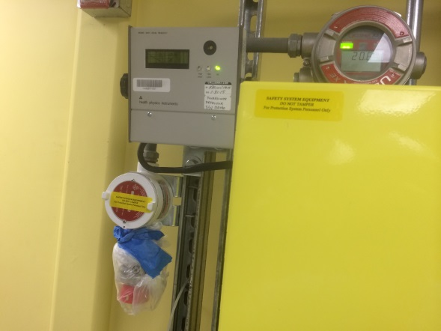
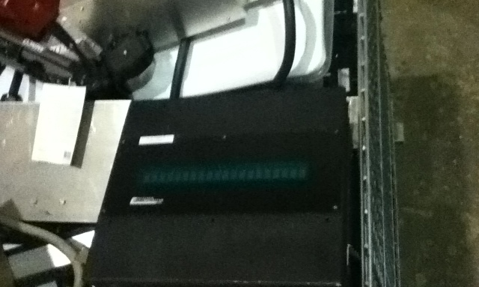
Photos of Config Concerns
Note: None of the below resulted in reduced safety. All were during major outage. The concern was the behavior and the trend.
Clockwise from upper left:
Trapped Key - mating gate removed
Typical safety interface to field equipment among non-safety connections.
Safety switches cast in concrete
Safety message display in trash bin
ODH Sensor bagged during painting. (no gases in area yet)
Others:
  Changes to electrical feeds to Safety System components.
  Defacto removal of configuration control locks when locked device is removed.

Slide 9
Common Concerns - Cont’d
Management of Safety System Configuration During Construction, D&D, and Major Maintenance
  Solutions:
    Customized training; re-enforced awareness
    Recognition for appropriate behavior
    Integrated work planning tools
    Escalating consequences based on combination of potential consequence, worker experience, egregiousness, …
      i.e. treated like an EH&S violation

Slide 10
Common Concerns – Cont’d
Requirements flow down/flow up
  Change management must assess impact at requirements level
    Requirements are the most likely source of common mode failures
    Validate Assumptions, Hazard Analysis, Interfaces,…
  Difficult to track changes, impacts
  Ideally should track high level through to implementation, test, operation, and management systems
  RM tools like DOORS are expensive and require large learning curve
Solution (SNS)
  Expanding capability of existing Project Lifecycle Management (PLM) tools to include document relationships and hierarchy.
  (JLab was starting this effort in 2014)

Slide 11
Other Concerns – Controversial Stuff
Active Engineered Controls
Use of Machine Safety Standards and Guidance does not adequately address Institutional Risk of large accelerator operations
  Plus
    Directly applicable to interlocks
    Large body of knowledge
    ‘Cookie cutter’ solutions
    Does not require dedicated safety professional
  Minus
    ‘Dumbed down’ implementation of safety instrumented functions
    Does not adequately address complex system of systems
    Does not address high reliability systems management
    Does not require dedicated safety professional
Recommend continued integration of DOE, Process Safety, Aerospace, and International Nuclear standards and practices
For Institutional Risk, See Supplementary slide
MITIGATION
RISK

Slide 12
Reliability Models
OLD
NEW
Safety system management follows a lifecycle from concept to retirement…
  Defined set of processes with outcomes
  Risk is quantified
    Residual Risk Recorded and Accepted before Operations
  Risk is not considered dynamic
Safety system management is like a control system with feedback…
  Continuous change
  Perturbations to the system create vulnerability or risk
    Human Performance
    Regulatory Environment
    Resource quality and availability
  Controls must detect perturbations and correct problem before an accident
  Better fits realistic accident models

Slide 13
New Approach to Interlocks
Models:
  1990 – 2000: Central Processing/Concentrated I/O
  2000 – 2012: Central Processing/Distributed I/O
  2012 – 2014: Distributed Processing/Distributed I/O
  2014+ Distributed Safety Instrumented Subsystems

Slide 14
Summary
Experience at two accelerator facilities show there are common concerns related to
  Integrity management during construction/D&D
  Management of non-CECs
  Requirements management
Topics for Conversation
  Similar Experiences and Solutions
  Future Safety System Architectures
  New Reliability Models
  New Approach to Safety System Architectures

Slide 15
Backup Slides

Slide 16
Institutional Risk Assessment
New Risk Analysis Based on Multiple Risk Categories
  Direct Risk of Harm to People
  Direct Risk of Harm to Environment
  Direct Risk of Harm to Tangible Property
  Direct Risk of Financial Loss
  Direct Risk of Impact to Continuity of Operations/Mission
  Direct Risk of Enforcement Action
Each area is scored individually as well as summed
Data shows that items scoring low risk in individual categories can add up to significant cumulative risk
 | Any Individual Score (IS) | Combined Score (CS)
Risk Acceptance Level
Intolerable | ≥ 4 | > 10
Unacceptable | 2 < IS < 4 | 5 < CS ≤ 10
Tolerable | 1 < IS ≤ 2 | 1 < CS ≤ 5
Acceptable | ≤ 1 | ≤ 1

Slide 17
Distributed Safety Instrumented Subsystems
Autonomous functions
Simplified hardware, software, configuration management
Easier implementation of graded approach (SIL1-3 as needed)
‘Black Box’ inputs, outputs, interface
Scalable from very small to very large facilities
JLab Uses
  Beam Envelope Limit System (BELS)
  Injection Magnet Monitoring
  Beam Transport Monitor (BTM)
Future Direction
    Integrated Equipment Interlocks (SIL 2/3 Built-in to CCs)
    Semi-autonomous interlocks and access controls
    Multiple functional redundancy, checks, communication
Achieves Simultaneous:
High Safety Availability
High Reliability
Fault Tolerance
On-Line Self Test
On-line Maintenance

Slide 18
Single Safety PLC
Single CPU (internally redundant architecture)
  Redundant I/O Count remains unchanged
  Should still use redundant power supplies
  Plus
    Easier configuration management
    Able to safely pass information between A/B Programs
    Able to take advantage of built-in safety functions like evaluation of redundant switches, Output-Feedback evaluation,
  Minus
    Single Mode vulnerability to issues like network errors

Slide 19
Some Architectures
Accelerator | Function | IEC 61508 SIL Capability | CPU Configuration | I/O Configuration (Trip Conditions) | Software Configuration
SNS | Instrument Interlocks | 2 | 1 Safety | 1oo2 | Two Programs
Fermi | ODH |  | 1 Safety | 1oo1* | One Program
JLab | ODH | 2 | 1 Safety | 1oo1D* | One Program
JLab | BELS | 2 | 2 Standard | 2oo3 | Two Programs
JLab | BTM | 2 (Capable of 3) | 1 Safety | 2oo3D | One Program
JLab | Access Controls/ Interlocks | 3 | 2 Safety | 1oo2D | Two Programs
CERN | Radiation Interlocks | 3 | 2 Safety | 2oo2D (+HW Chain) | One Program

Slide 20
Key to Above Slide
      SIL1 = Average Probability of Dangerous Failure 10⁰ to 10⁻¹
      SIL2 = Average Probability of Dangerous Failure 10⁻¹ to 10⁻²
      SIL3 = Average Probability of Dangerous Failure 10⁻² to 10⁻³
      I/O Configuration
        1oo1, 1oo2, 2oo3 = m out of n
        n = # of systems (redundancy)
        m = # required to trip
        D = Fail-safe diagnostic coverage over 99%. No ‘D’ assumes diagnostic coverage between 60 and 90 %.
        * - ODH is a monitoring and alarm function. It may not act to automatically mitigate the hazard.

Slide 21
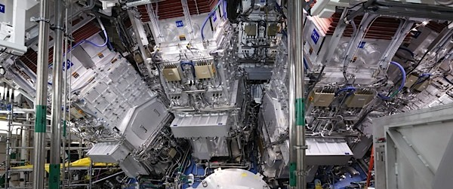
NIF Target Cell

Slide 22
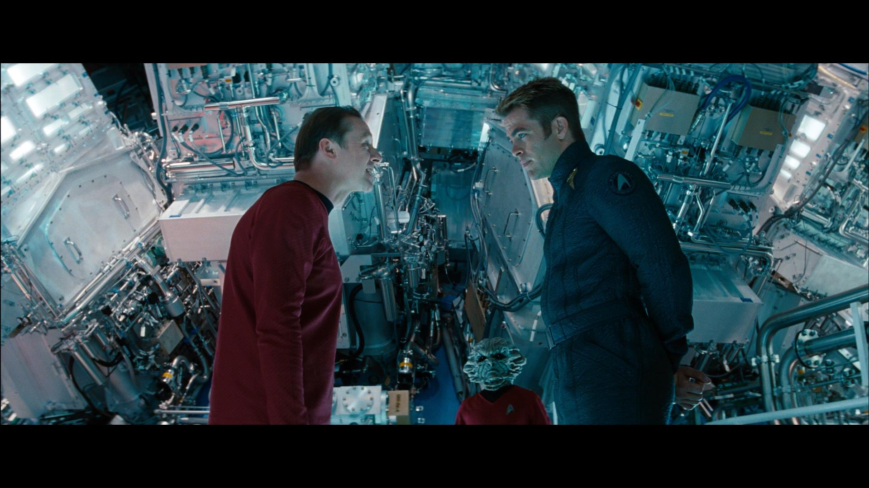
Enterprise Warp Core – The Ultimate Repurposing!

