Slide 1
Configuration Management
Ian Evans

Slide 2
Configuration Management
Requirements Developed
PPS, BCS, Lasers etc.
Hardware Installed
Systems
De-bugged
Tested
Certified per procedure
All science wants is a system that’s functional and will meet science needs.

Slide 3
Configuration Management
PPS – Personnel Protection System
Prevents personnel from entering areas where the possibility of a radiation hazard exists
Elements such as hutch door interlocks, key enforced searches, beam stoppers
BCS - Beam Containment Systems
Prevents beam from deviating from the design channel into spaces occupied by personnel
Water cooled apertures, water filled beam dumps, vacuum sensors etc.
Configuration Management
Also applies to shielding, search barriers, other systems deemed critical – laser components and interlocks etc.

Slide 4
Configuration Management
Radiation Safety System
Access Control
System (PPS)
Radiation Control
System
Burn
Through
Monitors
(BTM)
Beam Shut- Off Ion Chambers
(BSOIC)
Beam Containment
System
(BCS)
Shielding
ACM, PIC, LIONS

Slide 5
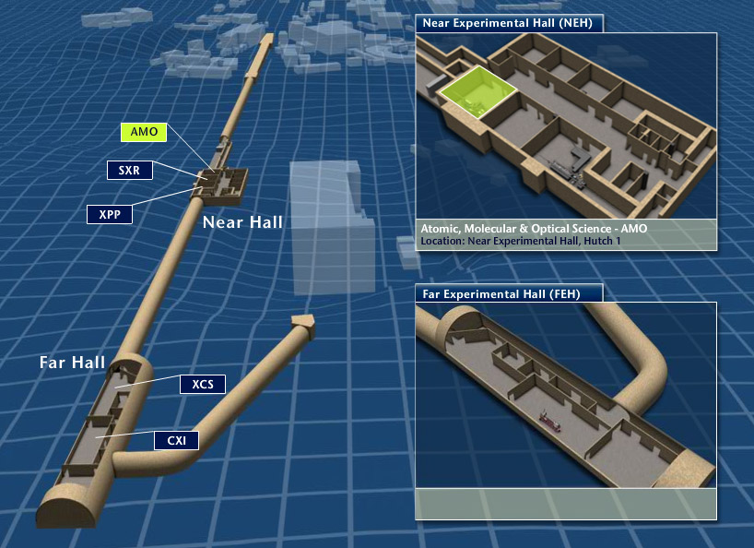
Configuration Management

Slide 6
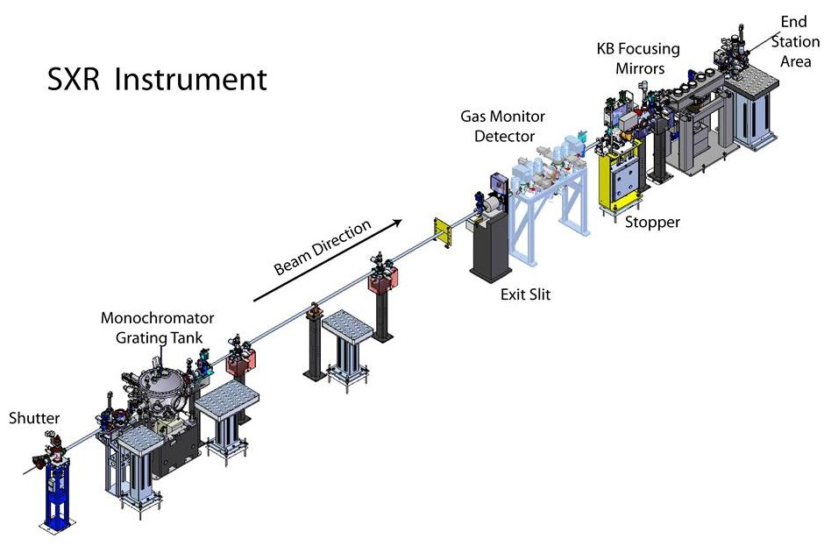
Configuration Management

Slide 7
Configuration Management
Beamline Authorizations (BLA’s) define the critical items that need to be in place to operate safely.
Controls determined via ESH Staff, Radiation Protection Group & Instrument Staff
Components
Stoppers, Apertures, Slits, Collimators
Systems
PPS, BCS, Vacuum
Shielding
Bulk, Local
Defines Operational Modes
Checklists for visible items
Checklists for non-visible items, in vacuum components, metrology, hard stop limits.

Slide 8
Configuration Management
Training
Staff
Responsibilities – what am I responsible for
Awareness – who own what systems
Communication – who do I call if I need help
Configuration Control – what it means and why its there
Labeling, Locks, Hardware - Checklists
Walk through of items with all involved
Users
Hutch Orientation – hands on/hands off, who to call if it doesn’t work.
Perform a Search, key aspects of the PPS system

Slide 9
Configuration Management
Controlling established configurations
Radiation Safety Work Control Forms (RSWCF’s)
Manages state of critical elements
Defines work to be performed
Identifies Hazards
Defines Requirements (Hazard Controls & Alternative Mitigations) that need to be in place before work can start.
Defines Requirements (tests, validations, inspections, sign-offs) that need to be in performed once work is complete.

Slide 10
Configuration Management
Lessons Learned (the hard way)
LCLS Hutch 3 laser class IV ops tied to radiation stopper
LCLS Hutch 5 laser shutter mechanical failure
Drilling through lead shielding
Executing work before RSWCF controls have been fully established
System are different
PPS fixed/rigid systems
LSS (lasers) by nature need to be more flexible
From a safety perspective we want systems (shielding placement, PPS, interlocks etc…) to work as planned and when needed, so managing their configuration is important.

