Slide 1


Electron Ion Collider
F. Willeke, BNL
EICUG Temple Meeting
18 March 2020
Electron Ion Collider

Slide 2
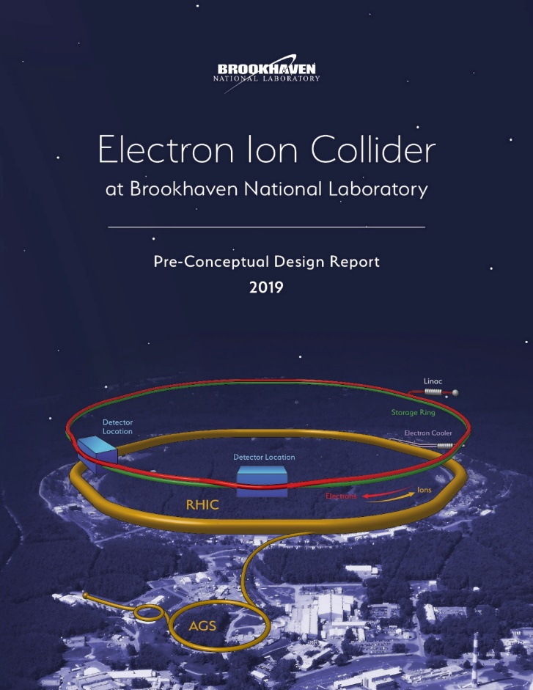
Outline
Electron Ion Collider Overview
Technical Scope
Recent Reviews
Center of Mass Energy
High Luminosity
Polarization Overview
Collaboration
Organization
New York State Support
Summary

Slide 3
EIC design will meet NSAC and NAS Requirements
Center of Mass Energies 20 GeV – 141 GeV
Maximum Luminosity 10³⁴ cm⁻²s⁻¹
Hadron Beam Polarization 80%
Electron Beam Polarization 80%
Ion Species Range p to Uranium
Number of interaction regions up to two

Slide 4
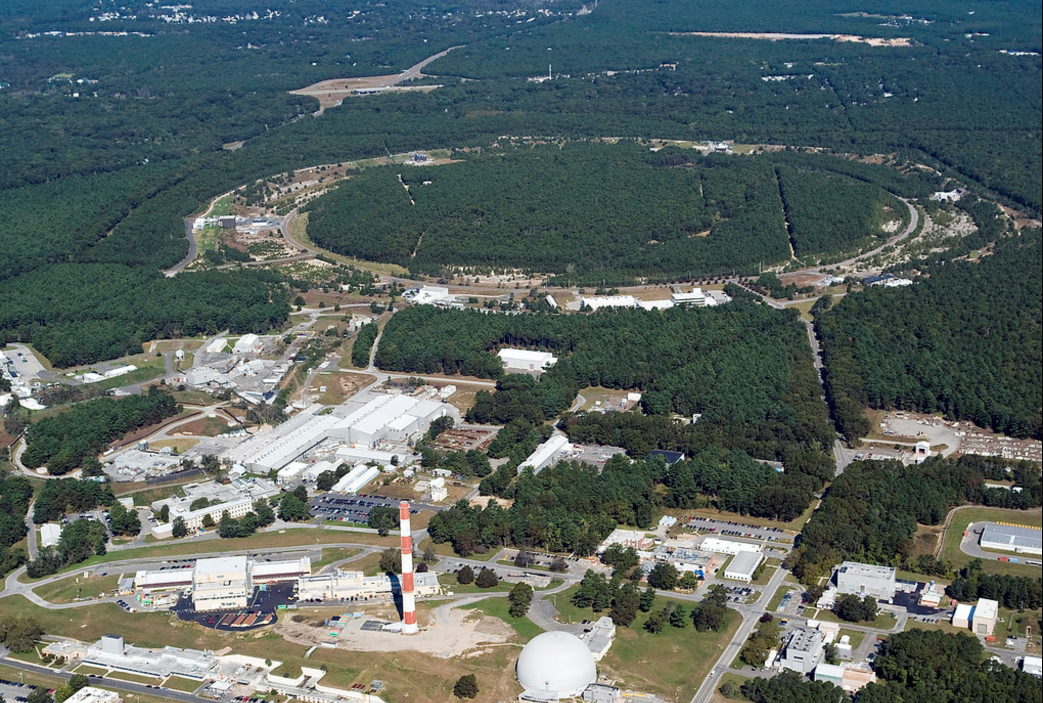

EIC Overview
Design based on existing RHIC,
RHIC is well maintained, operating at its peak
Hadron storage ring 40-275 GeV (existing)
  many bunches
  bright beam emittance
  need strong cooling or frequent injections
Electron storage ring (2.5–18 GeV (new))
  many bunches,
  large beam current (2.5 A)
Electron rapid cycling synchrotron (new)
  1-2 Hz
  Spin transparent due to high periodicity
High luminosity interaction region(s) (new)
  L = 10³⁴cm⁻²s⁻¹
  Superconducting magnets
  Crossing angle with crab cavities
  Spin Rotators (longitudinal spin)
  Forward hadron instrumentation
BNL-EIC

Slide 5
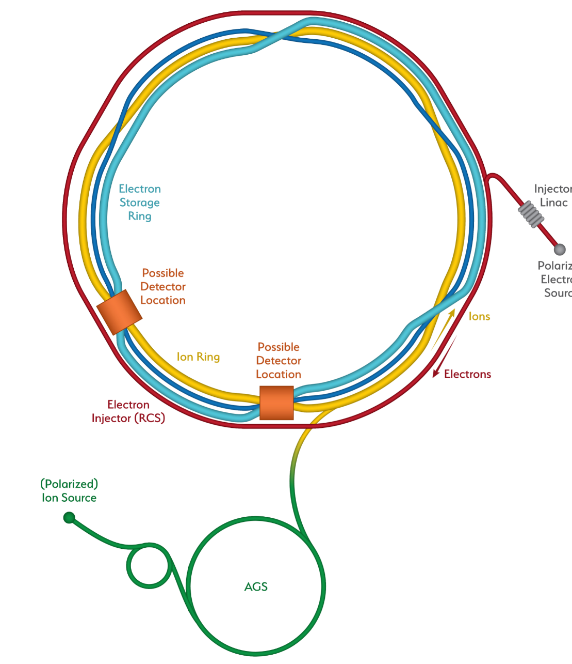

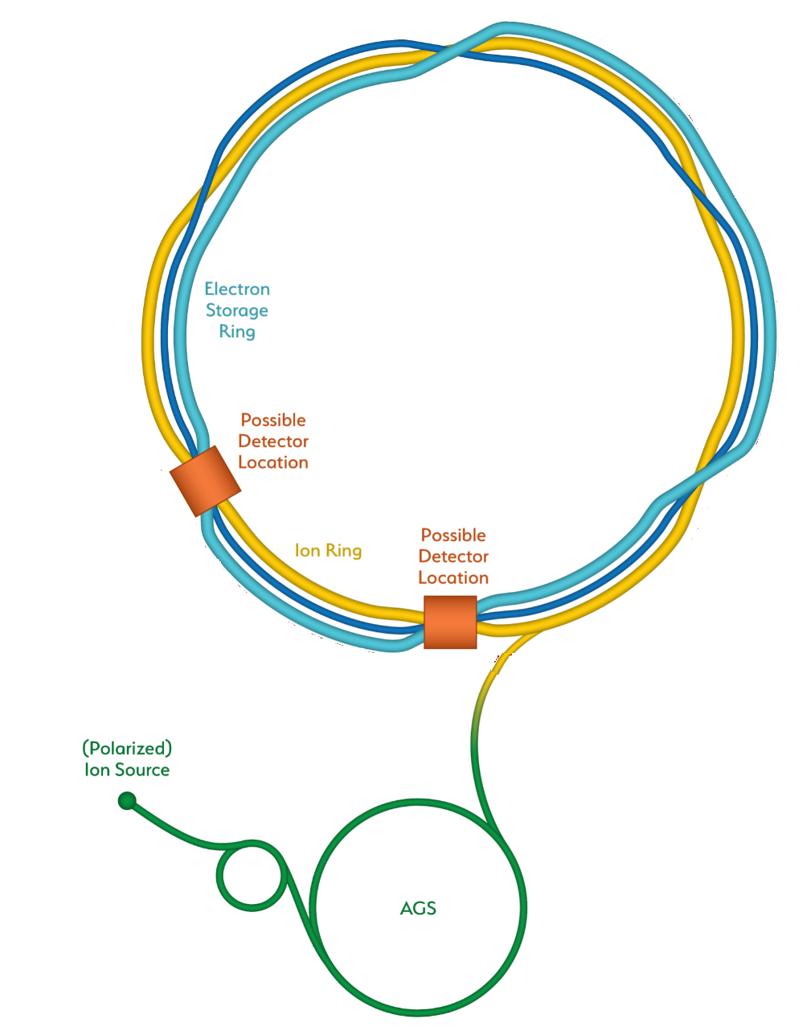
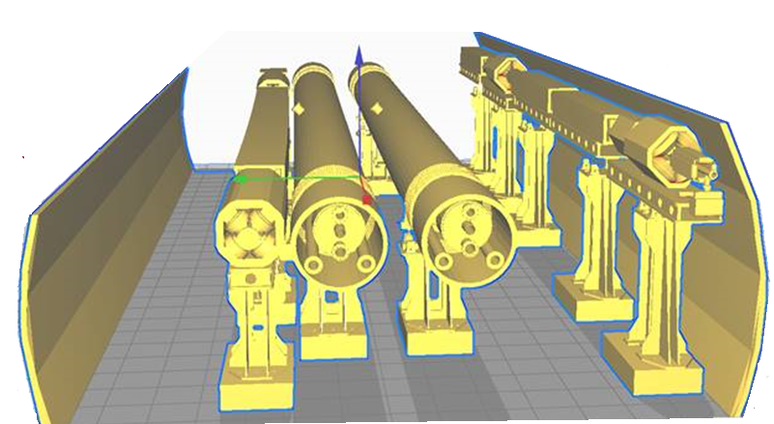
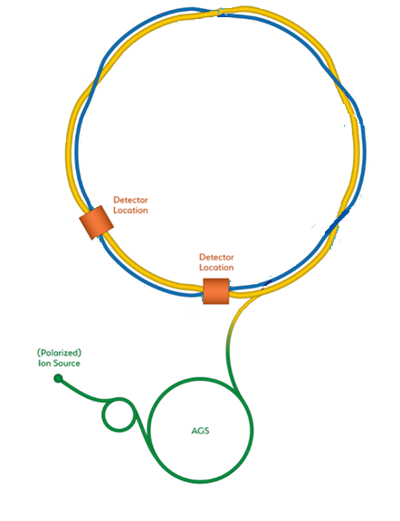
From RHIC to the EIC
Add electron storage ring
Which holds the electrons which collide with hadrons
BNL-EIC
We add an electron
Injector complex which delivers full energy electrons to the storage ring
The strong hadron cooling facility completes the facility
Existing RHIC with
Blue and Yellow ring
Hadron Storage Ring
Electron Storage Ring
Electron Injector Synchrotron
Possible on-energy Hadron
injector ring
Hadron injector complex

Slide 6
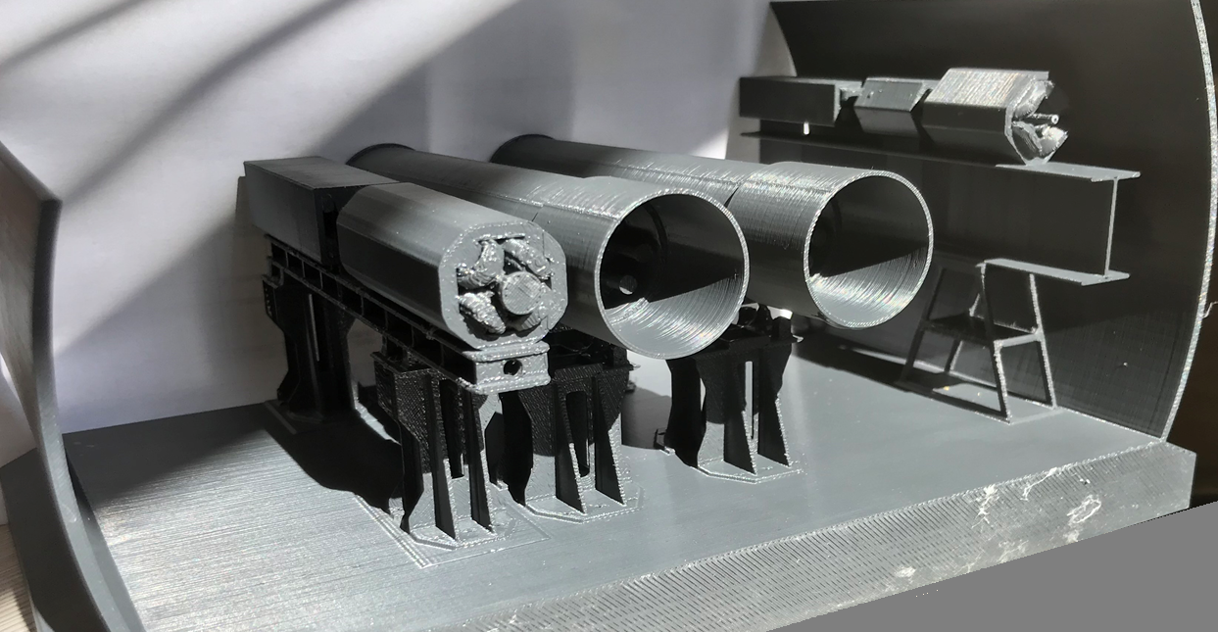
EIC Technical Scope
The technical scope consists of
3 accelerator rings:
  - Existing RHIC yellow ring (275 GeV)
  New Rapid Cycling electron Synchrotron (18 GeV)
  New Electron Storage Ring (18 GeV)
2 Injector complexes:
  - Hadron injectors (existing)
  - Electron Injectors
2 detector halls
Hadron Cooling Facility
Common systems (controls, cooling…)
Infrastructure (buildings, roads…)
Described in comprehensive pre-conceptual design report
PCDR

Slide 7

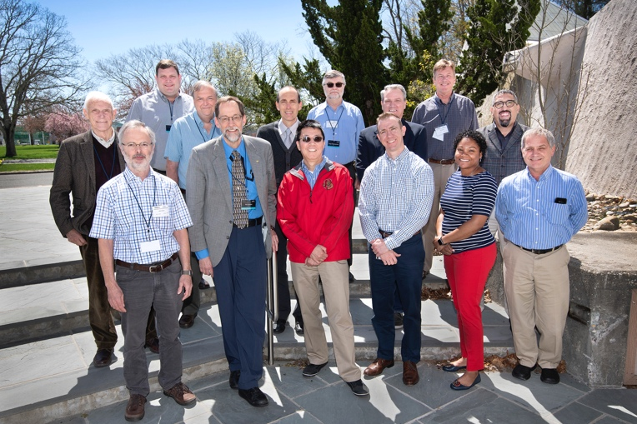

Important Reviews
Pre-Conceptual Review (Expert Review)
(A. Chao, SY Lee, G, Stupakov, G. Hoffstaetter, Y. Alexahin, J. Galayda, F. Zimmermann, R. York):
- EIC Ring-Ring quite feasible,
- low risk option of the EIC
Scope and Cost Review:
eRHIC Director’s Cost Review April 2019:
- scope is comprehensive and complete
DOE Independent Cost Review (May-July 2019)
- cost range reasonable
Source Selection Review (October 2019)
- BNL selected as EIC site (January 2020)

Slide 8
EIC covers full center of mass energy range of 20 GeV – 140 GeV
Protons up to 275 GeV:
  Use existing RHIC with superconducting Yellow ring with E_{p} = 275 GeV
  and down to E_{p} = 41 GeV is accommodated in the design
  RHIC beam parameters are close to what is required for EIC
Electrons up to 18 GeV:
Electron storage ring with up to 18 GeV installed RHIC tunnel,
readily achievable with
- large circumference of 3870 m and
- available superconducting RF technology U_{rf} = 62 MV
low electron energy of 2.5 GeV is easily implemented

Slide 9
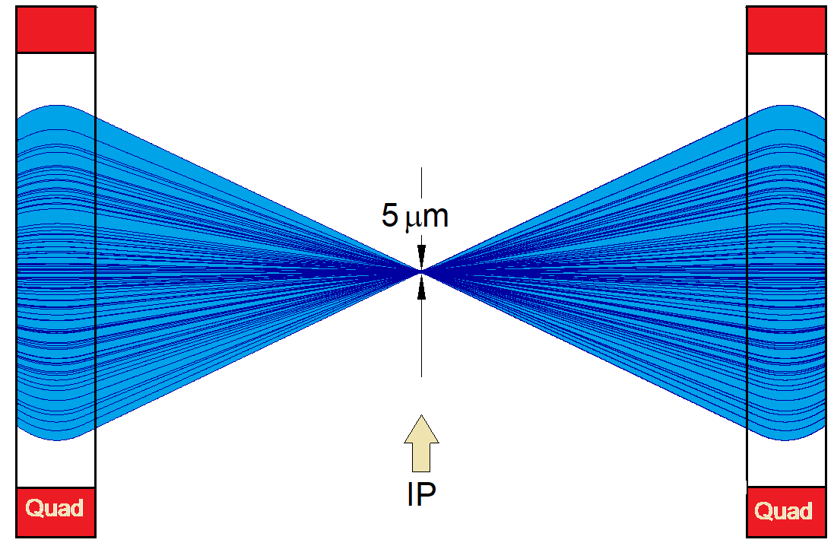
EIC achieves the high luminosity L = 10³⁴ cm⁻²s⁻¹
Large bunch charges N_{e} ≤ -1.7·10¹¹e, N_{p} ≤ 0.69·10¹¹e
Many bunches, n_{b}=1160
  crossing angle collision geometry
  large total beam currents
  limited by installed RF power of 10 MW
Small beam size at collision point achieved by
  small emittance, requiring either:
- strong hadron cooling to prevent emittance growth or
  - frequent hadron injection
  and strong focusing at interaction point (small β_{y})
Strong, but previously demonstrate d beam-beam interaction
Δν_{p} = 0.01 demonstrated in RHIC
Δν_{e} = 0.1 demonstrated in HERA, B-factories
Strong focusing β_{y} =5 cm

Slide 10
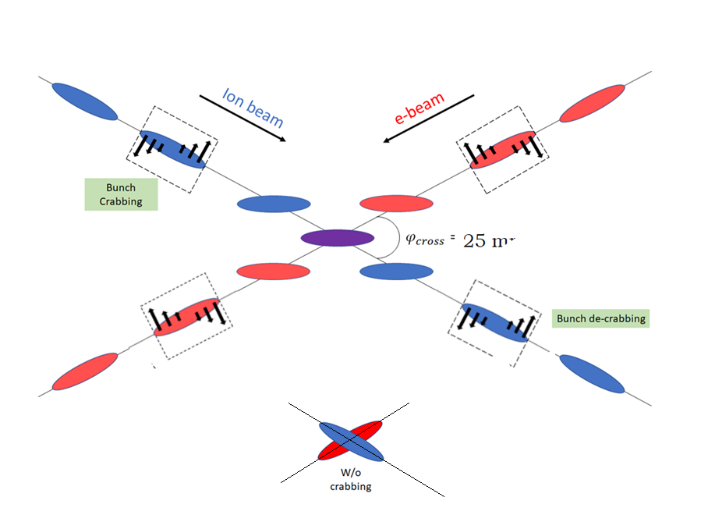
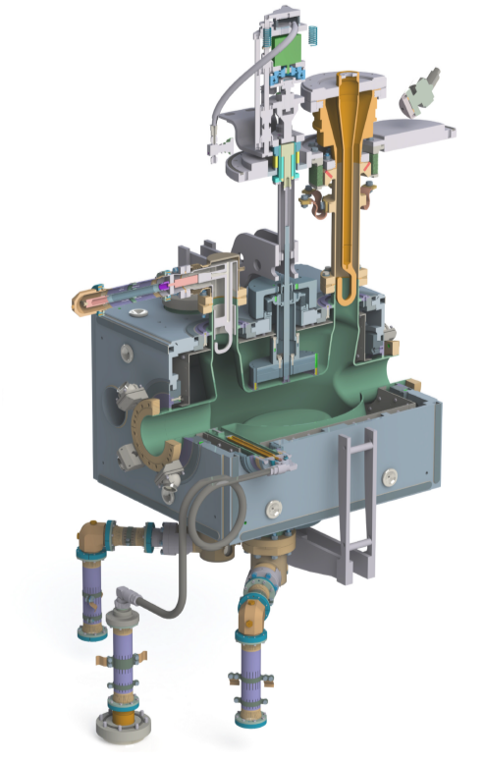
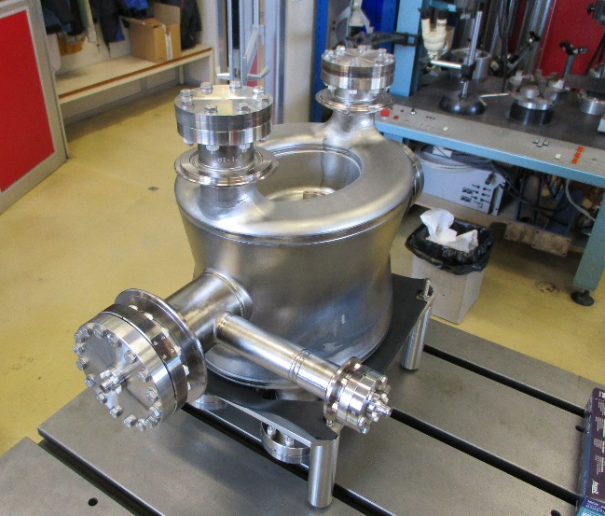
EIC High Luminosity with a Crossing Angle
Modest crossing angle of 25 mrad
  avoid parasitic collisions due to short bunch spacing,
  for machine elements, to improve detection
  reduce detector background,
However, crossing angle causes
  Low luminosity
  Beam dynamics issues
avoided by Crab Crossing
Then :
  Effective head-on collision restored
  beam dynamic issues resolved
RF resonator (crab-cavity) prototypes built
and tested with proton beam in the CERN-SPS

Slide 11
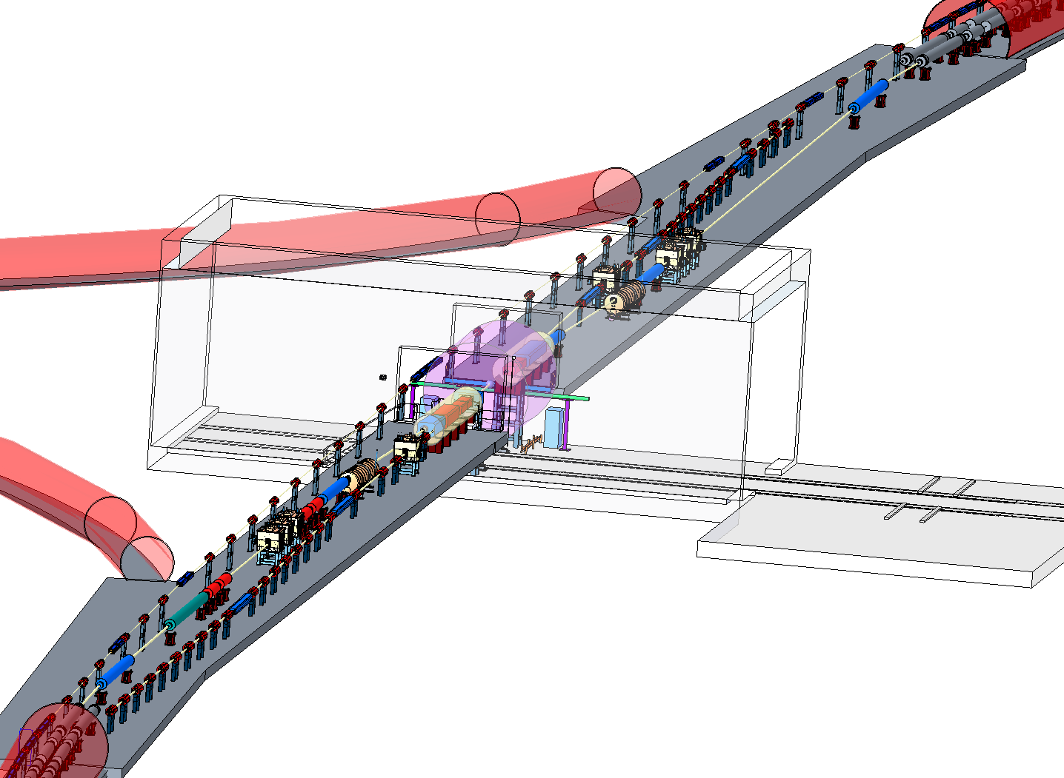
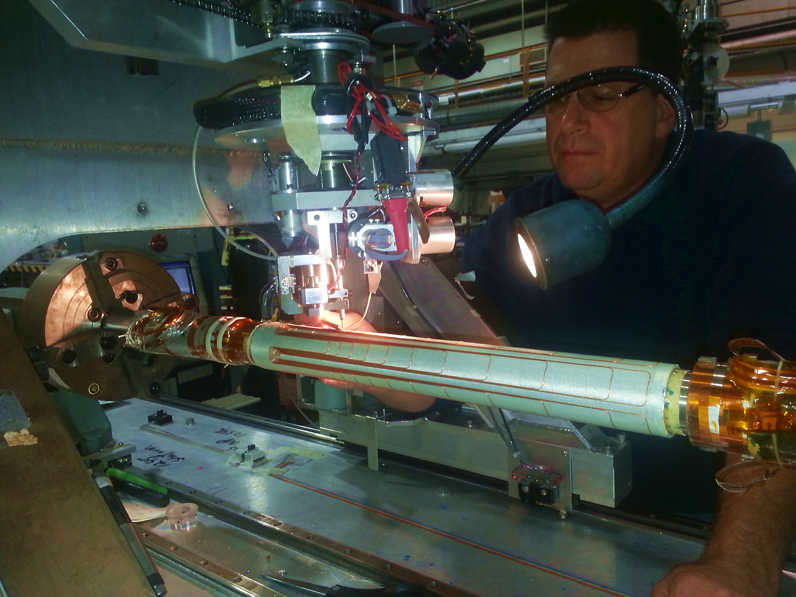
EIC Interaction Region
Focusing the beam down to β_{y} ≤ 5 cm @ beam size 5 μm, gives L=10³⁴cm⁻²s-¹
and provides full acceptance for the colliding beam detector; accommodates crab cavities and spin rotators; synchrotron radiation and impedance managed …
BNL accelerator scientists: specialized expertise
BNL scientists involved in IRs for HERA, RHIC, LHC and Super-KEKB (Japan).
BNL-EIC final focus magnets based on conventional NbTi superconducting magnet and direct wind technology, a unique BNL capability
Detector hall
Direct wind s.c. coil production in progress

Slide 12
Maintaining high luminosity during a fill
Issue: Dense hadron beam leads to emittance growth due to IBS causes luminosity decay, would imply reduced average luminosity
eA collisions: existing stochastic cooling system preserves emittance and e-ion maintains luminosity, thus for Ions, no issue
ep collisions: need to prevent actively p emittance growth with cooling scheme
BNL-EIC Strong Hadron Cooling: extension of established stochastic cooling to higher bandwidth: replacing cables @ amplifiers with electron beam and beam dynamical effects: Coherent Electron Cooling (CeC)
Establishing CeC desirable:
  long interrupted luminosity runs,
  advance in accelerator science
But: CeC not yet demonstrated (Risk), therefore:
BNL-EIC alternative: frequent on-energy injections using existing Blue Ring
restores average luminosity up to ~ the peak luminosity.

Slide 13
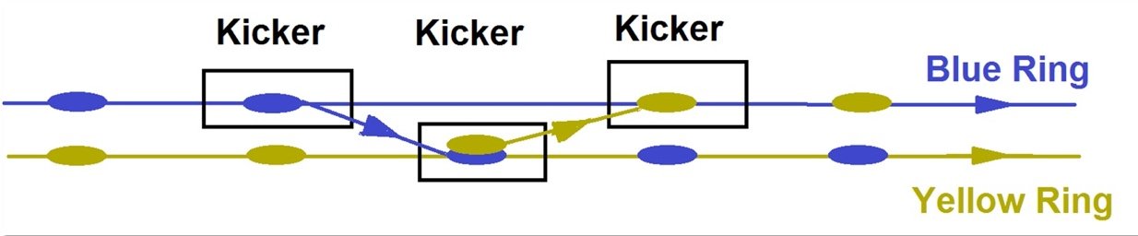
Maximum luminosity of 10³⁴ cm⁻²s⁻¹ doesn’t depend on feasibility of strong hadron cooling.
RHIC’s 2nd superconducting ring (Blue Ring) provides frequent on-energy injections into collider ring (Yellow Ring) replacing hadron bunches after 1 hr of storage.
Transfer takes 13 μs, preserves the total charge stored in both machines, avoiding transient injection effects
emittance growth between injections small gives average luminosity of up to ~ 10³⁴ cm⁻²s⁻¹
For small initial vertical emittance use standard DC electron beam cooling in the AGS.

Slide 14
Luminosity versus E_{CM} center of mass energy
EIC
Optimization for low E_{cm}
EIC
Optimization for high E_{cm}
Annual Integrated Luminosity [fb⁻¹]
Peak Luminosity [cm⁻²s⁻¹]
10³⁴
10³³
10³²
100
10
1
Tomography (p/A)
Spin and Flavor Structure of
the Nucleon and Nuclei
Internal
Landscape of the Nucleus
QCD at Extreme Parton Densities-
Saturation
150
Center of Mass Energy E_{cm} [GeV]

Slide 15
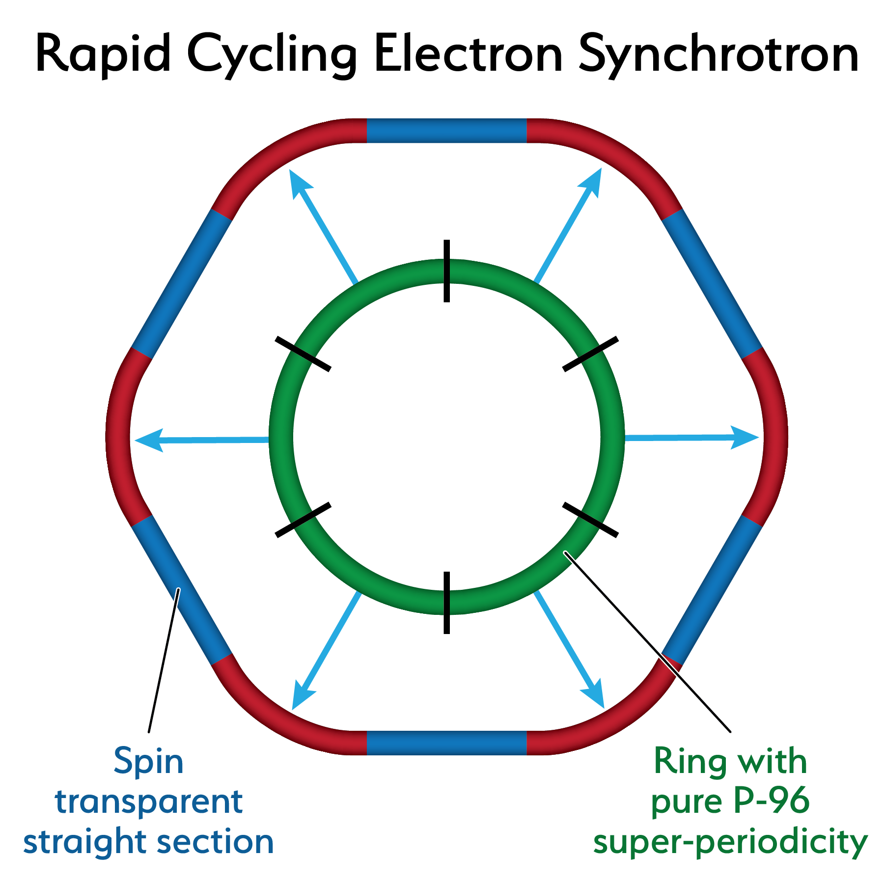
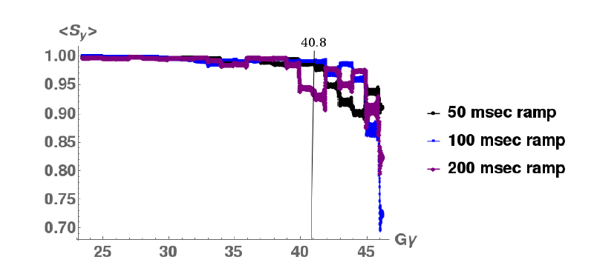
18 GeV Rapid Cycling Synchrotron enables high electron polarization in the electron storage ring
Ingenious optical design suggested by AGS experience: High quasi-periodicity arcs and unity transformation in the straights suppresses all systematic depolarizing resonances up to E >18 GeV
Good orbit control y_{cl.o.} < 0.5 mm; good reproducibility suppress depolarization by imperfection resonances.
➔ No depolarizing resonances during acceleration 0.4-18 GeV
no loss of polarization on the entire ramp up to 18 GeV (100 ms ramp time, 2 Hz)
RCS Design
RCS Polarization Performance

Slide 16
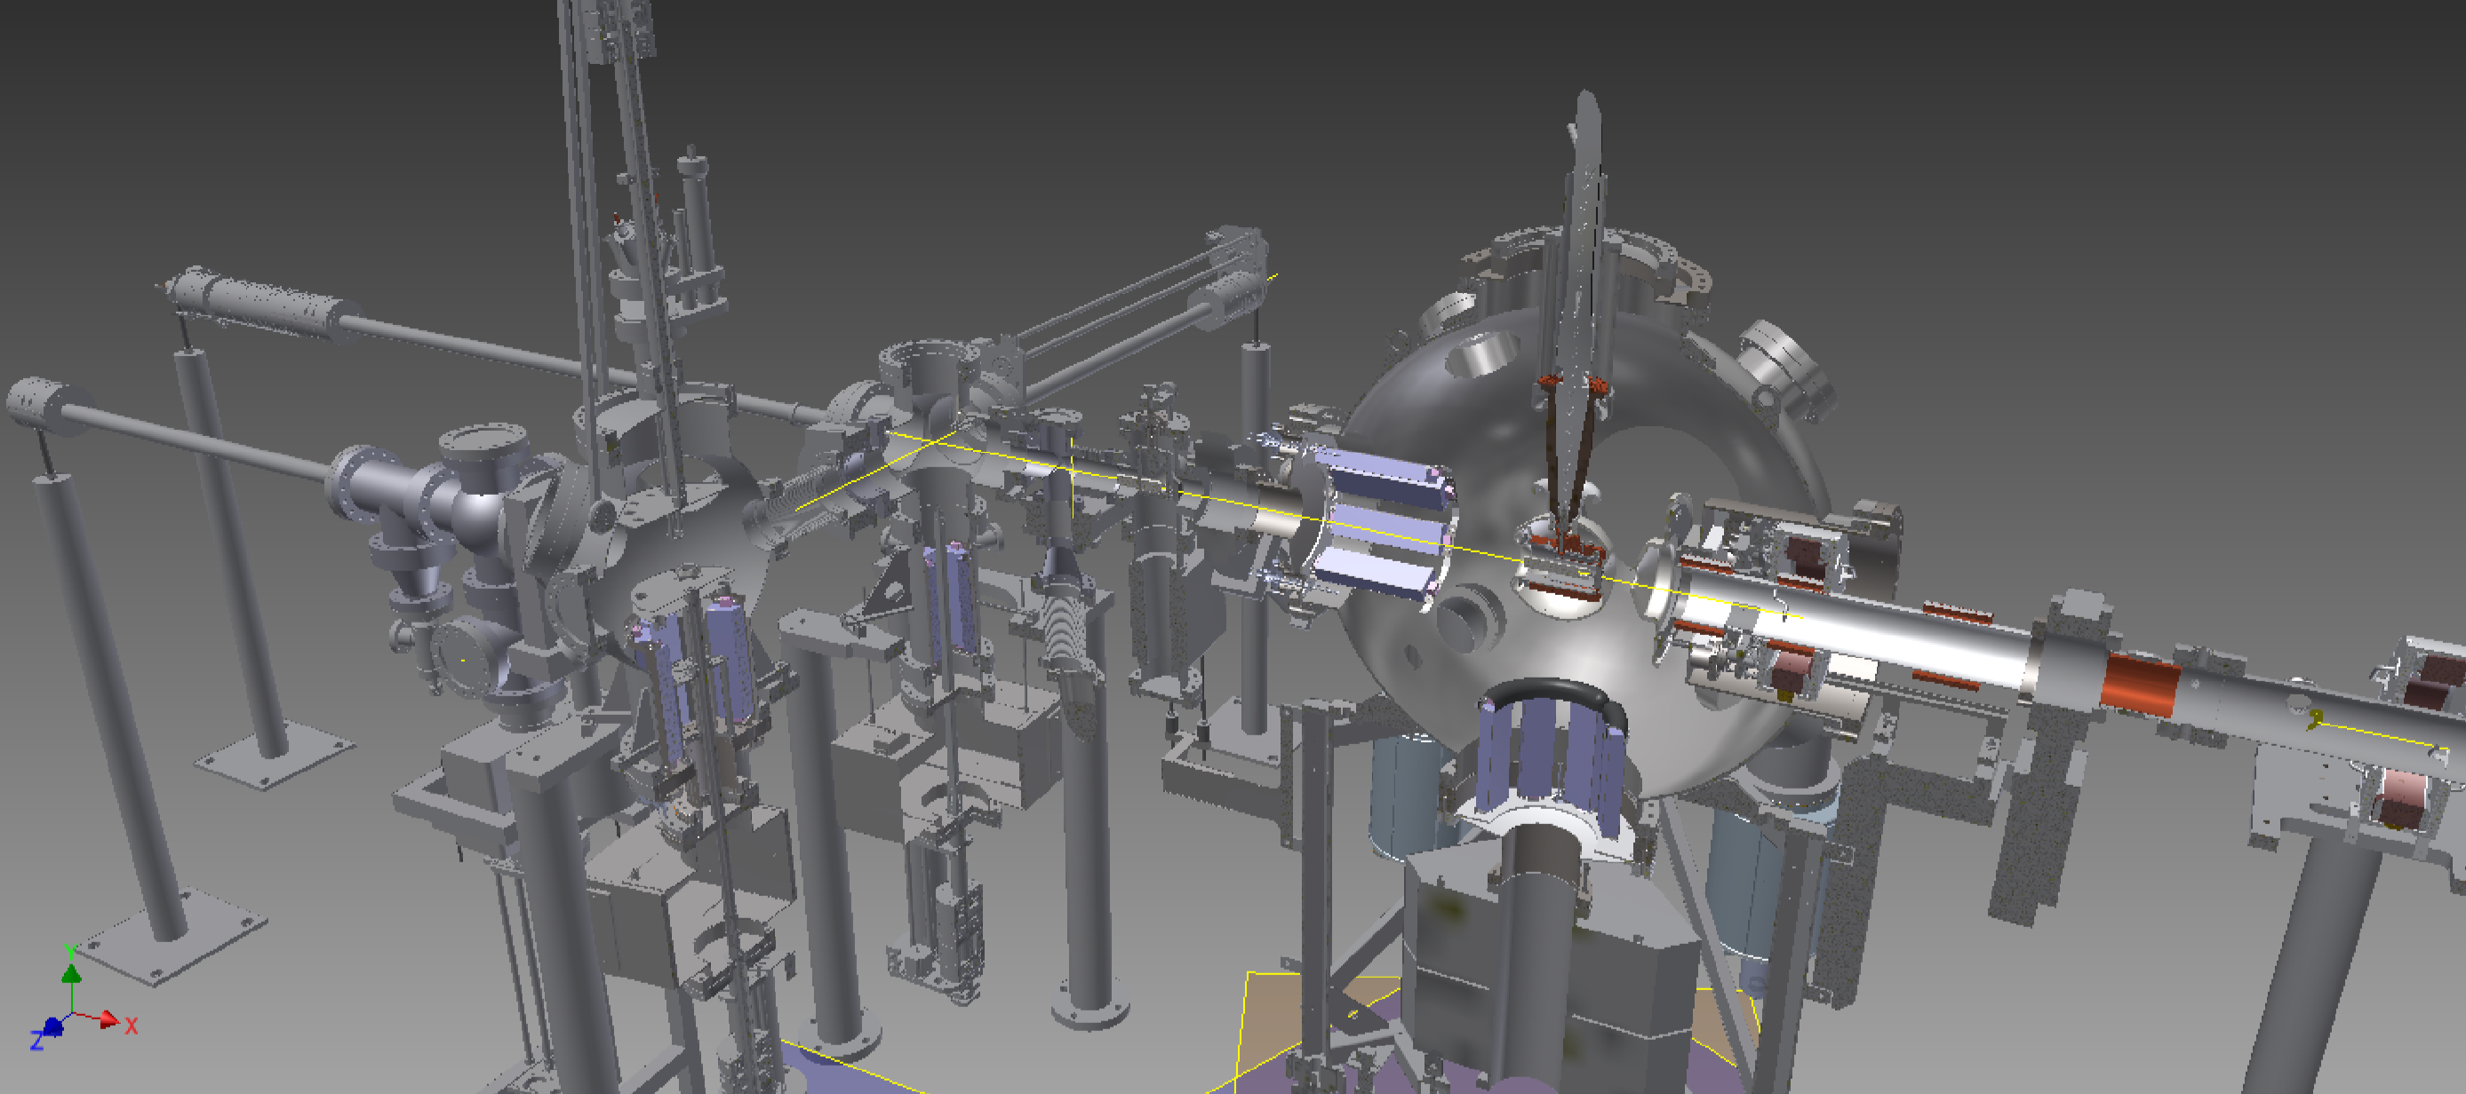
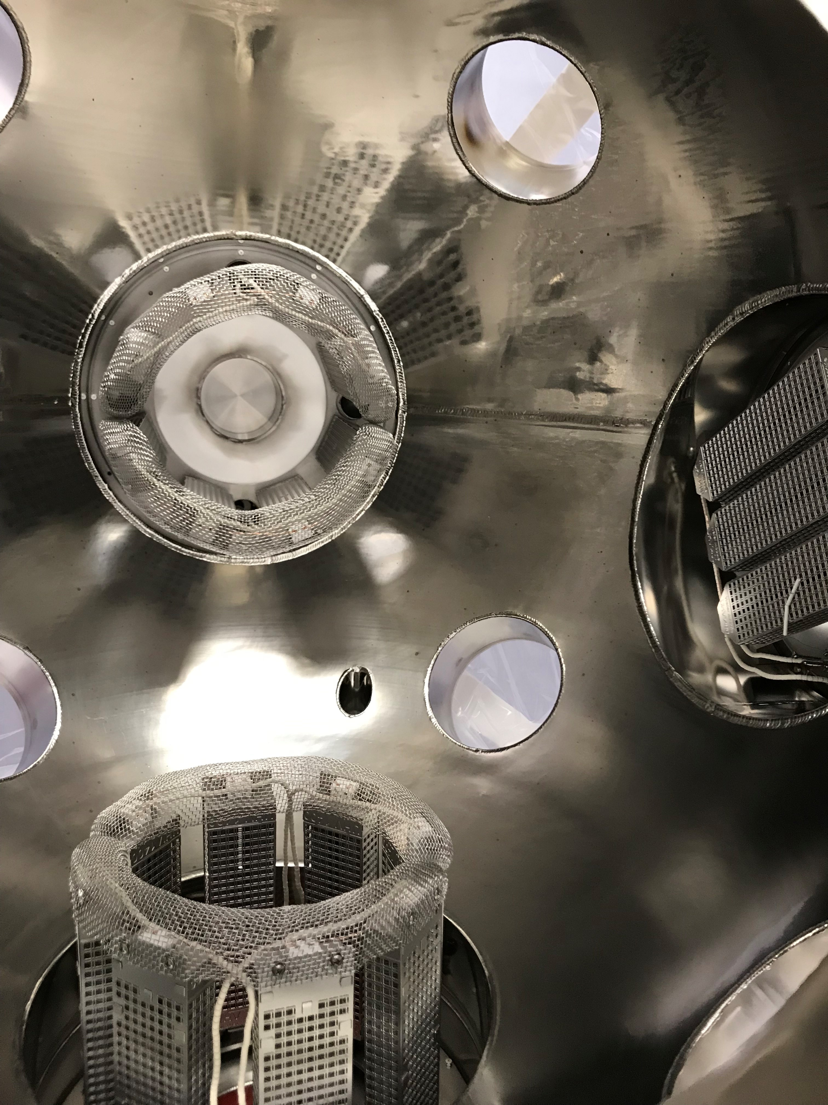
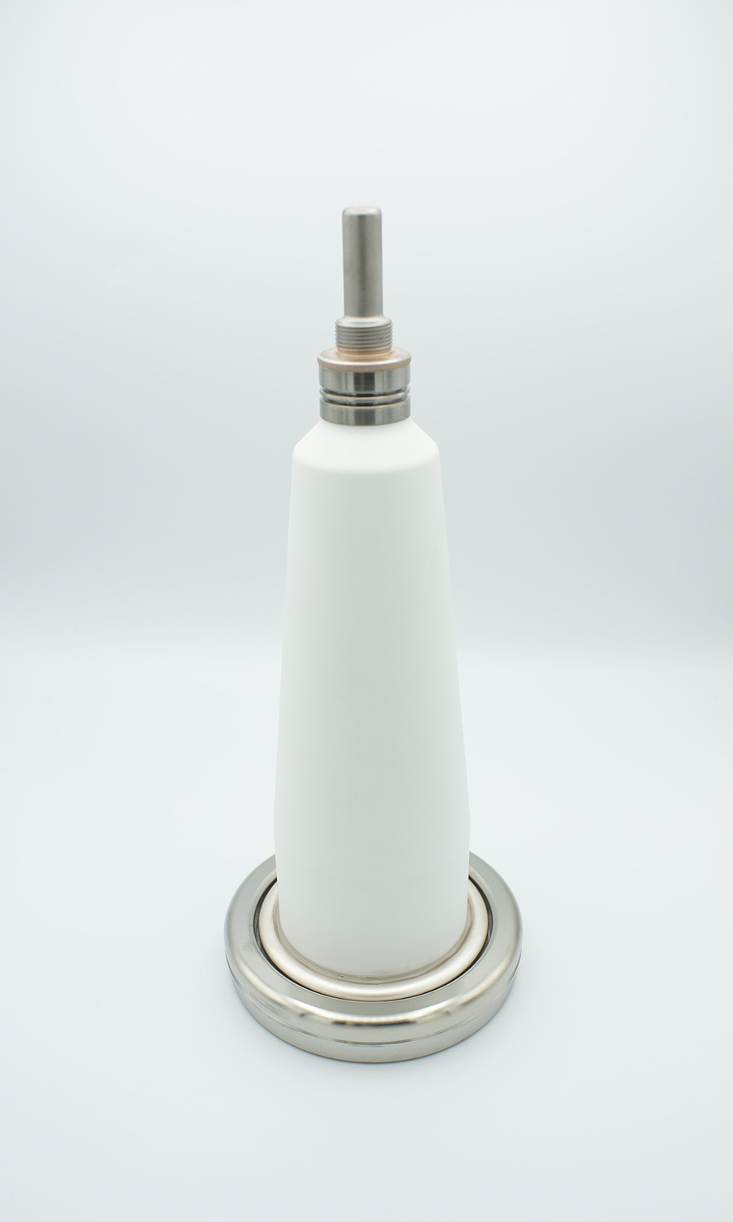
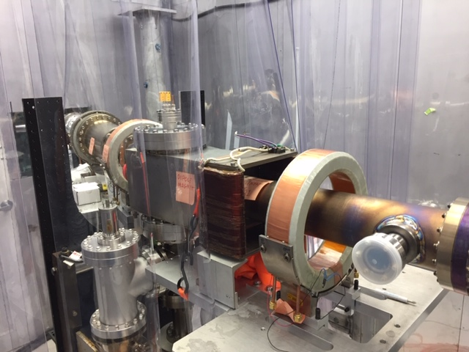
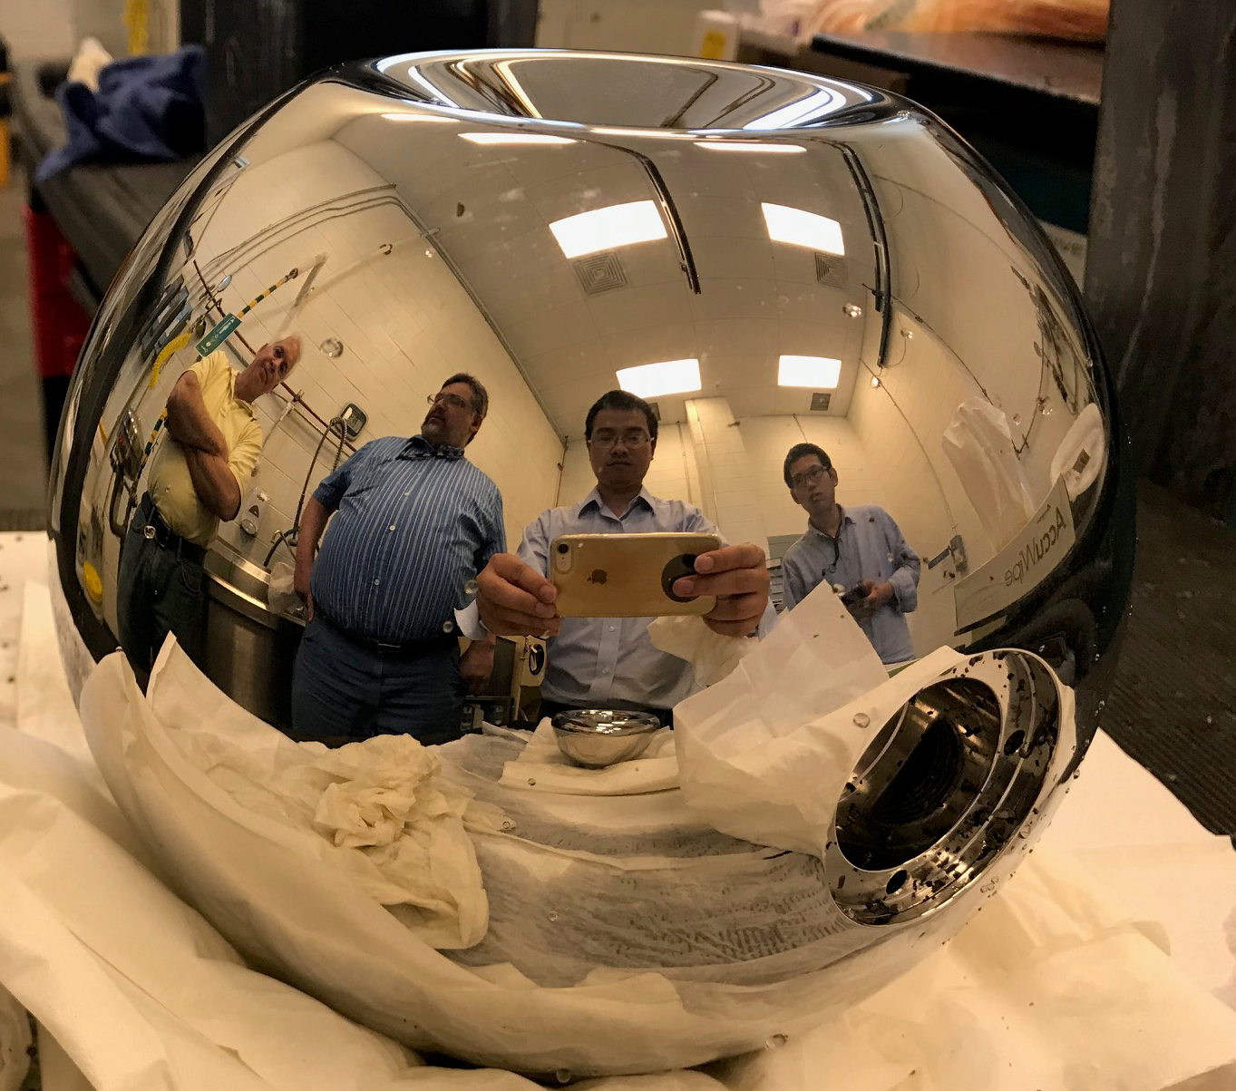
Polarized Electron Source
(Photo cathode gun R&D Prototype)
10-15 nC
400 kV electrons
80% polarization
With strained GaAs photocathodes
Gun vessel with 10⁻¹² torr scale vacuum
Inverted layout
Diagnostic beam line
Insulator ceramics
Submicron polished shroud

Slide 17
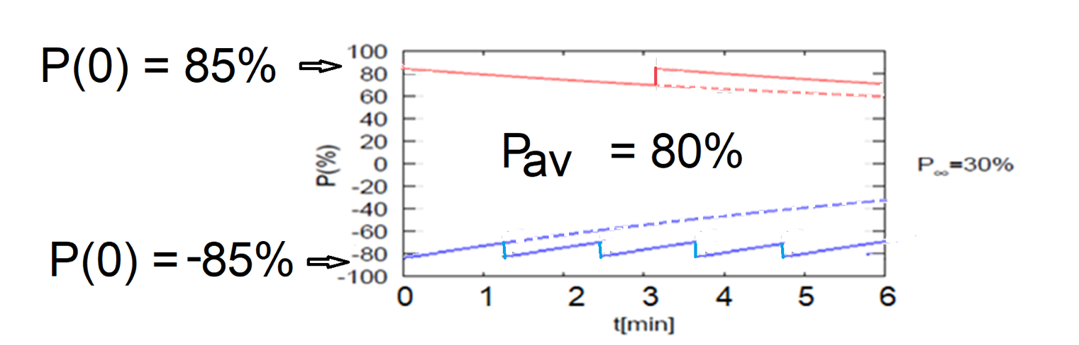
High average polarization at electron storage ring of 80% by
Frequent injection of bunches with high initial polarization of 85%
Initial polarization decays towards P∞ < ~50%
At 18 GeV, every bunch is refreshed in 2.2 min with RCS cycling rate of 2Hz.
B P
B P
Refilled every 1.2 minutes
Refilled every 3.2 minutes
Re-injection
P_{av}=80%
P∞= 30%
(conservative)
P_{av}=80%
Re-injections

Slide 18
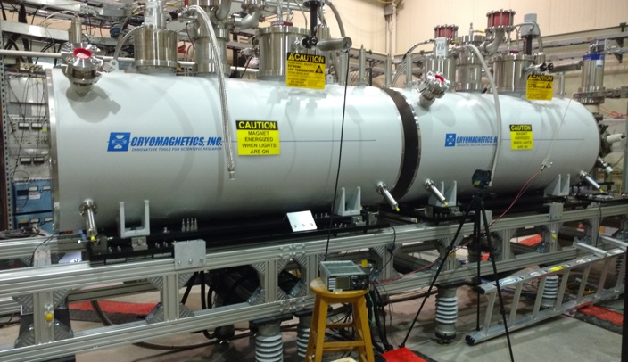
EIC Hadron Polarization
Existing p Polarization in RHIC achieved with “Siberian snakes”.
Near term improvements will increase proton polarization in RHIC from 60% to 80%.
³He polarization of >80% measured in source
80% polarized ³He in BNL-EIC will be achieved with six “snakes”,
Acceleration of polarized Deuterons in BNL-EIC 100% spin transparent
Need tune jumps in the hadron booster synchrotron
Electron beam ion source EBIS with polarized ³He extension

Slide 19
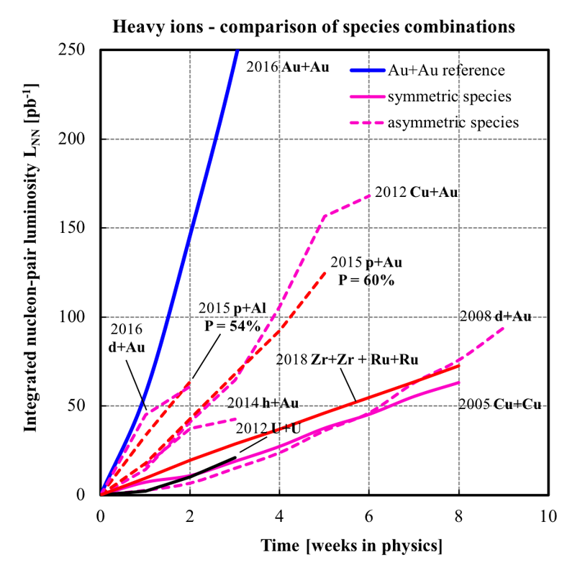
The existing RHIC ion sources & ion acceleration chain provides already today all ions needed for EIC
Ions from He to U have been already generated in the Electron-Beam-Ion-Source ion source (EBIS), accelerated and collided in RHIC
EBIS can generate any ion beam from ³He to U for the BNL EIC
Existing EBIS provides the entire range of ion species from He to U in sufficient quality and quantity for the EIC
Ion Pairs
in the RHIC Complex
Zr-Zr, Ru-Ru (2018)
Au-Au (2016)
d-Au (2016)
p-Al (2015)
h-Au (2015)
p-Au (2015)
Cu-Au (2012)
U-U (2012)
Cu-Cu (2012)
D-Au (2008)
Cu-Cu (2005)
Ion-Ion Luminosity Runs in RHIC 2005-2018
Accumulated Luminosity [pb⁻¹]
Enormous
versatility!
is a unique capability!
Operation Time [weeks]

Slide 20
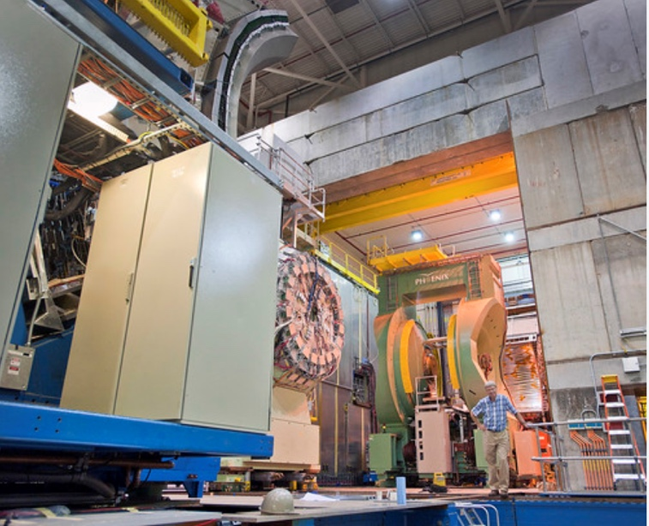
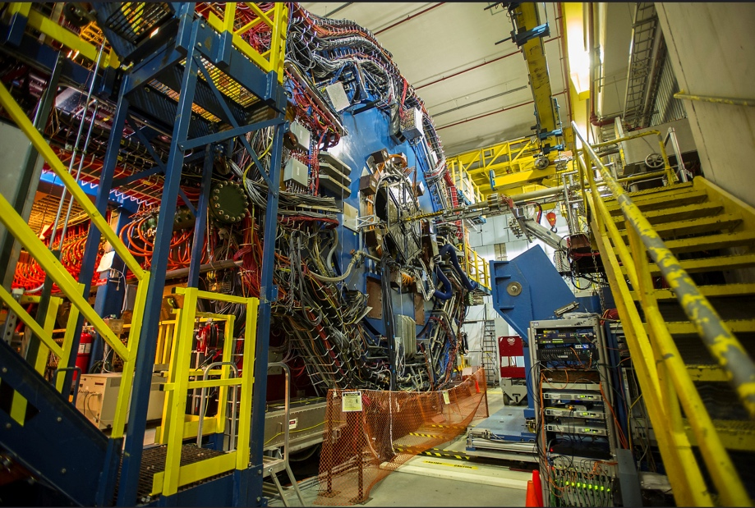
The EIC will benefit from two large existing detector halls in IR 6 and IR 8
Both halls are huge and fully equipped with infrastructure such as power, water, overhead crane, ….
20
20
IR 8 detector hall with PHENIX detector (transitioning to sPHENIX)
IR 6 detector hall with STAR detector
Both IRs can be implemented simultaneously in the BNL-EIC lattice and be accommodated within beam dynamics envelope
2 IR’s: laid out identically or optimized for maximum luminosity at different E_{CM}

Slide 21
BNL and JLAB are partnering in designing and building EIC
Ongoing FY20 Efforts
Developing the EIC design starting from the BNL EIC solution presented in FY19 (lattice design, dynamic aperture, beam-beam interaction, electron beam polarization polarization…)
  agreement on scope
  Organized in taskforces
  Taskforce charta and taskforce memos being finalized and
  participation close to final
  Taskforce coordinators determined (few require more discussion)
Additional Design scope for alternative design choices
  RF frequency changes – being investigated and discussed
  Alternative machine parameters for low center of mass energy
  Alternative methods of strong hadron cooling
EIC R&D tasks
Under discussion

Slide 22
Common Design Team Activities
RF Beam Physics in the Electron Storage Ring
Impedance Driven Instabilities in the Electron Storage Ring
Ion Instabilities in the Electron Storage Ring
Beam-beam
Compact spin rotators
Dynamic aperture at 18 GeV
eSR polarization
HSR polarization
RCS beam dynamics
RCS polarization
Radial shift in hadron ring
Detector/solenoid integration
Low energy luminosity / facility optimization
Crabbing dynamics
Detector beampipe design and vacuum system
Interaction region analysis for multipoles

Slide 23
Additional design work/changes Proposed by TJNAF
Alternative concepts of high energy cooling
and work on low energy pre-cooling
Spin rotator solenoids
Matching section magnets
RF frequency choice
…
➔ This needs further discussion and
some design changes imply a new design concept

Slide 24
New York State Support
NYS has announced that it will support an EIC being built at BNL with a 100 M$ grant to be spent on infrastructure development such as:
  Buildings,
  access road,
The execution of this scope require close collaboration between the laboratory support organizations, the EIC project, the collider accelerator division to coordinate
  New infrastructure
  Improvement and refurbishment of existing infrastructure
  Improvement on technical sub-system
➔ This demands a way of organizing and coordination of the work which is outside the project organization, but is closely tied to project management

Slide 25
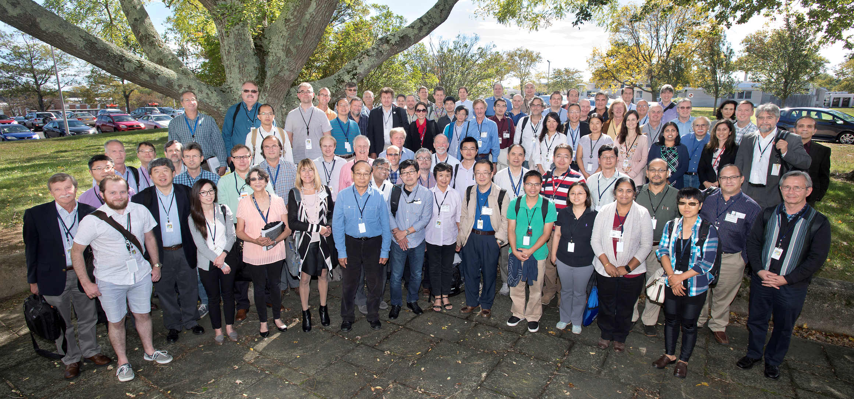
EIC Pre-CD0 Design: a collaboration effort
2017 EIC collaboration meeting at BNL

Slide 26
Summary
EIC pre-CD0 design efforts support all NSAC and NAS requirements
Pre-CD0 Development is a good starting point for the Conceptual Design
EIC exploits existing RHIC accelerator tunnel, service buildings, superconducting accelerator rings, and hadron injector chain incl. polarized particle sources and infrastructure ➔ enables cost effective implementation
Design of the electron storage ring and its injectors relies on established accelerator technology
Single design parameters are within values which have been demonstrated at other facilities before, but are novel and unprecedented as a whole
➔ Results in robust, low risk concept, implementable in a straightforward way
… will be quickly commissioned;
means that routine operation & physics data emerge soon after startup
First pass on EIC organization; is under discussion with potential partners
Efforts so far include many contributions from collaborators
Project execution envisioned as a multi laboratory partnership

Slide 27
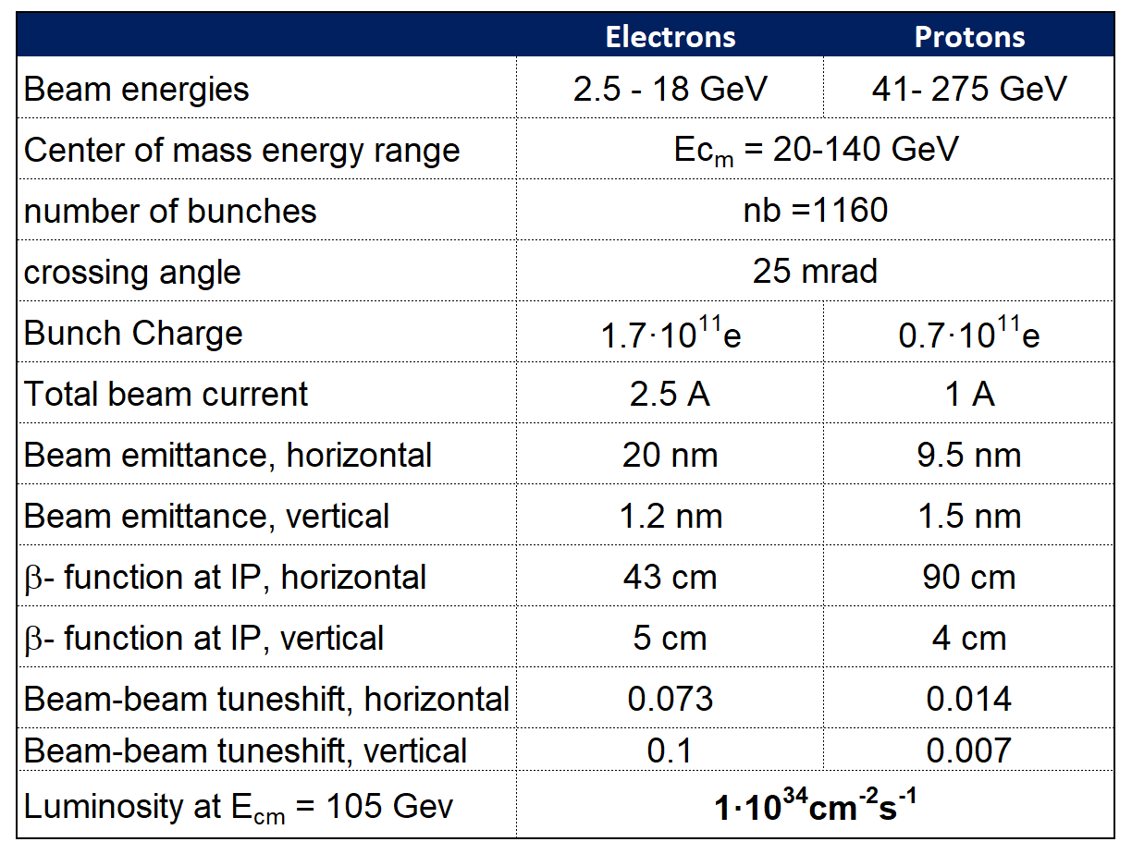
EIC Parameters for E_{cm} and Luminosity

