Slide 1
Tagging & Diffraction Working Group Update
19March 2020
Conveners: Wim Cosyn (Florida), Or Hen (MIT), Douglas Higinbotham (JLab),
Spencer Klein (LBNL) and Anna Stasto (PSU)

Slide 2
Topics and Collaborators
Physics topics include
Pion/Kaon Tagged Deep Inelastic Scattering
Deuteron & ³He Tagging (e.g. F2n)
Nuclei & Short-Range Correlations ( A > 2 )
Target Fragmentation
Incoherent vector meson photoproduction
Determination of the diffractive structure functions
Hadron spectroscopy
91 Collaborators Signed-up For This Working Group
People’s time to help currently limited with many now suddenly swamped creating online class material
Activity / excitement is ramping up with many people committing to help in the near future especially this summer

Slide 3
Presentations for 1st Yellow Report Meeting
Thursday Afternoon (16:30 to 17:30)
Zhoudunming Tu: Spectator tagging in deuteron breakups and kinematics determination using BeAGLE generator
Florian Hauenstein: Update on detection of SRC nucleons in QE kinematics
Dien Nguyen: Semi-inclusive DIS measurements on A =3
Friday Morning (09:30 to 13:00)
Michael Klasen: Perspectives on diffractive jet production at the EIC" Michael Klasen
Anna Stasto: Inclusive diffraction at future Electron - Ion colliders
Mark Strikman: Coherent vector meson production off heavy nuclei - lessons from studies of ultraperipheral collisions at the LHC
Christian Weiss: Probing quantum fluctuations of the nucleon’s gluon density with inelastic diffraction at EIC
Spenser Klein: Near threshold photoproduction a2(1320) and other topics
Richard Trotta: Meson Structure at the EIC
In addition we will have a joint session with exclusive reactions and the detector working group on Friday afternoon (14:00 to 15:30) with both physics discussion as well as simulation results with the interaction region and detectors with special thanks to Alexander Jentsch.

Slide 4
Some Selected Highlights Since Kick-off Meeting

Slide 5
Meson MC outputs lund files for use in GEANT4
Updated to the EIC crossing angle and beamline

Slide 6
Do To List From the Meson group
Currently only have Roman Pots in forward region, which is ok for DVCS, but will need more detectors for meson structure measurements
Determine where detectors should go by putting virtual detectors at different z-locations in-between the magnets
Based on these results determine what space is needed for these additional detectors.
More details and updates will be presented in Richard Trotta's talk on Fri. 11:30 am.

Slide 7
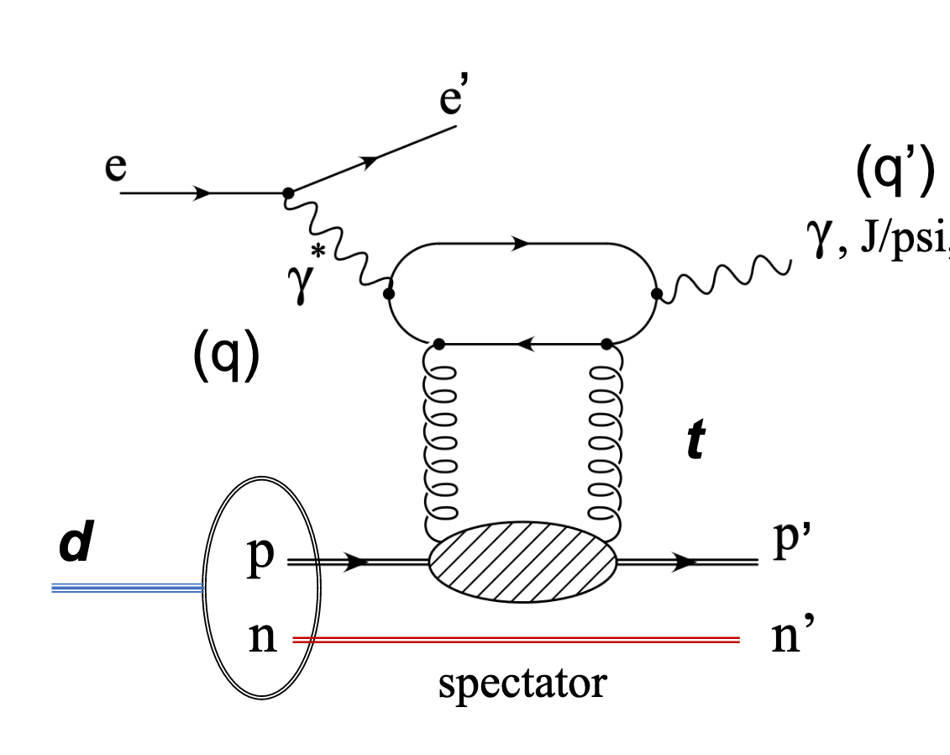
Deuteron Break-up In BeAGLE (J/Phi)
Kong Tu (BNL) with Mark Baker, Axel Jentsch, and others
e+D -> e’+J/psi+p’+n’
18 GeV electron scattering off 135 GeV deuteron
Realistic deuteron wavefunction from Phys. Rev. C 53, 1689
Light cone kinematics of nucleons in deuteron taken from Strikman & Weiss, Phys. Rev. C97, 035209
1M events with incoherent diffractive J/psi production
P_{m} is the momentum of the spectator
For more details: : https://indico.bnl.gov/event/7968/contributions/35578/attachments/26941/41029/Kong_03_05_2020.pdf

Slide 8
Low P_{m} limited by resolution effects while the high P_{m} limited by acceptance effects.
Simulations already done for other energies too and can be used in detailed simulations (e.g. EICROOT & GEANT4 )
For me details see Kong's talk on Thu [4:30pm]

Slide 9
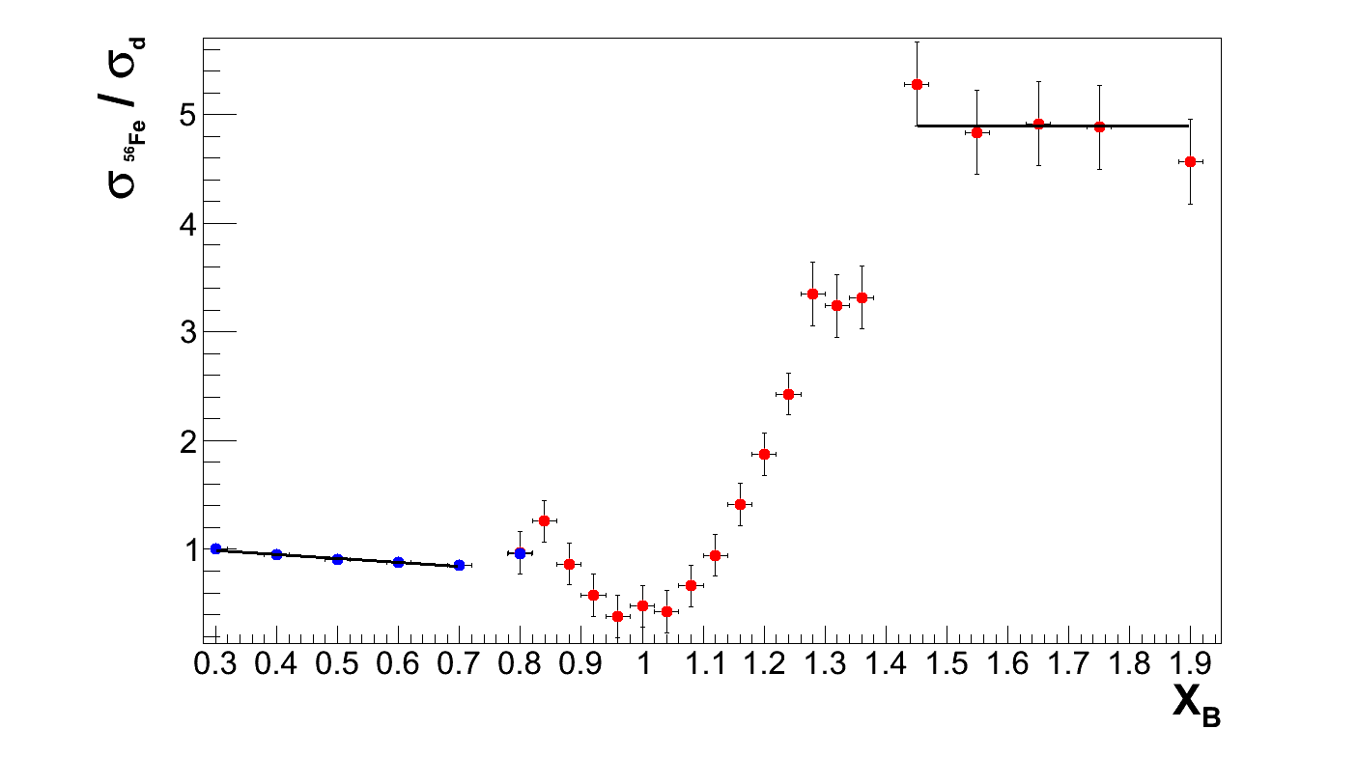
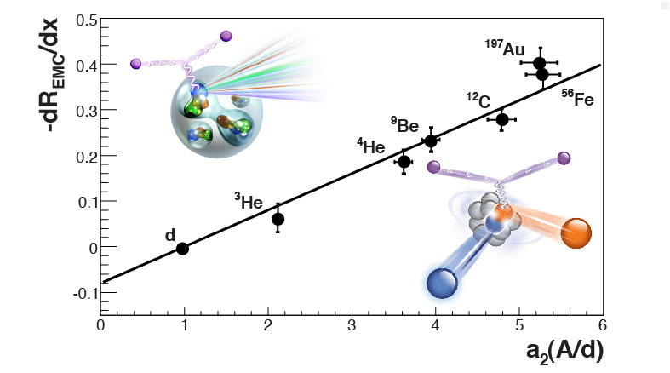
Short-Range Correlations & the EMC Effect
L. Weinstein et al., Phys. Rev. Lett. 106 (2011) 052301.
Q² = 2.5 [GeV/c]²
SRC Plateau
EMC Slope
Summary written for the CERN Courier: https://cerncourier.com/a/the-emc-effect-still-puzzles-after-30-years/

Slide 10
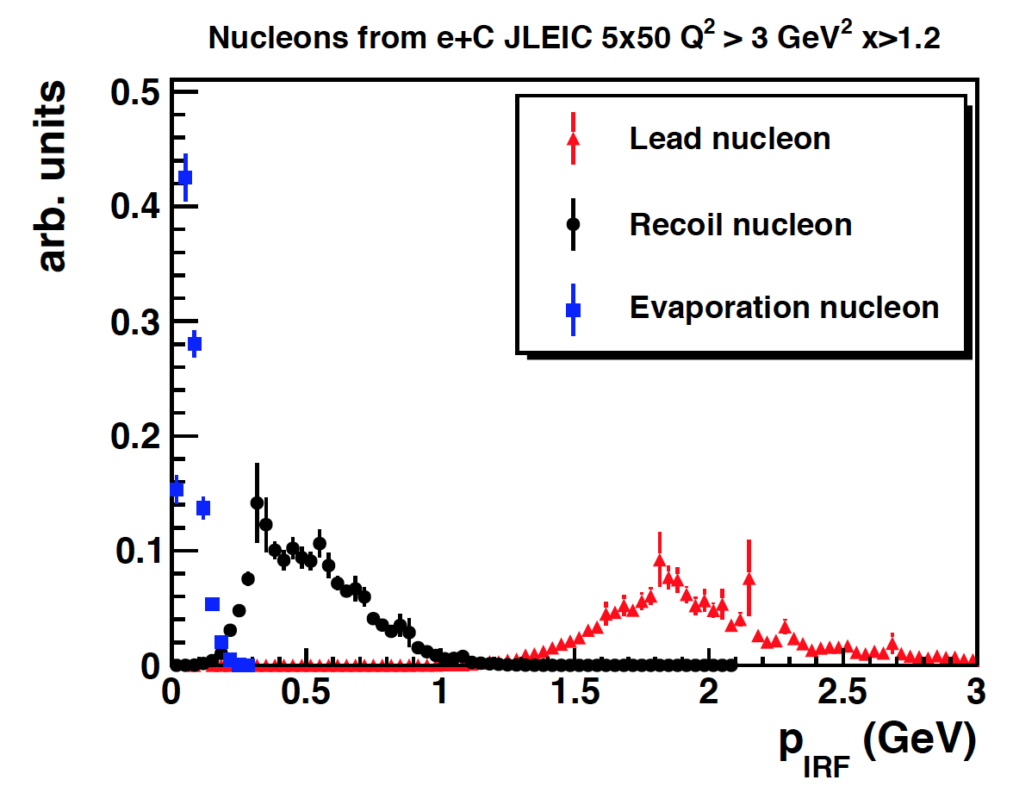
Detecting Quasi-Elastic SRC Events
BeAGLE updated to have a realistic high momentum tail based on GCF (e.g. A. Schmidt et al., Nature 578, 540–544 (2020). https://doi.org/10.1038/s41586-020-2021-6
Figure shows example momentum distribution in the ion rest frame (p_{IRF}) for the leading and recoiling nucleon of an SRC pair (red and black) and evaporating nucleons from the A−2 remnant nucleus (blue). The simulation was done with e+C reactions with beam energies of 5GeV for electrons and 50GeV for carbon for x > 1.2 and Q² > 3 GeV².
Florian Hauenstein (ODU) has redone these simulations for the yellow report (energies and angle) and yesterday his results were run through g4e and will also can be run through EICROOT so detailed results available very soon as well as a nice head-to-head comparison of codes.
More details in Florian's talk Thu. 5:00pm.

Slide 11
Next Step will be to add DIS SRC Events
Over the coming months (with support from MIT) plan to implement a DIS version of the generalized contact formalism into BaAGLE
This should create a rather realistic approximation of the EMC effect
This will let us test predictions of how the EMC effect should behave not just for inclusive but also for semi-inclusive events
Upcoming CLAS12 Experiments
EIC Yellow Report Detector Requirements
Hopefully will lead to the resolution of the EMC effort puzzle!

Slide 12
Summary & Outlook
Several of our sub-groups already have new Monte Carlo results:
Pion/Kaon TDIS (R. Trotta, Fri. 11:30)
Diffractive Deuteron (Z. Kong Tu, Thurs. 4:30)
Short-Range Correlations (F. Hausenstein 5pm Thurs. 5pm)
Generators ready and/or being updated and new Monte Carlo result expected soon:
Diffractive Jet Production (M. Klasen Fri. 8:30 am)
Inclusive diffractive structure functions (A. Stasto Fri. 9 am)
Coherent vector meson production on heavy nuclei (M. Strikman Fri. 9:30 am)
Quantum fluctuation of nucleon’s gluon density with inelastic diffraction (C. Weiss Fri. 10am)
Near threshold photoproduction (S. Klein Fri. 11 am)
New polarized ³He group efforts (Richard Milner et al.) are underway. This group is preparing a JLab/CLAS12 letter of intent while also making sure they setup their codes such that they can also do EIC simulations (D. Nyugen Thurs. 5:30pm). This should compliment previous studies.
Overall, the tagging and diffractive processes subgroup is working on understanding how the current IR acceptances affect our golden measurements and what the detector requirements will be for these reactions. We are also working on understanding our luminosity requirements.
We have strong overlap with the exclusive working group with our focus on those exclusive reactions that make use of the far forward detectors.
New collaborators are welcome!

Slide 13
Backup Material

Slide 14
Pion and kaon structure at the electron-ion collider
A.C. Aguilar et al., Eur. Phys. J. A 55, 190 (2019). https://doi.org/10.1140/epja/i2019-12885-0
Comparison of the electron-ion collider (EIC) with (HERA)
Paper shows how the EIC can answer questions about how the mass and structure arise in the pion and kaon
Done with geometric acceptance with standard Pythia
The group is now working on doing realistic simulations

