Slide 1
Summary of the Tracking WG session
1st EIC Yellow Report Workshop @ Temple University
Domenico Elia
Leo Greiner
Kondo Gnanvo

Slide 2
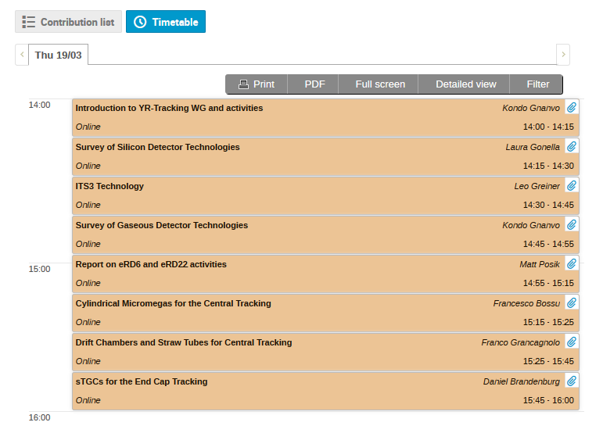
Tracking WG – Technologies Summary

Slide 3
Si tracking summary (instrumentation)
Report from Laura Gonella on the technology survey for inner detector Si tracking
https://indico.bnl.gov/event/7449/contributions/35954/attachments/27180/41558/20200319-EIC-YR-SiTech-v2.pdf
Technology assessment:
  Hybrid pixels, strip and pad sensors – do not meet EIC requirements for pixel size and X/X0
  LGAD – do not meet EIC requirements for pixel size, X/X0, power dissipation
  DEPFET and other technologies – do not meet EIC requirements as they are (rolling shutter readout). Would need extensive development path.
  DMAPS – Technology does meet EIC requirements. Has an existing development path for sensor that meets the EIC requirements.
  Conclusion: “the best path forward to arrive at an EIC Si vertex and tracking detector with the required performance is to join the ITS3 effort and contribute to integrating the EIC requirements into the ITS3 sensor design”
Report from Leo Greiner on ITS3 sensor silicon consortium
https://indico.bnl.gov/event/7449/contributions/35955/attachments/27131/41358/2020_03_18_EIC_ITS3_tech.pdf
The ITS3 effort is underway with work package (WP) meetings
There is a schedule defined and WP responsibilities defined – BUT – this is all pre covid-19
For EIC use we would need to add additional WP to develop discs/staves/infrastructure.
Non ITS/ALICE/CERN groups are welcome by design so we are developing a EIC silicon sensor consortium and joining this effort with many EIC interested groups (see Laura’s talk). Please contact Leo if any one wants to join.

Slide 4
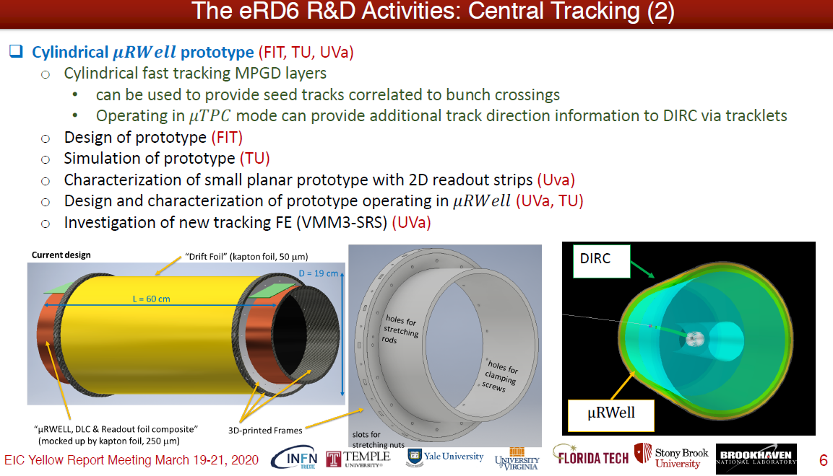
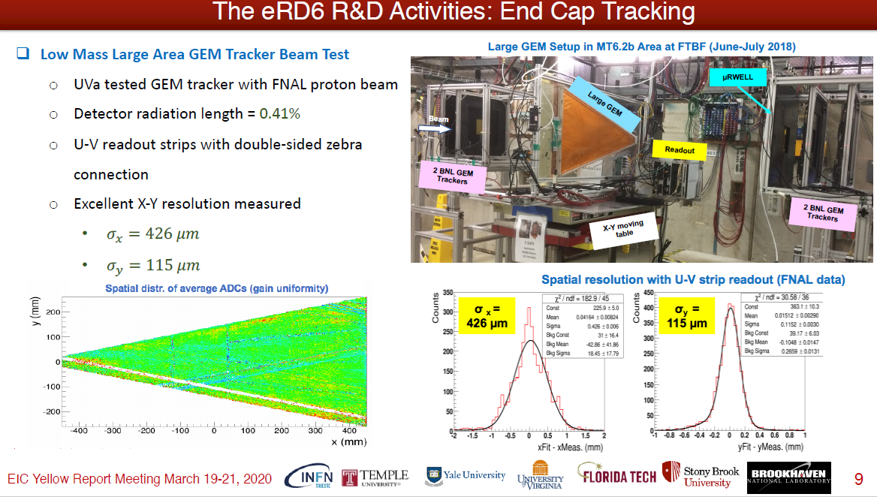
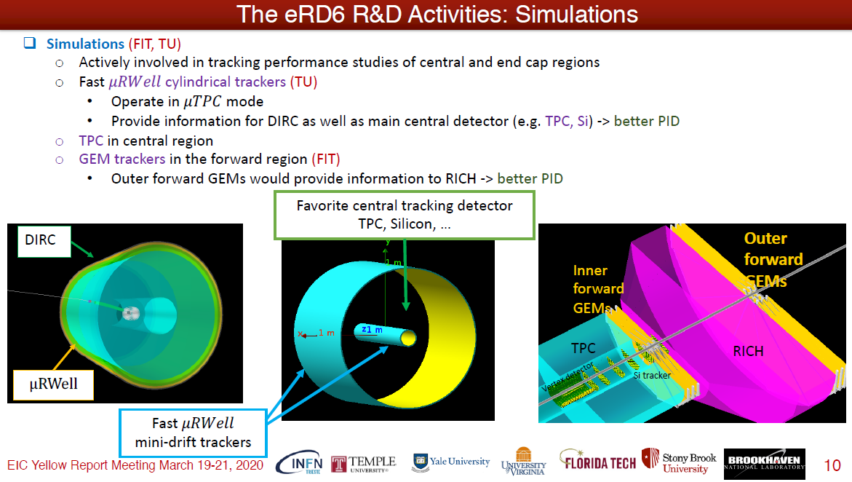
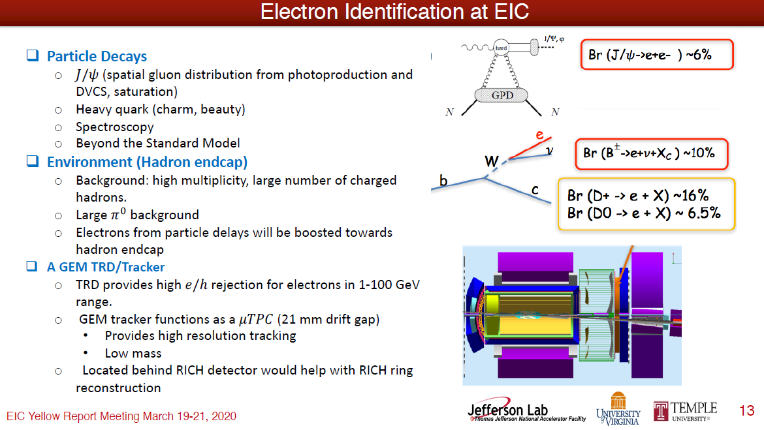
Overview of EIC R&D Gas Tracking Projects
M. Posik, Temple U.
eRD6 End Cap Tracking: MPGD (GEMs, µRWELL)
eRD6 Central Tracker: TPC + Cyl. Fast Signal µRWELL layer
https://indico.bnl.gov/event/7449/contributions/35957/attachments/27141/41373/posik-eRD6-Summary.pdf
eRD22 - Hadron End Cap Tracking & PID: (GEM-TRD/T)
eRD6 Simulation Effort: Synergy with YR Tracking WG

Slide 5
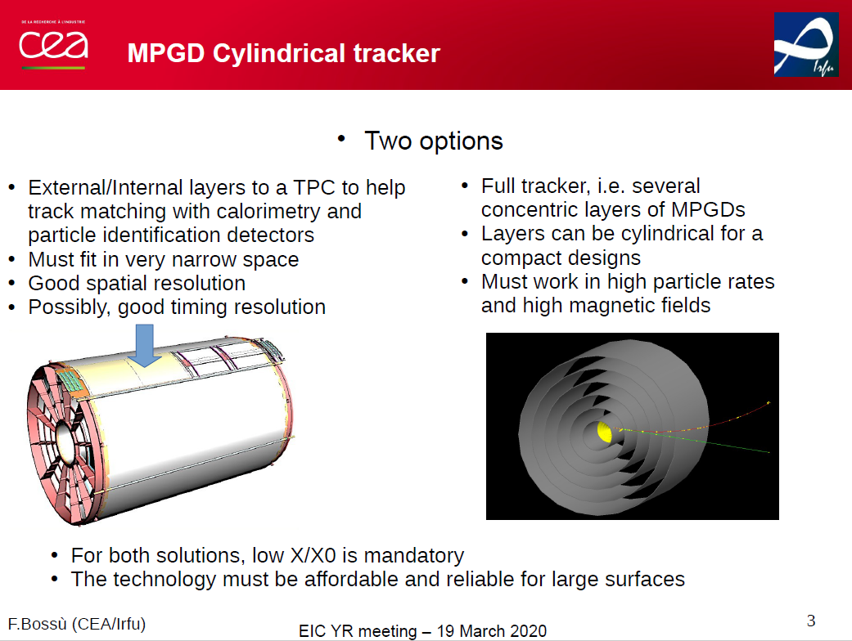
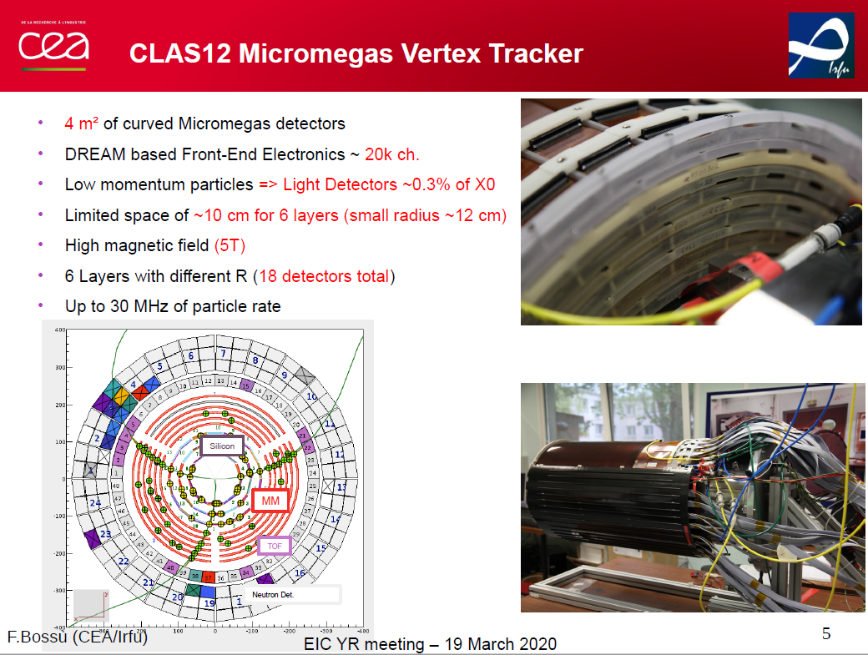
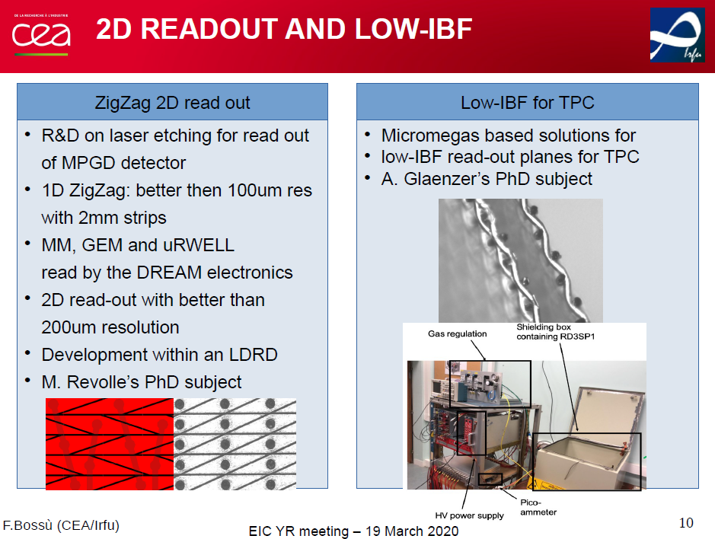
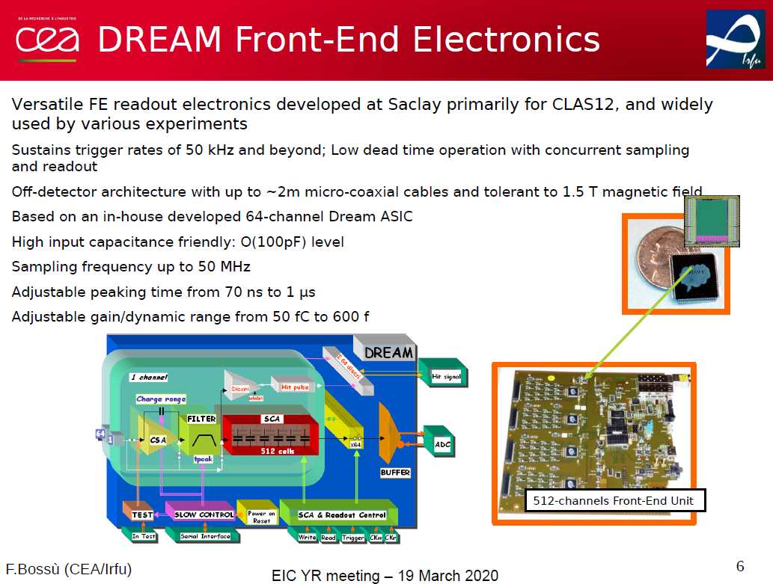
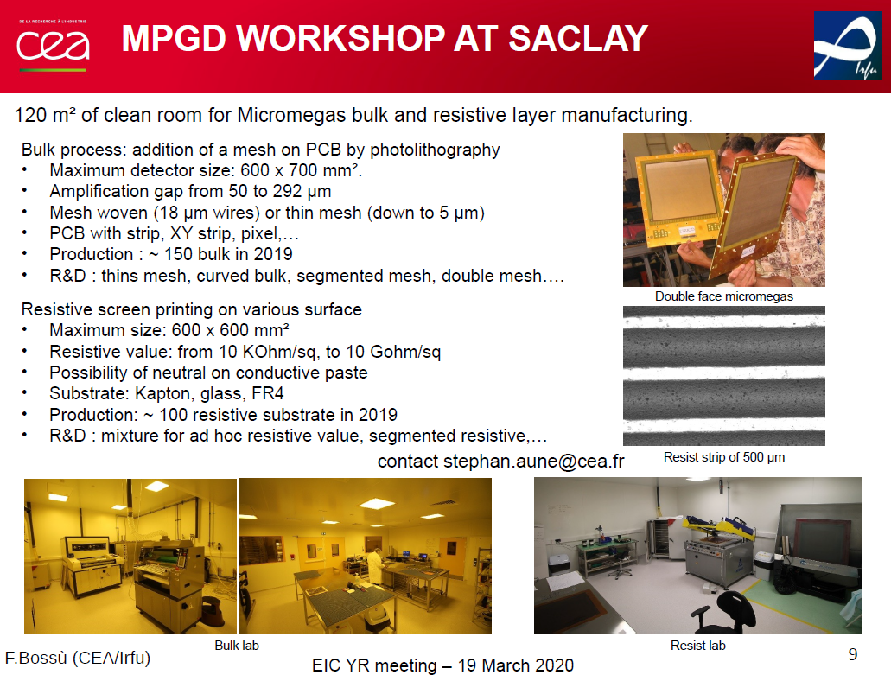
Cylindrical Micromegas Tracker and More …
F. Bossu, CEA Saclay, France
CEA Saclay: Exploring Cylindrical Micromegas
Full multiple cylindrical Outer Tracker
Fast signal tracking layer with TPC
Experience with CLAS12 @ Jlab
Cylindrical Micromegas Vertex Tracker (MVT)
Ongoing R&D:
Development of 2D strip readout structure
Minimization of IBF
https://indico.bnl.gov/event/7449/contributions/35958/attachments/27181/41436/CEASacaly_EICYR_Tracking_TempleMeeting.pdf
Experience with FE readout: DREAM Electronics for CLAS12 MVT

Slide 6
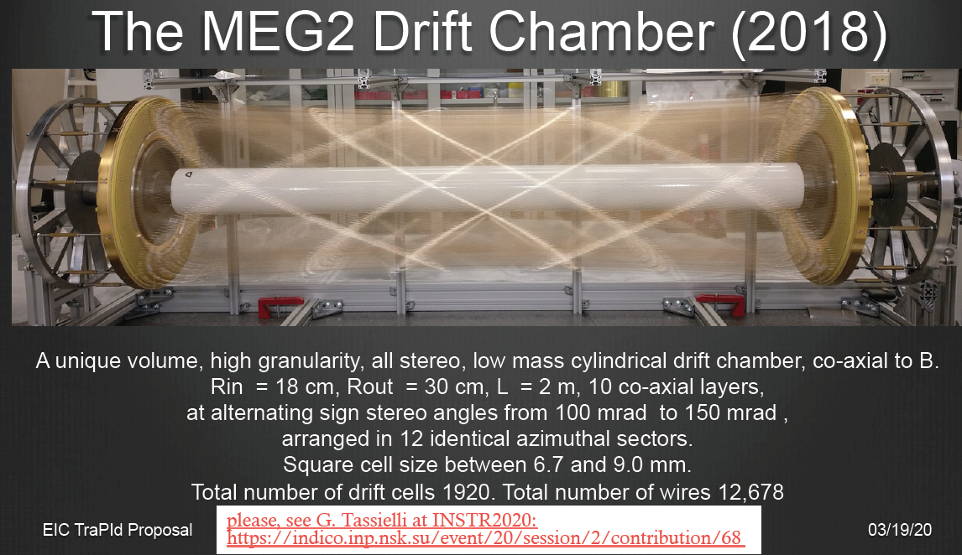
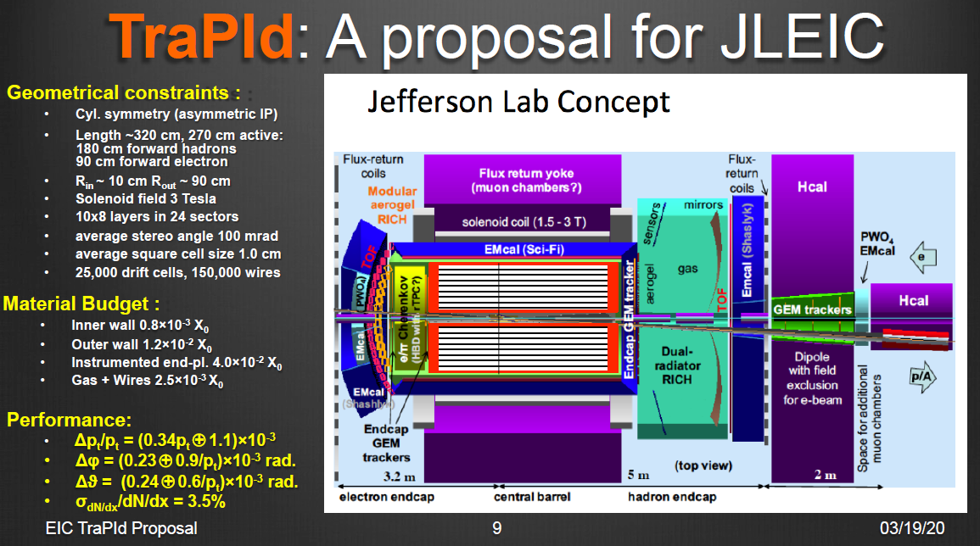
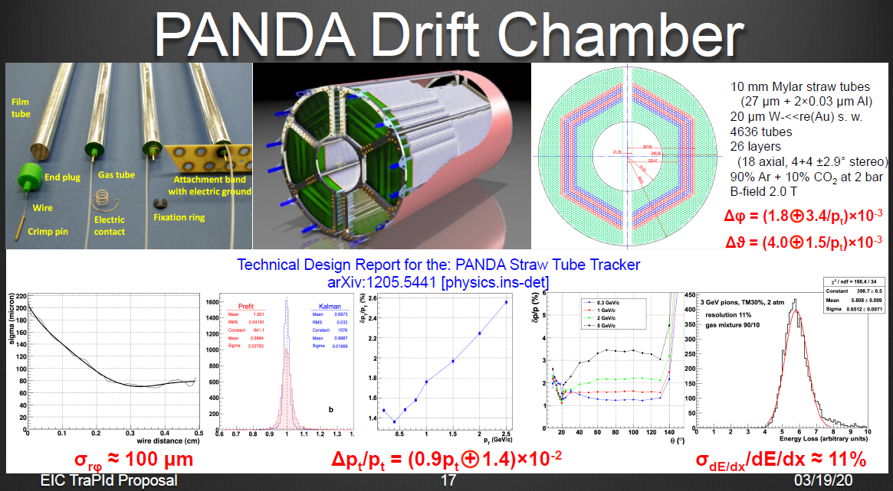
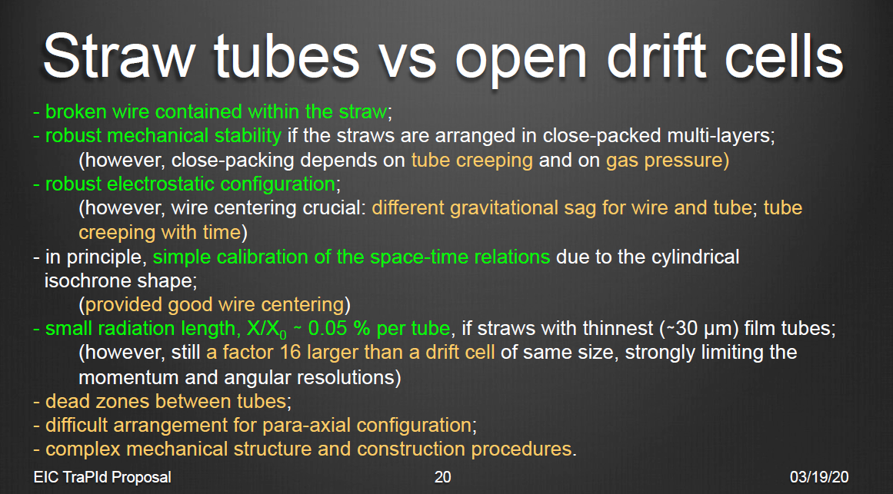
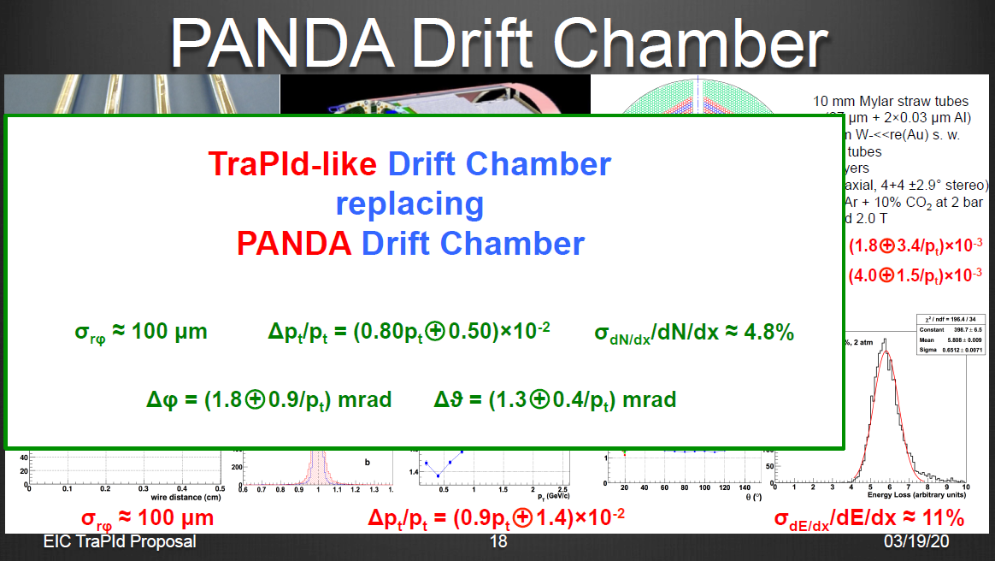
An Ultra Low-Mass Drift Chambers with Particle Identification for EIC
F. Grancagnolo, INFN Lecce, Italy
Innovation for Cyl. Low Mass Drift Chambers
Separation of gas containment from wire support
No feed through wiring
Large number of thinner wires (low mass)
Cluster timing for improved spatial resolution
Cluster counting (dN/dx) improved PID
TraPId: A proposal for JLEIC Detector
  New ideas worth exploring
Straw Tubes approach vs. Open cells DC
Low mass straw tubes i.e. PANDA or GLUEX
https://indico.bnl.gov/event/7449/contributions/35959/attachments/27182/41438/BrookhEIC180502.pdf

Slide 7
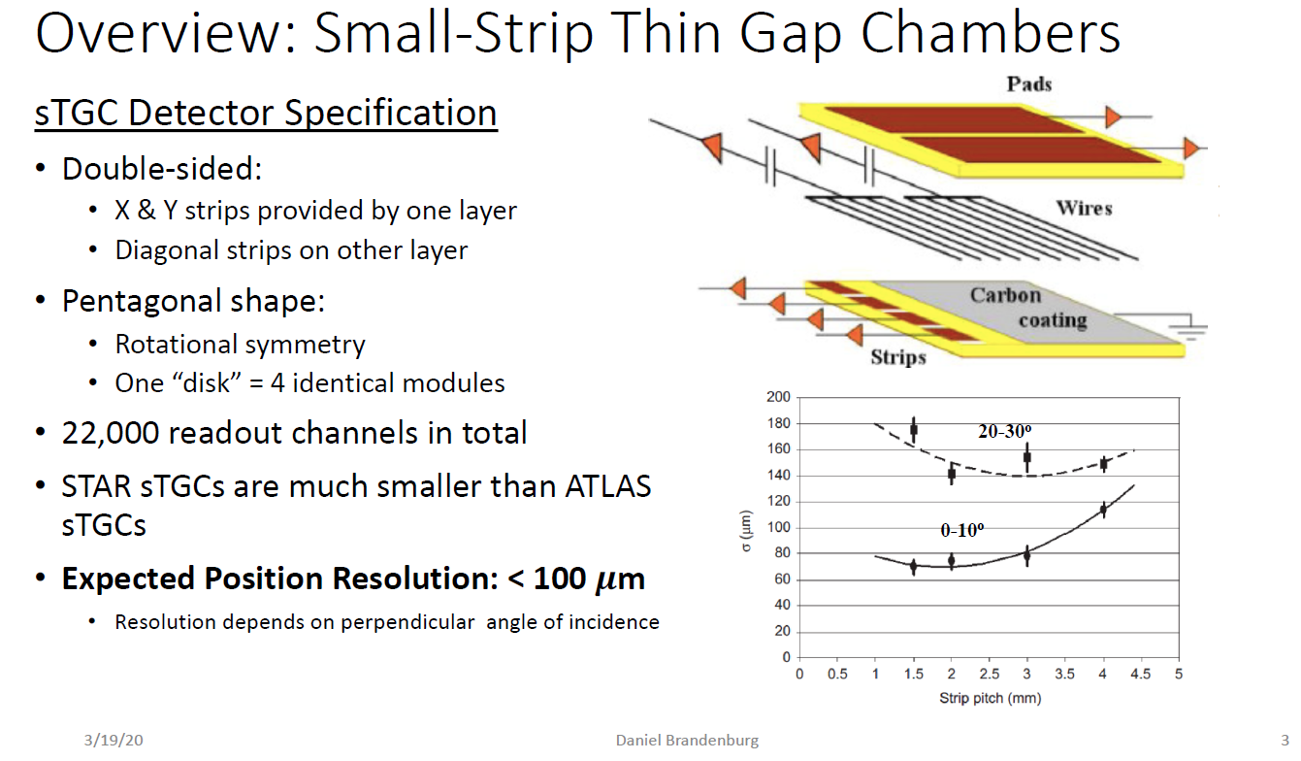
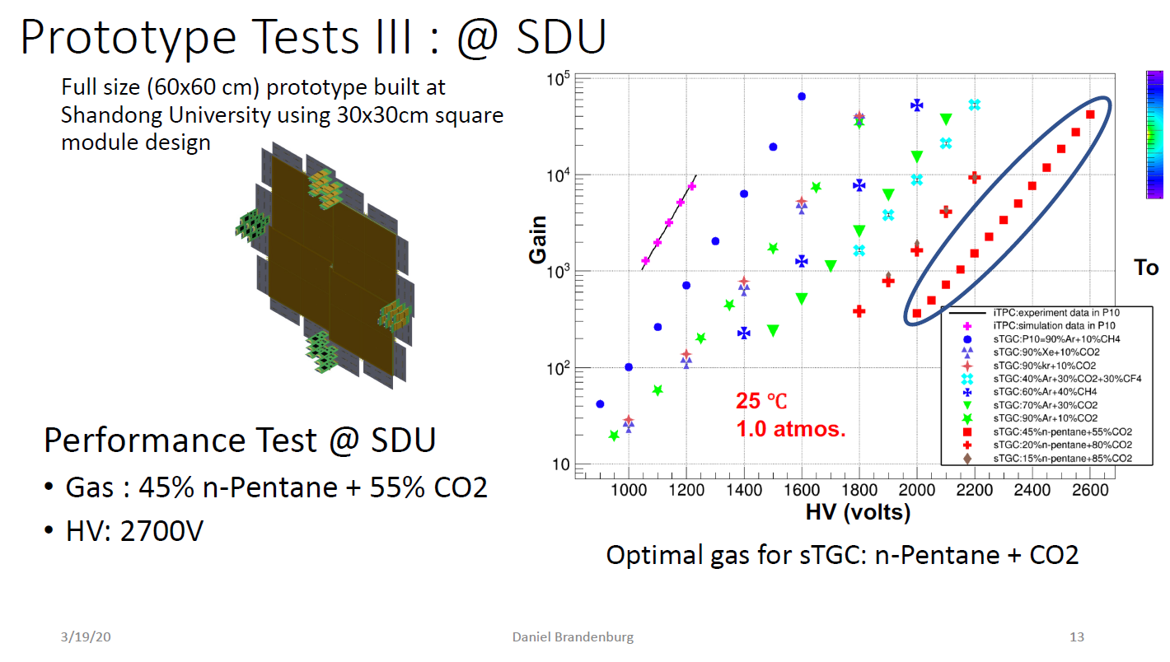
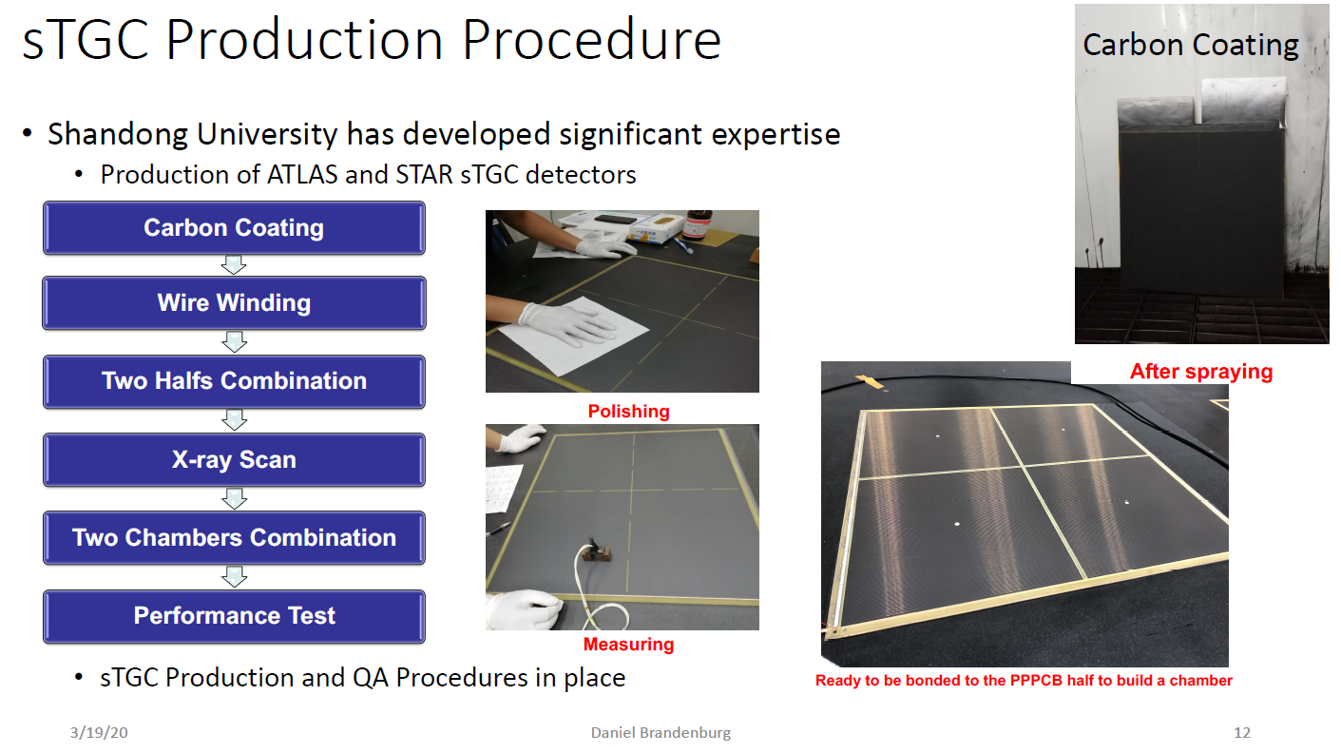
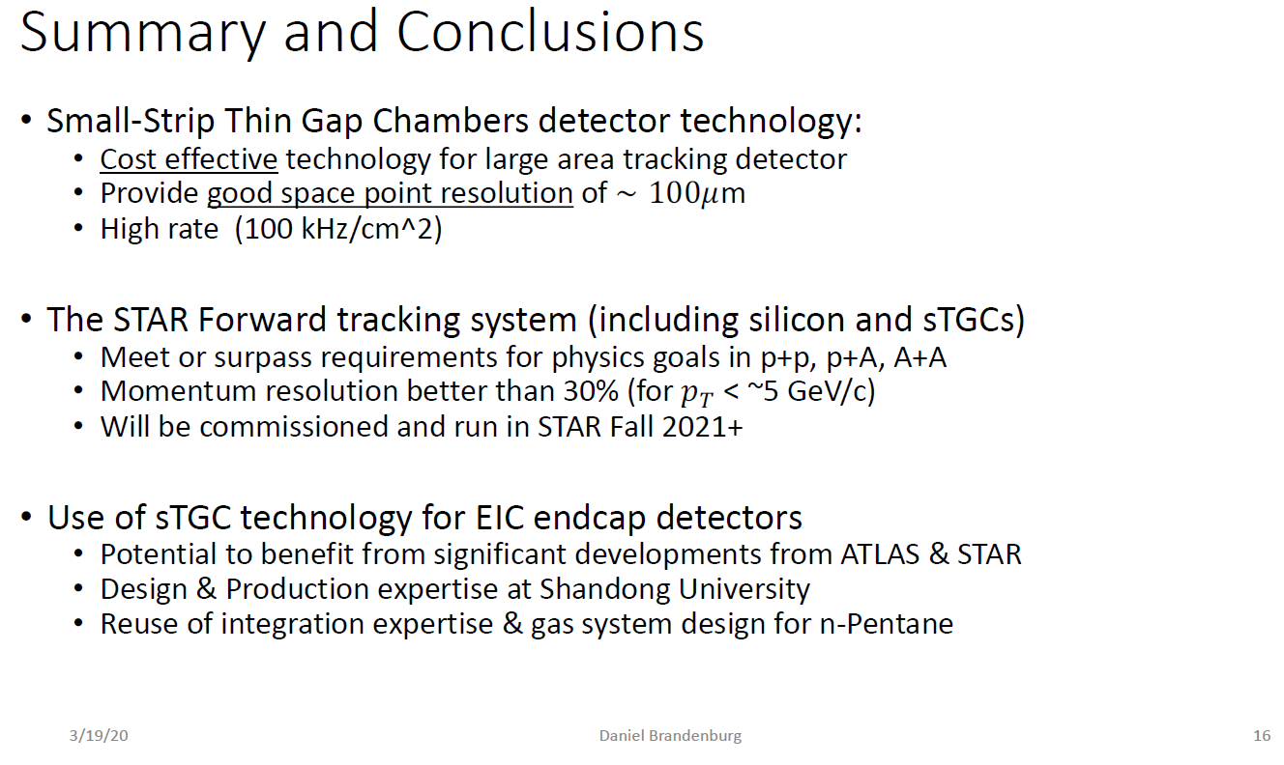
End Cap Tracking with Small-Strip Thin Gap Chambers (sTGCs)
Daniel Brandenburg, BNL-CFNS
sTGCs for End cap Tracking:
Shandong University with a lot experience with developing sTGCs for HEP/NP Experience
ATLAS Small Wheel sTGCs
STAR Forward Tracker
Efficiency > 98%

Slide 8
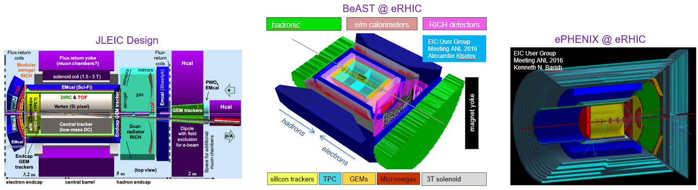
Summary of Gaseous Detectors Technologies
Many baseline EIC detector designs involved various gaseous detectors technologies for tracking in the central as well as end cap region
A few technologies are mature for EIC Detectors and would require only limited R&D
Some of these technologies seems more natural options for some subdetectors
There is still a need for small level of R&D to fully satisfy the EIC requirements
The anticipated simulation work within Tracking WG will help select the best technologies for EIC

Slide 9
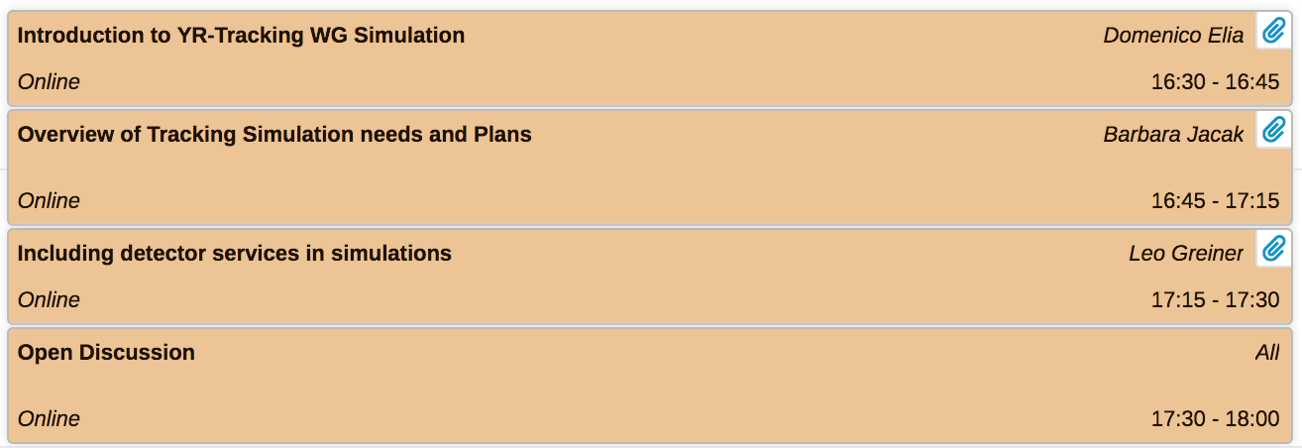
Tracking WG – Simulation summary
Simulation session agenda:

Slide 10
Tracking WG – Simulation summary
Tracking WG meetings:
weekly held (on Thursday), started on 13/2
collected interest from participating groups (next slide)
recently dedicated to simulation issues
  27/2: https://indico.bnl.gov/event/7689/
  presentation on framework simulation tools (fast and full) by the SWG (Markus)
  detailed presentations on G4E/eJANA (Dmitry, Yulia, Nathan) and Fun4All (Chris)
  12/3: https://indico.bnl.gov/event/7885/
  question / answer session on Fun4All with Chris (and participating groups)
plan to have next meeting with q/a session on G4E/eJANA
follow up developments and steer direction

Slide 11
Tracking WG – Simulation summary
Tracking WG meetings:
weekly held (on Thursday), started on 13/2
collected interest from participating groups:
Participating Institutes | Software oriented interest
eRD6: BNL, INFN Trieste, Florida Tech. Stony Brook U., Temple U., UVa, Yale U. | Central and forward tracking (gaseous)
eRD22: Jlab, Temple U., UVa | Central and forward tracking (gaseous)
CEA Saclay (France) | Central tracking
eRD18: University of Birmingham (UK) | Central tracking
LANL | Central and forward tracking
UC Berkeley / LBNL | Central and forward tracking
INFN Bari | Central tracking (silicon)

Slide 12
Tracking WG – Simulation summary
Simulation session agenda
Barbara Jacak – Overview of Tracking simulation needs and plans
https://indico.bnl.gov/event/7449/contributions/35962/attachments/27187/41446/tracking_simul_sum_Jacak.pdf
all-silicon tracker studies:
  Bari, Birmingham (eRD18), LBNL + UC Berkeley (eRD16)
    barrel only, barrel & endcaps, ALPIDE-like sensors
    1.5 / 3 T solenoidal field, different nr. of layers / pixel size / outer radius / layer thickness
    using fast simulation, transition to full (Fun4All, G4E/eJANA) ongoing/aimed to
  LANL (fast simulation, mid-rapidity + forward MAPS, preliminary performance vs EIC handbook)
hybrid / gas tracking studies:
  BNL/sPHENIX (full chain simulation and reconstruction in Fun4All, early EIC detector concept)
  eRD6 (EicRoot + BeAST configuration, investigate use of forward GEMs behind the RICH)
  CEA-Saclay (Fun4All, focus on curved Micromegas, first momentum resolution estimates)

Slide 13
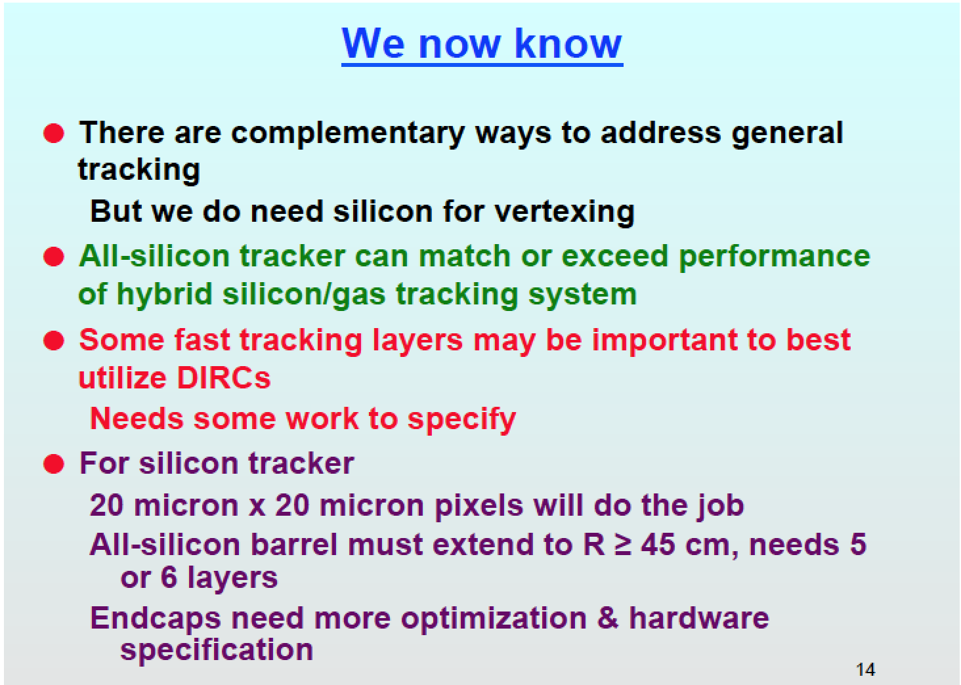
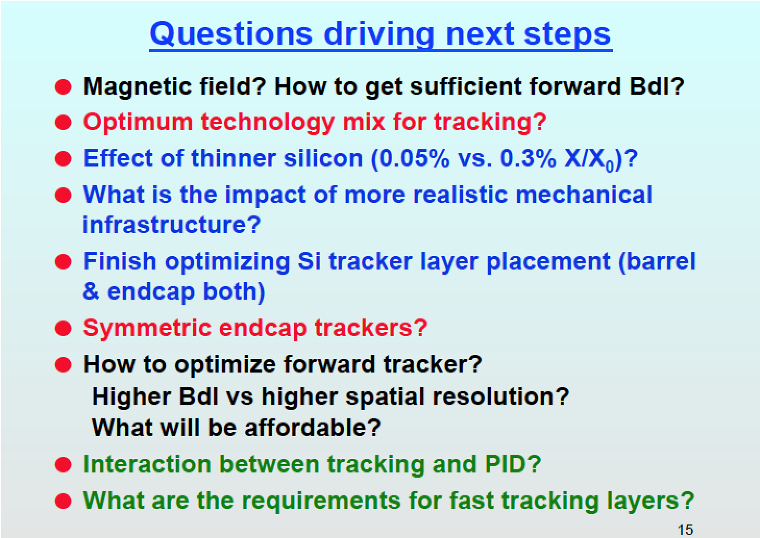
Tracking WG – Simulation summary
Simulation session agenda
Barbara Jacak – Overview of Tracking simulation needs and plans
https://indico.bnl.gov/event/7449/contributions/35962/attachments/27187/41446/tracking_simul_sum_Jacak.pdf
main conclusions and next steps:

Slide 14
Tracking WG – Simulation summary
Simulation session agenda
Barbara Jacak – Overview of Tracking simulation needs and plans
Leo Grainer – Adding services load to the EIC simulations
https://indico.bnl.gov/event/7449/contributions/35963/attachments/27118/41332/2020_03_16_EIC_Si_services_parametrization_for_sim.pdf
services are likely to be a major part of material in the large acceptance and can be reasonably parameterized as a function of silicon surface area
the service volumes can be similarly parameterized
examples are given for the sensor most often used in the simulations (ALPIDE)
there are options to reduce services (better sensor, targeted R&D)
recommended for all detector defining groups to provide this with their implementation

Slide 15
Tracking WG – Simulation summary
Preliminary workplan:
optimize detector layout via fast simulation, eg:
  checks with more realistic material sensor and services (Bari, Berkeley)
  optimize silicon barrel layout (Bari, Birmingham)
  optimize silicon endcap layout (LANL, Berkeley)
besides optimizations, proceed with integration in full simulation:
  define baseline detector concept (BeAST or ePHENIX? 1.5/3 T magnet?)
  keep working on both frameworks Fun4All and G4E
  implement realistic material and services, connection to integration issues
  define (1-2?) strawman silicon vertex barrel to allow optimization of outer barrel?
study gas tracker options (eRD6, Saclay)
move to non-ideal track finding algorithms (BNL, Berkeley)
study jet efficiency & resolution, jet substructure (Berkeley, LANL, BNL)
further connections to physics benchmarks

