Slide 1

Thoughts on Complementary
Detectors at an EIC
E.C. Aschenauer
Electron Ion Collider

Slide 2
Possible Detector Choices
General purpose detectors
similar to ATLAS and CMS at the LHC or H1 and ZEUS at HERA
Advantage:
one device for all physics, better background rejection and systematic control
More challenging to design
Lifetime = Facility lifetime
or
Specialized detector
such as ALICE and LHCb at the LHC
Advantage:
Potentially better for the measurement of a particular process
Less boundary conditions -> easier to design
Lifetime < Facility lifetime
or
Mixture of both
Till today seriously considered only general-purpose detectors
A general-purpose detector will most easily achieve all the science
in the EIC WP and NAS report

Slide 3
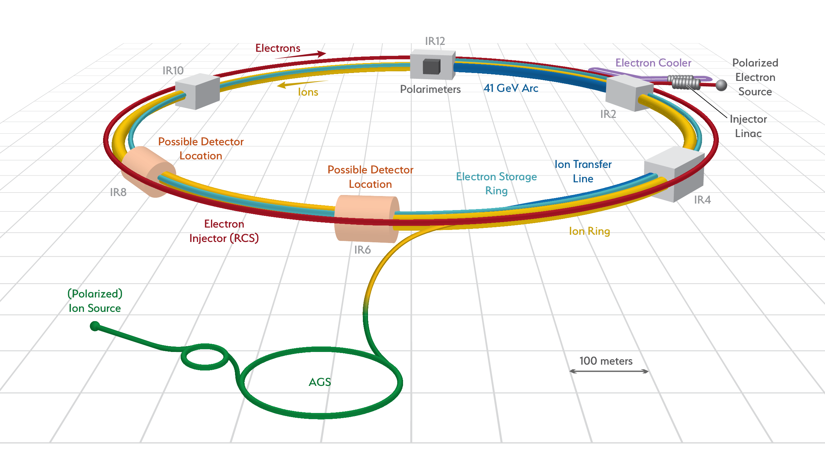
Possible Detector Choices
All big facilities have at least 2 general purpose detectors, i.e. LEP, HERA, RHIC, LHC or 2 facilities Belle and BABAR
  for a comprehensive summary look to
  https://indico.bnl.gov/event/3737/contributions/11071/attachments/9968/12149/1_TUllrich-DETECTORS.pdf
Two detectors is also the desire for the EIC from the user community
Two interaction regions possible at EIC

Slide 4
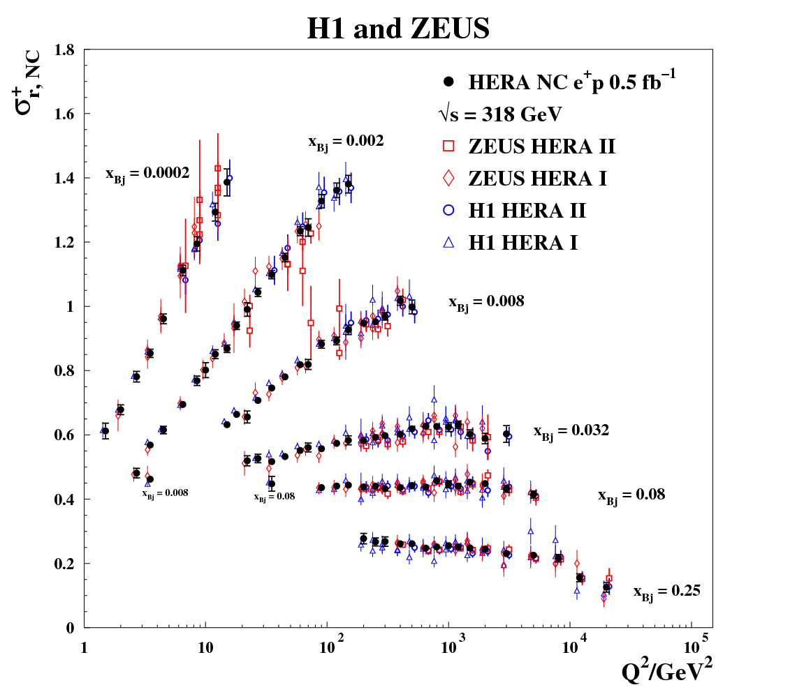
Why Two Detectors
Different emphasis on physics goals between the 2 detectors including IR optimization
Cross checking each other results
Combining results → higher precision results due to reducing systematics
  uses luminosity most efficiently
  recent example HERA inclusive cross section
LHC shows 1000+ people collaborations pose quite some sociological challenges
  less opportunities for young people to grow and take leadership positions
  600+ collaborators per experiment seems optimal, currently 631 experimentalists in UG

Slide 5
Consequences for YR Report Activities
In general one needs crisp and clear arguments why two detectors will enhance the physics output of the EIC
  complementarity includes the IR design, need to keep consistency with accelerator design in mind
Assuming two detectors complementary in technology one needs to answer
  Detector:
    performance of different sub detector technologies (momentum / energy resolution, material budget, …)
    what drives the systematics of a subdetector based on a certain technology
    a rough cost estimate and time to construct a subdetector
    how much longer till the technology is ready for mass production
  Physics:
    what is driving the systematic uncertainties of the measurements you are studying
      impact on complementary technology choice of subdetectors
    what special measurement in your WG cannot be addressed by a general-purpose detector
      is there need for a specialized detector
      or has demands,
    which physics needs a modification of the baseline IR
Welcome feedback what other points are critical to answer to guarantee point 1
Answering these questions crisply will be critical to get the off-project contributions
we need to realize 2 detectors

Slide 6
What is required to realize 2 detectors

Slide 7
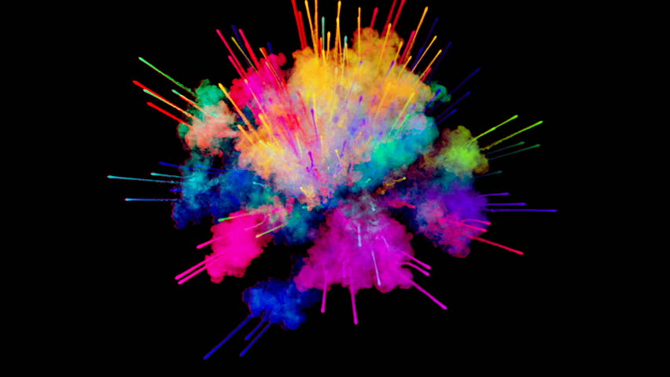
EIC General Purpose Detector: Concept
p/A beam
electron beam
high Q²
lepton
medium x
hadrons
Θ = 90º
scattered
hadrons
Θ = 135º
Θ = 45º
low Q²
low x
high x
Lepton
Endcap
Central
Detector
Hadron
Endcap
Θ = 178º
Θ = 2º
z
and all the detectors integrated in the IR along the beam line

Slide 8
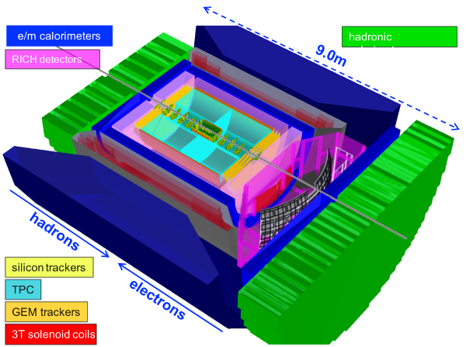
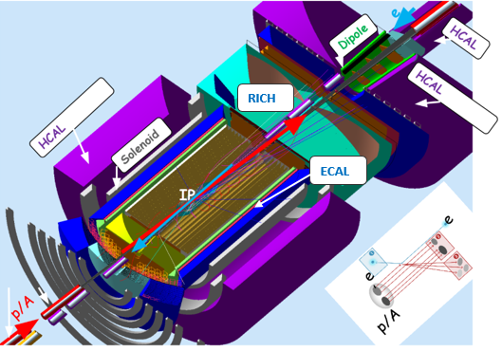
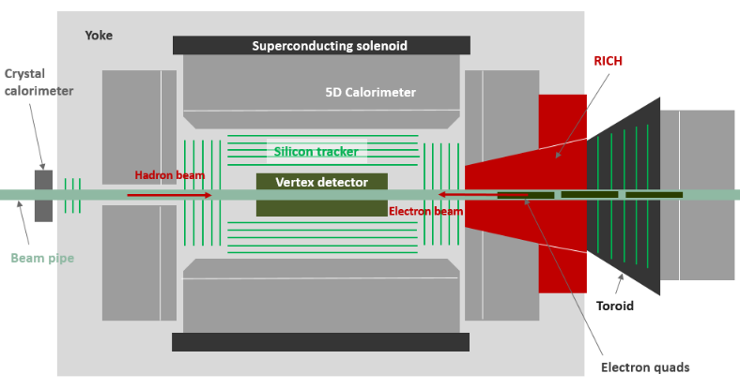
EIC General Purpose Detector Concepts
A general purpose EIC Detector system is complex
Large rapidity (-4 < η <4) coverage
  Electromagnetic and Hadronic Calorimetry
  Particle ID detectors (positive π, K, p identification)
  Tracking: small (μ-vertex) and large radius (i.e. TPC) Tracking
  need all to be realized in +/- 4.5 m
detector components extend along the beam line: Roman Pots, ZDC, …..
Ancillary Detectors: electron & hadron Polarimetry, luminosity monitors
Brookhaven concept: BEAST
Jefferson lab concept: JLEIC
Argonne concept: TOPSiDE

Slide 9
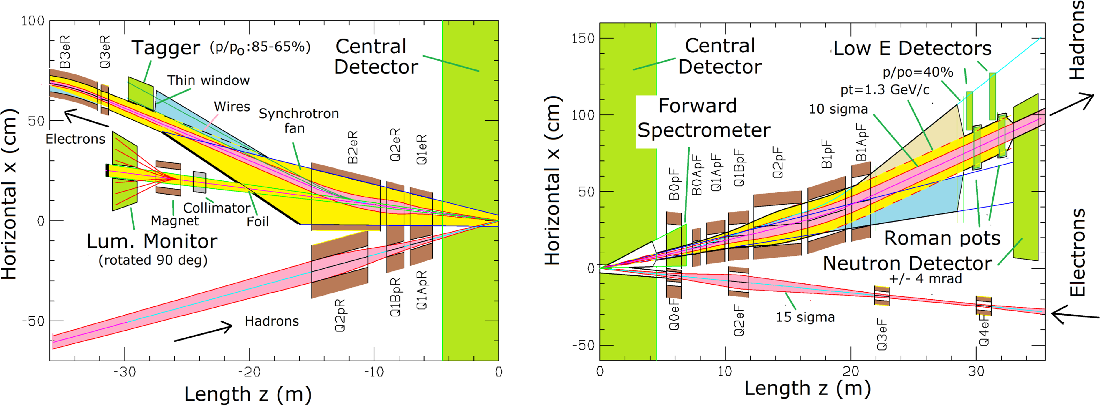
EIC IR Design
Rear Side
Detector Region
Forward Side
crossing angle to separate beams
and avoid synchrotron radiation from dipoles
Important detectors:
Hadron Beam: Si detectors in B0, Roman Pot, low-E Detectors, Zero Degree Calorimeter
Lepton Beam: LowQ² tagger
General: Luminosity Detector, electron and hadron polarimetry (different location)

Slide 10
Funding Requirements
What is included in the Project:
Nomenclature:
experimental equipment includes main and forward detector
interaction region: all accelerator equipment between the crab-cavities including
polarimeters and Luminosity monitor and spin rotators
Remember:
US costing includes overhead (location dependent), contingency (35%) and labor costs
to avoid confusion I quote only direct costs for subdetectors and equipment in general
See also Rolf’s US Costing 101 slide EICUG_1st_YR_Meeting_Temple_Timeline_v4.pdf
Let’s go to numbers:
Interaction Region:
Total: $106 M
  with IR Magnets + Spin Rotator: $68 M
  Crab cavities: $21 M
Experimental Equipment:
Total: $150M for labor and M&S → more details to come

Slide 11
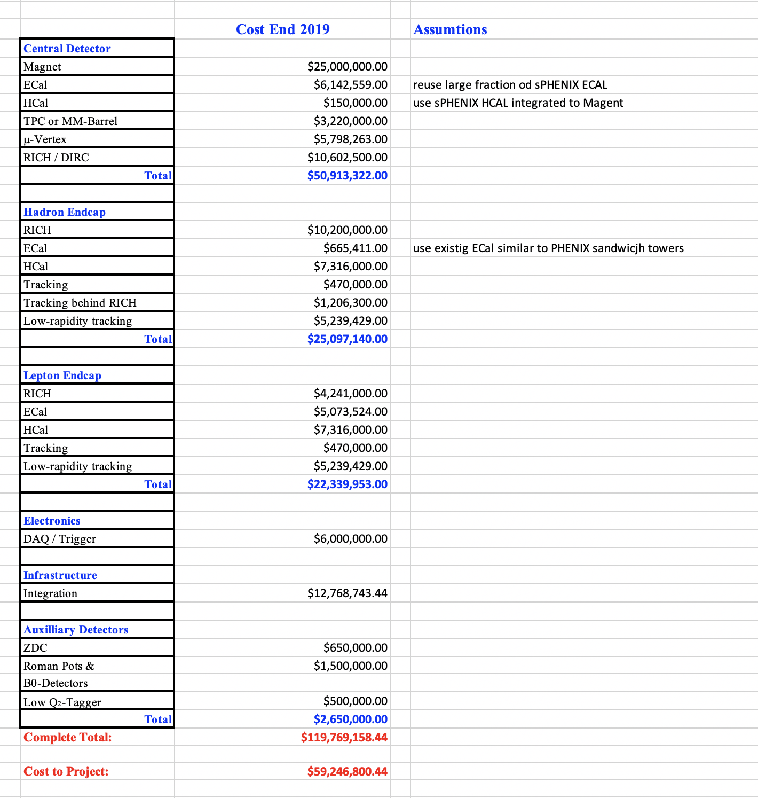
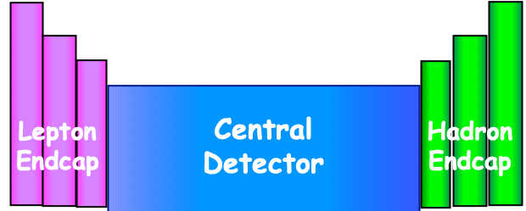
Funding Requirements
Estimated 315 FTEs
over a period of 9 years
amounts to $88 M using BNL
labor bands
Assumptions:
reuse existing equipment
ECal towers in Hadron Arm
HCal towers in Central Det.
some ECal towers in Central Det.
Reuse an existing Solenoid
In-kind contributions:
in the order of $35M

Slide 12
Funding Requirements
What is needed for the 2nd detector and IR
  everything which was discussed on the slide before
  Detector system: Main and forward detectors $120 M + the cost for the assumed reused equipment ~$ 25 M
    Labor is normally assumed 1:1 to the hardware cost: $145 M
      this number depends strongly on the methodologies used in different countries for costing
  Interaction Region: $ 106 M this cost might increase if IR design changes significantly
Total: $251 M for M&S and equivalent of $145 M for labor
We can also for 2nd Detector offset M&S cost for experimental equipment reusing existing equipment:
an other Detector Solenoid
Jlab has enough PGW0₄ towers for a lepton endcap ECal
BABAR DIRC bars for Central Detector PID
…… everything else which fulfills the requirements as determined by YR studies

Slide 13

Summary
Let’s get to work
The information of the EoI will be critical to see
one can secure enough funds from non-DOE national and international sources
Will urge people/groups/consortia to submit an EoI

Slide 14


Slide 15

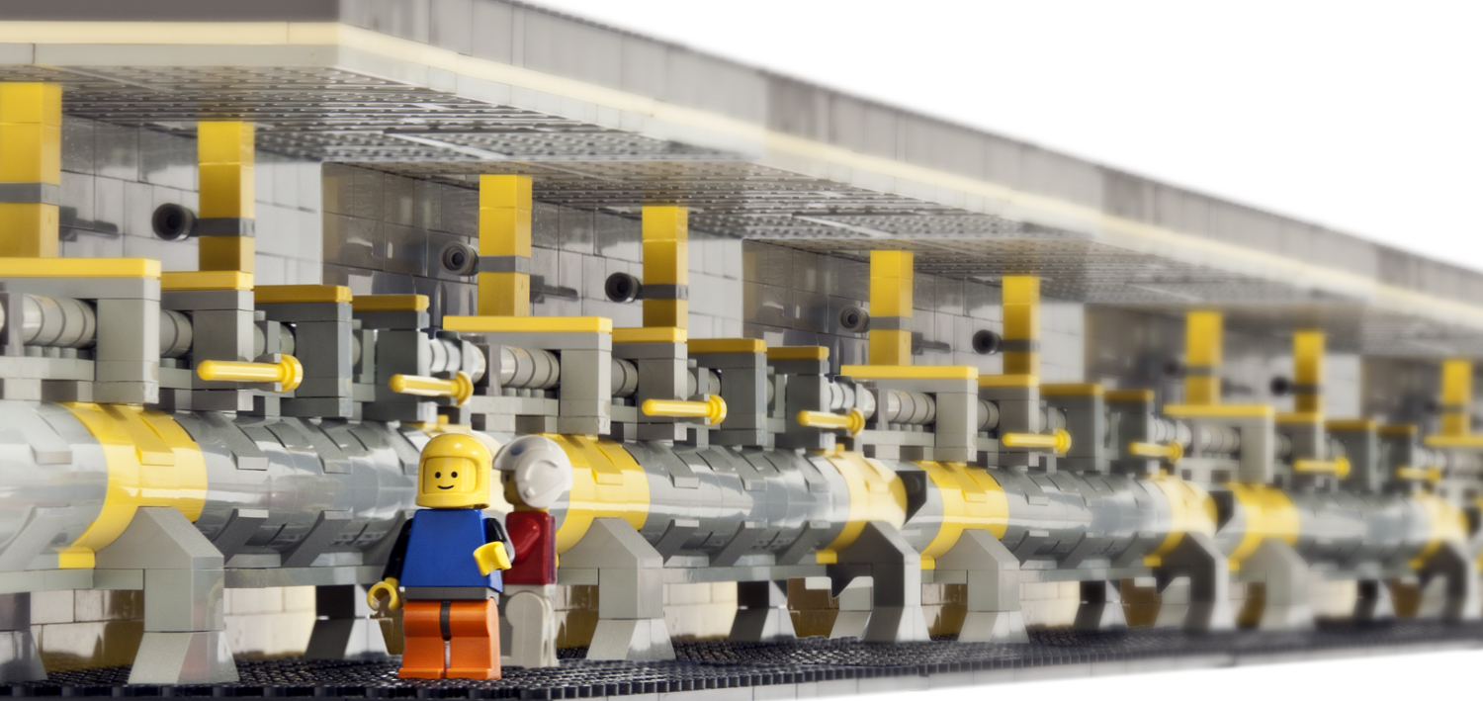
Important Missing Puzzle Stones
Interaction Region
and
ancillary detector systems:
hadron and lepton polarimeters
luminosity detector
low Q² tagger
ZDC and Roman Pot systems
all needed from the beginning

Slide 16
IR Requirements from Physics
 | Hadron | Lepton
Machine element free region | High Luminosity → beam elements need to be very close to IP eRHIC: +/- 4.5 m JLEIC: +/- 3.5 m for main detector
Beam pipe | Low mass material i.e. Beryllium
Low Q² tagger |  | Acceptance: Q² < ~0.1 GeV
Zero Degree Calorimeter | 60cm x 60cm x 2m @ ~30 m
scattered proton/neutron acc. all energies for ep | Proton: 0.2 GeV < p_{t} < 1.3 GeV Neutron: p_{t} < 1.3 GeV
scattered proton/neutron acc. all energies for eA | Proton and Neutron: Θ < 6 mrad (√s=50 GeV) Θ < 4 mrad (√s=100 GeV)
Integration of detectors | Local polarimeter
Luminosity | Relative Luminosity: R = L^{++/--}/L^{+-/-+} < 10⁻⁴
 |  | γ acceptance: +/- 1 mrad → δL/L < 1%

Slide 17
Requirements for EIC Detectors
Vertexing
Event vertex, secondary vertices, track impact parameter
Vertex detector
Central tracker and solenoid
Electron identification and measurement
-4 < η < +4
Central tracker and solenoid
Calorimeter
Jet measurement
Excellent energy resolution, kinematic reconstruction
-4 < η < +4
Central tracker and solenoid
Calorimeter
Pion/kaon/proton separation
Barrel PID needed for p < 10 GeV/c
In forward direction needed for p < 50 GeV/c
In backward direction needed for p < 10 GeV/c
Central tracker and solenoid
Forward dipole/toroid
TOF or Čerenkov
Forward proton/ion detection and measurement
Large acceptance for momenta up to almost the beam energy
Roman pots
with timing
Forward neutron detection and measurement
Excellent energy and angle measurement
0⁰ calorimeter

Slide 18
Popular choices for the Major Subsystems
Vertex detector → Identify event vertex, secondary vertices,
track impact parameters Silicon pixels, e.g. MAPS
Central tracker → Measure charged track momenta
Drift chamber, TPC + outer tracker or Silicon strips
Forward tracker → Measure charged track momenta
GEMs, Micromegas, or Silicon strips, MAPS
Particle Identification → pion, kaon, proton separation
Time-of-Flight or RICH + dE/dx in tracker
Electromagnetic calorimeter → Measure photons (E, angle), identify electrons
Crystals (backward), Shashlik or Scintillator/Silicon-Tungsten
Hadron calorimeter → Measure charged hadrons , neutrons and K_{L}⁰
Plastic scintillator or RPC + steel
+ Beam pipe, Solenoid, very forward and backward detectors
Radius/Distance from IP

Slide 19
Impact of eRHIC Accelerator Design on Detector Design
high luminosity 10³³⁻³⁴ cm⁻²s⁻¹:
use detector technologies which can with stand high rates and radiation
focusing magnets as close as possible to IP → confined space of detector
High collision frequency
separation of signal to background becomes more challenging
  bunch-by-bunch polarization measurement needs to be adapted
crossing angle
need excellent vertex resolution to correct for the crossing angle in the measurement
asymmetric beam energies → boosted kinematics → high activity at high |η|
a large acceptance detector is a must
colliding different beam species: ep & eA has consequences for beam backgrounds → hadron beam backgrounds, i.e. beam gas events and synchrotron radiation
detector and IR need protection systems designed in
nuclear beams: D to Pb
high acceptance for nuclear breakup particles → p,n,γ
polarized electron and hadron (p,d,He-3) beams:
high precision lepton and hadron polarimetery → bunch-by-bunch
high precision luminosity measurement → spin sorted

Slide 20
Hadron PID Requirements
Interplay between different technologies
Here, electron/hadron separation shown only from Cherenkov detectors.
Main e/h rejection is done by calorimeters.

Slide 21
EIC General Purpose Detector: Concept
p/A beam
electron beam
high Q²
lepton
medium x
products
scattered
Θ = 90º
collision
collision
products
Θ = 135º
Θ = 45º
low Q²
low x
high x
Θ = 178º
Θ = 2º
z

