Slide 1
Broad Discussion Outline
P Rossi, TK Hemmick

Slide 2
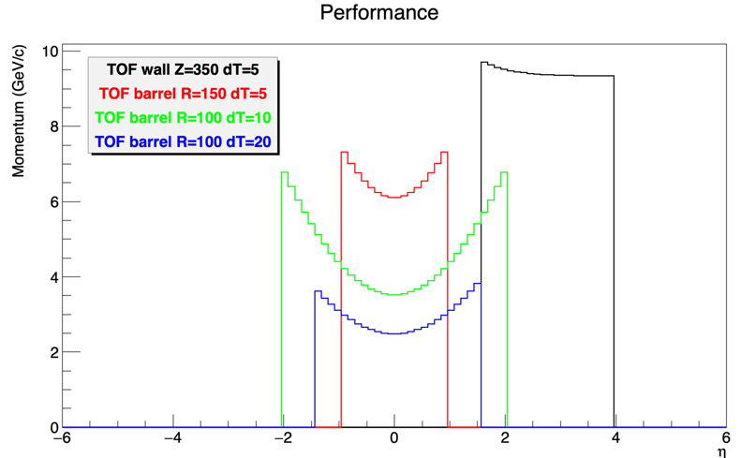
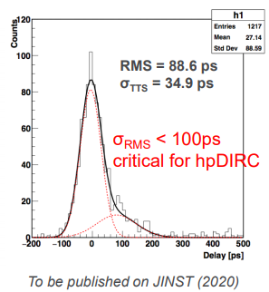
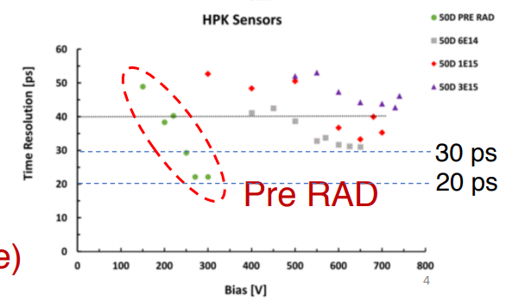
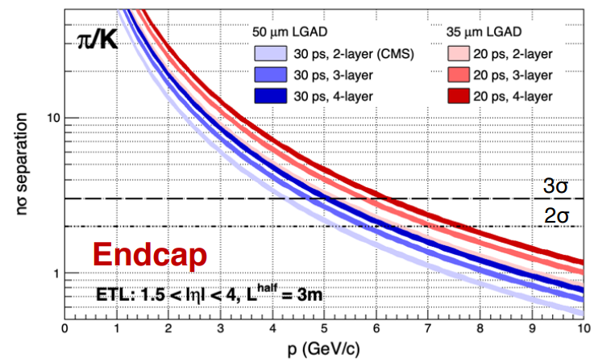
TOF plots
From Mickey
From Junqi
From Wei Li
 | 2020 | 2023 | 2026 | Assumptions
Barrel
Endcap
High p

Slide 3
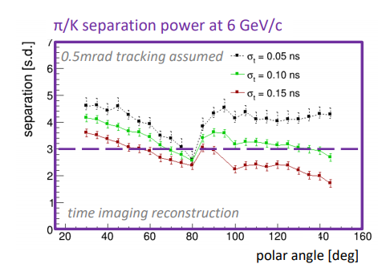
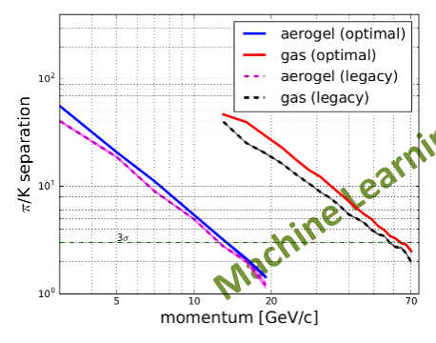
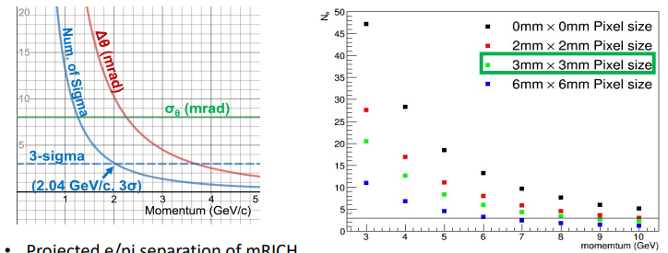
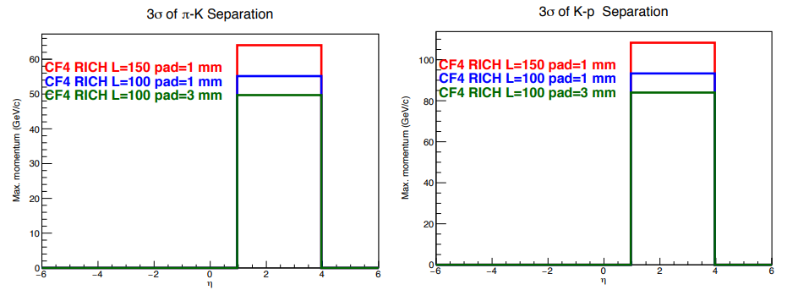
Cherenkov Plots
Greg DIRC
Evaristo dRICH
Xiaochun mRICH
Prakhar CF₄
High and Very High P
Valid comment from SDT:
Gas RICH must be sensitive to future env. Limits
Developing photon det choices.

Slide 4
External Assumptions
Interaction region assumptions? (space, crossing angle)
B-field limits?
Space required.
Internal performance assumptions
External performance assumptions
Momentum resolution.
Material budget
Can we make a standard or request/requirement?
Time for completely new ideas?
CD1 and Yellow Report:
Show plausible options using existing or close tech.
Include further reaching ideas shown as options to enhance/improve baseline.
Response from PID to 1 vs. 2 interaction regions (crossing angle differences)

Slide 5
Sketches
DIRC
Dual RICH
Gas RICH
B-tolerant TOF
mRICH
mRICH?
TOF
??
TOF
Arrows indicate options.

Slide 6
The Game:
Detector #1
Detector #2
Move the stars
Stars indicate choices
we need to move these around to make two complementary options…

