Slide 1
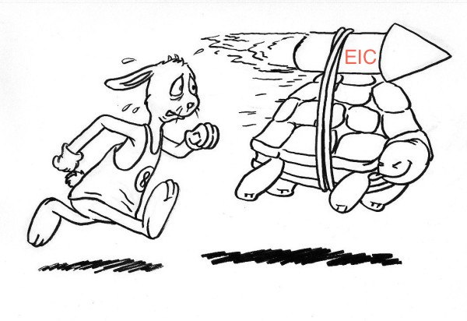
psTOF PID for the EIC
Mickey Chiu

Slide 2
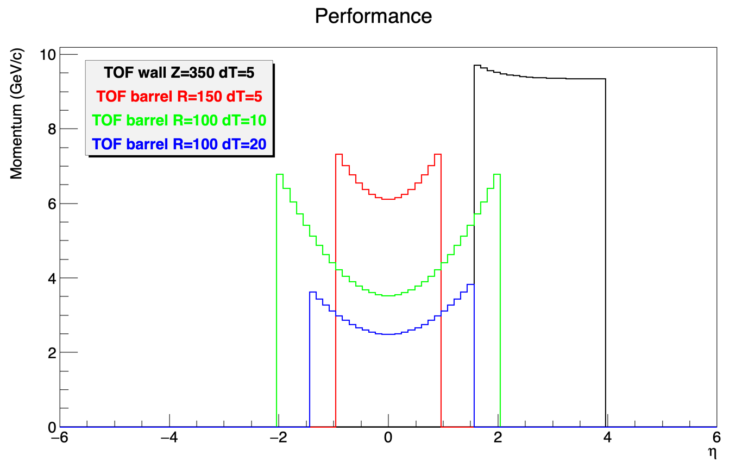
TOF PID at RHIC/EIC
Momentum reach of TOF PID reaches interesting levels if one can achieve ~ 20 ps
mRPC TOF Positives
Compact (only 10 cm of space needed), allowing more room for other detectors
Can possibly contribute to electron identification using TPC dE/dx
Can work at high multiplicity (e.g. in vicinity of center of jet cone or at very forward rapidities)
More cost-effective compared to other solutions
mRPC TOF Negatives
None that I know of except that R&D needs to be done to implement high resolution system-wide

Slide 3
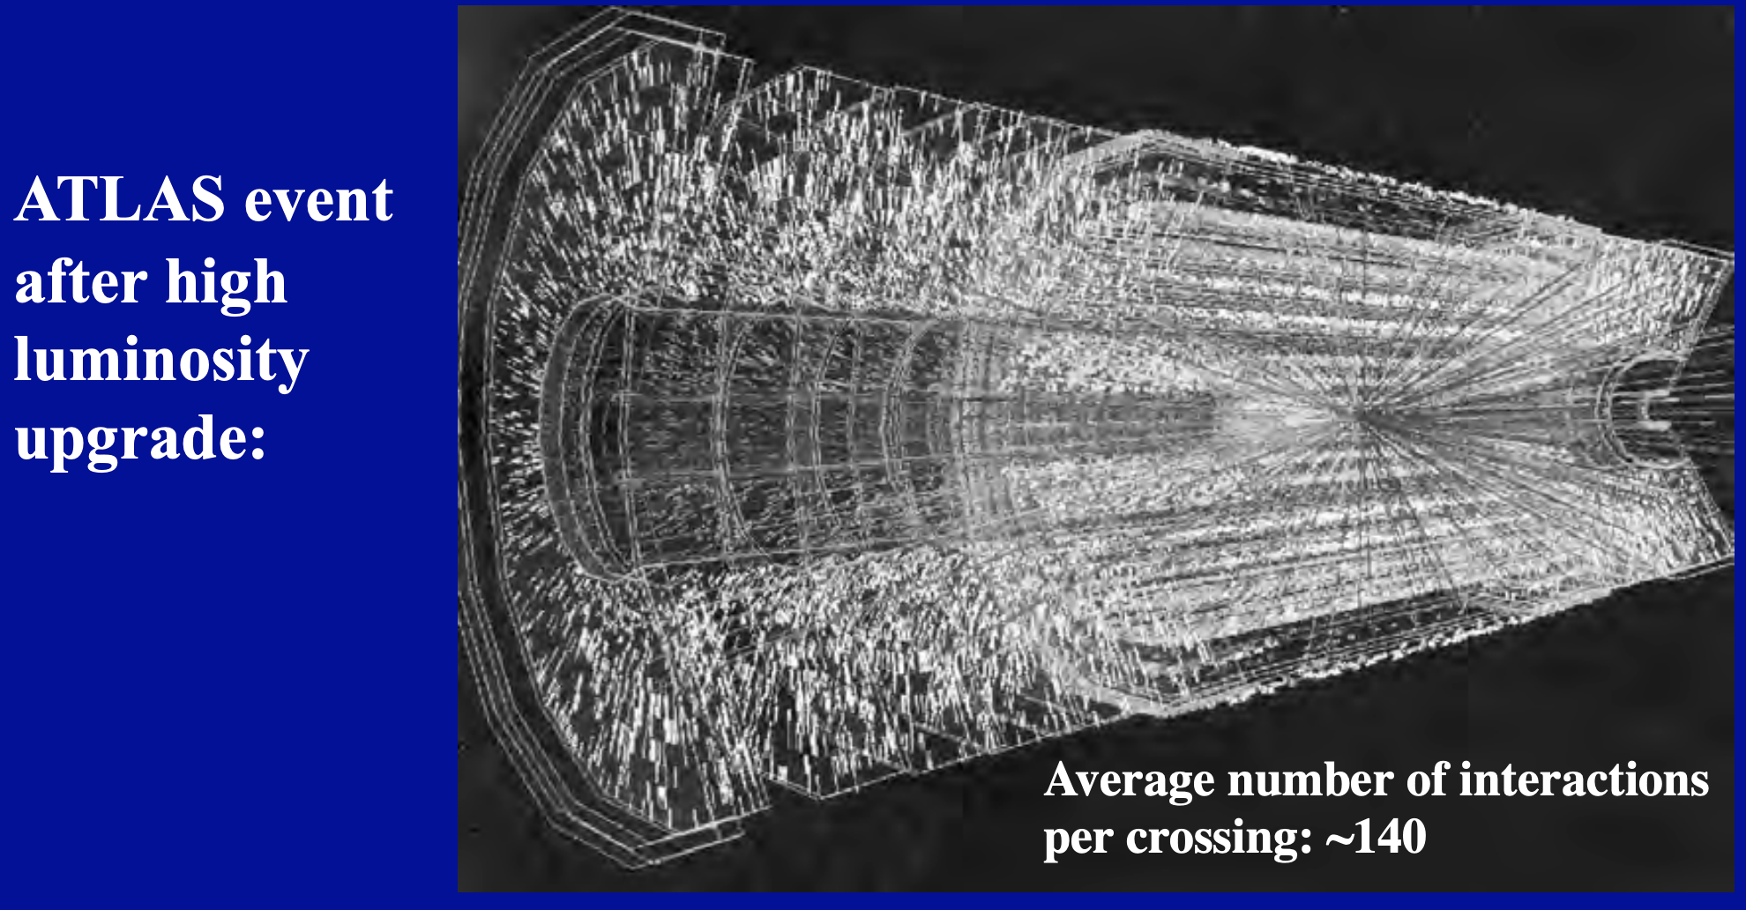
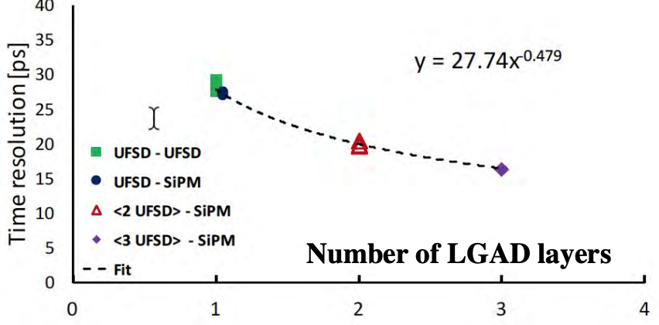
TOF Technology Today
There’s an extraordinary amount of R&D on fast timing these days, driven by the HL-LHC, and largely showing that ~20 ps is achievable (LHC req = 30 ps)
Much of the LHC tech could be imported for the EIC (eg LGADs with mm pixels, ALTIROC ASIC), but with trade-offs, especially cost

Slide 4
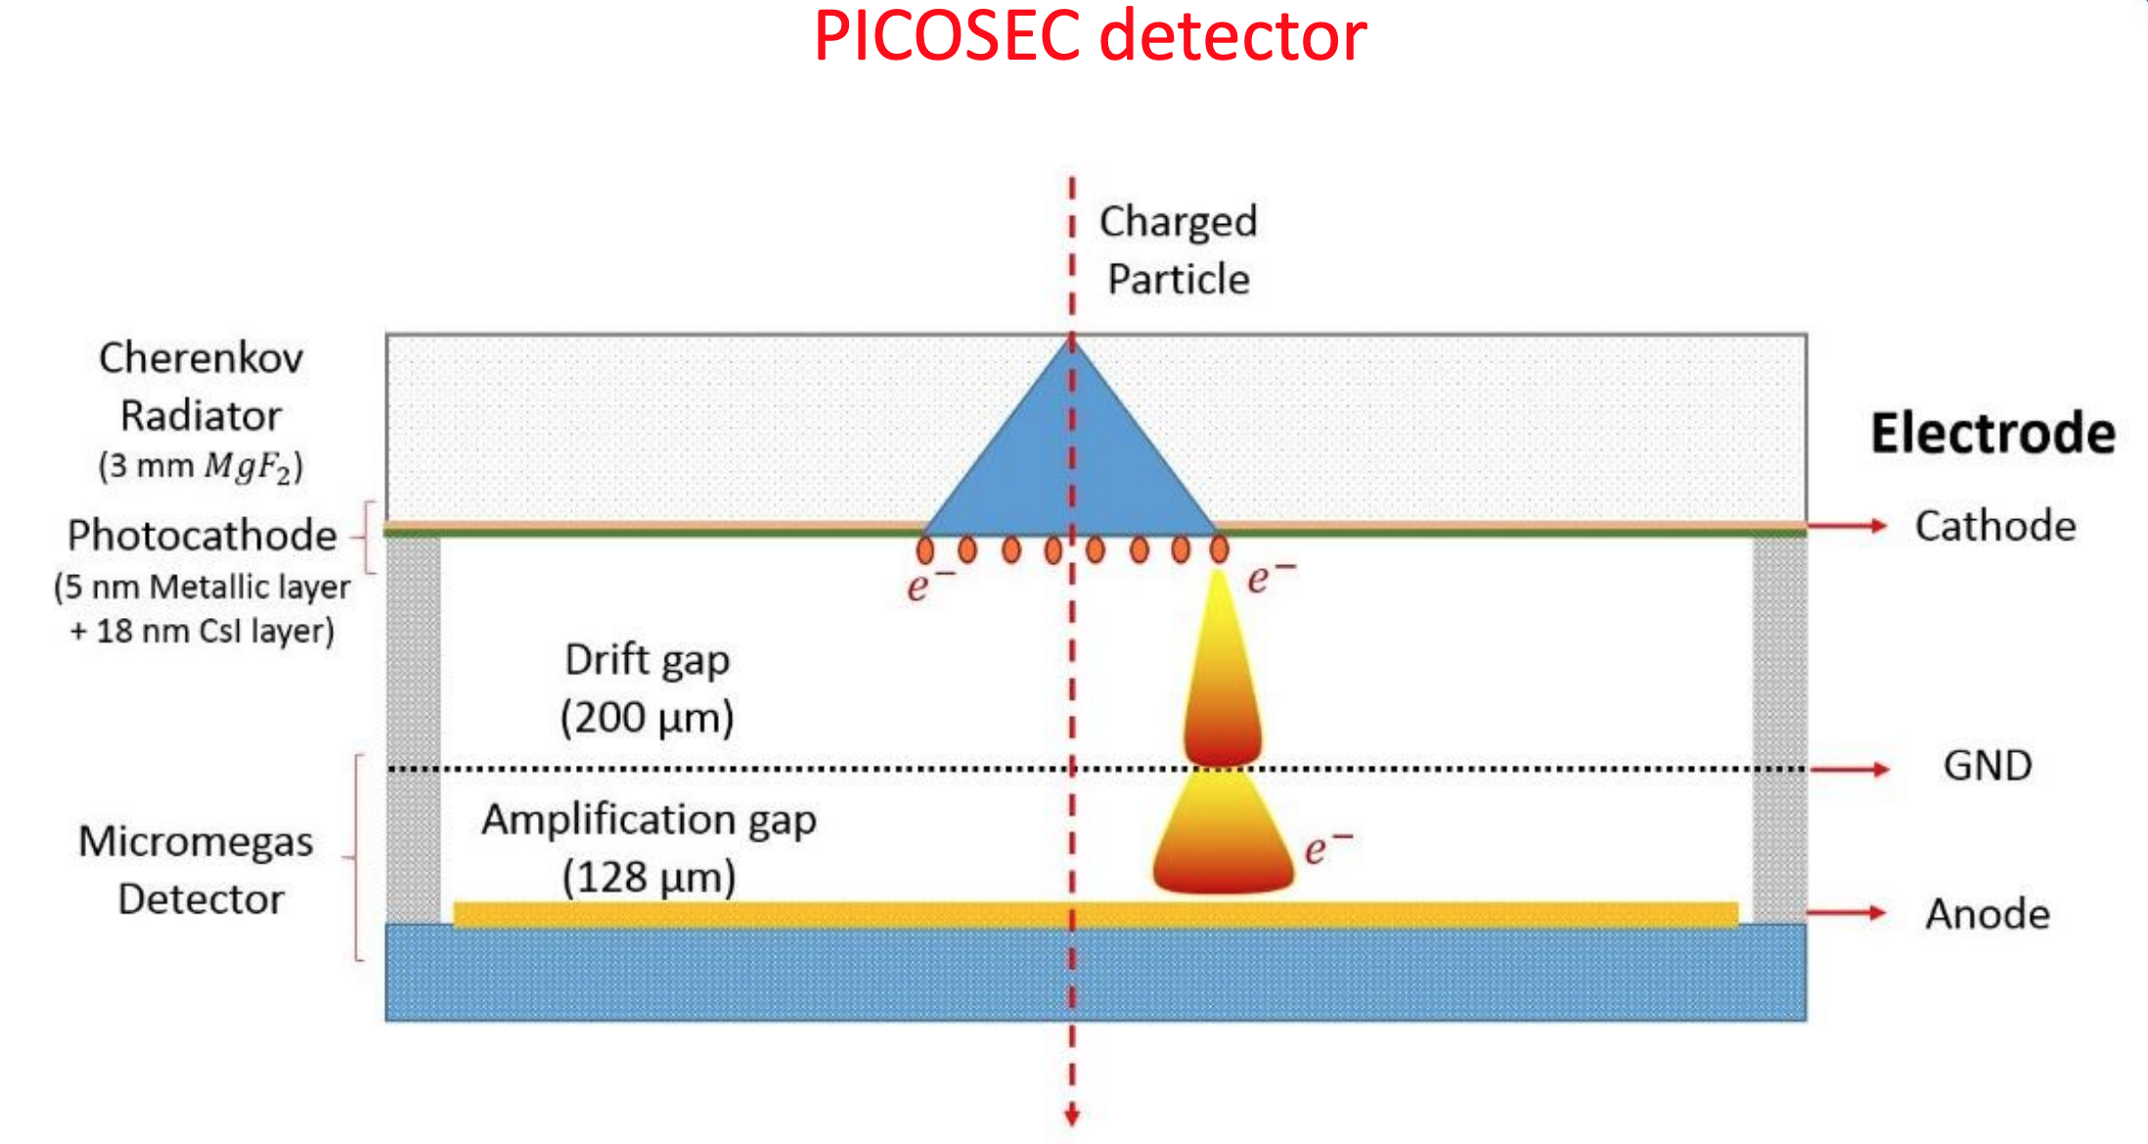
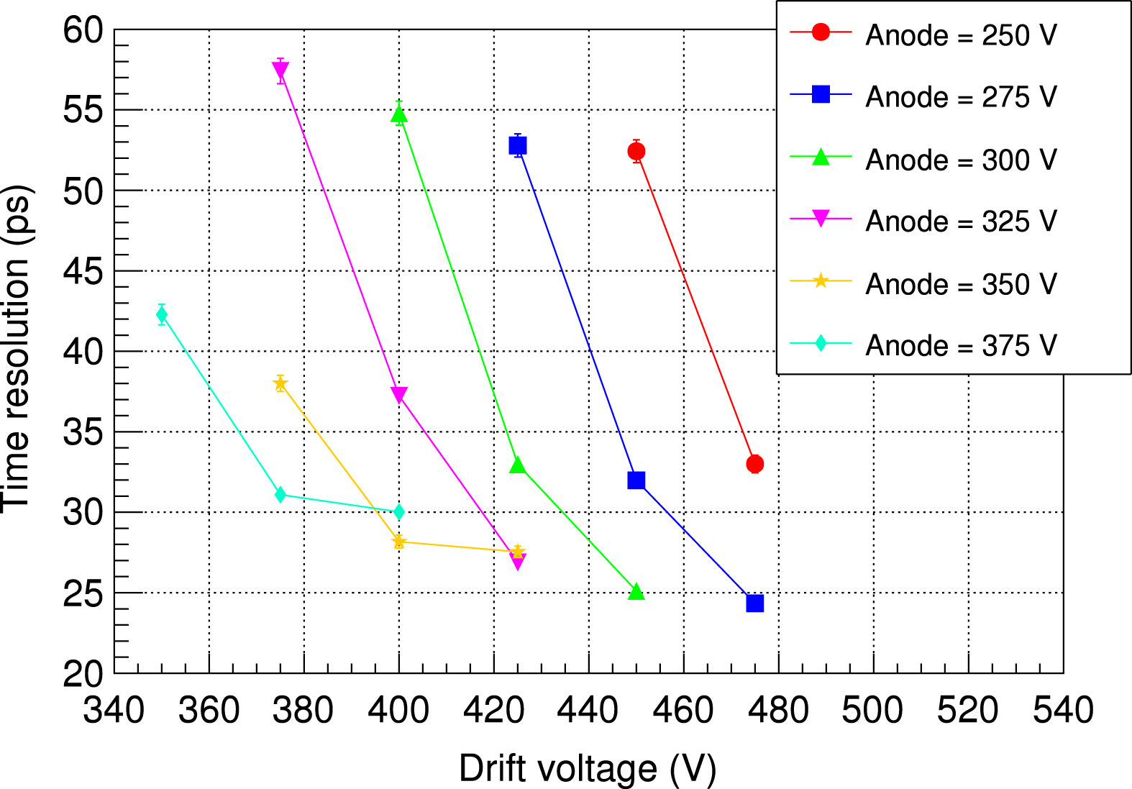
Some Other TOF Technology Today
RD51 supported PICOSEC has achieved ~25 ps
MCP-PMTs have been shown to be capable of ~5 ps since 2006 (K. Inami et al), but for very few channels, and at very high cost
LAPPDs as a possible solution?

Slide 5
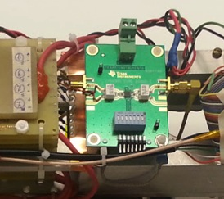
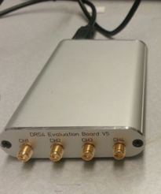
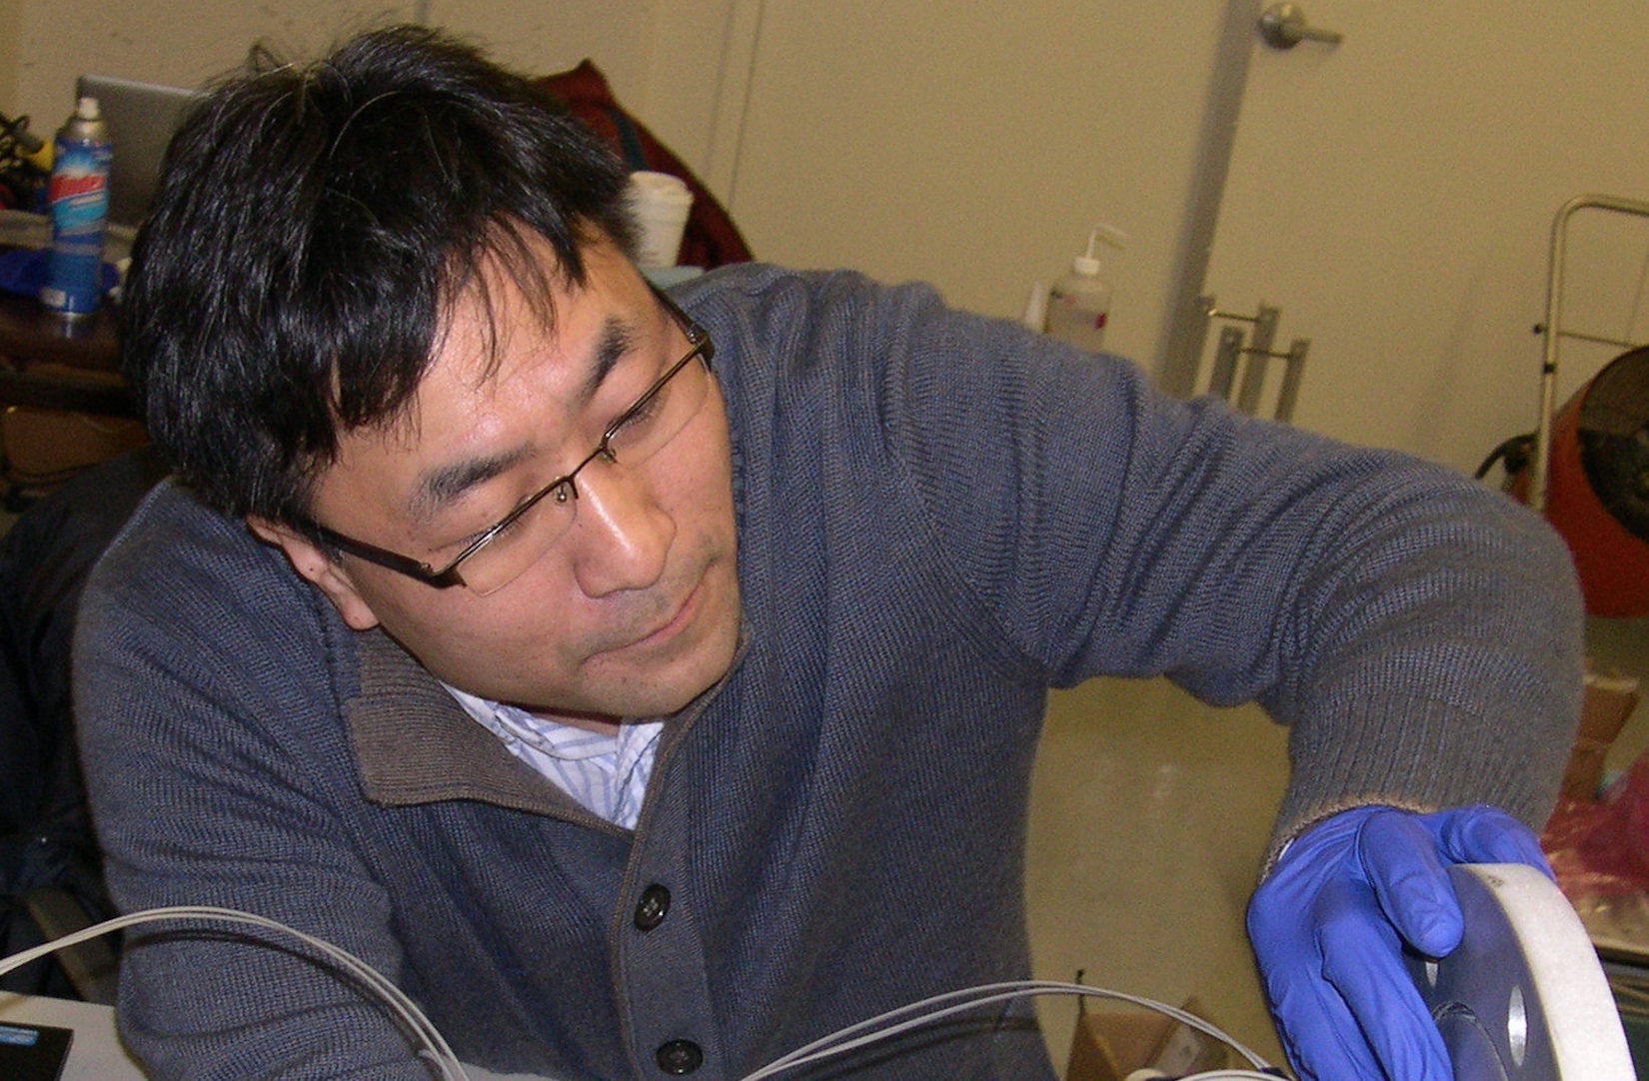
eRD10 MRPC Test with Cosmic Rays (2015)
Gas chamber in the cosmic ray test stand at UIUC
Differential Preamp.
TI, LMH 6881
2.8GHz bandwidth
28 v/v
MRPC1
MRPC2
Gas Input & Output
Waveform
Analyzer
(DRS4-V5)
5GHz sampling
speed
HV : ~15-25kV ( +10kV, -10kV)

Slide 6
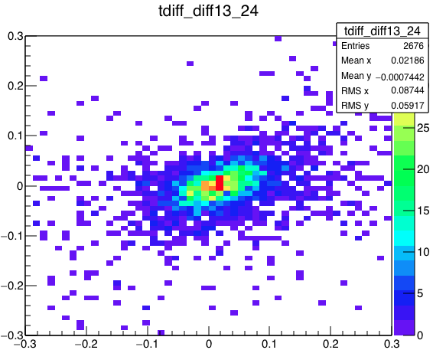
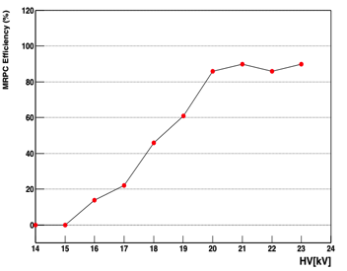
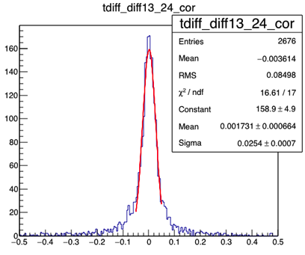
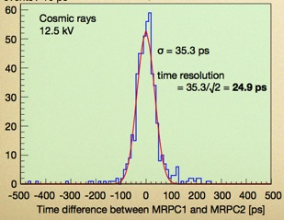
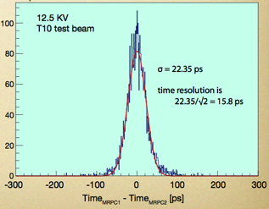
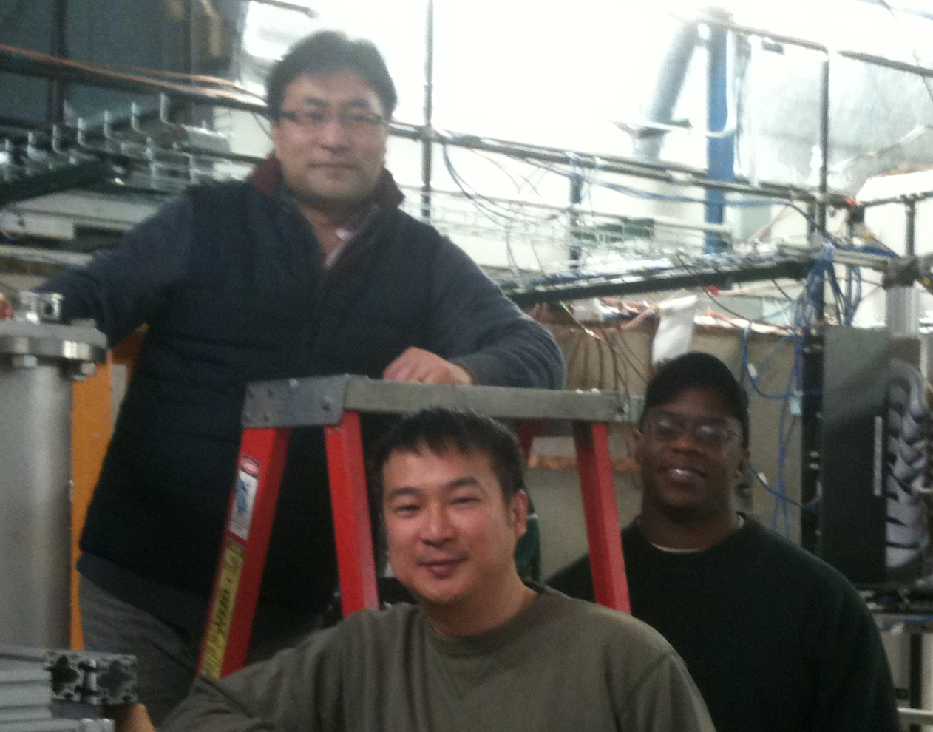
eRD10 mRPC Efficiency and Time Resolution
Cosmic rays
22kV
Efficiency
[ns]
eRD10
MRPC1- MRPC2
C. Williams
CERN, 2010
Cosmic rays
22kV
25.4ps / √2
~ 18ps!
Preamp : NINO
10 GHz, Oscilloscope
MRPC1- MRPC2
[ns]

Slide 7
eRD10 Prototype MRPC
Crispin Williams, CERN, 2010
Gas gap width : 160um
eRD10 Prototype, 2015
Gas gap width : 105um
PCB
Glass
Gas gap
Narrower gap width -> fast charge dominant in the induced signal -> Better timing resolution
Efficiency will be recovered by adding more gas gaps
 | MRPC ( C. Williams et al. ) | eRD10 MRPC
Gas Gap Width | 160um (fishing line) | 105um (diameter of fishing line)
# of Gas Gaps | 4 stack x 6 gas gaps = 24 | 4 stack x 9 gas gaps = 36
# of thin glass layers | 4 stacks x 5 layers = 20 (250um thick glass) | 4 stack x 8 layers = 32 (210um thick glass)
Preamplifier | Differential type, NINO chip (3GHz bandwidth) | LMH6554 2.8-GHz + Evaluation Board
TDC and DAQ | Oscilloscope (Sampling speed of 10Gs) | DRS4-V5 (5GSPS) + PC
Time resolution | 25 ps with cosmic ray / 16 ps at T10 beam test CERN | ?, Cosmic ray test / Beam halo test at COMPASS

Slide 8
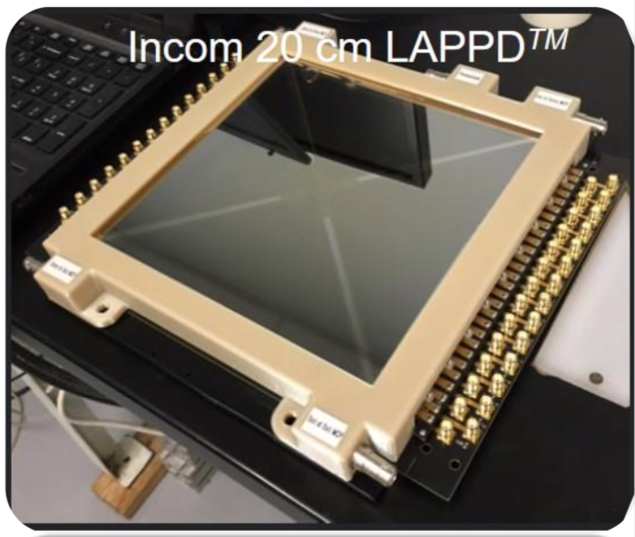
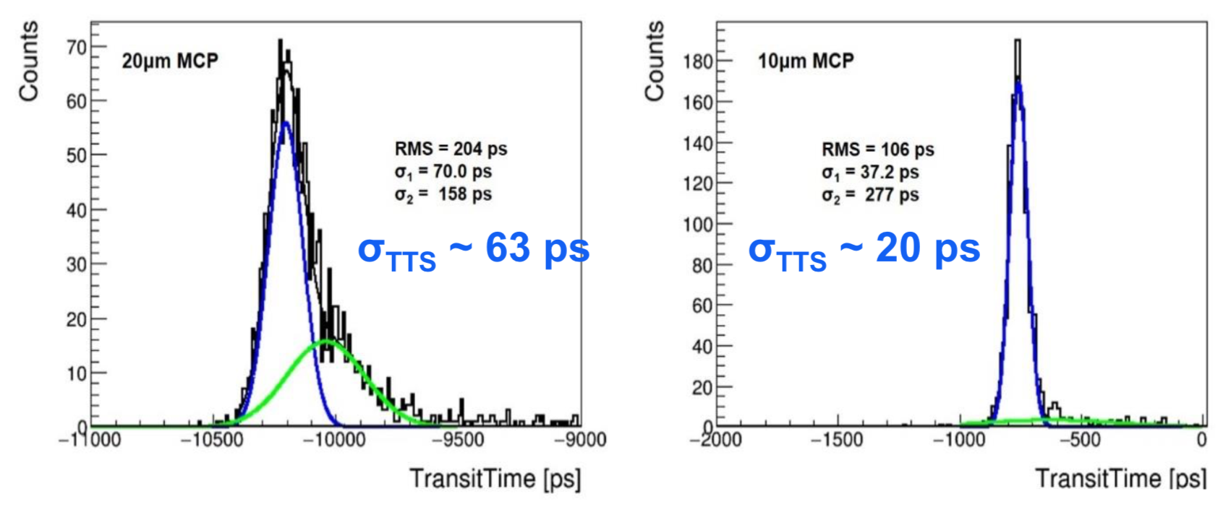
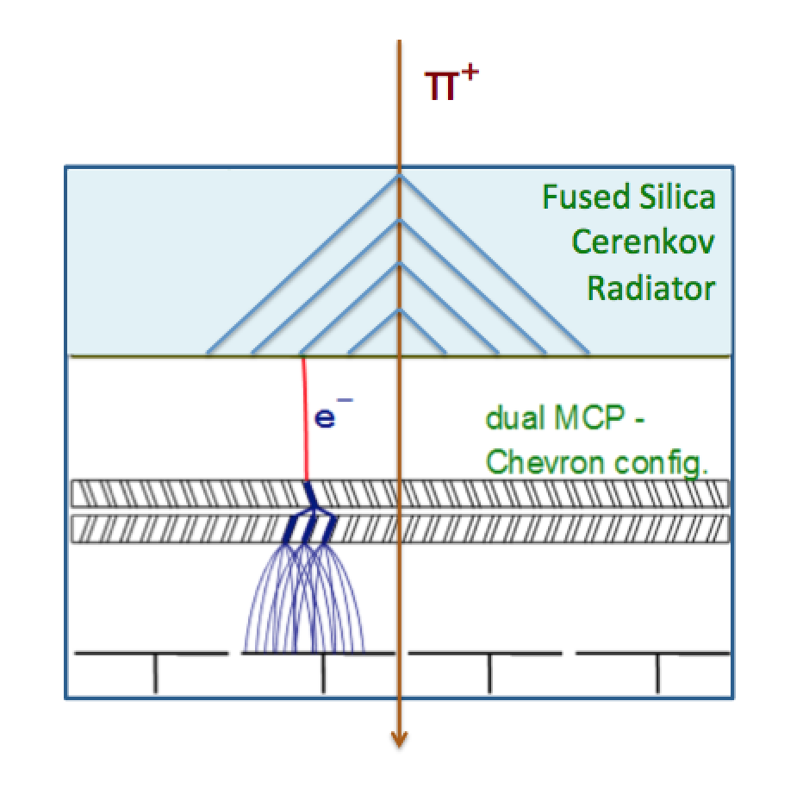
LAPPDTM MCP-PMT for psTOF
Recent developments in commercialization of MCP-PMTs (Incom LAPPD) offers a possible way to achieve 5 ps for a detector
𝜎 = 𝜎_{TTS} / √n.p.e.
Potentially can do even better with 10 um pore.

Slide 9
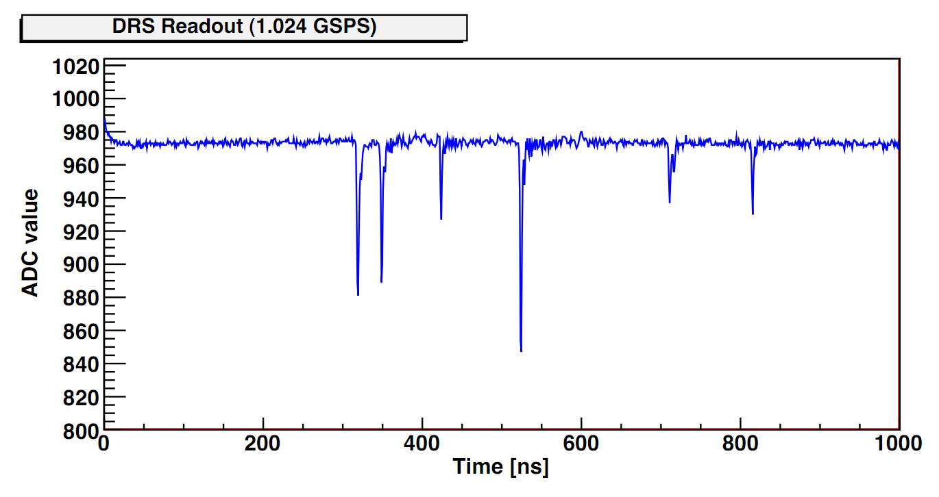
Region of Interest (Windowed) Readout
DRS4 running at 5 GSPS takes 200 ns to fill 1024 SCA buffer
Collider trigger signals require at least a few μs to be sent to FEM
PHENIX trigger latency is 4 μs >> 200 ns.
To solve this, we propose to use the ROI readout for the DRS4 – have a fast LOCAL threshold trigger on each channel, and digitize small window immediately
Need to generate accurate timestamp for ROI
Digitizing a 6 ns window with a 37.52 MHz ADC (4x RHIC clock), takes ~3 μs (1+2 overhead), where the DRS4 is dead
Q: What is deadtime effect? At 100 kHz Au+Au rate, we expect about 500 tracks on average per event, over 12K channels, or 4 kHz hit rate on one channel
Poisson prob P(N>=2; 5 kHz hits and 3 us deadtime) ~ 1.5% lost events

Slide 10
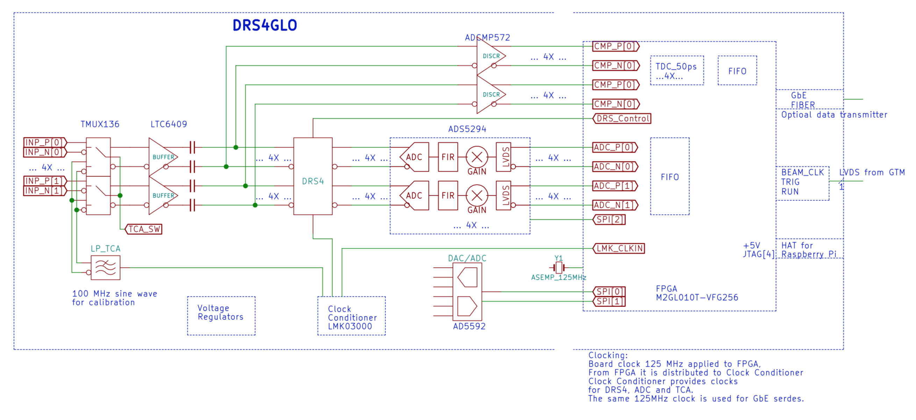
DRS4GLO ROI Electronics Block Diagram
sPHENIX psTOF I/O Board
TI-based
Preamp
Input
Miracle funding through SBIR Phase I (BK Tech LLC) to build DRS4GLO board
Implements windowed readout to overcome short SCA buffer (1024 cells) so that it can be used for a collider detector readout (trigger latency + rate capability)

Slide 11
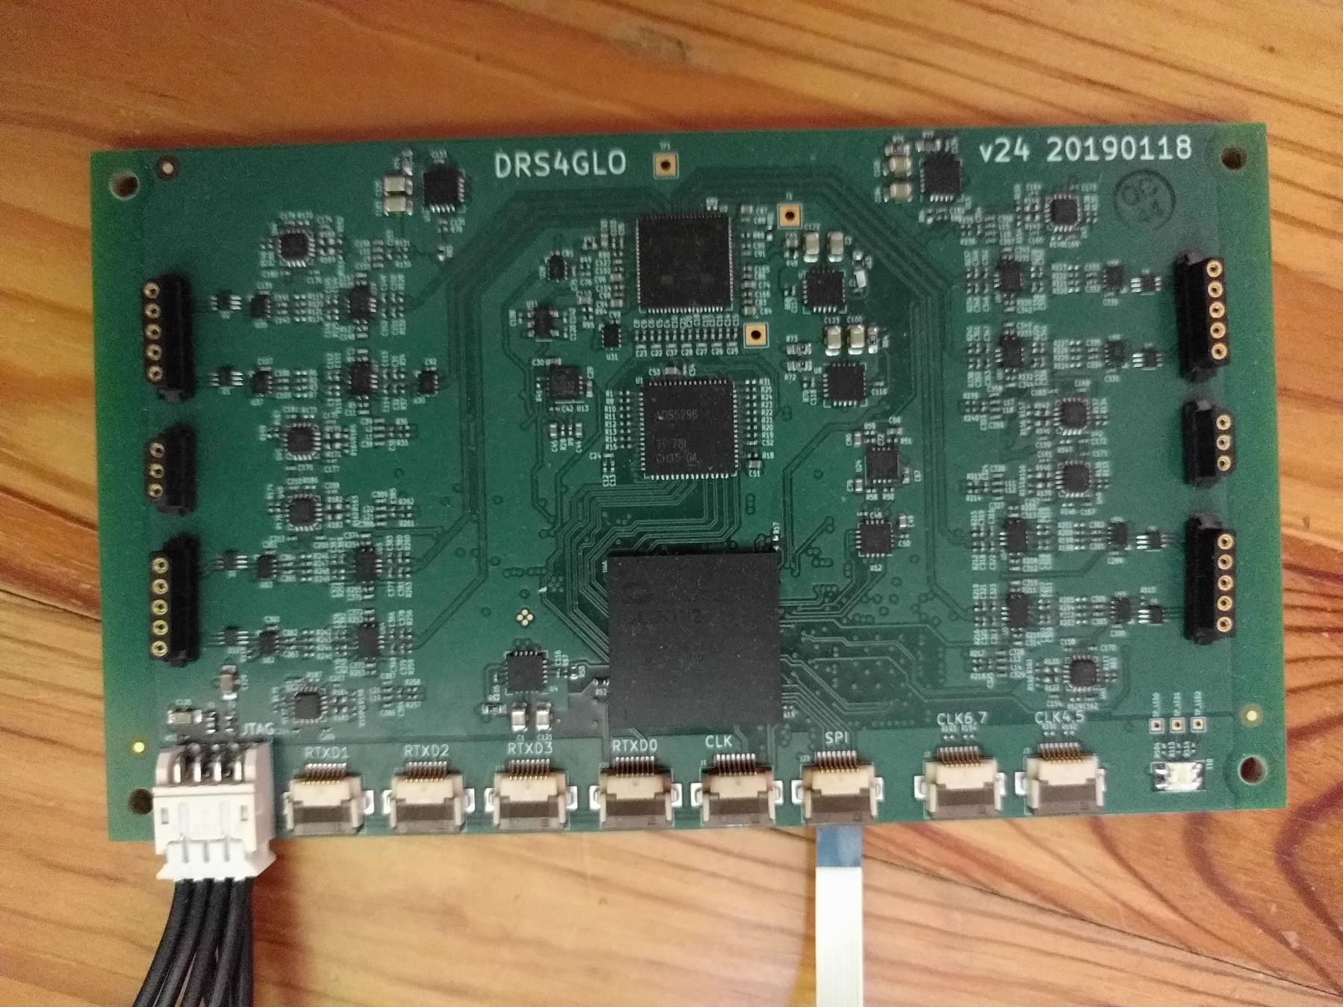
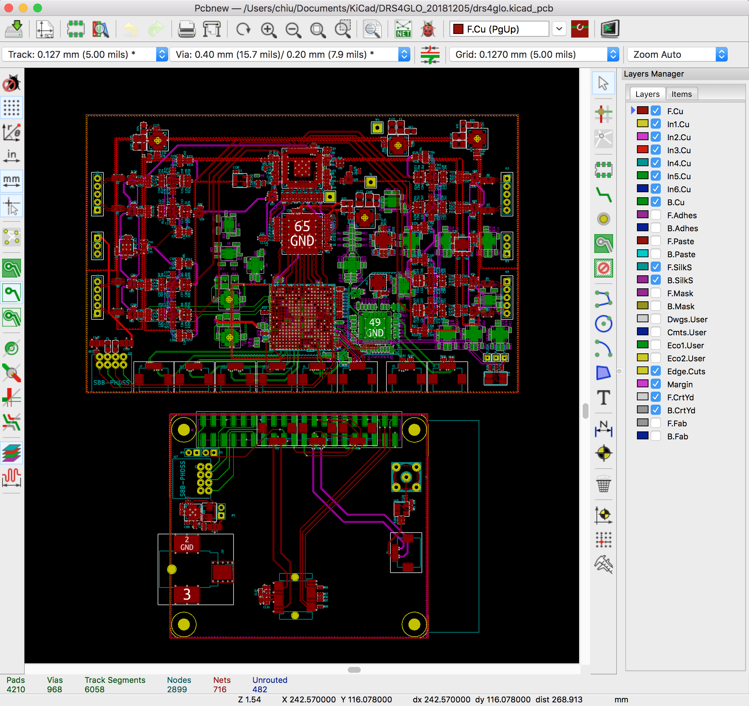
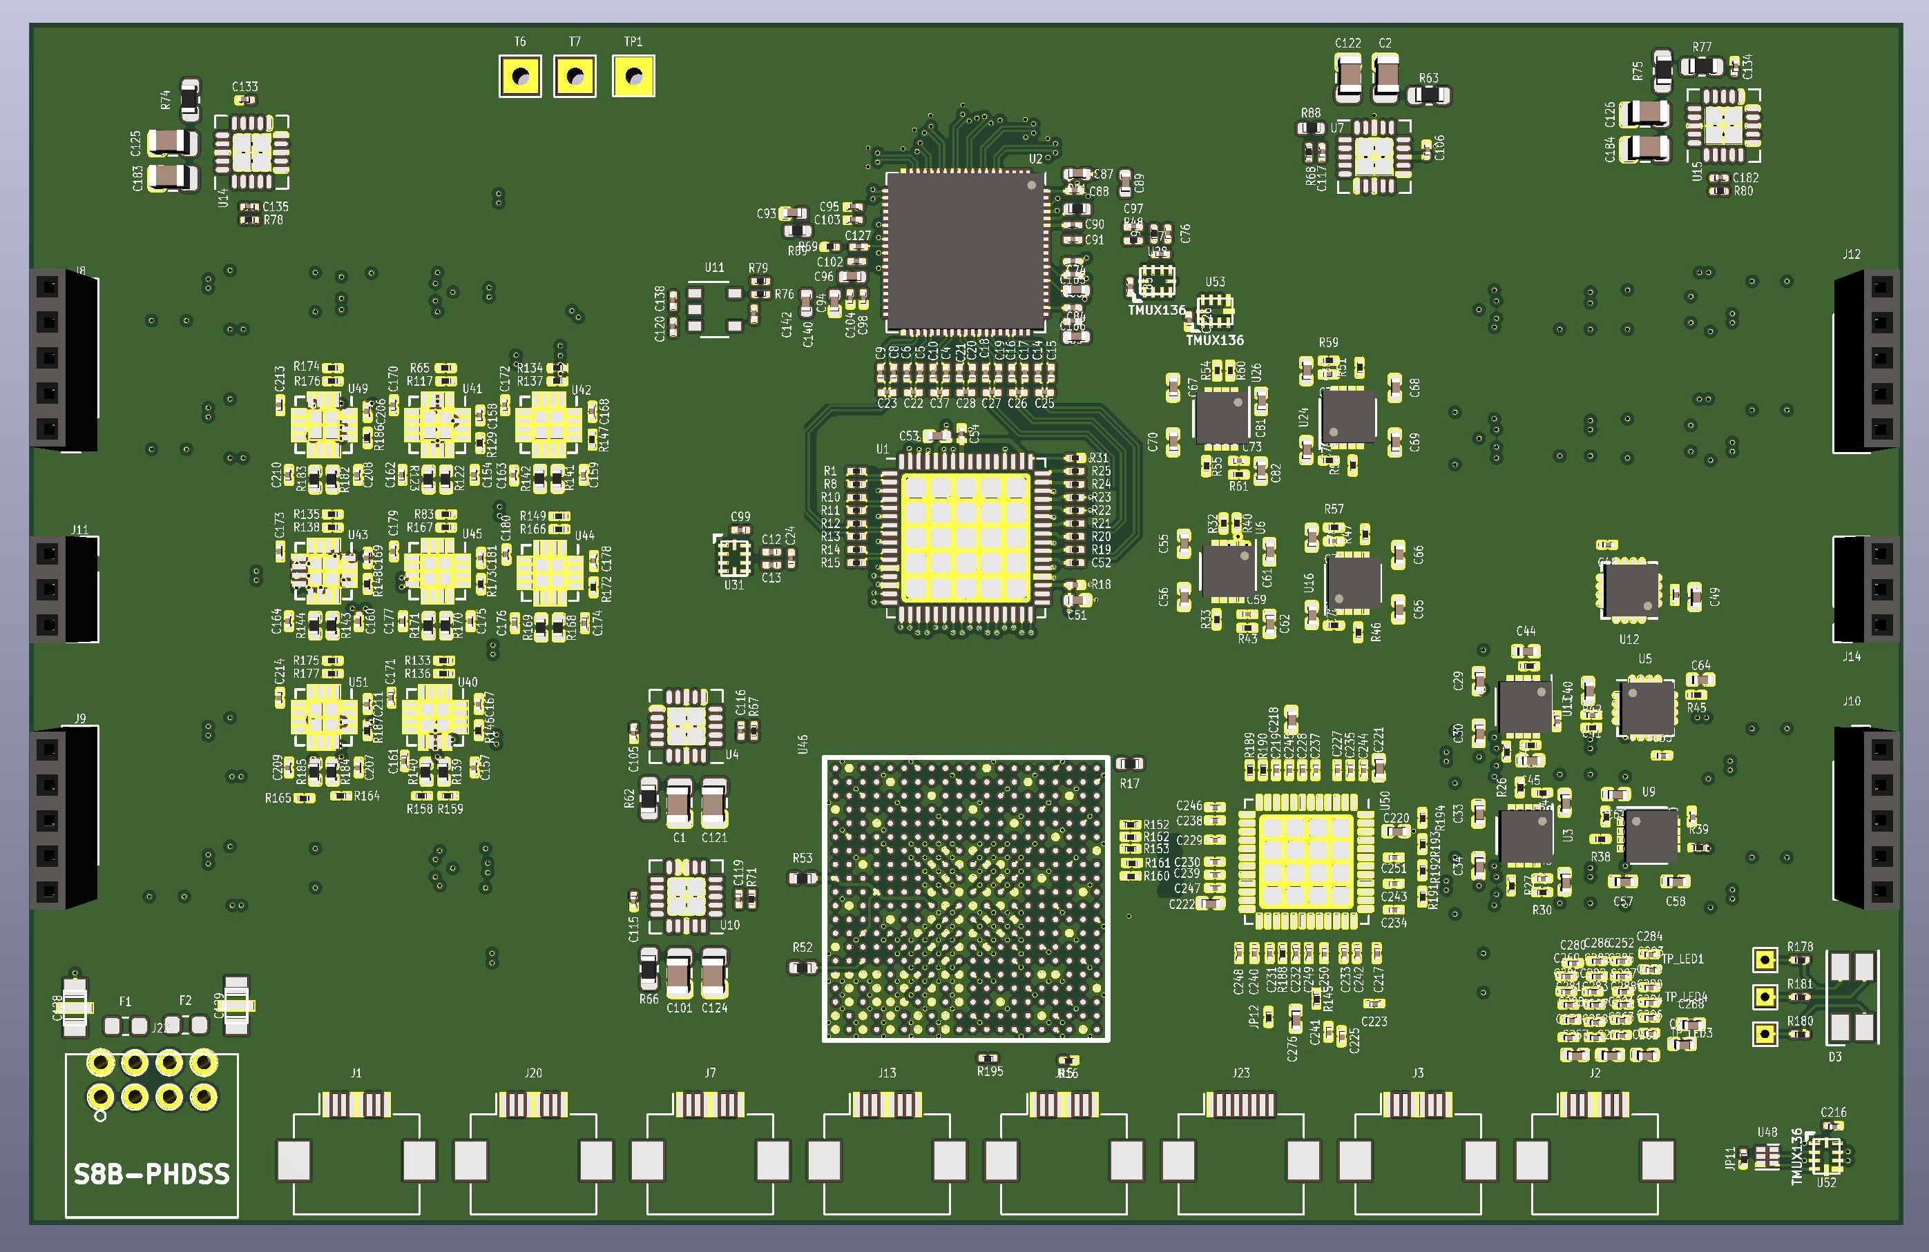
DRS4GLO Status
SBIR Phase I Funded, BK Tech LLC
Schematics have been completed
Make as ready for use in sPHENIX as possible
Used whatever rad-hard components we knew about (eg, regulators tested for TPC readout card, Microsemi Igloo2)
Reviewed by Stefan Ritt
6 months for firmware programming and testing

Slide 12
Alternative Readout: AARDVARC

Slide 13
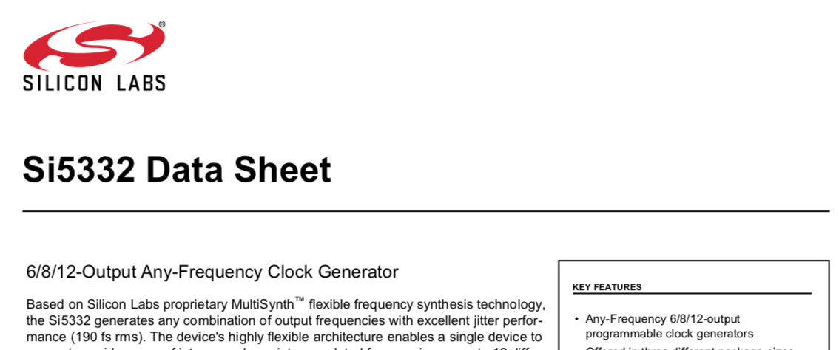
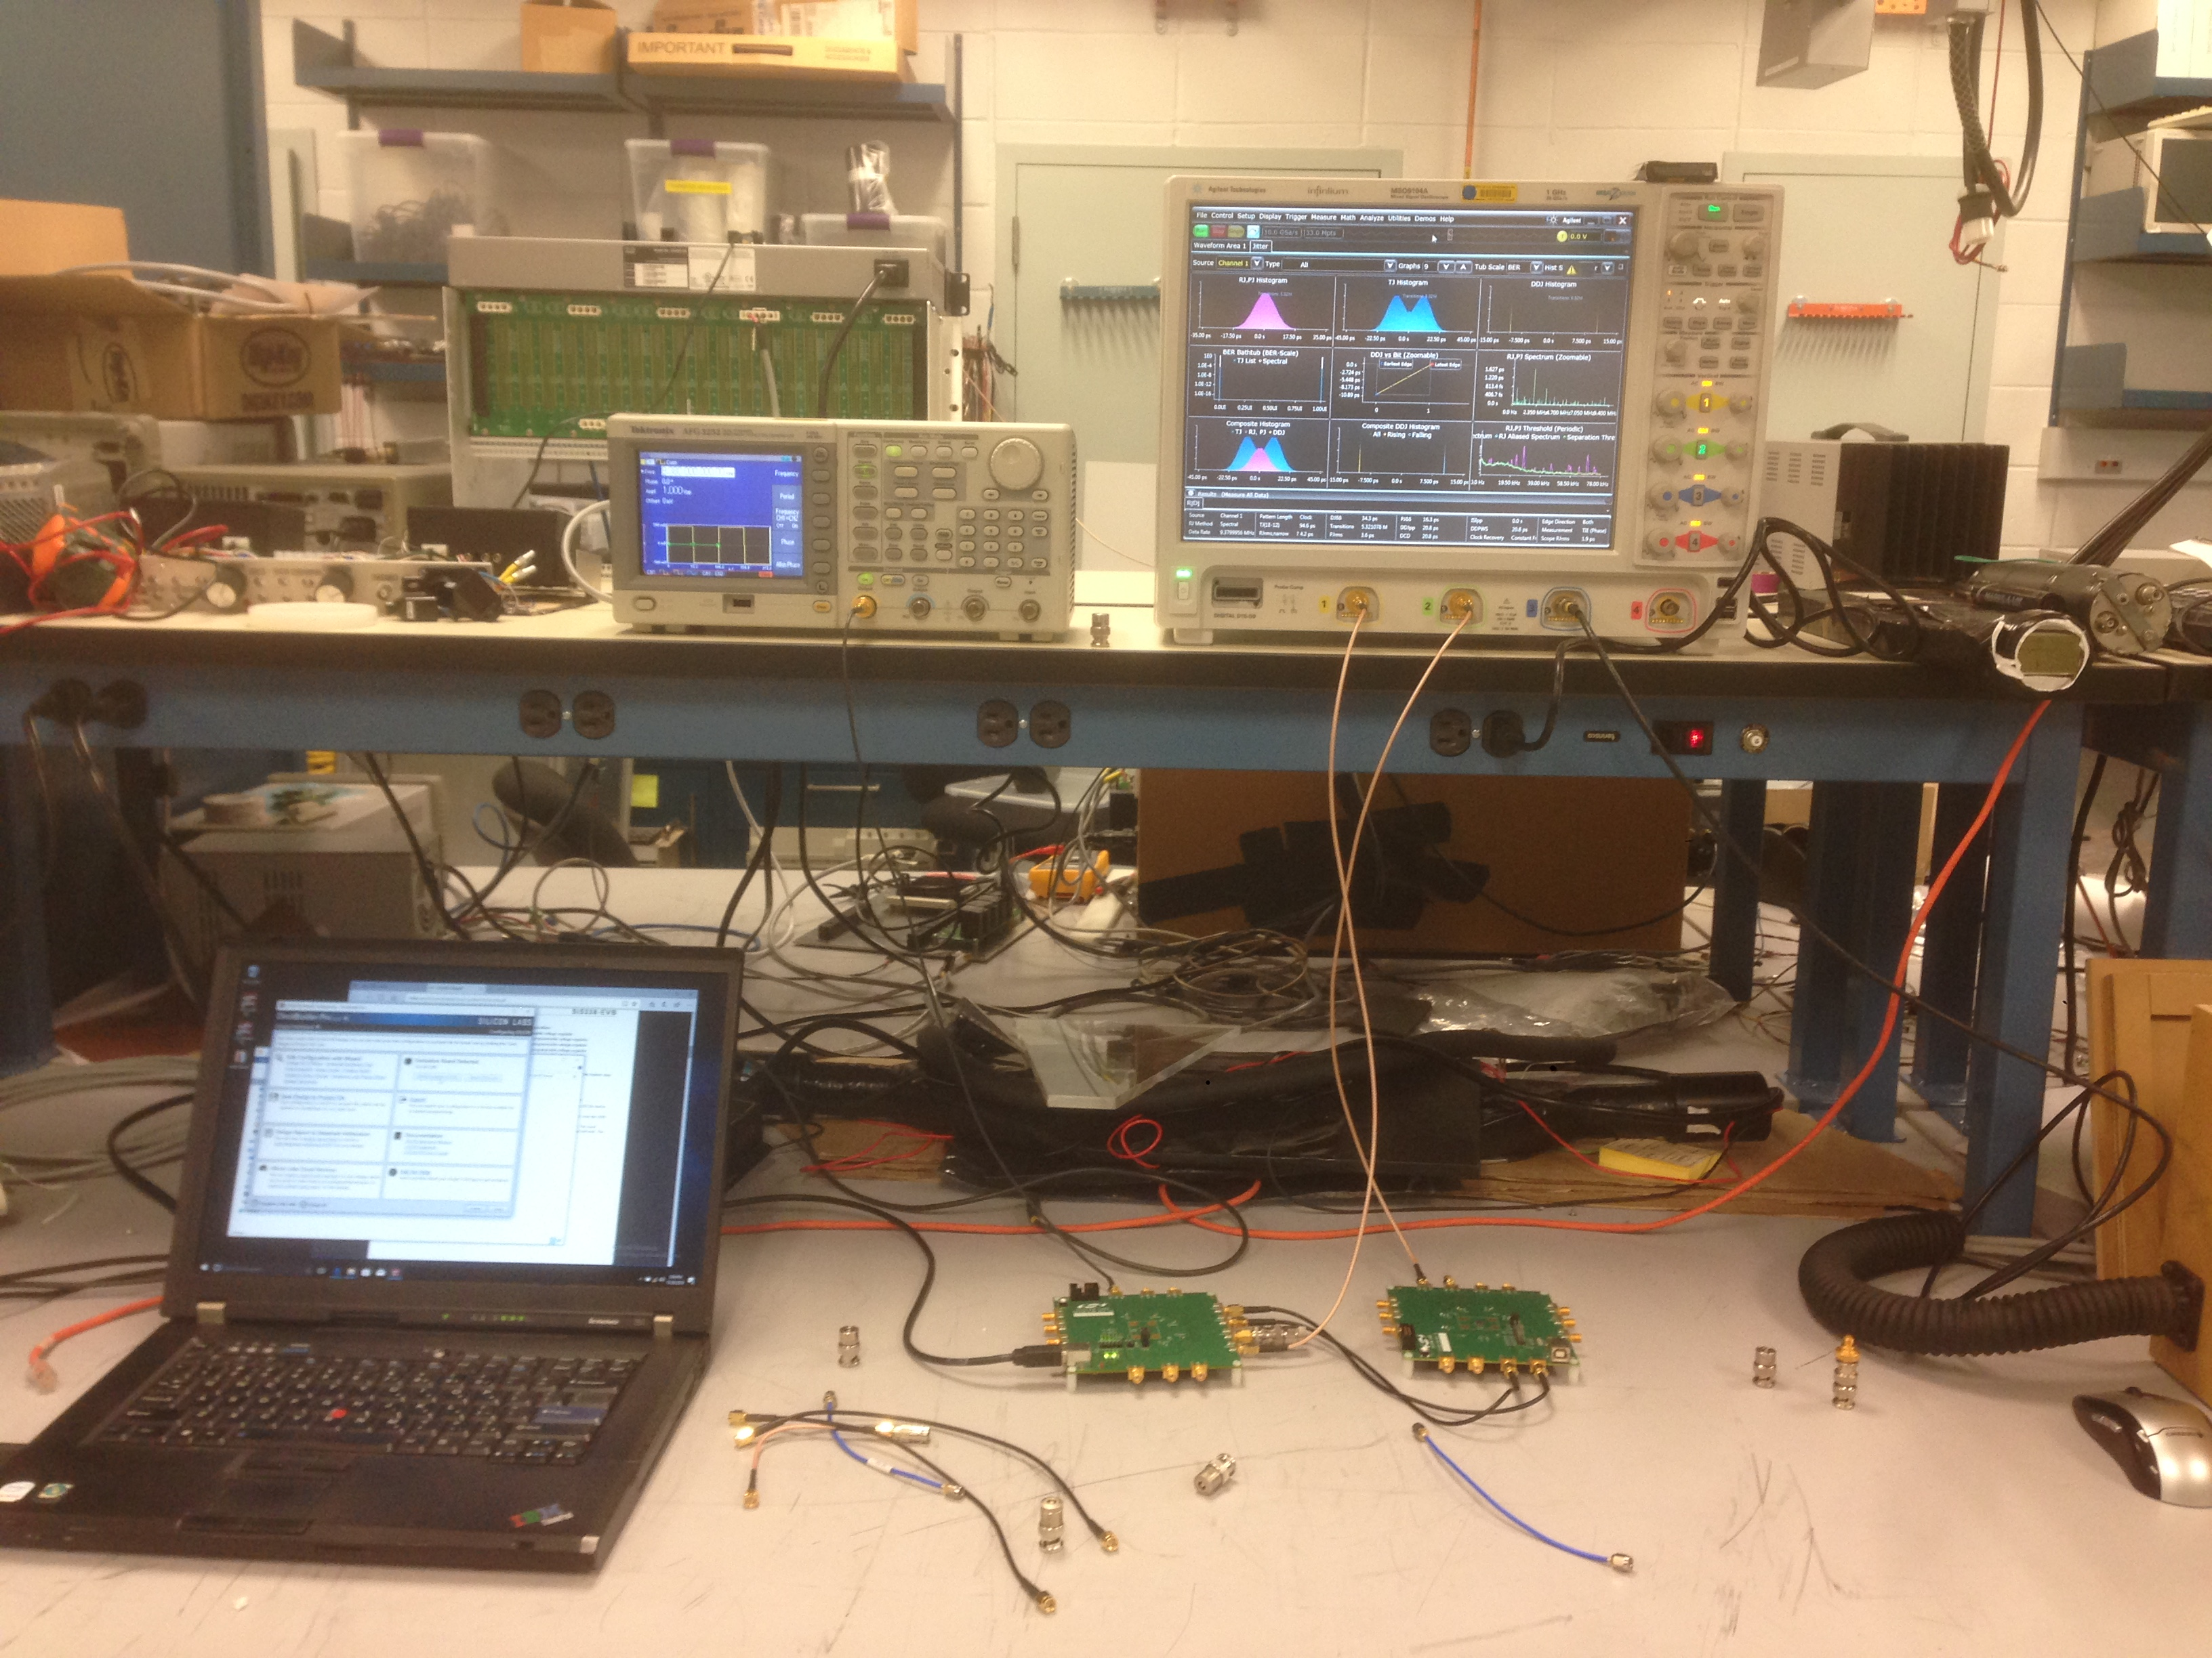
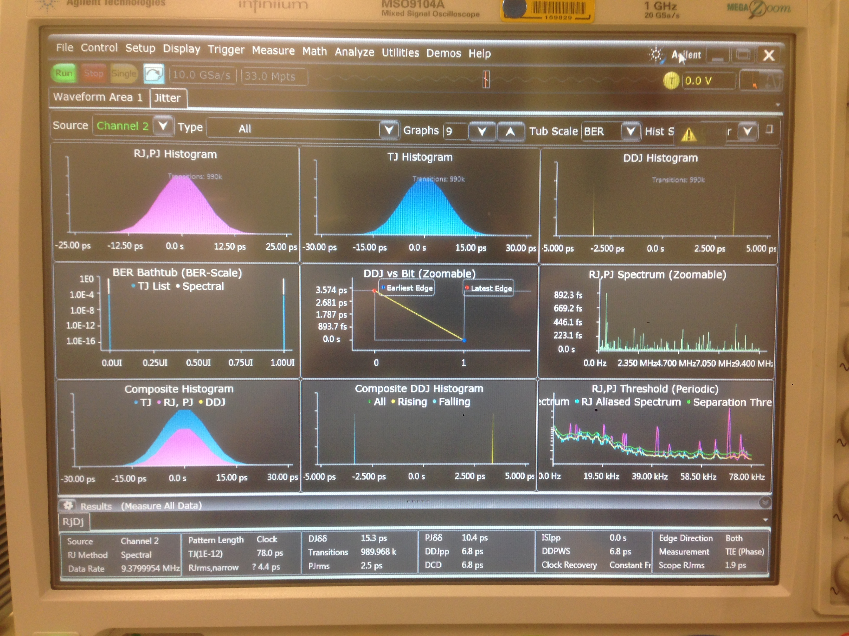
Synchronous Clock Distribution at << 20 ps
From RHIC CLK FANOUT L2
Row A
Row B
To FELIX
CLK SRC
CLK FANOUT
(SI5332)
12 outputs
CLK FANOUT
(SI5332)
12 outputs
Mixed Signal Scope
w/ John K
Need to send a synchronized clock with low jitter across man thousands of modules across several meters
Started testing COTS fanout chips (eg, Si5332)
Need N levels of fanout, eg, 12^{N} > 3000 implies N=4
So far results look promising – getting ~5ps jitter over 2 levels

Slide 14
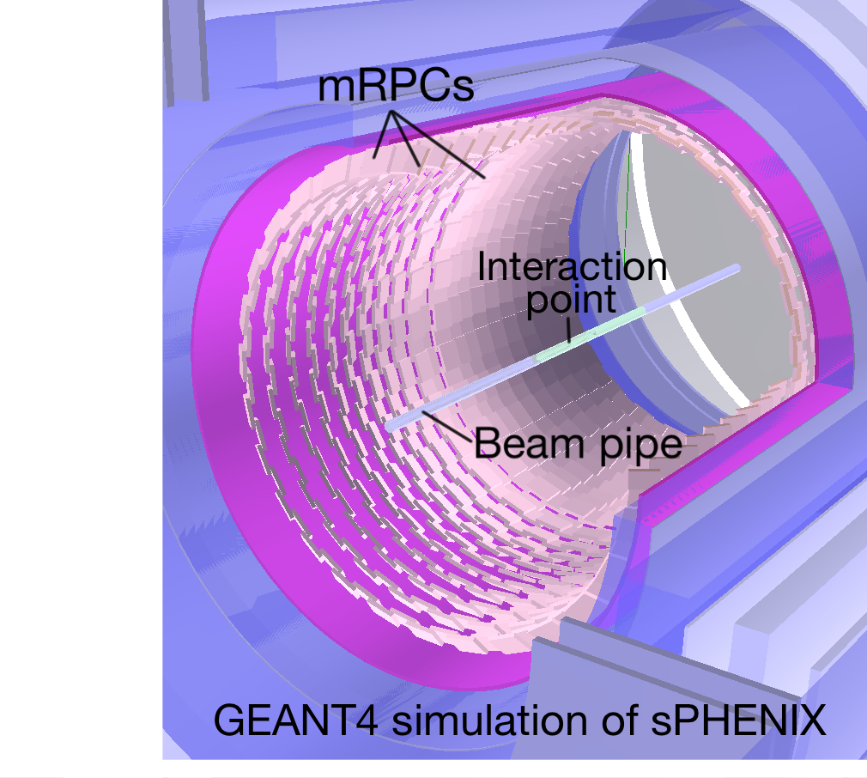
Placement of mRPC in sPHENIX
Row A
Row B
Row A
Row B
r=20-78 cm
TPC
MVTX + INTT
sPHENIX has allocated only r=80-89 cm for PID, only 9 cm!
Module is 7 x 13 x 2.5 cm³ thick, and needs to fit in 10 cm radial space (originally 10 x 12 cm²)
Signals are expected to be 1 x 10 cm² strips, with long side running in phi, and 4 channels per module (4x10 cm² active area)
Modules must overlap to create continuous active coverage, including in phi
Have just barely enough space if we offset alternating rows in phi (A and B)

Slide 15
Question of Start Time
It’s often said that you can’t get a good start counter at the EIC
Completely wrong – there are several solutions
Put TOF Wall on electron endcap and use electron timing
Will help with e-ID
Put Fast Timing into very forward detectors (roman pots, ZDCs, etc)
You want this anyway to ID those fragments
Self-timing using tracks
Need enough acceptance since you need 2+ tracks to do this
Add fast timing layer in inner silicon tracker (eg, LGADs)

Slide 16
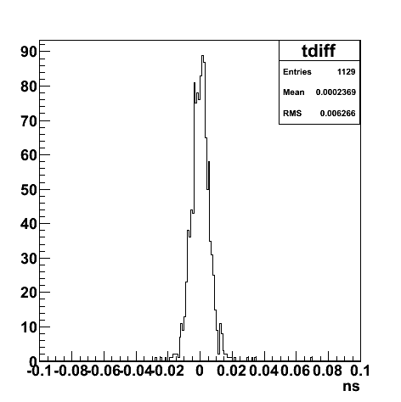
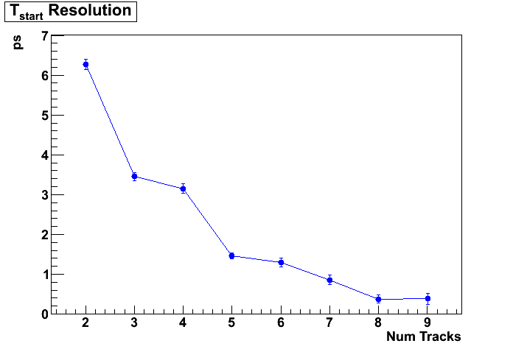
Self-Determined Start Time Study
Did a simple study using particles generated from e+p collisions in PYTHIA6
Using particles that hit the mRPC detectors in the barrel, did a brute force determination of the start-time
Assumed the particles could be either pions, kaons, or protons and tried all combinations
Selected the combination with the best chi-2 difference to the self-determined start time
Need to ensure that there’s enough coverage to get at least two tracks into timing detectors

Slide 17
Measuring the Bunch Profile
Must measure both z-vertex and start-time
Bunches are 1-5 cm RMS, while 5 ps = 1.5 mm
This can be done with detectors in the central region, but a psTOF in the forward region is useful since there is often a remnant in e+A collisions, and in e+p there is a proton in diffractive events

Slide 18
Summary
TOF technology is a very hot item these days due to interest of our High Energy colleagues
Work is being done to address the several items that prevent one from building a 20 ps or better TOF for PID in a collider detector
Electronics (DRS4GLO, AARDVARK, ATLAS ALTIROC, …)
System Issues are being addressed (low-jitter clock propagation, power consumption, cost, etc)
20 ps is not a lower bound… e.g. MCP-PMTs have achieved 5 ps
LAPPDs might solve the cost issue
Can only be implemented at forward rapidities where B-field is small enough
Good timing may help with reducing systematics from transverse momentum of incoming colliding particles that is created by crab-cavities by measuring where in bunch colliding particles come from
AFAIK, nothing fundamental really prevents a high performance TOF from being ready in time for the EIC

Slide 19
Backup slides

Slide 20
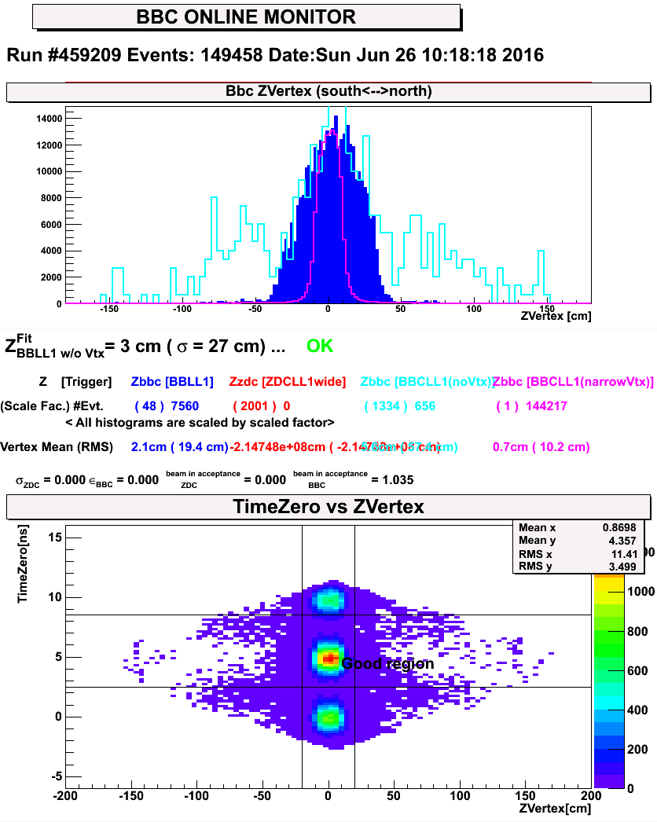
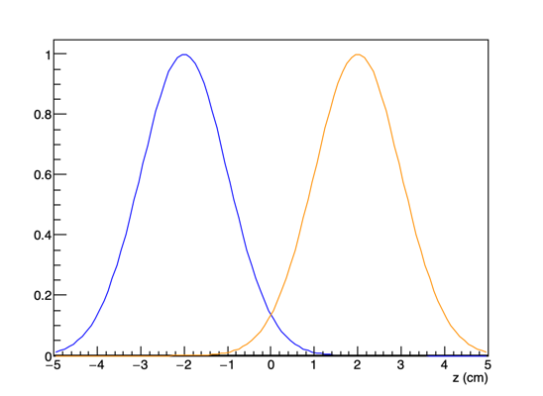
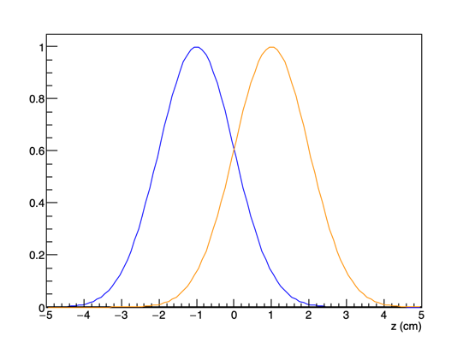
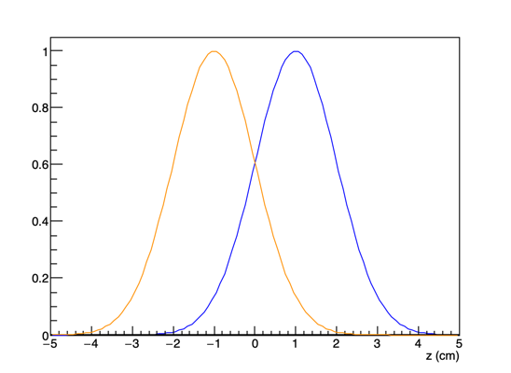
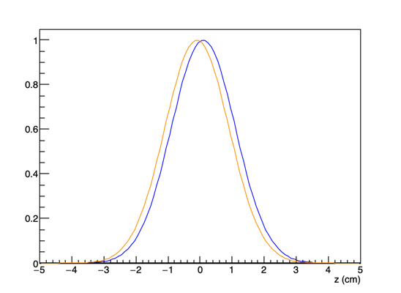
Collision Vertex and Time Dist
Example from RHIC: There are 3 bunches colliding on 3 bunches
At z=0, there will be collisions at different locations in the bunch

